Slide 1
High Impact Practice Set (HIPS) for Outpatient Settings:
Caring for People with Substance Use Disorder to Improve Maternal Health
Daisy Goodman, DNP, MPH, CNM, CARN-AP
Meg Sheahan, MSN, CNM, MPH
Jennifer Godfrey, Patient Advocate
Notes:
Welcome, everyone. My name is Sydney Pelley. I'm with the Reproductive Health National Training Center, and I'm so excited to welcome you to today's webinar, Focus on High Impact Practices to Care for People With Substance Use Disorder and to Improve Maternal Health Outcomes. The RHNTC developed the high-impact practice set that we are going to discuss today in collaboration with the American College of Obstetricians and Gynecologists. The set is adapted from work developed by the Alliance for Innovation on Maternal Health, or AIM. So to start off, I have a few announcements, first, everyone on the webinar is muted. We'll have time for questions at the end, so please type out your questions into the chat at any time. A recording of today's webinar, this slide deck, and transcript will be available on rhntc.org within the next couple of days. To view closed captioning, you can click the CC icon at the bottom of your screen. Your feedback is extremely important to us, it helps us improve our work. So please take a second to open the evaluation link that will be put in the chat, and consider completing the evaluation in real-time. In order to obtain a certificate of completion, or CEUs, you have to complete the evaluation, and you must be logged into the rhntc.org when you do it.

Slide 2
Meet your speakers
Meg Sheahan
MSN, CNM, MPH
Jennifer Godfrey
Patient Advocate
Daisy Goodman
DNP, MPH, CNM, CARN-AP
Notes:
Now, I'd like to introduce our speakers in order of appearance. I'll be speaking on behalf of Meg Sheahan, who was unable to make it today. Meg is a clinical consultant at the Reproductive Health National Training Center and is a certified nurse midwife. She has been a hospitalist and an outpatient care midwife over the past 15-plus years, and directed the Title X program in the US Virgin Islands for about 10 years before joining the RHNTC. Joining me today is Jennifer Godfrey, a patient advocate who works with MoMMA's Voices, a patient advocacy coalition that amplifies the voices of those who have experienced pregnancy and childbirth complications to ensure that they're activated as partners with providers and researchers to improve maternal health outcomes. Dr. Daisy Goodman is the director of the Women's Health Services Perinatal Addiction Treatment Program and associate professor of obstetrics and gynecology at the Geisel School of Medicine at Dartmouth University. Dr. Goodman was a core contributor to the Alliance for Innovation on Maternal Health patient safety bundles on care for pregnant and postpartum women with substance use disorder. Jennifer, Dr. Goodman, thank you so much for joining us today.

Slide 3
Objectives
By the end of this session, participants will be able to:
Describe the impact of substance use disorder (SUD) on maternal health, including its impact on maternal morbidity and mortality differences across populations
Describe high impact practices that sexual and reproductive health providers can implement to care for people with SUD for improved health outcomes
Describe at least two resources that sexual and reproductive health providers can use to implement high impact practices for caring for people with SUD
Notes:
So our intention is that by the end of this webinar, you'll be able to:
Describe the impact of substance use disorder (SUD) on maternal health, including its impact on maternal morbidity and mortality differences across populations
Describe high impact practices (HIPS) that sexual and reproductive health providers can implement to care for people with SUD for improved health outcomes
Describe at least two resources that sexual and reproductive health providers can use to implement high impact practices for caring for people with SUD

Slide 4
SUD and maternal mortality (1 of 2)
Drug overdose deaths reached record highs in 2020 and 2021
  Likely exacerbated by the COVID-19 pandemic
Prevalence of pregnancy-associated deaths (PAD) because of drug use increased 190% between 2010–2019
  11.4% of PADs were due to use of illicit or prescription drugs
Between 2018–2021, drug overdose mortality ratios rose more than threefold in pregnant and postpartum women aged 35 to 44 years
  Women in the late postpartum period were at greatest risk
Overdose Deaths in Pregnant and Postpartum Women Rose Sharply in 2020. American Journal of Nursing. March 2023.
Notes:
Drug overdose deaths, particularly deaths involving synthetic opioids like fentanyl, reached record highs in 2020 and 2021, which likely was exacerbated by social, economic, and healthcare disruptions associated with the COVID-19 pandemic. The prevalence of pregnancy-associated deaths because of drug use increased 190% between 2010 and 2019. A study published in 2022 in the journal "Obstetric and Gynecology" found that of the nearly 12,000 pregnancy-associated deaths identified by the researchers during that time, 11.4% were due to the use of illicit or prescription drugs. And between 2018 and 2021, drug overdose mortality ratios rose more than threefold in pregnant and postpartum women aged 35 to 44 years, with women in the late postpartum period at greatest risk.
Overdose Deaths in Pregnant and Postpartum Women Rose Sharply in 2020. American Journal of Nursing. March 2023.

Slide 5
SUD and maternal mortality (2 of 2)
Increases in use of amphetamines, opioids, and cannabis have led to a rise in number of pregnant women with SUD
Opioid use in pregnancy has escalated in parallel with the epidemic observed in the general population
Opioid use disorder during pregnancy is linked with serious negative health outcomes
Notes:
Substance use disorder affects the risk of severe maternal morbidity and mortality through both biological mechanisms, such as increased risk of infectious disease and poor nutrition, and through social mechanisms, such as stigma and poverty. Increases in the use of amphetamines, opioids, and cannabis have led to a rise in the number of pregnant women who develop a substance use disorder. Opioid use in pregnancy has escalated dramatically in recent years, paralleling the epidemic observed in the general population. Now, SUD involves more than just opioid use disorder, but opioid use disorder is a significant driver of maternal mortality. Opioid use disorder during pregnancy has been linked with serious negative health outcomes for pregnant women, including cardiovascular risks, preeclampsia, and hemorrhage, and for developing babies, including preterm birth, stillbirth, and neonatal abstinence syndrome.

Slide 6
Differences in SUD and treatment across populations
SUD is higher for people reporting two or more races, and for American Indian or Alaska Native people
White individuals are more likely to receive SUD treatment than Black and Hispanic individuals
Black and Hispanic pregnant women were significantly less likely to complete treatment compared to White pregnant women
  May have less successful treatment outcomes
Barriers include: poverty, stigma, limited availability or affordability of SUD treatment options, unmet social needs, and limited availability of culturally and linguistically effective providers
Notes:
There are differences across populations in SUD and in substance use treatment which impact overall and maternal health outcomes. For example, SUD is higher for American Indian or Alaska Natives than for other groups. Black and Hispanic individuals are less likely to receive SUD treatment compared to white individuals, and Black and Hispanic women undertaking treatment while pregnant were significantly less likely to complete treatment compared to white individuals. These groups experience barriers to care and treatment, including poverty, stigma, limited availability or affordability of SUD treatment options, unmet social needs, and limited availability of culturally and linguistically effective providers. While treatment for substance use disorder is available during pregnancy, significant barriers, such as penalization, fear of losing one's children, stigma, and limited socioeconomic resources, uniquely affect pregnant women. We'll hear more about this over the course of this hour. With this, I'll pass it over to Jennifer to share her experience and wisdom.
Center for Behavioral Health Statistics and Quality. (2021). Racial/ethnic differences in substance use, substance use disorders, and substance use treatment utilization among people aged 12 or older (2015-2019) (Publication No. PEP21-07-01-001). Rockville, MD: Substance Abuse and Mental Health Services Administration. Retrieved from https://www.samhsa.gov/data/

Slide 7
Jennifer Godfrey
Family Support Specialist, CLC
Patient Advocate
Six years in recovery from SUD
Notes:
Hi, my name's Jennifer Godfrey. I am a patient advocate for MoMMA's Voices. I am a family support specialist and NICU family support coordinator at Valley Medical Center in San Jose, California. I'm also a CLC, and I have six years in recovery from substance use disorder. And that's my little family right there.

Slide 8
Our story
Lofa was born at 27 weeks gestation
I was abstinent for 4 months when delivered
We spent 91 days in the NICU
I was in a treatment program (THU and outpatient)
Some of my experiences with prenatal care:
  Constant screenings—with no offered resources
  Repetitive questions
  Judgment and stigma
Notes:
So my story, well, our story, my son, Lofa, was born at 27 weeks. I was abstinent from substance use for four months when I delivered. So I had remained abstinent since nine weeks of my pregnancy, but that didn't stop the complications. I had recurring UTIs, and I developed a subchorionic bleed in my placenta, which ultimately resulted in me delivering early. So we spent 91 days in the NICU. I was in a treatment program, I was in an outpatient program and a THU at the time of my delivery. So I was already receiving care. I can tell you some of my, a little bit about my story is, i started off getting prenatal care while I was incarcerated. So I remember coming in for my full first ultrasound in the MFM, the Maternal Fetal Medicine, and I was in custody. So I came in handcuffs in my jumpsuit, and I just remember, you know, it was just not a good experience, like, right? So, and I still had to go to these places after I got released. So I got released shortly after my first scan. And I just remember, whenever I would come into any of my appointments, there was always, "Have you used in the last 24 hours? Where are you staying?" I know that most of these things were in my chart because the substance use program I was going to was actually linked to the health system that I was in. So all of these things were in the chart. They knew, I mean, if they had just taken a chance to like do a chart review before they talked to me, they would have this information, but they would just come in and say, "When was the last time you used? Are you homeless?" Like, and I would have to repeat myself over and over and over again, and it was very harrowing, it would make me feel like running away because I was like, "I have to explain my situation again. I have to receive the judgment for explaining my situation again." And, you know, the judgment and stigma. I remember when I, my son was, when I was, you know, having problems, complications with my pregnancy, I was in labor and delivery in and out of that place, like, you know, twice a week, sometimes I would stay, sometimes they would send me home, and I remember I had passed a blood clot like the size of my hand, and I brought it into labor and delivery and was like, "What's going on?" Like, "I need some answers," like, "Why is this happening? Is my baby okay?" And the nurse told me she thinks my pregnancy is terminating probably because of the drug use early on in my pregnancy. And I remember just feeling, I started to shake with, like, I was so terrified. I still feel the anxiety come up when I talk about it. And then the doctor come in and reassured me that my baby was fine and that this was something that was going on with my placenta, and my baby was healthy, active, everything was okay. They were just gonna monitor me for a few hours. And I remember feeling relieved, but it was just that initial stigma that I received when I came into the room about, you know, my pregnancy is terminating because of, you know, and I've been doing all the right things since then, right? And I felt like I was getting no recognition. I was going to my doctor's appointments, I was staying abstinent, I was going to my meetings, I was, you know, doing all the things that I could do to make my life and my son's life better. And I just didn't, I didn't feel seen. And so, that's a, you know, a little bit about our story.

Slide 9
Peer support for SUD
Peer support can:
Level the playing field when there is an unequal power dynamic
During meetings, improve the chances that clients will advocate for themselves
  Amplifying family/client voices during all clinical and multidisciplinary meetings can move decisions towards more family-centered care
Decrease stress and trauma
Improve client satisfaction and experience (client self-care, self-advocacy)
Increase psychological safety: Creates a safe space so the client doesn’t feel alone.
The support of someone who has walked a similar path cannot be matched.
Notes:
So one of the things that I've learned in my recovery and in working in the hospital with other substance use disorder moms is that peer support is like one of the best things that you can receive. I received peer support while I was here in the NICU, and it gave me hope that, it like gave me the hope that nobody else could, right? Somebody that's walked this path showed me that they had gone through it and were able to like get through it. So some of the things peer support can really do is, it can level the playing field when there is an unequal power dynamic. So we all know, as providers and as, you know, working in the medical field, that there is an authoritative stance that we have, right, or that you have. And so, when you have peer support available to these moms that like are walking through this, and empowering these moms to advocate for themself, it really does level the playing field. During meetings, family meetings, any conferences that you're gonna have with moms, you wanna have these peer support people available. It improves the chances that the clients will advocate for themselves, it amplifies their voices, and then, we also have this peer support workers available for, you know, multidisciplinary meetings and whatnot. They can help move decisions towards for more family-centered care practices. It definitely decreases stress and trauma in the NICU, especially if you have somebody that knows what this is like and can walk this with you. It improves client satisfaction and experience in the NICU. It improves client self-care, client self-advocacy, and it increases psychological safety. So we want our moms to know that they're seen, they're heard, and that they're okay and that we're here to help them, and it creates a safe place so that they don't feel alone. And the support of someone who has walked a similar path cannot be matched.

Slide 10
Trauma-informed care for clients with SUD
Remember:
Work with a healing intention
Earn client trust (a smile, a compliment, or sitting at eye-level can go a long way)
Create space and give clients the grace to share their stories
Practice active listening
Most (if not all) people who struggle with SUD have experienced traumatic situations
Grief and shame are often displayed with defensive behaviors, and can show up as denial
Educate staff who work with clients with SUD about trauma-informed care
Notes:
So some of the practices that I'm really passionate about is trauma-informed care for clients with substance use disorder. Some key points I wanna point out and just for people to remember, I'm pretty sure everybody's aware of what trauma-informed care is, and if you don't, we have resources available, and we wanna work with healing intention. So we wanna make our patients feel safe, we wanna make them feel like they're heard, we wanna offer encouragement. So how you can earn trust is, you can give them a smile, a compliment, just sit down with them, have a, like a, just a chit-chatty conversation, just like a regular, like, "How are you doing? I'm so glad to see you. What's been going on?" Those things can change the whole dynamic of a interaction with a mom, right, or a client, I should say. You wanna create space and give them the chance to share their story. So, you know, when we're asking open-end open-ended questions, we wanna give them the chance to actually really express themselves, right? And that wherever that leads, let them lead the conversation. You wanna practice active listening. So we really wanna, we don't wanna have to listen to, with the intent to reply to them and have... We don't need to fix their problems, what we need to do is listen, and then we can go back and like real, and absorb what they're saying, 'cause they're the experts on themselves, right? So they know what their needs are, we just need to figure out how to listen and how to like pick out those needs, right? We like guide the conversation. One of the biggest things I encourage too when we're working with women with SUDs or parents with SUDs is, you want to check your assumptions about your client before initiating conversation. You wanna go through and remove all those emotions that you have about this, you just clear it, like, just ummm before you go and talk to a mom, I mean it just really changes 'cause you don't know this person and the trauma that they've experienced. I just wanna say that most, if not all, people who struggle with substance use disorder have experienced traumatic situations. I mean, this goes hand in hand, mental health goes hand in hand with this. And I just, you know, you really, you have to like look beyond what's on the surface because a lot of the time, these emotions that are displayed, like guilt and shame and grief, are really displayed as defensive behaviors. So you need to like chip at that. And they can show up as denial, like they're not in a place where they can actually talk about it yet because they're still trying to hide from their trauma. And I really highly encourage educating staff who work with clients that have substance use disorder about trauma-informed care, it's a game changer, it can really level the playing field with these moms or these patients. And that's pretty much it for me. And I thank you for your time.

Slide 11
Why focus on SUD in the SRH setting?
Sexual and reproductive health (SRH) settings, including Title X agencies:
Are often clients’ only or usual source of care
Present the opportunity for primary, secondary, and tertiary prevention
Are highly likely to encounter clients with SUD
Engage with partners and the community
  Provide effective referrals and linkages to care, including to prenatal and other services
Often see clients within a year of pregnancy
Also, individuals with SUD are less likely to use contraception.
Notes:
All right, can you all hear me? Can someone give me an indicator that you can hear me? Jennifer, can you? Okay, great. Thank you. So thank you, Jennifer, so much. And before I start, I'll introduce myself quickly. My name is Meg Sheahan. Thanks for being patient with my tech issues, and a big shout out to Sydney for taking charge. I'm back. Okay, why focus on SUD, specifically in the outpatient sexual and reproductive health setting? Well, there are a few good reasons. Sexual and reproductive health providers are highly likely to encounter clients with SUD, and sexual and reproductive health, or SRH, settings, including Title X agencies, are often the client's only source of care. So if clients don't receive care and connection to resources and services from the SRH provider, they might not receive them at all. Visits for sexual and reproductive healthcare present an opportunity for SUD prevention, either primary, secondary, or tertiary prevention, through care, either in-house or through linkages to care. Also, we know that individuals with SUD are less likely to use contraception and more likely to use contraceptive methods that are less effective, even when they don't desire a pregnancy at that time. And addressing SUD is an important component of preconception care, which SRH providers offer. So SRH providers have an important role and opportunity to support clients in achieving their reproductive and their broader life goals and supporting overall health. Finally, SRH providers often see clients within a year of pregnancy or during the late postpartum period, which is a vulnerable time, and it's a critical time for supporting maternal and newborn health and wellness. So there's a lot of need here, and there's a lot of opportunity here. ot focus just on preventing unintended pregnancy, and connect individuals with other services and resources
https://contraceptivetechnology.org/substance-use-disorder-contraceptive-options-counseling

Slide 12
High Impact Practice Sets (HIPS) (1 of 2)
RHNTC and ACOG adapted AIM’s Patient Safety Bundles* (PSBs) to create High Impact Practice Sets (HIPS)
High Impact Practice Sets highlight evidence-based practices that can be implemented in the outpatient sexual and reproductive health setting to improve maternal health outcomes
*Alliance for Innovation on Maternal Health (AIM) PSBs are collections of clinical condition-specific best practices to improve maternal and overall health outcomes. https://saferbirth.org/patient-safety-bundles/
Notes:
And if you're wondering where to begin, we've got some guidance for you. The high-impact practice sets are a series of five sets of evidence-based practices to address the leading known causes of preventable severe maternal morbidity and mortality in the United States, including SUD. The RHNTC and ACOG work together to adapt the patient safety bundles created by the Alliance for Innovation on Maternal Health, or AIM, to the outpatient sexual and reproductive health setting. And these sets are building blocks or like a roadmap for improving maternal health outcomes and reducing maternal mortality.
Resources
Patient Safety Bundles (https://saferbirth.org/patient-safety-bundles/)

Slide 13
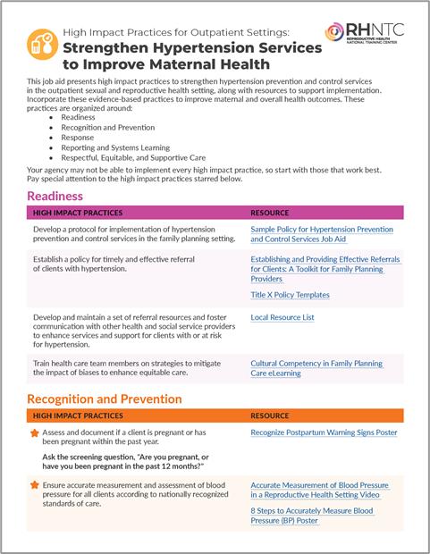
High Impact Practice Sets (HIPS) (2 of 2)
HIPS focus on five areas:
  Hypertension
  Cardiac conditions
  Substance use disorders
  Mental health conditions
  Postpartum transition
Notes:
As I just mentioned, the high-impact practice sets address the leading known causes of preventable severe morbidity and mortality in the United States, and these include hypertension, cardiac conditions, SUD, mental health conditions, and the postpartum transition. So to support programs in implementing the high-impact practices on each topic, the RHNTC offers a package, the package includes a webinar like this one, a job aid like the one that you see on the screenshot on this slide, and a measurement tool, which I'll explain in a little bit.

Slide 14
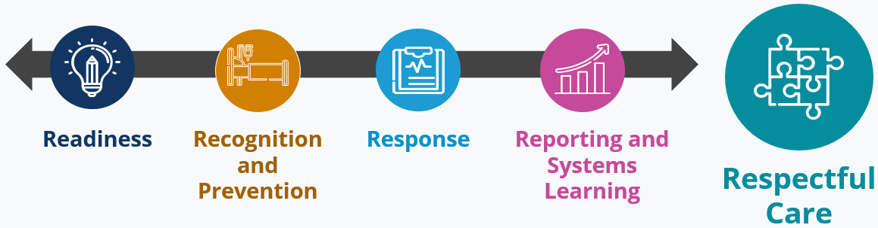
The 5 Rs
Information/Data from Alliance for Innovation on Maternal Health. Measurement of Respectful Care in AIM Statement. Accessed November 20, 2023. https://saferbirth.org/measurement-of-respectful-care-in-aim-statement/
Notes:
Each high-impact practice set is structured around what we call the Five Rs, which you see here. And this is how the Alliance for Innovation on Maternal Health structures their patient safety bundles. So the high-impact practices are grouped into practices that support readiness to address the issue, recognition and prevention of the issue, response to the issue, systems reporting and systems learning, and respectful care. So to carry this conversation forward, I will now pass it over to Dr. Goodman. Thanks, Dr. Goodman.

Slide 15
Caring for people with SUD in the SRH setting
Recognize SUD as a chronic condition.
Acknowledge that substance use is not the same as SUD
Center harm reduction
Support self-management leading to remission, including facilitating access to pharmacologic treatment
Notes:
Dr. Daisy Goodman:
Hi. So building on what Jennifer and Meg have both presented, there are a few fundamentals that can help ground our practice when providing respectful care for people with SUD in the sexual and reproductive health setting. So, first and foremost, to recognize that substance use disorders are chronic conditions like any other condition that a person might have when they come to you for care. And secondarily, acknowledging that substance use is not the same as having a substance use disorder, that is, people can use substances in a variety of different ways. And also, that people who have a history of substance use disorder are often living happy and healthy lives in recovery. Secondarily, for a person who tells you that they are using drugs, particularly in a way that might put their life at risk, please center harm reduction, and we'll talk about how to do that. And finally, as for any chronic medical condition, for example, asthma, diabetes, et cetera, it's our job as providers to ask about how they're doing with that, and especially to facilitate their self-management, leading to remission of their symptoms, including access to pharmacologic treatment when it's needed.

Slide 16
Readiness (1 of 3)
Provide clients with information related to SUD, harm reduction strategies, and support resources, as indicated.
Trustworthy sources
Accessible language
Welcoming of all relationships along the continuum, from active use to recovery
Focus on harm reduction, and avoid an abstinence-only approach.
Provide naloxone and harm reduction education, and facilitate access to harm reduction supplies
Notes:
So in order to prepare ourselves to be a trustworthy source of information, it's important to really do your homework. So we need to be able to provide clients with information related to substance use disorder, and that is accurate information, harm reduction strategies and resources that meet their needs. We need to use trustworthy sources, accessible language that is person first and respectful, it may not be exactly the same words that someone would use to refer to themselves, and we have resources to help guide choice of language, and welcoming, and we need to be welcoming of all people's relationships with substance use along the continuum, from active use to recovery. Finally, we need to recognize that recovery is not a linear process. So sometimes substance use disorders lead to relapse or a return to use, and that they are basically a chronic condition that sometimes has ups and downs. Finally, a focus on harm reduction and avoiding an attitude of only accepting abstinence as a positive is really critical. So we need to be able to informed and able to provide naloxone and harm reduction education for our clients and to facilitate their access to harm reduction supplies when they're needed. This does require us to know what our state and community resources are, for example, are there laws in the state that allow us to provide naloxone or limit the type of harm reduction supplies that are permitted? And if harm reduction supplies are allowable and where we work, then we wanna know how to get people connected with those.

Slide 17
Readiness (2 of 3)
Prescribe or dispense naloxone to individuals at elevated risk for opioid overdose, and to their friends and family.
  Develop awareness among staff about community overdose rates, state laws and policies around harm reduction, and access to naloxone
Train staff on substance use disorders, including how to provide trauma-informed care to clients with SUD.
  Facilitate access to pharmacotherapy for SUD
    Methadone
    Buprenorphine
    Naltrexone
    Medications for alcohol use disorder
Notes:
With regards to naloxone, this is one of the most powerful lifesaving tools in the harm reduction toolbox. It's also hard to treat yourself for an overdose. So naloxone being an overdose reversal medication. So we need to be able to provide education about how to use naloxone, not only to people who might need it for themselves, but also to friends and family who might be in the situation of needing to administer it to somebody who's lost consciousness. We also need to work with our staff to make sure that our staff understands about the severity of overdose epidemic in our communities and to teach them about the importance of access to naloxone. States do have differing laws and policies around harm reductions, so understanding what those are is important, and reaching out to your local harm reduction resources can help you understand that. And finally, many of us who've been working in the field of sexual and reproductive health for a while did not learn much about substance use in our training programs, therefore, we're all on a learning journey about how to optimize respectful care for clients with SUD. And some important things that we may need to learn about are access to pharmacotherapy for SUD, for example, where clients may find a method of treatment, opportunity, or prescribers for buprenorphine or naltrexone, and also, where medications for alcohol use disorder may be available from providers in the community.

Slide 18
Readiness (3 of 3)
Engage relevant partners and collaborate to increase linkages between sexual and reproductive health and SUD services.
  Community-based SUD treatment programs
  Social services
  State agencies
Develop and maintain a set of referral resources, and foster communication with other health and social service providers to enhance services and supports for clients with SUD.
  Know treatment resources in community and how to refer
  Cultivate relationships with treatment providers to facilitate warm handoffs when clients accept referrals
Notes:
So the structure of medical care in our country, unfortunately, is such that substance use treatment is very often siloed in separate clinics or outpatient treatment programs away from regular medical care. So it's critical for us to engage, and that's also often true for sexual and reproductive health services too, right? So we know how that feels. So it's really important for us to make those alliances, to engage relevant partners and collaborate together to increase the linkage between sexual and reproductive health settings and SUD services. This way, we can meet clients where they are and make sure that they have access to really important reproductive healthcare as well as what they're receiving from their SUD program. And these allies and partners may be community-based SUD treatment programs, they may be social services, where folks go to receive other resources, or they may be state agencies. We also wanna make sure we have and maintain an accurate and up-to-date set of referral resources and foster communication with other health and social service providers to enhance services and supports for clients who have SUD, that means we need to know where those treatment resources are in the community and how we refer to them, and then to cultivate relationships with those treatment providers. So we're not just giving somebody a phone number, but we're actually sitting with them and helping them make that phone call if they're ready to engage with a treatment provider, and make sure that that's a warm handoff when a client accepts a referral. So it's never harmful to get a release so that if you need to follow up with somebody and you can't find them, and you know that they go to an area substance use treatment program, and you have a release, you may be able to get them a message, for example, about a critically important test result. Those things can only happen if we have appropriate relationships with the treatment programs that we work with in our communities and appropriate consents with our patients. Of note, there is a special consent form that is required by federal law, 42 CFR, compliant consents. And when we communicate with treatment programs, we can ask them for a copy of the appropriate consent so that we can have them on hand, and therefore, we can facilitate that exchange and make sure we have the right consent so that they could actually get a message to a client.

Slide 19
Recognition and Prevention (1 of 2)
⭐ Verbally screen all clients for SUD using validated self-reported screening tools.
  Universal screening with validated verbal screening instruments is best practice
  Differentiate between screening and testing (e.g., toxicology)
  Very few clinical indications exist for toxicology (drug testing) in reproductive care settings
  Clients may request testing for legal or other reasons
Notes:
So I wanna turn now to the second R, recognition and prevention. So universal screening with a validated verbal screening instrument, either a digital questionnaire or potentially on paper, is best practice. And that goes along with the other ways that we screen our patients for chronic conditions when they come to see us for primary care. It's really important to differentiate between screening, as I just described, and testing, which is toxicology or drug testing. There are very few, I would say, hardly any indications clinically for use of drug testing and reproductive care settings. The one that does come to mind is that sometimes a client might request testing for legal or for other reasons. When somebody asks me for a drug test because they might need it for court or something like that, that's something that I could consider doing. But there's really no clinical reason why we would need to perform drug testing in our practice settings.

Slide 20
Universal screening: A client-centered approach to preventing substance-related harm
Screening
Brief intervention
Referral
Primary
Secondary
Tertiary
Early intervention
Prevent progression
Mitigate harm
Referral for treatment
Preventing morbidity and mortality
Harm reduction education
Screening
Prevent onset
Provide education
INCREASING SEVERITY
Notes:
In my clinic, we utilize a screening brief intervention and referral to treatment approach for screening for substance use. This requires us to think in terms of universal screening for everybody who walks through the door, just the use of a validated questionnaire to ask if they have any substance use in their life, and the point there being to provide education and assist them in preventing onset of harmful use. For those people who have risk factors on screening or are using but are not at a place yet where they would identify as having a substance use condition, we can provide additional education, offer resources, and work with them to mitigate a more harmful use. And then, finally, for those who disclose that substance use is a present and potentially harmful part of their lives, we can offer referral for treatment, we can make sure that they have access to harm reduction resources and education, offer naloxone, and our goal there is to keep them safe.

Slide 21
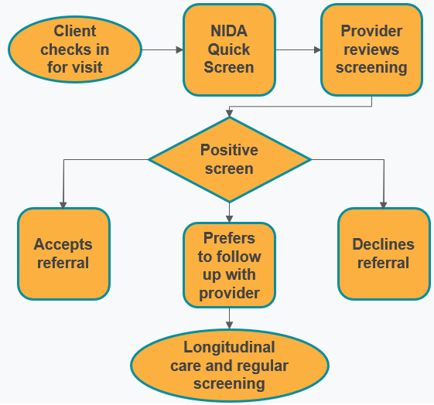
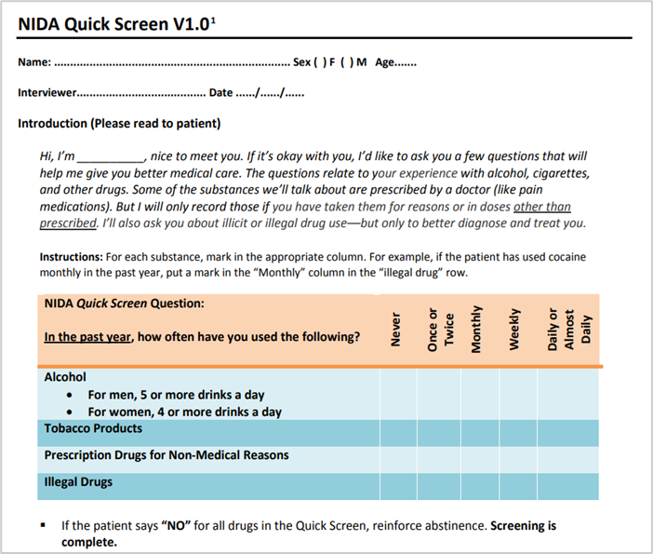
Example screener: NIDA Quick Screen
https://nida.nih.gov/sites/default/files/pdf/nmassist.pdf
Notes:
Here's an example of what this process looks like at our clinic. We use a questionnaire that's very similar to this NIDA quick screen. So there's a little script at the top here. Sometimes people find it uncomfortable to talk to somebody and ask them questions about substance use, so they do give you a hint. This is also available digitally. If you go to this website, you can see a digital version of this as well as a PDF version if you wanna print it out. So our screening process is that a client checks in for a visit, they get a tablet which has the NIDA a quick screen on it, that if the provider reviews the screening results, and if it's positive, then we will talk with the client about the positive screen, offer them a referral, if that seems like the right thing, if they screen in an area, a place where they might need to be referred for a treatment program or counseling. Sometimes client might say, "No, you know what? I would really rather just follow up with you. I think I'm gonna try to stop on my own," or, "I feel like it's not at the point now where it's really risky, but I appreciate talking to you about it, and thank you for caring," or it might be that somebody says, "You know what? I don't think I have any problem in this area. I'm good." In which case, I will ask permission to raise the question with them again the next time I see them. Longitudinal care and regular screening is really important. We all need to be reminded about the things in our lives that can cause us harm, and that's part of our job as primary care providers.

Slide 22
Follow-up to NIDA Quick Screen
https://nida.nih.gov/sites/default/files/pdf/nmassist.pdf
Image of NIDA Quick Screen titles Questions 1-8 of the NIDA-Modified ASSIST V2.0. Text: Instructions: Patients may fill in the following form themselves but screening personnel should offer to read the questions aloud in a private setting and complete the form for the patient. To preserve confidentiality, a protective sheet should be placed on top of the questionnaire so it will not be seen by other patients after it is completed but before it is filed in the medical record.
There is a table titled Question 1 of 8, NIDA-Modified ASSIST with 11 rows and 2 columns; Yes, No, the data cells are blank.
Row 1: In your lifetime, which of the following substances have you ever used?
*Note for Physicians: For prescription medications, please report nonmedical use only.
Row 2 - a. Cannabis (marijuana, pot grass, hash, etc.)
Row 3 - b. Cocaine (coke, crack, etc.)
Row 4 – c. Prescription stimulants (Ritalin, Concerta, Dexedrine, Adderall, diet pills, etc.)
Row 5 – d. Methamphetamine (speed, crystal meth, ice, etc.)
Row 6 – e. Inhalants (nitrous oxide, glue, gas, paint thinner, etc.)
Row 7 – f. Sedatives or sleeping pills (Valium, Serepax, Ativan, Xanax, Librium, Rohypnol, GHB, etc.)
Row 8 – g. Hallucinogens (LSD, acid mushrooms, PCP, Special K, ecstasy, etc.)
Row 9 - h. Street opioids (heroin, opium, etc.)
Row 10 – i. Prescription opioids (fentanyl, oxycodone [OxyContin, Percocet], hydrocodone [Vicodin], methadone, buprenorphine, etc.)
Row 11 – j. Other-specify:
Notes:
When somebody screens positive on the NIDA quick screen, there is a follow-up questionnaire that NIDA recommends for use, which is the ASSIST, and that asks more specific questions about specific types of substances, so you could really get a feel for what someone is using, what impact it might have in their lives, and whether or not they're in a place where they might be interested in changing that relationship. Here, it's super important to take a very matter-of-fact and non-judgmental approach to this. And as Jennifer said, if you have difficulty doing that and you find that you have strong feelings about substances or specific substances or substance use, it's really important to think about where those are coming from and to check our assumptions.

Slide 23
Recognition and Prevention (2 of 2)
⭐ Provide clients with SUD with a warm referral for additional services and resources.
⭐ Screen for health related social needs. Link clients to resources.
Notes:
So when somebody discloses to you with trust that they have a substance use condition, or you think it's very likely that they do, it's really important to make the referral for additional services and resources as warm as possible, that is to say, "I know the folks over there at the methadone clinic, and they usually see people on Mondays and Thursdays for intakes. Let me sit with you, and we'll call their intake person. I'll connect you, and hopefully, you can get in there later this week." We also need to think about health-related social needs that might actually impact their someone's ability to get into treatment. For example, I live in a rural area, and access to a methadone treatment program is very dependent on road conditions, whether or not we're having a snowstorm, whether or not somebody has a car, and whether or not they have Medicaid, which will pay for a ride or not. So it's really important for us to think about what are the things that might actually impact somebody's ability to access care, and to link clients to culturally and linguistically appropriate resources as well that align with their health literacy.

Slide 24
Screening for health-related social needs
Universal screening approach recommended by Centers for Medicare and Medicaid Services (CMS)
The Accountable Health Communities Health-Related Social Needs Screening Tool
Notes:
So we recommend, and it's part of the HIPS program, that screening for social determinants of health is an important part of responding to a client's disclosure of substance use. We recommend a universal screening approach for this as well. And the Centers for Medicare and Medicaid Services also recommend that.

Slide 25
Example: Comprehensive electronic health record (EHR) based screening
A flowchart diagram from top to bottom with two flow types: EHR, Staff Handoff: Tablet-based screening at check-in: Alcohol use; Drug use; Depression; Anxiety; SDOH, flows by EHR to EHR alert activated for critical positive screens: substance use, high depression score, or suicidality arrow pointing to Alert to provider; food insecurity with arrow pointing to Alert to all clinical staff, which flows by EHR to Brief intervention and warm handoff. Brief intervention and warm handoff flows to 3 separate sections by Staff handoff: Referral to substance use treatment, Behavioral health clinician, link to community resources.
Notes:
So here's an approach that we've been taking in our clinic. So we use tablet-based screening at check-in for all of our clients. Everybody gets alcohol and drug use screening, depression and anxiety screening, and health-related social needs. We're fortunate, in that, we use an electronic health record that can activate an alert for a provider for any critical positive screen. So those we count as substance use of scoring in the at-risk range. A high depression or anxiety score or any score at all on the suicidality question, that immediately alerts a provider. And if somebody screens positive for food insecurity, that alerts everybody that the patient sees clinically, they get an alert that says, "Your client so-and-so has screened positive for food insecurity." We actually have food, emergency food boxes in our clinic. So this can be a really helpful way of working with your clients to make sure that they walk out the door with having some pressing needs that they walked in with addressed. For all of these positive screens, we'll provide a brief intervention and a warm handoff. If that problem is lack of transportation, we'll help link to community resources. If the problem is that somebody wants to get into an opioid treatment program, we'll refer 'em to that treatment program. And we also have a behavioral health clinician embedded in our clinic. So we feel like we really have an embarrassment of riches where I work, but it's taken us a lot of years to put that in place to say.

Slide 26
Response
Offer reproductive life planning discussions and resources, including access to a full range of contraceptive options for which the client is medically eligible.
People who use drugs have been subjected to reproductive coercion and forced sterilization by health systems and criminal legal systems
Ask about pregnancy intention
Be aware of comorbidities that might limit use of certain contraceptive types (concurrent tobacco use, hx DVT/PE, hepatic conditions, etc.)
Trauma history may make initiation of some types of contraception difficult to tolerate
Some clients may need confidential methods to maintain safety
Notes:
So it's also very important to offer reproductive life planning discussions and resources to anyone who has an SUD or who is using drugs. People who use drugs have often been subjected to reproductive coercion and even to force sterilization by health systems and in the criminal legal system, we must never ever participate in that. We need to ask folks about pregnancy intention in an open-ended way. We need to provide appropriate and accurate information about the impact of substance use during pregnancy. And we must also be aware of comorbidities related to substance use that might limit the use of certain contraceptive types, for example, over 35 using tobacco. Many of my clients have a history of DVT or a pulmonary embolism, so estrogen-containing contraceptives will not be accurate, I mean inappropriate for them. And some of my patients have untreated hepatitis C, and they also should not have estrogen-containing contraception until we link them to treatment. So trauma history may also make the initiation of some types of contraception difficult to tolerate, specifically thinking there about IUD placement. So we do a lot of shared decision-making around IUD placement in my clinic. And some clients may need confidential methods to maintain safety. For example, Depo-Provera is not obvious to a partner who might be objecting to somebody being on contraception, but it's also very effective, and it's easy to do in the clinic, and nobody knows.

Slide 27
Reporting and Systems Learning
Monitor outcomes and process data related to SUD, and disaggregate by race and ethnicity.
Convene partners and community stakeholders—including those with lived experience—to identify opportunities and share strategies for reducing barriers to care and improving outcomes.
Notes:
So I'm gonna talk just briefly about reporting and systems learning. Obviously, we want to monitor outcomes and data related to our care for people with SUD, and we want to disaggregate that by race and ethnicity and make sure that the care that we're providing is culturally appropriate. And I think it is particularly important. And Jennifer, I just wanna thank you so much for what you've shared, that we convene community stakeholders and people with lived experience specifically to identify opportunities and share strategies to improve the care that we provide at all levels, and specifically to help us identify where the barriers are to care, so we can improve outcomes.

Slide 28
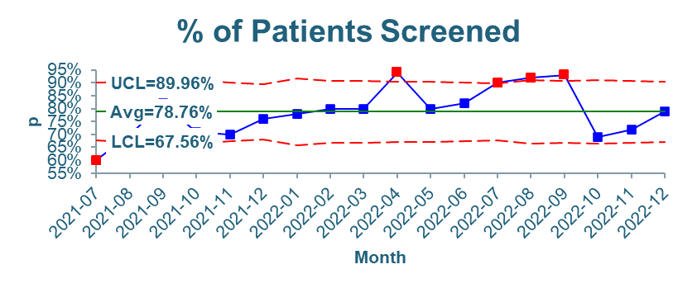
Example metrics for SUD screening
Are referral resources and communication pathways in place to enhance services and supports for clients with SUD?
Number of staff who were trained on substance use disorders
Proportion screened using validated self-reported screening tools
Proportion who screened positive who received a warm referral for additional services or resources
Variables disaggregated by
  Ethnicity
  Race
Notes:
Just some example metrics for SUD screening. Do we have the referral resources and communication pathways in place to enhance the services and supports for our clients with SUD? Have we trained our staff about substance use disorders to understand them as chronic conditions? Are we effectively screening people using validated self-reporting screening tools, that, is universal screening really universally applied? And are the people who screen positive receiving a warm referral for additional services or resources? We wanna look at all of those variables desegregated by ethnicity and race. And I would also encourage people to look at these variables by pair as well.

Slide 29
Respectful Care
Provide patient-centered, trauma-informed communication and counseling to support the client in understanding recommendations and options.
High prevalence of trauma among people who use drugs, especially among women and LGB community members
Stigma is especially intense against pregnant and parenting women who use drugs
  There are profound differences across populations in child protection reporting and in family separation
  Drug Tests Are Not Parenting Tests: The Fight to Reimagine Support for Pregnant People Who Use Drugs
Use person-first, non-stigmatizing language
  Your Words Matter – Language Showing Compassion and Care for Women, Infants, Families, and Communities Impacted by Substance Use Disorder (CME available)
Notes:
And finally, it's very important for us always to center the clients that we're working with and provide person-centered, trauma-informed communication and counseling. There is, as Jennifer mentioned, a high prevalence of trauma among people who use drugs, especially among women and among LGB community members. Stigma is especially intense against pregnant and parenting people, and there are also profound differences across populations both in drug testing and in child protection reporting and in family separation. So it's really critical that we understand the intersectionality there. And finally, words really matter, so using person-first and non-stigmatizing language is important and we can model that for our partners in practice.

Slide 30
Key takeaways
SRH providers, including Title X agencies, can show leadership in providing respectful care for people with SUD
SRH providers are uniquely positioned as trusted health care providers for communities facing barriers to care
Screening, referral to treatment, and harm reduction save lives!
Notes:
So just a few takeaways, sexual and reproductive health providers, including Title X agencies, can show leadership in providing respectful care for people with SUD, and this is really critically important and needed. SRH providers, as mentioned, are uniquely positioned as trusted health providers and may be the only health providers that many people see. And finally, asking about substance use, referral to treatment, and especially harm reduction save lives, and we all need to be part of that. I’m gonna hand it back over to Meg.

Slide 31
High Impact Practice Set (HIPS)
Resources
Notes:
All right. Thank you, thank you, Dr. Goodman. So we've got some great resources to support your implementation of these high-impact practices to care for people with substance use disorder. We'll chat the links in to these resources, and they'll be in the slides that you can download off of rhntc.org in a couple days.

Slide 32
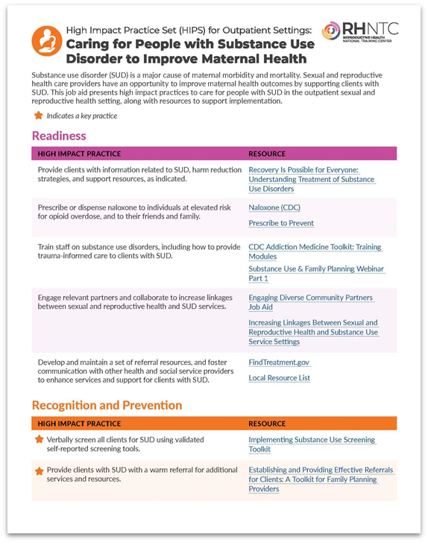
HIPS job aid
High Impact Practice Set (HIPS) for Outpatient Settings:
Caring for People with
Substance Use Disorder to
Improve Maternal Health Job Aid
Notes:
So this job aid is available on rhntc.org, presents the high-impact practices that Dr. Goodman just explained along with resources to support implementation of each practice. So if you can see this on the screenshot here, on the left-hand side, you've got the high-impact practice itself. And then on the right-hand side, there are hyperlinks that will take you to resources that will help you implement each of the practices. Your agency might not be able to implement every high-impact practice right away, that's absolutely okay, it's normal, it's expected. Start with those that make sense and that are feasible within your context. I'll also point out that a couple of the high-impact practices have a little star icon next to them, so pay special attention to those because those are the ones that we consider key practices.

Slide 33
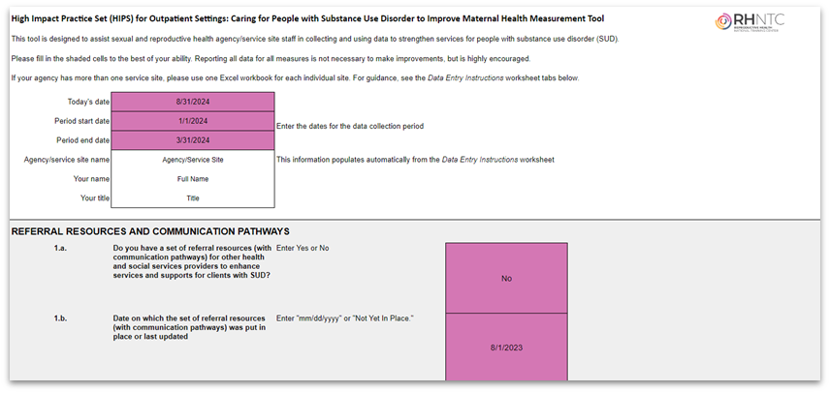
HIPS measurement tool
High Impact Practice Set (HIPS) for Outpatient Settings:
Caring for People with Substance Use Disorder to
Improve Maternal Health Measurement Tool
Notes:
Next, we've got a measurement tool, and it measures the elements that Dr. Goodman just talked about, it's an Excel spreadsheet, and it was designed in collaboration with ACOG, American College of Obstetricians and Gynecologists, to help you collect and use data to track how you and your team provide care to people with substance use disorders. This sheet allows the disaggregation of data by race and ethnicity.

Slide 34
Resource list
High Impact Practice Set (HIPS) for Outpatient Settings: Caring for People with Substance Use Disorder to Improve Maternal Health Job Aid
High Impact Practice Set (HIPS) for Outpatient Settings: Caring for People with Substance Use Disorder to Improve Maternal Health Measurement Tool
Implementing Substance Use Screening Toolkit
Overdose Deaths in Pregnant and Postpartum Women Rose Sharply in 2020. American Journal of Nursing. March 2023.
Patient Safety Bundles For Safer Birth | AIM
NIDA Quick Screen V1.0F
The Accountable Health Communities Health-Related Social Needs Screening Tool
Drug Tests Are Not Parenting Tests Report
Your Words Matter – Language Showing Compassion and Care for Women, Infants, Families, and Communities Impacted by Substance Use Disorder
Notes:
This slide is hidden from view during the webinar, but will be included in the slide deck that will be shared with participants and on the RHNTC website.

Slide 35
Questions?
Notes:
Okay, so that was a lot. What questions do you have for Dr. Goodman, for Jennifer, or for us here at the RHNTC? Please feel free to type your questions into the chat, and we will see what we can do. Give you a couple minutes to do that.

Slide 36
What’s one thing you’ll do—or do differently—as a result of this discussion?
Notes:
Okay. So we would love to hear just a little bit more from you. Please type into the chat, everybody, what is one thing that you can do, or that you can do differently, as a result of this discussion to strengthen your services or improve your services to care for people with a substance use disorder?

Slide 37
THANK YOU!
Please fill out the evaluation form after the webinar.
CONTACT US
rhntc@jsi.com
This webinar was supported by the Office on Women’s Health (Grant ASTWH2000-90-01-00). The views expressed do not necessarily reflect the official policies of the Department of Health and Human Services; nor does mention of trade names, commercial practices, or organizations imply endorsement by the U.S. Government.
Notes:
Thank you, everyone, for joining us!
And a big thanks to Dr. Goodman and Jennifer for sharing the expertise and experience, and to the RHNTC team who work behind the scenes to help bring these webinars together so beautifully!
Please complete the eval - the link should pop up soon for you… We truly appreciate your thoughtful feedback and we use it to improve our work to better serve you.

Slide 38
Engage with us
Subscribe to the RHNTC monthly eNewsletter at rhntc.org/enewsletter
Contact us on rhntc.org
Sign up for an account on rhntc.org
Follow us on LinkedIn
Subscribe to the RHNTC podcast
podcast.rhntc.org
Notes:
Please connect with the RHNTC and the resources and support that we have for you! If you go to our homepage at rhntc.org you can browse or search for training and resources, you can request technical assistance, learn more about the training tracking system that we’ve got to help you develop training lists for your team and track their completion, and you can sign up for our newsletter, which we keep you up to date on all the relevant Title X information and resources to support your work.
Thank you!

