Slide 1
Same-Visit Contraception: Implementation Strategies and Tools From the Field
August 30, 2018
Notes:
Hello everyone and welcome to today’s webinar on: Same-Visit Contraception: Implementation Strategies and Tools From the Field.
During today’s webinar we will be discussing how family planning providers can ensure clients get their contraceptive method of choice without delay, when not otherwise medically contraindicated.

Slide 2




Speakers
Katie DeAngelis, MPH
Training Consultant,
Family Planning National Training Center
Jennifer Kawatu, RN, MPH
Clinical Consultant,
Family Planning
National Training
Center
Bernadette Meily, RN, BSN
Supervisor, Family Planning Program
Southern Nevada
Health District
Erin Cooke, APRN
Nurse Practioner,
Southern Nevada Health District
Notes:
The speakers on todays webinar include:
Katie DeAngelis and Jennifer Kawatu of the Family Planning National Training Center. Katie and Jennifer have worked with dozens of Title X grantees, including during two national learning collaboratives on expanding access to contraception, and together led the development of the Same-Visit Contraception: Implementation Guide for Family Planning Providers.
Bernadette Meily and Erin Cooke of the Southern Nevada Health District. Bernadette is the supervisor of the Family Planning program there, and Erin is an Advanced Practice Registered Nurse. They will be sharing how they have been successful in providing all methods, including IUDs and implants, during the same visit clients first request it.

Slide 3
Objectives
Describe the rationale for providing the full range of contraceptive methods during the same visit when initially requested by the client
Identify at least 3 examples of successful strategies used by Title X providers to increase client access to all methods same-visit
Identify resources that can be used to support implementation of same-visit contraception, including Same Visit Contraception: An Implementation Guide for Family Planning Providers
Notes:
Here’s what you can expect for today’s webinar.
We will start with a review of the rationale for providing methods during the same visit initially requested by the client (i.e., same-visit), which is now a best practice recommendation
Bernadette and Erin will share their experience and successful strategies for implementation.
Finally, we will highlight new resources that can support you to provide the full range of methods same visit, including a new Implementation Guide from the Family Planning National Training Center.

Slide 4
Defining Same-Visit Access
“Same-visit” access to all methods means that during a single visit, clients can request a method and leave their visit with that selected method*
  Not requiring clients to come back for new appointment on a different day, or later the same day
  Including for provider-dependent methods: IUD, implant, and injectable
Option should be available to clients
  Regardless of reason for initial visit
  Not expected that this will work for all clients
*When the provider can be reasonably certain that the client is not pregnant
Notes:
As we start to review the rationale, let’s first make sure we’re all on the same page about what we mean when we say “same-visit provision.”
Same-visit access to methods means that during a single visit, clients can request a method and leave their visit with that selected method. That is, providing immediate access to contraceptive methods using Quick Start, and not requiring clients to return for a separate appointment on another day or even later the same day to initiate contraception.
Most of you have been doing this for a long time when it comes to providing short-acting methods like the pill, patch, ring, condoms, and fertility awareness. A challenge has been providing methods same-visit for provider-dependent methods- like the IUD and implant. Thus, we will be focusing must of our discussion today on these methods; however, it’s important that all patients have access to their method of choice, regardless of what that method is.
This option should be made available to all clients—regardless of reason for the initial visit—and regardless of method of choice; although it is not expected that all clients will choose this option, nor that it will be right for everyone.

Slide 5
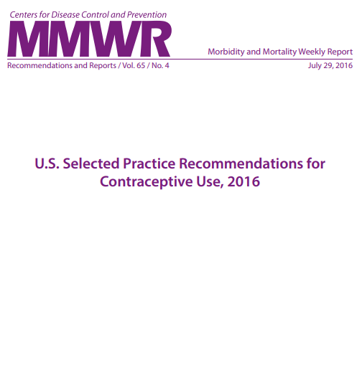
Rationale for Same-Visit Access
There is no medical reason to routinely require multiple visits to initiate any contraceptive method, if the provider can be reasonably certain that the client is not pregnant
Notes:
Briefly – let’s recap why this is so important. There is no medical reason to routinely require multiple visits to initiate any contraceptive method if the clinician can be reasonably sure that the client is not pregnant.
Source (for reference)
Curtis KM, Jatlaoui TC, Tepper NK, et al. U.S. Selected Practice Recommendations for Contraceptive Use, 2016. MMWR Recomm Rep 2016;65 (No. RR-4):1–66. DOI: http://dx.doi.org/10.15585/mmwr.rr6504a1

Slide 6
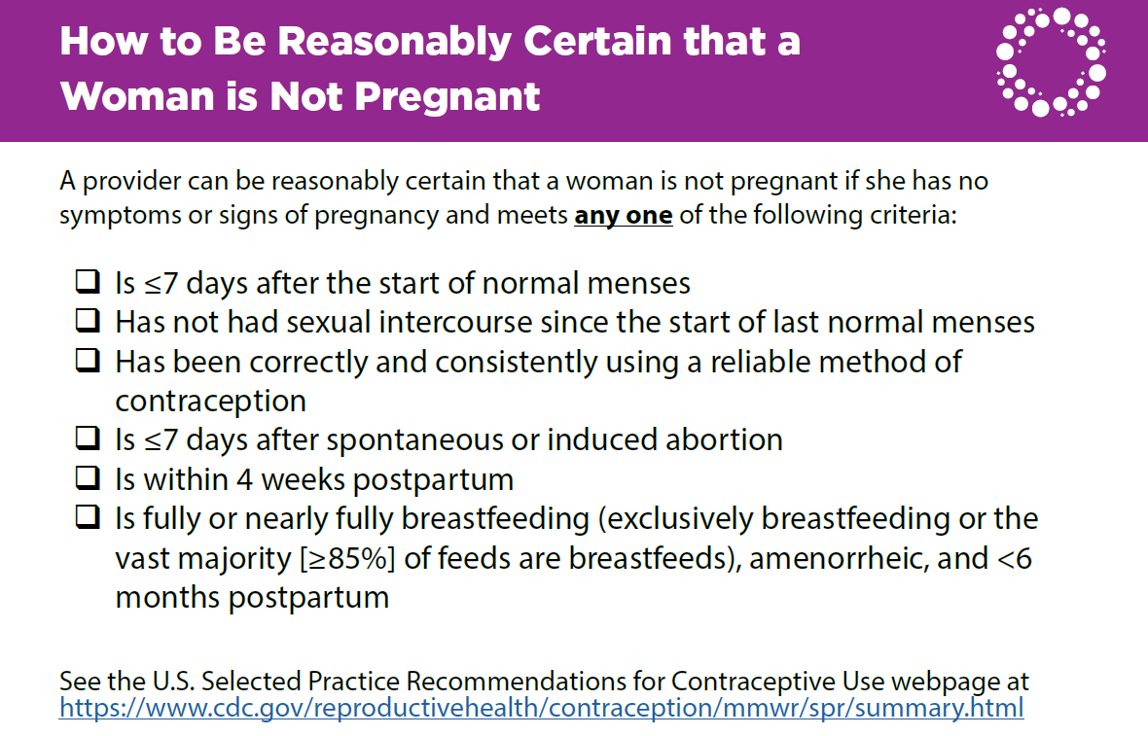
Access this palm card at: https://www.fpntc.org/resources/how-be-reasonably-certain-woman-not-pregnant-and-when-start-contraceptive-methods-palm
Notes:
The CDC’s 2016 Selected Practice Recommendations include guidelines to help clinicians be reasonably certain a client is not pregnant.
A clinician can be reasonably certain that a woman is not pregnant if she has no symptoms or signs of pregnancy and meets any one of these.
On the screen is a Palm Card that FPNTC developed. You can download it from our FPNTC website.

Slide 7
Rationale for Same-Visit Access (cont’d)
CDC and ACOG agree that clinicians can provide the client’s method of choice in a single visit, unless additional testing is medically indicated
Use the Quick Start method to initiate contraceptive methods same-visit
Notes:
Recent guidelines state that clients should be able to begin contraception at the time of visit rather than waiting for their next menses—or returning for another appointment—using the Quick Start method.
Although it has been common practice to require multiple appointments for methods such as the IUD or implant, in the past, CDC and ACOG recommend that clinicians initiate and provide the client’s method of choice in a single visit, unless additional testing is medically indicated.
Sources (for reference)
Gavin L, Moskosky S, Carter M. Providing Quality Family Planning Services: Recommendations of CDC and the U.S. Office of Population Affairs. MMWR Recomm Rep 2014;63 (No. RR-4):1–54
Curtis KM, Jatlaoui TC, Tepper NK, et al. U.S. Selected Practice Recommendations for Contraceptive Use, 2016. MMWR Recomm Rep 2016;65 (No. RR-4):1–66. DOI: http://dx.doi.org/10.15585/mmwr.rr6504a1
American College of Obstetricians and Gynecologists. “Long-Acting Reversible Contraception: Implants and Intrauterine Devices.” Practice Bulletin Number 186, November 2017.

Slide 8
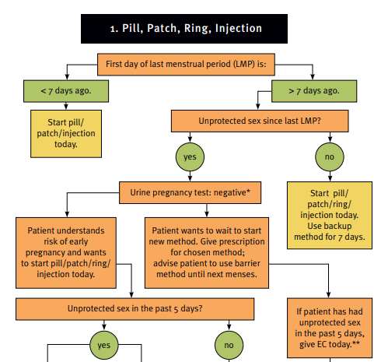
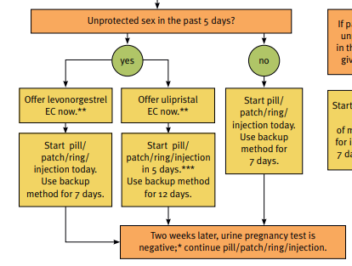
Quick Start Algorithm
Link: https://www.fpntc.org/resources/quick-start-algorithm
Notes:
Initiation of a contraceptive method on any day during the menstrual cycle, rather than restricting initiation to the subsequent Sunday or day 1 of the cycle is referred to as the Quick Start method.
Conventional initiation of hormonal contraception at the beginning of the next menstrual cycle may mean a delay of several weeks between the time a client receives her prescription and starts contraceptive use.
Compared to that approach, clients who begin contraception with the Quick Start method have reduced risk of unintended pregnancy and increased initiation and continuation rates.
To use Quick Start:
If the last menstrual period (LMP) was within the last 5 days, the method can be started immediately.
If LMP was more than 5 days ago and a pregnancy test is negative, assess the last episode of unprotected sex to determine if emergency contraception is required before the woman starts the method.
If the woman had unprotected sex within the last 2 weeks, start the contraceptive method and advise the client to return for a pregnancy test in 3 weeks.
Instruct women who are using the pill, patch, ring, injection, hormonal IUD, or implant whose LMP was more than 5 days ago to use back-up contraception for the first 7 days.
If intrauterine contraception is the choice, the provider should consider the possibility of an early undetected pregnancy. Intrauterine contraception poses a risk to the pregnancy (and thus is designated MEC category 4), whereas the other Quick Start contraceptive methods do not.
This particular Quick Start Algorithm on the screen was developed by the Reproductive Health Access Project and is available to download from the FPNTC website (link is on the slide).
Sources (for reference)
Reproductive Health Access Project. Quick Start Algorithm: https://www.reproductiveaccess.org/resource/quick-start-algorithm/
Curtis KM, Jatlaoui TC, Tepper NK, et al. U.S. Selected Practice Recommendations for Contraceptive Use, 2016. MMWR Recomm Rep 2016;65 (No. RR-4):1–66. DOI: http://dx.doi.org/10.15585/mmwr.rr6504a1
Phelps R, Murphy P, Godfrey E. Choosing a Birth Control Method. Association for Reproductive Health Professionals. Published September 2011, updated June 2014. http://www.arhp.org/Publications-and-Resources/Quick-Reference-Guide-for-Clinicians/choosing/Initiation-Hormonal-Contraceptives

Slide 9
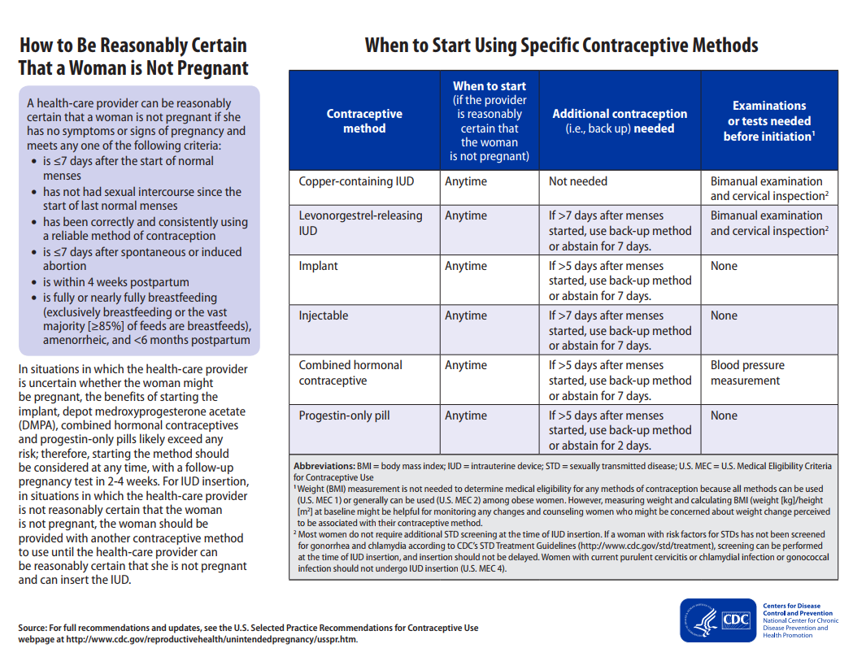
Notes:
According to CDC, if providers can be reasonably certain a client is not pregnant, they can start any method “anytime.”
In situations in which the provider is uncertain whether the woman might be pregnant:
The benefits of starting the implant, injectable, combined hormonal contraceptives, and progestin-only pills likely exceed any risk; therefore, starting the method should be considered at any time, with a follow-up pregnancy test in 2-4 weeks.
For IUD insertion, the woman should be provided with another contraceptive method to use until the provider can be reasonably certain that she is not pregnant and can insert the IUD.
Source (for reference)
Curtis KM, Jatlaoui TC, Tepper NK, et al. U.S. Selected Practice Recommendations for Contraceptive Use, 2016. MMWR Recomm Rep 2016;65 (No. RR-4):1–66.

Slide 10
Notes:
Historically, a reason for delaying initiation of contraceptive methods was to conduct and obtain results for exams and tests.
According to CDC, for implants, injectables, and progestin-only pills, there are no necessary exams or tests needed before initiation. For the copper IUD and hormonal IUD, bimanual examination and cervical inspection are needed before initiation. Blood pressure measurement is needed prior to dispensing combined hormonal contraceptive pills.
CDC says that most women do not require additional STD screening at the time of IUD insertion. If a woman with risk factors for STDs has not been screened for gonorrhea and chlamydia according to CDC’s STD Treatment Guidelines (http://www.cdc.gov/std/treatment), screening can be performed at the time of IUD insertion, and insertion should not be delayed.
Note: Women with current purulent cervicitis or chlamydial infection or gonococcal infection should not undergo IUD insertion. (See footnote #2 on the slide.)
Sources (for reference)
Curtis KM, Jatlaoui TC, Tepper NK, et al. U.S. Selected Practice Recommendations for Contraceptive Use, 2016. MMWR Recomm Rep 2016;65 (No. RR-4):1–66.
Centers for Disease Control and Prevention. Sexually Transmitted Diseases Treatment Guidelines, 2015. MMWR Recomm Rep 2015;64 (No. RR-3): 1-137.

Slide 11
Concern for Pelvic Inflammatory Disease
GC and CT Screening at IUD Insertion and PID Sufrin CB, et. al Obestet Gynecol 2012;120:1214-21
  57,728 IUD insertions
  47% were unscreened w/in 1 year of insertion
  Rate of PID was the same
Contraceptive Choice Project
  CT/GC + and IUD insertion 0.47 PID rate
  CT/GC - and IUD insertion 0.30 PID rate (not statistically significant)
Notes:
Despite the recommendations there are still concern, from some providers, particularly in a young woman, that if you insert an IUD without a negative CT/GC test, that it increases her risk for PID. There are a number of studies that show that is not the case.
The most important of these is from Carolyn Sufrin and colleagues in “The Green Journal” in 2012.
They did a retrospective review of almost 58,000 IUD insertions in the Kaiser Permanente population in Northern California.
About half the women were not screened for CT/GC within a year, the other have were. The overall risk of PID was 0.5% (1/200 women) but there was no difference in rates of PID in those who were screened and those who were not screened.
Another study, the Contraceptive Choice project also provides some additional data. They found the overall rate of PID was very low; and that it was less than 0.5% in women who were CT/GC positive, and 0.3% - which was not found to be statistically significant. So, the overall risk was very low, and that it was not influenced by whether they had CT/GC.
If a woman does need to be screened for Gonorrhea or Chlamydia, they recommend it is safe to do so on the day of the IUD insertion, and treat women with a positive result, and this can be done safely without removing the IUD.
Sources (for reference)
Sufrin, et al. Neisseria gonorrhea and Chlamydia trachomatis screening at intrauterine device insertion and pelvic inflammatory disease. Obstet Gynecol. 2012 Dec;120(6):1314-21
Grentzer, et al. Risk-based screening for Chlamydia trachomatis and Neisseria gonorrhoeae prior to intrauterine device insertion. Contraception. 2015 Oct;92(4):313-8.

Slide 12
Additional Visits are a Barrier for Clients
National Clinical Training Center for Family Planning online survey of APRNs (n=390)
  35% of respondents had policies that permitted same-visit provision
  Over half (56%) required ≥2 visits to provide method
  Every one visit increase required for LARC provision resulted in fewer insertions
Hormonal IUD
-27%
National Clinical Training Center for Family Planning, 2016.
Notes:
Same-visit access is also appreciated by clients.
There is evidence that each additional visit that clients have to make to the clinic greatly reduces the likelihood that they will receive a LARC method after having selected it as their method of choice.
This study from the Clinical Training Center for Family Planning (CTCFP) of advanced practice registered nurses (APRN) found that each additional visit resulted in 24% fewer placements of copper IUDs, 27% fewer placements of hormonal IUDs, and 32% fewer placements of implants.
The low rate of follow-up for visits, along with subsequent lack of access to methods due to multiple visits, means that clients are choosing a method and then not getting the method they want. They continue to be at risk of unintended pregnancy, despite coming to the clinic and in order to prevent pregnancy.
Source (for reference)
National Clinical Training Center: Findings from a National APRN LARC Survey. Presented at the National Family Planning and Reproductive Health Association Meeting, April 19, 2016.

Slide 13
Clients are Busy
Client barriers to accessing care
  Child care
  Transportation
  Time off from work
“If the patient wants a LARC method and we provide it the same day, that prevents an issue with the patient having to come back to the clinic. It prevents the risk of an unplanned pregnancy because they're going to forget a pill or forget to come back for their next Depo or not be able to take another day off work to come back and get that LARC method.”
- Nurse Practitioner,
Southern Nevada Health District
Notes:
Clients don’t always come back for their follow-up appointments
As you all are aware and see every day, they may have issues obtaining childcare, finding affordable transportation, being able to take time off of work, etc.
Part of Title X’s mission is serving and meeting the needs of vulnerable populations, and when we remind ourselves of the additional barriers that our clients face when accessing care, it becomes that much more important to put in the extra effort to be client-centered in the services we offer.
One clinician at a Southern Nevada Health District clinic who makes it a priority to provide methods same-visit when possible summed up these challenges nicely, saying, “If the patient wants a LARC method and we provide it the same day, that prevents an issue with the patient having to come back to the clinic. It prevents the risk of an unplanned pregnancy because they're going to forget a pill or forget to come back for their next Depo or not be able to take another day off work to come back and get that LARC method.”

Slide 14
Client Satisfaction
Offering methods same-visit increases client satisfaction
Client satisfaction drives demand
When clients are satisfied, staff are satisfied!
“What I'm hearing from patients about how they feel about being able to get all of their needs met, including their contraceptive needs in one visit, is that they are sometimes surprised and always very excited to be able to do this.”
- Physician, NYC Health + Hospitals
Notes:
When clients are able to get the services they want–all the services they want–in one visit, they leave their visit happy and satisfied.
One physician in New York City, who has found that clients are extremely satisfied and appreciative of being able to receive methods same-visit, said, “What I'm hearing from patients about how they feel about being able to get all of their needs met, including their contraceptive needs in one visit, is that they are sometimes surprised and always very excited to be able to do this.”
Clients recognize that this is an effort by their providers to meet their needs, and respect their time and resources.
When clients are satisfied, they are more likely to come back to the clinic, more likely to refer their friends and family to the clinic for services, and when our clients are satisfied, the staff are more satisfied too! We all know how good it feels to have clients leave their visits happy and healthy.

Slide 15

Barriers
Stocking
Clinic flow and wait time
Staff training
Financial implications
Inertia. Change is hard!
Notes:
Of course – if this was easy, everyone would be doing this already. This is challenge!
So, what are some of the barriers we’ve hard from providers?
Stocking: In order to provide the full range of methods on site – you have to have them stocked on site –a prerequisite!
There is a common perception that providing methods same-visit will cause an increase in wait time
You have to also have the adequate staff available who are trained to provide all methods – training and availability
And then there are often concerns about financial implications and reimbursement of methods same-visit. If it is getting billed correctly for insured patients, it should be reimbursed, but this is always a concern.
The idea is that this option should be made available to all clients—regardless of reason for the initial visit—although it is not expected that all clients will choose this option, nor that it will be right for everyone. The goal is to work toward this being an option and becoming common practice - for all the reasons we just talked about.

Slide 16
Southern Nevada
Health District
CASE STUDY
Notes:
Now Bernadette Meily and Erin Cooke from the Southern Nevada Health District will talk about their experience providing the full range of methods same-visit, including IUDs and implants, and how they’ve addressed some of the barriers they faced.

Slide 17
Same day IUD insertions: Why?
Patient satisfaction
Effective method
Avoid risk of no return/no method
Decreased cost for self pay patients
Reduced risk of unwanted pregnancy
Notes:
There are many reasons why at Southern Nevada Health District thought that it was important to offer clients methods during the same visit including: increased patient satisfaction; increased access to effective methods for patients that want to prevent pregnancy; avoid the of clients not returning and having no method, when they desired a method; decreased cost for self pay patients; and ultimately reduced risk of unwanted pregnancy.

Slide 18
How can we do this?
Adequate supplies (IUDs, insertion packets)
Adequate staff
Discuss clinic flow with staff, might be different per clinic/provider
Be open to adjustments along the way
Important to incorporate staff involvement
  Set up rooms
  Assist with consent forms
  Post procedural assistance, if needed (vasovagal, additional instructions not included with consultation)
Time to place Nexplanon: 2 minutes (not including consultation)
Time to place IUD: 5 minutes (not including consultation)
Notes:
From a clinician’s perspective, some of the keys to our success were:
Adequate supplies (IUDs, insertion packets)
Adequate staff
Discuss clinic flow with staff, might be different per clinic/provider
Be open to adjustments along the way
Important to incorporate staff involvement
Set up rooms
Assist with consent forms
Post procedural assistance, if needed (vasovagal, additional instructions not included with consultation)
In our experience, we did not find that offering methods same-visit increased visit time substantially
Time to place Nexplanon: 2 minutes (not including consultation)
Time to place IUD: 5 minutes (not including consultation)

Slide 19
Implementing Same-Visit Insertions
Keep the full range of methods available all the time – avoid shortage.
Maintain adequate insertions and removal supplies.
HOW?
FORECAST: Use inventory data from previous months, such as monthly usage and stocks on hand; develop a monthly par level; monitor trends; weekly inventory and order.
BUDGET: Most challenging
OUR STRATEGY: Find opportunities to save; bill appropriately to increase revenue
Americares.org
Partnership with programs like TPP
Grant funding opportunities
340 B Drug Pricing Program
Patient Assistance program –Arch Mirena
Notes:
From an administrative perspective, some keys to success were to: keep the full range of methods available all the time – avoid shortage; and maintain adequate insertions and removal supplies. How did we do this?
We forecasted using inventory data from previous months, such as monthly usage and stocks on hand; develop a monthly par level; monitor trends; weekly inventory and order.
Budgeting was most challenging
To overcome that challenge, we found opportunities to save; billed appropriately to increase revenue; and identified other revenue sources

Slide 20
Staff on Board
Understand the goal
Provide training
Clear definition of roles
Discuss workflow/process
Staff input/challenges
Open discussion
Resolving issues together
Agree as a group to implement the change
Re-evaluate: make adjustments as necessary
Notes:
Getting staff on board with same visit insertions was critical.
To get staff on board, we:
Articulated so they would understand the goal
Provided training
Provided a clear definition of roles
Discussed workflow/process
Obtained staff input/challenges
Opened discussion
Resolved issues together
Agreed as a group to implement the change
Re-evaluated regularly to make adjustments as necessary

Slide 21
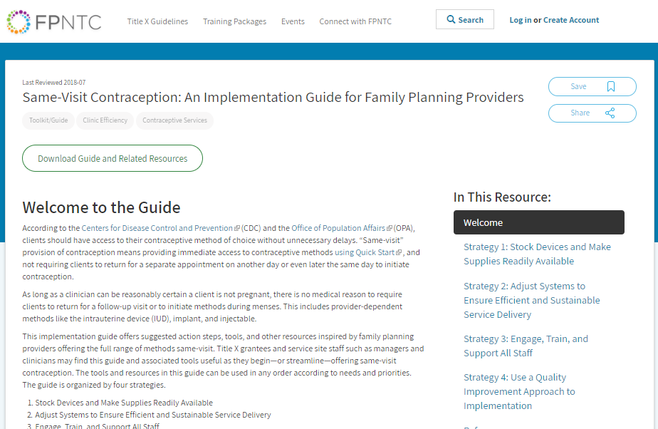
http://fpntc.org/samevisit
http://fpntc.org/samevisit
Notes:
Drawing from the experience of Title X network providers, the Family Planning National Training Center has developed an implementation guide to support family planning providers to provide methods same-visit.
It is available online as an interactive webpage, or for download to print if you prefer.

Slide 22
Same-Visit Contraception Implementation Strategies
1. STOCK
Stock devices and make supplies readily available.
2. SYSTEMS
Adjust systems for efficient and sustainable service delivery.
3. STAFF
Engage, train, and support all staff.
http://fpntc.org/samevisit
Notes:
The guide offers suggested action steps, tools, and other resources inspired by family planning providers offering the full range of methods same-visit. Title X grantees and service site staff such as managers and clinicians may find this guide and associated tools useful as they begin—or streamline—offering same-visit contraception. The tools and resources in this guide can be used in any order according to needs and priorities.
The guide is organized into 3 sections with overarching strategies.
Strategy 1: Stock devices and make supplies readily available.
Strategy 2: Adjust systems for efficient and sustainable service delivery.
Strategy 3: Involve all staff through training and support.
Within each strategy are action steps and supportive tools to help providers implement these steps.

Slide 23
Stock Devices and Make Supplies Readily Available
Stock the full range of methods, including at least one of each provider-dependent method.
  i.e., hormonal IUD, copper IUD, implant, and injectable
Keep supplies for IUD and implant insertions and removals in exam rooms.
Develop a system to maintain sufficient stock of contraceptive methods.
Notes:
The first strategy is to stock devices and make supplies readily available. This includes:
Stock the full range of methods, including at least one of each provider-dependent method (i.e., hormonal IUD, copper IUD, implant, and injectable).
Keep supplies for IUD and implant insertions and removals in exam rooms (e.g., in kits or a portable caddy).
Develop a system to maintain sufficient stock of contraceptive methods to avoid having too much or too little stock.
Consider at your own site: Which of these strategies do we already do? Which strategies are we not already doing, but could, with a small amount of difficulty, implement?

Slide 24
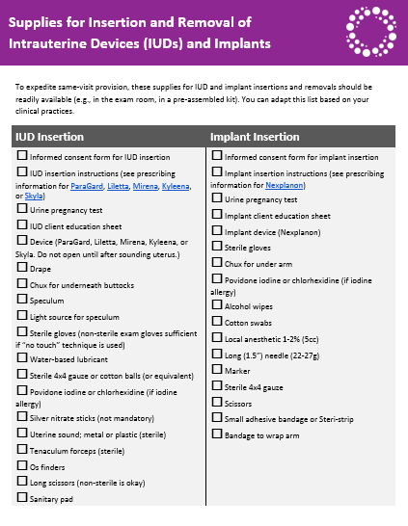
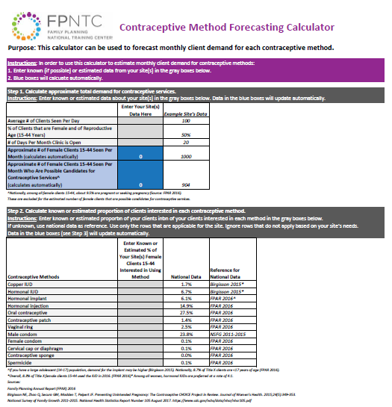
Tools for Stocking and Supplies
http://fpntc.org/samevisit
Notes:
Here are two examples of tools in this section
On the left is an editable list of supplies needed for insertions and removals of IUDs and implants. This can be used as a checklist to ensure that the exam rooms are stocked with the necessary supplies to expedite same-visit insertions. This was adapted from a checklist from Unity in DC.
On the right is a calculator that is an Excel file which you can use to forecast demand for a method if you are not already stocking it. The same file also includes a tab to help with monitoring of stock and to determine how much of a method to order based on the stock on hand and prior utilization.
Other tools available in this section include: a checklist of which methods should be available on site (i.e. at least one type of each category of methods); a one pager on how to order and obtain discounts for each LARC method; and FAQs on the 340B drug pricing program.

Slide 25
Adjust Systems for Efficient and Sustainable Service Delivery
Adopt a policy that supports same-visit provision.
Make adjustments to the schedule, if necessary, to enable flexibility in service provision.
Make changes, if necessary, to clinic workflow to ensure same-visit integration does not increase client cycle time.
Notes:
The second strategy is to adjust clinic systems for efficient and sustainable service delivery. This includes things like:
Adopting a policy that supports same-visit provision of all methods. – This is really important foundation on which other strategies can be built around.
You may need to make adjustments to the schedule if necessary (e.g., block appointments, eliminate double booking, use one appointment length) to enable flexibility for same-visit provision. This may include eliminating designated appointment slots for IUD and implant insertions, and streamlining the appointment schedule (eliminating double booking, using one standard appointment length).
You may also need to make changes as necessary to the clinic workflow (e.g., reduce number of client stops, eliminate duplication of effort, increase efficiency of client flow) to ensure same-visit integration does not increase client cycle time.

Slide 26
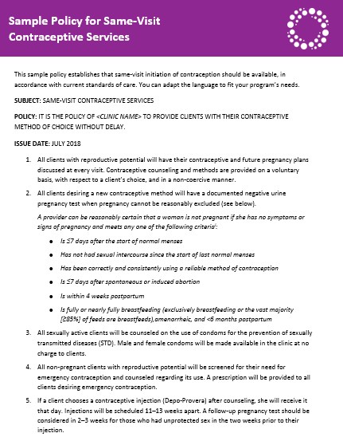
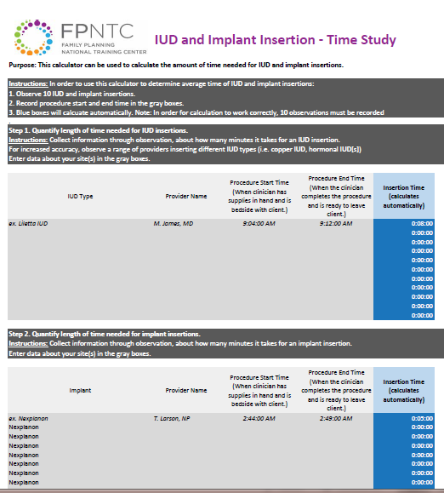
Tools for Systems and Processes
http://fpntc.org/samevisit
Notes:
Here are two examples of tools in this section
On the left is a sample policy that supports same-visit provision. It is editable so you can adapt it for your site. It was originally developed by a healthcare provider in New York City.
On the right is an excel tool that you can use to conduct a time study to see how long IUD and implant insertions take and this tool can also help you consider what, if any, schedule adjustments might need to be made in order to provide methods same-visit.

Slide 27
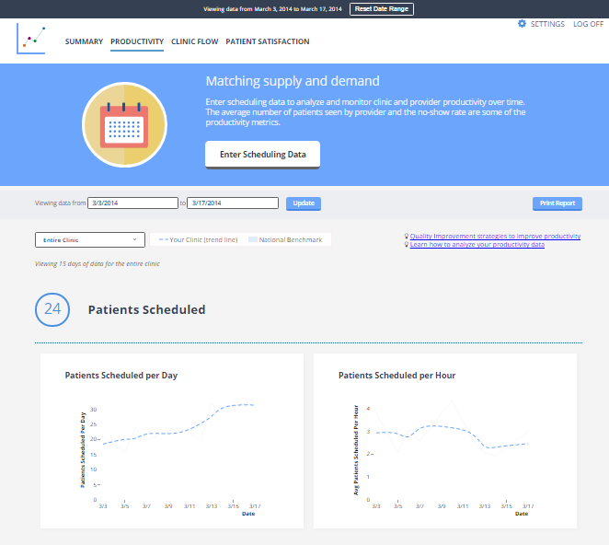
Clinic Efficiency Dashboard
Clinic Efficiency Dashboard: www.clinicefficiency.com
Notes:
In addition, there are lots of tools to help you improve clinic efficiency. There is a clinic flow checklist, and also a link to this dashboard –clinicefficiency.com– where you can enter data for staff utilization and productivity, clinic flow, and patient experience and you can track and visualize that data.

Slide 28
Engage, Train, and Support All Staff
Clinicians - Current standards of care, insertion and removal of LARC methods, Quick Start (including posting of reference guides)
Administrative and support - How to respond to clients’ questions about obtaining methods
Billing and coding - Use of coding modifiers, tracking claims data and quality assurance of coding and billing to ensure adequate reimbursement
Notes:
Finally, we hear consistently from Title X providers that this has to be a team effort!
Clinicians may need additional training and support around current standards of care for provision of contraceptive services, how to insert and remove the full range of LARC methods, and job aids (like those about Quick Start) in exam rooms for quick reference guides.
Administrative and support staff may need additional support to respond to clients’ frequently asked questions about obtaining methods, including receiving methods same-visit
Staff responsible for billing and coding may need support around accurate coding for same-visit services.
The important thing is that everyone has a role to play in providing methods same-visit, and this is not just going to fall on one person or role.
Consider at your own site: Which of these strategies do we already do? Which strategies are we not already doing, but could, with a small amount of difficulty, implement?

Slide 29
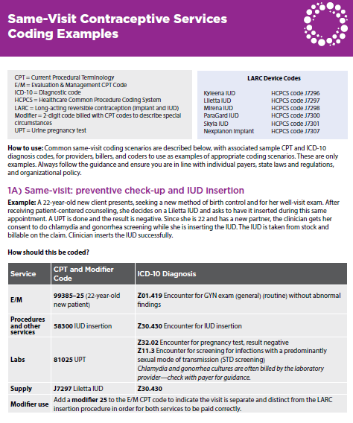
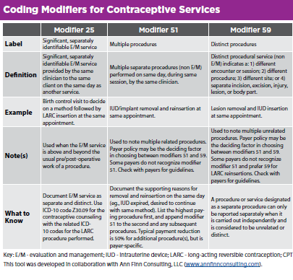
Tools for Supporting Billing and Reimbursement
http://fpntc.org/samevisit
Notes:
We already showed you some of the resources to support clinicians including the palm card (on how to be reasonably certain a patient is not pregnant) and the Quick Start Algorithm developed by Reproductive Health Access Project
Here are two examples of other tools in this section
We know there are lots of questions about reimbursement of same-visit services. We know of a lot of sites that are billing and getting reimbursed adequately for methods provided same-visit, when coding modifiers are used
On the left is a section of the overview of coding modifiers.
On the right common same-visit coding scenarios, with associated sample CPT and ICD-10 diagnosis codes, for providers, billers, and coders to use as examples of appropriate coding scenarios.
Other resources to support billing and reimbursement include a palm card with coding modifiers and a tracking tool to help you keep track of reimbursement, by device and insurance type.

Slide 30
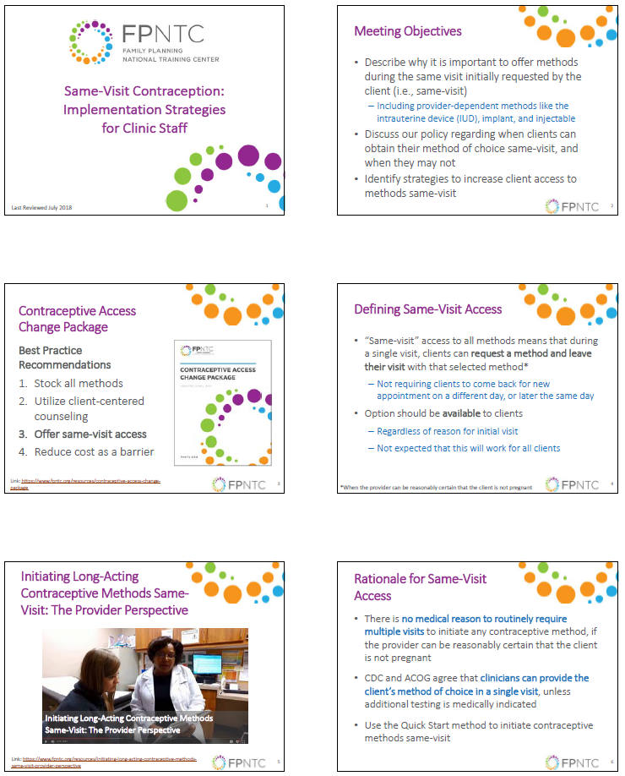
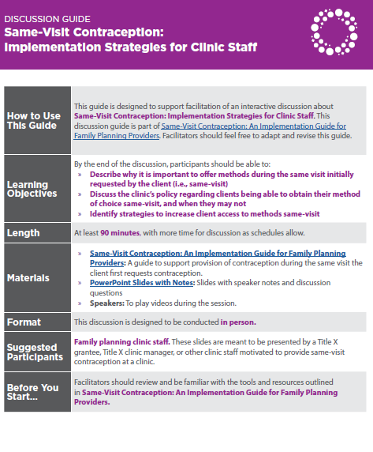
Tools for Engaging Staff
http://fpntc.org/samevisit
Notes:
Finally – a couple of other tools to help with engaging staff at your site. Ultimately, as you all know, it’s the staff that need to work together to make same-visit contraception a reality, and we have some resources to support that process.
The first is a slide deck and facilitation guide to help walk a site’s staff through the process of developing an action plan. It sets the stage for why offering methods same-visit is important, your policy, and ultimately, what actions you want to take to start or streamline offering methods same-visit.

Slide 31

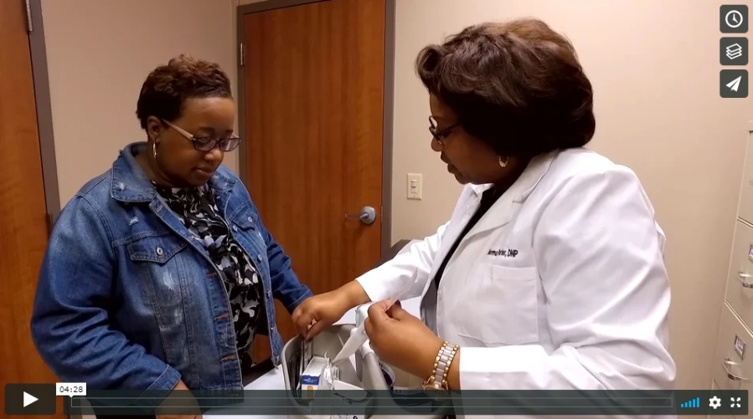
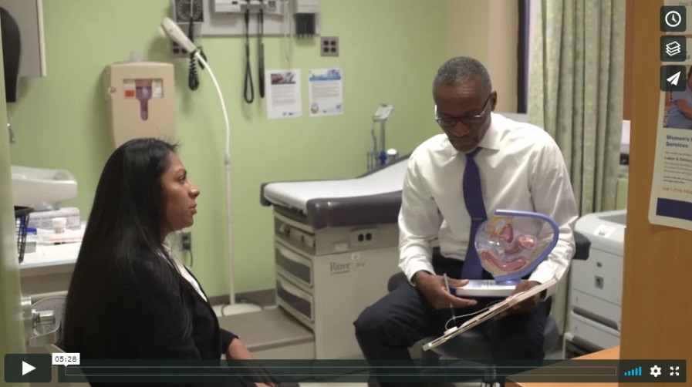
Case Study Videos
A Case Study: Same-Visit Provision of Contraception at the Southern Nevada Health District, East Las Vegas Health Clinic
A Case Study: Same-Visit Provision of Contraception at the Louisiana Office of Public Health, Rapides Parish Health Unit
A Case Study: Same-Visit Provision of Contraception at New York City Health + Hospitals, Gotham Health, Morrisania and Lincoln
Links:
https://www.fpntc.org/resources/case-study-same-visit-provision-contraception-southern-nevada-health-district-east-las
https://www.fpntc.org/resources/case-study-same-visit-provision-contraception-louisiana-office-public-health-rapides
https://www.fpntc.org/resources/case-study-same-visit-provision-contraception-nyc-healthhospitals-morrisania-and-lincoln
Notes:
And, there are three case study videos of real sites that are already doing same-visit insertions. One profiles Southern Nevada Health District, which was profiled during this webinar.
These are great tools to show staff that success is possible!

Slide 32
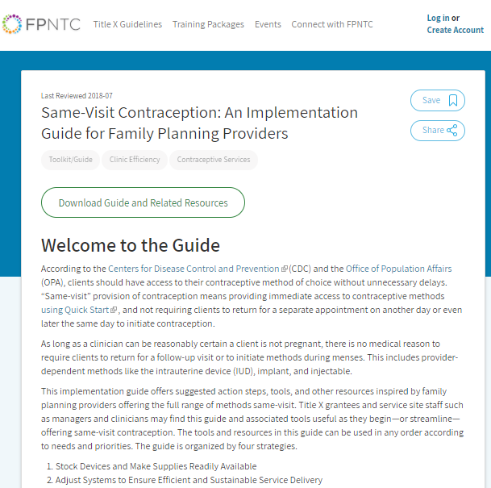
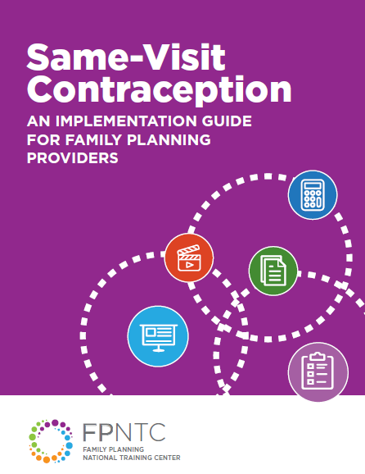
Same-Visit Contraception Implementation Guide
http://fpntc.org/samevisit
Notes:
Again, all of these tools are available at fpntc.org/samevisit – you can either use the online, interactive version, or print it out if you prefer.

Slide 33
Questions?

Slide 34
Thank you!
Contact:
fpntc@jsi.com

