Slide 1
Reducing Maternal Mortality from Intimate Partner Violence and Substance Use
April 26, 2023
Notes:
- [Devon] Hello everyone. This is Devon Brown from the Title X Reproductive Health National Training Center, and I'd like to welcome you all to today's webinar, Reducing Maternal Mortality from Intimate Partner Violence and Substance Use. I have a few announcements before we begin today. Everyone on the webinar is muted, given the large number of participants. We will have some time for questions at the end of the webinar, but please don't hesitate to ask your questions using the chat at any time in today's session. We'll gather the questions as we go along, and we'll save most of them for the Q&A portion at the end of the webinar. We'll also be asking for your participation at a few points during the webinar, so don't hesitate to engage through the chat. A recording of today's webinar, along with the slide deck and a transcript, will be available on rhntc.org within the next few days. Closed captioning has been enabled for this webinar and to view it you can click on the CC icon at the bottom of your screen. Your feedback is extremely important to us and it has enabled the RHNTC to make quality improvements in our work based on your comments. Please take a moment to open the evaluation link in the chat and consider completing it in real time. Just a note that in order to obtain a certificate of completion for attending the webinar, you must be logged into rhntc.org when you complete the evaluation. This presentation was supported by the Office of Population Affairs, or OPA, and the Office on Women's Health, or OWH. Its contents are solely the responsibility of the authors and do not necessarily represent the official views of OPA, OWH, or HHS.

Slide 2
Speaker
Rebecca Levenson, MA
Senior Health Policy Consultant for FUTURES Without Violence
Notes:
So today we are really excited to welcome back as our speaker, Rebecca Levenson. Rebecca Levenson has decades of experience helping reproductive healthcare systems respond to intimate partner violence, or IPV. She's a former Planned Parenthood clinic director and senior health policy consultant for the National Nonprofit FUTURES Without Violence. Rebecca is a nationally recognized researcher, educator, advocate, and speaker. Ms. Levenson is an author of numerous additional IPV training resources and publications, including the FUTURES Evidence-based intervention CUES, which applies the power of universal education and altruism to improve provider's ability to help clients experiencing IPV. And with that, I will turn it over to Rebecca.
- [Rebecca] Thanks so much, Devon. And there are 148 of us on this call, so I'm very excited to be with you all today.

Slide 3
Learning objectives
Participants will be able to:
Describe the prevalence of maternal deaths related to intimate partner violence (IPV) and substance use
Explain the connections between IPV-associated substance use overdose and suicide among pregnant people
Identify at least two strategies for responding to clients experiencing IPV and/or substance use
Notes:
And I just want to start by sharing a little bit of the learning objectives. So what's the journey we're going to be on together today? We're going to be looking at the prevalence of maternal deaths related to intimate partner violence, and then we're going to look at connections between what we call IPV-associated substance use overdose and suicide among pregnant people. And then we are going to identify two strategies for responding to clients, because I know many, some of you may actually do prenatal care, wear another hat in another sort of world, but in the Title X world I know you all are doing reproductive health. So how can we be supportive around these issues relative to preconception and interconception care? So I'm going to be leaving you with some kernels as we go forward.

Slide 4
Let’s take a moment to ground ourselves…
Notes:
Okay, my friends, there are 159 of us now, and I have no idea how many different states are represented in that 159, or 161 as is the case. But I want to just take a collective minute and have us all get grounded, right? So maybe you just came from clinic, maybe you just came from lunch. And I'm going to invite you, if you'd like, you know, uncross your legs, put your feet on the floor, feel your heels, feel your toes, take your palms and rub up on your knees, and just take a second to be here with us, thank you.

Slide 5
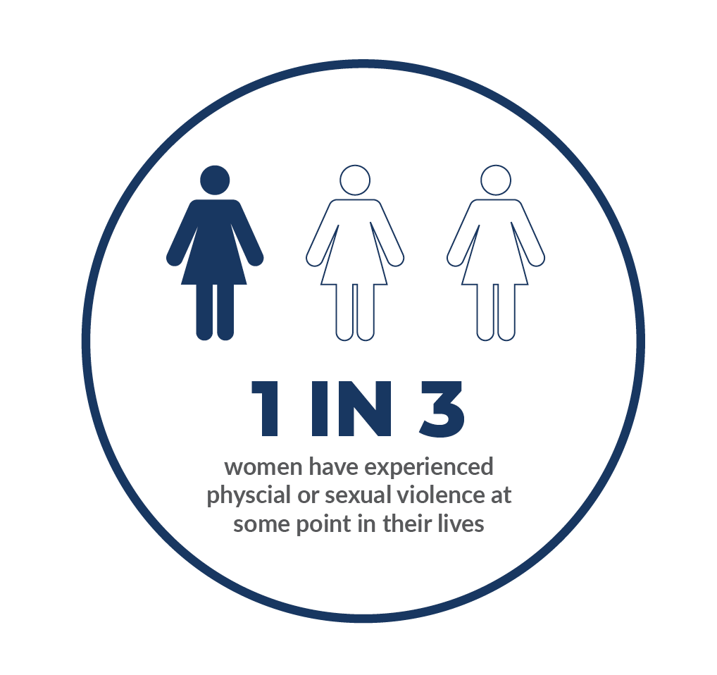
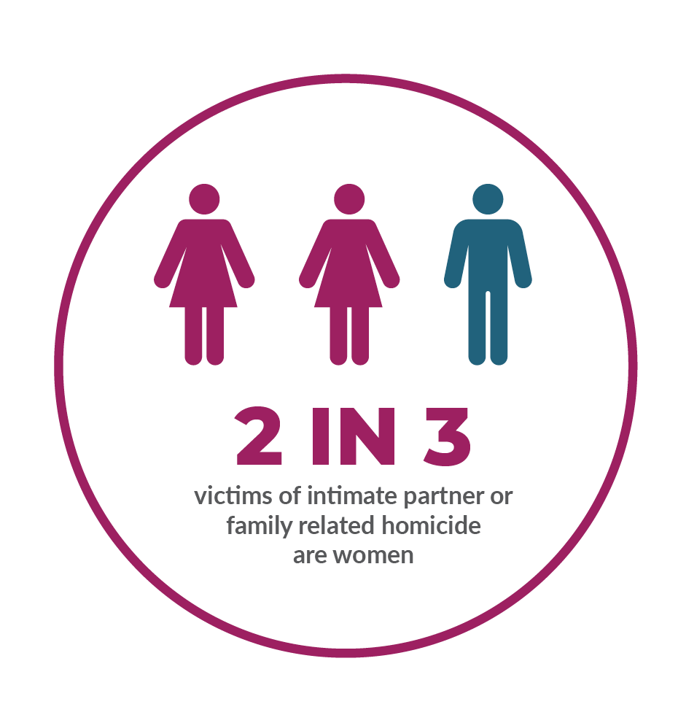
How common is IPV?
In the United States, 1 in 3 women have experienced physical or sexual violence
IPV cuts across all race, class, sexual orientations/gender identities, but some groups
more at risk
  Black, Indigenous, and other people of color
  Transgender/non-binary/gender
  non-conforming people
  Highest risk ages 18–24
  High percentage of mothers
Notes:
So how common is intimate partner violence, right? In the United States, we know that one in three women will have experienced physical or sexual violence. We know that intimate partner violence cuts across race, class, sexual orientations, gender identities, but we know that some groups, right, and these are groups that are oppressed and greater numbers are impacted in a more significant way. So this includes Black and Brown folks, indigenous folks, trans folks, gender nonconforming folks. And we certainly know that intimate partner violence is concentrated in our 18 to 24 year old age range. And we see a high percentage of mothers who experience this as well.

Slide 6
Pregnancy-associated deaths from IPV-related homicide, suicide, and drug overdose
CDC defines pregnancy-associated death as: maternal death attributable to a condition that is unaffected by the pregnancy and occurs within one year of the end of the pregnancy (Creanga, 2014)
Homicide is a leading cause of death during pregnancy and the postpartum period (Wallace, 2021)
Notes:
So we'll be talking about those numbers as we move forward. And I'm bringing in the Centers for Disease Control and their sort of definition of this time. And I realized on the learning objectives, I talked about it during pregnancy, and actually it really should be, it's broader than what I think often people are thinking about pregnancy. You conceive, and then you have the baby, and that's the end of it, right? But for the CDC, they're defining pregnancy associated death as maternal death attributable to a condition that's unaffected by the pregnancy and occurs within one year of the end of the pregnancy. So we're talking about that full, during the time of pregnancy, and then that year afterwards. And we certainly know that homicide is a leading cause of death during the postpartum period.
Sources:
Wallace M, Gillispie-Bell V, Cruz K, Davis K, Vilda D. Homicide During Pregnancy and the Postpartum Period in the United States, 2018-2019. Obstet Gynecol. 2021 Nov 1;138(5):762-769.
Creanga AA, Berg CJ, Ko JY, et al.. Maternal mortality and morbidity in the United States: Where are we now? J Womens Health (Larchmt) 2014;23:3–9 [PMC free article] [PubMed] [Google Scholar]
Maryland Department of Health. Health-General Article, §13-1207, Annotated Code of Maryland-2019 Annual Report–Maryland Maternal Mortality Review. Annapolis, MD: Maryland Department of Health, 2020

Slide 7
Maternal mortality data: 2020
There were 5.23 pregnancy-associated homicides per 100,000 live births in 2020, a notable increase from previous years.
Rates were highest among adolescents and non-Hispanic Black women.
Eighty percent of incidents involved firearms.
The risk of death by homicide was 35% greater for pregnant and postpartum women than for their nonpregnant, nonpostpartum counterparts. (Wallace, 2021)
Notes:
And let's get a little bit more specific here, you know. So what does the maternal mortality data look like from 2020? There were about five pregnancy associated homicides for every 100,000 live births. This is an increase from previous years. The highest rates, which matches actually with the data I shared with you around where we see the highest prevalence of intimate partner violence was around adolescents and Black women. And this next little bullet, which is in blue, is one thing that stood out for me as I was getting ready and pulling research to do this talk today, that 80% of incidents involve firearms. And, I mean, it's logical, right? But it's sort of shocking when you see it written down, at least it was for me, so it may be new information for some of you as well. The risk of death by homicide was about 35% greater for pregnant and postpartum women than for their nonpregnant, nonpostpartum counterparts. And so we see pregnancy as this very vulnerable time relative to IPV and homicide.
Source: Wallace M, Gillispie-Bell V, Cruz K, Davis K, Vilda D. Homicide During Pregnancy and the Postpartum Period in the United States, 2018-2019. Obstet Gynecol. 2021 Nov 1;138(5):762-769.

Slide 8
Intimate partner violence and firearms
Research shows:
A gun in the home is a key factor in escalation from nonfatal spousal abuse to homicide.
Abusers who possess guns inflict the most severe abuse such that gun-ownership by an abuser may increase risk of homicide by other means.
Rates of firearm-related intimate partner homicide are greatest in states where firearm prevalence is highest. (Wallace, 2021)
Notes:
So let's talk a little bit more about that gun research I mentioned. We know that a gun in a home is a key factor in escalation from non-fatal spousal abuse to homicide. And that abusers who possess guns, and I thought this was really interesting, inflict the most severe abuse such that gun ownership by an abuser may increase the risk of homicide by other means. So I'm going to give you a second to take that in. So abusive partner in a home with a gun indicator for harm that doesn't necessarily have to involve the gun, but can involve other means. And then the rates of firearm related intimate partner homicide were greatest in states where the firearm prevalence is the highest. Again, no surprise there.
Source: Wallace M, Gillispie-Bell V, Cruz K, Davis K, Vilda D. Homicide During Pregnancy and the Postpartum Period in the United States, 2018-2019. Obstet Gynecol. 2021 Nov 1;138(5):762-769

Slide 9
What happens when providers get training?
An educational intervention increased:
Provider comfort with firearm safety counseling
Increased knowledge of CT State Firearm Law
Knowledge of safe storage and use of firearms. These outcomes corresponded to the major barriers identified by providers in implementing firearm safety counseling
(Rubin, 2019)
Notes:
And so one of the things that I did as I was looking at the literature was sort of start asking myself, so do providers talk about guns with their clients? Are they aware of this and is this incorporated into your sort of clinical differential diagnosis conversations with yourself? Or are these conversations you're having with your clients? And I came across this study from Connecticut, and it was specifically looking at OB-GYNs, and they did an educational intervention with these OB-GYNs, meaning they trained them on how to talk to people about gun safety in the home, bring up some of these issues. And so as a result of going through a course, providers' comfort level went up significantly, they learned about their state laws, and then they also had a better idea about how to talk about safe storage and the use of firearms.
Source: Rubin, Nicole MD; Morosky, Christopher MD, MS. ObGyn Physician Knowledge, Comfort, and Current Practices of Firearm Safety Counseling [35F]. Obstetrics & Gynecology 133():p 71S-72S, May 2019. | DOI: 10.1097/01.AOG.0000559066.02886.b8

Slide 10
Chat in 1
How often do you discuss firearms in general with clients (e.g., about the presence of firearms in the home, experience with firearms)?
Notes:
And so we know that this is possible, and I am very curious to hear from all of you, because again, you know, I know there's many states represented here, and so I'm curious to hear how often are you discussing firearms in general with clients? So I'm going to give you a second to share in the chat. "Never." Okay, others? "We don't discuss firearms." Okay, anybody else? Never, never, never, never, never. "No." Okay. "Every intake." Ooh, interesting. "Not usually, not unless IPV is identified." Interesting. "We ask if there are firearms in the home with our intake." And a lot of nevers. "I've never discussed." So I hope you feel if you're a never or no person, I do want to say, I hope you don't feel alone. And I think this again, is new to the field to be thinking about, wow, we have this key information in the research that we're doing nationally, and I don't know that it's actually trickled down to folks on the ground.

Slide 11
Chat in 2
With approximately how many clients per month do you discuss gun safety and storage?
Notes:
So I'm going to go ahead and skip this next question, because given the response to the first question, I'm going to guess it's very low. And the question was with approximately how many clients per month do you discuss gun safety and storage? So I think we got our answer in the first one.

Slide 12
Pregnancy-associated deaths from IPV-related overdose
“The perinatal period is also a time of unique vulnerability for overdose due to potential for intensified IPV and mental health issues.” (Mehta, 2016)
“Significant numbers of pregnant women in [substance use disorder] SUD treatment report abuse during their pregnancy (41% emotional, 20% physical, 7% sexual).” (Velez, 2006)
Notes:
So I want to shift gears away from guns for a minute and talk a little bit about pregnancy associated deaths from overdose. And there are a couple pieces of data here that I think are eye-opening. So we know the perinatal period is a time of unique vulnerability for overdose due to the potential for intensified IPV and mental health issues. And the second bullet is looking specifically at a study of women who are pregnant, who have entered into a substance use disorder program. And what we found is that a significant number of the pregnant women in this program reported abuse during their pregnancy. So 41% said that they were experienced emotional abuse, 20% said physical, and 7% said sexual. So we want you to be thinking about these intersections as we move forward.
Sources:
Mehta PK, Bachhuber MA, Hoffman R, Srinivas SK. Deaths from unintentional injury, homicide, and suicide during or within 1 year of pregnancy in Philadelphia. Am J Public Health 2016;106:2208–2210
Velez ML, Montoya ID, Jansson LM, et al.. Exposure to violence among substance-dependent pregnant women and their children. J Subst Abuse Treat 2006;30:31–38

Slide 13
Among women with opioid use disorders…
…nearly 9 out of 10 pregnancies are unintended.
(Heil, 2011)
Notes:
What else do we know about substance use? And this may not be a surprise for many of you, but nearly 9 out of 10 pregnancies for folks with opioid disorder use had unintended pregnancies.
Source: Heil SH, Jones HE, Arria A, Kaltenbach K, Coyle M, Fischer G, Stine S, Selby P, Martin PR. Unintended pregnancy in opioid-abusing women. J Subst Abuse Treat. 2011 Mar;40(2):199-202.

Slide 14
Contraceptive trends among women with opioid use disorders
Women who use opioids use less-effective contraceptive methods because of:
Low perceived risk of pregnancy while using opioids
Barriers to accessing family planning services to prevent or space pregnancies
Lack of inclusion of pregnancy planning support into drug treatment programs
Co-located opioid treatment and family planning services are one viable option to combatting unintended pregnancy among women with opioid use disorders. (Auerbach, 2021)
Notes:
Why is that? Well, I think there's a lot of pieces. One is there's a low perceived risk of pregnancy while using opioids. You're just not thinking about pregnancy, you're thinking about the drugs that you're using. And I think this next one though is something for us to all consider together. So barriers to accessing family planning services is one of the barriers. And one of the solutions, this particular author, and this is a 2021 article, shared in the sort of discussion section of this article, is that co-located opioid treatment and family planning services are one viable option to combating unintended pregnancy among women with opioid disorders. And it makes so much sense. And I don't know, so this is 2023, I'm all about let's change everything we possibly can to make the world a better place, and this occurs to me as a really innovative, cool thing that we should be thinking about nationally, right? So when I was a Planned Parenthood clinic director, we actually had one of our nurse folks go to the shelter and do basic reproductive health there, pregnancy tests, birth control pills, depo shots, STI testing, chlamydia and gonorrhea, all those things, and it was a really powerful partnership. And I think about that example, and then I think, wow, we didn't think about substance use treatment programs when I was a clinic director many years ago, 20, 25, 30, how old? I'm old. A long time ago. But I just wanted to share that with you all to put a pin in that.
Source: A Review of Unintended Pregnancy in Opioid-Using Women Implications for Nursing, Samantha L. Auerbach, MSN, WHNP-BC, ANP-C m Kafuli Agbemenu, PhD, MPH, RN, CTN-A, Gretchen E. Ely, PhD m Rebecca Lorenz, PhD, RN Journal of Addictions Nursing, Volume 32, Number 2, 107–114. Copyright © 2021 International Nurses Society on Addictions

Slide 15
Tobacco cessation and IPV
42% of women experiencing some form of IPV could not stop smoking during pregnancy, compared to 15% of women not experiencing IPV.
(Bullock, 2001)
Notes:
I also think that women do not wake up every morning who are pregnant and say, "How can I hurt my baby today?" And I think that there's a real component around empathy when we think about this, right? So you can imagine substance use being a way of coping with the harm that you're experiencing at the hands of your partner. And here's some, this is a study done in 2001, so it's a long time ago, but it still just stands out to me because it's so powerful. So 42% of the women in this study who were experiencing intimate partner violence could not stop smoking during pregnancy compared to 15% of women who were not experiencing intimate partner violence. And it makes so much sense. So if you, for my friends who wear the hat that, you know, you do perinatal health work and you also do reproductive health work, if you've got somebody who's a smoker or has a substance use issue, I want to know, and I want you to be asking about what's happening with their partner as a clinical indicator.
Source: Bullock L, Mears J, Woodcock C, Record R. Retrospective study of the association of stress and smoking during pregnancy in rural women. Addictive Behaviors. 2001;26:405–413.

Slide 16
Substance use coercion
Results from National Domestic Violence Hotline & National Center on Domestic Violence, Trauma & Mental Health Survey N = 3,224
26% ever used substances to reduce pain of partner abuse
27% pressured or forced to use alcohol or other drugs, or made to use
more than wanted
24.4% afraid to call the police for help because partner said police wouldn’t
believe them because of substance use or they would be arrested for using
15.2% tried to get help for substance use
60.1% partner or ex-partner tried to prevent or discourage them from getting help
37.5% partner or ex-partner threatened to report alcohol or other drug use to
someone in authority to prevent access to something they wanted or needed
(Warshaw et al., 2014)
Notes:
We talked about this in an earlier webinar I did, but I thought it was just really important to bring it up again here. This was a big study done on the National Domestic Violence Hotline by my friend Carol Warshaw. And one of the things that we learned about power and control in relationships is it's connected to substance use. So if we scooch down to the fourth bullet, we see that 15% of the callers tried to get help for the substance use issue, but 61% had a partner or an ex-partner that tried or prevented them or discouraged them from getting help. So one of the other things I want you all to be thinking about is is that happening? So if you've got someone who shared with you, "Yep, I have this issue, I want to get help for it," they come back in, they still have the issue. I want to know if their partner is impeding their ability to get the treatment that they want to get.
Sources:
Learn more about responding to mental health and substance use coercion
Substance Use/Abuse in the Context of Domestic Violence, Sexual Assault, and Trauma, Patricia J. Bland, M.A. CDP & Debi Edmund, LPC CADC (Dec 2014).
Carole Warshaw, MD; Eleanor Lyon, PhD; Patricia J. Bland MA, CDP; Heather Phillips, MA; Mikisha Hooper, BA Mental Health and Substance Use Coercion Surveys, A Report from the National Center on Domestic Violence, Trauma & Mental Health and the National Domestic Violence Hotline, March (2014).

Slide 17
Breaking news!
On March 29th, the U.S. Food and Drug Administration approved Narcan—4mg naloxone hydrochloride nasal spray—for over-the-counter, nonprescription use: the first naloxone product approved for use without a prescription.
Official FDA news release
Notes:
Breaking news! On March 29th, the Food and Drug Administration approved Narcan for over-the-counter non-prescription use. I hope everybody has some in their clinic. I just think this is a real amazing opportunity for us to be helping and doing more, for each of us to be doing that. My daughter actually said, "Mom, can I have some in my backpack?? And I'm like, "That's such an interesting question. Let me put a pin in that." Not because she has friends that use, but, you know, I think when you realize that you can be part of a solution, it's pretty exciting to think about how we can exercise that.
Source: Official FDA news release

Slide 18
Opportunities for intervention and prevention
Notes:
So let's talk a little bit about opportunities for prevention and intervention.

Slide 19
National SAMHSA survey:
Implications for work with teens
In 2011–2012 pooled data for pregnant teens aged 15 to 17:
18.3% of young pregnant teens reported past-month illicit drug use, representing:
  A significant increase from 2009–2010 (15.7%)
  Greater use than non-pregnant peers (13.8%)
  Double the use rate of pregnant youth aged 18 to 25 (9%)
  Six times the rate of pregnant women aged 26 to 44 (3.4%)
(SAMHSA, 2013)
Notes:
Again, we're going to be talking about teens. And this is data from 2012 that's looking at pregnant teens ages 15 to 17. 18% of those pregnant folks reported past month illicit drug use. That's an increase from 2010. They are using more than their non-pregnant peers. Double the use rate of pregnant youth ages 18 to 25. So these younger teens, 15 to 17, are in this really vulnerable category. And let's think about this for a minute. Why are they pregnant at 15 or 17 or 16? And, you know, we could think about adverse childhood experiences, childhood sexual abuse, rape, adolescent relationship abuse or intimate partner violence as all elements of this. And so again, that using substances to cope and also not thinking about pregnancy might be a part of this.
Source: Substance Abuse and Mental Health Services Administration. Results from the 2012 National Survey on Drug Use and Health: Summary of National Findings. Substance Abuse and Mental Health Services Administration; Rockville, MD: 2013. NSDUH Series H-46, HHS Publication No. (SMA) 13-4795.

Slide 20
The CRAFFT substance use disorder screening tool
The CRAFFT screening tool was designed specifically for adolescents and has been validated in multiple community and hospital-based clinical contexts.
It has also been effectively used to detect preconception substance use in a small cohort of pregnant women aged 17 to 25. (Chang, 2011)
Notes:
So we're going to talk a little bit more about the kinds of things that you all can be doing. And one thing to think about is this CRAFT screening tool, if you're looking for a tool. It was designed specifically for adolescents, and it's been validated in a bunch of different contexts. It's also been used to detect preconception substance use. And I think that that's really where our sweet spot is for my reproductive health friends on this call. You know, that I want that teen to not become pregnant, that substance using teen who's really vulnerable.
Resource: The CRAFFT screening tool
Source: Chang G, Orav EJ, Jones JA, Buynitsky T, Gonzalez S, Wilkins-Haug L. Self-reported alcohol and drug use in pregnant young women: a pilot study of associated factors and identification. J Addict Med. 2011 Sep;5(3):221–6.

Slide 21
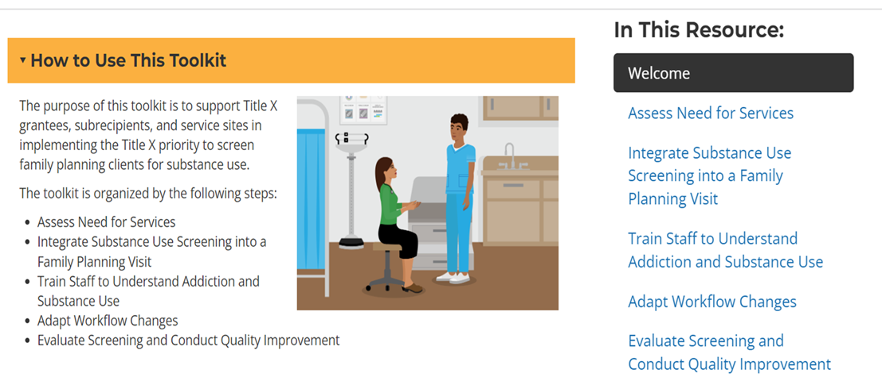
Substance Use Screening Toolkit
RHNTC Substance Use Screening Toolkit
Notes:
And that lends itself to let's talk about what are you doing as part of your clinical care. And, you know, RHNTC has so many beautiful gifts that they share with the world, and one of them is this Substance Use Screening Toolkit. It walks you through how to set up your clinical setting. So I just wanted to share that with you.
Resource: RHNTC Substance Use Screening Toolkit

Slide 22
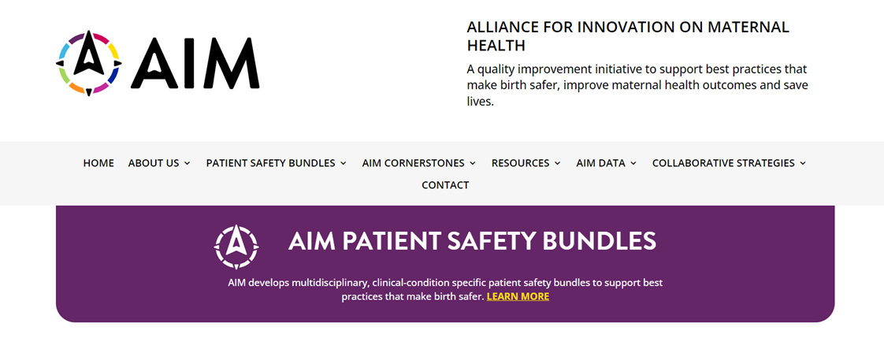
Patient safety bundles
AIM Patient Safety Bundle
Notes:
And for those of you who are specifically working on perinatal health, this is another resource.
Resource: AIM Patient Safety Bundle

Slide 23
Behavioral health-associated maternal deaths as a newer concept to the field
There is robust data surrounding medical conditions such as postpartum hemorrhage or hypertension as they relate to maternal mortality.
In contrast, research surrounding pregnancy-associated homicide and suicide and maternal mortality has been limited.
Until recently, deaths related to behavioral health were not considered to be pregnancy-related and not counted towards maternal mortality rates. (Chin, 2022)
Notes:
So I want to talk a little bit about behavioral health associated maternal deaths and why we're doing this webinar, I think, you know it? And that is to say that there's a lot of data around medical conditions that cause maternal mortality. So lot of data around hemorrhage, hypertension, blood clots, hypertension, the list goes on. Preeclampsia. But in contrast, the research surrounding pregnancy associated homicide and suicide and maternal mortality has been limited. Why? That's the big question. And that's why the last little piece is bolded. Until recently, deaths related to behavioral health were not considered to be pregnancy related, and so they weren't counted toward maternal mortality rates. And so this is a big shift nationally, right? So individual states have been looking at data like that, but in terms of the big picture of looking at what's happening relative to maternal homicide, that these elements of how intimate partner violence show up relative to suicide, relative to substance use disorder and overdose is new and that's part of the reason we're talking with you today about it.
Source: Chin, K., Wendt, A., Bennett, I.M. et al. Suicide and Maternal Mortality. Curr Psychiatry Rep 24, 239–275 (2022). https://doi.org/10.1007/s11920-022-01334-3

Slide 24
Pregnancy-associated homicide and suicide
Pregnancy-associated homicide and suicide each account for more deaths than many other obstetric complications, including hemorrhage, obstetric embolism, or preeclampsia/eclampsia, which may be thought of as more “traditional” causes of maternal mortality. (Palladino, 2011)
Notes:
And this is just sort of building on that same concept. You know, pregnancy associated homicide and suicide, each one count for more deaths than any other obstetric complication. And again, I don't think that's something the average person knows. And I think that, yeah, the more traditional causes of maternal mortality is what we tend to think about as opposed to this. And these are things that we can ideally help prevent and intervene in.
Source: Palladino CL, Singh V, Campbell J, Flynn H, Gold KJ. Homicide and suicide during the perinatal period: findings from the National Violent Death Reporting System. Obstet Gynecol. 2011 Nov;118(5):1056-1063.

Slide 25
Pregnancy-associated deaths from IPV-related suicide
A 2019 review recognized depression, substance use disorder, and IPV as the three highest risk factors for pregnancy-associated suicide. (Mangla, 2019)
54.3% of pregnancy-associated suicides involved intimate partner conflict attributable to the suicide. (Palladino, 2011)
Notes:
So again, looking at the IPV related suicide, we know that IPV and substance use disorder and depression, the nexus of the three, come with the highest risk of pregnancy associated suicide and that 54% of pregnancy associated suicides involve intimate partner conflict attributable to that suicide. So again, here's the story that we're part of the journey that we're on together today is recognizing that this wasn't thought about 10 years ago in this way.
Sources:
Palladino, C. L., Singh, V., Campbell, J., Flynn, H., & Gold, K. J. (2011). Homicide and suicide during the perinatal period: findings from the National Violent Death Reporting System. Obstetrics and gynecology, 118(5), 1056–1063. doi:10.1097/AOG.0b013e31823294da
Mangla K, Hoffman MC, Trumpff C, Grady SO, Monk C. Maternal self-harm deaths: An unrecognized and preventable outcome. Am J Obstet Gynecol 2019;221:295–303

Slide 26
State of maternal practice: What’s missing?
Screening for mental health problems—including suicidality—during the perinatal period is critical to helping prevent suicide; however, universal screening is not yet widespread in practice.
Clinicians should be aware of important risk factors for perinatal suicide, including: mental health and substance use diagnoses; interpersonal violence; a history of abuse; and poor social support. (Chin, 2022)
Notes:
So what's missing? You know, I think because it's new to the field, screening for mental health problems including suicidality during the perinatal period is critical, but it's not necessarily widespread in practice. Clinicians should be aware of the important risk factors for perinatal suicide, including mental health, substance use diagnosis, interpersonal violence, a history of abuse, and poor social support. And again, I mean, these are all things that we could be thinking about relative to preconception and interconception care as we're doing our work in reproductive health. So trying to get in front of this before the person becomes pregnant.
Source: Chin, K., Wendt, A., Bennett, I.M. et al. Suicide and Maternal Mortality. Curr Psychiatry Rep 24, 239–275 (2022).

Slide 27
The role of implicit bias in responding to clients’ IPV and substance use disorder needs
Notes:
So I want to talk a little bit about the role of implicit bias and how that is connected to some of this work as well.

Slide 28
Disparities in maternal health
African American women are affected by pregnancy-associated homicides, with increased risk ranging from three to seven times that of White women.
(Campbell, 2021)
Notes:
So African American women are affected by pregnancy associated homicides with an increased risk ranging from three to seven times that of white women. And I want to just paint a particular picture here.
Source: Campbell J, Matoff-Stepp S, Velez ML, Cox HH, Laughon K. Pregnancy-Associated Deaths from Homicide, Suicide, and Drug Overdose: Review of Research and the Intersection with Intimate Partner Violence. J Womens Health (Larchmt). 2021 Feb;30(2):236-244. doi: 10.1089/jwh.2020.8875. Epub 2020 Dec 8. PMID: 33295844; PMCID: PMC8020563.

Slide 29
Maternal Morbidity and Mortality Report (MMMR):
Illinois as a case study
In Illinois, non-Hispanic Black women are six times as likely
to die of a pregnancy-related condition as non-Hispanic
White women.
Black women were about three times as likely to die within a year of pregnancy as women of any other race/ethnicity.
Homicides accounted for 15% of all pregnancy-associated deaths for Black women. In contrast, homicide was a very rare cause of pregnancy-associated death for White women (2%).
Notes:
So this is data from the state of Illinois and it's telling a certain, it's helping sort of fill in the frame of the story. So in Illinois, non-Hispanic Black women are six times as likely to die of pregnancy related conditions as non-Hispanic white women. Black women are about three times as likely to die within the year of pregnancy as women of any other race or ethnicity. Homicides accounted for 15% of all pregnancy associated deaths for Black women. And this is, again, in the state of Illinois. In contrast, homicide was a very rare cause of pregnancy associated death for white women.
Source: Data taken from Illinois Maternal Mortality and Morbidity Report, 2018.Illinois Releases First Maternal Morbidity and Mortality Report

Slide 30
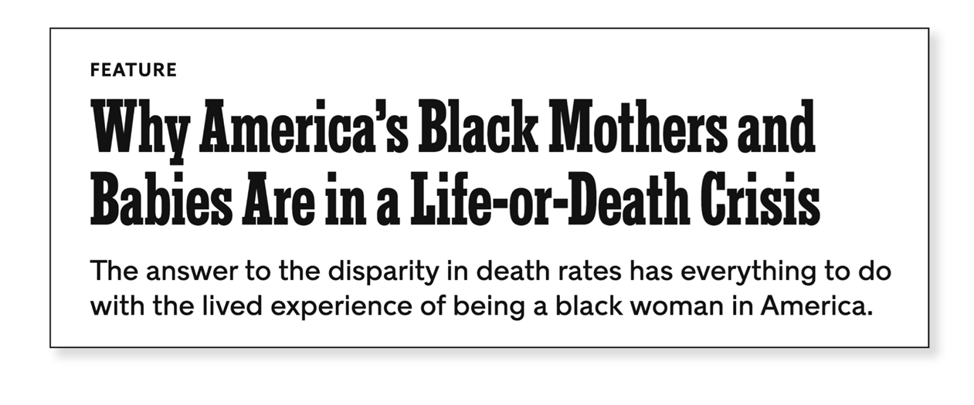
Spotlight on Black maternal health
Notes:
So when we think about these issues, maybe some of you read the same article I did in 2018, but it was super striking because this was the first time, this is New York Times, that they looked specifically at Black women who were living in poverty and Black women who were middle class, had access to health insurance, good care, all the things. And what they found is that the outcomes didn't particularly look different. And so all of a sudden what we had perhaps been telling ourselves about issues related to maternal mortality in the Black community shifted out of, oh, this is just a problem for poor people versus we have a situation around medical racism that we all need to be looking at and addressing as part of what we're doing.
An NYT article that blew the lid off our comfortable way of thinking about the disparities around Black maternal death and increased likelihood of low birth rate babies in the U.S. It is not just poor black mothers who are experiencing high rates of maternal death and low birth weight babies—but middle-class mother do as well—those with good access to care and health insurance.
To sum this truth up, according to Dr. Joia Crear-Perry, “The language of the moment suggests that it's Blackness that's the problem, not bias. Historically, we would say it’s a problem with ‘Black mothers’ never looking at bias and racism as the cause of the problem.
Source: The New York Times: Why America's black mothers and babies are in a life-or-death crisis (April 2018) [subscription required]

Slide 31
Implicit bias among providers harms clients
“Most health care providers appear to have implicit bias in terms of positive attitudes toward Whites and negative attitudes toward people of color. Interventions targeting implicit attitudes among health care professionals are needed because implicit bias may contribute to health disparities for people of color.” (Hall, 2015)
Notes:
And so this fits into the IPV realm, and I'll keep making this connection here, but implicit bias is an element that we all need to be working on, right? So we all have implicit bias. Your brain has a particular pattern, you're making decisions quickly, and what we want to do is slow people down so that they're seeing the full person in front of them and they're not just putting them in a box, right? And I think this is worth sharing in this way. Most healthcare providers appear to have implicit bias in terms of positive attitudes toward whites and negative attitudes toward people of color. So interventions targeting implicit attitudes among healthcare providers are really needed, because implicit bias may contribute to the health disparities of people of color.
Source: Hall, W. J., Chapman, M. V., Lee, K. M., Merino, Y. M., Thomas, T. W., Payne, B. K., Eng, E., Day, S. H., & Coyne-Beasley, T. (2015). Implicit Racial/Ethnic Bias Among Health Care Professionals and Its Influence on Health Care Outcomes: A Systematic Review. American journal of public health, 105(12), e60–e76. https://doi.org/10.2105/AJPH.2015.302903

Slide 32
How does implicit bias relate to maternal IPV, substance use disorder, and suicide?
Studies show that people with more implicit ethnic/racial bias have poorer interpersonal interactions with minority individuals.
Such interactions can impact providers’ ability to accurately assess clients’ views on treatment plans and curtail productive discussion, especially if the topic is sensitive (e.g., the need for lifestyle changes or the use of drugs and alcohol).
On the client side, a poor interaction due to provider bias can undermine trust and engagement in care, leading to less follow-up and worse adherence to the treatment plan. (Zestcott, 2016)
Notes:
And how does this all tie together? Studies show that people with more implicit bias have poor interpersonal interactions with minority individuals. Such interactions can impact providers' ability to accurately assess client's views on treatment plans and curtail productive discussions, especially if the topic is sensitive, right? So especially if we're talking about substance use. Especially if we're talking about intimate partner violence.
Source: Zestcott CA, Blair IV, Stone J. Examining the Presence, Consequences, and Reduction of Implicit Bias in Health Care: A Narrative Review. Group Process Intergroup Relat. 2016 Jul;19(4):528-542.

Slide 33
How can we address implicit bias?
Understand how implicit bias shows up in health care settings
Identify and address our own implicit biases
Identify strategies to counter or mitigate implicit biases
Two resources:
Cultural Competency in Family Planning Care eLearning (RHNTC): 1.5-hour eLearning course; CEUs offered
Awareness to Action: Dismantling Bias in Maternal and Infant Healthcare (March of Dimes): 1.5-hour eLearning course or a 3 to 4-hour in-person course
Notes:
So this is an area where all of us can grow and take this knowledge and make changes in what we're doing. And the ways we do that, there's a couple really great programs out there that help with that. One of them is through the March of Dimes. There certainly is one from RHNTC as well.
Resources:
Cultural Competency in Family Planning Care eLearning
Awareness to Action: Dismantling Bias in Maternal and Infant Healthcare

Slide 34
Chat in: Spotlight on us
Consider a time you suspected a problem with someone you are close to because of something you saw or heard (e.g., intoxicated at a dinner party, passed out a party, received a DUI).
What thoughts went through your head about that person?
Consider a time you had a discussion with a friend or family member about their controlling, coercive, abusive relationship or were concerned about this as a possibility.
What thoughts went through your head about that person?
Notes:
And I think what I'm going to do here is just ask you all, again, to enter your thinking in the chat. Consider a time when you suspected a problem with someone you're close to because of something you saw or heard. So let's say they got intoxicated at a dinner party. They passed out at a party, they got a DUI. What thoughts went through your head about that person? "They're probably going through something really hard." "Irresponsible." "Here we go again." "I felt guilty that I did not stop them." So there's a whole host of things. "Needs help." "How can I help without imposing my prejudices?" You know, bless you for thinking that way. "They need some help." Nice. And, you know, what I want you to also be considering is a time when you discussed with your friend or your family member about their controlling, coercive, abusive relationship, or you had a concern that this was a possibility. And chances are you would say some of the same things you just said around the substance use issue that, you know, "How can I help without feeling judgmental?" "I'm worried." All the things.
Source: Heron RL, Eisma MC. Barriers and facilitators of disclosing domestic violence to the healthcare service: A systematic review of qualitative research. Health Soc Care Community. 2021 May;29(3):612-630. doi: 10.1111/hsc.13282. Epub 2021 Jan 13.

Slide 35
Chat in: What is going on for them?
For a survivor of IPV or somebody experiencing substance use
disorder, what do you imagine they think you and others think of
them or their issue?
What do you imagine your friend/family member thinks about your thoughts about:
  Their ability to parent
  Their ability as a partner, friend, or family member
Notes:
So, we have one more question for you here. For a survivor of IPV or somebody experiencing substance use disorder, what do you imagine they think of you and how other people are thinking of them and their issue? And you know, the point of this was really to help everybody think about how can we center empathy in the way in which we're holding these very complicated issues for folks. So not go into our judgy bear hat, but really sit with empathy and recognize that if we were the ones in those shoes, we would be probably struggling with shame or guilt or lots of other pieces. So as we think about this as providers, how do we address that empathy piece in the ways that we're having these conversations?

Slide 36
Spotlight on client perspectives:
Barriers related to health care providers (HCP)
A lack of a positive relationship with the HCP was viewed as a barrier to disclosure. This included:
Not trusting in the HCP
Limited time with the HCP
Not expecting that the HCP would be empathetic
Perceiving the HCP to have low capability to help them
Concern that confidentiality would be broken by the health service personnel
(Heron, 2021)
Notes:
So quickly, I want to shift gears here and talk a little bit about reproductive coercion. So how does addressing reproductive coercion fit into preconception and interconception care as an opportunity to prevent maternal mortality?
Source: Heron RL, Eisma MC. Barriers and facilitators of disclosing domestic violence to the healthcare service: A systematic review of qualitative research. Health Soc Care Community. 2021 May;29(3):612-630. doi: 10.1111/hsc.13282. Epub 2021 Jan 13.

Slide 37
Shifting gears: Reproductive coercion
How does addressing reproductive coercion fit into pre/interconception care as an opportunity to prevent maternal mortality?
Notes:
So, I'm just going to go ahead and remind folks about what reproductive coercion is, right? So it's behaviors to maintain power and control in a relationship with someone who is, was, or wishes to be involved in an intimate or dating relationship. And these are explicit attempts to get you pregnant when you don't want to be. Maybe that's poking holes in condoms. Maybe that's throwing your birth control pills away. Maybe that's preventing you from being able to use transportation to get to the clinic. And then it also morphs into controlling the outcomes of a pregnancy, right? Either forcing someone to carry to term or even forcing someone to terminate a pregnancy. So, and birth control sabotage or, you know, is another element of that.

Slide 38
Definition: Reproductive and sexual coercion
Behaviors to maintain power and control in a relationship related to reproductive health by someone who is, was, or wishes to be involved in an intimate or dating relationship with an adult or adolescent.
Explicit attempts to impregnate a partner against their wishes or interfering with contraception
Controlling outcomes of a pregnancy
Coercing a partner to have unprotected sex
(Miller, 2011)
Notes:
And I think that, you know, we want to be, if we're really going to be doing prevention, we want to be thinking about reproductive coercion because we don't want an unintended pregnancy as part of power and control, as part of reproductive coercion to occur. And so providers, my friends on the phone, if you've heard me talk about reproductive coercion before, there's a new call, there's a new siren that we now need to be paying attention to and that is, if we can prevent an unintended pregnancy connected to reproductive coercion and intimate partner violence, we can prevent a maternal mortality from happening, right? That's how these things work.

Slide 39
Addressing reproductive coercion as an opportunity to prevent maternal mortality
Birth control sabotage increased the odds of unintended pregnancy by 58% (Miller, 2014)
20% of women who experienced reproductive coercion felt it would have been helpful had a health care provider discussed nondetectable methods of contraception with them (Clark, 2014)
Women who disclosed abuse were at an increased risk for rapid repeat and unintended pregnancy (Raneri, 2007)
Notes:
And have historically been barriers to what, for people to feel like they can trust their healthcare provider. And some of this has to do with issues of being treated badly in the past. Some of it has to do with not trusting your healthcare provider. It's hard to talk about intimate partner violence or substance use because you have a limited amount of time with your healthcare provider. I think this is data around, you know, patients feeling like their healthcare provider would not be empathetic if they shared it with them, perceiving that the healthcare provider had a low capability to help them, and concern that confidentiality would be broken. So these are some of the barriers, and I always share the barriers 'cause I'm like, "Okay, how do we get in front of this? How do we change it up? How do we create more safety? How do we innovate around what's in the way?"
Sources:
Clark, L. E., Allen, R. H., Goyal, V., Raker, C., & Gottlieb, A. S. (2014). Reproductive coercion and co-occurring intimate partner violence in obstetrics and gynecology patients. American Journal of Obstetrics & Gynecology, 210, 42.e1–42.e8. doi:http://doi.org/ 10.1016/j.ajog.2013.09.019
Raneri LG, Wiemann CM. Social Ecological Predictors of Repeat Adolescent Pregnancy. Perspectives on Sexual and Reproductive Health. 2007;39(1):39-47.
Miller, E., McCauley, H. L., Tancredi, D. J., Decker, M. R., Anderson, H., & Silverman, J. G. (2014). Recent reproductive coercion and unintended pregnancy among female family planning clients. Contraception, 89, 122–128. doi:http://doi.org/10.1016/j.contracep tion.2013.10.011
Arkar, N.N. (2008). The Impact of Intimate Partner Violence on Women’s Reproductive Health and Pregnancy Outcome. Journal of Obstetrics and Gynaecology, 28(3):266-271.

Slide 40


CUES: An evidenced-based intervention
Confidentiality
Universal education
Empowerment
Support
Notes:
And one of the ways that we innovate around what's in the way is CUES. And so this is our evidence-based intervention that was developed in concert with, you know, folks at Harvard and UC Davis and a whole lot of folks. And the very first study on this was done at Planned Parenthood in Northern California and the intervention CUES stands for confidentiality. So we want to see the client alone if we're going to talk about intimate partner violence. Universal education. So we just recognized in this last slide all of these barriers that exist to people feeling like they can disclose. And I don't even think I mentioned the fear of child welfare involvement, but that's a huge one if we're talking about parenting folks. So we want to be getting in front of it. And the way we do that is making sure everybody has the information rather than only giving information to the people who tell us something's going on, because you got to see the prevalence of the problem in our very opening today. One in three women will experience this in her lifetime. So we want to create as much safety and intention around the way that we're creating this prevention opportunity around reproductive coercion as a way to prevent maternal mortality specific to IPV. And this is one of our pieces here that we can be doing collectively as part of preconception and interconception care. So you're going to talk to the patient alone, we're going to do this universal education talking about healthy relationships and complicated or unhealthy relationships. The E stands for empowerment. We shape this intervention around offering two of these cards and you can see the card on the top is called "Hanging Out and Hooking Up." That's obviously for adolescents. And then the card just below it, "Sex Pleasure in You" is brand new and we worked with lots of clinicians and lots of different clinical sites across the country. It is a gender neutral card, so both of these cards can be used with any comers to your clinic and we're pretty excited about it. So I think that Sydney might have put in the link, or in the chat a link to the cards, and also there you can find how to purchase them. So they're free, but we ask for you to cover the postage when we send them to you.
Resources:
Futures Without Violence – Adolescent Health Safety Card
Futures Without Violence – Sex, Pleasure, Choice patient education brochure

Slide 41

Reproductive coercion conversation: Opportunity to prevent maternal mortality
Navigating Reproductive Coercion with a Client in a Reproductive Health Setting
Notes:
So what I want to do now is just show you an example of a clinician having a real conversation around reproductive coercion with a vulnerable teen. So let me start, hopefully this is going to work, and I'm going to fast forward it here. [Start video at 02:59]
[Video dialog] - Do about something that we see happen. Boyfriend front. I want to talk to you about something that we see happen and see if it's something that you're possibly worried about. Sometimes we see partners try to get you pregnant to keep you with them or so that people know that you're theirs, even if that's not the case. And I know you talked about the condom breaking or sometimes not being used. Could this be why this happening?
- Maybe. I guess that's part of the reason why I didn't tell him that I was coming to see you today.
- Thank you for sharing that with me. I know it must be anxiety producing. Are you worried about anything else with him, possibly getting mad or threatening you with social media, anything like that?
- No, no. He's sweet. There isn't anything like that. I just don't want him in my business. I want the birth control, but he does not have to know about that.
- Okay, I hear that. There are methods of birth control that he doesn't need to know about. Would it be helpful to hear about those?
- Yeah, it would be helpful to hear about those. I really, really don't want to get pregnant. Like he keeps saying he's worried about me getting all messed up inside. Like I think he would know and be upset if I didn't get my period because of the birth control.
- Okay. There are methods of birth control that can be kept private and methods that do not disrupt your cycle. For many women it's important that they get their period every month. Would it be helpful to hear about those?
- Yes, I would like to hear about those. I think it would take some of the pressure off me, you know?
- Yeah. Got it. Besides that, is there anything else that's important to you in a birth control method?
- Learn more at rhntc.org. [End video dialog]
- [Rebecca] So I really, I love that video because I think the clinician does such a good job of helping educate and opening the door for that conversation in a way that feels very client centered. I never felt like the clinician was telling the client what to do. I felt like they were in, it's a great example of being in partnership and I know so many of you are so excellent at that. So I'm excited about the idea of, you know, folks and what you didn't get to see in this video is, you know, we would give two cards, we give two of these cards to all of the folks coming into our clinic and we give you two so you have the information for yourself and also so you can have the information to help somebody else if they were to need it. And what's really cool about the intervention being framed that way is that young people, and we have nice data both looking at school-based health clinics as well as other adolescent health clinics out in the world, and the adolescents were all about helping their friends. So 84% of the folks involved in the study said they would absolutely give that card to a friend. And I can tell you, as somebody who was doing the research in a Planned Parenthood clinic, we literally had folks, teenagers who would come and say, "I got this card from my friend and I that think you guys are the place that can maybe help me, 'cause she got it here." And so when you've had that experience, it's kind of a little life changing in you and you get excited about it. But I just have been thinking about how can we, collectively, in our wonderful world of reproductive health have the impact we want to have? And I think if we're not addressing substance use disorder, if we're not addressing reproductive coercion, we're not able to help the clients as fully as we might otherwise. And I think that for so many people, they put their reproductive health in one box and they put their controlling abusive partner stuff in another box. And so it's when you can bring those things together that the light bulb goes off and like, "Wow, yeah, actually I did say to you that the condom broke six times." So I think there's just a real opportunity to do more.
Source: Video clip: Navigating Reproductive Coercion with a Client in a Reproductive Health Setting

Slide 42
Client identification/recognition of abuse
Victims chose not to disclose because they were, at the time, unaware that they were experiencing abuse.
(Heron, 2021)
Notes:
I think too, and this is again, this is 2021 data, but this really stood out to me, and it's a study looking at why folks didn't disclose to providers. But one of the reasons why is that victims chose not to disclose because they were at the time unaware they were experiencing abuse. So let's think about that together. How important is it then to talk about what a healthy relationship looks like and what an unhealthy relationship looks like all the time? Because if, remember, for those folks who grew up in homes with abuse and witnessed things, what's happening in their relationship might not be nearly as bad as what they saw. "So this isn't abuse, I know what that looks like. That looks like a trip to the emergency room. That's not what's happening to me. He just ripped out my IUD or he just poked holes in the condom." Or he just, you know, so you can imagine as we're trying to talk, especially to young people, about these things that we don't want to assume that they understand what a healthy relationship looks like. We want to make sure that they have that information so that they can have that light bulb turn on, because you might be the first person who's laid that out for them. And you also might be the first person who's offered support and help, because the client is isolated otherwise. So there's so much power in what you all can do every day. I get excited just thinking about it. I kind of miss clinic, can you tell?

Slide 43
Next steps following IPV disclosure
DV hotline is also there for YOU: to provide guidance, discuss cases, and offer resources and expertise
Leaving is not the goal
The goal is to reduce isolation
Consider co-locating or establishing a memorandum of understanding (MOU) with an IPV service organization
Notes:
Also, I just want to say we aren't expecting reproductive health providers to be experts on intimate partner violence. I want you to know that the domestic violence hotline and your local domestic violence programs are there for you. Meaning you can call as a clinician and say, "I've got a client and do you have any ideas for me about how I can handle this conversation? Or would you be willing to get on the phone with them if they're open to it kind of thing?" They're there for you to process and ask questions and get support for yourself. So I also think that if you make that phone call, and you know what it's like when you call, that when you suggest to your client that, "Hey, the DV hotline is amazing, they speak 173 different languages, you know, they're folks that really have so much heart and care in what they do." I just feel really good about sending anybody over there. I think you're not going to be able to say it with that much meaning, and I can say that, 'cause I've actually trained people at the National Domestic Violence Hotline and they are all lovely, warm, caring people. Unless you called, I think that you don't necessarily know what that referral's going to be like. So I'm just going to encourage you to think about doing that as part of activities that you can do after the webinar today. So, and our goal is to reduce, you know, so leaving isn't the goal with intimate partner violence. Our goal is to reduce isolation. We know that leaving comes with the highest risks of homicide actually, and harm, so staying might be the safest choice for many of the folks that you're serving. And I think I mentioned this earlier, but I like to plant seeds everywhere. And so I am strongly going to recommend you consider co-locating. So we talked about that with substance use disorder clinics. Co-locating with your DV advocacy program, establishing memorandums of understanding between those organizations so that your folks can talk to their folks. I would say that when we did the partnership with our local domestic violence shelter, which is called Safe Haven, I mentioned that we sent our nurse over to do reproductive healthcare for the folks in shelter, but when we had a hot positive, so somebody who's in a really difficult situation wanting to make a police report, wanting to take action, wanting to do something like that, the DV advocate would come, if they weren't already occupied, and come and sit with that client and do that work with them. And that's one of the things that we would love to see happen more across the country.

Slide 44
Things to say
Things to say to people who have experienced harm.
I believe in you.
I am so sorry this is happening to you.
Thanks for sharing this.
I don’t even know what to say right now, but I am so glad you told me.
You don’t deserve this.
Thank you for telling me.
It’s not your fault.
You are not alone.
You get to choose what you do next.
Notes:
So what do you say when someone discloses, and I'm just going to touch on this for a second. I believe you. I'm so sorry this is happening to you. Thank you for sharing this. Thank you for telling me. You don't deserve this. You're not alone. We know from the research that when you have that in your back pocket, a phrase like that, it's what the client's going to remember. And so the nice thing about having all these slides is you can take them and, you know, look at them after the fact, and hopefully put one of these in your pocket in case you get a disclosure.

Slide 45
Establishing an MOU
An MOU between your agency and a domestic violence service organization may help:
Establish a formal working relationship
Create an avenue for bi-directional warm referrals
Identify strategies to serve survivors more holistically through coordinated care
RHNTC MOU tools and resources
Notes:
RHNTC has MOU tools for you, so you can download those.
Resources: RHNTC MOU tools and resources

Slide 46
Q&A
What questions do
you have for us?
Notes:
And we're going to stop here. And I'm going to invite my friend Devon Brown to come back, and we are anxious to hear, and Devon, maybe there were questions that were put in the chat as I was talking, but we want to open up this time for Q&A so that you can pick my brain before you go back to clinic or whatever your next steps are in your day.
- [Devon] Thank you so much, Rebecca. That was such a rich presentation, and we've had a, you know, wonderfully active chat and I just encourage people to keep sharing ideas or questions, anything that comes up for you in the chat as we go through some of the questions we do have. So the first one, Rebecca, is more of an observation, less of a question. But, "I'm really struck by that one statistic from the Illinois case study," it was kind of early on in the presentation, I think, "from the maternal morbidity and mortality report that said that homicides accounted for 15% of pregnancy associated deaths for Black women compared to 2% for white women."
- [Rebecca] Yeah, I mean it's interesting, 'cause we could talk about the IPV piece, we could talk about the maternal disparity piece too. And, you know, I think it comes down to histories of oppression. I really do. I think that we see high rates of intimate partner violence among the most marginalized among us, and that has to do with great big societal reckoning that we all need to be thinking about. And it's part of why I brought in the implicit bias piece and thinking about like how can we in our one-on-one interactions make it a little bit more right? And so, yeah, it's awful when we think about it and we are nationally recognizing that we are in a crisis. We're, you know, one of the wealthiest countries in the world and we have women dying, and particularly Black women dying in childbirth and during that first year in numbers that other countries do not see. You know, you'd be better off if you were a Black woman having a baby in France or in England or in other places. And just recognizing that piece of it is horrifying. And I think the hope though that I was trying to plant today was our opportunities around preconception and interconception care to have deeper, more robust conversations. Recognizing that people can't necessarily tell us their truths, but you might be the person that gives them information that makes them go, "Oh wait, there's a method of birth control I can use that my partner won't know about and I still get my period?" Like that could be the harm reduction strategy of a lifetime for somebody. So as awful and big as those pieces are, I got to come back to the individual, 'cause otherwise we can't hold it anymore.
- [Devon] Yeah, yeah. Those are the points of intervention, those interactions. Thank you, Rebecca. Another question just came up that I saw in the chat that I want to make sure we get to. "Are you aware of any handouts, educational materials for moms that would educate them about their elevated risk of death from IPV during pregnancy?"
- [Rebecca] Really good question. And you're watching me think hard. I don't, but I want to make that tool right now. So we have a great tool called Connected Parents, Connected Kids, and we're using it in the perinatal framework. We're using this as part of what OB-GYNs would do, what perinatal counselors and support home visitors would use, et cetera. And it definitely is laying out the stuff about healthy relationships and unhealthy relationships and what we phrase as complicated relationships. And I think we've done a lot of. What? How should we talk about these issues when it comes to clients? And you know, I would say that in all the years I've been doing this, that I've had very few people who were in it say, "I'm in a domestic violence situation." They're going to say, "I'm in a complicated situation, things are really hard. I feel worried, I feel scared, I feel." They might describe behaviors that are happening, but that language isn't sort of what they use. So you asked a good question about do we have any materials or do I know specifically about things relative to IPV and homicide for pregnant folks? And I don't. The best we have is sort of this general framework, but the beauty of what this webinar did is, you know, it allows you to expand on it, right? So while you talk about complicated relationships, you could say, "And one of the things I talk to everybody about is guns." Because here's what we know. When people are in complicated relationships and there's guns in the house, we have to worry about homicide and what's happening in people's homes. And so even though there's, I really like Connected parents, Connected kids. It's not, I don't think, in the chat, but I can forward it to Devon and we can share it out with all of you, but I don't know about that tool, but I think it could be really helpful. But in the meantime, I think the general conversation and then building on it with what you've learned today can be an incredibly powerful tool.
- [Devon] And I'm just going to lift up a comment in the chat that was in response, Rebecca, to what we were talking about, about kind of the individual intervention related to racism in healthcare. And Linda says, "Although important to include what can be done as individuals, this is a systemic issue which will not change throughout the system unless systemic efforts are also employed long-term."
- [Rebecca] Amen.
- [Devon] Just wanted to lift that up.
- [Rebecca] Yeah, the thing is, right, so as somebody who's been part of systems that unfortunately weren't where they needed to be, I don't know if any of you share that with me, but perhaps, or maybe not. Maybe many of you are part of systems that have really taken this on in a meaningful way. So I mentioned the individual piece, because sometimes if you can't control things at this level, I think that there's this helplessness or hopelessness that can overcome folks and it's like, nope. You doing this as an individual and then holding the system accountable and saying, "You know what, this is what I'm doing, this is what I learned in the webinar." That's actually part of the reason why I put this stuff out there. It's like, "I learned this in the webinar and we aren't really doing anything about implicit bias. Why is that?" You know, and I think it is these conversations that push our systems to think differently about this. I really think that what CUES does is kind of blow up the medical model and say, "You know what the screen refer doesn't really work when we're talking about issues like this. We need to approach it differently. We need to do it in a client-centered way, as opposed to a provider or system-centered way." And that's sort of, that's the magic sauce is when we let go of these institutions that create harm, even when they're trying to help. And we just, we know too much to pretend like that doesn't happen. So I really appreciate that comment and thanks for sharing that, Devon.
- [Devon] Yeah, and there's another one I just, these, you know, people's insights are so helpful. And I'm realizing we're about six minutes out. So the next one, Rebecca, "I would like to say that we could perhaps change the language of saying that we don't want drug users to get pregnant because there are many stages in someone's journey. I have seen in birth work people who had the final motivation to stop using drugs because they became pregnant."
- [Rebecca] Beautiful. And thank you for sharing that. And forgive me if I misspoke and had folks... I agree with you that there is a journey involved, and I think that while we want to support people in that journey, when I think about reproductive coercion and the co-occurrence of substance use and intimate partner violence and how these pieces fit together, and that's where my brain is a little bit, right? So it's like I'm using because I'm being hurt and I want to be, have us be thinking about opportunities to and prevent the unintended pregnancy if that's what that client wants, right? So it's a different thing than somebody who's got a wanted pregnancy or you know, they're whatever. That's a very different experience. But I think that we want to be thinking about how can we help earlier, you know? And I think about the data relative to those 15 to 17 year olds in substance use. And I think about, I think about the level of hurt that so many of them have had, right? That's the vulnerability. And so how can we as clinicians and as people be thinking about how to have those broader conversations as part of prevention, but also recognizing, you know, I think your point is a good one. I'm not talking about throwing anyone away or suggesting that we're here to decide for somebody what they should be doing with their bodies if they're using substances. I'm not here to decide that at all. It's really more about when we have that young person in front of us, have we leveraged all of the thinking and all of the information as much as we might to support them in what they want to do or how we can best support their stories.
- [Devon] Thanks, Rebecca. We've got just enough time for one quick last question. "I hadn't thought about IPV prevention as part of pre or interconception care in the context of IPV before. Can you say a little bit more about what you're thinking?"
- [Rebecca] Yeah, I mean, I appreciate that question. You know, it goes back to this idea about, you know, reproductive coercion. You know, I want to prevent unintended pregnancies in people who are experiencing power and control relative to their reproductive health. It's just that simple. And I think that, I appreciate that someone said, "I hadn't really thought about that before." And we expected that. And I hope that we've inspired you all to be thinking about having those conversations, using the CUES intervention and the CUES cards, and if you're interested in more, 'cause I just gave you like a little taste, there's actually a series of webinars from last year that goes into depth about CUES. And there's also a series of videos. So you got to see one little clip of one little video.

Slide 47
THANK YOU!
Please fill out the evaluation form after the webinar!
CONTACT US
rhntc@jsi.com
This webinar was supported by the Office of Population Affairs (Grants FPTPA006030, TPSAH000006) and the Office on Women’s Health (Grant ASTWH2000-90-01-00). The views expressed do not necessarily reflect the official policies of the Department of Health and Human Services; nor does mention of trade names, commercial practices, or organizations imply endorsement by the U.S. Government.
Notes:
- [Devon] Thank you all so, so much for joining us today and I hope that you will thank me on joining, join me in thanking Rebecca. I saw a bunch of thank yous in the chat, which is wonderful. If you have any additional questions for the RHNTC on this topic, please don't hesitate to email us at rhntc@jsi.com. I think Sydney put the evaluation link in the chat again, but our final ask is that you please complete the evaluation today, the links in the chat, and it will also appear when you leave the webinar. And it will be emailed to you after the webinar. So lots of opportunities to complete it. We really love getting your feedback and we use it to inform future sessions. In order to obtain a certificate of completion for attending the webinar, you must be logged into rhntc.org when you complete the evaluation. And then just as a reminder, we will have the materials from today's session available on RHNTC within the next few days.

Slide 48
Engage with us
Subscribe to the RHNTC Monthly eNewsletter at rhntc.org/enewsletter
Contact us on rhntc.org
Sign up for an account on rhntc.org
Follow us on Twitter @rh_ntc
Subscribe to the RHNTC podcast
podcast.rhntc.org
Notes:
So to stay in touch with RHNTC, you can subscribe to our monthly e-newsletter by visiting rhntc.org/e-newsletter. You can contact us through our website, rhntc.org. You can sign up for an account on our website, you can follow us on Twitter, find us at RH_NTC. And finally, you can subscribe to our podcast through podcast.rhntc.org or through your favorite podcast app. So thank you again so much for joining us today, and that concludes our webinar.

