Slide 1
Introduction to Adaptive Leadership for Tackling Complex Family Planning Challenges
August 13, 2019
Notes:
Slide 1
Welcome to today’s webinar on Adaptive Leadership for Tackling Complex Family Planning Challenges.

Slide 2



Speakers
Erin Burks, MPH
Family Planning National Training Center
Kristen Hassmiller-Lich, PhD
Family Planning National Training Center
Joan Healy, MPH
Family Planning National Training Center
Notes:
Slide 2
Our speakers today work with the Family Planning National Training Center and are located at the University of North Carolina Gillings School of Global Public Health in Chapel Hill:
Erin Burks, MPH, Research assistant with the FPNTC.
Kristen Hassmiller Lich, PhD. Kristen is faculty in the Department of Health Policy and Management. She has expertise in systems thinking, systems mapping, modeling, and use of local data to improve decision-making and programs at multiple levels within health systems and to engage system stakeholders in the process. As part of her FPNTC work, Kristen also provides adaptive leadership coaching for Title X grantees.
Joan Healy, MPH. Joan is a program manager in the Department of Maternal and Child Health. She has expertise in developing and implementing coaching, mentoring, training, health systems improvement programs and research in public, private and non-profit settings. Joan also provides adaptive leadership coaching for Title X grantees.

Slide 3
Objectives
By the end of this webinar you will be able to:
Define adaptive leadership and explain why it is important for addressing complex family planning challenges
Describe the purpose of the adaptive leadership tools available on the FPNTC website
Discuss how a Title X grantee used adaptive leadership skills and tools to address a complex family planning challenge
Notes:
Slide 3
By the end of this webinar you’ll be able to:
Define adaptive leadership and explain why it is important for addressing complex family planning challenges
Describe the purpose of the adaptive leadership tools available on the FPNTC website
Discuss how a Title X grantee used adaptive leadership skills and tools to address a complex family planning challenge

Slide 4
Leadership Definitions
Technical leadership is the ability to solve well-understood problems with clear, and agreed-upon solutions.
Adaptive leadership is the ability to manage change effectively in complex and uncertain environments.
Notes:
Slide 4
When we refer to “leadership” we are often thinking of technical leadership – leadership that helps us to address challenges and to solve well-understood problems with clear, and agreed-upon solutions.
In this webinar, we will discuss another element of leadership, which is adaptive leadership. Adaptive leadership is the ability to manage change effectively in complex and uncertain environments where the causes of the problems or solutions are not well known.
Adaptive leadership can help you to better explore, define, and achieve agreement on complex challenges in your programs and to develop and implement potential solutions in the context of changing or uncertain circumstances.

Slide 5

Leadership Examples (1 of 2)
Technical: Selecting and installing an electronic health record system.
Adaptive: Addressing staff concerns during the transition from a paper health record system to electronic health records.
Notes:
Slide 5
Let’s start by looking at some typical challenges you may be facing in your setting and what are the technical and adaptive leadership skills required to overcome those challenges.
For those participants working in a clinic setting, you may be undergoing or have already undergone the transition from paper-based clinic records to an electronic health record system. There are components of this challenge that require both technical and adaptive leadership skills.
There is considerable agreement that paper-based clinic records significantly limit the ability to document, monitor, and improve the quality of services provided; and the ability to report on Title X services being provided. Selecting and installing an electronic health record system is an example of a technical challenge.
However, what about the changes staff have to make in order for the transition to an electronic health record system to be successful?
Do some staff feel strongly that the electronic record system takes away from quality face-to face interaction with clients?
Are some staff uncomfortable or resistant to using new computer technology?
What is needed to get staff buy-in on the change and adjust to the new way of working?
When new systems are brought in without addressing underlying issues of staff concern or frustration, that can impact whether the initiative is successful or not. This can be an adaptive challenge if there is not agreement or certainty among staff about the shift to an electronic health record system.

Slide 6

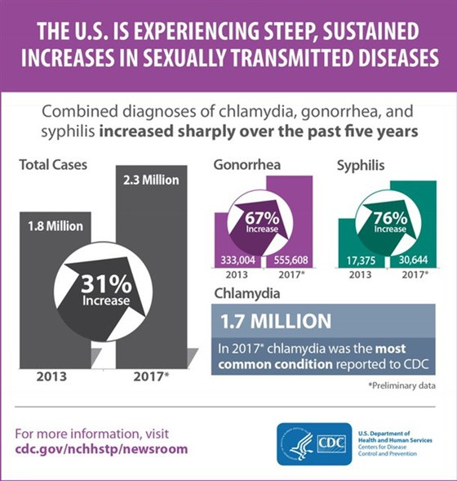

Leadership Examples (2 of 2)
Technical
Adaptive
Ensuring staff know the evidence-based guidelines
Identifying and addressing reasons for rising cases of STDs in your facility.
https://www.cdc.gov/mmwr/pdf/rr/rr6304.pdf
https://www.cdc.gov/std/news.htm
Notes:
Slide 6
Another example of a challenge with both technical and adaptive components is the rising number of Sexually Transmitted Diseases (STDs) in the U.S. On a national public health level, the rising cases of STDs is an alarming trend. As examples, the CDC reports that gonorrhea diagnoses have increased 67% from 2013 to 2017 and primary and secondary syphilis has increased 76% from 2013 to 2017.
On a clinical level, there are evidence-based guidelines for screening and treatment of clients.
The CDC and Office of Population Affairs recommendations for Quality Family Planning services and the CDC’s STD Treatment Guidelines provide technical guidance on assessment, screening and treatment.
Over time, as evidence-based guidelines evolve, providers must change their working processes accordingly.
Making changes and adapting to new ways of work can be difficult, but it is still a technical challenge in that there are high levels of agreement and certainty about evidence-based practices related to STDs.
Technical challenges have known solutions.
The CDC recommends a renewed commitment to implementing technical guidance and for health care providers to make STD screening and timely treatment a standard part of medical care in order to reverse current trends.
However, the CDC acknowledges that they are uncertain about the reasons for these alarming increases in STDs and what might additionally be needed to address these increases. Making matters worse, what matters in one community might differ from another. Thus, part of this challenge is also adaptive. For adaptive challenges, we need to create more agreement and certainty about the causes of the problem and the solutions. Adaptive challenges call for adaptive solutions.
Suggested technical solutions include ensuring staff know the evidence-based clinical guidelines and monitoring the adherence to them in your clinic.
Potential adaptive solutions may require identifying what might be contributing to rising cases of STDs in your community and implementing actions designed to reverse these trends – for example addressing subpopulations disengaged from your clinic’s services or increasing communication and coordination of care between your family planning and STD treatment services, which may be siloed in your setting.
Sources:
Providing Quality Family Planning Services Recommendations of CDC and the U.S. Office of Population Affairs, https://www.cdc.gov/mmwr/pdf/rr/rr6304.pdf
CDC, Sexually Transmitted Diseases (STDs), What’s New, https://www.cdc.gov/std/news.htm
Retrieved June 5, 2019

Slide 7
Technical Challenge Definition
Technical challenges are straightforward. There is typically agreement on what the problem is, and there is certainty about the cause of a challenge and the solution, even though it may be difficult to implement the solution.
A technical challenge can be resolved with authoritative expertise through an organization’s current processes.
Heifetz, R. A., Grashow, A., & Linsky, M. (2009). The Practice of Adaptive Leadership Tools and Tactics for Changing Your Organization and the World. Boston: Harvard Business Press
Notes:
Slide 7
To summarize, technical challenges are straightforward – though not necessarily easy.
There is typically agreement on what the problem is, and there is more certainty about the cause of a challenge and the appropriate solution, even though it may be difficult to implement the solution.
A technical challenge can be resolved with authoritative expertise through an organization’s current processes.

Slide 8
Adaptive Challenge Definition
Adaptive challenges are complex. There may not be wide agreement or certainty about the cause of the problem. There may be uncertainty about what will work to address the problem, or agreed-upon solutions may still need to be tested.
An adaptive challenge requires changing people’s priorities, beliefs, habits, and loyalties.
Heifetz, R. A., Grashow, A., & Linsky, M. (2009). The Practice of Adaptive Leadership Tools and Tactics for Changing Your Organization and the World. Boston: Harvard Business Press
Notes:
Slide 8
Adaptive challenges are complex. The problem is often ill-defined and ambiguous, lacking a known solution. There may not be wide agreement or certainty about the cause of the problem (or if there even is a problem), or what to do about it. If there is agreement on the best approach, specific solutions may still need to be tested.
With an adaptive challenge, you may have tried to solve it using known solutions, but the challenge keeps recurring, or persists. You may not even
be able to get started on addressing the challenge because no one agrees on what to try first.
An adaptive challenge requires changing people’s priorities, beliefs, habits, and loyalties.
Source:
Heifetz, R. A., Grashow, A., & Linsky, M. (2009). The Practice of Adaptive Leadership Tools and Tactics for Changing Your Organization and the World. Boston: Harvard Business Press

Slide 9
Need for Adaptive Leadership
Title X funded family planning organizations have indicated a need for their leaders to improve capacity to identify and resolve adaptive challenges.
Notes:
Slide 9
The landscape in which family planning services are delivered is continually changing. With changes in client needs, health care priorities, funding, and evidence-based practices come new opportunities and challenges. These challenges and opportunities call for leadership at all levels of an organization to manage change.
In a survey of Title X grantees conducted in 2017 by the FPNTC, family planning agencies indicated a need for their leaders to improve capacity to identify and resolve adaptive challenges – challenges without a clear or agreed upon definition or readily identifiable solution.

Slide 10
Examples of Adaptive Leadership Competencies
Community/Ecosystem
Organization/
Service System
Team(s)
Individual
Promoting health equity
Stakeholder engagement
Systems thinking
Continuous
improvement
Effective teams
Creating shared
vision
Resilience
Problem solving
Notes:
Slide 10
Adaptive leadership recognizes that everyone can take on a leadership role.
Adaptive leadership typically requires a different set of skills and competencies than we use when exercising technical leadership.
To effectively manage change in complex and uncertain environments requires skills and competencies at the individual, team, organization or service system and a community/ecosystem levels.
Recently, Title X grantee and reproductive health leaders prioritized 34 adaptive leadership competencies for the Title X workforce. For example, individual competencies include problem solving and resilience.
When working in teams, we need to be able to create shared vision and build effective teams.
At an organization or a service system level, we need systems thinking and continuous improvement competence.
And, at the community or ecosystem level, competencies include promoting health equity and building stakeholder engagement.

Slide 11
Adaptive Challenge Poll
Think of a complex, adaptive challenge you and/or your organization is facing in relation to providing family planning services.
Which challenge reflects your complex issue? Select one of the following:
Ensuring adherence to EBPs
Integrating FP services
Resistance to change
d) Other
Notes:
Slide 11
Now let’s answer a poll -- so we can hear from you. Based on the description and definition of complex, adaptive challenges, think of an adaptive family planning challenge you and/or your organization is facing.
Here you see some common adaptive challenges in family planning settings: Does your adaptive challenge fall into one of the following areas? If so, type the corresponding letter into the chat box:
Ensuring adherence to policies and evidence-based practices (that change!)
Integrating family planning services into other services
Resistance to changing cultural norms in your organization or partner organizations (e.g., ‘But this is how we’ve always done it.’)
Other
If you selected ‘Other’, please write a few key words to describe your complex challenge in the chat box.
Keep in mind: An adaptive challenge may be one that’s ‘keeping you up at night’ -- It may be a complex problem that keeps recurring despite applying known solutions, or one you just can’t reach agreement or certainty on.
RESULTS
Let’s discuss what some of the adaptive components of these challenges might be. If you selected:
a) Ensuring adherence to policies and evidence-based practices.
Let’s consider an example of HPV vaccinations. In 2017, the CDC reports that 49% of all adolescents aged 13-17 were up to date with their HPV vaccination schedule (“More US adolescents up to date on HPV vaccination | CDC Online Newsroom | CDC,” n.d.). HPV vaccination schedules are an evidence-based practice for which we have guidelines, yet the vaccination coverage is still below the Healthy People 2020 goal of 80% coverage (“Immunization and Infectious Diseases | Healthy People 2020,” n.d.). Encouragingly, national coverage rates have increased in each successive year.
However, factors that differ by community on both the patient and provider side may need to be addressed to increase vaccination coverage to recommended levels in your setting. Among parents reporting that they are not planning to vaccinate their child, two of the most frequent reasons given are that the vaccine isn’t necessary and safety concerns persist. So while health providers may believe that HPV vaccine is necessary and safe, not all parents are in agreement. A provider’s recommendation for a child to get the HPV vaccine is one of the most important factors influencing a parent’s decision. While there have been great strides in providers recommending the vaccine, lower levels of recommendations by providers serving clients of certain ethnic backgrounds suggest potential cultural or language barriers (Hirth, Fuchs, Chang, Fernandez, & Berenson, 2019). Understanding which of these factors is influencing the uptake of the HPV vaccine and identifying appropriate strategies can make this a complex challenge in your setting.
Sources:
More US adolescents up to date on HPV vaccination | CDC Online Newsroom | CDC. (n.d.). Retrieved June 5, 2019, from https://www.cdc.gov/media/releases/2018/p0823-HPV-vaccination.html
Immunization and Infectious Diseases | Healthy People 2020. (n.d.). Retrieved May 24, 2019, from https://www.healthypeople.gov/2020/topics-objectives/topic/immunization-and-infectious-diseases/objectives
Hirth, J. M., Fuchs, E. L., Chang, M., Fernandez, M. E., & Berenson, A. B. (2019). Variations in reason for intention not to vaccinate across time, region, and by race/ethnicity, NIS-Teen (2008–2016). Vaccine, 37(4), 595–601. DOI: https://doi.org/10.1016/j.vaccine.2018.12.017
If you selected:
b) Integrating family planning services into other services
When we are trying to integrate any service, it is critical that those involved have a shared vision for the integration of services and that staff understand their roles for provision of integrated services. The system needs to support those new roles and ways of work.
For example, there may be a family planning nurse who does all the counseling and services, and other staff in a facility may not be addressing family planning during other primary care visits. Achieving integration of family planning throughout a primary care facility may require building a common vision among all staff about how they can achieve that goal or coming to agreement about new roles and responsibilities.
If you selected:
c) Resistance to changing cultural norms in your organization or partner organizations (e.g. ‘But this is how we’ve always done it’)
Changing the way things have always been done brings uncertainty and can be uncomfortable. This is a challenge that requires people changing habits, priorities, and sometimes even values that can get in the way of trying new approaches to achieving the high quality family planning services. Perhaps staff are used to management telling them what needs changing, rather than staff feeling empowered to identify and make needed changes within their realm of responsibilities. Instilling new problem-solving skills can be an adaptive component of this challenge.
d) Other
[Acknowledge a few of the challenges mentioned by participants]

Slide 12
Typical Adaptive Leadership Approaches
Convening staff and/or stakeholders
Examining and describing patterns
Designing and testing solutions to address the problems discussed among staff and/or stakeholders
Notes:
Slide 12
Typical adaptive leadership approaches involve:
Convening staff and/or stakeholders to learn, together, and achieve agreement on causes of problems or their solutions
Examining and describing patterns in your environment that suggest potential courses of action based on past trends
Designing and testing solutions to address the problems discussed among staff and/or stakeholders

Slide 13
Right Solution for the Problem at Hand
Technical challenges warrant technical solutions
Adaptive challenges warrant adaptive approaches to understanding the problem and finding solutions
For challenges with both technical and adaptive components, it is important to distinguish between the two with actions selected accordingly
Notes:
Slide 13
As with shifting to an evidence-based practice, challenges may have both technical and adaptive components. It is important to apply the right leadership and actions for the type of challenge you are facing.
Oftentimes, leaders apply technical solutions to complex, adaptive challenges. This would not adequately address the complex, adaptive nature of the challenge. As busy health professionals, we frequently find it easier to turn to an off-the shelf solution or call in a technical expert than to grapple with uncertainty and work to build agreement in your family planning service system. But, failing to meaningfully address the adaptive challenge tends to frustrate people and does not really resolve the challenge.
And, conversely, we don’t want to make things more complex than they need to be. If a challenge is technical, find the best practice or the expert and work on implementing the solution. Learning to recognize the difference between technical and adaptive challenges and matching your leadership to the problem at hand is key for success.
In this next section, Joan will discuss how you can diagnose problems you are facing as technical and/or adaptive, and she will introduce a few adaptive leadership tools available on fpntc.org to help you tackle the adaptive challenges you are facing.
Before we move ahead to the next section, are there any clarifying questions people have?

Slide 14
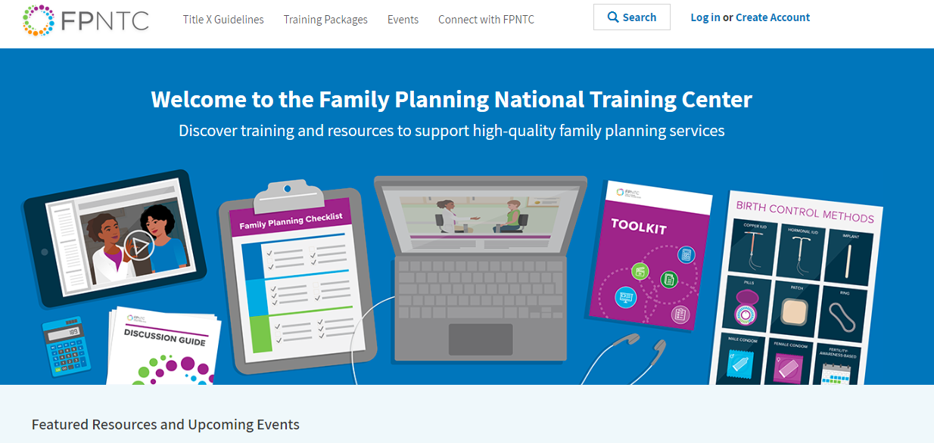
Adaptive Leadership Tools (1 of 2)
Notes:
Slide 14
Adaptive leadership tools can be help build your skills to better understand and address complex, persistent challenges. Adaptive leadership tools on the FPNTC website can, for example, help to build your problem solving skills and to gain agreement and certainty on how to proceed.

Slide 15
Adaptive Leadership Tools (2 of 2)
Notes:
Slide 15
You will find ‘Adaptive Leadership’ under the ‘Training Packages’ menu of the fpntc website.
From here you can navigate to any of the tools we specifically categorized as adaptive leadership tools.

Slide 16
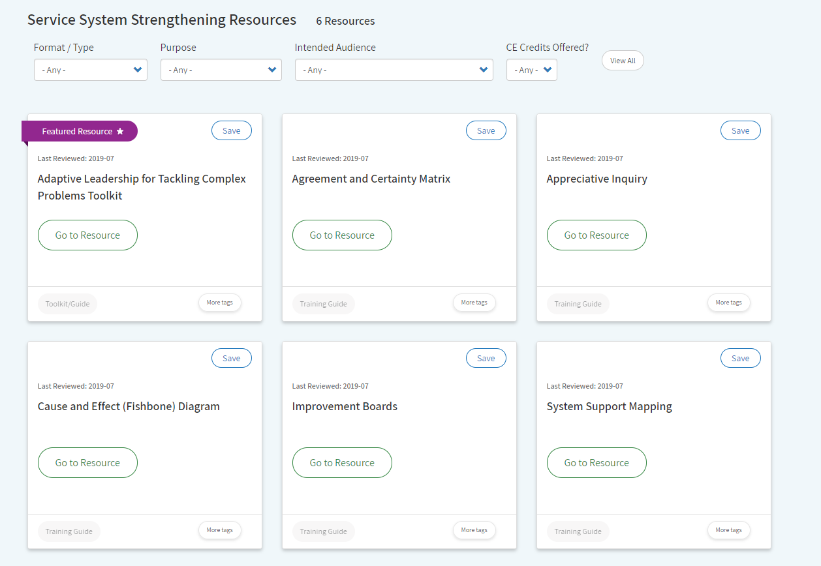
Adaptive Leadership Training Package Homepage
Notes:
Slide 16
In the adaptive leadership training package you will find tools and resources for understanding adaptive leadership and building adaptive leadership capacity with your team.

Slide 17
Adaptive Leadership for
Tackling Complex Problems
Toolkit (1 of 2)
Notes:
Slide 17
Today we will review the Adaptive Leadership for Tackling Complex Problems Toolkit, which provides a series of action steps and complementary resources (tools and example uses) that support building adaptive leadership capacity.
If you are just beginning to learn about adaptive leadership, we recommend starting with the Toolkit resource.

Slide 18
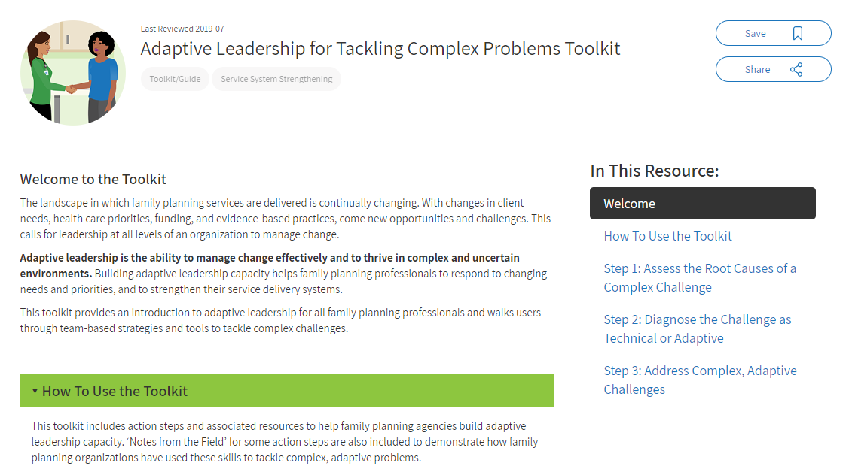
Adaptive Leadership for Tackling Complex Problems Toolkit (2 of 2)
Principles of adaptive leadership:
Identify root causes of a problem
Diagnose which root causes of a problem are technical and which are adaptive
Identify and use appropriate approaches to address complex, adaptive challenges.
Notes:
Slide 18
In the toolkit, the first thing you will notice is a link to a short video which introduces key concepts of adaptive leadership. It highlights examples of adaptive challenges in family planning settings.
The toolkit outlines 3 major principles of adaptive leadership:
It is important to begin by identifying the root causes of a problem.
Diagnose which root causes of a problem are technical and which are adaptive
Identify and use appropriate approaches to address complex, adaptive challenges.

Slide 19
Step 1: Identify Root Causes of a Problem
Notes:
Slide 19
Let’s get started with Step 1: identifying the root cause of a problem.

Slide 20

Why Take the Time to Identify Root Causes?
In healthcare, providers diagnose before prescribing treatment.
We should understand a problem before applying a solution.
Heifetz, R. A., Grashow, A., & Linsky, M. (2009). The Practice of Adaptive Leadership Tools and Tactics for Changing Your Organization and the World. Boston: Harvard Business Press
Notes:
Slide 20
In healthcare, it is crucial to diagnose a client’s problem before prescribing treatment. Frequently, tests, time, thought, and discussion are devoted to assessing the client’s problem first.
Treatment comes second.
Similarly, in adaptive leadership, understanding the problem thoroughly first can help you and your team to avoid wasting resources that only address the symptoms rather than underlying root causes.

Slide 21
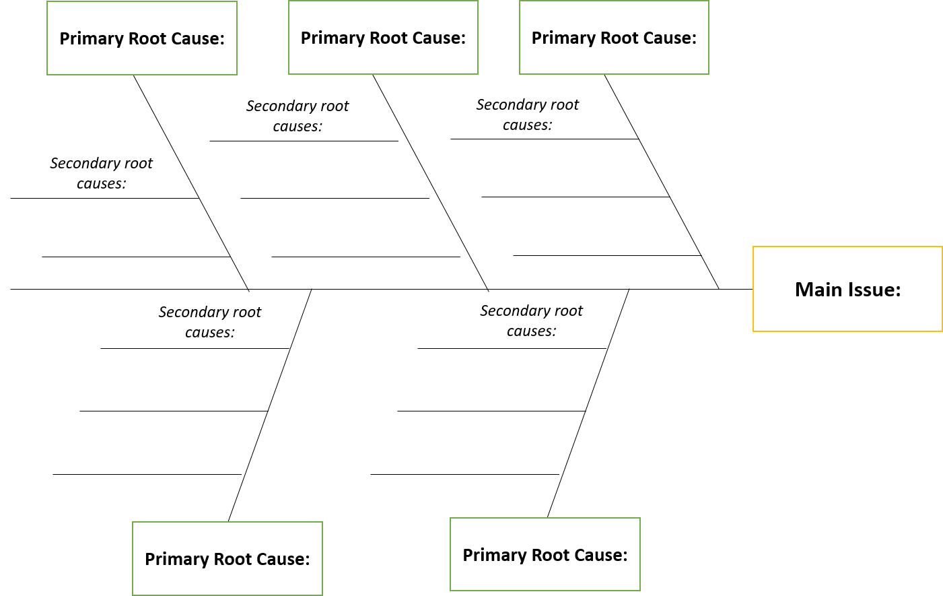
Identify Root Causes
Cause and Effect Diagram
Notes:
Slide 21
The Cause and Effect Diagram is a tool for ‘diagnosing’ the problem by understanding root causes.
Other FPNTC resources, such as the ‘Model for Improvement e-learning course’ provide additional tools for diagnosing root causes. https://www.fpntc.org/resources/quality-improvement-methodologies-using-model-improvement-elearning-module-2

Slide 22
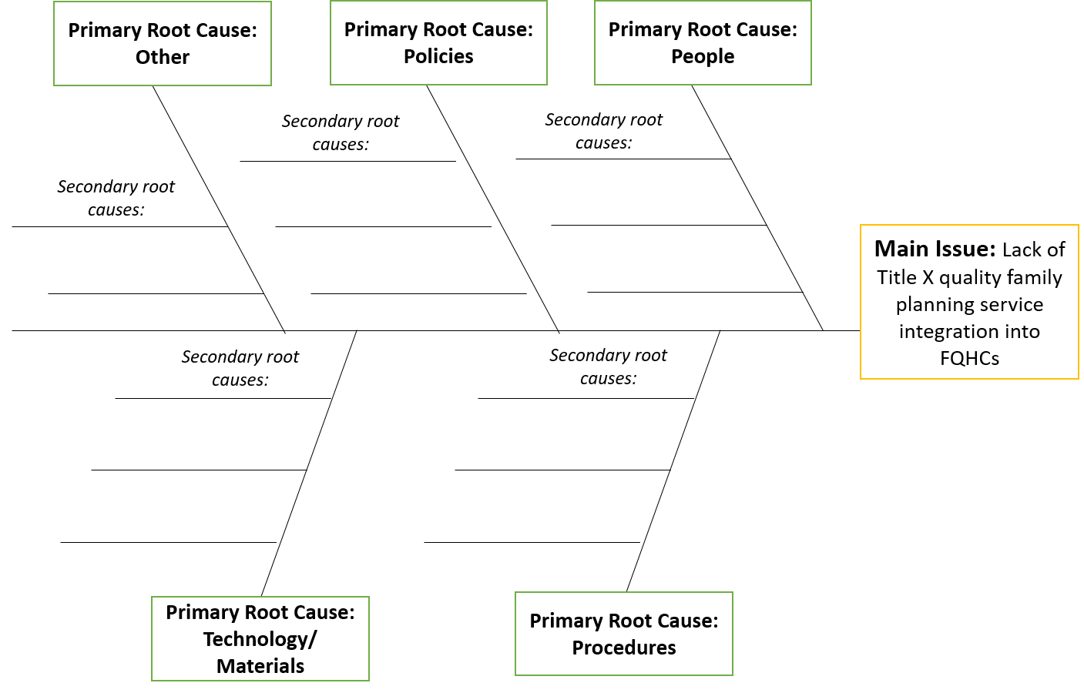
Cause and Effect Diagram (1 of 2)
Notes:
Slide 22
Many of you may be familiar with the Cause and Effect Diagram, also known as the fishbone diagram.
The Cause and Effect Diagram is one adaptive leadership tool that identifies, sorts, and graphically displays all the possible causes of a problem or challenge. This tool helps you and your team or stakeholders to understand the root causes and relationships between factors affecting a complex problem. Using this tool sparks conversation and builds shared understanding and agreement about the causes of a problem, and supports quality, systems improvement. After completing the diagram, the different causes underlying a problem become clearer and how different root causes are interrelated.
When using the Cause and Effect or Fishbone Diagram, the main problem you and your team are facing is “the head” of the fish.
For example, one Title X grantee used the Cause and Effect Diagram to diagnose root causes of an issue, “Lack of integration of quality family planning services (QFP) at a Federally Qualified Health Center (FQHC)”.
The ‘bones of the fish’ represent the primary root causes – typical categories for the main causes of a problem include People, Policies/Environment, Procedures/Systems, Technology/ Materials.

Slide 23
Cause and Effect Diagram (2 of 2)
Lack of knowledge around QFP requirements
Workload burden
Notes:
Slide 23
After identifying the primary root causes, the Cause and Effect Tool is used to dig deeper into those underlying causes. In this example, you can see here under the ‘People’ category that ‘Lack of knowledge and education about QFP’ and ‘Workload Burden’ are contributing root causes in the ‘People’ category for lack of integration of QFP at an FQHC.
You and your team can apply this tool to explore the root causes of any complex challenge that you are facing.
Using the Cause and Effect Diagram requires open, honest communication about what people perceive as the contributing root causes. Those in management roles should cue their staff that it is safe to speak up when it comes to opinions and concerns related to tough challenges. Being able to ‘call out the elephant in the room’ if needed is a key part of an adaptive culture within an agency.

Slide 24
Step 2. Diagnose the Root Causes of the Problem as Technical or Adaptive
Notes:
Slide 24
After determining the root causes of a problem, the next step is to identify if the root causes of the problem are technical or adaptive.

Slide 25
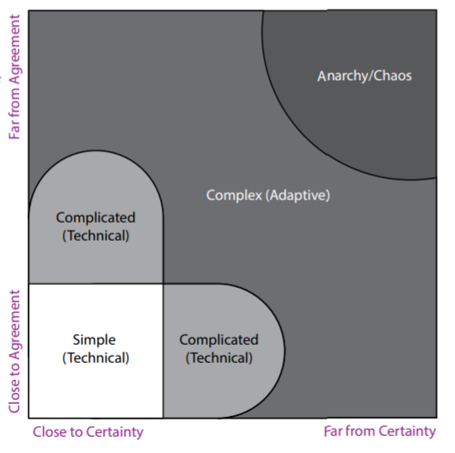
Diagnose the Problem
Agreement and Certainty Matrix (1 of 2)
Notes:
Slide 25
The agreement and certainty matrix tool will help you delineate which root causes are technical and which are adaptive.
You locate the root causes on the matrix, depending on the level of certainty and the level of agreement among your team and/ or key stakeholders.
The degree of certainty runs on the horizontal axis and certainty decreases as you move to the right. The level of agreement runs on the vertical axis and agreement decreases as you move up.
When there is high agreement and high certainty about a root cause of the problem, the root cause falls in the lower left corner on the matrix. This would be a technical problem.
When there is less certainty and less agreement about the causes or the potential solutions to the challenge, the root cause falls in the complex area of the matrix, and is therefore is an adaptive problem.

Slide 26
Diagnose the Problem
Agreement and Certainty Matrix (2 of 2)
Workload burden
Lack of knowledge of QFP requirements
Notes:
Slide 26
Recall the root causes from the example of integrating family planning in FQHCs. One of the root causes identified was: “Lack of knowledge of QFP requirements”. In this case, the challenge is well understood and there are known solutions, which include training providers and clinic staff on QFP requirements, which can be a straightforward, technical problem. We want to note that ensuring adherence to QFP is a different problem and may be a complicated or complex problem.
From the previous example in the Cause and Effect Diagram, we recall that ‘Workload Burden’ was listed as a root cause of lack of integration of quality family planning at FQHCs. Reducing workload burden of staff is a complex challenge that often lacks agreement or certainty about how to proceed.
While there may be some agreement on provider’s workload burden being a deterrent to the inclusion of family planning counseling in primary care visits, there may be a lack of certainty about which solutions to address this issue will lead to better outcomes. Therefore, workload burden falls in the complex (adaptive) area of the matrix.

Slide 27
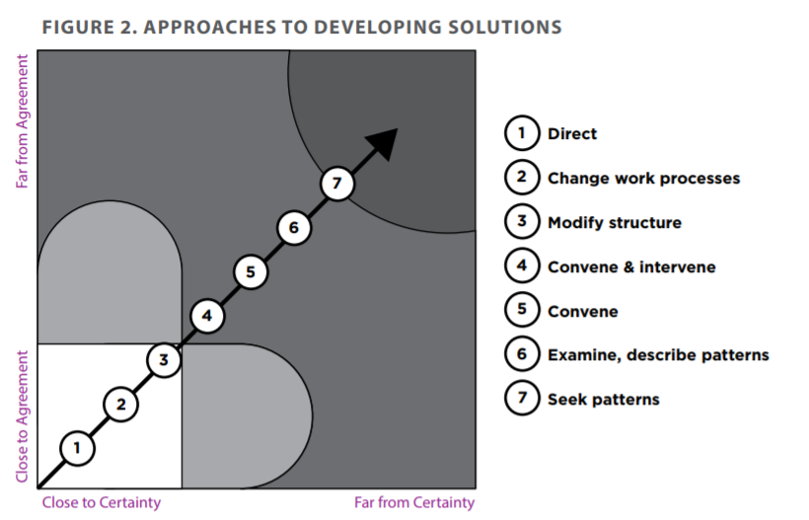
Approaches to Finding a Solution
Notes:
Slide 27
Depending on where you placed the root cause of the challenge on the Matrix, there will be corresponding approaches to develop a solution.
Approaches to developing solutions are as follows:
Direct, this involves assigning individuals to complete straightforward tasks
Change work processes, this involves revising work practices and procedures to address a problem where there is sufficient control of variables to allow planned change in systems, organization, or information flow.
Modify structure is similar to changing work processes. It involves adapting or revising existing systems, such as work group composition, meeting structures, and organizational reporting relationships to address a problem.
Convene and intervene. This involves gathering representatives involved in a complex adaptive problem to achieve agreement and/ or certainty about the problem or appropriate solutions and subsequently to test or implement a potential solution.
Convene. This involves gathering representatives involved in a complex problem to achieve agreement and/or certainty about the problem or appropriate potential solutions.
Examine, describe patterns. This involves identifying information and analyzing trends in order to better understand the nature of the problem or solutions that may have been used previously.
Seek patterns. This means continually scanning the context of the problem for emerging trends and/or patterns.

Slide 28
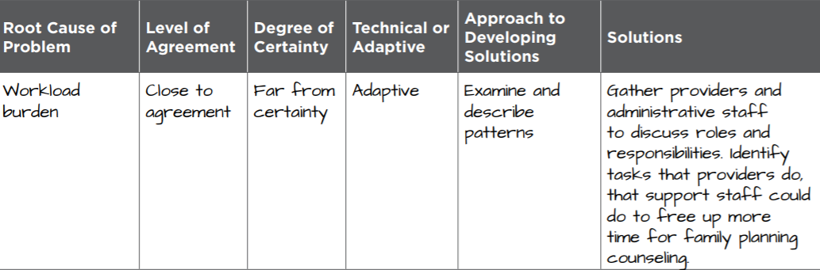
Example From the Agreement and Certainty Matrix
Notes:
Slide 28
In order to increase agreement and certainty among staff for the problem of workload burden, an approach for developing a solution is to convene staff and identify potential ways of intervening to address the problem.
To begin identifying potential solutions you and your team may need to examine and describe the work patterns in your setting. By gathering providers and administrative staff to discuss roles and responsibilities you may be able to identify tasks that providers do that support staff could do to free up more time for family planning counseling.

Slide 29
Step 3. Address Complex, Adaptive Challenges
Notes:
Slide 29
We want to acknowledge that we spent a fair amount of time to cover the first two steps to diagnosing your complex challenge. After the challenge has been diagnosed, there are several possible next steps, and the FPNTC has tools to further address complex challenges.
The following tools are examples of what you can use to help build your skills in systems thinking, building effective teams, creating shared vision, problem solving and continuous improvement.

Slide 30
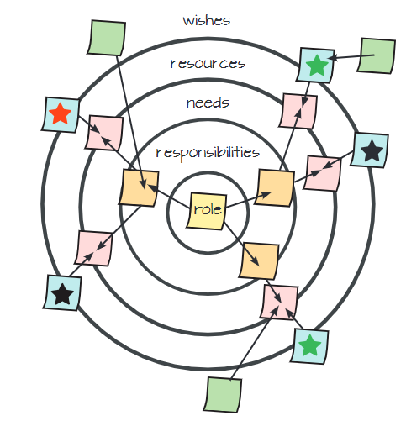
System Support Mapping Tool
Helps to build efficient teams
Notes:
Slide 30
Do you ever feel in work with your colleagues that the “left hand doesn’t know what the right hand is doing”? The System Support Mapping Tool helps to build effective teams, identify targets for change and improvement, and better coordinate resources to achieve your common goals.
It’s difficult to change a system unless you understand the system. Using this tool, each team member identifies their Roles, Responsibilities, Needs, Resources, and Wishes within the system.
This slide is a representation of a system support map. When team members gather to discuss their maps, the discussion can help identify gaps and commonalities in the levels of support for achieving their goals.

Slide 31
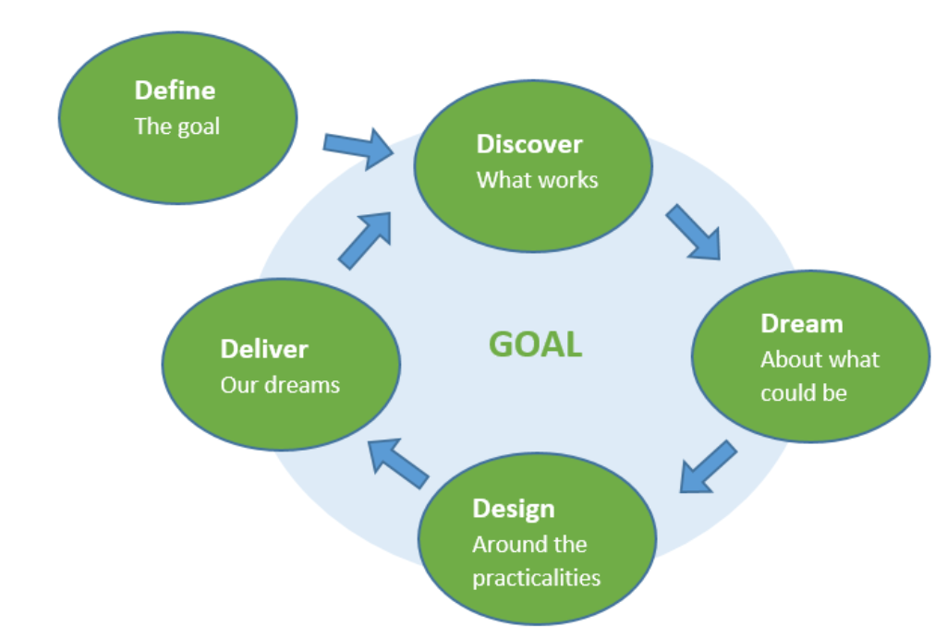
Appreciative Inquiry Tool
Helps to create a shared vision
Notes:
Slide 31
We’ve focused on the importance of diagnosing challenges or problems you may be facing. However, you and your teams may be experiencing ‘problem fatigue’. The Appreciative Inquiry Tool can help overcome the negativity that comes from focusing solely on the problems.
The image on the slide is representative of what the Appreciative inquiry process entails: first defining the goal, then discovering what works, dreaming about what could be, designing around the practicalities, and delivering on the dreams.
Adaptive challenges often require envisioning what an organization and service system will look like to best meet changing client needs. This tool helps you, your team and stakeholders to appreciate what is working well and to build a shared vision for new innovative directions, goals and plans based on your strengths.
Family planning organizations have used the Appreciative Inquiry tool with external partners and internal team members.
For example, a Title X clinic staff member who is responsible for coordinating with community partner agencies used Appreciative Inquiry to overcome partners’ negative perceptions around family planning and to work toward a common vision for patient health and well-being in their community.
Within another Title X grantee agency, team members used Appreciative Inquiry to become more energized about their vision for success despite persistence problems and bureaucratic obstacles to implementing their program. By discussing what has worked well in the past and dreaming together about an ideal future, they were able to identify action steps that they believe will help them to achieve breakthrough program results.

Slide 32
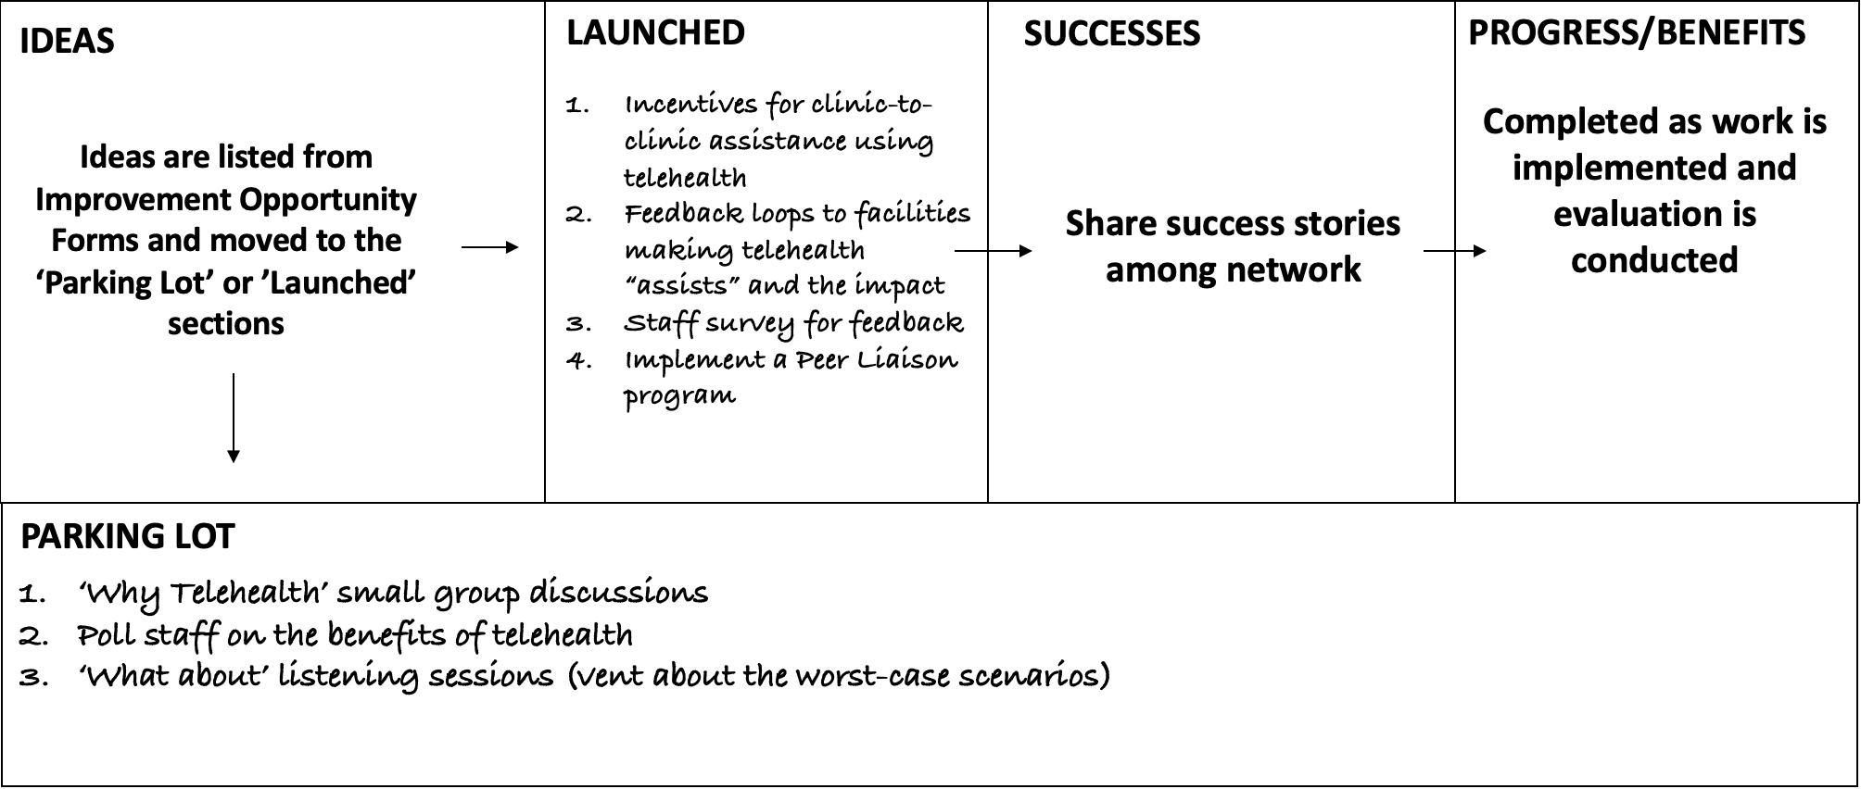
Improvement Boards
Helps to engage staff in change management
Notes:
Slide 32
As the saying goes, “If you’re not part of the solution, you are part of the problem.”
Improvement Boards are a way to engage staff in being part of the solution. This tool helps empower staff at all levels, especially frontline staff, to identify and come to agreement on needed changes and take ownership for implementing solutions.
The image on the slide is an example Improvement Board that begins with a section for employees to write ideas related to a certain goal.
The group meets together to decide which ideas to implement and moves these into the launched section.
The ideas requiring further discussion or approval are sent to the parking lot.
If launched ideas are successful, the group writes what was successful about the idea and then what are the progress/ benefits of that idea related to the goal.
The Improvement Board is be placed in a convenient location, so staff are able to monitor progress on improvement ideas and celebrate successes on a regular basis.

Slide 33
Title X Grantee Experience Tackling Complex
Adaptive Challenges
Notes:
Slide 33
In this section we will discuss how a Title X grantee used adaptive leadership skills and tools to address a complex family planning challenge.

Slide 34
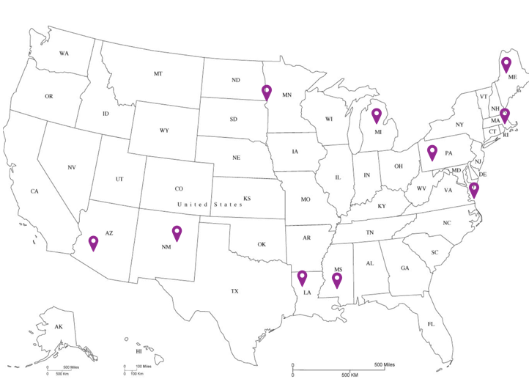
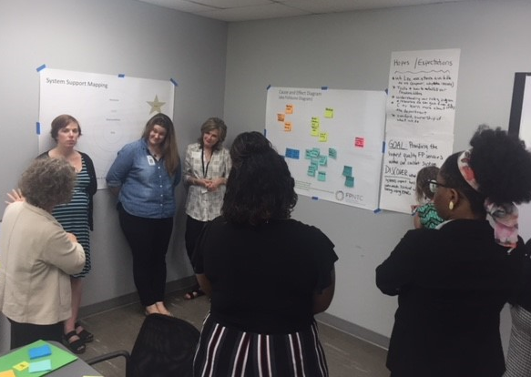
Tackling Complex Adaptive Challenges
Notes:
Slide 34
Now we would like to discuss how Title X grantees used adaptive leadership skills and tools to address complex challenges in their family planning networks.
On the map you can see the states where FPNTC provided coaching to Title X grantees to build their leadership capacity. Coaching was a collaborative process in which grantees and FPNTC coaches discussed a challenge their network was facing and then brought teams together to work through adaptive leadership tools to address the challenge.

Slide 35
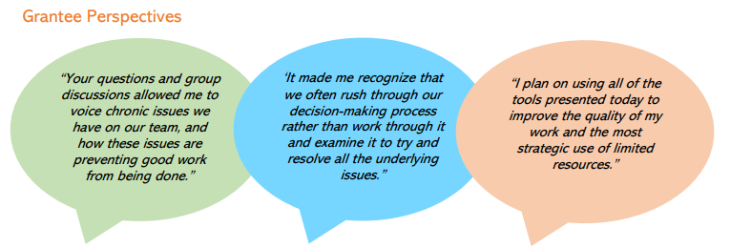
Tackling Complex Adaptive Challenges
Notes:
Slide 35
Many Title X grantees found the adaptive leadership capacity building to be a useful exercise.
One said they were able to voice chronic issues they were having on their team that prevented good work from being done.
Another said that they often rush through the decision making process rather than examine it and try to resolve underlying issues.
And a third said they planned to use all of the adaptive leadership tools presented to improve the quality of their work and to strategically use limited resources.

Slide 36
Tackling Complex Adaptive Challenges in Louisiana (1 of 4)
Notes:
Slide 36
One example of Adaptive Leadership approaches is that in July of 2018, the FPNTC provided tailored coaching to the Louisiana Department of Health and Hospitals (LADOH), a Title X grantee, to help build adaptive leadership capacity around improving their strategic planning processes.
The LADOH first used the Cause and Effect Diagram to examine reasons why they have been unable to achieve a common understanding of strategic actions needed and development of actionable plans.
This problem-solving tool helped LADOH to identify, graphically display and see the relationships between the potential root causes of their problem in three key categories.

Slide 37
Tackling Complex Adaptive Challenges in Louisiana (2 of 4)
People
Lack of awareness about the evidence supporting strategies
Getting Common Understanding of Strategic Actions Needed
Perceptions of inequitable allocation of resources
Inadequate community input
Resources
Notes:
Slide 37
Examples of root causes that the Louisiana team identified included staff’s lack of awareness about evidence supporting strategies and underlying issues related to resources such as community perceptions about inequitable resource allocation between urban and rural sites, and inadequate community input into priorities.

Slide 38
Tackling Complex Adaptive
Challenges in Louisiana (3 of 4)
Perceptions of inequitable allocation of resources
Inadequate community input
Lack of awareness about the evidence supporting strategies
Lack of awareness about the evidence supporting strategies
Notes:
Slide 38
With a better understanding of the root causes for not achieving common understanding of strategic actions needed, the group proceeded to use the Agreement and Certainty Matrix to help identify the technical and adaptive elements of their root causes.
For example, using the Agreement and Certainty Matrix, the Louisiana staff were certain and in agreement that lack of awareness about the evidence supporting strategies was a cause for not achieving common understanding of needed strategies, and therefore was a straightforward technical issue.
Community perceptions about resource allocation and inadequate community input were identified as complex, adaptive problems.
While there was agreement and certainty that this problem contributed to not achieving common understanding of strategic actions needed, staff were uncertain about the best way to address community perceptions and input to their strategic planning process.
Once the team categorized the challenges as technical or adaptive, they followed guidance from the Agreement and Certainty Matrix to find an appropriate solution.

Slide 39
Tackling Complex Adaptive Challenges in Louisiana (4 of 4)
Perceptions of inequitable allocation.
Inadequate community input.
Lack of awareness about the evidence supporting strategies.
Notes:
Slide 39
The staff identified the convene approach for including community partners early in the strategic planning process to give voice to their priority needs and get input on potential strategies.
Staff identified the convene and intervene approach to bring community stakeholders together, to develop scenarios that would guide the organization’s resource allocation during strategic planning and increase community ownership and buy-in to strategies and their implementation.
Overall, Louisiana Department of Health and Hospitals staff was able to better understand the complexity of issues and identify ways to improve their strategic and programmatic planning overall.
Increasing the adaptive leadership capacity of staff helped them to understand the underlying causes of their problem, identify how to address the technical and adaptive components of their problem and identify appropriate approaches for addressing their challenge.
These skills will not only improve their strategic planning processes, but also to improve other change efforts.

Slide 40
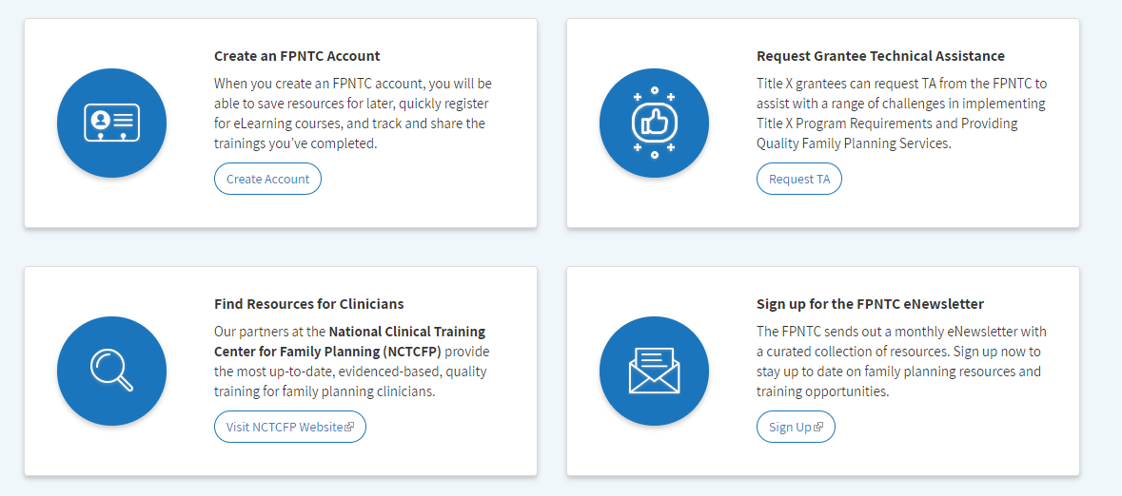
Request Technical Assistance
Only agencies that directly receive Title X funds from OPA are eligible for this tailored technical assistance.
Notes:
Slide 40
If you are a Title X grantee, you may be able to receive technical assistance and coaching through the FPNTC for a complex or persistent challenge you are grappling with.
You may request TA in the area of adaptive leadership, or for any topic, by submitting a technical assistance request through the form located on the fpntc.org homepage.
You will find ‘adaptive leadership’ under the subcategory of ‘service system strengthening’, since adaptive leadership capacity is an essential component of a strong service system.
Only agencies that directly receive Title X funds from OPA are eligible for the tailored TA, but Title X subrecipient agencies may be able to work with their grantee agency to request tailored assistance for a wide range of topics – including adaptive leadership coaching.

Slide 41
Questions?
Notes:
Slide 41
Now, we will take your questions. Please use the chat feature to type in your questions to us.
Plant questions if there are none:
Plant questions:
Q: I am not in a management role, how can I influence my higher-ups to take time for using an approach based in adaptive leadership for addressing challenges ?
A: Some of the tools, like Improvement Boards, are designed to help you figure out what you can do within your realm of responsibility—you may find things you can do that don’t require management support. If you want to have a discussion with management about applying some adaptive approaches, try and think of a situation in which slowing down to think about the problem first before jumping to a solution would have been helpful. Adaptive leadership is about stepping back momentarily to examine the problem and figure out what approach really makes sense. Your management might buy-in to the idea of working to gain agreement and certainty.
Q: Can I use the adaptive leadership tools even if I am not sure my problem is an 'adaptive problem'?
A: Many problems have both technical and adaptive components, through using the first 2 tools we discussed, the cause and effect diagram and the agreement and certainty matrix, you will have a better idea of which parts of your problem require technical approaches and which require adaptive approaches.
Q: Why is it called 'adaptive' leadership?
A: We are experiencing changes in our world and our family planning system. Adaptive leadership is about shifting ourselves, our agencies, our communities in relation to the changes occurring in order to thrive. We must build on our successes from the past while recognizing that what worked then, may not have the same results now. Change is the only constant.

Slide 42
Thank you!
Contact:
fpntc@jsi.com
Notes:
Slide 42
If you have additional questions please don’t hesitate to email the FPNTC at fpntc@jsi.com.

