Slide 1

Bill the Correct Payer and Optimal Amount
Financial Management Change Package Best Practice 1
Notes:
Facilitator Notes
Today we will be discussing the first best practice in the Financial Management Change Package: Bill the Correct Payer and Optimal Amount.
Revenue optimization begins with assuring that the correct payer is billed the accurate amount for services provided.
Billing the correct payer and optimal amount are essential to sound financial management practices, and is one strategy leading to increased revenue.
Activity
Conduct participant and facilitator introductions.
Note to Facilitators
We recognize that Title X grantees have networks of sub-recipients and service sites, and how they’re described can be confusing. For the purposes of this training, we have used agency and site throughout (and interchangeably). We encourage you to refer to your network in the terms you’re most comfortable with/accustomed to using.

Slide 2
Financial Management Change Package
Best Practice Recommendations
Bill the correct payer and optimal amount
Monitor and manage client fee collections
Monitor and manage payments from third-party payers (TPPs)
Link: https://www.fpntc.org/resources/financial-management-change-package
Notes:
Facilitator Notes
Billing the correct payer and optimal amount is the first best practice recommendation outlined in the Financial Management Change Package, which was developed by the Family Planning National Training Center.
The Financial Management Change Package, which is an overview of best practice recommendations and strategies, draws from the literature and most current practice guidelines to improve financial management practices and factors that have an impact on organizational financial health.
The other two best practices in the Financial Management Change Package are:
BP 2: Monitor and manage client fee collections
BP 3: Monitor and manage payments from third-party payers (TPPs)
In order to increase revenue, it’s important to consider all three best practices and utilize a comprehensive approach that addresses each. We strongly encourage you to refer to the Financial Management Change Package for more ideas about strategies and successes. It can be found on the FPNTC website.

Slide 3
Financial Management Change Package:
Best Practice 1
Bill the correct payer and optimal amount.
Notes:
Facilitator Notes
We are going to start with Best Practice 1: Bill the correct payer and optimal amount.
This best practice could be: Charge the correct payer and optimal amount. The words “charge” and “bill” are synonymous in this instance.
A Title X agency may consider implementing a quality improvement (QI) initiative specific to this best practice if:
An agency identifies payer mix issues or is concerned about the number of third-party payer (TPP) clients
An agency’s fee schedule has not been appropriately adjusted recently
An agency has concerns or questions about the thoroughness of its charge coding
An agency has concerns about the number or percentages of fully discounted clients

Slide 4
Meeting Objectives
By the end of today, you should be able to:
Describe the importance of billing the correct payer and optimal amount
Describe challenges related to billing the correct payer and optimal amount
Describe at least one strategy to bill the correct payer and optimal amount
Describe one tool available to support front-end practices
Notes:
Facilitator Notes
There are four objectives for today’s session. By the end of our meeting, you should be able to:
Describe the importance of billing (or charging) the correct payer and optimal amount
Describe challenges related to billing the correct payer and optimal amount
Describe at least one strategy to bill the correct payer and optimal amount
Describe one tool available to support front-end practices

Slide 5
Rationale for Billing the Correct Payer and Optimal Amount
Revenue optimization begins with assuring:
Correct payer is billed
Charges are accurate
    Accurate discounting of services
    Accurate coding of services
Full charge for services is appropriate
Notes:
Facilitator Notes
Revenue optimization begins with assuring that the correct payer is billed (or charged) the accurate amount for services.
Starting with billing the optimal amount is an important part of optimizing revenue.
To identify and bill the correct payer (public or private), capture clients’ insurance and other required information accurately during front-end procedures.
Reminder, third-party insurance is not only the payer an agency must bill according to Title X requirements, but also third-party insurance reimbursement is almost always higher than what an uninsured/self-pay client will pay.
To accurately charge uninsured/self-pay clients (and calculate fees due for TPP-covered clients), gather family size and income information accurately.
Analyze and compare site(s) indicators—such as payer mix, charge per client, and percent of clients in each discount category—and conduct chart reviews and coding audits to identify problems.
Ensure that charges are high enough to capture TPP-payer negotiated rates.
For example, if your agency’s full charge is less than the negotiated rate for a service, the insurance company will pay your agency’s full charge, not the negotiated rate, and you will not be able to capture the additional revenue (difference between the charge and the negotiated TPP rate for the service) contractually due to your agency.

Slide 6
Suggested Performance Indicators to Bill the Correct Payer and Optimal Amount
  Can be broken out by:
    Uninsured/self-pay clients
    Medicaid
    Private insurance
Monthly Charges
Sub-indicators related to monthly charges
Charge per client
  Broken out by:
    Uninsured/self-pay clients, Medicaid, and private insurance
Client in each discount category
  Broken out by:
    Number and/or percentage
Link: https://www.fpntc.org/resources/financial-management-performance-report-and-improvement-plan
Notes:
Facilitator Notes
Indicators can point you to areas in need of improvement.
The suggested indicators to bill the correct payer and optimal amount are:
Overall monthly charges, broken out by payer. This is useful when working on payer mix initiatives such as charges for each payer as a percent of total charges; or to initiatives related to accurate discounts and/or third-party payer (TPP) client fees to assess uninsured/self-pay client
Charge/client in each payer category
This is useful when working on coding initiatives or initiatives to assure appropriate discounts for uninsured clients
Clients in each discount category:
Can be measured or broken out by the number of clients in each discount category or as a percentage in each discount category
Data are submitted for FPAR (number of payers in each category)
This is useful when working on accurate discounting of uninsured/self-pay clients

Slide 7
Suggested Performance Indicators to Bill the Correct Payer and Optimal Amount (cont.)
  Can be calculated by:
    Visits
    Revenue
Payer Mix
Sub-indicators related to Payer Mix
Medicaid applications (submitted)
  Broken out by:
    Number of applications submitted
Medicaid applications (approved)
  Broken out by:
    Percentage
Notes:
Facilitator Notes
An additional indicator for billing the correct payer and optimal amount is payer mix. While payer mix is typically calculated using revenue or visits, we have included it in the charges best practice since it can be an important indicator for billing the correct payer, and for improving charges. This can occur when more clients are covered by either Medicaid and private insurance vs. uninsured (where charges are most often discounted). So billing the “correct” payer will most likely result in increased charges and revenue.
Sub-indicators listed are a good choice if your agency is examining its Medicaid enrollment data. These sub-indicators can be useful when Medicaid enrollments are conducted on-site.
Medicaid applications (submitted): This can be calculated by the number of applications submitted
Medicaid applications (approved): A percentage approval rate that can be calculated by dividing the number of applications completed by the number of applications approved

Slide 8
Payer Mix Impact
Grantee Example, 2015 Data
Health Insurance Coverage | Number of Encounters (Visits) | % of Encounters (Visits) | Revenue | Payer as a % of Total Revenue | Revenue per Encounter (Visit)
Medicaid | 98,721 | 40% | $10,912,653 | 72% | $111
Private Insurance | 77,071 | 31% | $2,904,005 | 19% | $38
Uninsured/ Self-Pay | 69,992 | 28% | $1,432,484 | 9% | $20
Unknown | 2,992 | 1%
Total | 248,776 |  | $15,249,142
Notes:
Facilitator Notes
Let’s review the table on this slide to determine the impact of a diverse payer mix.
Payer mix is the percentage of visits and revenue in each payer category for Medicaid, private insurance, and uninsured/self-pay.
Each agency’s payer mix will vary depending on:
The state
Possibly on type of facility
Number of TPP contracts, etc.
(Note: The data on this slide is FPAR information that Title X grantees are required to collect from your agency.)
The table highlights revenue, not charges, and illustrates the importance of payer mix related to revenue (which flows from charges).
Discuss
In looking at this table, what jumps out at you?
Facilitator Notes re Discussion
Points to highlight when reviewing table:
Revenue generated from Medicaid and private insurance visits is almost always higher than revenue from uninsured/self-pay visits.
Visit mix in column 3—this is a very healthy visit mix.
Compare to the 5th column. The percent of revenue that comes from each payer source is higher for Medicaid, and typically is higher for private insurance as compared to uninsured/self-pay.
In addition to the revenue opportunity, Title X guidelines require you to charge a TPP for services… (8.4.6):“Where there is legal obligation or authorization for third party reimbursement, including public or private sources, all reasonable efforts must be made to obtain third party payment without the application of any discounts(42 CFR 59.5(a)(9)).”
In column 6, the revenue per encounter for Medicaid ($111) and for private insurance ($38) are higher than the revenue from uninsured/self-pay visits.
Revenue per visit is almost always higher for Medicaid and private insurance compared to uninsured/self-pay visits because of discounts applied.
In this example, private insurance revenue per visit is low.
Typically, private insurance revenue is as high or higher than that of Medicaid.
This grantee may have an A/R issue. These data should lead you to investigate A/R and denials reports to identify issues to resolve.
If the front-desk (registration staff) wasn’t consistently gathering accurate Medicaid information for every visit, some of these visits would have become self-pay visits, which in this case would reimburse at $20 vs. $111 on average, or $91 less per visit. This adds up!

Slide 9
Accurate Family Size and Income Charges Impact
Example of QI initiative focused on accurate gathering of family size & income for uninsured/self-pay clients
Pre QI Initiative.
Clients in each discount category:
No fee #: 140.
No fee %: 93%.
25% fee #: 4.
25% fee %: 3%.
50% fee #: 2.
50% fee %: 1%.
75% fee #: 2.
75% fee %: 1%.
100% fee #: 2.
100% fee %: 1%.
Total Revenue: $550.
Post QI Initiative.
Clients in each discount category:
No fee #: 80.
No fee %: 53%.
25% fee #: 40.
25% fee %: 27%.
50% fee #: 15.
50% fee %: 10%.
75% fee #: 10.
75% fee %: 7%.
100% fee #: 5.
100% fee %: 3%.
Total Revenue: $3,000.
Monthly Revenue Difference: $2,450.
Total clients in both scenarios is 150; full charge for each visit is $100.
Notes:
Facilitator Notes
Let’s examine the impact on charges by gathering accurate family size and income information.
This is a sample quality improvement (QI) initiative that focused on gathering of family size and income for every client. You can see two rows of data—before the QI initiative and after the QI initiative.
Discuss
In looking at this table, what jumps out at you?
Be mindful that this example has one assumption—that the full charge for a service is $100.
In this example, if your agency was collecting 95% of the charges (which is a best practice), what would the difference in your annual revenue be?
(Note: Give participants a minute to calculate scenario, $2,450 x 12 x .95 = $27,930 increase in revenue!)
Facilitator Notes re Discussion
Look at the reduction in the number of clients in the no fee category (indicating 100% slid) going from 140 to 80.
Look at the numbers and percentage of clients in each category:
The pre-QI initiative has a majority of clients in the no fee category but in the post-QI initiative, there is a greater spread in the discount breaks.
Compare your agency’s distribution to the national averages (and/or your grantee’s averages) to identify opportunities for improvement.

Slide 10
Discussion of Challenges
What are your agency’s challenges related to billing the correct payer and optimal amount?
Notes:
Discussion
What are your agency’s challenges related to billing the correct payer and optimal amount?

Slide 11
Discussion of Challenges (cont.)
Time
Training
Policies and procedures that are not clear
Data extraction issues
  User knowledge
  System limitations
Cost analysis-related issues
Notes:
Facilitator Notes
(Note: Bring up additional challenges if not previously mentioned. If all of the challenges on this slide were discussed, skip this slide.)
There are many challenges that come to mind when thinking about billing the correct payer and optimal amount.
Time—including time at the front desk to check insurance information and gather family size and income information accurately for each client.
Training—including training for front desk staff on why it is important to gather the information accurately, and training clinicians on documentation and coding.
Staff turnover makes training even more challenging.
The third challenge relates to agency policies and procedures. Often we assume that staff have read the policy, or know how to implement a policy. Observing staff is one approach to uncovering issues and training needs. If policies and procedures are not clear, that presents another challenge in billing the correct payer and optimal amount. Policies and procedures need to be clear and detailed.
Data extraction—related to user knowledge of using the practice management and/or electronic health record system.
It may be helpful to ask a system vendor to assist with data extraction. Running reports on client registration and total discounts is a helpful starting point.
Cost analysis issues include how frequently your agency conducts a cost analysis, knowledge of how to analyze the data, and how to use the data to make informed decisions.

Slide 12
Overview of Strategies for Best Practice 1
Develop and/or update policies and procedures
Conduct cost analysis, utilize data to inform fee schedule adjustments, and to make other business decisions
Implement front-end procedures that assure accurate gathering of TPP, family size, and income information
Provide training on documentation and coding
Notes:
Facilitator Notes
These strategies will address the challenges we discussed. We will go into details for each of these four strategies.
Now that we have a list of barriers to financial management, let’s talk about strategies to improve revenue.
The Financial Management Change Package has identified several strategies to support Title X grantees and their network of sub-recipient and service sites to support implementation of billing the correct payer and optimal amount.
Strategies are modified for relevancy to Title X sites (or agencies) and include:
Develop and/or update policies and procedures
Conduct a cost analysis, utilize data to inform fee schedule adjustments, and to make other business decisions
Implement front-end procedures that assure accurate gathering of TPPs, family size, and income information
Provide training on document and coding
Let’s dive into the first strategy focusing on policies and procedures.

Slide 13
Strategies for Policies and Procedures
Think about frequency or approach to reviewing and/or developing policies and procedures
Suggested topics to include in policies and procedures on:
  Scheduling communications
  Check-in data gathering and communications
    Insurance verification/gathering of all insurance information
    Family size & income information gathering/income verification
  Minors
Notes:
Facilitator Notes
Let’s go into detail about policies and procedures.
The first strategy is to develop and/or update policies and procedures to ensure they are accurate and efficient.
You may need to train staff to ensure they are followed.
You may want to assess front-end procedures including scheduling, collection/electronic verification of insurance information, family size and income information, and review whether your policy includes a proof of income, income declaration or client self-reported income in line with the 2021 final rule. Your policy should reflect guidance from the 2021 final rule that “if a client’s income cannot be verified after reasonable attempts to do so, charges are to be based on the client’s self-reported income.” For more information refer to: https://opa.hhs.gov/grant-programs/title-x-service-grants/title-x-statutes-regulations-and-legislative-mandates
Suggested items to include/document in policies and procedures:
Scheduling—tell clients to bring insurance and/or income verification information.
Uninsured clients—ensure policy outlines that payment is expected at time of visit
Insured clients— ensure policy outlines communication for balances not paid by TPP (copays, deductibles, coinsurance)
Check-in—assure that all insurance information is gathered and accurate.
Document confidential billing process to potential TPP clients. Repeat communications about payment expectations (outlined at time of scheduling, listed above).
During the check-in process, it is recommended that you think about your agency’s verification process and assess whether your policy includes a proof of income or an income declaration. It is recommended that you verify this information for all of your clients (not just uninsured), so appropriate discounts can be calculated.
Assure policy clarifies when TPPs can be billed for a minor, and appropriate assessment of income for a minor.
If a minor requests confidential services, only the minor’s income is assessed.
It should not be assumed that a minor is requesting confidential services. If a minor is not requesting confidential billing, then a TPP can and should be billed, and family income and household size should be assessed.

Slide 14
Charging the TPP and Confidential Services
Inaccurate client communication
  “Do you want confidential services?”
Accurate client communication. Explain:
  All services are confidential
  Billing may not be—Is the EOB suppressed and/or can an EOB be mailed safely?
NFPRHA Resource, Managing Family Planning Revenue Cycles & Workbook
Notes:
Facilitator Notes
Review communications at the front desk to assure that staff correctly explain that all services are confidential and that billing the TPP will involve an explanation of benefits (EOB).
Staff should ask, “Do you require confidential billing?” Then explain that an EOB will be mailed to the home if there is no EOB suppression arranged with the TPP in question.
If confidentiality is requested, consider training the front desk staff to identify and ask if the confidentiality requested is specific to certain services only. As an example, a client may request confidentiality regarding STD testing, but is okay if an EOB is sent to their home that identifies the visit to the clinic. In this case, you may bill the TPP for the visit, and bill the client the appropriate discounted amount for the STD testing. This is often called a split bill.

Slide 15
Importance/Value of a Cost Analysis
Knowing the cost of providing services is a Title X requirement
Recommended to conduct annual cost analysis
Is more than a requirement—it’s an opportunity to use your data to:
  Inform fee schedule adjustments
  Make informed business decisions
Notes:
Facilitator Notes
Cost analysis is an important assessment for all Title X agencies. First and foremost, knowing the cost of providing services is a Title X requirement.
Since costs and utilization change from year to year, agencies or sites should consider conducting a cost analysis annually.
(Note: If you as the grantee have a required frequency in your sub-contracts, insert here.)
Having a sound rationale and process for determining the cost of services is a Title X requirement. Title X sites or agencies can utilize cost analysis data not only to meet this requirement, but also to inform fee schedule adjustments and to make informed business decisions.

Slide 16
Using Cost Analysis Data
Adjusting Fee Schedule
Compare costs to industry standards
Compare costs to current fees for each service
Compare costs and fees to TPP rates
Compare costs to market rates
Notes:
Facilitator Notes
As mentioned, cost analysis data can be used to adjust an agency’s fee schedule. This can be done by:
Comparing costs to industry standards
Comparing costs to current fees for each service
Comparing costs and fees to TPP rates
Comparing costs to market rates

Slide 17
Fee Schedule Example
Importance of Charges
Scenario: | TPP 1
Scenario 1: Agency’s charge is $90 | $4,500 per month
Scenario 2: Agency’s charge is $120 | $6,000 per month
Scenario 3: Agency’s charge is $130 | $6,000 per month
Annual Revenue Difference | $18,000
Scenario assumes insurance contracted reimbursement rate for the service is $120
Scenario assumes that this client service is provided 50 times per month for this TPP, all deductibles met for non-essential health services
Notes:
Facilitator Notes
This example illustrates the impact of a fee adjustment considering a contracted TPP rate for the service.
Three scenarios are presented in the table:
Scenario 1 (row 1)—the current charge/fee is $90
Scenario 2 (row 2)—the proposed charge/fee is $120
Scenario 3 (row 3) – the current charge/fee is $130 and is higher than the contracted rate ($120)
In all scenarios, the negotiated TPP contracted rate for this particular service is $120
The example assumes that this particular service is provided 50 times a month.
Discuss
In looking at this table, what jumps out at you?
Facilitator Notes re Discussion
The monthly difference between scenarios 1 and 2 by adjusting the fee/charge is $1,500, which over the course of a year is an $18,000 difference! (Note: If participants do not understand yearly difference, walk through this calculation with them—scenario 1: $4500 *12 months = $54,000 and scenario 2: $6000 * 12 months = $72,000. $72,000 - $54,000 = $18,000 annual revenue difference)
Reminder: If your agency’s full charge is less than its negotiated rate for a service, the insurance company will pay your agency’s full charge, not the negotiated rate, and you will not be able to capture that additional revenue (difference between the charge and the negotiated TPP rate for the service) that is due contractually.
A second reminder, if your agency’s full charge is more than its negotiated rate for a service such as in scenario 3, the insurance company will pay the negotiated rate.

Slide 18
Using Cost Analysis Data 2
Making Informed Business Decisions
Set informed fees, develop schedule of discounts
Make informed decisions on TPP contract rates
Assess need to modify expenses or services
Determine if services provision costs are on par with market rates
Assess profitability
Measure productivity
Make budgeting decisions
Allocate expenses
Notes:
Facilitator Notes
Cost analysis data can be used to make informed business decisions.
These actions can include:
Fee adjustments
Slide category/amount adjustments
TPP negotiations
Adding services
Eliminating services
Cost containment measures
Improving productivity (utilization) and more

Slide 19
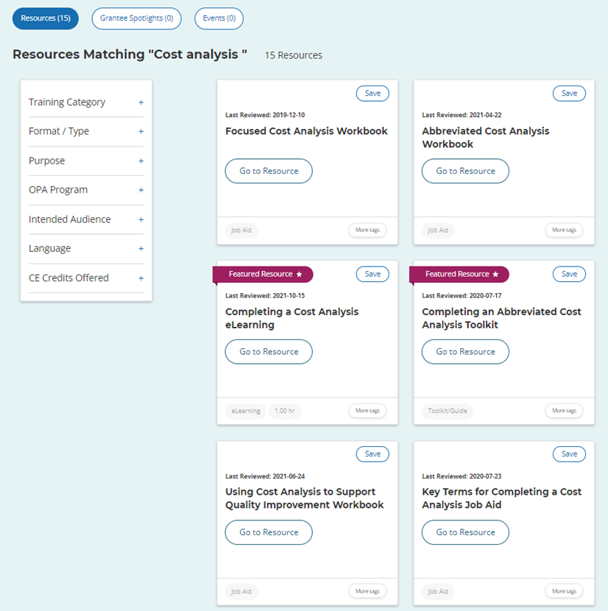
Cost Analysis Tools
Notes:
Facilitator Notes
The Family Planning National Training Center has many cost analysis resources to support you in meeting this requirement.
There are 15 resources available when you search for “cost analysis.” The cost analysis eLearning course is a great place to start if you are new to this topic.

Slide 20
Strategies for Front-End Procedures
Scheduling process
  Communicate policies with client
Front-end processes
  Gather accurate client information
    Demographic information
    Insurance coverage
    Electronic verification system (EVS)
    Family size and income
  Authorization process
Notes:
Facilitator Notes
During the scheduling process, communicate to your clients what your agency’s policies are on: payment at time of visit, bringing insurance card to visit, which payment methods are accepted, proof of income needed at time of visit, past due balances, etc. While it is important to have and communicate policies on proof of income to clients, remember: a client’s inability to prove income should not be a barrier to receiving services.
Other front-end processes to focus on include: gathering accurate client information (demographic information, insurance coverage, etc.) and authorization process for any services that require prior-authorization by TPPs
While these strategies are important, remember family planning services should be provided regardless of a client's ability to pay.

Slide 21
Strategies for Providing Training
Provide training to clinical team on documentation and coding
Provide training to front desk staff on front-end policies and procedures
Observe your team
Monitor team performance
  Performance indicators
  Chart audits
Notes:
Facilitator Notes
Training is needed to ensure accurate implementation of policies and procedures. Observe staff and provide feedback. Bad habits can develop, so consider doing this periodically.
Training can include focusing efforts on documentation and coding with your clinical team.
Training can also support front desk staff to implement your agency’s policies and procedures accurately.
Often, policy and procedure books are handed out for review. Certain elements may be missed or misinterpreted. As a suggestion, review policies and procedures in person and allow for dialogue/questions with staff. One strategy to utilize in training staff is observation. Do staff behaviors or actions match your agency’s policies? You can use observation and monitoring of indicators as a way to identify when more training is necessary.
Discuss
How often are your agency’s policies reviewed/updated?
When and how are new staff trained on the policies?
When and how are staff notified of changes to the policies? Are there opportunities for staff to discuss these changes?
Is there a mechanism in place for staff to provide feedback on the policies and procedures? If there are barriers or challenges related to implementing a policy or procedure, how is management informed?

Slide 22
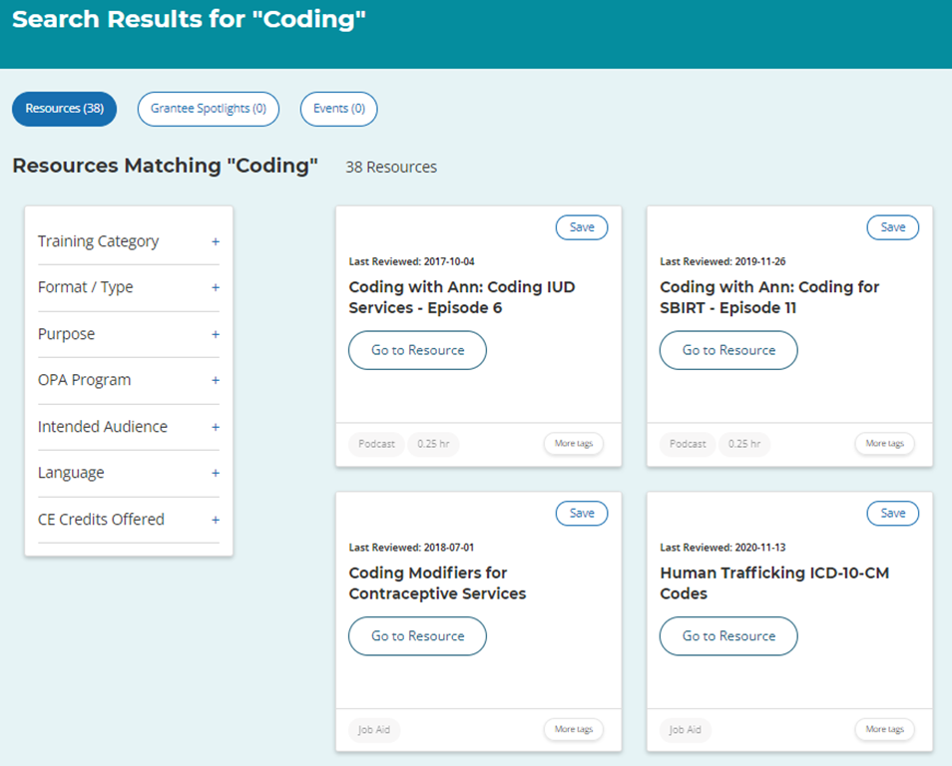
Coding Tools
NFPRHA Revenue Cycle Management Resources
Notes:
Facilitator Notes
The Family Planning National Training Center has over 38 resources to support your coding and documentation. The three-part Coding in the Reproductive Health Care Environment module is a great place to start!
The National Family Planning & Reproductive Health Association has several resources that also support coding and documentation. These revenue cycle management and coding-specific resources are restricted to NFPRHA dues-paying members and require a log-in.

Slide 23
Case Scenario
As you gather information for FPAR, you note 91% of your clients are in the full (100%) discount category. Your grantee shares that the average percentage for other sites in the network is 74%. While some differences among sites are to be expected in this metric, you are concerned that there may be an issue with information gathering at your front desk (based on this information).
What do you do?
Notes:
Facilitator Notes
Let’s work through a scenario together. I’m going to read aloud what’s on the screen, and then let’s have a discussion.
Discuss
What is a small change you can make, and how can you measure improvement?
Suggestions/Potential Answers
Observe front-desk staff performing family size and income information gathering during the registration process.
Ask front-desk staff specific questions about how they handle the income information gathering, such as questions they ask clients at scheduling and at check-in.
Review/update family size and income-gathering tool.
Review/update your agency’s policy on income-gathering procedures.
Share data with staff and involve them in identifying issues and potential solutions.
Train and observe staff implementing updated policies and procedures.
Measure number and percentage of clients and/or visits in each discount category monthly to monitor. Share this information with staff.

Slide 24
Success Story
The Florida Department of Health, a Title X grantee, wanted to focus on the process of enrolling clients in their Medicaid waiver program as staff determined 46% of prior applications across the state were either denied and/or had errors.
Actions Taken:
Grantee staff focused on the application process with one site in their network
They analyzed the application error data to identify reasons for errors
Based on the error types, they developed a detailed process and flow chart for application completion, and shared with the site
The grantee incorporated site feedback
Training on the tools was conducted
Notes:
Facilitator Notes
Now let’s look at a success story from the field. We know it can be valuable to see how other Title X sites are implementing these best practice recommendations.
I’m going to read the scenario/success story on the slide and walk you through each action taken:
Grantee staff focused on the application process with one site in its network
Specifically, grantee staff set a goal of increasing the number of clients in their Medicaid waiver program by 4%
They analyzed the application error data to identify reasons for errors
Based on the error types of errors they identified, they developed a detailed process and flow chart for application completion, and shared it with the site
The grantee incorporated site feedback
Training on the tools was conducted statewide, regionally, and individually at sites

Slide 25
Success Story (cont.)
Results:
At the end of the QI initiative, the Medicaid application approvals increased by 10%. Statewide error rates decreased by 38%.
Key points/lessons learned:
Small changes can make a big impact
Observation and communication are key—disseminating a policy alone likely won’t have the impact you want
You don’t always have the answer—involve staff involved in the process
Notes:
Facilitator Notes
Now let’s talk about the results:
At the end of the QI initiative, the Medicaid application approvals increased by 10%. Statewide error rates decreased by 38%.
The key points and lessons learned may be familiar to you:
Small changes can make a big impact
Observation and communication are key—just disseminating a policy likely won’t have the impact you want
You don’t always have the answer—involve staff involved in the process
Periodic retraining (to accommodate turnover, to maintain results) became an important part of the plan
Discuss (if time allows)
What actions jump out at you?
What actions could you take at your site (or agency)?

Slide 26
What other questions do you have?
What other issues would you like to discuss?
Notes:
Discuss (if time allows)
What other questions do you have for each other before we end? Are there other issues or challenges that we haven’t discussed yet? (Note to facilitators: If challenges came up in earlier discussions, this could be a good time to discuss them.)
Before we leave, what is one thing you will take away from today’s discussion? (Note to facilitators: Consider round robin sharing or ask a couple of participants to share.)

Slide 27
Thank you!
Contact:
fpntc@jsi.com
Notes:
Facilitator Notes
Thank you for participating in today’s discussion!
If applicable, you can contact me at:_________
You can also always contact the Family Planning National Training Center (fpntc@jsi.com) with questions/comments.

