Slide 1
Contraceptive Performance Measures: Striving for Patient-Centered Contraceptive Access
May 6, 2020

Slide 2



Meet our speaker!
Christine Dehlendorf, MD MAS
Professor, Vice Chair for Research, Family & Community Medicine
Director, Person-Centered Reproductive Health Program
Departments of Family & Community Medicine, Obstetrics, Gynecology & Reproductive Sciences, and Epidemiology & Biostatistics
University of California, San Francisco
Notes:
Dr. Christine Dehlendorf is a family physician with advanced training in family planning and a master's degree in clinical research.
She is the director of the Person-Centered Reproductive Health Program at the University of California San Francisco, which develops, evaluates, and disseminates interventions to meet women's reproductive needs and preferences and conducts research to better understand women's contraceptive experiences, social communication about contraception, and disparity in contraceptive use and counseling.
Dr. Dehlendorf is the vice chair for research in the Department of Family Community Medicine at UCLA.

Slide 3
Why Performance Measures Matter
Performance measures provide a consistent and accountable approach to assess the delivery of healthcare against recognized standards. They can be used to:
Drive improvement – So providers and health systems can make adjustments in care, share successes, and probe for causes when progress comes up short.
Inform consumers – Who can make choices, ask questions, and advocate for high quality health care.
Drive payment – So payers can use them as preconditions for payment and targets for bonuses.
Performance measurement is a central component of health care reform.
Notes:
What do performance measures do for us in the healthcare system?
to identify gaps in quality that can allow us to do a better job of providing quality healthcare.
to inform consumers so that consumers can make informed choices about where they get their healthcare.
for payment decisions in terms of incentivizing quality care.
When talking about quality measurement and quality improvement in the United States, it is important to acknowledge that this is a relatively new effort – with the use of standardized metrics to assess the quality of care really starting in 1998.
Since then there has been a rapid increase in interest in this area and the number of measures that are endorsed and used. The goals of performance measurement are multifaceted, and include informing quality improvement, including pay for performance, accreditation standards, and public reporting.
The Affordable Care Act furthered this trend, with an emphasis on quality improvement and pay-for-performance approaches to incentivizing quality using these measures.
The effort to improve quality measurement over the past two decades started with hospital based initiatives, and only more recently has expanded out to include outpatient settings, including metrics related to blood pressure and diabetes control.
These ambulatory measures have been largely focused on chronic disease, and importantly have not focused on women’s health and family planning specifically.

Slide 4
Quality Improvement in Family Planning
Until 2016, no performance measures for family planning endorsed by relevant entities
Desire to develop and validate family planning measures for endorsement in order to:
  To identify gaps in quality
  To motivate quality improvement
  To ensure family planning is prioritized in changed health care system
Notes:
The relatively recent movement into the outpatient setting means that there hasn't been a lot of development of performance measures related to non-chronic care conditions, and that includes family planning.
What we saw in early 2010 is that there was no performance metric at all related to family planning.
This led to interest among multiple working groups of trying to develop these types of metrics for family planning based on a desire to both identify gaps in quality to drive improvement, but also based on the recognition that what gets measured gets done.
If we don't have a metric to talk about family planning, then we're going to be deprioritize an evolving healthcare system that is paying attention to the things that have quality metrics associated with them.

Slide 5
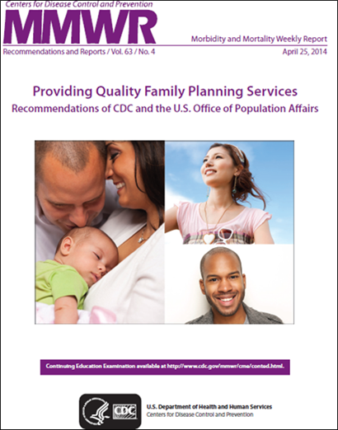
What is Quality in Family Planning: Recommendations from CDC and OPA
Women who wish to delay or prevent pregnancy should have access to a broad range of contraceptive methods, preferably on a same-day, on-site basis.
It is important that contraceptive services are provided in a patient-centered manner, providing accurate, easy-to-understand information based on the needs and goals identified by the client and reflecting the client’s preferences and values.
Notes:
To develop metrics in family planning, we need to think about:
What is quality?
What should we be measuring to be able to do a good job of developing performance metrics?
To define quality, we have can look of course to the quality in family planning guidelines developed by the CDC and OPA, which I'm sure you are all very familiar with.
There are two aspects of quality that rise to the surface:
Having access to a broad range of contraceptive methods, preferably on a same day basis, and
Providing contraceptive services in a patient-centered manner.

Slide 6
Contraceptive Care Measures Using Claims Data
In 2016, NQF endorsed new measures:
Measures for all women:
  The percentage of women aged 15-44 years at risk of unintended pregnancy that is provided a most effective or moderately effective (MME) contraceptive method
  The percentage of women aged 15-44 years at risk of unintended pregnancy that is provided a long-acting reversible contraceptive (LARC) method
Measures for postpartum women:
  Among women aged 15-44 years who had a live birth, the percentage that is provided a MME contraceptive method within 3 and 60 days of delivery
  Among women aged 15-44 years who had a live birth, the percentage that is provided a LARC method within 3 and 60 days of delivery
Notes:
The first performance metrics:
efforts in family planning focused on that first bullet, working to incentivize
measure gaps in quality
providing access to methods
incentivize clinics to do a better job of providing the access to methods
The group of people, including CDC, OPA, Planned Parenthood and other stakeholders worked together to define and validate a measure looking at contraceptive provision on a facility and health system level.
These measures were endorsed by NQF, found to be reliable and valid.
It's defined as three different measures, but it's actually four bullet points.
Measures for all women, which are women aged 15 to 44 that are provided most or moderately effective contraceptive methods, is the percentage of all women who receive a long-acting reversible contraceptive method. This is measured in a calendar year. There are equivalent measures in the postpartum context.

Slide 7
Public Comments During NQF Process
“The National Partnership for Women & Families strongly supports the committee’s recommendation to endorse this measure….It is extremely important to keep in mind that reproductive coercion has a troubling history, and remains an ongoing reality for many, including low-income women, women of color, young women, immigrant women, LGBT people, and incarcerated women. We hope this measure will be paired with a woman-reported “balancing measure” of experience of receiving contraceptive care. Such a measure can be expected to help identify and/or check inappropriate pressure from the health care system.“
National Partnership for Women & Families
Notes:
When these measures were being evaluated by NQF, there's always a public comment process.
NQF is a National Quality Forum that serves as the good housekeeping seal of approval for performance metrics that then allows these measures to be used in a range of quality improvement reporting processes.
During the public comment period for the National Quality Forum consideration of these measures, there was concern expressed about the fact that these measures focused on most or moderately effective methods or LARC methods alone.
The concern was that this could incentivize non patient-centered care and work against the bullets, the second bullet that I listed from QFP and negatively impacts the patient-centeredness of care that was provided.

Slide 8
Public Comments During NQF Process (2)
“The National Partnership for Women & Families strongly supports the committee’s recommendation to endorse this measure….It is extremely important to keep in mind that reproductive coercion has a troubling history, and remains an ongoing reality for many, including low-income women, women of color, young women, immigrant women, LGBT people, and incarcerated women. We hope this measure will be paired with a woman-reported “balancing measure” of experience of receiving contraceptive care. Such a measure can be expected to help identify and/or check inappropriate pressure from the health care system.“
National Partnership for Women & Families
Notes:
This perspective was summed up very well by one of the comments that was submitted during this process.
It says, while the National Partnership for Women & Families strongly supports the recommendations to endorse this measure, it's extremely important to keep in mind that reproductive coercion has a troubling history and remains an ongoing reality for many including low income women, women of color, young women, immigrant women, LGBT people, and incarcerated women. We hope this measure will be paired with a woman reported balancing measure of experience of receiving contraceptive care.
Such a measure can be expected to help identify and/or check inappropriate pressure from the healthcare system.
The National Partnership for Women & Families
https://www.nationalpartnership.org/about-us/

Slide 9
Quality, and Quality Improvement, is Complicated
Performance measures are blunt tools that can incentivize non-patient centered care
  Transferring patients for non-compliance
  Testing for Chlamydia without consent
Provision measures can promote access, but have potential to incentivize directive or coercive counseling
Quality is multi-dimensional, and one measure cannot capture all aspects
Baker, Ann Int Med, 2011
Casalino, NEJM, 1999
McDonald, Ann Fam Med, 2009
Notes:
In thinking about the potential for negative unintentional consequences of the NQF endorsed measures looking at methods provision, it's important to recognize that this is not a problem that is unique to contraception.
Performance measures universally are blunt tools that have been documented to in some cases incentivize or to have adverse outcome on other aspects of quality and what they are directly measuring.
On this slide, I give you two examples of studies that have looked at this, including one study that showed that patients were forcibly transferred out of practices if they were noncompliant to facilitate high scores on specific metrics related to, for example, hypertension or diabetes.
Another study that found that women were being tested for chlamydia without consent in order to meet chlamydia testing metrics.
It's important to recognize that the measures that were endorsed by the National Quality Forum in 2016 have the potential to promote access, which is their goal, to make sure that women have access to highly effective and moderately effective contraceptive methods.
They do have the potential to incentivize counseling towards those methods in a way that deprioritize women's own values and preferences, especially if those values or preferences are for a method that does not fall into the highly or moderately effective category like condoms or fertility awareness based methods.
Then the last point on this slide is just to recognize that this is not a surprise, we know that quality is multidimensional.
Anytime we try to boil quality down to one measure, it's going to be complicated and we're going to have to think about the consequences of that and think about if there are other measures that can be used to allow us to do a better job of incentivizing the care that we want to provide.

Slide 10
Patient-centered contraceptive counseling as a quality indicator in its own right
“Patient-centered care is care that is respectful of and responsive to individual patient preferences, needs, and values.” - Institute of Medicine
Recognized by IOM as a dimension of quality
Associated with improved outcomes
Communication is a core component of patient-centered care
Notes:
It's also important to recognize though while the comments I read from the NQF process focused on a Patient-Reported Outcome Measure of contraceptive counseling as a response to the potential for the method based measures, the measures based on whether women receive the highly or moderately effective method.
In fact, it's important to recognize that this is an aspect of patient-centered care and whether people are getting care that meets their needs.
It's not just something that matters because we're worried about it in the context of these other performance measures, but it's something that we care about in its own rights as an ethical mandate of the healthcare system regardless of these other measures and their potential impacts.
This was something that has been again, increasingly recognized, the importance of patient-centered care in the past two decades.
It was catalyzed by a 2001 Institute of Medicine report called Crossing the Quality Chasm where they defined patient-centeredness as one of the core dimensions of quality care.
It’s also important to recognize that patient-centeredness is actually associated with improved outcomes on the things that we care about as a clinical system.
An example I often use is diabetes, in that when we just try to push insulin on people and they don't want to be taking insulin for various reasons and we don't hear them, then they end up having higher hemoglobin A1Cs because they don't use their insulin the way that we would like them to. But if we listen to them and if we talk to them and address their concerns related to pill burden or pain with injections or whatever it might be, then we develop a better therapeutic relationship that allows them to meet their needs and have lower hemoglobin A1C at the same time.
In general, in terms of patient-centered care, it's important to recognize that communication is central to being able to provide patient-centered care. That is because we need to be able to communicate with patients in order to elicit their values and preferences.
We need to have quality communication to allow us to respond to those preferences and integrate those preferences with what we know about the evidence related to the care that we are providing.

Slide 11
  “Client-centered contraceptive care is defined as providing care that treats each person as a unique individual with respect, empathy, and understanding, providing accurate, easy-to-understand information based on the client’s needs and goals, and reflecting the client’s preference for decision making.”
  - Dehlendorf et al., Curr Obstet Gynecol Rep, 2016
Notes:
The quality in family planning guidelines give a general definition of how we think about patient or client centered contraceptive care.
We expanded on this in our team at the Person-Centered Reproductive Health Program a few years ago in a publication in the current obstetrics and gynecology reports. This is a foundation for the conversation about client-centeredness or patient-centeredness and contraceptive care.
We defined it as providing care that treats each person as a unique individual with respect, empathy, and understanding, providing accurate, easy to understand information based on the client's needs and goals and reflecting the client's preferences for decision making.

Slide 12
Need for Attention to Patient-Centered Contraceptive Care
Communication and patient-centeredness receive lower ratings than other aspects of family planning quality
In study in which 342 contraceptive counseling visits were audio-recorded, patient preferences for contraceptive methods were elicited in less than 50% of visits
Recent experience of patients experiencing resistance to removal of IUDs and implants by providers
Becker, PSRH, 2007
Amico, Contraception, 2016
Notes:
What do we know about patient or client-centeredness in contraceptive care? Is there a gap in quality? Is this something we need to be worried about? It's always the question when you're thinking about performance measurement and performance improvement.
The literature that's available on this subject suggests that there is a lot of room for improvement in the patient-centeredness of the care that we provide.
Systematic reviews and survey studies have found that communication in general and patient-centeredness specifically receive the lower ratings than other aspects of family planning quality.
If you survey people on quality, like access to care, cleanliness, the range of different things that have been measured with respect to family planning quality, communication and patient-centeredness are the things with the most need for improvement.
In addition, in a study that we did here in the San Francisco Bay Area, we audio-recorded contraceptive counseling visits because it's often hard to know what's happening if you're not actually in the room.
It obviously changes things if you're in the room. We wanted to do the best that we could to understand what was actually happening during contraceptive counseling visits.
What we've found is that patient preferences were infrequently elicited. Patient preferences related to what methods they wanted to use, how they felt about method characteristics. They were elicited in less than 50% of visits.
I know many of these providers that were involved in this study, and there are many, or I would say all of them are wonderful providers that are motivated by all the things that we all are motivated by about meeting people's needs, about taking care of women, about reproductive autonomy. Yet, this was still the case.
I think this reflects a number of different issues including time pressure and training. There is a gap in quality here that is not related to people's motivation to provide a good job but a lack of attention in the healthcare system to patient-centeredness as an end in and of itself.
This study that we did was in 2008 to 2010. Since that time, we've actually seen some concerning shifts in the healthcare system that I'm sure you are all aware of related to a shift towards and enthusiasm for IUD and implants to the point where that leap can potentially lead to enthusiasm for those methods eclipsing a focus on patient preferences.
This is not just a theoretical concern. The literature has borne this out, as done studies that have documented that women are experiencing this enthusiasm that many of us have for these very highly effective methods that I always say I'm a big fan of.
It's not that I don't think they are great methods, I just don't think they're the best methods for everyone.

Slide 13
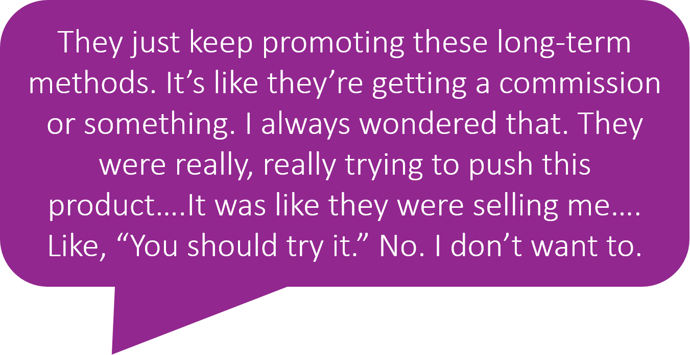
What this literature is telling us
Mann, Contraception, 2019
Notes:
To give you an example of some of the literature about this, this is from a study in South Carolina in the context of a peri-partum, immediate postpartum LARC initiative that was happening there.
This was a qualitative study interviewing women who had gotten LARCs in that context, IUD specifically immediately after delivery.
This woman said, “They just keep promoting these long-term methods, it's like they're getting a commission or something. I always wonder that, they were trying to push this product. It was like they were selling me like, you should try it. No, I don't want to.”
This provider was likely motivated by a desire to make sure this woman knew about her option for a highly effective method of contraception.
The way that the woman experienced it was that she was having something sold to her that she didn't want to have and that negatively impacted her experience both immediately, and I would argue also potentially in the long term her trust in reproductive health providers.

Slide 14
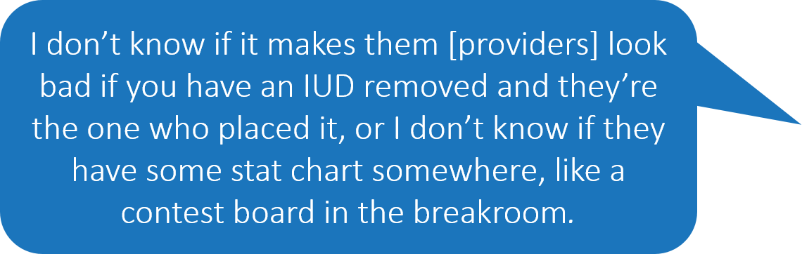
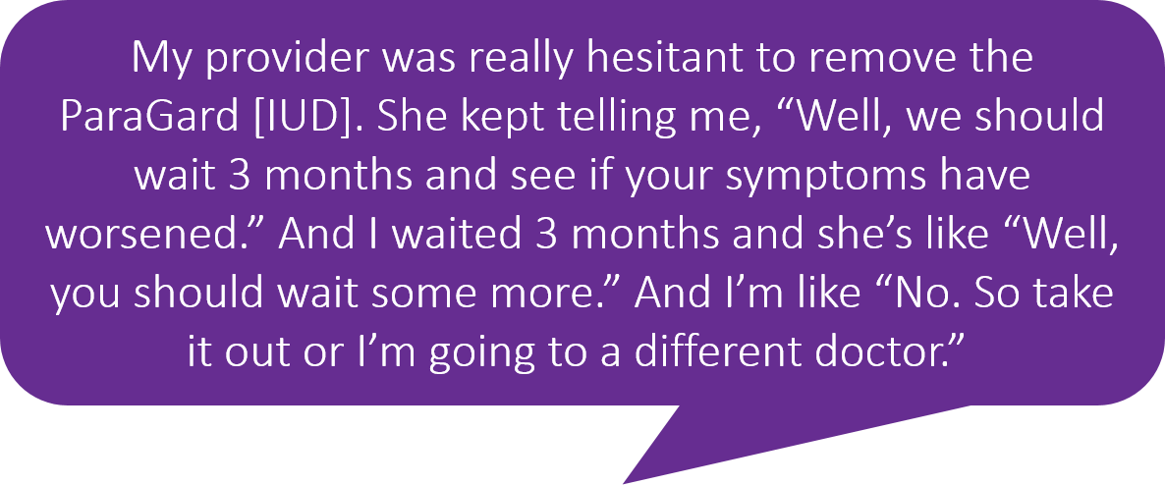
What this literature is telling us – cont’d
Becker, PSRSH, 2007
Dehlendorf, PSRH, 2014
Dehlendorf, Women’s Health Issues, 2017
Higgins, AJPH, 2016
Notes:
We've similarly seen this not just around IUD and implant provision, but also around removal of these methods. The enthusiasm for these methods has led providers to place barriers to removal of these methods, not because providers are motivated by malice, but because they're enthusiastic about this method that they don't understand or can't understand why someone would want to have it removed and have a difficult time honoring patients' desire for removal.
There have been a couple of studies on this. This is one that said, “My provider was really hesitant to remove the Paragard IUD. She kept telling me we should wait three months and see if your symptoms have worsened. I waited three months, and she's like, ‘Well you should wait some more.’ I'm like, ‘No, so take it out or I'm going to a different doctor.’“
Another woman said, "I don't know if it makes them providers look bad if you have an IUD removed and they're the one who placed it or I don't know if they have some stat charts somewhere like a contest board in the break room."
What these quotes in the qualitative studies they represent tell us is that in addition to just in general that there is a concern around patient-centeredness and the care that's being provided in the family planning context that this recently with the enthusiasm for IUDs and implants, there is added reason that we should be paying attention to this.

Slide 15
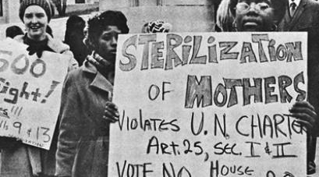

Context of Reproductive Injustices
Nonconsensual sterilization of poor women and women of color
Targeted marking of DMPA
Unethical testing of oral contraceptive pills in Puerto Rico
150 incarcerated women in California coercively sterilized from 2006-2010
Notes:
It is particularly important to pay attention to patient-centeredness and contraception because:
Contraceptive choice is a very personal, sensitive thing that has to do with fertility and sexuality and relationships and our bodies.
Non-patient-centered care has the potential to specifically impact populations that have been subject to reproductive coercion in the family planning setting in the past.
We all know that there is a history of family planning providers being complicit with reproductive injustices and reproductive oppression. This includes things like the non-consensual sterilization of poor women and women of color throughout the 1900s. This was particularly my state of California, was a particularly bad actor in that context. We also saw it in the 1990s with targeted marketing of Depo-Provera to urban black women.
We also saw it with the pill. When the pill was being developed, it was tested in Puerto Rico without women's knowledge or consent.
The systematic reproductive oppression is something that is still an issue today. Even in the past decade, it happened in California with women in the penal system being coercively sterilized.

Slide 16
And It Is Not Just History….
Low-income women of color more likely to report being advised to limit their childbearing and more likely to have IUDs recommended than White women
Black clients more likely than White clients to report having been pressured by a clinician to use contraception
In a survey of Black women, 28% reported being pressured to start one type of method when they preferred another
Dehlendorf: AJOG, 2010
Downing: Am J Public Health, 2007
Becker: Perspect Sex Reprod Health, 2008
Thorburn: Women Health, 2005
Notes:
Institutionalized reproductive oppression, more subtle forms of reproductive oppression specifically targeting women of color, is not just in the distant past.
We've seen this in research that's been done that has included research that's found that low income women of color are more likely to report being advised to limit their childbearing than are white women.
In another study we did, again out of our group using standardized patients and completely controlling for any potential variables that could influence provider recommendations, we found that black and Latino women were more likely to have the IUD recommended by clinicians than were white women.
Other studies have found that black clients are more likely than white clients to report being pressured to use contraception.
A study of 500 black women found that over a quarter of them reported being pressured to start one method when they preferred another.
I think we can all agree that anyone feeling that they're being pressured to use a method is not a positive patient-centered outcome.

Slide 17
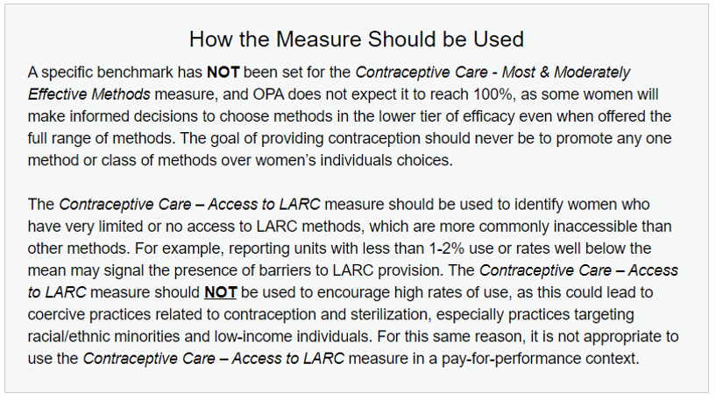
OPA’s Response
Office of Population Affairs – Performance Measures
Notes:
The Office of Population Affairs (OPA) is the steward for the currently endorsed NQF measures focused on whether or not someone receives a highly or moderately effective method, or whether they receive a LARC method. In their process of getting these measures endorsed by the National Quality Forum, OPA heard these concerns and recognized them. As a result, they provided explicit guidance about how these measures should be used as one attempt to mitigate any potential impact on non-patient-centered care.
This is from their website. For example, what they say is that for the most and moderately effective method measure, they do not expect it to reach 100%, as some women will make informed decisions to choose methods in the lower tier even if they are offered access to the methods.
Again, the goal of this measure is to make sure people are offered access to the full range of methods.
They're saying don't expect to reach a hundred, and reaching a hundred may not be a good thing.
In addition, in the access to LARC measure, they've made it very clear that this was an access measure, this was not a more is better measure.
Most measures in performance measurement are always more is better, more vaccinations against flu is better, more people reaching your hemoglobin A1C target is better.
They made it very clear that that was not the case with the LARC measure. They wanted to use it as what's called a floor measure, and that at least there was some provision of LARC that individual facilities or health systems would report.
They also said at the bottom that it's very important that the LARC measure not be measured in a pay-for-performance context.

Slide 18
The Person-Centered Contraceptive Counseling Measure (PCCC)
The Person-Centered Reproductive Health Program (PCRHP) at UCSF developed and validated a four-item measure designed to capture patient experience of contraceptive counseling
Goal of the measure: Evaluate patients’ experience of contraceptive counseling at provider and facility level
The measure is designed to be applicable regardless of patients’ specific history, contraceptive preferences or needs
Dehlendorf et al; Women's preferences for contraceptive counseling and decision making. Contraception, 2013
Notes:
In addition to providing this guidance designed to mitigate the impact on patient-centered care and counseling, they also recognized that having a patient-reported measure that measured itself the patient-centeredness of counseling would be valuable in the same way that I mentioned the NQF comment period elicited that request to have a patient-reported measure.
In response to that, they funded us at the Person-Centered Reproductive Health Program to develop and validate a measure and submit this NQF.
Our funding was ended in 2017 two years early from that, but we have continued to work with OPA on this measure and have received private foundation funding to continue this work.
The goal of our measure is to evaluate patients' experience of contraceptive counseling at the provider and the facility level.
One of the things that we wanted to focus on in validating this measure is to make it specific to the contraceptive context but also universal with respect to what women want.
We didn't want it to be a measure that was only right for women who had already had babies, or for women who already have had a lot of counseling in the past, or for women who had never had counseling before; but, to find questions that captured a measure that represented quality care regardless of a patient's specific history, contraceptive preferences or needs.

Slide 19
Initial 11 Item Scale
Construct validity – associated with:
  Global visit satisfaction (100% vs. 51%)
  Satisfaction with process of method selection (77% vs. 30%)
Convergent validity – associated with audio recording derived measures of patient centered care
Predictive validity – associated with contraceptive continuation and use of an effective method
Discriminant validity – not associated with minutes in counseling
Dehlendorf, Contraception, 2018
Notes:
To develop this measure, we started with an 11-item scale that we had previously developed for the purpose of research drawing on patient-centered scales and other medical conditions and the broader literature on patient-centered communication.
We had found it had what's called construct validity, that it was aligned with other measures of patient experience that we found.
We compared it to the actual audio recording of contraceptive counseling visits and patient-centered communication that we could objectively measure in that context and found it to be associated with those audio recording derive measures.
We also found that it was associated with contraceptive continuation and use of an effective method. Importantly, it was not associated with the minutes spent with counseling.
It wasn't something that was about it just provides more counseling meant that you would get a higher score. It's about the quality of the counseling that it provided and whether it meets that specific patient's needs.

Slide 20
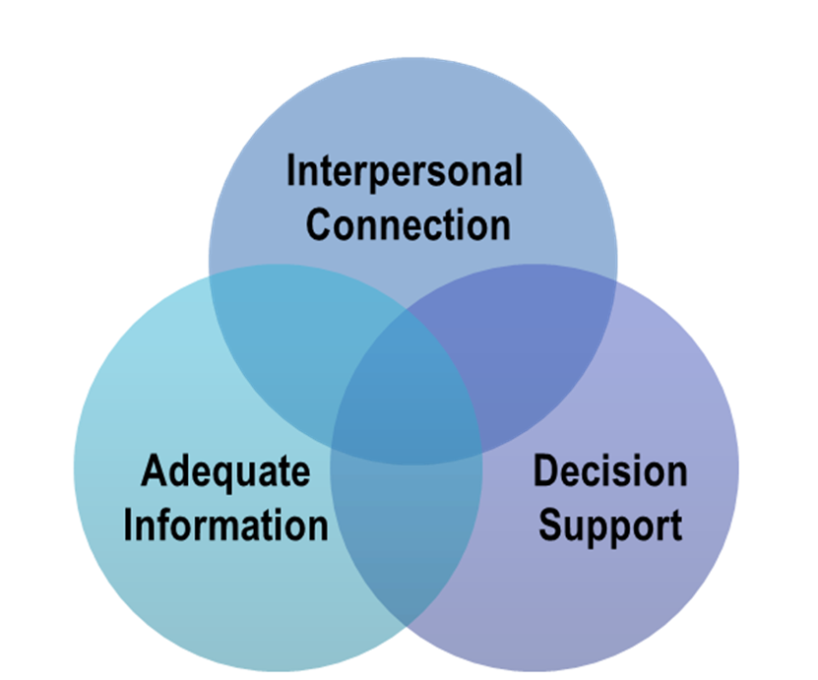
Domains of Patient Experience of Counseling
Dehlendorf, Contraception, 2013
Notes:
We wanted to reduce this scale down from 11 items, which felt too long for the purpose of performance measurements. In doing so, we wanted to pay attention specifically to the domains of counseling that we had found to be important to patients in qualitative work that our team had done previously.
These three domains that we had found to be important are on this slide:
interpersonal connection,
adequate information, and
decision support
Interpersonal connection is something people felt is sensitive to talk about.
Being able to make sure that people feel comfortable with disclosing personal details was important. Then decision support, women wanted to feel like they were getting engagement from their provider while they ultimately wanted to be able to make the decisions on their own.

Slide 21
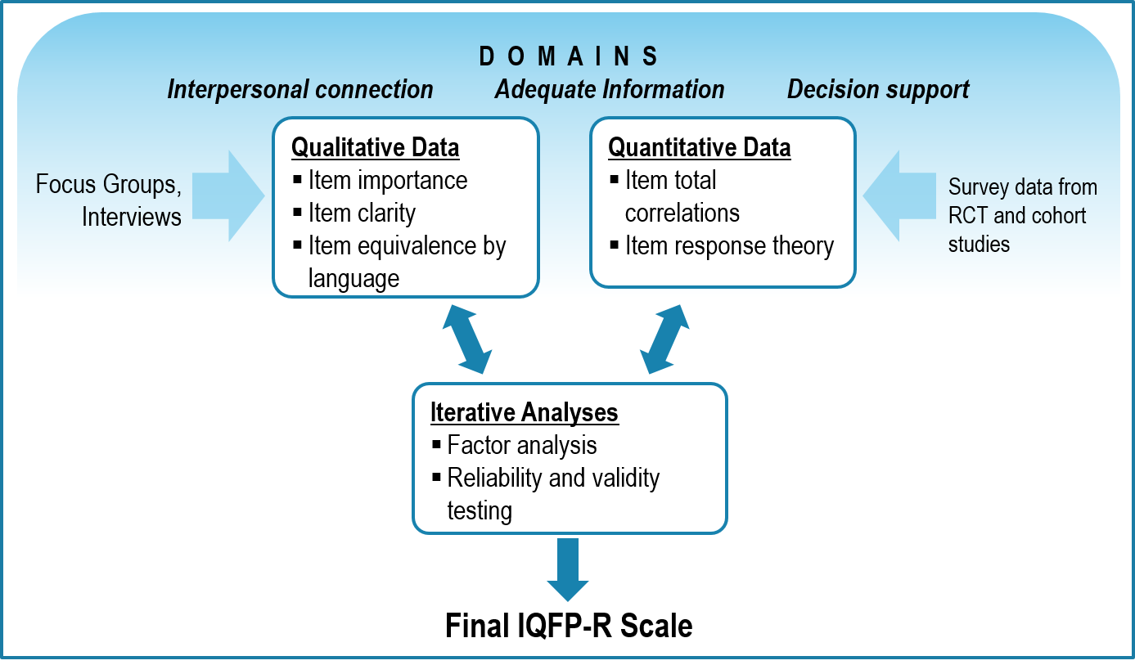
IQFP Item Reduction Process
Notes:
To define a smaller set of questions from the original 11-item scale, we did an iterative process where we made sure that all the three domains were represented in the final measure.
Then, we used qualitative and quantitative data to triangulate which specific items were both most important and clear for patients and retained the validity and reliability of the original 11-item scale.

Slide 22
Measure Refinement
Combined qualitative and quantitative data regarding patient experience to reduce items from 21 to 4
Final measure had the following characteristics:
  Equivalent meaning in English and Spanish
  Meaningful to patients
  Associated with objective patient-centered counseling behaviors, as determined by audio recordings
  Associated with contraceptive continuation
Notes:
In that process, we came up with a four-item measure. This measure, the final measure had equivalent meaning in English and Spanish because we hadn't tested that in our qualitative work with women.
We found that these were the four items that were most meaningful to patients in terms of what they wanted out of contraceptive counseling and was associated with these audio-recorded objective measurements of patient-centered contraceptive counseling. Importantly, it was also associated with contraceptive continuation.
It retained that predictive validity that we had found previously.

Slide 23
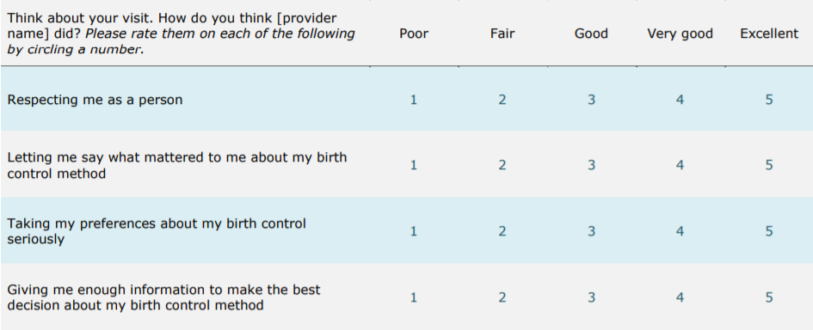
The Person-Centered
Contraceptive Counseling
Survey (PCCC)
Notes:
This is the survey that we ended with. As you can see, it says:
Think about your visit today--this is a visit specific measure.
How do you think your provider did it?
Respecting me as a person
Letting me say what mattered to me about my birth control method
Taking my preferences about my birth control seriously, and
Giving me enough information to make the best decision about my birth control methods.
This is giving me enough information.
It's important to recognize that will vary by people--what is enough information for an individual person. This is about whether that individual got enough information not some universal standard for what enough information is.
Not surprisingly, respecting me as a person was far and away the most important thing that we heard from patients--the thing that they both felt was most important and that they felt was often lacking.

Slide 24
PCCC Use and Interpretation as a Performance Measure
Patients who are identified as having received contraceptive counseling respond on the day of their visit
Survey can be distributed by paper or in an electronic format (tablet or kiosk)
Responses are collected and recorded anonymously (either mail, online submission, or secure box)
Responses are aggregated and reported as a percentage of patients who gave ‘top-box’ score at the provider or facility level
Notes:
How is this survey designed to be used as a performance measure specifically?
It was collected the day of the visit by patients who had been identified as having received contraceptive counseling.
We validated it using both paper or electronic format. You can use a tablet or a kiosk to collect the data.
The data is collected anonymously.
The responses are then aggregated and reported on a provider and a facility level as the percentage of patients who gave what's called a top-box score.
This is the same strategy that's used for the cap survey, which is the most well-known patient-reported outcome performance measure (PROPM). It's endorsed by NQF and is often used to measure client or patient experience.
They also use this top-box approach.
What this top box means is that a patient will have a positive finding, a positive score if they give five on this scale across the board; and, they will have a non-positive score if they give anything less than five on any of these four items.
There's a concern that this was too high a standard to hold providers to because you have to be perfect. In fact, that's not the case. The reason for that is that we know that there's social desirability bias and that it's very hard to get patients to express dissatisfaction with providers.
That is true across the board regardless of context. That therefore any expression of something less than excellent is a meaningful gap in quality.

Slide 25
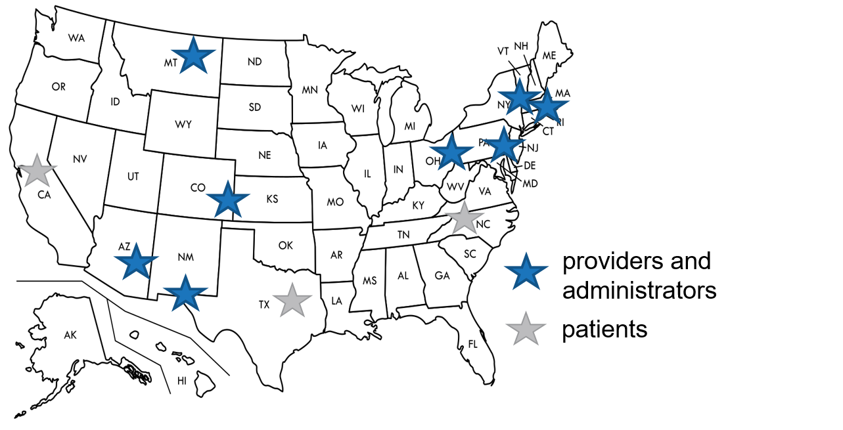
Validity and Reliability of PCCC
Face validity testing conducted with patients, providers, and clinic administrators across the country

Slide 26
PCCC Face Validity Testing
Interviews and Focus Groups with patients (n=43)
Participants recently experienced contraceptive counseling (Texas, North Carolina, and California)
88% of patients reported that a facility or provider having a higher score on the performance measure would make them more likely to choose that facility or provider for their care
Patients responded to the measure in an equivalent fashion in both paper and electronic versions
Notes:
To test the validity and reliability of this measure, this new patient-centered counseling scale, the PCCC as we call it, we did first a base validity testing with patient providers and clinic administrators across the country.
Recognizing that San Francisco and the Bay Area is not the rest of the country, we wanted to make sure that we gained information from a wider swath of the community. So, we did base validity testing with interviews and focus groups with patients in Texas, North Carolina, and California.
We found that the vast majority of patients felt that this was a meaningful measure that would help them to make decisions about their healthcare. Also, we compared the tablet versus the paper version and they felt that it was equivalent.

Slide 27
PCCC Face Validity Testing – cont’d
Providers and Administrators
Two Modified Delphi/consensus building processes with 14 administrators and 19 providers from facilities across the country
90% of providers and 92% of administrators indicated they would be likely to consider a provider receiving a higher score on this measure to be providing better care.
88% of providers and 93% of administrators agreed that reporting the percentage of responses that were top-box scores would be understandable as an indicator of performance and meaningful for quality improvement
Providers agreed that it is important to be clear that provider-level results reflect areas for growth and should be shared confidentially with supervisor
Notes:
In terms of providers and administrators, we did this using an online process called a modified Delphi process, which is consensus building.
We were able to have a broad representation from around the country from administrators and providers.
What we found using the Delphi process was that you were able to achieve a high level of consensus, which was the goal of the Delphi process?
We were able to achieve a high level of consensus that a high score on this represented better care and that it would be useful for them as an indicator of performance and meaningful for quality improvement.
We also found that providers felt that it was very important that their responses or their scores on the measure not be used in a punitive way and that it would be used as a opportunity for improvement and not for a negative performance review, for example.

Slide 28
PCCC Real-World Pilot Test 2018-2019
PCCC survey given to women at clinics across the country who received contraceptive counseling, were ages 15-44 and not pregnant (n=3,478)
Reliability analysis at facility-level and provider-level conducted for those with at least 25 patient response
Facilities included in facility-level analysis (n=22)
FQHCs (n=3)
Public health departments (n=8)
Family planning clinics (n=7)
University-based clinics (n=2)
OB/GYN clinic (n=1)
Non-FQHC primary care (n=1)
Providers included in provider-level analysis (n=34)
MD, NP, CNM, PA (n=15)
Nurse (n=3)
Non-licensed medical assistant, health educator, counselor (n=10)
Two-person team with one NP and one RN or medical assistant (n=6)
Notes:
Building on the base validity, we then did quantitative testing of the reliability and validity of this performance measure, working with clinics across the country again to do this.
As you can see, we also worked with a broad variety of types of facilities and types of providers recognizing that there is a broad range of contexts in which family planning care is provided in the united states. We include FQHCs, public health departments--the broad range.
We also worked with licensed providers, and we intentionally included non-licensed providers as those being assessed recognizing that in many contexts this is how contraceptive counseling is provided.
We also included dyads in cases where a medical assistant would hand off counseling, for example, to a nurse practitioner.

Slide 29
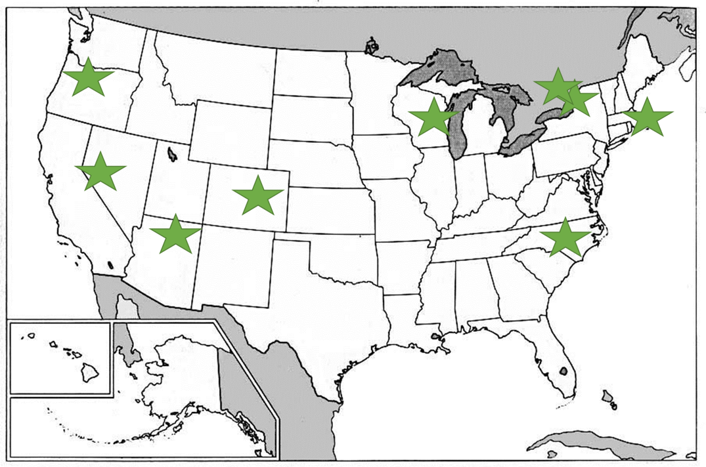
PCCC Real-World Pilot Test 2018-2019: Location of Clinical Partners
Notes:
These are the clinical partners we worked with from around the country.

Slide 30
PCCC Real-World Pilot: Results
PCCC measure was found to be reliable in distinguishing between providers and facilities without being influenced by random error with a panel size of:
  30 for providers
  50 for facilities
Provider-level analysis (n=34 providers and 2,477 patient responses)
  Mean score: 81% of patients gave top-box score
  Range: 44% to 95%
Facility-level analysis (n=22 facilities and 3,478 patient responses)
  Mean score: 79% of patients gave top-box score
  Range: 51% to 97%
Notes:
What did we find using these sites? What we found is that PCCC was reliable in distinguishing quality of care in a way that you could tell the signal above and beyond just from random noise.
Because that's always the concern with any quality metric is to what extent is there variability just because there's a broad range versus it's representing true differences in quality.
We found that with a panel size of 30 for providers and 50 for facilities, we were able to have adequate reliability to identify differences in quality.
In terms of the results that we got on the surveys, we found that using a provider level analysis on average, 81% of patients gave a top box score.
Going back to what I said about whether or not the top-box score was too rigorous, this 81% tells you the vast majority of patients gave their providers a top-box score, which indicates that it is not too high as standard.
In fact, as you can see here, some providers got as high as 95%.
Then on facility level analysis, we similarly saw 79% of patients gave a top box score and there was also a broad range from 51 to 97%.
Using these results, we have submitted to the National Quality Forum again in order to obtain the field approval from them with the hopes that this will be integrated into quality programs in the future.
This will be, for example, CMS or OPA could use these to drive quality improvement.
We submitted it in 2019, and in February, there was a vote by the NQF perinatal and women's health panel and they voted 18 to 1 to recommend the measure for endorsement.
In doing that, they both indicated that our statistical methods indicated this measure's reliability and validity as well as the fact that it represented an important area where we should be prioritizing our quality improvement.
I want to just pause for a moment and let you know that this is currently in the public comment period that I mentioned earlier.
Our measure is currently in that period pending. Then after the public comment period is over on May 24th, that will allow us to proceed to the next stage. I encourage you all to submit comments.
There's an NQF account that you have to create, but it's a relatively simple process. Then you go to the perinatal and women's health page.
I want to take a moment to talk about implementation of the measure because that is something that we've spent a lot of time talking about and thinking about, and I think is often a concern, especially for providers or for administrators.
As I said, there is the opportunity to implement the measure using either paper or electronic versions.
We are interested in the future of thinking about pushing this out, for example, on portal. We have not yet evaluated that modality.
We worked a lot with clinics around the country to understand their processes for implementing this as part of our pilot study.
We're able to understand certain approaches that could be used and implemented in multiple different settings to do this in a customized but yet overall standardized way.
For example, just to give you one way a clinic did it was they had chart flags that were placed by the provider who performed contraceptive counseling, which then at checkout led to the person doing checkout giving the survey to the patient.
In thinking about implementation and how to make it both customized and standardized, we defined three basic jobs that had to be done to be able to successfully implement this measure.
That was patient identification, a person has had contraceptive counseling; and then distributing the survey to that patient; and then data collection and management.

Slide 31
NQF Endorsement Process
Submitted to National Quality Forum (NQF) in 2019
  Primary organization that endorses measures that meet standards of validity, reliability, and that address a gap in care
  Once endorsed, measures can be used by healthcare systems and government agencies to publicly report and drive quality improvement (e.g. CMS, OPA)
NQF Perinatal and Women’s Health Panel voted 18-1 to recommend the measure for endorsement (Feb 2020) based on its reliability and validity, as well as the evidence for its contribution to the provision of high quality, patient-centered care
Notes:
Based on these results, we submitted the measure to NQF in 2019.
Received positive feedback both on the statistical findings of our reliability and validity testing, as well ask the need for our measure. This ultimately culminated in a vote for endorsement in February .

Slide 32
Public Comment Process
Open for public comment March 26 – May 24, 2020
To submit a comment:
  Create an NQF account
  Go to the Perinatal and Women’s Health page
  Click “May 24 COMMENT”

Slide 33

PCCC Real-world Pilot: Implementation
Clinics found implementation of paper and electronic (tablet) version of the survey to be feasible
Workflow was adapted to suit individual clinic needs.
  For example, several clinics implemented chart flags placed by providers to identify eligible patients. Staff distributed survey at check-out.
  At one site, implementation of survey helped establish patient check-out as important part of clinic flow
Notes:
In process analyses assessing implementation, we found that sites found the implementation to be feasible.
We did work to ensure workflow was customized, and defined specific categories of activities that sites had to complete for successful implementation

Slide 34
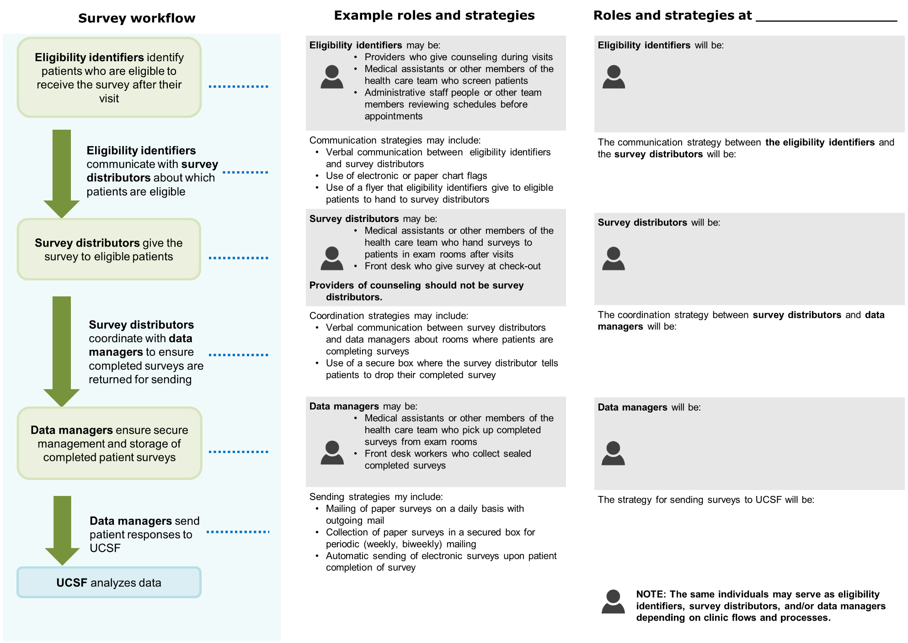
Survey workflow tool
Notes:
To assist sites in the future in implementing this measure, we have created implementation materials to allow people to think about how to map that on to their specific context and clinical flows.
For example, here we have the survey workflow on the left identifying who needs it, survey distribution, and data managers.
Then we have example roles and strategies in the middle, and then a worksheet for individual clinics to fill in on the far right.

Slide 35
PCCC Website and Resources pcccmeasure.ucsf.edu
Copies of the survey in English and Spanish
Implementation Guide for clinical and research sites hoping to use the measure
Information about the development of the measure
Contact Us
  Christine Dehlendorf, MD, MAS, Principal Investigator, christine.dehlendorf@ucsf.edu
  Ilana Silverstein, BA, Project Manager, ilana.silverstein@ucsf.edu
  Katie Giessler, MPH, Program Director, katie.giessler@ucsf.edu
Notes:
All these implementation materials are available free of charge at our website, the pcccmeasure.ucsf.edu.
If you just search me, you'll be able to find that as well.

Slide 36
Development of Electronic Provision Measures
Claims-based measures not as helpful in systems with prospective payment systems
Need alternative measures to determine access in these settings
Electronic measures (eCQMs) use standardized EHR data elements to measure quality
  Opportunity to refine measurement of access to contraceptive methods
Notes:
It’s important to talk about the next steps in performance measurement in family planning because even though we now are looking at potentially having two NQF measures of quality, of course, there's always more work to be done.
One particular area where we're working is in figuring out how to develop electronic provision measures.
The current measures that I mentioned that our NQF endorsed use claims data in order to measure whether individual patient in a calendar year received a method.
This is not as helpful in contexts in which there is not fee for service billing such as federally qualified health centers where they use prospective payment systems.
In addition, electronic measures moving away from claims data and using standardized data elements that are part of EHRs provides the opportunity to refine the measure of contraceptive provision and specifically work to define the denominator.
Our goal is to make sure that women who need contraceptive care receive it.
The current measures endorsed by NQF are all women, whether or not we know if they're sexually active or desiring get pregnant, et cetera, because the claims measure doesn't allow us to differentiate that.
Electronic measures could have the potential to allow us to do a better job of refining the denominator.

Slide 37
Progress in Development of Electronic Measures
Working to define denominator (patients/clients in need of contraceptive care)
Build in standardized data elements to capture both denominator inclusion and method choice (including non-prescription method)
Optimize data collection and workflow together to optimize care and care processes
Notes:
With funding from the Office of Population Affairs, we're currently working to think about how this electronic measure could be optimized to this end.
For example, the finding the denominator, like I said, and creating standardized data elements to allow us to capture who should be in the denominator as well as whether or not someone received a method.
We're also interested in looking at whether or not someone received a nonprescription method because those can't be captured in claims. But it would be great if we could also capture whether someone received condoms as a way to track that as well.
That's something that could be done using the EHR, or was counseled about fertility awareness.
One of the things we're thinking about when we're doing this is how not to overburden systems. We all have alert fatigue, and we all have too many check boxes in the EHR.
We're trying to think strategically about how not to just create something that doesn't work for a system, but how to optimize data collection with workflow so that they actually work hand-in-hand in a bi-directional process.

Slide 38
Use and Interpretation of Performance Measures
Use of measures individually can be used to identify opportunities for quality improvement:
  Provision measures: Are patients being screened for a need for and offered contraception?
  Counseling measures: Are patients receiving patient-centered counseling?
Clinic/facility-level interventions to drive QI have been defined
  EHR-enabled screening for need for contraception (Srinivasulu, Contraception, 2020)
  Counseling training (fptnc.org)
Notes:
How can the provision measures, whether they are claims or electronic like I mentioned, and the PROPM, Patient-Reported Outcome Performance Measure, be used?
They can each be used individually to measure quality and track quality, the impact of quality improvement efforts. The provision measures can be used to screen for:
Are women getting screened for their need for and offered contraception and counseling measures?
Are patients getting patient-centered counseling?
This can drive quality improvement. There are defined interventions that can be used to drive QI in these two spaces.
Just to give an example, there was a recent publication out of New York that used an HER-enabled screening mechanism that was standardized to ensure that women in an FQHC who wanted contraceptive care were identified.
Then training or patient-centered counseling trainings that have been developed, including those at the FPNTC, can be used.
It's not just about using each one of these measures in isolation; it's also these measures.

Slide 39
Tandem Use of Provision and Counseling Measures
Measures can be used together to track and incentivize patient-centered access to contraceptive methods
Can inform clinic- and system-level quality improvement efforts to increase patient-centeredness in contraceptive care
Notes:
Multifaceted metrics of quality and contraceptive care can be used together to promote the ultimate goal of patient-centered access to all contraceptive methods.

Slide 40
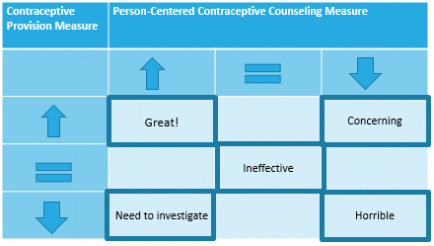
Tandem Measurement
Notes:
This can inform clinic and system-level quality improvement. We're also working on that currently with the National Association of Community Health Centers to think about how we can do that.
In doing that, one of the things we're thinking about is how do we think about tandem use? How do these metrics relate to each other? I think any specific site if they measure their metrics at baseline, do a quality improvement, intervention and then measure them afterwards are going to see a range of different patterns of how these two different metrics play together.
For example, they might find that both of them go up, that they have more access and more patient-centeredness. That's a great outcome. They may find that they both go down, and that's bad. That's a concerning thing regardless.
These two extremes are obviously very clear, their interpretation. What happens if the contraceptive provision measure goes up but patient-centeredness goes down? That's concerning and something that needs to be looked into that there may be less patient-centered counseling that's driving the increased provisions.
What if the patient-centeredness goes up and the provision goes down? That's an interesting question that would need to be investigated. Particularly, I would want to know, what was the counseling? How patient-centered was the counseling before, and were people being subject to directed counseling and now they're not? That would be one potential avenue of investigation.
Then of course, if nothing changed for either one of them, it would just be ineffective. Of course, you can fill in all the other boxes too. I just wanted to give you a sense of how we're thinking about how to interpret tandem use in the real world context.

Slide 41
Use and Interpretation of Performance Measures – cont’d
Ongoing work with NACHC and NFPRHA to understand use of measures in tandem and develop QI materials
Explore opportunities to drill down on results to deepen understanding of measure results
  Method mix?
  Gaps in quality across the care continuum (screening->counseling->method access)
Notes:
We're currently working with both NACHC, the National Association of Community for Health Centers, which is the membership organization for federally qualified health centers in the United States, and NFPRHA to understand this and develop qi materials that would allow for optimal engagement with and responses to the measurement of these two metrics in tandem.
We're also thinking about how recognizing that quality measurement is a broad tool and it only gives you just one broad overview of what's happening, how we can provide materials to allow clinics to drill down and try to figure out what's happening if they, for example, have a low score on one of the two quality metrics.
For example, one option is to look at method mix. If there's non-patient-centered counseling and then you just find out that 90% of people are getting Mirena, you might want to think about if there is a provider bias for the Mirena.
We're also thinking about how you can look at gaps in quality across the care continuum. For the ultimate outcome of patient-centered access, there are multiple different points in the care continuum that you can intervene on or that can potentially have gaps that you can think about.
How do we drill down on those different points in the care continuum?

Slide 42
Future Directions in Performance Measurement in Family Planning
Stratification of measures by race/ethnicity to understand inequities in care
Evaluation of whether or not patients have their needs met for services related to desired, healthy pregnancies?
Reproductive well-being as the ultimate outcome of interest?
Notes:
I'm going to end with mentioning future directions in performance measurement. Quality is multifaceted, we need to be thinking about this. How can we do even a better job than the tandem use metric does to allow us to understand and incentivize quality family planning care?
One thing we're thinking about is how we can specifically address concerns about reproductive oppression and coercion for our patients of color. We are in the future going to think about how we can stratify the measures that currently exist by race, ethnicity to understand inequities in care.
We can also think about whether or not recognizing the patient's ability to have a pregnancy is part of family planning and is part of QFP guidelines. Are there ways that we can also develop metrics down the road to think about whether patients are having their needs met for services related to desired healthy pregnancies?
Our ultimate goal is not just preventing unintended pregnancy or achieving the pregnancy people want; it's people having their reproductive autonomy honored and their reproductive goals met overall.
Thinking about ways that we can define and measure a broader construct of reproductive wellbeing is something that I'm thinking about moving forward with in the future.

Slide 43
Thank you!
Questions or suggestions?
Email fpntc@jsi.org
Subscribe at www.fpntc.org/enewsletter
This presentation was supported by Award No. FPTPA006028-04-00 from the Office of Population Affairs (OPA). Its contents are solely the responsibility of the authors and do not necessarily represent the official views of OPA or HHS.

