Slide 1
Develop a Site-Level
Improvement Plan
Introduction to Quality Improvement in the Family Planning Setting
Last Reviewed November 2017
Notes:
Facilitator Notes
Welcome to today’s meeting, where we will work to develop an improvement plan.
In this session, we’ll introduce a quality improvement framework—the Model for Improvement—and discuss how to use that framework to develop a site-level improvement plan.
By the end of this session, you should have an early version of a plan for improvement, which you can continue to adapt going forward.
(Note to facilitators: To make this session most useful, facilitators are encouraged to tailor it to a particular improvement area of interest (for example, financial management, contraceptive access, chlamydia screening, or other topic). Check out fpntc.org for resources to help tailor this session to these and other improvement areas.)
Activity
Conduct participant and facilitator introductions.

Slide 2
Meeting Objectives
By the end of today, you should be able to:
Describe the Model for Improvement
Explain how the Model for Improvement can be used in the family planning setting
Develop a plan for improvement in order to obtain a site-level improvement goal
Notes:
Facilitator Notes
There are 3 objectives for today. By the end of today’s meeting you should be able to:
Describe the Model for Improvement
Explain how the Model for Improvement can be used in the family planning setting
Develop a plan for improvement in order to obtain a site-level improvement goal

Slide 3
Overview of Model for Improvement
What are we trying to accomplish?
How will we know that a change is an improvement?
What changes can we make that will result in improvement?
ACT
PLAN
DO
STUDY
Notes:
Facilitator Notes
We know there are many quality improvement (usually referred to as QI) approaches and methodologies out there, which you may already be familiar with. Using a structured QI framework increases your chances of meeting your improvement goals. You should feel free to use any improvement methodology you are familiar with to guide improvement. We’re now going to introduce a relatively simple and practical approach (The Model for Improvement) that will establish a shared understanding and language of QI to support our further discussions around improvement planning.
The Model for Improvement, or MFI, is an approach made popular by the Institute for Healthcare Improvement (IHI). The model is based on a combination of three fundamental questions that drive all improvement:
What are we trying to accomplish?
How will we know that a change is an improvement? (i.e., what do we need in terms of measurement/data?)
What changes can we make that will result in improvement? (what can you do about it?)
Then, you use Plan-Do-Study-Act rapid cycles of change to test your change ideas.
Source (for reference)
http://www.ihi.org/resources/Pages/HowtoImprove/default.aspx

Slide 4
Model for Improvement
What are we trying to accomplish?
How will we know that a change is an improvement?
What changes can we make that will result in improvement?
ACT
PLAN
DO
STUDY
Look at data to identify areas in need of improvement.
Notes:
Facilitator Notes
The first question is: What are we trying to accomplish? (What’s our objective?)
Often we are trying to improve a specific indicator, or performance measure. Where are we now, and where are we trying to go on these indicators (measures)?
Looking at data is a great first step to identify areas in need of improvement.

Slide 5
Model for Improvement
What are we trying to accomplish?
How will we know that a change is an improvement?
What changes can we make that will result in improvement?
ACT
PLAN
DO
STUDY
Notes:
Facilitator Notes
The second question is: How will we know that a change is an improvement?
It’s easy to make a change and check it off the list. Done! But did the change make a difference? Did it result in an improvement? Did it help to get you where you want to go?
Data help separate what we think is happening, from what is really happening, and then establish a baseline and allow for periodic monitoring.
Data can be qualitative or quantitative–and may be large-scale or very small-scale. Data could be making tick-marks on the back of an envelope OR from your electronic health record (EHR). Either way, you need some way of knowing if this change worked before you start changing clinical practice, administrative systems, EHR templates, etc.

Slide 6
Model for Improvement
What are we trying to accomplish?
How will we know that a change is an improvement?
What changes can we make that will result in improvement?
ACT
PLAN
DO
STUDY
Data-informed processes can help you:
Identify root cause
Identify needed changes
Select a change
Notes:
Facilitator Notes
The third and final question is: What changes can we make that will result in improvement? In other words, what can be done?
This is where we talk about changes that can drive improvement.
When thinking about impactful changes, it’s important to identify the root cause of an issue—whether it relates back to administrative systems, provider behavior, financial processes, etc. The deeper you go, the greater impact your change is likely to have.

Slide 7
Testing the Change
What are we trying to accomplish?
How will we know that a change is an improvement?
What changes can we make that will result in improvement?
ACT
PLAN
DO
STUDY
PLAN to test your change
DO try carrying out the change
STUDY the test to see if it worked
ACT based on your measured results
Notes:
Facilitator Notes
Okay, again, so the third question is: What changes will result in an improvement? Your ideas are, essentially, educated guesses on what you think will drive improvement. Your solution (or change) is really just a hypothesis.
How do you know that your idea will make a difference? Too often we implement change and then check the box, “done.” The change idea is just the first step. Instead, start small and test it! Start with one client, with just one provider, on one day (for example) before you make changes that involve larger systems and staff. You want to be sure that it will have the impact you are looking for.
Plan do Study Act—or PDSA cycles—help ensure that you’re testing your change in a deliberate way, so that you can easily evaluate its impact.

Slide 8
PLAN: What’s happening now?
Tasks
Clarify your objective
Predict your outcome
Identify steps you need to take
ACT
PLAN
DO
STUDY
Notes:
Facilitator Notes
The first step of the testing cycle is Plan. Planning is the most important and most involved step.
In this step we:
Clarify objective—Determine the change you want to test.
Predict outcome–What do you think will happen? Will it help?
Identify steps—What data do you need to show change? Who? What? When? How?

Slide 9
DO: Let’s try it!
Tasks
Carry out the plan
Document observations
Begin analysis
ACT
PLAN
DO
STUDY
Notes:
Facilitator Notes
Next, we “Do.” This is where we try the change.
Try it small first. And we really mean small… This is important! All of you are probably familiar with we refer to as “change fatigue” in your sites. And what you want to make sure is that you’re not just one more person coming in with grand ideas for changes that should be made. Really fine-tuning the change on a small level can demonstrate to staff that you’re committed to getting this right before causing all sorts of disruptions.
Here’s a tip. When you’re working with your team to design a test, listen to what people suggest as the time frame. Then, move down two levels. For example:
If you hear “at the end of the quarter”…ask what test can be done by the end of next week?
If you hear “weeks,” ask what can be done in the next few hours.
The point is to get moving, to try something out. You’ll never make a change if you don’t… actually make a change.

Slide 10
STUDY: Did it work?
Tasks
Analyze qualitative & quantitative data
Compare data against predictions
Summarize lessons learned
ACT
PLAN
DO
STUDY
Notes:
Facilitator Notes
The third step is “Study,” and the question is: Did it work?
Analyze both qualitative and quantitative data.
Compare data against predictions
Summarize lessons learned

Slide 11
ACT: Decide what to do
Tasks
Decide if you will:
Adopt
Abandon
Adapt
ACT
PLAN
DO
STUDY
Notes:
Facilitator Notes
Finally – you “Act.” Use your data to determine if you are going to adopt, abandon, or adapt the change.
Adopt means you take the change as is, and start doing it a little bit more and/or go bigger
Abandon means you scrap it—not all ideas will work
Adapt means you tweak it or revise it, and then try it again—on a small scale—until you see improvement

Slide 12
PDSA Scale-Up
ACT
PLAN
DO
STUDY
Learn from one cycle and apply those findings to the next.
ACT
PLAN
DO
STUDY
ACT
PLAN
DO
STUDY
ACT
PLAN
DO
STUDY
Notes:
Facilitator Notes
Just because we start small, that doesn’t mean that that is where we end up. The PDSA process is supposed to be iterative with the learning building from one cycle to the next.
As we build our degree of belief that a change is an improvement, the scale of the test increases.
Have we quickly identified a promising idea? Only changes that show promise are expanded for testing on larger and larger scales, until the team can be confident that the change should be adopted widely.
At the end of the day we want a change that results in improvement implemented for every case. So, we take small steps to get there, making sure they’re being implemented the right way.

Slide 13
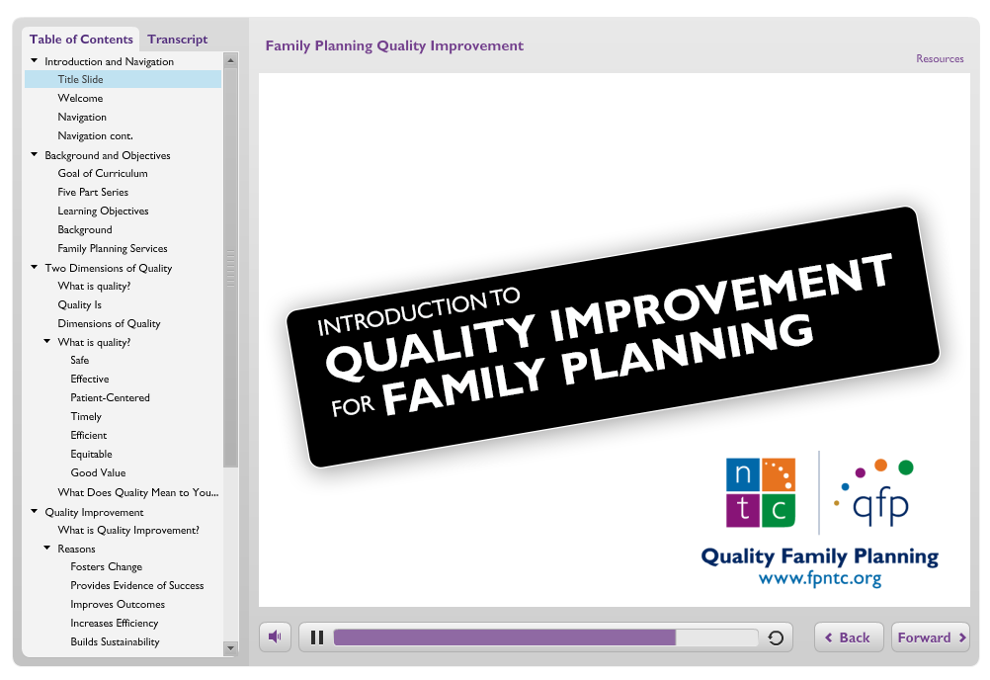
Quality Improvement eLearning Course
Introduction to QI for Family Planning
QI Methodologies:
Using the Model
for Improvement
Data-driven QI
Implementing
Sustainable QI
Building a Culture
of Quality for Family Planning
Link: https://fpntc.org/training-and-resources/quality-improvement-for-family-planning
Notes:
Facilitator Notes
That was a quick introduction to the Model for Improvement and PDSA cycles.
To learn more on quality improvement for family planning, we highly encourage you to take the Quality Improvement for Family Planning eLearning course, available on the FPNTC website.

Slide 14
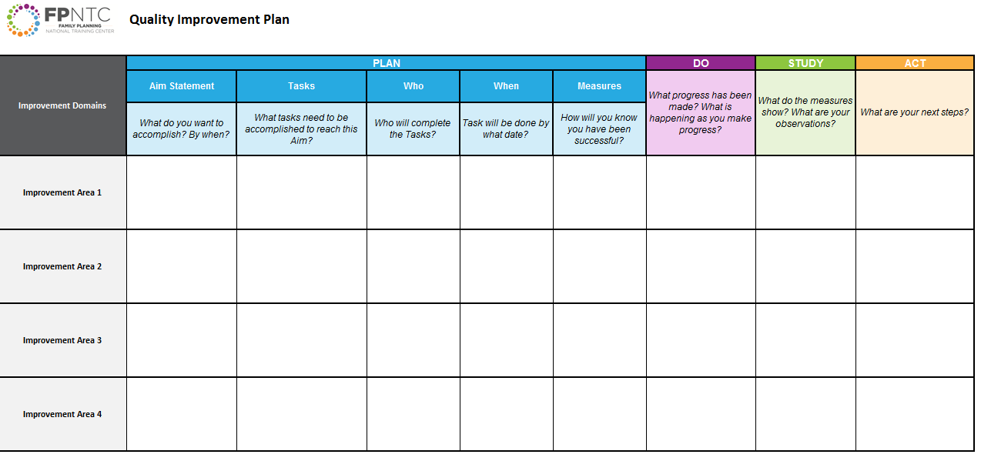
Improvement Plan
Link: https://www.fpntc.org/resources/quality-improvement-plan
Notes:
Facilitator Notes
Now that we have a foundation in the Model for Improvement, let’s start talking about developing the improvement plan.
The improvement plan is a living document that helps to organize a comprehensive strategy in the area you are trying to improve.
Across the top, you will see the PDSA steps broken down. As you can see, planning takes up the brunt of the work! After we start the plan today, you will work on implementing the ideas over the next few months. As ideas are tested, this will be recorded in the “Study” column, and as we decide to adopt, adapt, or abandon, we’ll record that in the “Act” column. We’ll keep adding new ideas to try out as we understand what’s working and what’s not working.
Along the left are Improvement Areas. These could be best practice recommendations. The purpose of having multiple improvement areas is to ensure the overall approach is broad and comprehensive enough to get the results you want to achieve.
(Note to facilitator: In addition to the generic improvement plan on this slide, there are also improvement plans available for specific topics (e.g. financial management, contraceptive access, and chlamydia screening) available on FPNTC.org.)

Slide 15
Improvement Planning Question 1:
What Are We Trying to Accomplish?
Notes:
Facilitator Notes
The first question in the MFI is: What are we trying to accomplish?
Let’s start our improvement planning process there.

Slide 16
What Will You Measure?
Is there a recognized performance measure?
  For example: HEDIS Chlamydia Screening measure, or NQF-endorsed contraceptive care measures
Is there a generally accepted measure used?
  For example: service collection rate, number of clients enrolled in Medicaid waiver (if applicable)
What is a measure you can produce regularly that is an assessment of what you are trying to improve?
Notes:
Facilitator Notes
Consider the area that you are trying to improve upon.
The gold standard measure would be to use a recognized performance measure. These are measures that have clear guidance about how to calculate and interpret. Examples include the HEDIS Chlamydia Screening measure and NQF-endorsed contraceptive care measures.
If there isn’t a standard performance measure, is there a generally accepted measure used in the field? For example, look at time of service collection rate or number of clients enrolled in Medicaid waiver, if applicable.
If neither of these exists in your situation, the last resort should be to find a measure you can produce regularly that gets at what you are trying to improve.
Activity
If you haven’t already, determine the measure that you will look at to track improvement.

Slide 17
Goal-setting Methods
Consider, how much of an increase is:
  Feasible, given resources (time, support, capacity)
  Within your control
  Reasonable
Obtain a benchmark
  National benchmarks like Healthy People 2020
  Title X average using FPAR data
Set a percentage increase goal (e.g., 10% improvement over baseline)
Notes:
Facilitator Notes
Okay, think about what your goal should be. Consider what is feasible given resources (time, support, capacity), what is within your control, and reasonable or appropriate given the measure.
There are a couple of common methods for establishing goals.
You can work toward obtaining a benchmark, using national benchmarks like Healthy People 2020 or a Title X average using FPAR data
Or you can consider setting a percentage increase goal (e.g., 10% improvement over baseline)

Slide 18
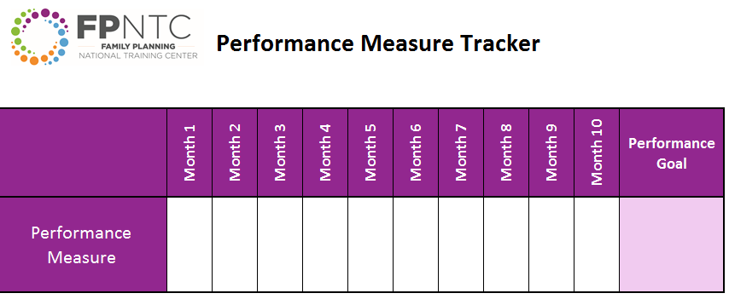
Identify Your Performance Goal
Link: https://www.fpntc.org/resources/quality-improvement-plan
Notes:
Activity
Using one of the goal-setting methods from the previous slide, identify your performance goal and write it on the improvement plan.
Facilitator Notes
Now that you have your goal, it’s important to track progress toward your goal, to know if you are getting there.
In the Improvement Plan (available on the FPNTC website), you can use this example performance measure tracker sheet.
(Note to facilitator: In addition to the generic performance measure tracker on this slide, there are also specific tracker tools available for select topics (e.g. financial management, contraceptive access, and chlamydia screening) available on FPNTC.org.)

Slide 19
Improvement Planning Question 2:
How will we know a change is an improvement?
Notes:
Facilitator Notes
Moving on to the next step of the improvement planning process, let’s look at the second question: How will we know change is an improvement?

Slide 20
Aim Statements
An aim statement:
Helps create a shared vision
Defines the scope of your quality improvement
Defines what you are working toward
Is a commitment to achieve improvement
Has a definite time line
Has quantified goals
Notes:
Facilitator Notes
An aim statement is a clear, explicit summary of what your team hopes to achieve over a specific amount of time. The aim statement guides your work by establishing what success looks like.
Aim statements use a shorter time frame and are more specific than the overarching performance measure goal.

Slide 21
Examples of Aim Statements
Reduce waiting time to see the provider to less than 15 minutes within 9 months
Increase the percent of clients who receive their method of choice in a single visit from 35% to at least 50% by March 1
By July 1, increase method availability by stocking all provider-dependent methods on site
Increase proportion of patients with Medicaid or Private insurance by 10% by August 1
Notes:
Facilitator Notes
Let’s look at some examples.
Reduce waiting time to see the provider to less than 15 minutes within 9 months
Increase the percent of clients who receive their method of choice in a single visit from 35% to at least 50% by March 1
By July 1, increase availability by stocking all provider-dependent methods on site
Increase proportion of patients with Medicaid or Private insurance by 10% by August 1
What makes these good aim statements?
Specifies by when we want this to occur—are time-bound
Specifies what we want to happen—to increase or decrease
Specifies by how much we want to see a change—the magnitude

Slide 22
Tips for Aim Statements
Control
Is this something you have control over?
Time
Can the aim be achieved in the time specified?
Resources
Are there sufficient resources?
Team
Who needs to be involved for success?
Alignment
Is your aim aligned with the organization’s mission and goals?
Be Specific!
Notes:
Facilitator Notes
Aim statements need to be specific to be effective. Ask yourselves these questions:
Is this something you have control over?
Can the aim be achieved in the time specified?
Are there sufficient resources?
Who needs to be involved for success?
Is your aim aligned with the organization’s mission and goals?

Slide 23
Aim Statements Build on Each Other
By July 1, increase availability by stocking all provider-dependent methods on site
By September 1, at least 95% of clients will respond on the client experience survey that they got their method of choice
Notes:
Facilitator Notes
An aim statement give you something to work toward.
Once you achieve the aim statement you’ve established, it’s important to build on it.
Now that you have the methods stocked, are clients getting what they want? Are there any access barriers?
For instance, “By July 1, increase availability by stocking all provider dependent methods on site.”
“By September 1, at least 95% of clients will respond on the client experience survey that they got their method of choice.”
The idea is to keep pushing improvements after these shorter-term aim statements are accomplished.

Slide 24
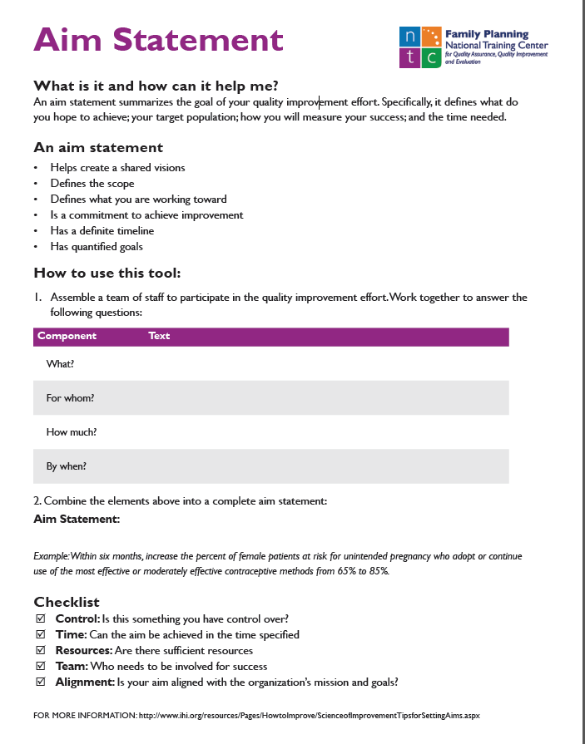
Develop an Aim Statement
Think about what will make an impact on the measure you are looking at for improvement
Develop and write down the aim statement using the Aim Statement Worksheet
Link: https://www.fpntc.org/resources/aim-statement-worksheet
Notes:
Facilitator Notes
Now it’s time for you to try developing an aim statement. We’ll develop one aim statement together using the Aim Statement Worksheet.
Activity
Think about what will make an impact on the measure you are looking at for improvement.
Develop and write down the aim statement, using the worksheet.
Take 10 minutes for this activity.

Slide 25
Improvement Planning Question 3:
What changes will result in an improvement?
Notes:
Facilitator Notes
Now for the final question: What changes will result in an improvement?
In this section, we will build out the remaining sections of the improvement plan. Again, this is a living document, and you will revise and update this improvement plan as the changes evolve and you have new ideas to test.

Slide 26
Ask Yourself WHY?
Problem: Clients sometimes do not get their method of choice and leave without a method
Clients have to return for second visits to obtain IUDs or implants
We do IUD/implant insertions only on Fridays, in the procedure room
IUDs and the instruments are all stocked in that room and it is convenient for providers to have them all done the same day
Because that’s how we’ve always done it… But we can try something different!
Why?
Why?
Why?
Why?
Link: https://www.fpntc.org/resources/five-whys-worksheet
Notes:
Facilitator Notes
As you think about ideas for improving practices at your site, think about why something is not happening. It is often tempting to think that the answer to a challenge is additional staff training. Think about underlying systems that may be causing the problem.
Problem: Clients sometimes do not get their method of choice and leave without a method. Why?
Clients often have to return for second visits to obtain IUDs or implants after they have already decided to get them. Sometimes they never come back. Why?
We only do IUD/implant insertions only on Fridays, in the procedure room. Why?
IUDs and the instruments are all stocked in that room and it is convenient for providers to have them all done the same day. But, why?
Keep asking yourself why until you find a potential change that you can test. See if that change has an impact on the problem you have observed. For example, try making insertion kits and stock them in all exam rooms rather than a separate procedure room.

Slide 27
Ask Yourself WHY? Cont.
Problem: Client fee collection rate is 32%
Clients are unprepared/not expecting to pay for services on date of service
They are not used to paying then (or ever)
We haven’t communicated payment expectations clearly to them
Staff are uncomfortable asking clients to pay
We are not sure how to balance asking for money with customer service
Because that’s how we’ve always done it… But we can try something different!
Why?
Why?
Why?
Why?
Why?
Why?
Link: https://www.fpntc.org/resources/five-whys-worksheet
Notes:
Facilitator Notes
Here is another example of asking why something is not happening related to financial operations. Similar to the last example, it is often tempting to think that the answer to a challenge is additional staff training and make sure to think about underlying systems that may be causing the problem.
Problem: Client fee collection rate is 32%. Why?
Clients are unprepared/not expecting to pay for services on date of service. Why?
They are used to not paying then (or ever). Why?
We haven’t communicated payment expectations clearly to them. Why?
Staff are uncomfortable asking clients to pay. Why?
Because they have never done it and are not sure how to balance asking for money with customer service initiatives. Why?
Because they have never had to do it… But we can try something different!
Again, keep asking yourself why until you find a potential change that you can test. In this case, consider developing a script with specific language addressing the payment request for the front desk team that they can use at time of scheduling, while checking in a client, and while exiting a client. Obtain staff input, and address their concerns.
If you find yourself thinking: Because that’s how we’ve always done it… Instead, think: But we can try something different!

Slide 28
Complete Your Improvement Plan
Link: https://www.fpntc.org/resources/quality-improvement-plan
Notes:
Activity
If you haven’t done so already, now start to fill out the rest of the “Plan” section of the improvement plan, adding detail for each aim statement. Add the necessary tasks, who should complete the tasks, when the tasks need to be completed by, and what measures you’ll use to track success.
You should take the aim statement that you brainstormed/put on the worksheet and write it into the improvement plan. For developing other aim statements, you can use other copies of the Aim Statement Worksheet (if available), or just write them right into the improvement plan.
Take 25 minutes for this activity.
(Note to facilitators: If you don’t have time for this activity, participants can be instructed to complete the improvement plan on their own time, after the meeting.)

Slide 29
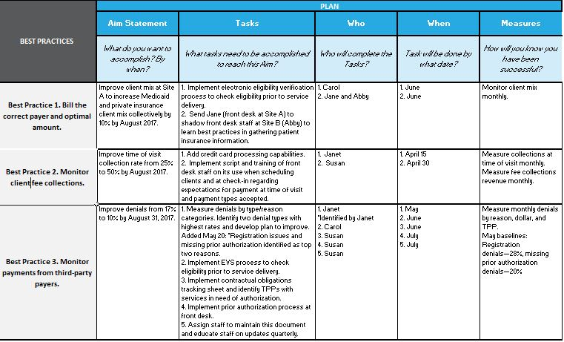
Sample Improvement Plan
Notes:
Facilitator Notes
Hopefully by now you have something that looks like these two “Sample Improvement Plans.” (Note to facilitator: click twice to see the two improvement plans.)
There should be a number of planned changes, in a variety of improvement areas. More aim statements can be added after the results of these changes come in.

Slide 30
Next Steps
Get input from and communicate Improvement Plan to relevant staff
Designate regular meeting time for QI team
Designate staff member to provide data on a regular basis (e.g., monthly)
Notes:
Facilitator Notes
This concludes the initial improvement planning activity for today.
Some next steps you might consider are:
Communicate your improvement plan to relevant staff. Again, refer back to who you included in the plan to determine if anyone is missing today
Designate regular meeting time of quality improvement (QI) team
Designate staff member to provide data on a regular basis (e.g., monthly)
Discuss
In addition to what are listed on the slide, what other next steps will you take?

Slide 31
Thank you!
Contact:
fpntc@jsi.com
Notes:
Facilitator Notes
Thank you for participating in today’s discussion.
If applicable, you can contact me at:_________
You can also always contact the Family Planning National Training Center (fpntc@jsi.com) with questions/comments.

