Slide 1
Discuss Pregnancy Intention and Support Patients through Evidence-Informed, Patient-Centered Counseling
Contraceptive Access Change Package
Best Practice 2
Last Reviewed November 2017
Notes:
Facilitator Notes
Today we will be discussing routine assessment of pregnancy intention, and supporting patients through evidence-informed, patient-centered counseling.
The routine assessment of pregnancy intention helps identify patients who may have unmet contraceptive needs. Evidence-informed counseling helps patients identify the most appropriate contraceptive method for them.
Activity
Conduct participant and facilitator introductions.

Slide 2
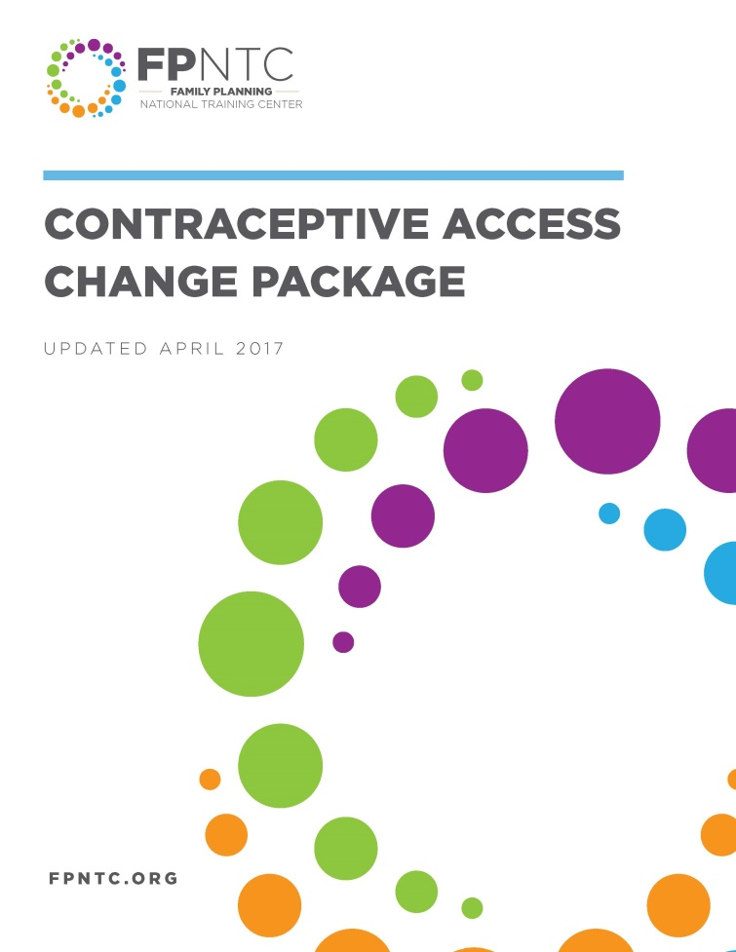
Introduction to the Contraceptive Access Change Package
Best Practice Recommendations
Stock all methods
Utilize patient-centered counseling
Offer same-visit access
Reduce cost as a barrier
Link: https://www.fpntc.org/resources/contraceptive-access-change-package
Notes:
Facilitator Notes
Discussing pregnancy intention and providing patient-centered counseling is the second “best practice recommendation” outlined in the Contraceptive Access Change Package, which was developed by the Family Planning National Training Centers.
The Contraceptive Access Change Package, which is an overview of the best practice recommendations and strategies, draws from the literature and most current practice guidelines to increase access to the full range of contraceptive methods.
The other three best practices in the Contraceptive Access Change Package are:
BP 1: Stock a broad range of provider-dependent FDA-approved contraceptive methods.
BP 3: Develop systems for same-visit provision of all contraceptive methods, at all visit types.
BP 4: Utilize diverse payment options to reduce cost as a barrier for the facility and the patient.
In order to increase access, it’s important to consider all four best practices and utilize a comprehensive approach that addresses each. We strongly encourage you to refer to the Contraceptive Access Change Package for more ideas about strategies and successes. It can be found on the FPNTC website (the link is provided on the slide).

Slide 3

Contraceptive Access Change Package:
Best Practice 2
Discuss pregnancy intention and support patients through evidence-informed, patient-centered counseling that enables them to choose from the full range of contraceptive methods if they do not desire pregnancy presently
Notes:
Facilitator Notes
There are two parts to this best practice.
First part: discuss, or assess, pregnancy intention with patients of reproductive age.
Second part: support patients through evidence-informed, patient-centered counseling that enables them to choose from the full range of contraceptive methods if they do not desire pregnancy presently.

Slide 4
Meeting Objectives
By the end of today, you should be able to:
Describe the rationale for using a shared decision-making approach to contraceptive counseling
Identify at least two best practice strategies for ensuring counseling is patient-centered
Identify at least two strategies for ensuring providers routinely assess patients’ pregnancy intention and need for contraceptive counseling
Notes:
Facilitator Notes
There are 3 objectives for today’s discussion. By the end of today, we hope you will be able to:
Describe the rationale for using a shared decision-making approach to contraceptive counseling
Identify at least two best practice strategies for ensuring counseling is patient-centered
Identify at least two strategies for ensuring providers routinely assess patients’ pregnancy intention and need for contraceptive counseling
As the objectives imply, we want to take time today to talk about not just what should happen, but also what makes these recommendations a challenge. By discussing challenges, we hope to help identify potential strategies for breaking down those barriers—ultimately, to increase patients’ access to their contraceptive methods of choice.

Slide 5
Rationale for Routine,
Patient-Centered Counseling
Evidence-informed counseling helps patients identify the most appropriate contraceptive method for them
Adhering to a patient-centered counseling approach can
  Increase patient knowledge, use, and satisfaction with services
  Reduce risk of reproductive coercion and provider bias
Notes:
Facilitator Notes
Evidence-informed counseling helps patients identify the most appropriate contraceptive method for them.
Adhering to a patient-centered counseling approach can contribute to increased patient knowledge and use of contraception, as well as satisfaction with services.
Unfortunately, health care professionals have not always been unbiased in providing reproductive health services to certain populations. Some patients continue to report feeling coerced, or that they received racially-biased counseling. Using a patient-centered approach reduces the risk for reproductive coercion and provider bias.
Sources (for reference)
Gavin L, Moskosky S, Carter M et al. Providing Quality Family Planning Services: Recommendations of CDC and the U.S. Office of Population Affairs. MMWR 2014;63(4)
Yee L, Simon M. Urban minority women’s perceptions of and preferences for postpartum contraceptive counseling. J Midwifery Womens Health. 2011 Jan-Feb;56(1):54-60.
Dehlendorf C et al. 2014. Counseling about IUDs: A mixed-methods analysis. Perspectives on Sexual and Reproductive Health, 46 (3)
Higgins JA. 2014. Celebration meets caution: LARC’s boons, potential busts, and the benefits of a reproductive justice approach. Contraception, 89.
Gomez AM, L Fuentes L, A Allina A. 2014. Women or LARC first? Reproductive autonomy and the promotion of long-acting reversible contraceptive methods. Perspectives on Sexual and Reproductive Health, 46(3)
Gold RB. 2014. Guarding against coercion while ensuring access: A delicate balance. Guttmacher Policy Review, 17(3)
Gilliam ML, Neaustadt A, Gordon R. A call to incorporate a reproductive justice agenda into reproductive health clinical practice and policy. Section of Family Planning, Department of Obstetrics and Gynecology, The University of Chicago, Chicago, IL Association of Reproductive Health Professionals, Oakland, CA, USA. Published Online: February 02, 2009

Slide 6
Overview of Strategies
Discuss pregnancy intention routinely with all patients of reproductive age
  Regardless of reason for visit
  Including male and female patients
Counsel in accordance with QFP guidelines
Have a policy of voluntary services
Notes:
Facilitator Notes
The strategies for this best practice recommendation are to:
Discuss pregnancy intention routinely with all patients of reproductive age. Support patients in developing a pregnancy intention and/or reproductive life plan.
If pregnancy is not desired in the next year, provide contraceptive services in response to the patient’s identified goals and preferences in line with QFP recommendations
Have a written and widely circulated policy stating that services must be provided solely on a voluntary basis and that patients will not be coerced to use a particular method or any method at all.
Sources (for reference)
Gavin L, Moskosky S, Carter M et al. Providing Quality Family Planning Services: Recommendations of CDC and the U.S. Office of Population Affairs. MMWR 2014;63(4)

Slide 7
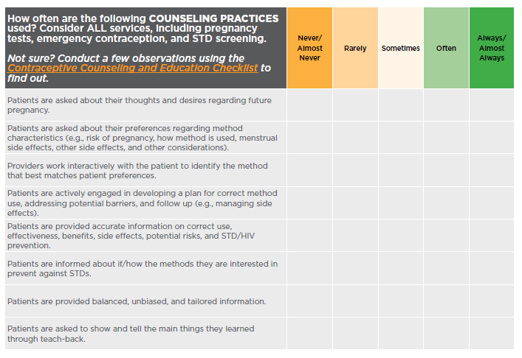
Contraceptive Access Assessment
Notes:
Facilitator Notes
If you haven’t already, please take a minute to complete the Contraceptive Access Assessment questions related to counseling practices.
We encourage you to be critical—how often are these practices happening really (not what you hope is happening!)? This tool is designed to help you identify areas to improve.
Activity
Participants will fill out or refer to the Contraceptive Access Assessment tool. Ask participants to fill out ahead of time, or provide 10-15 additional minutes to fill it out during the session.

Slide 8
Discussion of Current Implementation of Best Practice
What counseling practices are most frequently being done? What helps contribute to routine implementation of these practices?
What practices are least frequently being done? What is challenging about these practices in particular?
Notes:
Facilitator Notes
Consistent implementation of best practices is a challenge. Let’s take a minute to reflect on your assessment findings before we have more discussion.
Discuss
Which of the counseling practices are most frequently being done? What helps contribute to routine implementation of these practices? (How do you know?)
What practices are being done least frequently, or are harder to do consistently? What is challenging about these practices in particular?

Slide 9
Routine Assessment of Reproductive Intention
Opens the door for discussion of unmet reproductive health needs
“Do you think you would like to have (more) children some day?¹
  When do you think that might be?
  How important is it to you to prevent pregnancy (until then)?”
Ask every patient at least annually (male and female), regardless of reason for initial visit
¹ Callegari et al. Am J Obstet Gynecol. 2017 .
Notes:
Facilitator Notes
Let’s start by talking about the first part of this best practice recommendation, which is to assess pregnancy intention routinely with all patients of reproductive age.
Asking the question, “Do you think you would like to have (more) children someday?” is an introduction to the conversation that opens the door for further discussion of reproductive health needs.
Follow-up questions—like “When do you think that will be?” and “How important is it to you to prevent pregnancy until then?”—can provide useful information for a discussion about potentially unmet contraceptive needs.
The questions on the screen were developed by Patty Cason, Family Nurse Practitioner and Assistant Clinical Professor at UCSF, and build on the questions originally developed by CDC such as “One Key Question” and other approaches which are often called, “Reproductive Life Planning.”
Although the concept of planning for pregnancy may not work for everyone, for some patients whose initial reason for a visit was not related to preventing or achieving pregnancy, discussing pregnancy intention and/or reproductive life planning may help identify unmet reproductive health care needs.
CDC recommends that providers take every opportunity to engage patients—both men and women—in a conversation about reproductive life planning.
Reproductive life planning encourages the patient to think about whether, or when, she or he wants to have children and how best to meet their goals.
Sources (for reference)
Gavin L, Moskosky S, Carter M et al. Providing Quality Family Planning Services: Recommendations of CDC and the U.S. Office of Population Affairs. MMWR 2014;63(4)
Preconception Health and Healthcare: Reproductive Life Plan for Professionals. http://www.cdc.gov/preconception/documents/rlphealthproviders.pdf
One Key Question http://www.onekeyquestion.org/
Callegari LS, Aiken AR, Dehlendorf C, Cason P, Borrero S5 Addressing potential pitfalls of reproductive life planning with patient-centered counseling. Am J Obstet Gynecol. 2017 Feb;216(2):129-134.

Slide 10
Discussion of Challenges Related to Assessing Pregnancy Intention
(How) are you routinely (at least annually) assessing pregnancy intention?
  Regardless of initial reason for visit
  All male and female patients of reproductive age
What is currently working well?
What is challenging about routine assessment pregnancy intention?
Notes:
Facilitator Notes
Routinely assessing pregnancy intention can be a challenge. Ensuring all patients are asked about their reproductive intention may require workflow changes and mindset shifts. We know that’s not easy! Let’s discuss what currently makes routine assessment of reproductive intention a challenge. This will help set the foundation as we then move into discussing some strategies for addressing these challenges.
Discuss
Are you routinely (at least annually) assessing pregnancy intention?
How do you ensure this is being done regardless of initial reason for visit?
What about visits where the patient wasn’t scheduled to see a clinician (e.g., HIV test)?
How do you ensure this is being done for all patients, including both male and female patients, of reproductive age?
How are you currently doing this?
What is currently working well?
Is pregnancy intention a field in your electronic health record?
Who asks the question? How is the information communicated to the clinician (if needed)?
What is challenging about routinely assessing pregnancy intention?
What changes do you need to make, so that you can assess pregnancy intention more consistently?

Slide 11
5 Principles of Quality Counseling (QFP)
If a patient wants to prevent pregnancy, the provider should counsel according to QFP recommendations for quality counseling:
  Establish and maintain rapport with the client;
  Obtain clinical and social information;
  Work with the client interactively to select the most effective and appropriate method;
  Conduct a physical assessment, when warranted;
  Provide method, help the client develop a plan for using the method and for follow-up, and confirm client understanding.
Notes:
Facilitator Notes
Let’s now talk about the second part of this best practice recommendation: supporting patients through evidence-informed, patient-centered counseling.
According to Providing Quality Family Planning Services: Recommendations of CDC and OPA, if patient wants to prevent pregnancy, providers should counsel using these five principles of quality contraceptive counseling:
Establish and maintain rapport with the client. Strategies to achieve these goals include the following:
making eye contact, and small talk in the exam room
using open-ended questions
demonstrating expertise, trustworthiness, and accessibility
ensuring privacy and confidentiality
explaining how personal information will be used
encouraging the client to ask questions and share information
listening to and observing the client
being encouraging and demonstrating empathy and acceptance
Obtain clinical and social information from the client—including medical history, pregnancy intention assessment, contraceptive experiences and preferences, and sexual health assessment
Work with the client interactively to select the most effective and appropriate contraceptive method
Conduct a physical assessment related to contraceptive use, when warranted. Most women will need no or few examinations or laboratory tests before starting a method of contraception. See the Selected Practice Recommendations for details.
Provide the contraceptive method along with instructions about correct and consistent use and help the client develop a plan for using the selected method and for follow-up. Confirm client understanding.
We’ll explore steps 2 and 3—where the conversation between the client and provider occurs—more in depth now.
Sources (for reference)
Gavin L, Moskosky S, Carter M et al. Providing Quality Family Planning Services: Recommendations of CDC and the U.S. Office of Population Affairs. MMWR 2014;63(4)
Curtis KM, Jatlaoui TC, Tepper NK, et al. U.S. Selected Practice Recommendations for Contraceptive Use, 2016. MMWR Recomm Rep 2016;65(No. RR-4):1–66.

Slide 12
Approaches to Counseling
Informed Choice: Provide information about all methods
Approach
Foreclosed: Ask patients “What methods are you interested in?” provide information about those methods
Drawbacks
Time-consuming
A lot of information, and information that is out of context for the patient
Patient may not be aware of all methods
Patient may not have accurate information about non-discussed methods
Notes:
Facilitator Notes
There are two categories of counseling that have been traditionally used for contraception.
With an informed choice approach to counseling, counselors provide patients with information about all methods to ensure that they know about the full range of methods available. This can be time-consuming and overwhelming to patients who receive information but no support in helping them interpret that information in the context of their lives.
With the foreclosed approach, counselors ask patients, “What method(s) are you interested in?” While more attuned to patient needs, the drawbacks to this approach are: patients may not be aware of all methods, and may not have accurate information about some methods, leading them to be uninterested in them.

Slide 13

Shared Decision Making
Collaborative process where patients and their providers work together to make health care decisions
Takes into account best scientific evidence, as well as patient’s values and preferences
Goal to provide patients the support they need to make the best decision for them
Gold Standard Approach!
Informed Medical Decisions Foundation
Notes:
Facilitator Notes
Improving on these counseling methods, the gold standard approach to contraceptive counseling is a shared decision-making approach.
Using a shared decision-making approach means that patients and providers work together to make health care decisions, although it is still the patient who ultimately decides what is best for them.
With a shared decision-making approach, patients are considered the expert on themselves.
The provider is the expert on contraceptive methods and the medical practice recommendations for using these methods.
Working collaboratively, the conversation draws on best scientific evidence. It also draws on patient values and preferences.
The goal is to provide patients the support they need to make the best decision for themselves.
Source (for reference)
Informed Medical Decisions Foundation: http://www.informedmedicaldecisions.org/what-is-shared-decision-making/

Slide 14
Patient Considerations in Choosing A Method
Effectiveness
Safety
Ease of use
How to remember how to use it
How it works
How long it lasts
Possible side effects
Ability to become pregnant after stopping the method
Ability to control the method
Impact on period
Ability to keep method private
Other?
Notes:
Facilitator Notes
Why is it important that counseling incorporate and respond to patient preferences?
There are a lot of factors that go into a patient’s choice of a method, and each patient has a different set of priorities.
Some of the characteristics that patients might consider about a method before deciding which method is best for them, include:
Effectiveness
Safety
Ease of use
How to remember how to use it
How it works
How long it lasts
Possible side effects
Ability to become pregnant after stopping the method
Ability to control the method
Impact on period
Ability to keep method private
Other?
Patients may feel more strongly about some characteristics than others. For example, some patients may feel strongly about having regular periods. Other patients may prefer that methods are effective and safe, while others may prefer being able to keep their method of choice private.
Discuss
Have you encountered other patient considerations when they choose a method?
Which considerations do your patients mention most often?

Slide 15


Patient-Centered Counseling: How to Start
Possible responses:
Effectiveness
Safety
Ease of use
How to remember how to use it
How long it lasts
Possible side effects
Ability to become pregnant after stopping the method
Ability to control the method
Impact on period
Ability to keep method private
Other?
What is important to you in a contraceptive method?
Notes:
Facilitator Notes
So, how do you start a counseling conversation in a way that honors patient preference?
Start with an open ended question such as: “What is important to you in a contraceptive method?” This encourages patients to describe the characteristics most important to them.

Slide 16
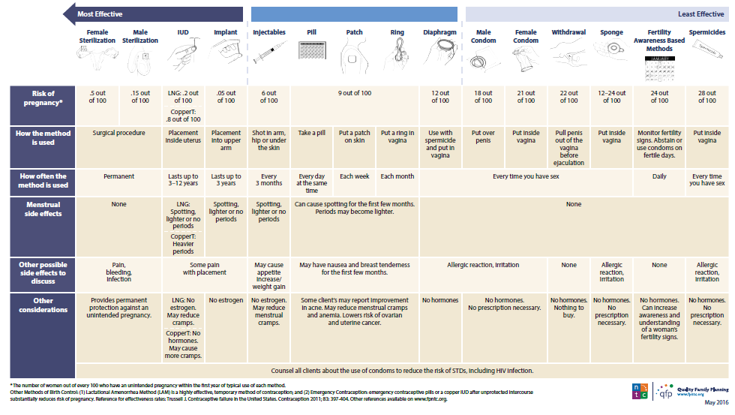
Birth Control Method Options Chart
Link: http://fpntc.org/training-and-resources/birth-control-method-options-chart
Notes:
Facilitator Notes
This is a job aid that was developed by the Family Planning National Training Center to help facilitate this patient-centered conversation. The chart summarizes each method and its characteristics that may be of interest for a patient.
On the next two slides, we’ll talk through an example of how this chart can be used in practice.

Slide 17
Meet Tina….
19 years old
Visiting the clinic for STD screening
Would you like to have children some day?
  Yes, but not for a couple of years, at least
What is important to you in a method?
  Effectiveness, “wouldn’t want any surprises”
  Not something to remember every day
  Would prefer if period was lighter
Notes:
Facilitator Notes
Let’s look at a hypothetical patient. Imagine that Tina is an 19-year-old who is going to community college and works as a cashier at Walmart. She lives with her mother and four siblings. She is visiting the clinic today for a STD test.
While there, as part of the routine pregnancy intention assessment, she is asked if she would like to have children some day. She responds yes, but not for several years.
The counselor asks if she’d be interested in discussing contraceptive options, and Tina says yes. When asked, What is important to you in a method? Tina says that effectiveness is most important and that she doesn’t want any surprise pregnancies while she’s trying to finish school.
Through further discussion, the counselor finds out that Tina would also prefer a method she doesn’t have to worry about, and ideally would like her period to be lighter.

Slide 18
Using the Birth Control Method Options Chart
Link: http://fpntc.org/training-and-resources/birth-control-method-options-chart
Notes:
Facilitator Notes
Using the tool, the counselor can first start with methods that are most effective at preventing pregnancy, which Tina has expressed is her main concern. Given Tina’s preferences and looking at rows three and four—how often the method is used and menstrual side effects—the counselor can see that the two methods that Tina might be most interested in are Liletta and Nexplanon. The counselor can provide information on this methods and show how these might meet her needs.
By narrowing in on Tina’s preferences, the counselor can then provide information about the two methods that may be a good fit for her. Tina may still desire information on other methods, and may end up choosing a different method. Ultimately she is the expert on what will work best for her.

Slide 19
Benefits of Shared Decision Making
By using a shared decision-making approach to counseling, the goal is that the patient is able to choose a method that will work best for them.
When patients obtain their method of choice, they are more likely to use it consistently and correctly, and have higher satisfaction and continuation rates.
Dehlendorf C et al. Contraception. 2017
Gavin L et al. Providing Quality Family Planning Services. MMWR 2014
Notes:
Facilitator Notes
In summary, by using a shared decision-making approach to counseling, the goal is that patients are able to choose methods that will work best for them.
Recall that when patients obtain their methods of choice, they are more likely to use them consistently and correctly, and have higher satisfaction and continuation rates.
Note that in the sources section, we’ve highlighted work by Dr. Christine Dehlendorf. She’s been a leader in this field of patient-centered contraceptive counseling. We will provide a list of other papers by Dr. Dehlendorf at the end of this session.
Source (for reference)
Dehlendorf C, Grumbach K, Schmittdiel JA, Steinauer J. Shared decision making in contraceptive counseling. Contraception. 2017 May; 95(5):452-455. PMID: 28069491.
Gavin L, Moskosky S, Carter M et al. Providing Quality Family Planning Services: Recommendations of CDC and the U.S. Office of Population Affairs. MMWR 2014;63(4)

Slide 20
Patient-Centered
Counseling Sample Questions
Start with the question: “What is important to you in a method?”
  Use counseling job aids to help patients identify methods that meet most (if not all) of their preferences.
Use probe questions about characteristics:
  Some methods don’t have to be taken every day whereas others do have to be taken every day to work correctly. How would it be for you to take the method every day?
  Some methods are more effective at preventing pregnancy than others. How important is method effectiveness?
Notes:
Facilitator Notes
That was a very brief overview of what a shared decision-making approach to patient-centered counseling is. More resources to support quality contraceptive counseling are included at the end of this presentation.
Let’s talk now about how to put this into practice. We discussed already how to get the conversation started with the question, “What is important to you in a method?”
You can then probe with more questions about different characteristics that will elicit preferences that may not have been articulated before this counseling conversation. Consider the following:
Some methods don’t have to be taken every day, whereas others do have to be taken every day to work correctly. How would it be for you to take a method every day?
Some methods are more effective at preventing pregnancy than others. How important is method effectiveness?

Slide 21
Putting Patient-Centered Counseling into Practice
Use teaching aids, including visual aids and models of methods, that patients may not be familiar with (e.g., IUD and implant)
Present natural frequencies rather than percentages
  e.g., “less than 1 in 100 women get pregnant using the implant”
Materials should be at the 4th-6th grade reading level
Notes:
Facilitator Notes
Another patient-centered practice is to use teaching aids, including visual aids and models of methods, that patients may not be familiar with (e.g., IUD and implant).
Counselors should use words and concepts that patients can understand. It’s better to use natural frequencies rather than percentages. For example, you can say, “less than 1 in 100 women get pregnant using the implant.”
To ensure the information is accessible, patient education materials should be written at the 4th-6th grade reading levels and available in the patient’s preferred language when possible.

Slide 22
FAQs About Shared Decision Making
Q. Does patient-centered counseling take more time than other forms of counseling?
A. Many providers find that this approach actually takes less time because the conversation focuses on what is most important to the patient instead of trying to cover what might be important.
Q. How should we talk about method effectiveness?
A. Method effectiveness is one method characteristic. Counselors should elicit preferences about effectiveness during counseling by asking “how important is method effectiveness to you?” Counselors can help patients identify methods that reflect this preference. For many patients, method effectiveness is very important, for others it may be less so.
Notes:
Facilitator Notes
Two common questions that come up when we talk about patient-centered counseling:
First, does patient-centered counseling take more time than other forms of counseling? In fact, many providers find that this approach actually takes less time because the conversation focuses solely on what is most important to the patient. It certainly takes less time than talking about all characteristics of all methods. Plus, when patients are given the space to find a method that works best for them, they are more likely to use them consistently and correctly.
Second, how should we talk about method effectiveness while being patient-centered? Method effectiveness is one method characteristic, and providers should elicit preferences about effectiveness during counseling. For example, counselors can ask, “how important is method effectiveness to you?” Counselors can help patients identify methods that reflect this preference. For many patients, method effectiveness is very important, for others it may be less so.
Discuss
Are staff routinely using a patient-centered approach to contraceptive counseling, when patients do not desire pregnancy currently?
What strategies do you use for ensuring quality counseling (e.g., role playing, observations)?
What is working well currently?
Who provides contraceptive counseling? How is that information conveyed efficiently to providers?
What is challenging about utilizing a shared decision-making counseling approach?
What changes will you need to make, so that you can use patient-centered counseling more consistently?

Slide 23
Quality Contraceptive Counseling and Education:
A Client-Centered Conversation eLearning Course
5 Modules (2.5 hours)
Foundations for Counseling and Education
Building Rapport and Communication Skills
Quality Education Strategies
Interactive Client-Centered Decision Making
Confirming Understanding and Supporting a Plan
Link: https://fpntc.org/training-and-resources/quality-contraceptive-counseling-and-education-a-client-centered-conversation
Notes:
Facilitator Notes
There are several resources available on FPNTC.org to support consistent implementation of quality patient-centered counseling.
The first resource is a five-lesson eLearning course that takes about 2.5 hours to complete. This course will prepare you to provide quality, client-centered contraceptive counseling and education. It will help you to meet the unique needs of each of your patients, even during brief visits. Several videos in the course provide examples of quality counseling. You can also download helpful job aids and other resources relevant to your practice.
Completing the lessons in order will help you build on your knowledge and skills learned from the previous lesson(s).
Lesson 1: Foundations for Counseling and Education
Lesson 2: Building Rapport and Communication Skills
Lesson 3: Quality Education Strategies
Lesson 4: Interactive Client-Centered Decision Making
Lesson 5: Confirming Understanding and Supporting a Plan
This course is for anyone who provides contraceptive counseling and education—educators, counselors, medical assistants, nurses, advanced practice clinicians, and physicians.
You can request a Certificate of Completion and/or a continuing education certificate at no charge after completing the online evaluation.

Slide 24
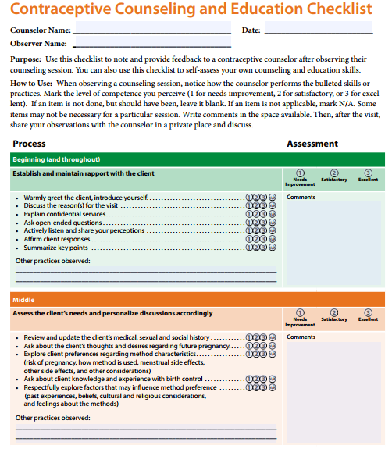
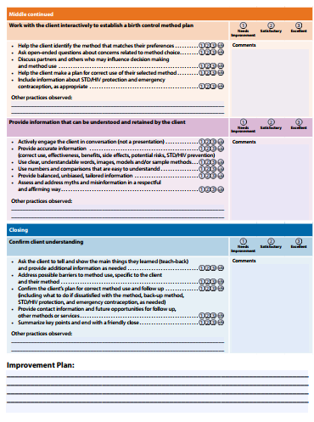
Counseling Observation Checklist
Link: http://www.cardeaservices.org/documents/Observational_Contraceptive_Counseling_Checklist.pdf
Notes:
Facilitator Notes
There are additional resources, such as this checklist, to note and provide feedback to a contraceptive counselor after observing counseling session. You can also use this checklist to self-assess your own counseling and education skills.

Slide 25
Interpersonal Quality Family Planning Scale
Think about your visit with [provider] today. How do you think they did? Please rate them on each of the following by circling a number. | Poor | Fair | Good | Very good | Excellent
Respecting me as a person | 1 | 2 | 3 | 4 | 5
Letting me say what mattered to me about my birth control method | 1 | 2 | 3 | 4 | 5
Taking my preferences about my birth control seriously | 1 | 2 | 3 | 4 | 5
Giving me enough information to make the best decision about my birth control method | 1 | 2 | 3 | 4 | 5
Dehlendorf C et al. Contraception. 2017
Notes:
Facilitator Notes
The Interpersonal Quality Family Planning Scale is a series of questions, developed by researchers at the University of California San Francisco, to assess patient experiences with counseling.
Clinics can consider incorporating this question as part of their patient satisfaction survey, or other feedback form, to elicit responses from patients.
Source (for reference)
Dehlendorf C, Henderson JT, Vittinghoff E, Steinauer J, Hessler D. Development of a patient-reported measure of the interpersonal quality of family planning care. Contraception. 2017 Sep 18. pii: S0010-7824(17)30437-7. doi: 10.1016/j.contraception.2017.09.005.

Slide 26
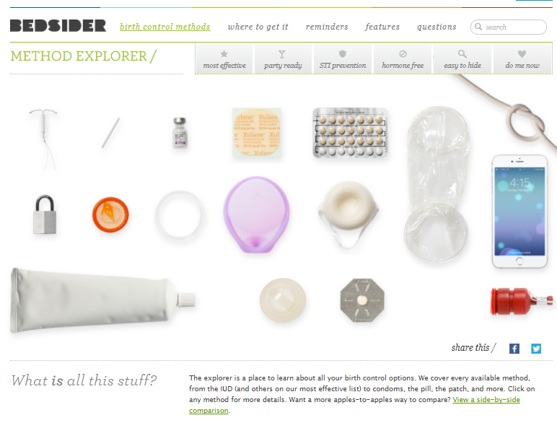
Patient Education: Bedsider.org
Notes:
Facilitator Notes
Great materials are available from Bedsider.org, including this free online Birth Control Method Explorer.
Bedsider.org is an online birth control support network for women 18-29 operated by The National Campaign to Prevent Teen and Unplanned Pregnancy, a private nonprofit organization.
Providers can order print materials from: https://shop.thenationalcampaign.org/.

Slide 27
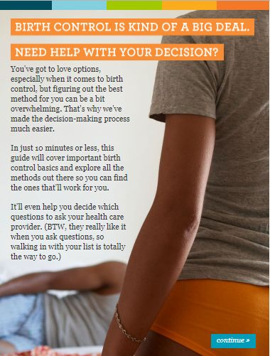
Patient Education: Online Decision Support Tool
In ~10 minutes, walks patients through basics on contraceptive methods, with goal of helping patients identify their questions to ask providers about different methods
Link: https://clinic.mybirthcontrol.org/
Notes:
Facilitator Notes
Another great online resource is the Online Decision Support Tool.
This tool was developed through a collaboration between University of California San Francisco and Bedsider.
In about 10 minutes, this tool walks patients through the basics on contraceptive methods, with the goal of helping them figure out the questions about methods they want to ask their providers.

Slide 28
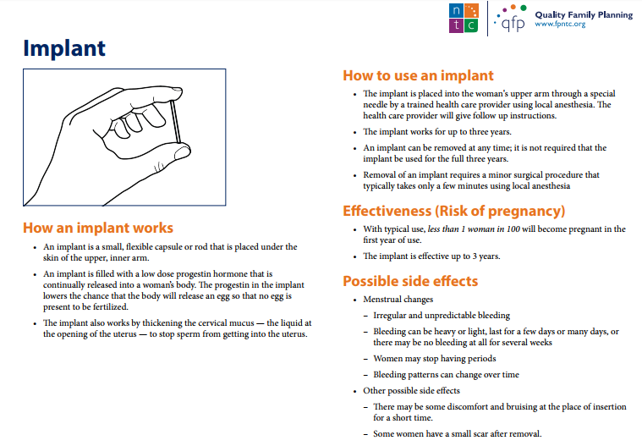
Patient Education:
Explaining Contraception Handouts
Handout with details and characteristics available for each method
Link: https://fpntc.org/sites/default/files/resource-library-files/TrainingTools-ExplainingContraception.pdf
Notes:
Facilitator Notes
Another resource is this series of handouts on Explaining Contraception for providers. It gives a snapshot of each method to support counselors while they are talking with patients.
Discuss
What patient education resources do you use?
How do you use them? Do you refer to them together or hand them to the patient to read?
Do you provide them before the visit, in the waiting room, in the exam room?

Slide 29
Further Reading on Shared Decision Making
Dehlendorf C, Grumbach K, Schmittdiel JA, Steinauer J. Corrigendum to "Shared decision making in contraceptive counseling" [Contraception (2017) 95:452-455]. Contraception. 2017 Sep 05. PMID: 28886761.
Dehlendorf C, Anderson N, Vittinghoff E, Grumbach K, Levy K, Steinauer J. Quality and Content of Patient-Provider Communication About Contraception: Differences by Race/Ethnicity and Socioeconomic Status. Womens Health Issues. 2017 Sep - Oct; 27(5):530-538.
Dehlendorf C, Grumbach K, Schmittdiel JA, Steinauer J. Shared decision making in contraceptive counseling. Contraception. 2017 May; 95(5):452-455. PMID: 28069491.
Dehlendorf C, Krajewski C, Borrero S. Contraceptive counseling: best practices to ensure quality communication and enable effective contraceptive use. Clin Obstet Gynecol 2014; 57(4): 659-73.
Dehlendorf C, Levy K, Kelley A, Grumbach K, Steinauer J. Women's preferences for contraceptive counseling and decision making. Contraception 2013; 88(2): 250-6.
Higgins JA. Celebration meets caution: LARC's boons, potential busts, and the benefits of a reproductive justice approach. Contraception 2014; 89(4): 237-41.
Notes:
Facilitator Notes
There is a lot of great research that is going on right now about quality contraceptive counseling. Here is a sample of further reading, if you are interested.

Slide 30
Success Story: Standard Messages and Documentation (AZ Family Health Partnership)
Reproductive life planning training for providers including
  Overview of reproductive life planning
  How to document in EHR
  Standardized messaging
2 months later, 80% of female patients had documented reproductive life plan, up from 50%
Key points: Standardizing messaging and reviewing documentation are important aspects of provider training.
Notes:
Facilitator Notes
We know it can be valuable to see how are other Title X sites are implementing these best practice recommendations. Let’s look at a success story from the field.
This is a story from a site that participated in the Family Planning National Training Center (FPNTC) Performance Measurement Learning Collaborative. Their story was written up and included in the Contraceptive Access Change Package.
Arizona Family Health Partnership set the goal that by May 2016, 60% of their female patients seen in the Theresa Lee Public Health Center would have documented reproductive life plans, a 20% increase from their baseline. They scheduled a training (providers were required to attend) that included an overview of reproductive life planning, how to document the reproductive life plan in the patient’s record, and standardized messaging for providers to use. Over 20 providers attended. Using a pre/post-test, they were able to measure an increase in staff knowledge of reproductive life planning questions, when and how often to ask these questions, and how to document the results. A chart audit conducted two months after the training revealed that 79% of women had reproductive life plans documented, exceeding their initial goal of 60%.
The key points of this story: standardizing messaging related to counseling (what to say), and reviewing documentation protocols (where to put it) are important aspects of provider training.
Discuss (if time allows)
What strategies have you used/can you use to increase consistency of messaging and/or documentation of counseling?

Slide 31
Success Story: Engaging All Staff
(NJ Family Planning League)
Reproductive life planning training for providers including
  For all staff, including Front Desk staff
  Provided opportunity for staff to practice new skills in assessing for reproductive intention
Chart audit showed that 90% of patients had reproductive life plan documented after staff training
Key point: Engage all staff and provide an opportunity for staff to practice new skills in training.
Notes:
Facilitator Notes
A second success story from the field is from a site that participated in the FPNTC’s Performance Measurement Learning Collaborative, and is also included in the Contraceptive Access Change Package.
New Jersey Family Planning League’s Paterson site tested a strategy to increase the frequency of assessing pregnancy intention. They provided training on reproductive life planning for all staff, including front desk staff. The training consisted of an overview of reproductive life planning questions and role plays for staff to practice new skills. Clinic staff say that this comprehensive training dramatically improved counseling flow and comfort related to assessing pregnancy intention. New Jersey Family Planning League then collected data on the rates of documented reproductive life plans. A chart audit in March 2016, after the staff training, revealed that 90% of patients had a documented reproductive life plan at the Paterson site.
The key point of this story is that it’s important to engage all staff and provide an opportunity for staff to practice new skills in counseling training.
Discuss (if time allows)
What roles can your front desk, billing, and administrative staff play in implementation of counseling best practice strategies?

Slide 32

What other questions do you have?
What other issues would you like to discuss?
Notes:
Discuss (if time allows)
What other questions do you have for each other before we end? Are there other issues or challenges that we haven’t discussed yet? (Note to facilitators: If challenges came up in earlier discussions, this could be a good time to discuss them.)
Before we leave, what is one thing you will take away from today’s discussion? (Note to facilitators: Consider round robin sharing or ask a couple of participants to share.)

Slide 33
Thank you!
Contact:
fpntc@jsi.com
Notes:
Facilitator Notes
Thank you for participating in today’s discussion.
If applicable, you can contact me at:_________
You can also always contact the Family Planning National Training Center (fpntc@jsi.com) with questions/comments.

