Slide 1
Establishing and Providing Effective Referrals for Family Planning Clients
Notes:
Facilitator Notes
Providing referrals to Title X clients is a core component of clinical care, and essential for ensuring access to the full range of services Title X clients may need. Quality care includes providing referrals for medical and social needs beyond the scope of clinic services.
Activity
Conduct participant and facilitator introductions.

Slide 2
Learning Objectives
By the end of this session, participants will be able to:
Describe the Title X Program Requirements related to providing referrals
Explain at least two reasons providing effective referrals is critical to quality care
List at least three strategies for creating systems to provide high-quality referrals
Notes:
Facilitator Notes
This session will share some strategies and resources Title X grantees can use to provide (or engage in oversight of) their sub-recipients to provide referrals.
By the end of this session, participants will be able to:
Describe the Title X Program Requirements related to providing referrals
Explain at least two reasons providing effective referrals is critical to quality care
List at least three strategies for creating systems to provide consistent, high-quality referrals

Slide 3
Family Planning is Entry Point to Health Care
Usual Source of Care for Title X Clients
Source: Gold RB et al, Next Steps for America's Family Planning Program: Leveraging the Potential of Medicaid and Title X in an Evolving Health Care System. Guttmacher Institute 2009.
Notes:
Facilitator Notes
For many women and men of reproductive age, family planning service sites are their only source of health care.
Six out of 10 Title X clients at publicly funded family planning centers identify these clinics as their “usual source of care.”
Family planning sites are often an entry point for all services needed by their clients, and visits should include provision of—or referral to—other preventive health services.
Quality care for Title X clients includes providing referrals for medical and social needs beyond the scope of clinic services to ensure access to the full range of services that clients may need.
Source
Gold RB et al, Next Steps for America's Family Planning Program: Leveraging the Potential of Medicaid and Title X in an Evolving Health Care System. Guttmacher Institute 2009.
Gavin L, Pazol K, Ahrens K. Update: Providing Quality Family Planning Services—Recommendations from CDC and the U.S. Office of Population Affairs, 2017. MMWR Morb Mortal Wkly Rep 2017; 66. doi:10.15585/mmwr.mm6650a4.

Slide 4
Title X Program Requirements
Availability of Social Services:
  Other social and medical services agencies, any ancillary services which may be necessary to facilitate clinic attendance
Availability and Use of Referrals:
  Other providers of healthcare services, local health and welfare departments, hospitals, voluntary agencies, and health services projects supported by other federal programs
Provision of Family Planning and Related Services:
  Necessary referrals to other medical facilities when medically indicated
Notes:
Facilitator Notes
Providing referrals is a Title X Program Requirement.
Availability of Social Services: Projects must provide for social services related to family planning including counseling, referral to and from other social and medical services agencies, and any ancillary services which may be necessary to facilitate clinic attendance.
Availability and Use of Referrals: Projects must provide for coordination and use of referral arrangements with other providers of healthcare services, local health and welfare departments, hospitals, voluntary agencies, and health services projects supported by other federal programs.
Provision of Family Planning and Related Services: All projects must provide for medical services related to family planning and the effective usage of contraceptive devices and practices (including physician’s consultation, examination, prescription, and continuing supervision, laboratory examination, contraceptive supplies) as well as necessary referrals to other medical facilities when medically indicated.
Source
Office of Population Affairs. Title X Program Requirements. https://www.hhs.gov/opa/guidelines/program-guidelines/program-requirements/index.html

Slide 5
Other Health & Social Service Providers
Emergencies that require referral
Other providers of health care services not provided on site
Infertility specialists
Health services projects supported by other federal programs
Chronic care management providers
Behavioral health services
HIV/AIDS care and treatment
Hospitals
Local health and welfare departments
Voluntary agencies
Child care agencies
Transportation providers
Emergency housing
WIC programs
Notes:
Facilitator Notes
Title X-funded agencies are expected to develop and implement plans to coordinate with and refer clients to other providers of health care and social services such as:
Emergencies that require referral
Other providers of health care services not provided on site
Infertility specialists
Health services projects supported by other federal programs
Chronic care management providers
Behavioral health services
HIV/AIDS care and treatment
Hospitals
Local health and welfare departments
Voluntary agencies
Child care agencies
Transportation providers
Emergency housing
WIC programs
Efforts may be made to aid the client in finding potential resources for reimbursement of the referral provider, but projects are not responsible for the cost of this care.
Discuss
Are there other agencies you frequently refer clients to?
What agencies refer to you for family planning services?

Slide 6
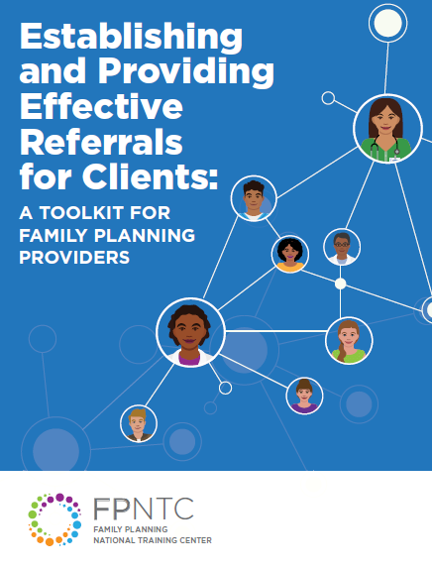
Establishing and Providing Effective Referrals Toolkit
Notes:
Facilitator Notes
The Establishing and Providing Effective Referrals for Clients: A Toolkit for Family Planning Providers outlines ways to establish systems for consistent provision of referrals in order to support Title X grantees’ abilities to provide effective referrals. These include developing sample policies and strategies, such as a memorandum of understanding, for providing high-quality supportive and effective referrals. The toolkit also contains resources for training subrecipients and service sites.

Slide 7
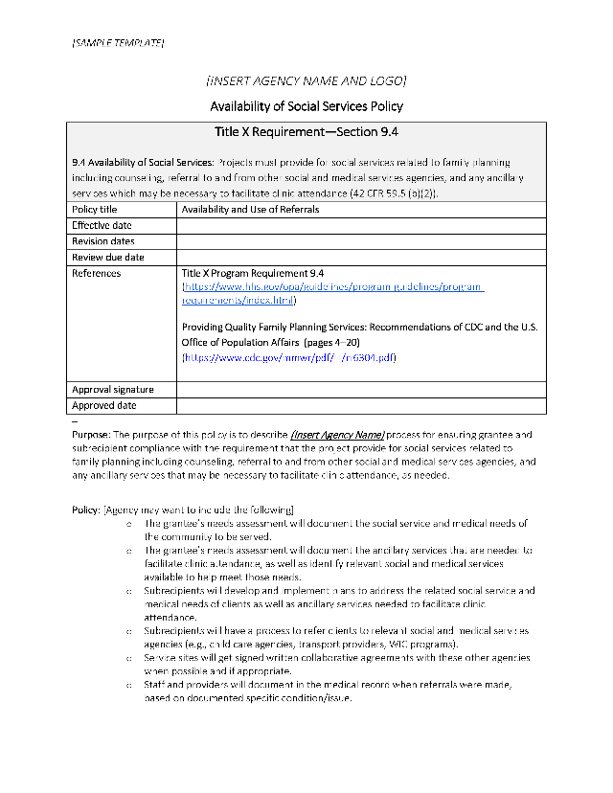
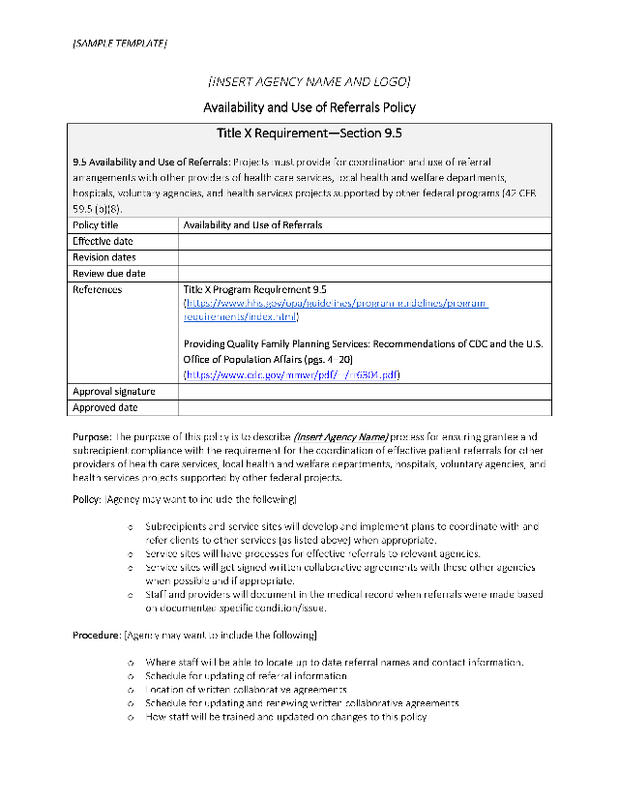
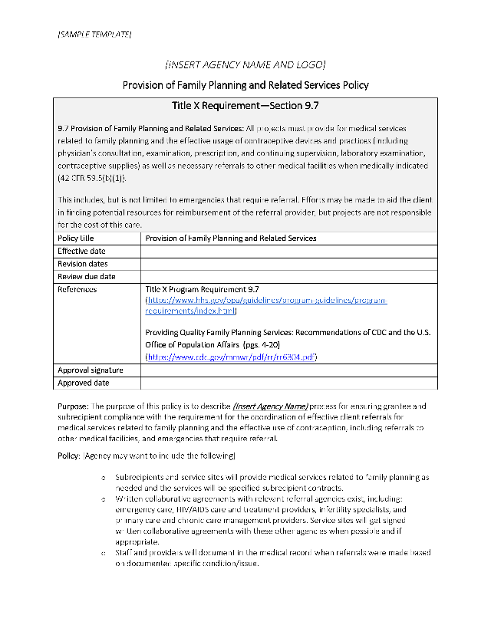
Written Policies
Develop Written Policies for Referrals
Notes:
Facilitator Notes
Title X grantees are expected to have a written policy requiring subrecipients and service sites to have referral policies.
Sample policy templates are included in the toolkit and are available on FPNTC.org.

Slide 8


Relationships with Other Service Providers
Explore and build relationships with other service providers
  Initiate conversations with specialists, hospitals, and community services
  Determine the value-add of potential referral partnerships
Primary Care Partnership Video
Notes:
Facilitator Notes
Title X agencies should identify other health care and social service agencies serving the same target population to explore whether an informal or formal relationship would be mutually beneficial.
Initiate conversations with key specialists, hospitals, and community services around mutual expectations for referrals. Be prepared to discuss the value of partnering with a Title X agency.
Determine the value-add of potential referral partnerships. How can you benefit the partner organization? What do you bring “to the table”?
This video on primary care partnerships presents a conversation between a Title X clinic and a federally qualified health center about establishing a memorandum of understanding for a formal referral agreement. Key points for making the case for a partnership, as well as how to respond to objections, are covered.

Slide 9
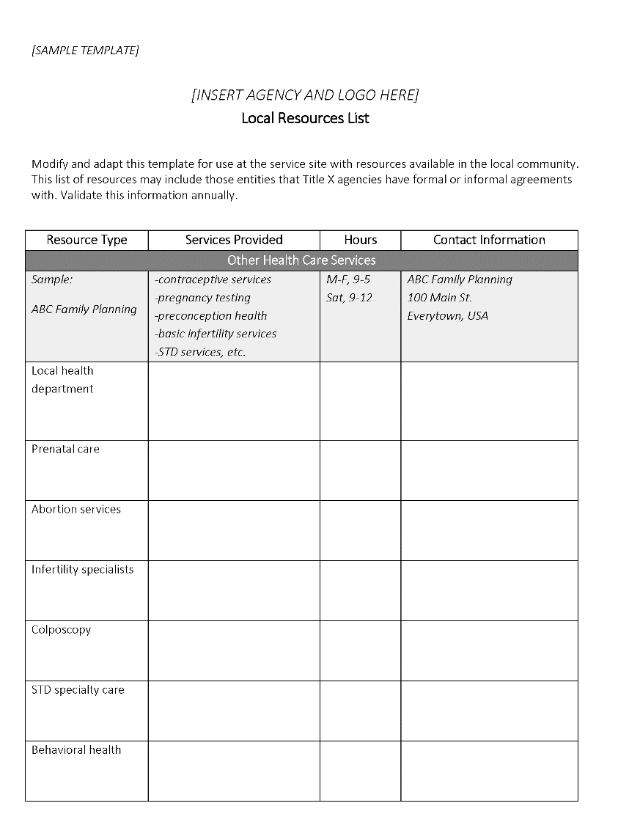
Local Resource List
Notes:
Facilitator Notes
Develop a list of local resources, including key contacts at each organization.
This Local Referrals Resource List can be modified and adapted for use with your local community.
Post or keep this list in a location that is easily accessible to all staff.
Develop a system to ensure list is accurate. Confirm or update the information at least annually, making sure that phone numbers are still correct, contact people still there, and addresses haven’t changed.
When possible, speak to someone at the service site. Visit the location, ask about updates, tell them about your services, and renew/review referral relationship when appropriate.

Slide 10
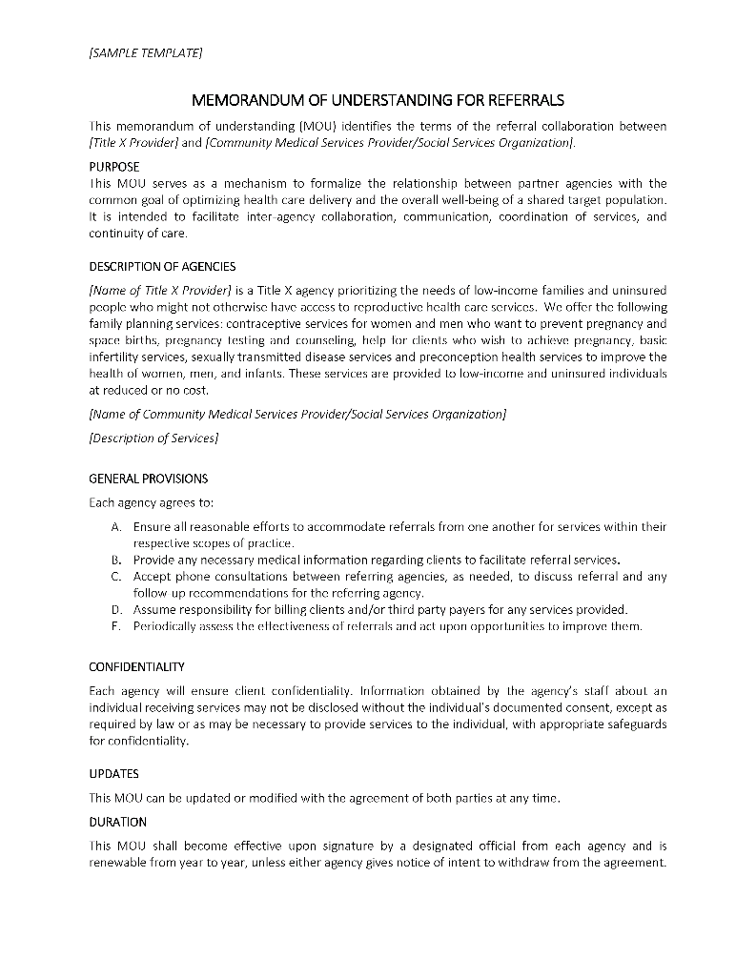
Referral Agreements
A memorandum of understanding (MOU) is a written document, generally not legally binding, that outlines a voluntary agreement between parties.
Notes:
Facilitator Notes
Establish referral agreements with other service providers.
For instance, a memorandum of understanding (MOU) is a written document that outlines a voluntary agreement between parties. It can facilitate inter-agency communication, coordination of services, and continuity of care for clients. A MOU is not legally binding—does not need to include complicated legal conditions, exclusions, indemnifications, etc. It should support the work of the collaboration, not inhibit it.
Developing and signing written, collaborative agreements can help to clarify both parties’ expectations and responsibilities in the partnership.
This is one sample of a MOU to adapt and use to fit any number of specific circumstances. (There are also sample letters of introduction in the toolkit.)

Slide 11
Referral Types
A cold referral may be appropriate for services like: | A warm referral may be appropriate for services like:
Alcoholics Anonymous | Syphilis treatment
Weight management treatment | Evaluation of a palpable breast mass
Food stamps | An HIV positive test result
WIC | Prenatal care
Notes:
Facilitator Notes
Referrals may be given to one of these agencies with whom you have a MOU, or to other agencies/services in the community.
Referrals should be provided any time a clinician determines that a client has either medical or social service needs beyond the scope of the clinic’s services.
Not all referrals, however, require the same level of support. There are different types of referrals.
Referrals can be described as either “cold” or “warm.”
A cold referral is providing information to the client about another agency or service. It is the client’s responsibility to contact the other agency.
Example: handing the client a business card or providing the name and phone number of a local resource
A warm referral involves contacting another agency or service provider on the client's behalf and following up to determine if appointment was kept.
Example: calling another local service provider and making an appointment for the client (Note: This would not be appropriate for abortion services referral within a Title X Program.)
Source:
Clarke S, Forell S. Pathways to justice: the role of non-legal services. Law and Justice Foundation of NSW 2007 June; 1. http://www.lawfoundation.net.au/ljf/site/articleIDs/B0B818584C14F361CA257306000716A2/$file/pathways_to_justice.pdf

Slide 12
Provide Supportive Referrals
Clients face potential barriers to accessing services:
Finances
Language
Transportation
Lack of child care
Age-based consent issues
Legal and policy
Fear of a lack of privacy
Fear of judgement
Fear of scorn, intimidation, coercion, or threats
Fear of disclosing immigration status
Notes:
Facilitator Notes
Providing high-quality referrals involves assessing individual clients’ circumstances, identifying potential barriers, and helping them to problem-solve and reduce all barriers, therein increasing their ability to access referral services.
Without support, clients may receive referral information, but still not access services.
Some of the many barriers Title X clients may face in accessing services are related to:
Finances
Language
Transportation
Lack of child care
Age-based consent issues
Legal and policy
Fear of a lack of privacy
Fear of judgement
Fear of scorn, intimidation, coercion, or threats
Fear of disclosing immigration status

Slide 13
Provide Referrals Proactively
Train staff on skills needed to:
  Identify referral needs
  Speak directly to the provider
  Provide a verbal and/or written handoff
  Manage difficult situations
  Follow up with the client about the referral
Notes:
Facilitator Notes
It’s important to train staff on the need for and skills related to providing effective referrals and helping clients to overcome potential barriers.
Provide staff an opportunity to practice key skills such as how to:
Identify referral needs
Speak directly to the referral provider (as appropriate)
Provide a verbal and/or written handoff (with the person's consent)
Manage difficult situations
Follow up with the client about the referral

Slide 14
Document and Develop Systems Support
Designate staff roles
Use a standard protocol and consistent documentation in the medical record
  The reason for referral, informed consent of the client, and any correspondence with the referral provider/organization should be included.
Develop shared referral tools and processes for services that you regularly refer to
Notes:
Facilitator Notes
Ensure that referrals and associated processes are well-documented, and periodically assess how these processes are working. Make adjustments accordingly.
Designate staff roles to provide referrals, along with a process for communicating that referrals have been made.
Use a standard protocol and consistent documentation for referrals in the medical record. The reason for referral, informed consent of the client, and any correspondence with the referral provider/organization should be included.
Develop shared referral tools and processes for services that you regularly refer to (and those that regularly refer to you).

Slide 15
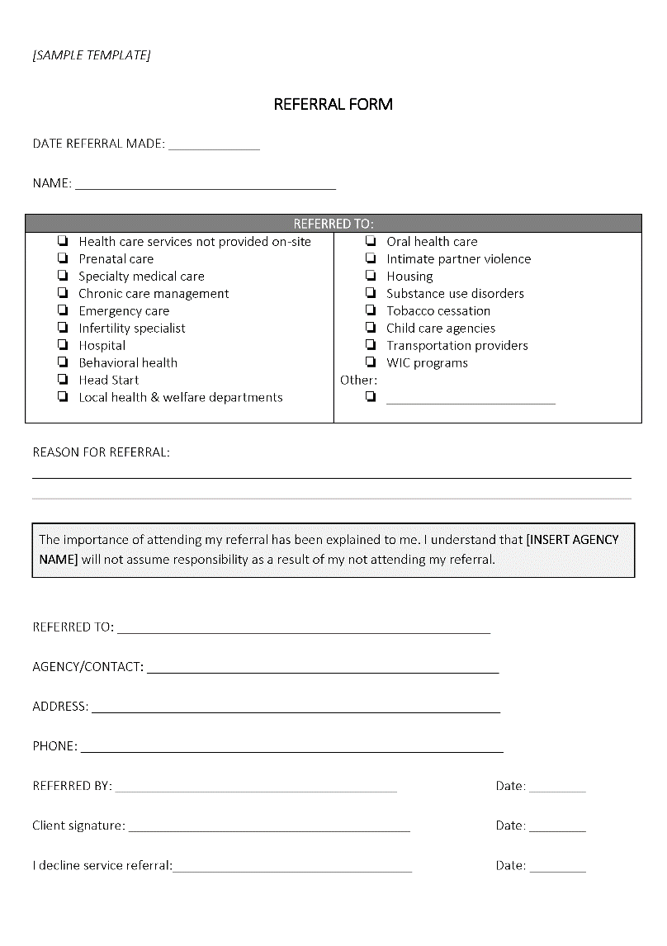
Sample Referral Form
Notes:
Facilitator Notes
Develop shared referral tools and processes for services that you regularly refer to (and those that regularly refer to you). Take a look at this sample referral form.
Discuss
What are we trying to accomplish? What is our goal?
How will we know (i.e., measure) that a change is an improvement?

Slide 16
Close the Loop
Identify client preference for communication and follow up
Set clear expectations at the time of referral
Ensure confidentiality for any provider to provider communications
Notes:
Facilitator Notes
Close the loop on communication. Not all referrals are the same, but for those with high levels of urgency and priority, it is imperative to establish a plan for follow up to determine if the appointment was kept.
Determine preferred and acceptable methods of communication.
Set clear expectations at the time of referral.
For provider communication, ensure confidentiality with signed consent forms.
Consider setting defined urgency criteria for different types of referral to ensure adequate follow up.

Slide 17
Track Referrals
Ensure adequate management of referrals
  EHR download
  Referral management software
  Manually enter on a grid
Notes:
Facilitator Notes
Track referrals to ensure adequate management.
This can be done by using “dummy codes” and downloading a report from your EHR, through use of referral management software, or by keeping a tally by manually entering on a grid that tracks required follow up for priority referrals.
Be sure to respect client confidentiality in all referral management.

Slide 18
Apply Principles of Quality Improvement
Verify referral information annually
If a referral is not completed, ask and document the reason
Periodically assess effectiveness of referral services
  Ask clients
  Ask referral agencies
Use principles of quality improvement to make changes to the referral process as necessary
Notes:
Facilitator Notes
Apply principles of quality improvement to the referral process.
As we discussed under the “document and develop systems support” slide, there are systems you want to have in place; they will support all your quality improvements efforts.
Verify referral information (contact information, hours, location) on an annual basis to ensure that it is current.
Clients are not obligated to follow up with referral recommendations. If a referral is not completed, talk to the client during the next visit to find out why, and document the response.
Periodically assess the effectiveness of referral services. Ask clients about their referral experience, and ask the partner agencies about their experience giving and receiving your client referrals.
Use principles of quality improvement to make changes to the referral process as necessary.

Slide 19
STAR Model for Referral Quality
Be a STAR:
Supportive
  Meet their needs
Thorough
  Pass on knowledge
Active
  Identify potential barriers
Referral quality
  Learn from and update
Notes:
Facilitator Notes
The “STAR Model” is a referral approach that helps service providers to make high-quality referrals. The STAR Model encourages staff to provide referrals that are:
Supportive: Do you know your role with your client and are you supporting them through provision of referrals to meet their other health care or community resource needs?
Thorough: Do you have the knowledge you need and have you passed on what you can about those services to your client?
Active: Have you helped your client locate and schedule, as indicated, the care she/he needs? Have you assessed your clients’ needs for supportive resources (e.g., language translation, culturally/linguistically appropriate services, child care, transportation) to help them utilize the services they are seeking?
Referral quality: Do you continuously learn from, and update, information in your referral information systems to ensure high-quality referrals? If appropriate, can you check with your client about the referral at a later date?
Source
Zurek M, O’Donnell J, Hart R, Rogow D. https://www.contraceptionjournal.org/article/S0010-7824(14)00701-X/fulltext

Slide 20
Peer Observation Activities
Pair off.
Use Handout 1: STAR Model
Select and act out one or more scenarios.
Role-play and get feedback from partner.
Switch roles and repeat.
Ask one pair of volunteers to role-play a scenario for the larger group.
Notes:
Facilitator Notes
The STAR Model: Referral Quality Staff Observation Activity is a training activity designed to build the confidence and comfort of staff providing referrals. It also provides an opportunity to improve the quality of referrals through peer feedback.
Activity
Participants pair off.
Use Handout 1 as a reminder of the STAR components.
Use Handout 2 to select and act out one or more scenarios. One participant plays the role of the client, one plays the referral-maker, and other participants are observers/mentors.
Role-play; ask partners to give each other feedback.
Discuss
What went well? Not so well? Was every aspect of the STAR model considered?
Second Activity
•Before asking all participants to reflect even more on using the STAR model (next slide), seek one pair of volunteers to role-play another scenario from Handout 2 for the larger group (a “fishbowl” activity).
Source
Zurek M, O’Donnell J, Hart R, Rogow D. https://www.contraceptionjournal.org/article/S0010-7824(14)00701-X/fulltext

Slide 21
Reflection
What went well?
Not so well?
Was every aspect of the STAR model considered?
  Supportive?
  Thorough?
  Active?
  Referral quality?
Notes:
Facilitator Notes
Now that one scenario has been role-played in front of the group, encourage participants to share their observations, referring to the STAR model.
Specifically, was the referral-maker in this scenario:
Activity
Get feedback on the role play from the larger group.
Was the referral-maker in the scenario:
Supportive? Compassionate? Non-judgmental?
In what ways?
Thorough? Complete?
Did the referral-maker gather and share all of the information needed for an effective referral?
Was the referral-maker knowledgeable about the services the client was seeking?
Active? Was this a “warm” or “cold” handoff?
Did the referral-maker do enough to locate and schedule the care the client needed?
Did the referral-maker address all of the potential barriers the client might face, keeping her/him from utilizing the referral?
Referral quality? Was there anything that could be improved?
Was there anything missing?
Did the client seem satisfied? Would you be if you were the client?
What could have been done or said differently?
Providing referrals is a core component to patient-centered, high-quality care. Keep the STAR model in mind when providing high-quality referrals.

Slide 22
Thank you!
www.fpntc.org
Notes:
Facilitator Notes
Thank you for participating in today’s discussion.
Discuss
For these resources and others, go to FPNTC.org.
Questions?

