Slide 1
Reducing Missed Opportunities for HPV Vaccinations at Title X Sites
December 3, 2019
Notes:
Welcome to today's webinar, Reducing Missed Opportunities for HPV Vaccinations at Title X Sites

Slide 2
Meet our speaker!
Cynthia Rand, MD, MPH
Associate Professor, Pediatrics
University of Rochester Medical Center
Cynthia_Rand@urmc.rochester.edu
Disclosures: None
Notes:
Dr. Rand is a general pediatrician and health services researcher who focuses on providing preventive care to pediatric clients in Rochester.
Her research experience combines expertise in adolescent immunization and preventive services delivery, quality improvement, and health informatics.
Dr. Rand is involved nationally in the American Cancer Society HPV Vaccine Roundtable, and is a member of the New York State HPV Vaccine Coalition.
She is Co-PI of a multi-center project, funded by the CDC, to improve HPV vaccination rates using QI methods in residency clinics and private practices nationwide. Over 300 practices have participated in the project and made significant improvements in HPV immunization rates.
In addition, Dr. Rand supervises residents and sees her own patients in a busy pediatric continuity clinic which provides the context for her translational research.

Slide 3
Learning Objectives
By the end of this session, participants will be able to:
Describe the burden of HPV infection and disease
Describe HPV vaccination rates in the U.S.
Explain HPV vaccine guidelines, insurance coverage, effectiveness, and safety
Implement strategies to increase HPV vaccination rates in family planning sites
Notes:
The learning objectives of this are:
To describe the burden of HPV infection and disease.
To describe HPV vaccination rates in the U.S.
To explain HPV vaccine guidelines, insurance coverage, effectiveness and safety, and
Finally, we'll talk about implementing strategies to increase HPV vaccination rates and family planning sites.

Slide 4
OBJECTIVE 1
Burden of HPV infection and disease

Slide 5
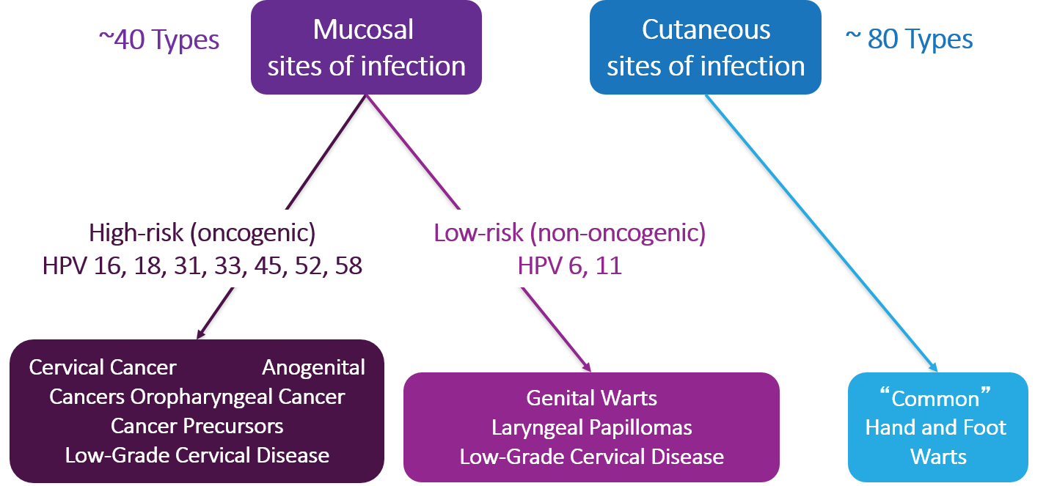
HPV Types Differ in Their
Disease Associations
Notes:
HPV types differ in their tendency to infect cutaneous and mucosal or genital epithelium.
There are approximately 40 types frequently found in the genital tract.
These are grouped as high risk or oncogenic types, including HPV 16, HPV 18.
Persistent infection with these types can result in cancers, including cervical, other anogenital and orpharyngeal cancer, and low-grade cervical disease.
Low-risk or non-oncogenic types, such as types HPV 6, HPV 11 can cause anogential warts as well as laryngeal papillomas and low-grade cervical disease.
The cutaneous HPV types cause the common hand and foot warts.

Slide 6
HPV Infection
Most people will be infected with at least one type of mucosal HPV at some point in their lives
  ~79 million Americans currently infected
  14 million new infections/year in the U.S.
  HPV infection is most common in people in their teens and early 20s
Most people will never know that they have been infected
Source: Jemal A et al. J Natl Cancer Inst 2013;105:175–201
Notes:
Most HPV infections happen during the teen and young adult years because HPV infection usually occurs soon after sexual debut.
Most people never know that they have been infected. Women may find out they are infected because of an abnormal pap test with a positive HPV test or a diagnosis of genital warts. Men may find out because of a genital warts diagnosis as well.

Slide 7
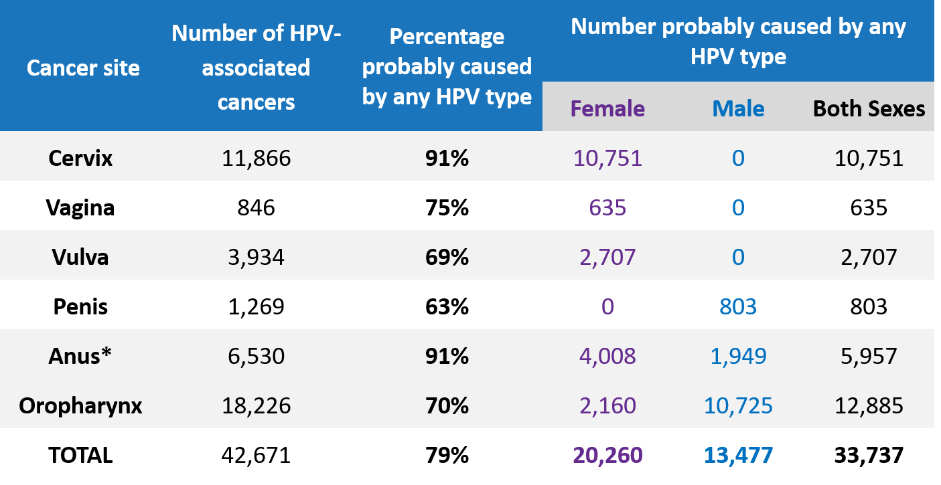
Number of HPV-Associated and HPV-Attributable Cancer Cases per Year
U.S., 2011–2015
*Includes anal and rectal squamous cell carcinomas
Sources: https://www.cdc.gov/cancer/hpv/statistics and Saraiya M et al. J Natl Cancer Inst. 2015;107
Notes:
This slide shows the numbers that were displayed in the figure in the previous slide and focuses on the number of cancers attributable to HPV per year in the United States from 2010 to 2015.
An HPV-attributable cancer is a cancer probably caused by HPV. The column with “percentage probably caused by any HPV type” comes from the CDC genotyping study.
HPV causes nearly all cervical cancers and many cancers of the vagina, vulva, penis, anus (including rectal squamous cell carcinoma), and oropharynx.
CDC estimated that during 2010 to 2015, HPV caused about 42,671 cancers in the U. S. each year, with 24,391 cancers in women and 18,280 cancers in men. Most HPV-associated cancers in women were cervical cancers, while in men most were oropharyngeal cancers.

Slide 8
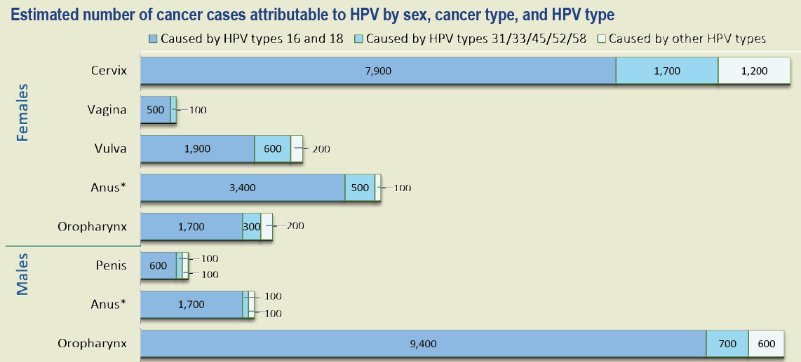
Number of HPV-Associated and HPV-Attributable Cancer Cases per Year, U.S., 2011–2015
^{b} Includes anal and rectal squamous cell carcinomas
.
For each cancer type, we estimated HPV-attributable cancers by multiplying the number of cancer cases by the percentage attributable to HPV based on a genotyping study. We estimated that 33,700 cancers (79%) were attributable to HPV each year during 2011–2015. Of these, we estimated that 31,200 cancers could have been prevented by the 9-valent HPV vaccine, including 27,100 caused by HPV types 16 and 18, and 4,100 caused by HPV types 31/33/45/52/58. HPV-negative cancers are not shown in the graph; it is estimated that about 10% of cervical and anal cancers, 30% of oropharyngeal, vaginal, and vulva cancers and 40% of penile cancers are HPV-negative.
Source: https://www.cdc.gov/cancer/hpv/pdf/USCS-DataBrief-No4-August2018-508.pdf
Notes:
The original Gardasil vaccine prevented HPV type 6 and 11 that causes 90% of genital warts, plus it prevented type 16 and 18.
This slide shows that most of the cases of cancer that we speak about cervical and all of the anogenital cancers as well as oropharyngeal are related to those types in the original Gardasil vaccine 16 and 18 in the medium blue here.
In the lighter blue, you can see that another 15% of cervical cancers plus some oropharyngeal cancers are prevented from the additional five types that were added to the nine-valent vaccine.
The vaccine that's available now is called Gardasil 9 and covers those additional types.
There are a few caused by other HPV types that are not covered by the vaccine.
The vaccine is expected to cover over 90% of cases of cervical cancer and over 70% of cases of oropharyngeal cancer.
Source: Estimated number of cancer cases attributable to HPV by sex, cancer type, and HPT type
https://www.cdc.gov/cancer/hpv/pdf/USCS-DataBrief-No4-August2018-508.pdf

Slide 9
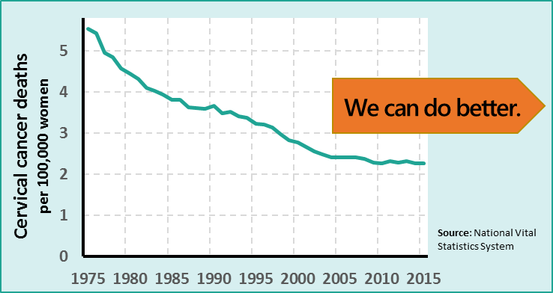
Cervical Cancer
Cervical cancer is the most common HPV-associated cancer among women
  570,000 new cases
  and 270,000 deaths
  worldwide in 2018
  In 2019 ~ 13,200
  new cases and 4,250
  deaths in the U.S.
Half of cervical cancers occur in women <50 yrs.
Sources: https://nccd.cdc.gov/uscs/ and http://gco.iarc.fr/today/home
Notes:
Cervical cancer was once the leading cause of cancer death for women in the United States.
Now it is the most preventable of all of the female cancers.
The Pap test has helped decrease the number of women in the U.S. diagnosed with cervical cancer by about 75% in the past 50 years.
However even with an excellent cervical cancer screening program in the U.S., there are still about 12,000 to 13,000 new cases of cervical cancer and 4,000 deaths each year in this country.
No women should die of cervical cancer. Worldwide, cervical cancer is the 4th most common cancer among women, and in some countries, it is the most common.
Half of cervical cancer cases in the U.S. occur in women younger than 50 years, with 1 in 4 of cervical cancer cases among women ages 25–39 years, during prime reproductive years.
A cervical cancer diagnosis and treatment may be devastating to women—and their families—for a variety of reasons, including negative effects on their health, welfare, finances, and ability to work.
Cervical cancer is treated at minimum with the removal of the cervix but may also include radical hysterectomy, radiation, and/or chemotherapy.
Sources:
Leading Cancer Cases and Deaths, Male and Female, 2016
https://gis.cdc.gov/Cancer/USCS/DataViz.html
Cancer Today, International Association of Cancer Registries
http://gco.iarc.fr/today/home

Slide 10
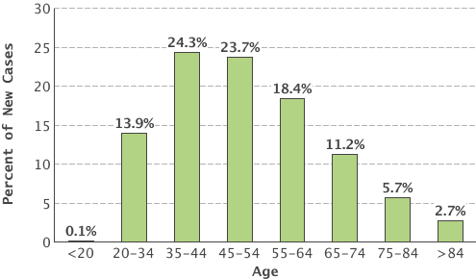
Cervical Cancer During Child-bearing Years
38% of cervical cancers occur in women 20-44 yrs.
Source: http://seer.cancer.gov/statfacts/html/cervix.html
Notes:
Half of cervical cancer cases in the U.S. occur in women who are younger than 50, with 1 and 4 cervical cancer cases among women aged 25 to 39 years during prime reproductive years.
A cervical cancer diagnosis and treatment may be devastating to women and their families for a variety of reasons, including negative effects on their health, welfare, finances and ability to work.
Cervical cancer is treated at a minimum amount with the removal of the cervix, but may also include a radical hysterectomy, radiation and chemotherapy.
Source:
National Cancer Institute, Surveillance, Epidemiology, and End Results (SEER) Program
http://seer.cancer.gov/statfacts/html/cervix.html

Slide 11
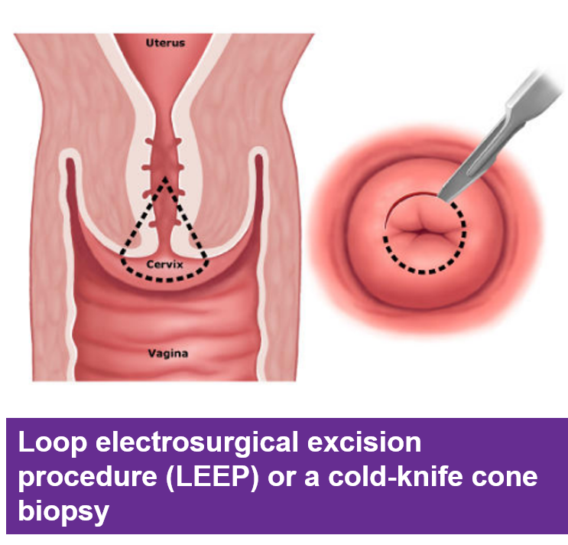
Even pre-cancerous lesions have implications for a woman and her offspring
New cases of cervical dysplasia each year in the U.S.:
  1.4 million
  low-grade
  330,000
  high-grade
Notes:
Even pre-cancerous lesions have implications for a woman and her family.
There are new cases of cervical dysplasia each year in the U.S.
In the pre-vaccine era, every year 1.4 million women were diagnosed with low-grade cervical dysplasia. Imagine being faced with the emotionally trying news of an abnormal pap test, a colposcopy with biopsy, and then waiting to hear whether or not you have cancer.
Additionally, each year, 330,000 women are diagnosed with HIGH-grade cervical dysplasia, or cervical pre-cancer. To receive this diagnosis each of these women had a colposcopy with biopsy.
Then after receiving the diagnosis, many will go on to have a loop electrosurgical excision procedure (LEEP) or a cold-knife cone biopsy of the cervix, which is shown in the image.

Slide 12
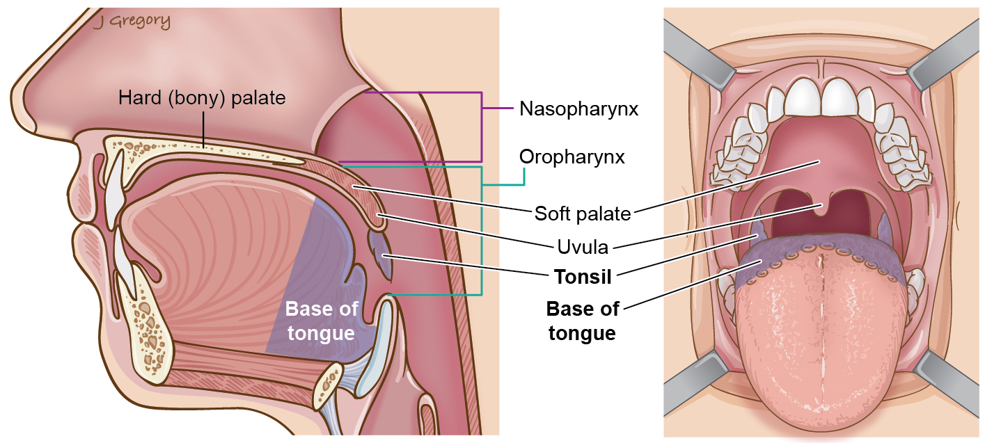
Where is the oropharynx?
Image Source: American Cancer Society
Notes:
This graphic on the right is designed to remind you of where the oropharynx is. It includes the base of the tongue, tonsils, and back of the throat—right behind the soft palate. The image on the left shows the view that an ENT surgeon sees when we’re evaluating someone with suspected oropharyngeal cancer.
Now draw your attention to the SHADED REGION THAT ARE MOST AFFECTED BY HPV-ASSOCIATED CANCERS.
I know that people think of this as an uncommon cancer, but as it was mentioned earlier, the annual number of HPV-positive oropharyngeal cancers has surpassed the annual number of cervical cancers.

Slide 13
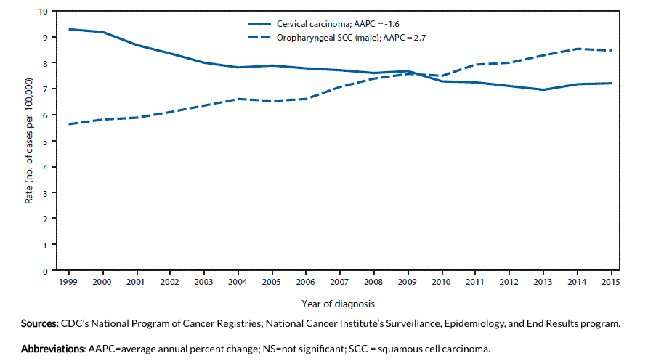
Trends in age-adjusted incidence of cervical carcinoma among females and oropharyngeal SCC among men—U.S., 1999–2015
Notes:
This graphic shows the trends, in the solid line at the top you can see cervical carcinomas declining over time and now there's that plateau.
Unfortunately, that rate of oropharyngeal SCC, or squamous cell carcinoma, is rising and has surpassed those rates of cervical cancers.

Slide 14
Treatment of Oropharyngeal Cancer
Treatment depends on cancer stage
  Early stage cancers: radiation alone or surgery alone
  Advanced staged cancers: require combinations of either surgery followed by radiation or
  concomitant chemotherapy + radiation therapy
Side effects of treatment can be extensive
and disruptive (e.g., may include dental decay and tooth loss, lack of saliva, eating and speech changes, permanent shoulder/arm weakness, fibrotic and atherosclerotic changes to carotid arteries)
Notes:
Oropharyngeal cancer treatment is really a good new, bad news story. It’s great that we have treatment that’s often effective. In early stage, it usually can be treated with radiation alone or surgery alone.
Advanced staged cancers often require combinations of either surgery followed by radiation or concomitant chemotherapy + radiation therapy.
The bad news is that side effects of treatment can be extensive and disruptive (such as the loss of saliva, loss of teeth, speech pathology, and damage to carotids or vital support of shoulder).
I know I’m preaching to the choir when I say how much better it is to prevent disease by vaccinating!

Slide 15
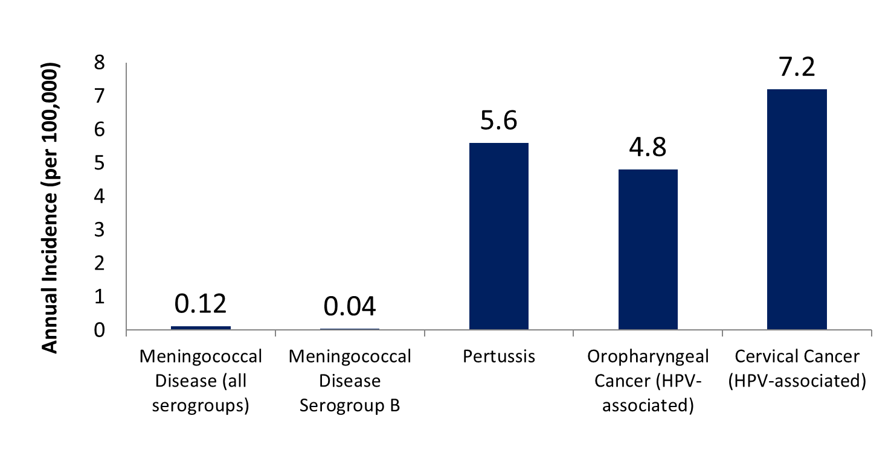
Incidence of Diseases Preventable by Adolescent Vaccine Series, U.S.
Sources: Meningococcal Disease, CDC, 2016, https://www.cdc.gov/meningococcal/downloads/NCIRD-EMS-Report.pdf; Pertussis, CDC, 2016, https://www.cdc.gov/pertussis/downloads/pertuss-surv-report-2016.pdf;
HPV, CDC, 2011-2015, https://www.cdc.gov/cancer/hpv/pdf/USCS-DataBrief-No4-August2018-508.pdf www.cdc.gov/mmwr/volumes/67/wr/mm6733a2.htm#T1_down
Notes:
This slide shows the incidence of diseases that are preventable by adolescent vaccines.
You can see that there are a lot more cases of cervical and oropharyngeal cancer that we can prevent, then there are cases of protest and these diseases are much more common than meningococcal disease.
I advocate for all adolescent vaccines, but it does help to put the incidence of infections into perspective.
Sources:
Meningococcal Disease, CDC, 2016
https://www.cdc.gov/meningococcal/downloads/NCIRD-EMS-Report.pdf
Pertussis, CDC, 2016
https://www.cdc.gov/pertussis/downloads/pertuss-surv-report-2016.pdf
HPV, CDC, 2011-2015
https://www.cdc.gov/cancer/hpv/pdf/USCS-DataBrief-No4-August2018-508.pdf
Trends in Human Papillomavirus–Associated Cancers — United States, 1999–2015
www.cdc.gov/mmwr/volumes/67/wr/mm6733a2.htm#T1_down

Slide 16
OBJECTIVE 2
HPV vaccination rates in the U.S.

Slide 17
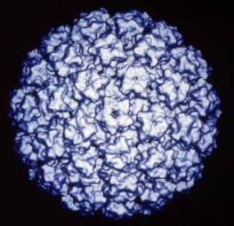
HPV Prophylactic Vaccine
Recombinant L1 capsid proteins that form
“virus-like” particles (VLP)
Non-infectious and
non-oncogenic
Produce higher levels of neutralizing antibody than natural infection
HPV Virus-Like Particle
Notes:
All available prophylactic HPV vaccines are made from virus-like particles.
The vaccines do not contain any viral DNA and therefore are non-infectious and cannot cause actual disease or cancer.
HPV vaccines produce a better immune response than an HPV infection.

Slide 18
Adolescent Vaccination Coverage United States, 2006–2017
Abbreviations: ACIP = Advisory Committee on Immunization Practices; HPV = human papillomavirus; MenACWY = quadrivalent meningococcal conjugate vaccine; Tdap = tetanus toxoid, reduced diphtheria toxoid, and acellular pertussis vaccine; UTD = up to date.
* ≥1 dose Tdap at or after age 10 years; ≥1 dose MenACWY or meningococcal-unknown type vaccine; ≥2 doses MenACWY or meningococcal-unknown type vaccine, calculated only among adolescents aged 17 years at time of interview. Does not include adolescents who received their first and only dose of MenACWY at or after 16 years of age; HPV vaccine, nine-valent (9vHPV), quadrivalent (4vHPV), or bivalent (2vHPV). The routine ACIP recommendation for HPV vaccination was made for females in 2006 and for males in 2011. Because HPV vaccination was not recommended for males until 2011, coverage for all adolescents was not measured before that year; HPV UTD includes those with ≥3 doses and those with 2 doses when the first HPV vaccine dose was initiated before age 15 years and at least 5 months minus 4 days elapsed between the first and second dose.
† ACIP revised the recommended HPV vaccination schedule in late 2016. The recommendation changed from a 3-dose to 2-dose series with appropriate spacing between receipt of the first and second dose for immunocompetent adolescents initiating the series before the 15th birthday. Three doses are still recommended for adolescents initiating the series between the ages of 15 and 26 years. Because of the change in recommendation, the graph includes estimates for ≥3 doses HPV from 2011 to 2015 and the HPV UTD estimate for 2016 and 2017. Because HPV vaccination was recommended for boys in 2011, coverage for all adolescents was not measured before that year.
§ NIS-Teen implemented a revised adequate provider data definition (APD) in 2014, and retrospectively applied the revised APD definition to 2013 data. Estimates using different. APD definitions may not be directly comparable.
Notes:
As you can see, the rates of first and third dose of HPV vaccine are not nearly as high as the coverage rates for the other vaccines routinely recommended for 11 and 12 year olds.
We recommend the Tdap, which is the tetanus diphtheria pertussis vaccine, as well as the meningococcal vaccine regularly at this age, and you can see that in red and blue at the top of the curve.
Also, these vaccines came on the market about the same time, the HPV vaccine has been available and recommended for girls since 2006, and then began to be recommended for boys in 2010.
However, the real important piece of information that this slide provides is that the strong coverage rates for Tdap vaccine demonstrate that not only are most preteens and teens getting to the doctor, but they're also getting at least one of the recommended adolescent vaccines.
That takes out the issue of access, we know there's something else going on here with these low rates of HPV vaccination.

Slide 19
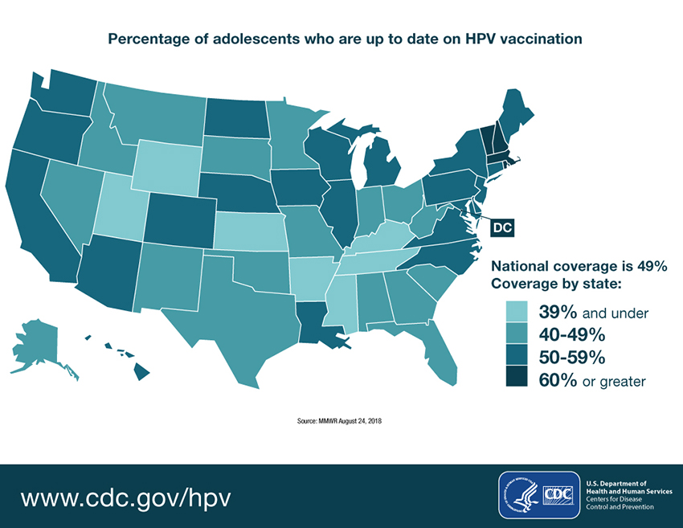
Percentage of adolescents who are up to date on HPV vaccination
Notes:
This infographic shows the percentage of adolescents aged 13 to 17 in each state who are up to date on HPV vaccination.
Take a look at and find the state that you're in and you can see where you stand. The darker colors have a rate of 60% or greater, and then the lightest color has 39% and under.
The highest rate in the country is in Rhode Island, which is at 78% and the lowest is in Mississippi at 33% with an average of 51% of the teens who are up to date.
Remember, this includes 13 to 17 year olds, we're really recommend the vaccine at 11 to 12.
If we just looked at 13 year olds who should be vaccinated, these numbers are much lower.
It means that only half of teens nationally are up to date, rates are becoming much more similar for boys and girls.
Nationally 54% of females and 49% of males are up to date. The boys are catching up, which is good news.

Slide 20
OBJECTIVE 3
HPV vaccine guidelines, insurance coverage, effectiveness, and safety

Slide 21
Dosing Schedules
Starting the vaccine series at ages 9–14 (ideally before age 13)
Starting the vaccine series at age 15–26
  Recommended schedule is
  2 doses of HPV vaccine
  Second dose should be administered 6–12 months after the first dose
  Minimum interval between doses is 5 months
Recommended schedule is
3 doses of HPV vaccine
  Second dose should be administered 1–2 months after the first dose, and the third dose should be administered 6 months after the first dose
  Minimum interval between dose 1 and dose 3 in a 3-dose schedule is 5 months
Source: Meites et al. MMWR. 2016.
Notes:
The new recommendations for HPV vaccine dosing schedules are:
For persons initiating vaccination before the 15th birthday, the recommended immunization schedule is 2 doses of HPV vaccine. The second dose should be administered 6–12 months after the first dose (for a 0, 6–12 month schedule).
For persons initiating vaccination on or after their 15th birthday, the recommendation for a 3-dose schedule remains. The second dose should be administered 1–2 months after the first dose, and the third dose should be administered 6 months after the first dose (for a 0, 1–2, 6-month schedule).
For persons who initiated vaccination with nine-valent, quadrivalent or bivalent HPV vaccine before their 15th birthday, and received two doses of any HPV vaccine at the recommended dosing schedule (zero, 6–12 months), or three doses of any HPV vaccine at the recommended dosing schedule (zero, 1–2, and six months), are considered adequately vaccinated. Persons who initiated vaccination with nine-valent, quadrivalent or bivalent HPV vaccine on or after their 15th birthday, and received three doses of any HPV vaccine at the recommended dosing schedule, are considered adequately vaccinated. Nine-valent HPV vaccine may be used to continue or complete a vaccination series started with quadrivalent or bivalent HPV vaccine.
For persons who have been adequately vaccinated with quadrivalent or bivalent HPV vaccine, there is no ACIP recommendation regarding additional vaccination with nine-valent HPV vaccine.

Slide 22
Catch Up
Catch-up vaccination is recommended for all persons through age 26 years.
Nine-valent HPV vaccine may be used to continue or complete a vaccination series started with quadrivalent or bivalent HPV vaccine.
If completed valid vaccination series with any HPV vaccine, no additional doses needed.
Source: Meites et al. MMWR. 2016.
Notes:
Catch-up vaccination has been recommended for all persons through age 26 years if not previously adequately vaccinated
For persons who initiated vaccination with nine-valent, quadrivalent or bivalent HPV vaccine before their 15th birthday, and received two doses of any HPV vaccine at the recommended dosing schedule (zero, six to twelve months), or three doses of any HPV vaccine at the recommended dosing schedule (zero, one to two, and six months), are considered adequately vaccinated. Persons who initiated vaccination with nine-valent, quadrivalent or bivalent HPV vaccine on or after their 15th birthday, and received three doses of any HPV vaccine at the recommended dosing schedule, are considered adequately vaccinated. Nine-valent HPV vaccine may be used to continue or complete a vaccination series started with quadrivalent or bivalent HPV vaccine.
For persons who have been adequately vaccinated with quadrivalent or bivalent HPV vaccine, there is no ACIP recommendation regarding additional vaccination with nine-valent HPV vaccine.

Slide 23
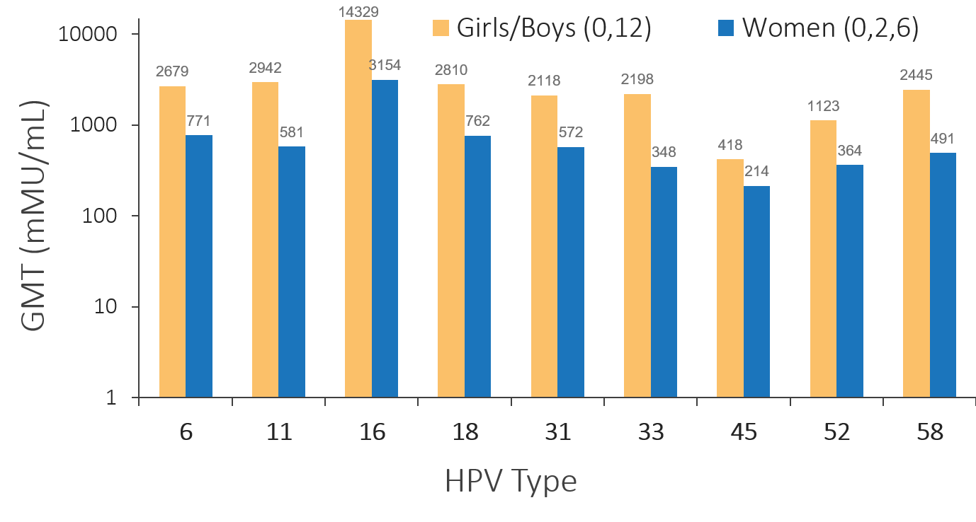
9vHPV 2-Dose Immunogenicity Trial
Non-inferior geometric mean antibody titers (GMT) 2-dose girls/boys age 9–14 yrs. vs. 3-dose women age 16–26 yrs.
Source: Luxembourg, presented at February 2016 ACIP. Data from 1 month after the last dose
http://www.fda.gov/downloads/BiologicsBloodVaccines/Vaccines/ApprovedProducts/UCM426457.pdf
Notes:
This change in recommendation that occurred over the last two years for today's schedule, what is the science little bit behind that?
There were not inferior antibody titers in 9 to 14 year olds, who received the two doses at 0 and 12 months that's shown in yellow compared to women who received the doses at 0, 2 and 6 months shown in blue. The younger girls and boys were age 9 to 14 in yellow, and blue, the women at 0, 2 and 6 months are 16 to 26.
You can see that the titers are higher in the younger age group for each HPV type that's in the Gardasil 9 vaccine.
Source:
Luxembourg, presented at February 2016 ACIP. Data from 1 month after the last dose
http://www.fda.gov/downloads/BiologicsBloodVaccines/Vaccines/ApprovedProducts/UCM426457.pdf

Slide 24
Vaccinating Adults, Ages 27–45
Vaccination is not recommended for everyone older than age 26 years
Some adults ages 27–45 years may decide to get the HPV vaccine based on discussion with their clinicians
HPV vaccination of people in this age range provides less benefit, as more have been already exposed to HPV
Shared clinical decision making is recommended
Source: Human Papillomavirus Vaccination for Adults: Updated Recommendations of the Advisory Committee on Immunization Practices, CDC MMWR, August 16, 2019, 68(32);698–702
Notes:
There's a brand new recommendation--MMWR came out in August 2019 for vaccinating adults 27 to 45.
The vaccine is not recommended for everyone older than age 26, but some adults who are 27 to 45 might decide to get the HPV vaccine based on discussion with their condition.
HPV vaccination of people in this age range provides less benefit, as more has been already exposed to HPV and shared clinical decision making is recommended.
Source:
Human Papillomavirus Vaccination for Adults: Updated Recommendations of the Advisory Committee on Immunization Practices. MMWR Morb Mortal Wkly Rep 2019;68:698–702.
http://dx.doi.org/10.15585/mmwr.mm6832a3

Slide 25
Patients’ Questions
Ages 27–45
Most sexually active adults have already been exposed to HPV
Having a new sex partner is a risk factor for getting a new HPV infection
HPV vaccination prevents new HPV infections but does not treat existing infections or diseases
Notes:
Most sexually active adults have already been exposed to HPV. We do know that having a new sex partner is a risk factor for getting a new HPV infection.
An HPV vaccination prevents new HPV infections, but does not treat existing infections or diseases.
That is a caveat, we don't want people believing that if they get vaccinated when they're older, that it will protect them as well because it's not meant to be a therapeutic vaccine, it is meant to be a preventive vaccine.
They're still definitely at risk of developing HPV-related diseases if they had been exposed when they were younger prior to being vaccinated.

Slide 26
Insurance Coverage for HPV Vaccine
Cost of HPV vaccine is about $250 per dose
The Affordable Care Act requires private insurance plans to cover recommended vaccines
Generally covered by insurance for ages 9–26 females, males to 21 (ACIP vote June 2019 to age 26 for males)
Vaccines for Children (VFC) if uninsured, Medicaid eligible to age ≤18 years
Merck has patient assistance program for ages 19–26
Ages 26–45 likely not covered yet
Notes:
The cost of the HPV vaccine is quite expensive at $250 per dose. The good news is that the Affordable Care Act requires private insurance plans to cover recommended vaccines and it will generally be covered by insurance for age 9 to 26 for females.
As I mentioned before, up to age 21 for male, however, that recent vote from ACIP in June, change that age to 26. We may see that coverage changing over the next year for males up to age 26.
Also, vaccines for children are VFC covers patients who are uninsured and Medicaid eligible up to age 19.
Once they turn 19, they're no longer eligible for VFC. However, Merck does have a Patient Assistance Program for age 19 to 26.
It is very likely that age 26 to 45 is not covered quite yet. Because insurance companies are allowed a year after an MMWR publication to cover those recommended vaccines.
It's a little bit tricky because it's a provider discussion, but it should hopefully be covered, ideally, by August of next year; there might be some lag in certain areas.

Slide 27
Parental consent for HPV vaccine
Varies by state
Example: NY: health care providers can provide HPV vaccination to sexually active minors without parental/guardian consent
California, Delaware, Washington, D.C. also allow teens under 18 to be vaccinated against sexually transmitted diseases, including HPV
Notes:
Parental consent for HPV vaccine does vary by state. An example in New York is that healthcare providers can provide the HPV vaccine to sexually active minors without parental or guardian consent.
A few other areas California, Delaware and Washington also allow teens under 18 to be vaccinated against sexually transmitted diseases, including HPV.
You do need to look for a specific legislation in your own area because these are specific rules that are brought up to the legislature for these permissive consents by teens themselves.

Slide 28
Registry Reporting
Some states require reporting to the Immunization Information System (IIS); others do not
Data exchange between IIS and primary care providers helps ensure timely immunizations
NY example: parents/guardians can access child’s vaccine information, including HPV vaccination
Minors who independently consent to the HPV vaccine should be advised of NYSIIS and availability of this information to parent/guardian
Find your state’s legislation: https://www2a.cdc.gov/vaccines/iis/iissurvey/legislation-survey.asp
Notes:
The other issue is about registry reporting, some states require reporting to the Immunization Information System or IIS and others do not.
It's very helpful because data exchange between the IIS and primary care providers helps to ensure timely immunizations. In New York, for instance, parents and guardians can access their child's vaccine information, including HPV vaccination.
It is important to let patients know if they're a minor, and they independently consent to the HPV vaccine. They should know that, that information is going to our own state registry, and that it could be available to the parent or guardian.
The CDC does keep track of state legislation; this resource should be able to help you to figure out what the legislation is for state registries in your own state.
Find your state’s legislation:
CDC Survey of State Immunization Information System Legislation
https://www2a.cdc.gov/vaccines/iis/iissurvey/legislation-survey.asp

Slide 29
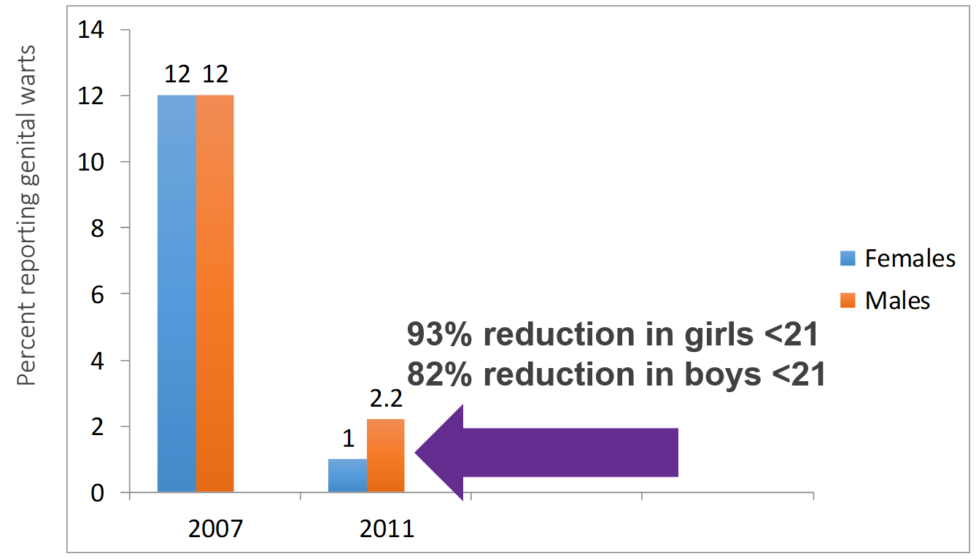
Near-disappearance of genital warts in Australia following introduction of HPV vaccination
Source: Ali H et al. BMJ 2013;346:bmj.f2032. ©2013 by British Medical Journal Publishing Group
Notes:
And if that wasn’t convincing enough, let’s go to Australia for 70% of their girls received all three doses of the quadrivalent vaccine. Vaccination is given at age 12.
Prior to 2007, up to 10% of girls and boys under the age of 21 had a visit for genital warts.
By 2011, four years after the vaccine program had started, genital warts had nearly disappeared in this age group, a 93% reduction in girls and 82% reduction in boys.
There was no decrease in rates of genital warts among older men and women during this time.

Slide 30
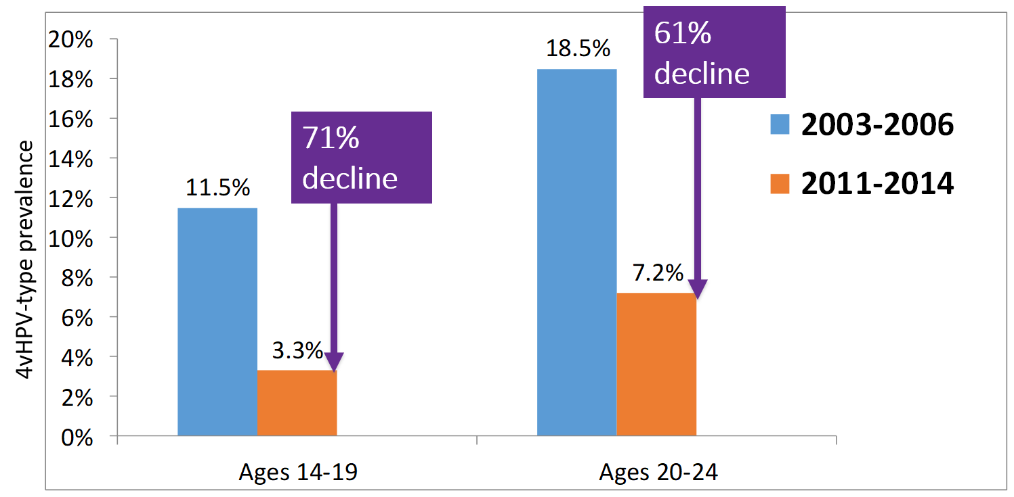
Within 8 years of U.S. vaccine introduction HPV-type prevalence has decreased significantly
Source: Oliver, et al. J Infect Dis. 2017 Sep 1;216(5):594-603. doi: 10.1093/infdis/jix244. https://www.ncbi.nlm.nih.gov/pubmed/28931217
Notes:
The United States is not the leader when it comes to HPV vaccination—other countries do a better job getting the populations vaccinated.
Despite this, we have seen population-wide reductions in diseases.
A national survey of women found a 56% decline in vaccine type of HPV among teenage girls, but not among those who were too old to be vaccinated.

Slide 31
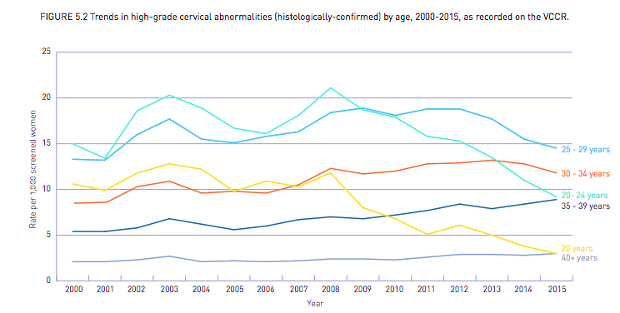
Decline in Pre-cancer Now Impacting Women Ages 20–30
HPV vaccine introduced
Age 20-24 years
Age 20 years
Source: Victorian Cervical Cytology Report, 2015 http://www.vccr.org/site/VCCR/filesystem/documents/dataandresearch/StatisticalReports/17030_VCS_StatsReport15_ART.3.pdf
Notes:
Australia has continued to monitor the effects of vaccination.
In Australia, all girls start getting Pap tests every year at age 18.
You can see that high-grade cervical dysplasia or pre-cancer has essentially disappeared in women under age 20, and fallen by nearly 70% in women ages 20–24.
This is population-level evidence that the most important effect of HPV vaccination, a reduction in cervical cancer, is already a reality in countries that have high vaccination rates.

Slide 32
Over 10 Years of HPV Vaccine Safety Data
HPV vaccines are safe
Reactions after vaccination may include:
  Injection-site reactions: pain, redness, and/or swelling in the arm where the shot was given
  Systemic: fever, headaches
HPV vaccines should not be given to anyone who has had a previous allergic reaction to the HPV vaccine or who has an allergy to yeast
Brief fainting spells (syncope) and related symptoms (such as jerking movements) can happen soon after any injection, including HPV vaccine
Clients should be seated (or lying down) during vaccination and remain in that position for 15 minutes
Source: Gee, et al. Hum Vaccine Immunother. 2016.
Notes:
Post-licensure HPV vaccine safety data from the United States and other countries over the past 10 years have been robust and reassuring.
Based on these data that show the vaccine is safe, what type of side effects do we expect?
We know that we can expect HPV vaccination to cause some injection-site reactions, possibly fever, and headache.
We know that anyone who has any severe allergies, including an allergy to yeast, anyone who has ever had a life-threatening allergic reaction to any component of HPV vaccine, or to a previous dose of HPV vaccine, should not be vaccinated.
We also know that fainting spells, or syncope, is very common with adolescents when they receive injections.
To reduce the risk of syncope, clients should be seated while vaccinated and remain in that position or should lie down for 15 minutes.

Slide 33
HPV Vaccination Is Safe
HPV vaccine safety studies have been very reassuring: HPV vaccine has a good safety profile.
CDC and FDA continue to monitor and evaluate the safety of HPV vaccines, along with all vaccines.
Clinicians can reassure parents who may have concerns that HPV vaccination is safe.
Source: https://www.cdc.gov/vaccinesafety/vaccines/hpv/hpv-safety-faqs.html
Notes:
The safety profile for HPV vaccines is well established.
The data from HPV vaccine safety studies have been very reassuring. CDC and FDA continue to monitor and evaluate the safety of HPV vaccines, along with all vaccines.
Despite the availability of reassuring data, concerns still persist and have been highlighted in the media, and especially social media, leaving some parents hesitant to initiate the vaccination series for their children.
It is important that clinician reassure parents who may have concerns, that there have been over 10 years of safety data collected for HPV vaccines, and that HPV vaccination is safe.

Slide 34
HPV Vaccine Duration of Immunity
Studies suggest that vaccine protection is long-lasting; no evidence of waning immunity
  Available evidence indicates protection for
  at least 10 years
  Multiple cohort studies are in progress to monitor the duration of immunity
Notes:
HPV vaccine is made in the same way as the Hepatitis B vaccine and uses the same adjuvant (except 2vHPV)
Hep B vaccination confers lifelong immunity and it is expected that HPV vaccination will be similar.
HPV vaccine has been available in the United States for 10 years and long-term studies from clinical trials also provide data that there is no evidence that protection against the vaccine types will decrease over time.

Slide 35
OBJECTIVE 4
Strategies to increase HPV vaccination rates

Slide 36
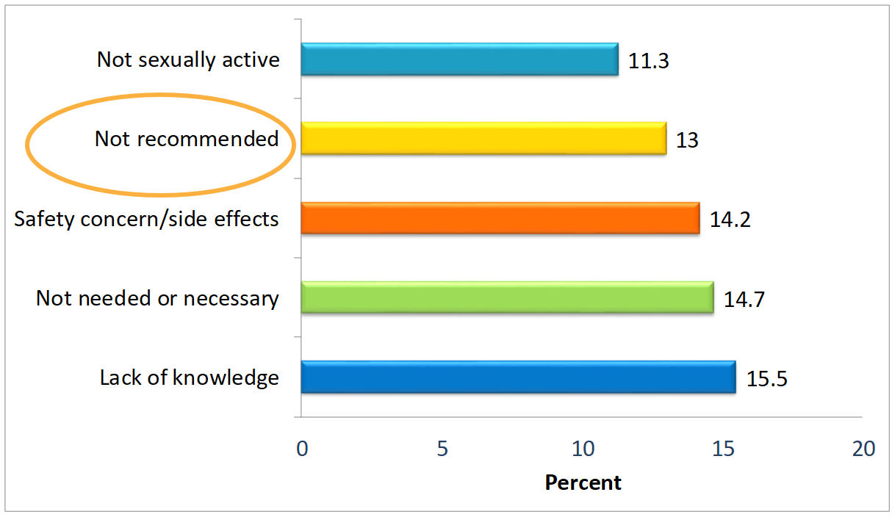
Parents of unvaccinated girls— top reasons for not starting HPV vaccine series
Source: Stokley et al. MMWR. 2014.
Notes:
Studies consistently show that a strong recommendation from you is the single best predictor of vaccination for any vaccine, including HPV vaccine.
In the 2013 NIS-Teen, nearly 15% of parents who said that they would not be getting their child vaccinated against HPV in the next 12 months identified not receiving a recommendation as one of the top reasons not to vaccinate.

Slide 37
Make an Effective Recommendation
Same way: Effective recommendations group all of the adolescent vaccines
Recommend HPV vaccination the same way you recommend Tdap and meningococcal vaccines
Same day: Recommend HPV vaccine TODAY
Recommend HPV vaccination the same day you recommend Tdap and meningococcal vaccines
Source: Brewer at al. Pediatrics. 2017. Unpublished CDC data, 2013.
Notes:
Successful recommendations group all of the adolescent vaccines.
Recommend the HPV vaccine series the same way you recommend the other adolescent vaccines.

Slide 38


Client story
Now that Sophia is 11, she is due today for three important vaccines.
The first is to help prevent an infection that can cause meningitis, which is very rare, but potentially deadly. The second is to prevent a very common infection, HPV, that can cause several kinds of cancer. The third is the tetanus booster, which also protects against pertussis, so she doesn’t get whooping cough.
We’ll give those shots at the end of the visit. Do you have any questions for me?
Notes:
Some of you may feel more comfortable with saying a bit more about each of the vaccines being recommended. Here’s another way to make the bundled recommendation.
You can say “Now that your child is 11/12, she is due today for three important vaccines. The first is to help prevent an infection that can cause meningitis, which is very rare, but potentially deadly. The second is to prevent a very common infection—HPV—that can cause several kinds of cancer. The third is the “tetanus booster,” which also protects against pertussis, so your child doesn’t get whooping cough, but also to protect babies too young to be vaccinated. We’ll give those shots at the end of the visit. Do you have any questions for me?”

Slide 39
Some Individuals Need Reassurance
Many simply accept this bundled recommendation
Some may be interested in vaccinating, yet still have questions. Interpret a question as they need additional reassurance from YOU,
the clinician they trust
Ask about their main concern
(be sure you are addressing their real concern)
Source: Unpublished CDC data, 2013.
Notes:
Many parents will accept the bundled recommendation without any questions. Other parents may be interested in vaccinating, yet still have questions for you.
A question from parents about HPV vaccine does not mean they are refusing or delaying. Many parents with questions about HPV vaccine are looking for additional reassurance from you. Taking the time to listen to parents’ questions helps you save time and give an effective response. Be sure to verify that you are addressing the right concern.

Slide 40
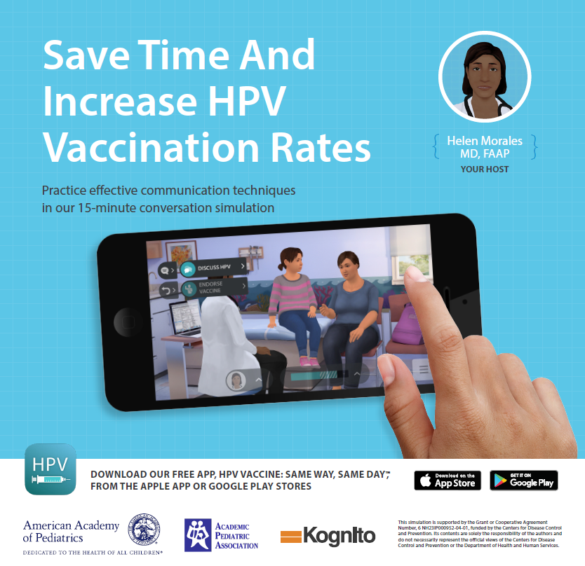
HPV Vaccine: Same Way Same Day Mobile App
A brief 15-minute, interactive, role-play simulation
Learn how to:
  avoid common conversation pitfalls and improve communication skills during HPV vaccine conversations
Download this complimentary App today from the Apple iTunes Store or Google Play Store.
Notes:
There's a terrific app that's been developed, it's called HPV Vaccine: Same Way, Same Day Mobile App, and it's a brief 15-minute interactive role play where you can avoid common conversation pitfalls, and improve your communication skills during HPV vaccine conversations.
It's available freely at the Apple iTunes Store or at the Google Play Store.

Slide 41
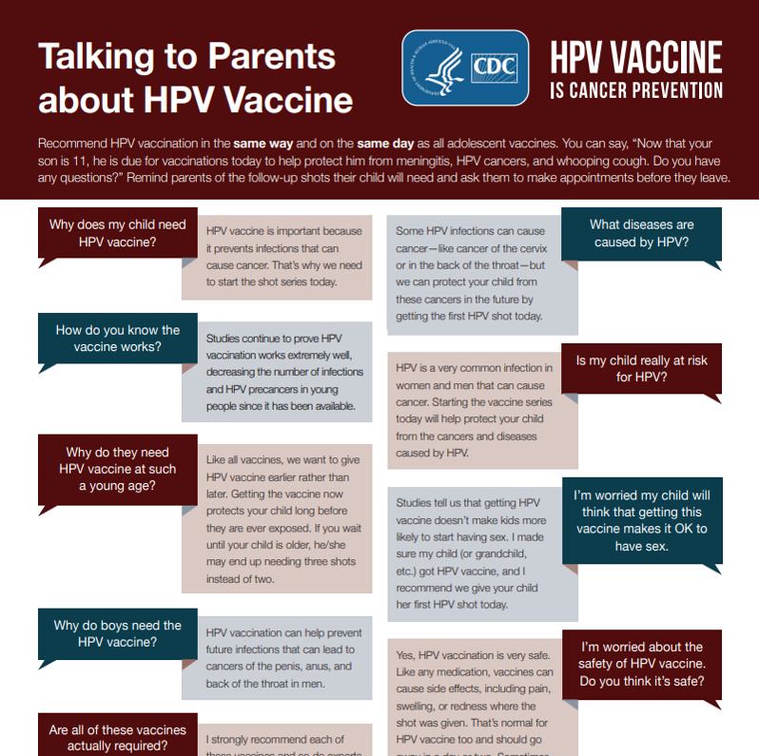
Talking to Parents about HPV Vaccine tip sheet
https://www.cdc.gov/hpv/hcp/for-hcp-tipsheet-hpv.pdf
Notes:
CDC has also developed a really excellent resource for answering common questions and it's posted at the site that's noted below.
Source:
Talking to Parents About Infant Vaccines (CDC)
https://www.cdc.gov/hpv/hcp/for-hcp-tipsheet-hpv.pdf

Slide 42
Will my teen see this as “permission” to have sex?
Kaiser Permanente Center for Health Research
1,398 girls who were 11 or 12 in 2006, 30% of whom were vaccinated, followed through 2010
No difference in markers of sexual activity, including
  Pregnancies
  Counseling on contraceptives
  Testing for, or diagnoses of STIs
Receipt of HPV vaccine does not increase sexual activity or decrease age of sexual debut
Source: Bednarczyk. Pediatrics Oct 2012
Notes:
Reassuringly, multiple studies have demonstrated that girls who receive HPV vaccine do not engage in sexual intercourse sooner than their peers who did not receive HPV vaccine.
One such study was done by the Kaiser Permanente Center for Health Research.
Among 1,398 girls who were 11 or 12 in 2006, 30% of whom were vaccinated. All the girls were followed through 2010.
There were no difference in markers of sexual activity, including:
Pregnancies
Counseling on contraceptives
Testing for, or diagnoses of, sexually transmitted infections

Slide 43
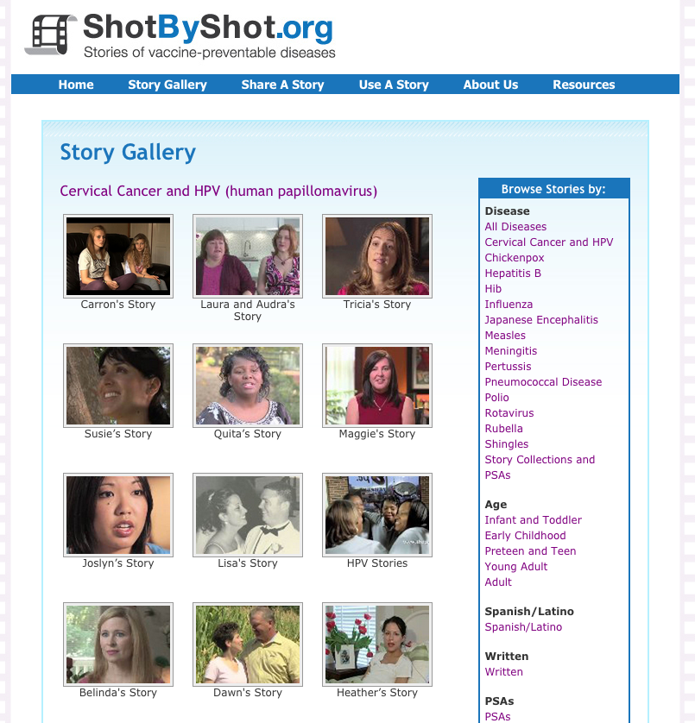
Create Immunization Champions
Be sure everyone in the office understands the mission
Human stories usually influence people more than statistics
To understand the human stories behind HPV, listen to survivors
  Shot By Shot.org
  ACS HPV survivor stories
Notes:
First, we have to Create immunization champions….Be sure everyone in the office understands the mission.
One great way to get everyone on board is by watching the videos on Shot by Shot or Those on Unprotected People found on www.immunize.org.
The human stories behind the HPV cancers often influence people more than statistics.

Slide 44
How to Improve:
2 Approaches
Increase the # of eligible clients who:
1. Come in
2. Leave the office vaccinated
Notes:
Increase the # of eligible clients who:
1. Come in
2. leave the office vaccinated

Slide 45
1. Increase number who come in
Reminders:
For clients who haven’t been in
  Phone, text, patient portal
Follow-up doses
  Consider a reminder in your own system to send a text or phone call reminder 6–12 months later
Notes:
First, let's talk about how do you get more patients to come in. All of the methods noted here has been well studied and are quite effective.
You can send reminders to patients who haven't been in.
You could set up some auto dialer, a text message reminder, or if you have access to a patient portal, all of those methods can help to remind patients to come in.
Something that's also quite helpful to complete the series is to set up some reminder for follow up doses. If you give that first dose, maybe you can set up a reminder in your own system to send a text or a phone call reminder six to 12 months later, to bring back that adolescent or young adult for the second dose.

Slide 46
2. Increase number who leave vaccinated
A) By vaccinating at every visit type
Preventive care
Chronic care
Acute care
Notes:
Let's think about what you can do in your own office to increase the number who leave vaccinated.
You can vaccinate any type of visit, anytime a patient comes in, if they are there for any visit unless they're currently pregnant because the vaccine is not recommended during pregnancy.
If they're planning to continue with the pregnancy, you would not want to vaccinate them.
If they're there for any type of preventive care, for an STD check, for any chronic care, for any acute care. If you see them, offer the vaccine.

Slide 47
2. Increase number who leave vaccinated (cont’d 2)
B) Standing Orders
Empower non-physician personnel to vaccinate clients (after assessing for specific contra-indications) without direct provider involvement
  Follow state laws for administration e.g., RN, LPN, LVN, MA
Preapproved orders to vaccinate on file, as allowed
  Verify laws with state medical/nursing boards
  Templates available for all routine vaccines at
  www.immunize.org/standing-orders/
  Update clinic protocols and agency policies if adopted
Need staff buy-in for all vaccines due
Notes:
Other ways to increase the number who leave vaccinated:
Develop a standing order in your practice, that allows non physician personnel to vaccinate clients after assessing for specific country indications without direct provider involvement.
You can follow state laws for administration, such as RN, LPN, LVN or MA.
You have pre-approved orders to vaccinate on file, as allowed.
You should verify the laws with your state medical and nursing boards, make sure that you're allowed to have them vaccinate. For instance, in New York State RNs can vaccinate but MAs can't, but that's different in different states.
Templates are available for all routine vaccines at immunize.org. If you take a look at that link, they're standing orders for every type of vaccine including HPV vaccine.
Then you would want to update your clinic protocols and your agency policies as adopted. However, you really need staff buy in for all vaccines do. If you have a standing order, say for flu vaccine and your nurses haven't learned sufficiently about why HPV vaccine is so important.

Slide 48
2. Increase number who leave vaccinated (cont’d 3)
C) Provider Prompts
Paper or EHR (better to use both)
Engage nurses/MAs to help
Pre-visit planning
Huddling
Notes:
Another way you can increase the number who will be vaccinated is to do some provider prompt.
We found over multiple studies that if you just have your electronic health record, give you a prompt, it's very easy to ignore it. It's much better to use two methods to prompt.
It also helps to engage the nurses or the medical assistance. It helps to do some pre visit planning, if you know you have a scheduled list of patients coming in, then you take a look at the schedule, and preview the EHR to see who's due for which vaccines, and then document on some paper.
Having huddles also certainly helps, if you have a huddle twice a day, say, for how things are going over the course of your day, you might take a few minute break, gather around the computer with the nurses and the providers, and take a look at the schedule and see who needs what each day.

Slide 49
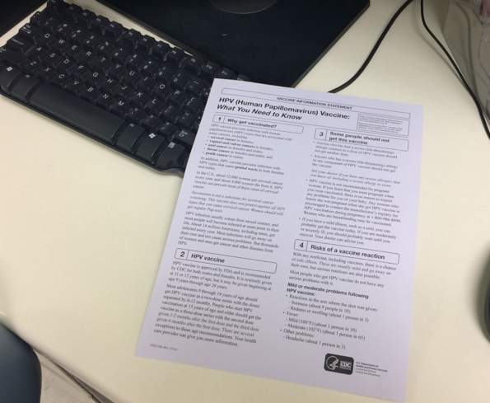
Example of a paper prompt
Notes:
One very simple thing to do is to make a colored copy of the VIF form or vaccine Information Statement. This is what we do in our practice, even though in my practice I have the EHR telling me a patient might be due for a vaccine, if I see this purple sheet of paper on my keyboard, I know that somebody has looked at the immunization schedule.

Slide 50
Reducing Missed Opportunities: QI
Learning collaborative
Monthly data collection (10–16 charts/month/practice)
Focus on integrating QI, strong recommendations, consistency in practice change, prompts
Notes:
Our experience with reducing missed opportunities has been gained through five years of learning collaboratives, where we have practices that collect monthly data from their practice.
They focus on integrating quality improvement, a strong or effective recommendation, meaning the same way in the same day as other vaccines, starting at least age 11 to 12, if not sooner and consistency in their practice change.
They adopt a common schedule, they train the front desk staff, the nurses and the MAs that everybody's going to follow the same schedule.
Most of them are implementing some provider prompt.

Slide 51
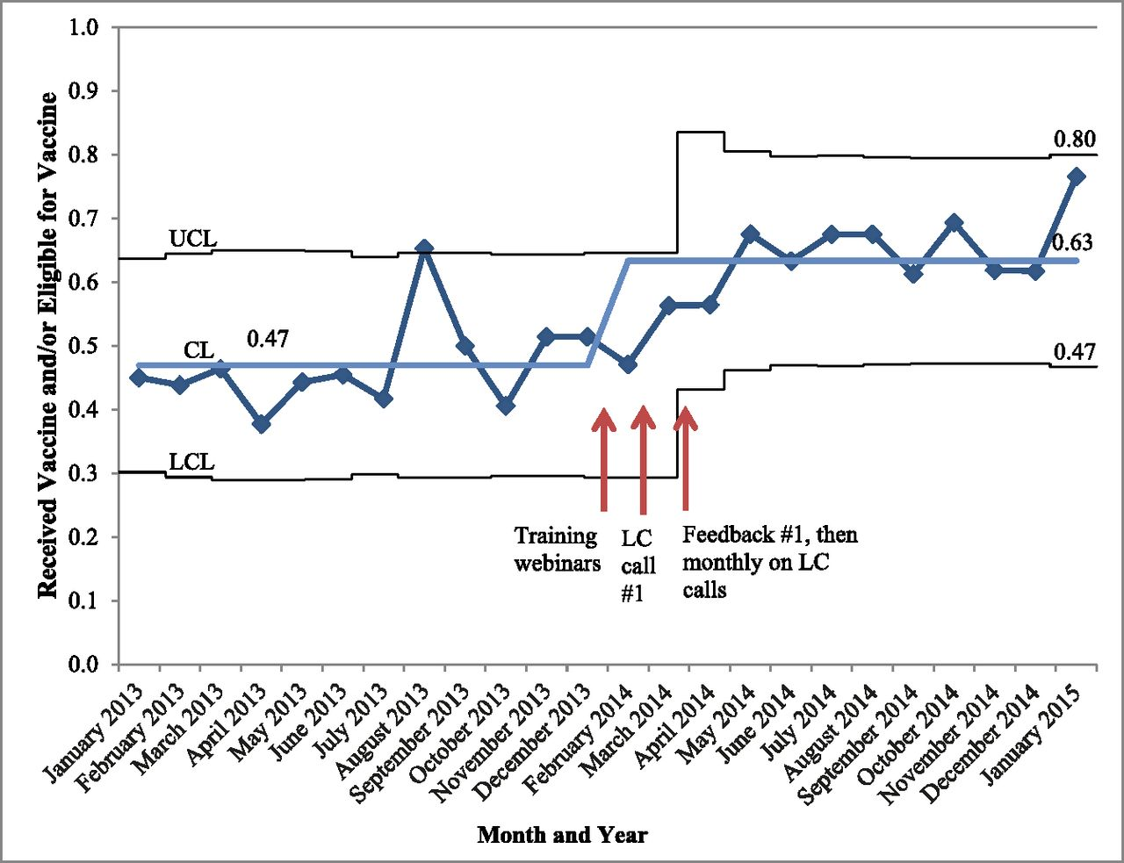
P-chart of captured opportunities for HPV vaccine, monthly chart reviews
Source: Rand, CM et al. Pediatrics 2018;141:e20170498 ©2018 by American Academy of Pediatrics
Notes:
This is some data from our first cohort, which was actually just with continuity clinics in pediatric practices in pediatric residency programs.
You can see the baseline data started at that point four, seven, where you see the CL, and that was their baseline data for missed opportunities. That meant that 47% of the time, they were having a captured opportunity, sorry for vaccines. In this case, it's good to improve on captured opportunities, meaning a patient was eligible for the vaccine and they received it.
You can see that after having some training webinars about learning about a strong recommendation, and getting together on learning collaborative calls and giving practices feedback, they really dramatically improve their captured opportunities to 63%.
Over time, they're continuing to do so, because they've implemented those changes in their practice, and they're really integral to how they operate now. You can make a really dramatic change in captured opportunities or in reducing missed opportunities for vaccination.
Key: CL, control limit; LCL, lower control limit; UCL, upper control limit.

Slide 52
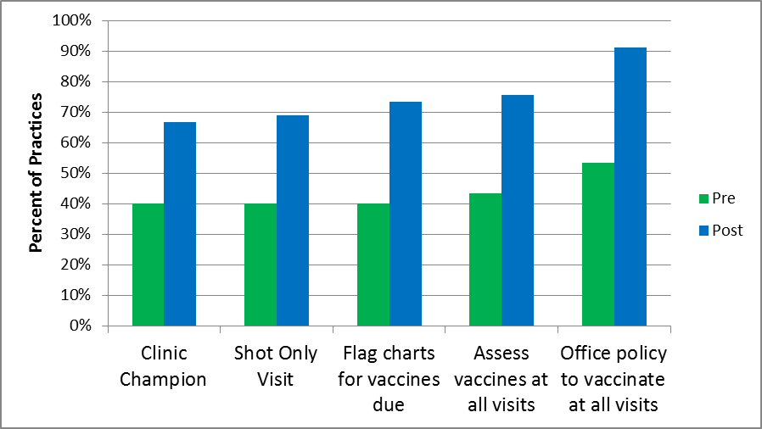
Results: Office Systems Changes
Notes:
About the office systems that I mentioned that they chose to implement:
They either assigned or encouraged a clinic champion, usually someone rose to the surface, who was really interested in improving immunization in their practice.
They developed shot only visit, instead of just having a flu vaccine only clinic, they add HPV vaccine to times when patients could just walk in for a vaccine, and they didn't have to appear at a well visit or a chronic care visit.
They could come to see the nurse for the shot. They also flag the charts for vaccines that were due, and assessed vaccines at all visits, and then developing a policy where they would be willing to vaccinate at all visits made a dramatic difference.

Slide 53

For More Information
Office of Infectious Disease and HIV/AIDS Policy (OIDP) HPV Vaccine Promotional Toolkit available at https://www.vaccines.gov
CDC: https://www.cdc.gov/hpv/index.html
AAP: HPV Champion Toolkit
Immunization Action Coalition: http://www.immunize.org/
American Cancer Society: https://www.cancer.org/healthy/hpv-vaccine.html
Notes:
Resources:
Office of Infectious Disease and HIV/AIDS Policy (OIDP) HPV Vaccine Promotional Toolkit
https://www.vaccines.gov
CDC HPV resources
https://www.cdc.gov/hpv/index.html
AAP: HPV Champion Toolkit - Immunization Action Coalition
http://www.immunize.org/
American Cancer Society
https://www.cancer.org/healthy/hpv-vaccine.html

Slide 54
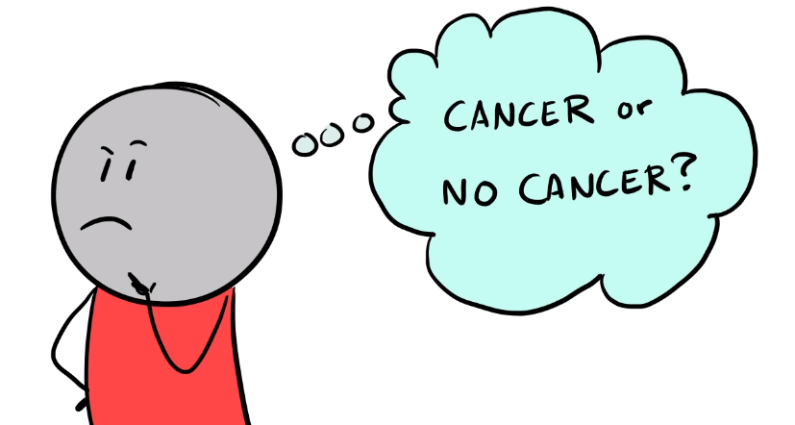
Questions?

Slide 55
Thank you!
Questions or suggestions?
Email fpntc@jsi.org
Subscribe at www.fpntc.org/enewsletter
This presentation was supported by Award No. FPTPA006028-04-00 from the Office of Population Affairs (OPA). Its contents are solely the responsibility of the authors and do not necessarily represent the official views of OPA or HHS.

