Slide 1
Contraceptive Access in
Family Planning Settings
Introduction to the Contraceptive Access Change Package
Last Reviewed March 2020
Notes:
Facilitator Notes
Welcome to today’s meeting, where we will discuss contraceptive access in the family planning setting—and, specifically, in your setting. In this session, we’ll introduce the Contraceptive Access Change Package, which was developed by the Family Planning National Training Center. We will review best practice recommendations for contraceptive access, and we’ll start to brainstorm ideas for improving contraceptive access in your setting. (Note to facilitators: See related discussion guides for more information, including the following session: Develop a Site-Level Improvement Plan.)
Activity
Conduct participant and facilitator introductions.

Slide 2
Meeting Objectives
By the end of today, you should be able to:
Define the best practice recommendations for increasing access to the full range of contraceptive methods outlined in the Contraceptive Access Change Package
Describe one tool available to help calculate and track the contraceptive care performance measures
Describe three strategies for improving performance on the contraceptive care performance measures
Notes:
Facilitator Notes
There are 3 objectives for today. By the end of today’s meeting you should be able to:
Define the best practice recommendations for increasing access to the full range of contraceptive methods outlined in the Contraceptive Access Change Package
Describe one tool available to help calculate and track the contraceptive care performance measures
Describe three strategies for improving performance on the contraceptive care performance measures

Slide 3

Why is Contraceptive
Access Important for Patients?
Sarah is 24 years old. She currently works as a waitress in a restaurant. She likes it, and is saving up money to one day attend school–perhaps to become a chef. Last year Sarah chose to get a Liletta. She remains grateful to the clinic staff for maintaining her privacy, providing her the services she needs, helping her to attain her life goals, and being respectful of her preferences. Sarah is one of the 4.6 million clients served each year by Title X.
Notes:
Facilitator Notes
But first, let’s take a step back. Why is contraceptive access important? First and foremost, this is about meeting the reproductive goals of a patient.
Think of Sarah. Sarah is 24 years old. She currently works as a waitress in a restaurant. She likes it, and is saving up money to one day attend school—perhaps to become a chef. Last year she chose to get a Liletta. She remains grateful to the clinic staff for maintaining her privacy, providing her the services she needs, helping her to attain her life goals, and being respectful of her preferences. Sarah is one of the 4.6 million clients served each year by Title X.

Slide 4
Why is Contraceptive Access Important for Communities?
Nearly half (45%) of all births are unintended.¹
All Title X-funded projects are required to provide a broad range of acceptable and effective family planning methods and related services on a voluntary and confidential basis.
Pregnancies by Intention Status in 2011¹
¹ Unintended Pregnancy in the United States. Guttmacher 2016
Notes:
Facilitator Notes
Access to contraception is also important to the health of the community.
A significant number—about 45%—of births each year are unintended. The two-thirds of U.S. women at risk for unintended pregnancy use contraceptives consistently and correctly throughout the course of any given year and account for only 5% of all unintended pregnancies. By contrast, the 18% of women at risk who use contraceptives inconsistently or incorrectly account for 41% of all unintended pregnancies. The 14% of women at risk who do not practice contraception at all or who have gaps of a month or more during the year account for 54% of all unintended pregnancies.
Annually, the contraceptive care delivered by Title X–funded providers helped women avoid 822,000 unintended pregnancies, which would have resulted in 387,000 unplanned births and 278,000 abortions (according to data from 2015). Without the contraceptive care provided by these health centers, the U.S. rates of unintended pregnancy and abortion would have been 31% higher, and the teen unintended pregnancy rate would have been 44% higher.
Finally, as a Title X funding recipient, it is a program requirement to ensure access. All Title X-funded projects are required to provide a broad range of acceptable and effective family planning methods and related preventive health services on a voluntary and confidential basis.
Sources (for reference)
Unintended Pregnancy in the United States. Guttmacher. September 2016 https://www.guttmacher.org/fact-sheet/unintended-pregnancy-united-states

Slide 5
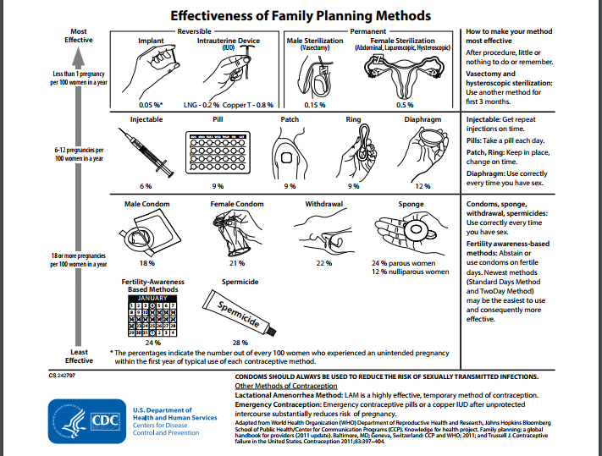
Notes:
Facilitator Notes
There are a wide range of FDA-approved contraceptive methods available in the U.S.
Family planning methods are categorized by CDC from “least” to “moderately” to “most” effective according to the number of women who experience an unintended pregnancy within the first year of typical use.
Access to the full range of methods allows women, couples, and families to meet their reproductive goals and decide if and when to have children.
Source (for reference)
https://www.cdc.gov/reproductivehealth/unintendedpregnancy/pdf/contraceptive_methods_508.pdf

Slide 6
NQF-Endorsed
Contraceptive Care Measures
Intermediate outcome measure: % of women aged 15-44 years at risk of unintended pregnancy that is provided a most effective (i.e., sterilization, implants, IUD/IUS) or moderately effective (i.e., injectables, pills, patch, ring, or diaphragm) FDA-approved method of contraception
Contraceptive access measure: % of women aged 15-44 years at risk of unintended pregnancy that is provided a long-acting reversible method of contraception (i.e., implants, IUD/IUS)
Contraceptive Care Measures: https://www.hhs.gov/opa/performance-measures/index.html
Notes:
Facilitator Notes
Access to contraception, however, is very difficult to measure. Directly measuring access would include looking at the ease by which patients obtain contraception in general, and certain methods in particular, how many barriers patients face, etc. Not easy concepts to measure! For that reason, contraceptive care measures have been developed as a proxy for access.
In 2016, the National Quality Forum (NQF) endorsed contraceptive care measures. These include:
An intermediate outcome measure: % of women aged 15-44 years at risk of unintended pregnancy that is provided a most effective (i.e., sterilization, implants, IUD/IUS) or moderately effective (i.e., injectables, pills, patch, ring, or diaphragm) FDA-approved method of contraception
A contraceptive access measure: % of women aged 15-44 years at risk of unintended pregnancy that is provided a long-acting reversible method of contraception (i.e., implants, IUD/IUS). Note that this is an access measure. We don’t necessarily want this number to increase, but we do expect that as access barriers that have historically existed are broken down, the result may be increases.
With NQF’s endorsement of these measures, there is now a standard way of measuring contraceptive care. It’s important that family planning providers can produce these measures, and demonstrate improvements.

Slide 7
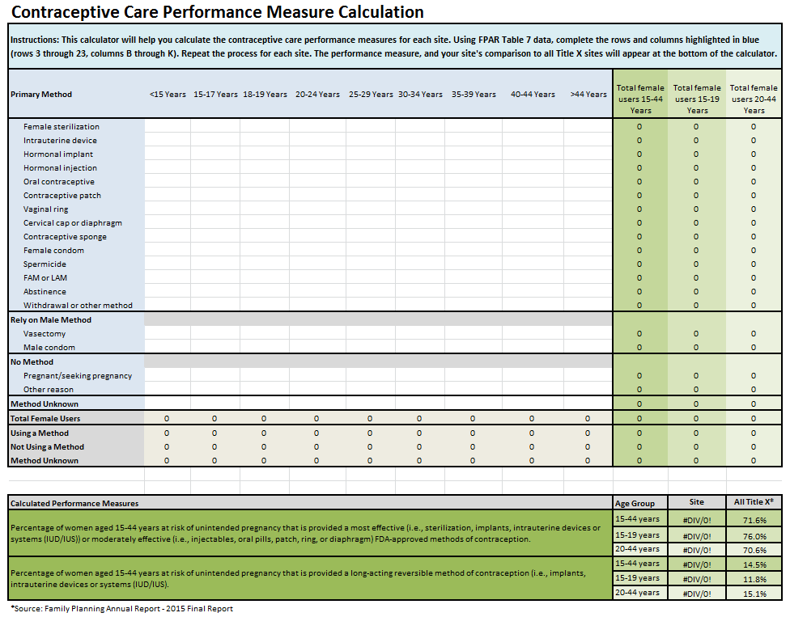
Contraceptive Care
Performance Measure Calculator
Link: https://www.fpntc.org/training-and-resources/contraceptive-care-performance-measure-calculator
Notes:
Facilitator Notes
First, let’s look at where you are starting. What is your site’s current performance on these two measures?
The Family Planning National Training Center has developed a calculator to help sites use their FPAR data to produce the two contraceptive care measures and compare that to the Title X average. The link to this calculator is included on the slide.
Activity
Ask site(s) to refer to their performance measure data. (Note to facilitators: Ask participants to calculate performance measures ahead of time)
Discuss
Is your current performance measure data surprising to you?
What access issues do the data indicate? Do the data indicate access issues either in general, or with any particular age range? Do the data indicate access issues for any particular method?

Slide 8
What Are Your
Performance Measure Goals?
Measure | Existing Benchmarks | Possible Methods for Goal Setting
% of female patients using most- or moderately- effective methods | Title X 2016 average = 71% 85% is a reasonable goal | Reach Title X average or 85% benchmark Achieve a percent increase (e.g., 10%) from baseline
% of female patients using LARC methods | There is no benchmark for this measure A rate of 2% or lower may indicate access issues exist | Generally, no goal should be set for this measure
Notes:
Facilitator Notes
Now that you’ve had a chance to reflect on your current performance on these two measures, let’s discuss: where do you want to go? What are your goals for the measures? As you set your goals, be sure that your first priority is increasing patient access to their methods of choice.
Recall that the first measure—percent of female patients using most or moderately effective methods—is an intermediate outcome measure. For this measure, it is reasonable to aim for increases, and 85% has been identified as a reasonable goal. As a reference point, in 2016, the average utilization for the Title X program was 71% among female patients 15-44. You may also consider a percentage increase goal—such as a 10% increase over baseline. As always, however, it is important to respect individual patient preference, and depending on your patient population, a higher percentage of patients may choose other, perhaps less effective, methods for other reasons.
The second measure—percent of female patients using LARC methods—is really an access measure. The goal here is not necessarily to increase LARC utilization, but to reduce barriers to LARC methods that may exist at your site. For this reason, there is no benchmark, and it is generally inappropriate to set a goal for this measure. A utilization rate of 2% or lower may indicate there are significant access barriers. (It could also indicate a patient preference to not use these methods, and that is something you’ll have to find out!)
Activity
Ask site(s) to develop performance measure goals. (Note to facilitators: Participants can write this down on a printout of their Access Assessment or on other scrap paper.)

Slide 9
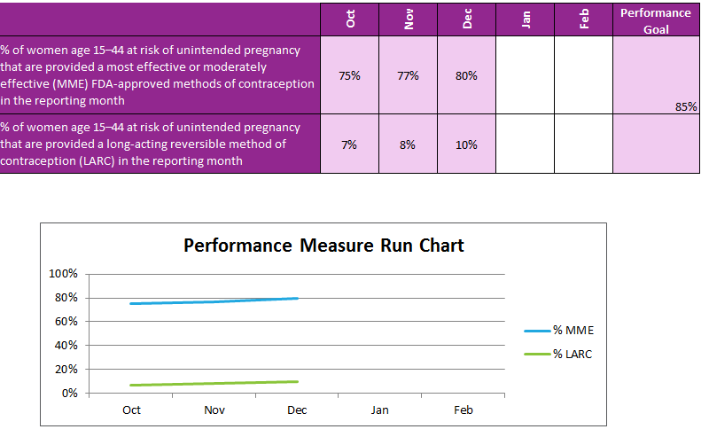
Track Progress Monthly
Link: https://www.fpntc.org/resources/contraceptive-access-quality-improvement-plan
Notes:
Facilitator Notes
Of course, having a goal is only as useful as the systems that are set up to help you get there.
In the Contraceptive Access Improvement Plan (available on the FPNTC website), there is a tracker sheet that will automatically update the run chart as you put in monthly data. You can also use your own tool that does something similar.
Looking at your data monthly is how you can track whether or not changes are working the way you think they should be!

Slide 10

Contraceptive Access Assessment
Tool to assess access to contraception at your site
Notes:
Facilitator Notes
There are certainly things that we are doing well when it comes to ensuring access. And there are always opportunities to improve.
To help identify possible areas of improvement, the Family Planning National Training Center developed this Contraceptive Access Assessment, which is a tool to assess access to contraception at your site. Think about the performance goal you just set. What is currently keeping you from reaching this goal? As you complete this assessment we encourage you to be critical—how often are these practices happening really (not what you hope is happening)? This tool is designed to help you identify areas to improve.
Activity
Participants will fill out or refer to the Contraceptive Access Assessment tool. Ask participants to fill out ahead of time, or provide 10-15 additional minutes to fill it out during the session.

Slide 11
Discussion of Barriers to Contraceptive Access
What practices are you doing most frequently? Least frequently?
Consider the practices you are doing least frequently:
  What are the patient barriers to obtaining a patient’s contraceptive method of choice?
  What are the facility barriers to providing patients the method of their choice?
Notes:
Discuss
Using the results of the contraceptive access assessment, what practices are you doing most frequently? Least frequently?
Consider the practices you are doing least frequently:
First, think about these barriers through the eyes of a patient. Even before the patient gets to you, what are their barriers to obtaining a method of contraception?
Then, think about the barriers after the patient contacts you. What are the facility-related barriers to providing patients the methods of their choice?

Slide 12

Overview of the Contraceptive Access Change Package
Goal: Support sites to increase access to all methods, and, ultimately, improve performance on the contraceptive care performance measures
Link: https://www.fpntc.org/training-and-resources/contraceptive-access-change-package
Notes:
Facilitator Notes
Now that we have a list of barriers to patient access, let’s start talking about strategies to improve access.
The Contraceptive Access Change Package was developed by the Family Planning National Training Center. It is a compendium of recommendations for increasing accessing to contraception at Title X sites. The Change Package can be used by sites to:
Increase awareness of best practice strategies
Compare best practices with existing practices in your service site
Select high-impact strategies to implement
Select measures to test impact of changes

Slide 13
Best Practice Recommendations
Stock a broad range of methods
Discuss pregnancy intention and support patients through evidence-informed, patient-centered counseling
Develop systems for same-visit provision of all methods, at all visit types
Utilize diverse payment options to reduce cost as a barrier
Notes:
Facilitator Notes
Outlined in the Change Package are four best practice recommendations for increasing access to contraception. These have been drawn from a literature review as well as from Providing Quality Family Planning Services: Recommendations of CDC and the U.S. Office of Population Affairs (QFP). The four recommendations are to:
Stock a broad range of methods
Discuss pregnancy intention and support patients through evidence-informed, patient-centered counseling
Develop systems for same-visit provision of all methods, at all visit types
Utilize diverse payment options to reduce cost as a barrier—for both the facility and the patient
The Change Package includes rationale for these recommendations, as well as specific strategies that are related to each recommendation. We’ll take a closer look at these strategies now. (Note to facilitators: For more discussion on these topics, see related discussion guides for each best practice.)

Slide 14

Best Practice 1. Stock a broad range of methods, including all provider-dependent
FDA-approved methods
Strategies
Obtain lower cost supplies
Optimize inventory system
Ensure staff with patient contact are trained & ensure clinicians are available to provide a broad range of methods
Notes:
Facilitator Notes
Best Practice 1 is to stock a broad range of methods including, at a minimum, all provider-dependent FDA-approved methods.
Although a patient may have access to other methods by prescription or over the counter, the provider-dependent methods (i.e., IUDs, implants, and injectables) are prioritized because a patient depends on the provider for access.
The primary strategies that drive this best practice recommendation are to:
Obtain lower cost supplies–to ensure sustainability of stocking methods regularly
Optimize the inventory system to ensure that the full range of methods are stocked and available at all times
Ensure all staff with patient contact are aware of and trained in current recommendations, and ensure clinicians are trained and available to provide the broad range of methods

Slide 15

Best Practice 2. Discuss pregnancy intention and support patients through evidence-informed, patient-centered counseling
Strategies
Discuss pregnancy intention routinely with all patients of reproductive age
Counsel in accordance with QFP guidelines
Have a policy written and circulated that services must be provided on a voluntary basis
Notes:
Facilitator Notes
Best practice 2 is to discuss pregnancy intention and support patients through evidence-informed, patient-centered counseling that enables them to choose from the full range of contraceptive methods if they do not desire pregnancy presently.
Strategies for implementing this best practice recommendation include:
Discuss pregnancy intention routinely with all patients of reproductive age. Support patients in developing a pregnancy intention and/or reproductive life plan
If pregnancy is not desired in the next year, provide contraceptive services in response to the patient’s identified goals and preferences in line with QFP recommendations, using a shared decision-making, patient-centered counseling approach
Have a written and widely circulated policy stating that services must be provided solely on a voluntary basis.

Slide 16

Best Practice 3. Develop systems for same-visit provision of all contraceptive methods, including LARC methods,*at all visit types
Strategies
Offer Quick Start as option for all methods*
Develop clinical and administrative systems
Follow the CDC U.S. Selected Practice Recommendations for Contraceptive Use
Remove barriers such as unnecessary exams, tests
Provide EC as appropriate
*Provided that you can be reasonably sure that the patient is not pregnant
Notes:
Facilitator Notes
Best practice 3 is to develop systems for same-visit provision of all contraceptive methods, including LARC, at all visit types.
Strategies related to this recommendation include:
Offer Quick Start as an option for all methods
Develop and implement the necessary administrative and clinical support systems to increase efficiency and support same-visit access to all methods
Remove unnecessary barriers to contraceptive access, including the routine requirement of the following as a prerequisite for receiving contraception:
Pelvic exams, unless inserting an IUD or fitting a diaphragm
HIV screenings
Cervical cytology or other cancer screening, including clinical breast exam
Laboratory tests for lipid, glucose, liver enzyme, and hemoglobin levels or thrombogenic mutations
Conduct preventive health and STD screening in accordance with CDC’s guidelines, and as medically indicated
Offer emergency contraception (Cu-IUD or pills) when appropriate

Slide 17

Best Practice 4. Utilize diverse payment options to reduce cost as a barrier for the facility and the patient
Strategies
Ensure organizational policy is in line with Title X program requirements
Obtain third-party reimbursement, when possible
Optimize billing & coding
Provide insurance screening and application
Optimize revenue cycle management and patient fee collection protocols
Notes:
Facilitator Notes
Best practice 4 is to utilize diverse payment options to reduce cost as a barrier for the facility and the patient.
Strategies include:
Ensure organizational policy is in line with Title X program requirements with regards to ensuring access, regardless of ability to pay, sliding fee discounts, and services for minors
Obtain third party reimbursement for patients with, or eligible for, coverage
Provide insurance eligibility screening and application assistance
Optimize billing and coding, especially for LARC
Optimize revenue cycle management and patient fee collection protocols
And additionally (not listed on the slide), identify and access all available sources of supplemental revenue
Source (for reference)
Office of Population Affairs (OPA). Title X Program Requirements. https://www.hhs.gov/opa/guidelines/program-guidelines/program-requirements/index.html

Slide 18
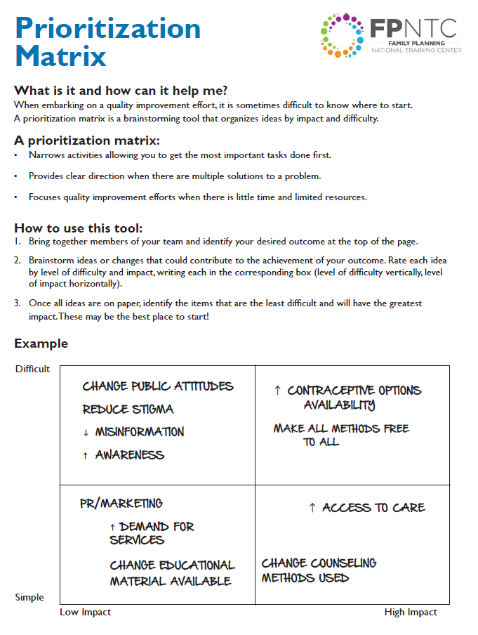
Brainstorm Ideas for Increasing Access
Brainstorm ideas that should contribute to the achievement of your outcome: increased MME & LARC access. Plot these on the Prioritization Matrix.
Discuss: What are your high-impact and low-effort change ideas?
Link: https://www.fpntc.org/resources/prioritization-matrix
Notes:
Facilitator Notes
By now, we’ve had a chance to discuss barriers to contraceptive access at your site, and to discuss the best practice recommendations highlighted in the change package.
You are probably already thinking about things you can do in your setting to improve! This is your chance to list some of those ideas, and think about where to start.
Working in teams, let’s work together to plot possible change ideas, in response to the access barriers we’ve discussed previously. This is a chance to get a lot of potential ideas for improvement on paper and organized in a way that is useful. We’re going to use the Prioritization Matrix, a brainstorming tool that organizes ideas by impact and difficulty.
Activity
Brainstorm ideas. Plot change ideas on the Prioritization Matrix in one of the four quadrants related to whether the idea is difficult or easy to implement.
(Note to facilitator: Team(s) should work together on this activity. If more than one site is participating in the discussion, encourage staff from the same site to work together. If one site is participating in discussion, everyone can work together.)
Take 10 minutes for this activity.
Discuss
High-impact, low-effort ideas can be the best ones to start with. What are your high-impact and low-effort change ideas?

Slide 19
The QI Team
A QI team should include representation from:
  Clinical
  Administrative/clinic management
  Billing and coding
  Front desk
  Clinic assistants
  Finance
Who do you have at the table already, and who do you need to add?
Notes:
Facilitator Notes
We hope you are feeling excited about possible improvements you can make at your site. QI is a team effort. In order to approach systems changes, you will need a team that represents all aspects of the system.
A good QI team is diverse—and should include representation of staff from clinical, administrative/clinic management, billing and coding, front desk, clinic assistants, and finance.
Think about the improvement ideas you just generated. Are the staff necessary to make these changes currently involved in the discussion? Consider if there is anyone else who isn’t already looped into the effort. Make sure to get them involved as early as you can.

Slide 20
Next Steps
Involve additional staff on the QI team, if needed
Designate regular meeting time for QI team
Designate staff member to collect and report data on a regular basis (e.g., monthly)
Designate meeting time for Develop a Site- Level Improvement Plan
Notes:
Facilitator Notes
Next steps should include:
Designate regular meeting time for QI team
Identify when future sessions will take place and who needs to be there
Designate staff member to provide data on a regular basis (e.g., monthly)
Designate meeting time for developing a site-level improvement plan.(Note to facilitators: The discussion guide, Develop a Site-level Improvement Plan, is designed to follow this session.)
Discuss
What are other next steps you will take in addition to what is listed here?
When will the quality improvement (QI) team meet next?

Slide 21
Thank you!
Contact:
fpntc@jsi.com
Notes:
Facilitator Notes
Thank you for participating in today’s discussion!
If applicable, you can contact me at:_________
You can also always contact the Family Planning National Training Center (fpntc@jsi.com) with questions/comments.

