Slide 1
Address Common Concerns for Providing Long-Acting Reversible Contraception (LARC) to Adolescents
Last Reviewed April 2019
Notes:
Facilitator Notes
Today we will be discussing how to address common concerns for providing LARC to adolescents.
Activity
Conduct participant and facilitator introductions.

Slide 2
Meeting Objectives
By the end of today, you should be able to:
Describe trends in LARC demand, utilization, continuation, and satisfaction, among adolescents
Use data and evidence-based guidelines to address common concerns about providing LARC to adolescents seeking contraception
Notes:
Facilitator Notes
There are 2 objectives for today’s discussion. By the end of today, you should be able to:
Describe trends in LARC demand, utilization, continuation, and satisfaction, among adolescents
Use data and evidence-based guidelines to address common concerns about providing LARC to adolescents seeking contraception

Slide 3
Rationale for Addressing Concerns
Title X-funded family planning projects shall offer “a broad range of acceptable and effective family planning methods and services (including natural family planning methods, infertility services, and services for adolescents).”
- Title X of the Public Health Service Act,
42 U.S.C. 300, et seq.
Notes:
Facilitator Notes
Why is it important that we address concerns about providing LARC to adolescents?
Title X-funded projects are required to provide a broad range of acceptable and effective family planning methods and services (including natural family planning methods, infertility services, and services for adolescents). Thus, ensuring adolescents have access to comprehensive services, which includes the full range of contraceptive methods, is a part of being a Title X provider.
Source (for reference)
Title X of the Public Health Service Act, 42 U.S.C. 300, et seq.

Slide 4
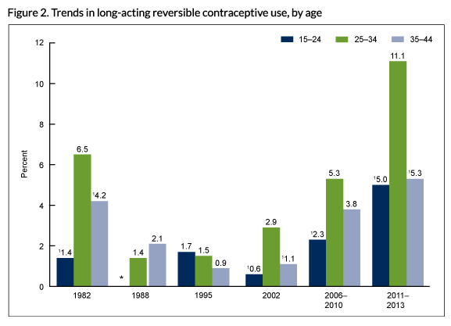
NCHS Data Brief No. 188, February 2015
Notes:
Facilitator Notes
Historically, utilization of LARC has differed by age group. CDC’s National Survey of Family Growth has tracked LARC utilization over time. Across time points, adolescents have been the least likely, compared to older women, to use LARC methods.
There may have been some good reasons for this in the past—LARC methods weren’t recommended for nulliparous women until recently.
Source (for reference)
Trends in Long-acting Reversible Contraception Use Among U.S. Women Aged 15–44. NCHS Data Brief No. 188, February 2015 http://www.cdc.gov/nchs/products/databriefs/db188.htm

Slide 5
In Title X, adolescents have higher utilization of most and moderately effective (MME) methods…
FPAR 2016 Report
Notes:
Facilitator Notes
These guidelines have since changed, as we’ll review in more detail later.
Today, in the Title X program, adolescents are more likely to use a most- or moderately-effective method (MME) than patients age 20-44. (76% of adolescents use a MME vs. 70% of patients 20-44 years of age.)
Source (for reference)
Title X Family Planning Annual Report 2016 National Summary. August 2017. https://www.hhs.gov/opa/sites/default/files/title-x-fpar-2016-national.pdf

Slide 6
In Title X, adolescents have lower utilization of LARC methods…
15-19
20-44
FPAR 2016 Report
Notes:
Facilitator Notes
However, adolescents served by Title X are less likely to use LARC methods than patients in the next age range (14% vs. 17% among 20-44 year-olds).
This begs the question of why this difference occurs. Are adolescents less aware of these methods? Are there access barriers that prevent them from being able to obtain these methods when they choose them? That’s what we want to discuss more in depth today.
Source (for reference)
Title X Family Planning Annual Report 2016 National Summary. August 2017. https://www.hhs.gov/opa/sites/default/files/title-x-fpar-2016-national.pdf

Slide 7
Missed Opportunities to
Discuss Methods with Adolescents
2012 American College of Obstetricians and Gynecologists (ACOG) Committee Opinion: LARC are safe and appropriate for most women and adolescents
Missed opportunities: According to a Guttmacher national survey of publicly-funded clinics in 2013:
  43% of providers discussed IUDs with teens; 58% with young adults
  41% of providers discussed implants with teens; 46% with young adults
Adolescents and long-acting reversible contraception. ACOG 2012
Guttmacher 2013
Notes:
Facilitator Notes
In 2012, ACOG released a committee opinion that LARC are safe and appropriate for most women AND adolescents, and promoted increased access to these methods for adolescents.
Yet, there is evidence that providers continue to miss opportunities to counsel adolescents or nulliparous women about LARC. According to Guttmacher Institute’s national survey of publicly-funded clinics in 2013, just about half of teens and young adults receive the opportunity to discuss LARC:
43% of providers discussed IUDs with teens; 58% with young adults
41% of providers discussed implants with teens; 46% with young adults
One possible reason for this: provider concerns about adolescents and LARC. Some providers continue to believe youth/adolescents to be ineligible. Also, we know that there are other reasons why providers may be hesitant to offer LARC to adolescents.
Sources (for reference)
Adolescents and long-acting reversible contraception: implants and intrauterine devices. Committee Opinion No. 539. American College of Obstetricians and Gynecologists. Obstet Gynecol 2012;120:983–8. Frowirth L, Guttmacher Institute.
LARC Services for Teens and Young Adults in Publicly Funded Clinics. Presentation to HHS/OAH. May 20-22 2013. https://www.hhs.gov/ash/oah/sites/default/files/ash/oah/oah-initiatives/teen_pregnancy/training/Assests/latest_contraceptiveuse.pdf

Slide 8
Concerns about Adolescents and LARC
What are some common concerns you hear among clinicians when it comes to offering or providing LARC to sexually active adolescents?
Notes:
Discuss
What are some concerns you have/hear among clinicians when it comes to offering or providing LARC to sexually active adolescents?

Slide 9
Common Concerns/
Questions
Are LARC methods safe for adolescents?
What about the risk for pelvic inflammatory disease?
Are adolescents interested in LARC?
Is insertion more challenging with LARC?
Are expulsions more common among adolescents?
Do I need to wait for STD screening results before initiating LARC?
Do adolescents have high discontinuation rates?
Are adolescents satisfied with LARC methods?
Notes:
Facilitator Notes
There is some hesitancy to offer LARC to adolescents because of a number of concerns.
Here are common concerns/questions from providers about adolescents and LARC:
Are LARC methods safe for adolescents?
What about the risk for pelvic inflammatory disease, or PID?
Are adolescents interested in LARC?
Is insertion more challenging with LARC?
Are expulsions more common among adolescents?
Do I need to wait for STD screening results before initiating LARC?
Do adolescents have high discontinuation rates?
Are adolescents satisfied with LARC methods?
Those are the common questions you might hear. Now let’s take a look at what the data say to address these concerns and questions.

Slide 10
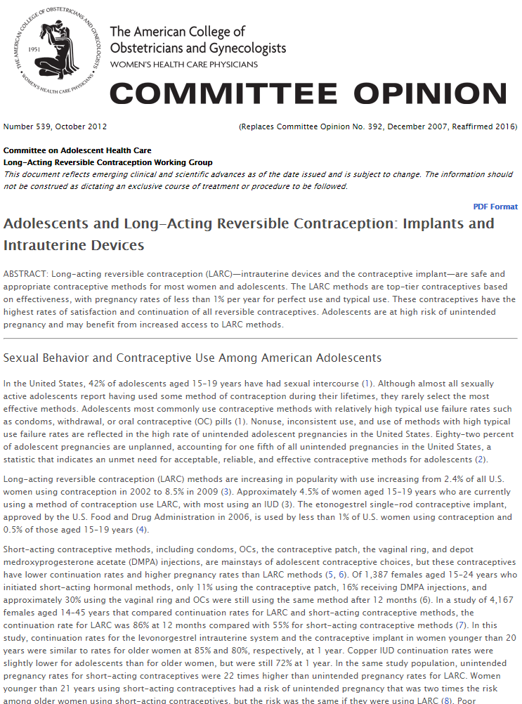
Safety: ACOG 2012 Committee Opinion
2012 American College of Obstetricians and Gynecologists Committee Opinion (reaffirmed 2016):
“LARC - intrauterine devices and the contraceptive implant—are safe and appropriate contraceptive methods for most women and adolescents.”
Adolescents and long-acting reversible contraception. ACOG 2012
Notes:
Facilitator Notes
In 2012, American College of Obstetricians and Gynecologists released a Committee Opinion that was later reaffirmed in 2016 and said, “LARC—intrauterine devices and the contraceptive implant—are safe and appropriate contraceptive methods for most women and adolescents.”
Source (for reference)
Adolescents and long-acting reversible contraception: implants and intrauterine devices. Committee Opinion No. 539. American College of Obstetricians and Gynecologists. Obstet Gynecol 2012;120:983–8.

Slide 11
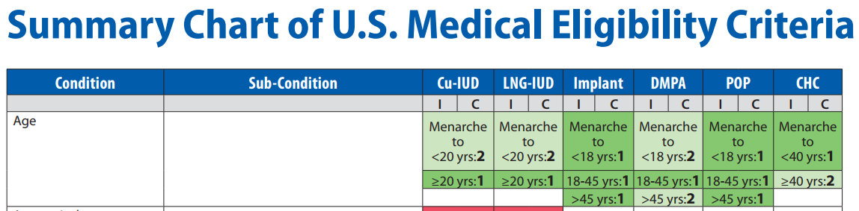
Safety: CDC 2016 Medical Eligibility Criteria
CDC 2016 MEC: “LARC methods are appropriate for most women, including adolescents and nulliparous women. All women should be counseled about the full range and effectiveness of contraceptive options for which they are medically eligible so that they can identify the optimal method.”
KEY
1 No restriction
2 Advantages generally outweigh theoretical or proven risks
3 Theoretical or proven risks usually outweigh the advantages
4 Unacceptable health risk
U.S. Medical Eligibility Criteria for Contraceptive Use, 2016. MMWR
Notes:
Facilitator Notes
In 2010 and again in 2016, CDC’s Medical Eligibility Criteria, which outlines which methods are safe and appropriate for patients, rated LARC methods as a 1 (no restriction) or 2 (advantages outweigh the risks) for those 18 years of age and younger. Implants have a 1 rating for adolescents. CDC says, “LARC methods are appropriate for most women, including adolescents and nulliparous women. All women should be counseled about the full range and effectiveness of contraceptive options for which they are medically eligible so that they can identify the optimal method.”
Source (for reference)
Curtis KM, Tepper NK, Jatlaoui TC, et al. U.S. Medical Eligibility Criteria for Contraceptive Use, 2016. MMWR Recomm Rep 2016;65(No. RR-3):1–104. DOI: http://dx.doi.org/10.15585/mmwr.rr6503a1

Slide 12
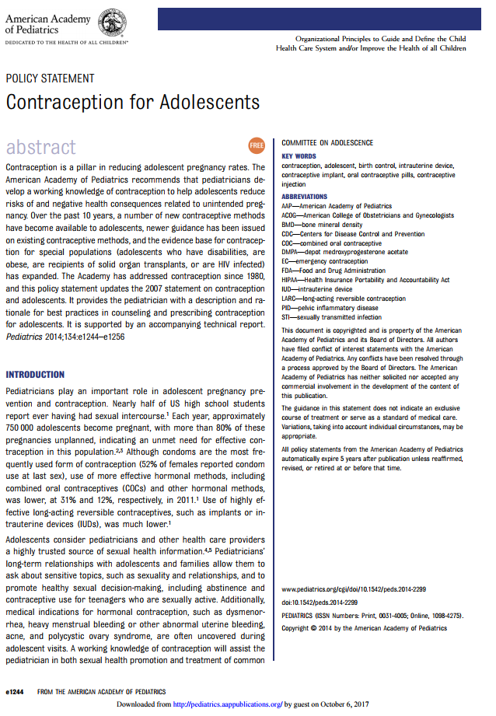
Safety: American Academy of Pediatrics 2014 Policy Statement
AAP 2014 Policy Statement Recommendations:
“Pediatricians should counsel about and ensure access to a broad range of contraceptive services for their adolescent patients… Pediatricians should be able to educate adolescent patients about LARC methods.”
Contraception for Adolescents. AAP 2014
Notes:
Facilitator Notes
In 2014, the American Academy of Pediatrics put out a policy statement that reaffirmed the safety of LARC for adolescents. Within the recommendations were the following statements: “Pediatricians should counsel about and ensure access to a broad range of contraceptive services for their adolescent patients… Pediatricians should be able to educate adolescent patients about LARC methods.”
Source (for reference)
Contraception for Adolescents. Committee on Adolescence. Pediatrics Oct 2014, 134 (4) e1244-e1256; DOI: 10.1542/peds.2014-2299

Slide 13
Historical Concern for PID: Dalkon Shield
Dalkon Shield was introduced in 1971 and heavily marketed
Longitudinal research linked Dalkon Shield to:
  Septic maternal deaths among women who became pregnant while using the device
  Increased risk of PID
Many providers continue to be concerned about PID from IUDs, especially for adolescent patients
Hubacher D. Guttmacher Institute. March 2002
Notes:
Facilitator Notes
Older methods had higher risk profiles of the methods available on the market today, and there were genuine concerns about safety.
Concern about safety and risk of PID comes from a dark history of unsafe IUDs. The most well known: the Dalkon Shield.
The Dalkon Shield was introduced in 1971 and heavily marketed.
The device had serious design flaws, however, which exacerbated the risk of poor outcomes. Research linked the Dalkon Shield to:
Septic maternal death among women who became pregnant while using the device
Increased risk of PID
Scientific, legal, and media actions resulted in a recall of all devices, class action lawsuits, and, ultimately, bankruptcy of the manufacturer.
Many providers remember the Dalkon Shield and the events that led to its demise. Many providers even know women who were themselves impacted by the unsafe Dalkon Shield. As a result, many providers continue to be concerned about IUDs causing PID, especially among young, nulliparous patients.
However, the devices that are on the market today have been rigorously studied, and safety has, as we’ve discussed, been confirmed.
Source (for reference)
David Hubacher. The Checkered History and Bright Future of Intrauterine Contraception In the United States. Perspectives on Sexual and Reproductive Health. March 2002 https://www.guttmacher.org/journals/psrh/2002/03/checkered-history-and-bright-future-intrauterine-contraception-united-states

Slide 14
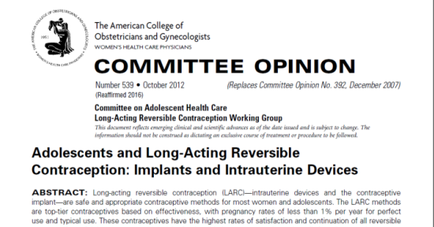
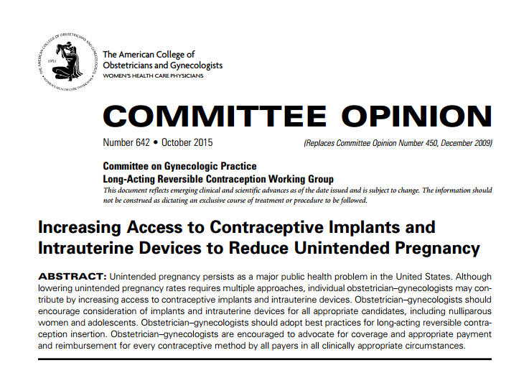
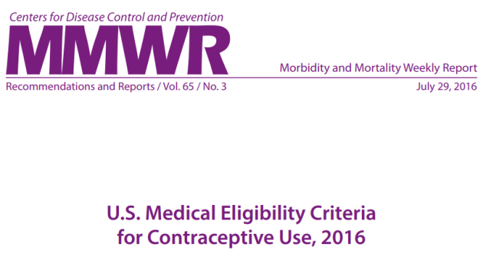
LARC Methods are Safe for Adolescents
ACOG 2012 Opinion on PID and infertility
  Relative risk of PID is increased only in the first 20 days after IUD insertion
  Absolute risk of PID remains small
  Bacterial contamination associated with the insertion is likely cause of infection, not the IUD
  Level of risk:
    0-2% when no cervical infection
    0-5% insertion with undetected infection
  Infertility is not more likely
Risk of PID not a concern for implant
Contraception for Adolescents. AAP 2014
Medical Eligibility Criteria for Contraceptive Use, 2016. MMWR
Adolescents and long-acting reversible contraception. ACOG 2012
Notes:
Facilitator Notes
As it relates to PID for adolescents, ACOG stated in their 2012 Committee Opinion: “Intrauterine devices are safe to use among adolescents.” ACOG states:
“Current evidence demonstrates the safety of modern IUDs. Although few studies have focused exclusively on adolescents who use currently available IUDs, good evidence suggests that the relative risk of pelvic inflammatory disease (PID) is increased only in the first 20 days after IUD insertion and then returns to baseline, while the absolute risk remains small. Bacterial contamination associated with the insertion process is the likely cause of infection, not the IUD itself. The risk of PID with IUD placement is 0–2% when no cervical infection is present and 0–5% when insertion occurs with an undetected infection. Women with positive chlamydia cultures after IUD insertion are unlikely to develop PID, even with retention of the IUD, if the infection is promptly treated. The levonorgestrel intrauterine system may lower the risk of PID by thickening cervical mucus and thinning the endometrium.”
“Intrauterine devices do not increase an adolescent’s risk of infertility. Infertility is not more likely after discontinuation of IUD use than after discontinuation of other reversible methods of contraception. In a large case control study that examined determinants of tubal infertility, the presence of chlamydial antibodies, not previous IUD use, was associated with infertility. Baseline fecundity returns rapidly after IUD removal.”
Additionally, the potential increased risk of PID is not a concern related to the hormonal implant.
Key clinical guidance entities, including the American College of Obstetricians and Gynecologists, CDC, and American Academy of Pediatrics, agree that the evidence indicates that LARC methods are safe and appropriate for adolescents.
Sources (for reference)
Contraception for Adolescents. Committee on Adolescence. Pediatrics Oct 2014, 134 (4) e1244-e1256; DOI: 10.1542/peds.2014-2299
Curtis KM, Tepper NK, Jatlaoui TC, et al. U.S. Medical Eligibility Criteria for Contraceptive Use, 2016. MMWR Recomm Rep 2016;65(No. RR-3):1–104. DOI: http://dx.doi.org/10.15585/mmwr.rr6503a1
Adolescents and long-acting reversible contraception: implants and intrauterine devices. Committee Opinion No. 539. American College of Obstetricians and Gynecologists. Obstet Gynecol 2012;120:983–8.

Slide 15

Adolescents are Interested in LARC
Contraceptive Method Chosen
LARC 75%
LARC 72%
Secura G. 2013
Notes:
Facilitator Notes
Another question providers might have when it comes to adolescents is: Are adolescents even interested in them?
The Contraceptive CHOICE project enrolled 9,256 women between 2007-2011. The project took place in St. Louis, MO. Participants represented a diverse group of women in terms of age, education, and race. Participants were counseled on the full range of methods, and all methods were available free of cost.
What the CHOICE study showed was that, yes, sexually active adolescents were, in fact, interested in LARC if there was access to them. In the overall cohort in the CHOICE study, 75% of women chose LARC, and similarly 72% of adolescents chose LARC. Adolescents were more likely to choose the implant as their LARC method of choice. Thirty-four percent of adolescents opted for the contraceptive implant.
Source (for reference)
http://www.choiceproject.wustl.edu/
Secura G. Trends in Adolescent Contraceptive Use from the Contraceptive CHOICE Project. 2013. http://www.hhs.gov/ash/oah/oah-initiatives/teen_pregnancy/training/Assests/latest_contraceptiveuse.pdf

Slide 16
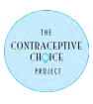
Contraceptive Implant is Popular Among Adolescents
Choice of LARC Methods by Teens
Secura G. 2013
Notes:
Facilitator Notes
Looking even more closely at adolescents: Sexually active patients,14-17 years of age were the most likely to select an implant. 50% of the approximately 75% of 14-17-years olds who selected LARCs chose the implant. This substantiates the need for making the implant available on site, as the evidence suggests sexually active adolescents may be particularly interested in this method.
Source (for reference)
http://www.choiceproject.wustl.edu/
Secura G. Trends in Adolescent Contraceptive Use from the Contraceptive CHOICE Project. 2013. http://www.hhs.gov/ash/oah/oah-initiatives/teen_pregnancy/training/Assests/latest_contraceptiveuse.pdf

Slide 17
Insertion is Not More
Challenging with Adolescents
“Little evidence to suggest that IUD insertion is more technically difficult in adolescents”¹
  In a retrospective cohort study IUDs were rated as commonly as “easy to insert” in nulliparous women as parous women (~80% each group)²
More than one half of nulliparous women will report discomfort with IUD placement.¹
  Use misoprostol does not appear to reduce insertion pain, and adverse effects are common¹
  2015 Cochrane review: “trials of lidocaine, tramadol, and naproxen showed some effect on reducing pain from IUC insertion”³
No special precautions or modifications to implant insertion or removal in adolescents⁴
Adolescents and long-acting reversible contraception. ACOG 2012
Bahamondes et al. Contraception. 2011
Lopez at al. Cochrane Database of Systematic Reviews 2015
McNicholas, Peipert. Current opinion in obstetrics & gynecology. 2012
Notes:
Facilitator Notes
According to the 2012 ACOG Opinion: “Intrauterine devices may be inserted without technical difficulty in most adolescents and nulliparous women.” Little evidence suggests that IUD insertion is technically more difficult in adolescents compared with older women.
In a retrospective cohort study comparing nulliparous and parous women, IUDs were rated as commonly as “easy to insert” in nulliparous women as parous women (~80% each group) (2.)
There are no special precautions or modifications to insertion or removal in adolescents. (4.)
Source (for reference)
Adolescents and long-acting reversible contraception: implants and intrauterine devices. Committee Opinion No. 539. American College of Obstetricians and Gynecologists. Obstet Gynecol 2012;120:983–8.
Bahamondes MV, Hidalgo MM, Bahamondes L, Monteiro I. Ease of insertion and clinical performance of the levonorgestrel-releasing intrauterine system in nulligravidas. Contraception. 2011 Nov;84(5)
Lopez LM, Bernholc A, Zeng Y, Allen RH, Bartz D, O'Brien PA, Hubacher D. Interventions for pain with intrauterine device insertion. Cochrane Database of Systematic Reviews 2015, Issue 7. Art. No.: CD007373. DOI: 10.1002/14651858.CD007373.pub3
McNicholas C, Peipert JF. Long-Acting Reversible Contraception (LARC) for Adolescent. Current opinion in obstetrics & gynecology. 2012;24(5):293-298. doi:10.1097/GCO.0b013e32835686d5.

Slide 18
Expulsions are Uncommon in Adolescents
ACOG 2012 Committee Opinion: IUD expulsion is uncommon in adolescents
Intrauterine device expulsion rates range
  from 3% to 5% for all IUD users
  from 5% to 22% in adolescents
Perforation: 1 per 1,000 insertions or fewer among adolescents
Prior expulsion should not be considered a contraindication for another IUD provided that appropriate counseling is given
Adolescents and long-acting reversible contraception. ACOG 2012
Notes:
Facilitator Notes
According to ACOG 2012 Committee Opinion: “Intrauterine device expulsion is uncommon in adolescents. Intrauterine device expulsion rates range from 3% to 5% for all IUD users and from 5% to 22% in adolescents. Young age, previous IUD expulsion, and nulliparity may slightly increase the risk of expulsion, but research on current IUDs is limited. Prior expulsion should not be considered a contraindication for another IUD provided that appropriate counseling is given.”
Expulsion is not a concern for Nexplanon, which, again we know, is particularly of interest to adolescents.
Source (for reference)
Adolescents and long-acting reversible contraception: implants and intrauterine devices. Committee Opinion No. 539. American College of Obstetricians and Gynecologists. Obstet Gynecol 2012;120:983–8.

Slide 19
Do Not Need to Wait for STI Screening Results Before Initiating LARC
ACOG 2012 Committee Opinion:
  Adolescents should be routinely screened for STIs (e.g., gonorrhea and chlamydia) at the time of IUD insertion
  It is reasonable to screen for STIs and place the IUD on the same day
  If a STI is diagnosed after the IUD is in place, it may be treated without removing the IUD
Adolescents and long-acting reversible contraception. ACOG 2012
Notes:
Facilitator Notes
According to ACOG 2012 Committee Opinion: “Adolescents should be routinely screened for STIs (eg, gonorrhea and chlamydia) at the time of IUD insertion.’’
Women aged 15–19 years have the second highest rates of chlamydia and the highest rates of gonorrhea of any age group. Thus, all adolescents should be screened for STIs at the time of or before IUD insertion. It is reasonable to screen for STIs and place the IUD on the same day (and administer treatment if the test results are positive) or when the test results are available. If an STI is diagnosed after the IUD is in place, it may be treated without removing the IUD. Routine antibiotic prophylaxis is not recommended before IUD insertion.”
Source (for reference)
Adolescents and long-acting reversible contraception: implants and intrauterine devices. Committee Opinion No. 539. American College of Obstetricians and Gynecologists. Obstet Gynecol 2012;120:983–8.

Slide 20
Continuation Rates of LARC are High
12-Month Continuation: Overall Cohort
LARC
Secura G. 2013
Notes:
Facilitator Notes
Another concern of providers is that adolescents may be likely to discontinue LARC methods.
According to the one-year follow-up data from the CHOICE study, overall participant LARC continuation rates are high. Eighty-six percent of all LARC users continued their method through 12 months, compared to 55% of non-LARC users.
Source (for reference)
Secura G. Trends in Adolescent Contraceptive Use from the Contraceptive CHOICE Project. 2013. http://www.hhs.gov/ash/oah/oah-initiatives/teen_pregnancy/training/Assests/latest_contraceptiveuse.pdf

Slide 21
Continuation Rates of LARC are High (cont.)
3-Year Continuation
LARC
Diedrich et al. Am J Obstet Gynecol. 2015
Notes:
Facilitator Notes
These high continuation rates have been sustained through three years, according to a 2015 published study by Diedrich et al. Two thirds (67%) of LARC users compared to just one third (31%) of non-LARC users were still using their method three years later.
Source (for reference)
Diedrich JT, Zhao Q, Madden T, Secura GM, Peipert JF. Three-year continuation of reversible contraception. Am J Obstet Gynecol. 2015 Nov;213(5):662.e1-8. doi: 10.1016/j.ajog.2015.08.001. Epub 2015 Aug 7.

Slide 22
Adolescents Have High LARC Continuation Rates
Continuation Rates, By Age
20-45 y LARC
14-19 y LARC
20-45 y Non-LARC
14-19 y Non-LARC
Diedrich et al. Am J Obstet Gynecol. 2015
Notes:
Facilitator Notes
How do these continuation rates compare by age? This graph shows continuation of LARC and non-LARC methods through three years, by age (14 to 19-year-olds vs. 20 to 45 year-olds). While adolescent continuation rates are slightly lower than non-adolescent continuation rates, continuation rates of LARC are about double that of non-LARC method continuation rates for adolescents.
Source (for reference)
Diedrich JT, Zhao Q, Madden T, Secura GM, Peipert JF. Three-year continuation of reversible contraception. Am J Obstet Gynecol. 2015 Nov;213(5):662.e1-8. doi: 10.1016/j.ajog.2015.08.001. Epub 2015 Aug 7.

Slide 23

Reasons for Discontinuation – May surprise you!
According to an Arizona Family Health Partnership QI project, the most common reasons for LARC discontinuation were:
Device expiring
Patient now seeking pregnancy
https://vimeo.com/149185647
Schmidt et al. J Adolesc Health. 2015
Notes:
Facilitator Notes
It is helpful to explore why patients discontinue LARC methods in your clinic.
Activity
Take a few minutes to watch this QI Case Study of the Arizona Family Health Partnership, and see what staff there learned about their discontinuation rates.
According to an Arizona Family Health Partnership QI project, the most common reasons for LARC discontinuation were:
Device expiring
Patient now seeking pregnancy
Source (for reference)
Schmidt E, James A, Curran KM, Peipert JF, Madden T. Adolescent Experiences With Intrauterine Devices: A Qualitative Study. J Adolesc Health. 2015 Oct;57(4):381-6. doi: 10.1016/j.jadohealth.2015.05.001. Epub 2015 Jun 27.

Slide 24
Reasons for Dis/Continuation
According to a 2015 study (Schmidt et al) adolescents:
Continued IUD use because:
Discontinued IUD use because:
Effectiveness
Duration of use
Convenience
Potential bleeding changes
Amenorrhea (LNG-IUS)
Non-hormonal method, continued menses (copper IUD)
Bleeding irregularities (also for implant, Grunloh et al 2013)
Expulsion (copper IUD)
Continued pain (LNG IUS)
“Discussion of effectiveness, duration and convenience, and anticipatory guidance regarding post-insertion side effects may be important in counseling young women.”
Schmidt et al. J Adolesc Health. 2015
Danielle et al. Obstet Gynecol. 2013
Notes:
Facilitator Notes
It’s worth exploring why adolescents choose to continue or discontinue their methods. In a qualitative study of adolescents who shared their experience with IUDs, they raised several factors that contributed to continuation and discontinuation.
A key finding of this study: Discussion of effectiveness, duration and convenience, and anticipatory guidance regarding post-insertion side effects may be important in counseling young women. This reiterates the importance of counseling in advance of side effects for adolescents.
Source (for reference)
Schmidt E James A, Curran KM, Peipert JF, Madden T. Adolescent Experiences With Intrauterine Devices: A Qualitative Study. J Adolesc Health. 2015 Oct;57(4):381-6. doi: 10.1016/j.jadohealth.2015.05.001. Epub 2015 Jun 27.
Danielle S, Grunloh, Teya Casner, Gina M. Secura, Jeffrey F. Peipert, and Tessa Madden. Characteristics Associated With Discontinuation of Long-Acting Reversible Contraception Within the First 6 Months of Use. Obstet Gynecol. 2013 Dec; 122(6): 1214–1221.

Slide 25
LARC Users are Highly Satisfied with Their Methods
12-Month Satisfaction: Overall Cohort
LARC
Secura G. 2013
Notes:
Facilitator Notes
Finally, what about satisfaction with methods? Data from the CHOICE study again show that overall satisfaction with LARC is higher than other methods. Over 8 in 10 LARC users were satisfied with their method after 12 months, compared to 5 in 10 non-LARC users.
Source (for reference)
Secura G. Trends in Adolescent Contraceptive Use from the Contraceptive CHOICE Project. 2013. http://www.hhs.gov/ash/oah/oah-initiatives/teen_pregnancy/training/Assests/latest_contraceptiveuse.pdf

Slide 26
Adolescents are Highly Satisfied with LARC Methods
12-Month Satisfaction: By Age
Secura G. 2013
Notes:
Facilitator Notes
Looking at satisfaction data from the CHOICE study by age: When compared with women older than 25 years of age, females aged 14-19 were significantly less likely to be satisfied with non-LARC methods (42% compared with 51%), but were similarly satisfied with LARC methods (75% compared with 83%). Satisfaction with LARC methods was overall much higher than satisfaction with non-LARC methods.
Source (for reference)
Secura G. Trends in Adolescent Contraceptive Use from the Contraceptive CHOICE Project. 2013. http://www.hhs.gov/ash/oah/oah-initiatives/teen_pregnancy/training/Assests/latest_contraceptiveuse.pdf

Slide 27
Summary: How to Address Common Concerns/Questions
Are LARCs safe for sexually active adolescents? Yes
Are sexually active adolescents interested in LARC? Yes
Is insertion challenging with adolescents? No
Are expulsions common among adolescents? No
Do I need to wait for STI screening results before initiating LARC? No
Do adolescents have high discontinuation rates? No
Are adolescents satisfied with LARC methods? Yes
Notes:
Facilitator Notes
So, how can you respond to these common questions/concerns?
Are LARC methods safe for sexually active adolescents? Yes
Are adolescents interested in LARC? Yes
Is insertion more challenging with LARC? Data currently suggest no.
Are expulsions more common among adolescents? Data suggest no.
Do I need to wait for STI screening results before initiating LARC? No
Do adolescents have high discontinuation rates? No
Are adolescents satisfied with LARC methods? Yes

Slide 28
Reflections
What in the data was surprising?
How will you use these data to address common concerns/questions about adolescents and LARC?
What other questions and concerns do you have?
Notes:
Discuss
What in the data was surprising?
How will you use these data to address common concerns/questions about adolescents and LARC?
What other questions and concerns do you have?

Slide 29
Thank you!
Contact:
fpntc@jsi.com
Notes:
Facilitator Notes
Thank you for participating in today’s discussion
If applicable, you can contact me at:_______
You can also always contact the Family Planning National Training Center (fpntc@jsi.com) with questions/comments.

