Slide 1
Mandatory Child Abuse Reporting in
Title X-Funded Family Planning Settings
[INSERT AGENCY NAME]
[INSERT STATE]

Slide 2
Objectives
By the end of this training, participants will be able to:
Identify at least one risk factor or possible indicator of child abuse or neglect
Explain the mandatory child abuse reporting process in [INSERT STATE]
Describe at least two trauma-informed best practices that support family planning clients
Identify at least one local resource for providers
Notes:
Facilitator Notes
The goal of this training is to provide you with the knowledge and skills needed to understand what is reportable as child abuse and neglect in our state and how to respond to cases of child abuse and neglect, either as an identified mandated reporter or other staff at a Title X-funded agency.
Specifically, by the end of the training you will be able to:
Identify at least one risk factor or possible indicator of child abuse or neglect
Explain the mandatory child abuse reporting process in our state (who, what, when, and how)
Describe at least two trauma-informed best practices that support your client(s)
Identify at least one local resource for providers

Slide 3
Mandatory Child Abuse Reporting
This training will address:
State mandated child abuse reporting laws
Information on whether child molestation, sexual abuse, rape, incest, intimate partner violence, and human trafficking are reportable as child abuse in our state
This training will NOT address:
Other state reporting laws
Notes:
Facilitator Notes
This training addresses mandated child abuse reporting laws in our state and includes information on whether child abuse, child molestation, sexual abuse, rape, incest, intimate partner violence, and human trafficking are reportable child abuse.
Mandated child abuse reporting is just one reporting law. This training will not cover any other reporting laws in our state.

Slide 4
Mandatory Reporting:
A Title X Legislative Mandate
“The Office of Population Affairs expects every Title X project will comply with applicable state laws in the proposed service area and will have project-wide monitoring and state-specific policies and procedures related to reporting of child abuse, child molestation, sexual abuse, rape, incest, intimate partner violence, and human trafficking."
https://www.hhs.gov/opa/title-x-family-planning/about-title-x-grants/program-priorities/index.html
Notes:
Facilitator Notes
As a recipient of Title X funds, our agency is required to comply with legislative mandates stated in the Health and Human Services Appropriations Act.
As providers of Title X-funded care, we must follow state laws related to the reporting of child abuse, child molestation, sexual abuse, rape, incest, intimate partner violence, and human trafficking.
References
Title X Family Planning Services and Population Act of 1970 (Public Law 91-572)
Consolidated Appropriations Act, 2014, Pub. L. No. 113–76, 128 Stat. 5 (2014) (“Notwithstanding any other provision of law, no provider of services under Title X of the Public Health Service Act shall be exempt from any State law requiring notification or the reporting of child abuse, child molestation, sexual abuse, rape, or incest.”)

Slide 5
Our Agency’s Mandatory Child Abuse Reporting Policy
[INSERT AGENCY-SPECIFIC INFORMATION HERE (clarify how staff can access the policy; where forms and phone numbers are located; who in the agency supervises and/or assists with mandated reports; where documentation should be kept, etc.)]
Notes:
Facilitator Notes
Let’s start with our agency’s mandatory reporting policy:
[INSERT AGENCY-SPECIFIC INFORMATION HERE (clarify how staff can access the policy; where forms and phone numbers are located; who in the agency supervises and/or assists with mandatory reporting; where documentation should be kept, etc.)].
Today’s training will go into detail about identifying cases, who is a mandated reporter, and how and when to make a report. All of this information is included in our agency’s policy as well.

Slide 6
Setting the Stage with Clients: Consent and Confidentiality
Notes:
Facilitator Notes
Understanding Title X consent and confidentiality rules is extremely important when it comes to mandated child abuse reporting, as well as when providing services to youth and protecting their rights in general.

Slide 7
Title X Consent Rule
Regulations require that Title X-funded services be made available to all adolescents, regardless of age.
  Minors of any age may consent to services for themselves when those services are funded in full or in part by Title X.
  Title X service provision cannot be conditioned on parental consent or notification, even if state law otherwise requires parental consent or notice.
Gudeman and Madge, The Federal Title X Family Planning Program: Privacy and Access Rules for Adolescents. National Center for Youth Law, 2011.
Notes:
Facilitator Notes
Often clinic staff incorrectly contact parents to obtain consent before providing services to an adolescent client; minors are able to consent for many of their own services.
It is important to know that Title X’s consent rule supersedes our state law, and to be familiar with minor consent laws in our state.

Slide 8
Title X Confidentiality Rule
Client information must be kept confidential. Release of client information is prohibited, unless:
  Client provides written authorization
  Release of information is necessary to provide services
  Release of information is required by law
    Mandatory reporting “requires” the release of information when reporting is indicated
If youth want to involve others in their care (parent, guardian, partner, etc.), they must provide permission.
Notes:
Facilitator Notes
Navigating mandatory reporting and client confidentiality can be challenging.
Title X requires client confidentiality, and mandatory reporting laws require disclosure.
Title X prohibits providers from releasing personal information, unless the client provides written authorization. The release of information is necessary to provide services to the client, or it is required by law.
Mandated child abuse reporting laws “require” the release of information when reporting is indicated.
Because there is an exception in both HIPAA and Title X for disclosures required by state law, mandated reporters do not violate Title X or HIPAA confidentiality provisions when they disclose otherwise protected health information as part of a child abuse report they are mandated to submit.
It is important to know that reporters may only release information to the required agency, and the client’s confidentiality must still be maintained when it comes to parents or other individuals.
References
42 C.F.R. § 59.11 (2013)(“All information as to personal facts and circumstances obtained by the project staff about individuals receiving services must be held confidential and must not be disclosed without the individual's documented consent, except as may be necessary to provide services to the client or as required by law, with appropriate safeguards for confidentiality. Otherwise, information may be disclosed only in summary, statistical, or other form which does not identify particular individuals.”)

Slide 9
Communicating Consent, Confidentiality, and Its Limitations
Start all adolescent visits with an explanation of:
  Title X minor consent and the services it includes
  Confidentiality and its limitations
Notes:
Facilitator Notes
Since any clinical interaction with an adolescent can potentially result in a disclosure of information that prompts child abuse reporting, all adolescent visits should begin with a clear, developmentally appropriate explanation of Title X minor consent and confidentiality.
It is also important to explain the limits of confidentiality, such as when a youth or others are at risk or have been harmed OR that the services they are receiving do NOT fall under Title X.

Slide 10
Sample Confidentiality Statement
"Before we begin, I want to let you know that whatever you share with me is confidential, meaning between you and me, and select staff here on a need-to-know basis. The only exception is if I find out you’ve been hurting yourself, someone else, or you’ve been harmed, in which case I will need to reach out to get help. Do you have any questions about that?"
Notes:
Facilitator Notes
Concepts related to confidentiality and child abuse reporting can be confusing for young people. Addressing these issues at the start of a visit can help to build the trust needed to provide good care and facilitate the reporting process, if needed.
Example of how to explain confidentiality and reporting requirements:
"Before we begin, I want to let you know that whatever you share with me is confidential, meaning between you and me, and select staff here on a need-to-know basis. The only exception is if I find out you’ve been hurting yourself, someone else, or you’ve been harmed, in which case I will need to reach out to get help. Do you have any questions about that?“
Discuss
There may be other ways to give this message about confidentiality and when it may need to be breached. Would anyone like to share how they explain this to clients?
How do clients typically respond?
What challenges have you experienced when explaining this to clients? (If needed, see if others can help brainstorm ways to address these challenges.)
Facilitator Notes
Providers often express concern that if they raise the issue of confidentiality exceptions, youth may not disclose information about abuse.
Research shows that assurances of confidentiality lead to both an increase in disclosure of sensitive information and an increase in willingness to disclose information in future health care visits.
On the other hand, making false assurances about confidentiality and then telling a young person that what they have told a provider has to be shared with someone else results in a sense of disempowerment, with youth feeling that they have been tricked or lied to. This impairs the young person's trust not only with the individual provider that they are working with, but with health care providers and systems in general.
References
English, A., & Ford, C. A. (2018). Adolescent health, confidentiality in healthcare, and communication with parents. The Journal of Pediatrics, 199, 11–13.
Ford, C., English, A., Sigman, G. (2004). Confidential Health Care for Adolescents: position paper for the society for adolescent medicine. Journal of adolescent health, 35(2), 160-167. English, A., & Ford, C. A. (2018). Adolescent health, confidentiality in healthcare, and communication with parents. The Journal of Pediatrics, 199, 11–13.
Ford, C, Millstein, S, Halpern-Felsher, B, Irwin, C. Influence of physician confidentiality assurances on adolescents' willingness to disclose information and seek future health care. JAMA, 278 (1997), pp. 1029–1034.

Slide 11
Sample Consent Statement
“At our clinic, young people can give permission for pregnancy tests, birth control, STI testing, and other services related to family planning and sexual health without involving an adult, like a parent or guardian. We encourage you to talk with a parent or another adult whom you trust about your visit, but we can’t talk with them about these services without your permission. If we need to provide a service or treatment for something not related to family planning or sexual health, we do need your parent or guardian’s permission. And if that’s the case, we’ll figure out together how to involve them in your care without telling them about your family planning or sexual health needs.”
Notes:
Facilitator Notes
Providing young clients with a clear explanation of their consent rights will likely lead to a frank, open, and honest conversation. Keeping the information concrete and using examples that youth can understand and relate to will increase understanding.
Example of how to explain consent:
“At our clinic, young people can give permission for pregnancy tests, birth control, STI testing, and other services related to family planning and sexual health without involving an adult, like a parent or guardian. We encourage you to talk with a parent or another adult whom you trust about your visit, but we can’t talk with them about these services without your permission. If we need to provide a service or treatment for something not related to family planning or sexual health, we do need your parent or guardian’s permission. And if that’s the case, we’ll figure out together how to involve them in your care without telling them about your family planning or sexual health needs.”
Discuss
There may be other ways to give this message about consent rights and Title X services. Would anyone like to share how they explain this to clients?
How do clients typically respond?
What challenges have you experienced when explaining this to clients? (If needed, see if others can help brainstorm ways to address these challenges.)

Slide 12
Recognizing Risk Factors for Sexual Coercion, Child Abuse, and Relationship Abuse
Notes:
Facilitator Notes
Although any client presenting for family planning services may have experienced—or currently be experiencing—sexual coercion or abuse, there are some indicators that should alert you to carefully explore these issues with your clients.

Slide 13
Risk Factors Associated with Sexual Abuse and Coercion
Early pubertal development in girls
History of childhood physical or sexual abuse
Living with a non-related adult male in the household
Early (<14) dating or dating older partners
Youth with disabilities
Youth who have run away or are homeless
Youth involved in the juvenile justice system
Notes:
Facilitator Notes
Risk factors associated with sexual abuse and coercion include:
Early pubertal development in girls
History of childhood physical or sexual abuse
Living with a non-related adult male in the household
Early (<14) dating or dating older partners
Youth with disabilities
Youth who have run away or are homeless
Youth involved in the juvenile justice system
References
Raj A, Silverman JG, Amaro H. The Relationship between Sexual Abuse and Sexual Risk among High School Students: Findings from the 1997 Massachusetts Youth Risk Behavior Survey. Matern. Child Health J. 2000;4(2):125–134.
Black, M.C., Basile, K.C., Breiding, M.J., Smith, S.G., Walters, M.L., Merrick, M.T., Chen, J., & Stevens, M.R. (2011). The National Intimate Partner and Sexual Violence Survey (NISVS): 2010 Summary Report. Atlanta, GA: National Center for Injury Prevention and Control, Centers for Disease Control and Prevention.
Yeater, E. A., Montanaro, E. A., & Bryan, A. D. (2015). Predictors of Sexual Coercion and Alcohol Use among Female Juvenile Offenders. Journal of Youth and Adolescence, 44(1), 114–126. http://doi.org.ucsf.idm.oclc.org/10.1007/s10964-014-0166-z.

Slide 14
Risk Factors Associated with Relationship Abuse/Dating Violence
Being young: 16–24 years old
Substance use, including alcohol
Growing up in a household with domestic violence or abuse (as a survivor or a witness)
Social isolation/lack of support
Depression and suicide attempts
Traditional gender norms and gender inequality
Poverty and associated factors
Jealousy, possessiveness, and negative emotion within an intimate relationship
Notes:
Facilitator Notes
Risk factors associated with relationship abuse/dating violence include:
Being young: 16–24 years old
Substance use, including alcohol
Growing up in a household with domestic violence or abuse (as a survivor or a witness)
Social isolation/lack of support
Depression and suicide attempts
Traditional gender norms and gender inequality
Poverty and associated factors
Jealousy, possessiveness, and negative emotion within an intimate relationship
References
McCauley, H. L., Dick, R. N., Tancredi, D. J., Goldstein, S., Blackburn, S., Silverman, J. G., ... Miller, E. (2014). Differences by sexual minority status in relationship abuse and sexual and reproductive health among adolescent females. Journal of adolescent health, 55(5), 652–658.
Satinsky, S., Jozkowski, K. (2014). Sexual coercion and behavior among a sample of sexual minority women. Women & Health, 54(2), 77–93.
Silverman JG, Raj A, Clements K. Dating Violence and Associated Sexual Risk and Pregnancy among Adolescent Girls in the United States. Pediatrics 2004;114: e220–5
Kantor GK, Jasinski JL. Dynamics and Risk Factors in Partner Violence. In: Jasinski JL, Williams LM, editors. Partner Violence: A Comprehensive Review of 20 Years of Research. Thousand Oaks (CA):Sage; 1998. p.1–43.
Yeater, E. A., Montanaro, E. A., & Bryan, A. D. (2015). Predictors of Sexual Coercion and Alcohol Use among Female Juvenile Offenders. Journal of Youth and Adolescence, 44(1), 114–126. http://doi.org.ucsf.idm.oclc.org/10.1007/s10964-014-0166-z
National Center for Injury Prevention and Control, Division of Violence Prevention

Slide 15
Family Planning-Related Indicators for Relationship Abuse/Dating Violence
Contraceptive non-use
Decreased condom use
Frequent STD testing
Repeated pregnancy testing
Multiple emergency contraception use
Unintended pregnancy
Rapid repeat pregnancies
Notes:
Facilitator Notes
Family planning clinics, along with school-based health centers and prenatal clinics, serve a higher percentage of youth who have experienced relationship abuse.
Family planning-specific indicators for relationship abuse/dating violence include:
Contraceptive non-use
Decreased condom use
Frequent STD testing
Repeated pregnancy testing
Multiple emergency contraception use
Unintended pregnancy
Rapid repeat pregnancies
None of these risk factors, behaviors, or care-seeking patterns automatically indicate abuse, but they should heighten your concern and lead to careful exploration of the issue with your client.
References
Miller E, Decker MR, McCauley H, Tancredi DJ, Levenson R, Waldman J, Schoenwald P, Silverman JG. Pregnancy Coercion, Intimate Partner Violence, and Unintended Pregnancy. Contraception 2010;81(4):316–22.
Sarkar, N. N. (2008). The impact of intimate partner violence on women's reproductive health and pregnancy outcome. Journal of Obstetrics and Gynaecology, 28(3), 266–271.

Slide 16
Responding to Risk Factors/Indicators
Focus on clinical intervention
  Explore client concerns
  Listen nonjudgmentally
  Provide access to:
    support
    counseling
    safety planning
    alternative housing
    advocacy
  Help to connect the abuse with possible health outcomes
Evaluate if information prompts reporting duty
Notes:
Facilitator Notes
It is important to remember to focus on intervention and services first, if possible.
Examples of how to increase safety and decrease isolation and fear, regardless of whether a report is required:
Explore client concerns
Listen nonjudgmentally and provide access to support, counseling, safety planning, alternative housing, and advocacy
Help the client to make the connection between the abuse she/he is experiencing and the health and mental health outcomes associated with abuse to motivate the client to engage in services and support
Evaluate whether information prompts the reporting duty

Slide 17
[INSERT STATE]
Child Abuse Reporting
Laws and Process
Notes:
Facilitator Notes
We are now going to review the process of making a report, including:
Who must report
What to report
When to report
How to report

Slide 18
Who Must Report
Notes:
Discuss
Who in the room knows that they are a mandated reporter? (Ask for a show of hands.)
Who knows that they are not a mandated reporter? (Ask for a show of hands.)
Who is unsure? (Ask for a show of hands.)

Slide 19
Who Must Report (cont.)
The following staff are mandated reporters in our state:
[INSERT STATE-SPECIFIC INFORMATION HERE]
Exemptions include (if any):
[INSERT STATE-SPECIFIC INFORMATION HERE]
Notes:
Facilitator Notes
In our state, the following staff are mandated reporters:
[INSERT STATE-SPECIFIC INFORMATION HERE (refer to Mandatory Reporters of Child Abuse and Neglect and scroll to “Professionals Required to Report” under your state)].
Exemptions include:
[INSERT STATE-SPECIFIC INFORMATION HERE (list exemptions and circumstances in which they are exempt, if any)].

Slide 20
Who Must Report (cont.)
Staff who are not mandated reporters can take action by:
[Insert agency policy for non-mandated reporting staff.]
Notes:
Facilitator Notes
If everyone in your clinic is a mandated reporter, delete this slide.
[INSERT STATE-SPECIFIC INFORMATION HERE (refer to Reporting by Other Persons section under your state)].
Some staff in our clinic are mandated reporters and some are not.
If you are NOT a mandated reporter:
Our clinic policy still requires that you share your concern or suspicions with your supervisor.
OR
Our clinic policy still encourages you to share your concern or suspicions with your supervisor.

Slide 21
Who Must Report (cont.)
[INSERT STATE-SPECIFIC INFORMATION HERE (clarify if reports are centralized or individual duty)]
[IF CENTRALIZED, INSERT CLINIC-SPECIFIC INFORMATION HERE (include name, department, and any other contact information helpful to staff)]
Notes:
Facilitator Notes
[INSERT STATE-SPECIFIC INFORMATION HERE (refer to Mandatory Reporters of Child Abuse and Neglect, scroll to “Institutional Responsibility to Report” section under your state)].
(If centralized reporting is allowed) Our state law allows us to establish an internal procedure that allows staff to share child abuse suspicions with a centralized person who then makes mandated reports on behalf of the agency.
At our agency, the centralized person is: [INSERT CLINIC-SPECIFIC INFORMATION HERE].
OR
(If reporting is an individual duty) Our state considers mandated reporting to be an individual duty. While the agency may establish an internal agency process to facilitate child abuse reporting, reporting remains an individual duty, and individual reporters are responsible for ensuring reports get filed.

Slide 22
What Must Be Reported

Slide 23
What Must Be Reported
Our state’s definition of reportable child abuse:
[INSERT STATE-SPECIFIC INFORMATION HERE (definition of child abuse for reporting purposes according to state law)]
Notes:
Facilitator Notes
In our state the definition of child abuse for reporting purposes is:
[INSERT STATE-SPECIFIC INFORMATION HERE (refer to Mandatory Child Abuse Reporting State Summaries)].

Slide 24
What Must Be Reported
Mandatory reporting and who committed the act of abuse:
For reporting purposes, we are required to report all acts of abuse as defined by our state [INSERT STATE-SPECIFIC INFORMATION HERE (see facilitator notes for additional statement regarding who committed act of abuse)]
We are required to report all acts of neglect as defined by our state [INSERT STATE-SPECIFIC INFORMATION HERE (see facilitator notes for additional statement regarding who committed act of neglect)]
Notes:
Discuss
Do you think acts of abuse or neglect are reportable if perpetrated by a teacher?
What about an adult who is living in the child’s home but is not related in any way?
Facilitator Notes
For reporting purposes, we are required to report all acts of abuse as defined by our state, regardless of the perpetrator or person who allowed the abuse (refer to Mandatory Child Abuse Reporting State Summaries).
OR
For reporting purposes, we are required to report all acts of abuse as defined by our state, if the acts were perpetrated or allowed by _________ (refer to Mandatory Child Abuse Reporting State Summaries).
We are required to report all acts of neglect as defined by our state, perpetrated or allowed by _________ (refer to Mandatory Child Abuse Reporting State Summaries).

Slide 25
What Must Be Reported
Mandatory reporting and intimate partner violence between adolescents:
[INSERT STATE-SPECIFIC INFORMATION HERE (specify if state’s definitions of child abuse and neglect incorporate intimate partner violence by or against a teen partner)]
Notes:
Facilitator Notes
Is intimate partner violence between adolescent partners reportable as child abuse?
The answer to this question relates to whether or not our state defines reportable abuse at the hands of anyone or only those who are in a caregiver role.
In our state, abuse is defined as acts at the hands of [INSERT STATE-SPECIFIC INFORMATION HERE (refer to Mandatory Child Abuse Reporting State Summaries)].
Therefore, intimate partner violence between teen partners that includes actions that meet the specific criteria for child abuse reporting [is/is not] reportable as child abuse.
Is intimate partner violence between adolescent partners reportable as neglect?
Even if not reportable as abuse, neglect on the part of a caregiver is also a possibility when a minor client reports intimate partner violence. [INSERT STATE-SPECIFIC INFORMATION HERE (refer to Mandatory Child Abuse Reporting State Summaries)].
Later in this presentation, we will discuss what to do if something is not reportable as child abuse, but still very concerning to you as a mandated reporter.

Slide 26
What Must Be Reported
Mandatory reporting and rape:
“Rape” in general refers to non-consensual sexual activity, though state law may use other terms
[INSERT STATE-SPECIFIC INFORMATION HERE (clarify when non-consensual activity is included in state definitions of child abuse and neglect)]
Notes:
Facilitator Notes
Non-consensual sexual activity is illegal. This is sometimes referred to as rape or sexual assault. The next slide will address statutory rape, specifically.
(If child abuse is defined as something perpetrated by particular individuals) In our state, child abuse is defined as something perpetrated by [INSERT STATE SPECIFIC INFORMATION HERE (refer to Mandatory Child Abuse Reporting State Summaries)].
Rape is only reportable as child abuse if perpetrated by one of these individuals.
OR
(If child abuse is defined as something perpetrated by anyone) In our state, child abuse is defined as something perpetrated by anyone.
Reportable activity that falls under the definition of rape includes: [INSERT STATE SPECIFIC INFORMATION HERE] (please work with legal counsel to develop this content, ideally listing acts which are reportable. Be sure to check for case law and opinions that may shape these rules.)
Even if not reportable as abuse, neglect on the part of a caregiver is also a possibility when a minor client reports rape. [INSERT STATE SPECIFIC INFORMATION HERE (refer to Mandatory Child Abuse Reporting State Summaries.)]
(If rape is not reportable in your state under child abuse and neglect reporting or ANY other reporting law) Staff must obtain patient consent in order to report it to law enforcement.
Later in this presentation, we will discuss what to do if something is not reportable as child abuse, but still very concerning.

Slide 27
What Must Be Reported
Mandatory reporting and statutory rape:
“Statutory rape” refers to illegal sexual activity based on the age of one or both individuals.
Child abuse reporting law does not require reporting all illegal sexual activity. It requires reporting abuse as defined in our state.
[INSERT STATE-SPECIFIC INFORMATION HERE (clarify if and how statutory rape is included in state definitions of child abuse and neglect)]
Notes:
Facilitator Notes
In our state, certain sexual acts with an adolescent are illegal based on the age of one or both individuals. This is sometimes referred to as statutory rape law, even though state law may use different terms.
The act is illegal based on age, not on an assessment of consent.
Illegal activity in and of itself is not reportable as child abuse. So the question is whether any violations of our state statutory rape law ever meet the definition of child abuse.
(If child abuse is defined as something perpetrated by particular individuals) In our state, child abuse is defined as something perpetrated by [INSERT STATE-SPECIFIC INFORMATION HERE (refer to Mandatory Child Abuse Reporting State Summaries)].
Reportable activity that falls under the definition of statutory rape includes: [INSERT STATE-SPECIFIC INFORMATION HERE] (please work with legal counsel to develop this content, ideally listing acts and ages at which it is reportable. Be sure to check for case law and opinions that may shape these rules.)
These acts are only reportable as child abuse if perpetrated by one of these individuals.
OR
(If child abuse is defined as something perpetrated by anyone) In our state, child abuse is defined as something perpetrated by anyone.
Reportable activity that falls under the definition of statutory rape includes: [INSERT STATE-SPECIFIC INFORMATION HERE] (please work with legal counsel to develop this content, ideally listing acts and ages at which it is reportable. Be sure to check for case law and opinions that may shape these rules.)
Even if not reportable as abuse, the possibility of neglect on the part of a caregiver should be explored. [INSERT STATE-SPECIFIC INFORMATION HERE (refer to Mandatory Child Abuse Reporting State Summaries.)]
Later in this presentation, we will discuss what to do if something is not reportable as child abuse, but still very concerning to you as a clinician.

Slide 28
What Must Be Reported
Mandatory reporting and prostitution, commercial sexual exploitation of children, and sex trafficking:
[INSERT STATE-SPECIFIC INFORMATION HERE (clarify if and how prostitution, commercial exploitation, and/or sex trafficking are included in state definitions of child abuse and neglect)]
Notes:
Facilitator Notes
Our state law does incorporate aspects of commercial sexual exploitation of children and sex trafficking in what is reportable as child abuse. [INSERT STATE-SPECIFIC INFORMATION HERE (refer to Mandatory Child Abuse Reporting State Summaries.)]
In addition, neglect is also a possibility when working with a minor who is engaging in coercive, dangerous, or illegal sexual activity. [INSERT STATE-SPECIFIC INFORMATION HERE (refer to Mandatory Child Abuse Reporting State Summaries)].

Slide 29
What Must Be Reported
In most states, an abuse report is not indicated solely based on a suspicion of or diagnosis of a pregnancy or STD.
[INSERT STATE-SPECIFIC INFORMATION (clarify if your state requires abuse reporting based on the age of the pregnant client or client with an STD)]
Notes:
Facilitator Notes
An abuse report (is/is not) not indicated solely based on a suspicion of (or diagnosis of) a pregnancy or STD.
In the process of providing appropriate care for these diagnoses, other issues may emerge that trigger a report, but it would be a breach of confidentiality to report only based on the presence of a pregnancy or STD diagnosis.
OR
In our state, an abuse report is required if the pregnant client or client with an STD is age __ (refer to Mandatory Child Abuse Reporting State Summaries).
It would be a breach of confidentiality to report only based on the presence of a pregnancy or STD diagnosis. In the process of providing appropriate care for these diagnoses, other issues may emerge that would trigger a report.

Slide 30
When to Report

Slide 31
When to Report (cont.)
[INSERT STATE-SPECIFIC INFORMATION HERE (clarify when the duty to report is indicated)]
Notes:
Facilitator Notes
The duty to report is indicated when: [INSERT STATE-SPECIFIC INFORMATION HERE (refer to Mandatory Reporters of Child Abuse and Neglect and scroll to “Standards for Making a Report” under your state’s heading)].
Discuss
Would it be reportable if on your way home, you saw your client on the street in front of your clinic hitting her young child?
How do you handle that?
(If not reportable in your state, what could you do if you're worried about your client or your client's child who may need support?)

Slide 32
When to Report (cont.)
You must make a report within: [INSERT STATE- SPECIFIC INFORMATION HERE]
Notes:
Facilitator Notes
In our state you must make a report within: [INSERT STATE-SPECIFIC INFORMATION HERE (refer to Making and Screening Reports of Child Abuse and Neglect under your state)].

Slide 33
How to Report
Notes:
Facilitator Notes
Reporting child abuse involves a number of variables:
how a case is reported
what information is required (versus included)
when a case must be reported
and by whom

Slide 34
How to Report (cont.)
In our state, reports are made:
[INSERT STATE-SPECIFIC INFORMATION HERE (clarify if reports are made orally, orally followed by a written report, via electronic submission, etc.)]
Reports are made to:
[INSERT STATE-SPECIFIC INFORMATION HERE]
Notes:
Facilitator Notes
In our state, you are required to make a report by: [INSERT STATE-SPECIFIC INFORMATION HERE (refer to Child Abuse and Neglect and scroll to “Individual Responsibility to Report” under your state.)]
When reporting a child abuse case, report to: [INSERT STATE-SPECIFIC INFORMATION HERE (refer to Making and Screening Reports of Child Abuse and Neglect, scroll to “Agency Receiving the Reports” section under your state.)]

Slide 35
How to Report (cont.)
The following must be included in a report:
[INSERT STATE-SPECIFIC INFORMATION HERE]
Notes:
Facilitator Notes
When making a report, we are required to include:
[INSERT STATE-SPECIFIC INFORMATION HERE (refer to Making and Screening Reports of Child Abuse and Neglect under your state.)]
Remember: Even if you do not have all of the "required" information, you should still make a report if you believe there is a reasonable suspicion of abuse. Make the report and let the expert child abuse investigators follow up.

Slide 36
How to Report (cont.)
At a minimum, the following should be documented for agency files:
  Report has been completed and filed
  Date of visit and name of the informant
  Date(s) of alleged abuse
  Any injuries
  Date and time the report was submitted
  Name of the individual who took the report (if applicable)
Notes:
Facilitator Notes
It is important that we maintain good records and documentation of all reporting. At a minimum, the following information, if available, should be documented for our files:
Report has been completed and filed
Date of visit and name of the informant (this will usually be the youth, but could also be a parent, caregiver, or other adult)
Date of alleged abuse (or date range for ongoing abuse)
Any injuries (this can be done on a body map)
Date and time the report was submitted
Name of the individual who took the report (if applicable)
Per our agency policy, documentation must be kept in: [INSERT CLINIC-SPECIFIC INFORMATION HERE]

Slide 37
Trauma-Informed Reporting
Notes:
Facilitator Notes
Being victimized is a frightening and disempowering experience, and disclosure of that victimization takes great strength and resolve.
It is important to do everything possible to assure that the reporting process does not add to the trauma and disempowerment that the youth has experienced.

Slide 38
Trauma-Informed Reporting (cont.)
“A program, organization, or system that is trauma-informed:
Realizes the widespread impact of trauma and understands potential paths for recovery;
Recognizes the signs and symptoms of trauma in clients, families, staff, and others involved with the system;
Responds by fully integrating knowledge about trauma into policies, procedures, and practices; and
Seeks to actively resist re-traumatization."
Source: https://www.integration.samhsa.gov/clinical-practice/trauma
Notes:
Facilitator Notes
According to SAMHSA’s concept of a trauma-informed approach, a program, organization, or system that is trauma-informed:
Realizes the widespread impact of trauma and understands potential paths for recovery;
Recognizes the signs and symptoms of trauma in clients, families, staff, and others involved with the system;
Responds by fully integrating knowledge about trauma into policies, procedures, and practices; and
Seeks to actively resist re-traumatization."
A trauma-informed approach can be implemented in any type of service setting or organization and is distinct from trauma-specific interventions or treatments that are designed to address the consequences of trauma and to facilitate healing.
Discuss
What are some ways to make mandatory reporting trauma-informed?
Key points
Care and services that are provided with a sensitivity and awareness of a client’s possible past trauma
Creating a physically, psychologically, and emotionally safe space
Allowing clients to feel a sense of power and control over the services they receive
Avoiding processes, procedures, etc. that could re-traumatize a client
The best practices on the following slides will help you implement a trauma-informed approach to child abuse reporting.
Reference
https://www.integration.samhsa.gov/clinical-practice/trauma

Slide 39
Trauma-Informed Reporting
Best Practice 1
1. Always address the reason the youth was seeking care first.
Example:
“Let’s start with why you came in today… It sounds like there are a lot of things going on for you, and I am worried about your health and your safety.”
Notes:
Facilitator Notes
Filing a report can dominate a client’s visit, leaving her/him feeling uncared for and that needs have not been met. Always address the reason the youth was seeking care first. Make sure that the client’s needs are heard and addressed throughout the visit.

Slide 40
Trauma-Informed Reporting
Best Practice 2
2. Respect what the youth wants to disclose and how (while considering your legal obligations).
  Provide options for follow-up, such as requesting that Child Protective Services (CPS) or law enforcement interview the client at the clinic, school, or another location of the youth’s choice.
Notes:
Facilitator Notes
Respect what the client wants to disclose and how (while considering legal issues in relation to reporting).
Provide options for follow-up, such as requesting that Child Protective Services or law enforcement interview the client at the clinic, school, or another location of the youth’s choice.

Slide 41
Trauma-Informed Reporting
Best Practice 3
3. Empower the youth by acknowledging the strength and courage it takes to disclose information about abuse.
Example:
“It took courage for you to talk with me today about what has been happening. Sharing this, and getting help, shows what a very brave, strong young person you are. Even though you may feel frightened right now, you have taken the first step by sharing your story.”
Notes:
Facilitator Notes
Empower the youth by pointing out the strength and recognizing the courage it takes to disclose information about abuse.
References
Norman, R E, Byambaa, M, De, R, et al. (2012). The long-term health consequences of child physical abuse, emotional abuse, and neglect: a systematic review and meta-analysis. PLoS Medicine, 9(11), e1001349-e1001349.

Slide 42
Trauma-Informed Reporting
Best Practice 4
4. Inform the youth of the need to report in order to get them the help they may need.
Example:
“Remember at the beginning of your visit, when we talked about situations in which I might have to share information with other people in order to get the help you may need? This is one of those situations.
What has happened to you is dangerous, I am very worried about your safety, and I need to share what you have told me with [INSERT STATE-SPECIFIC INFORMATION HERE (clarify Child Protective Services or law enforcement)].”
Notes:
Facilitator Notes
Inform the youth of the need to report in order to get them the help they may need, rather than “I have to report this because it is the law.”

Slide 43
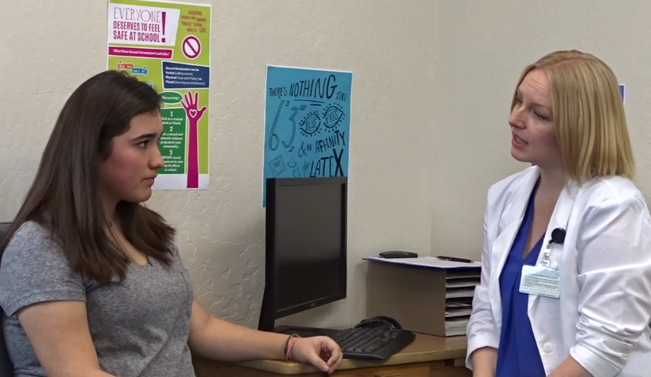
Video
Trauma-Informed Child Abuse Reporting in a Family Planning Setting
Notes:
Facilitator Notes
Here is a video that shows a provider demonstrating the use of trauma-informed reporting best practices: https://vimeo.com/335211508
We will watch the first half of the video and then do an activity that will give you the chance to practice applying these best practices.
Click on the link to show the video and make sure your speakers are on so that everyone can hear the audio.
FACILITATOR: Pause the video at 4:56.

Slide 44
Activity
Tanya, age 15, comes to your clinic wanting to change her method of birth control. She has been using oral contraceptives. You notice that she has a mark on her face that could be a slap mark. When you ask about it, she initially says that “it’s nothing,” but eventually discloses that her mother hit her when she discovered her birth control pills and learned that Tanya was sexually active. Tanya wants to switch to a more private method. You learn that her mother often hits her when she’s angry with her.
How would you handle Tanya’s care?
Notes:
Activity
Tanya, age 15, comes to your clinic wanting to change her method of birth control. She has been using oral contraceptives. You notice that she has a mark on her face that could be a slap mark. When you ask about it, she initially says that “it’s nothing,” but eventually discloses that her mother hit her when she discovered her birth control pills and learned that Tanya was sexually active. Tanya wants to switch to a more private method. You learn that her mother often hits her when she’s angry with her.
Participant Instructions
Work with a partner and decide who will play the provider and who will play Tanya. (Alternatively, remain in a large group and the facilitator can play the role of Tanya while participants share the role of the provider.)
Practice what you would say and how you would handle Tanya’s care, keeping in mind trauma-informed reporting best practices. *Don’t forget to start the visit with an explanation of Title X consent and confidentiality rules.
Facilitator Wrap-up
What approaches facilitated communication?
What approaches created barriers/impeded communication?
What suggestions do you have to modify approaches that were not trauma-informed (or created barriers)?
Remember to think about both verbal and non-verbal communication when reflecting on these questions.

Slide 45
Trauma-Informed Reporting
Best Practice 5
5. Acknowledge that disclosing information and making a report may be a frightening process and provide messages of support.
Example:
“I understand that this may be scary and that you are worried about what might happen. You may even feel really angry with me about this, but we still need to do it. You can be part of each step in the process, and I will show you what I write down in the report. I’ll let you know what usually happens with these reports, but, remember, every situation is different.”
Notes:
Facilitator Notes
Acknowledge that making a report may be a frightening process and provide messages of support.

Slide 46
Trauma-Informed Reporting
Best Practice 6
6. Engage the youth in the reporting process:
  Show the paperwork
  Allow them to be present when you call the report in, if this is feasible
Example:
“Even though you don’t have a choice about whether or not I fill out this report, you can decide how much information you want to share with me; we can complete the paperwork together. We can ask the social worker/police officer to meet with you in a place where you feel safe, at a time that works for you.”
Notes:
Facilitator Notes
Including the youth as much as possible in the reporting process reduces fear, anger, and the perceived lack of control that can accompany mandatory abuse reporting.
Invite the youth to participate by showing them the paperwork that you are filling out and allowing them to be present when you call the report in, if this is feasible.

Slide 47
Trauma-Informed Reporting
Best Practice 7
7. Educate the youth about his/her rights, safety, and unhealthy relationship patterns.
Notes:
Facilitator Notes
Relationship patterns learned in adolescence can affect future relationships. It is important to discuss with youth the difference between healthy and unhealthy patterns and provide important skills to help reduce the potential for sexual risk and relationship violence.

Slide 48
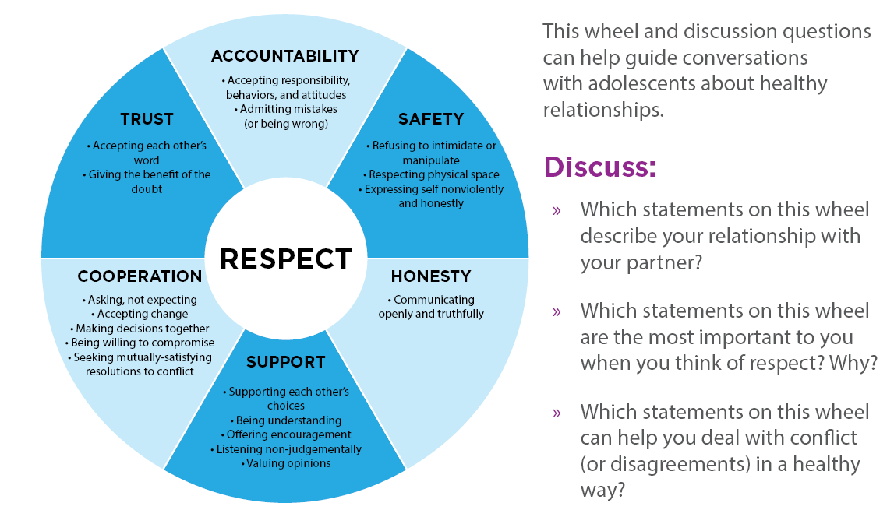
Trauma-Informed Reporting
Healthy Relationship Wheel and Questions
Notes:
Facilitator Notes
The Healthy Relationship Wheel and discussion questions can help you guide conversations with adolescent clients about healthy relationships.
.

Slide 49
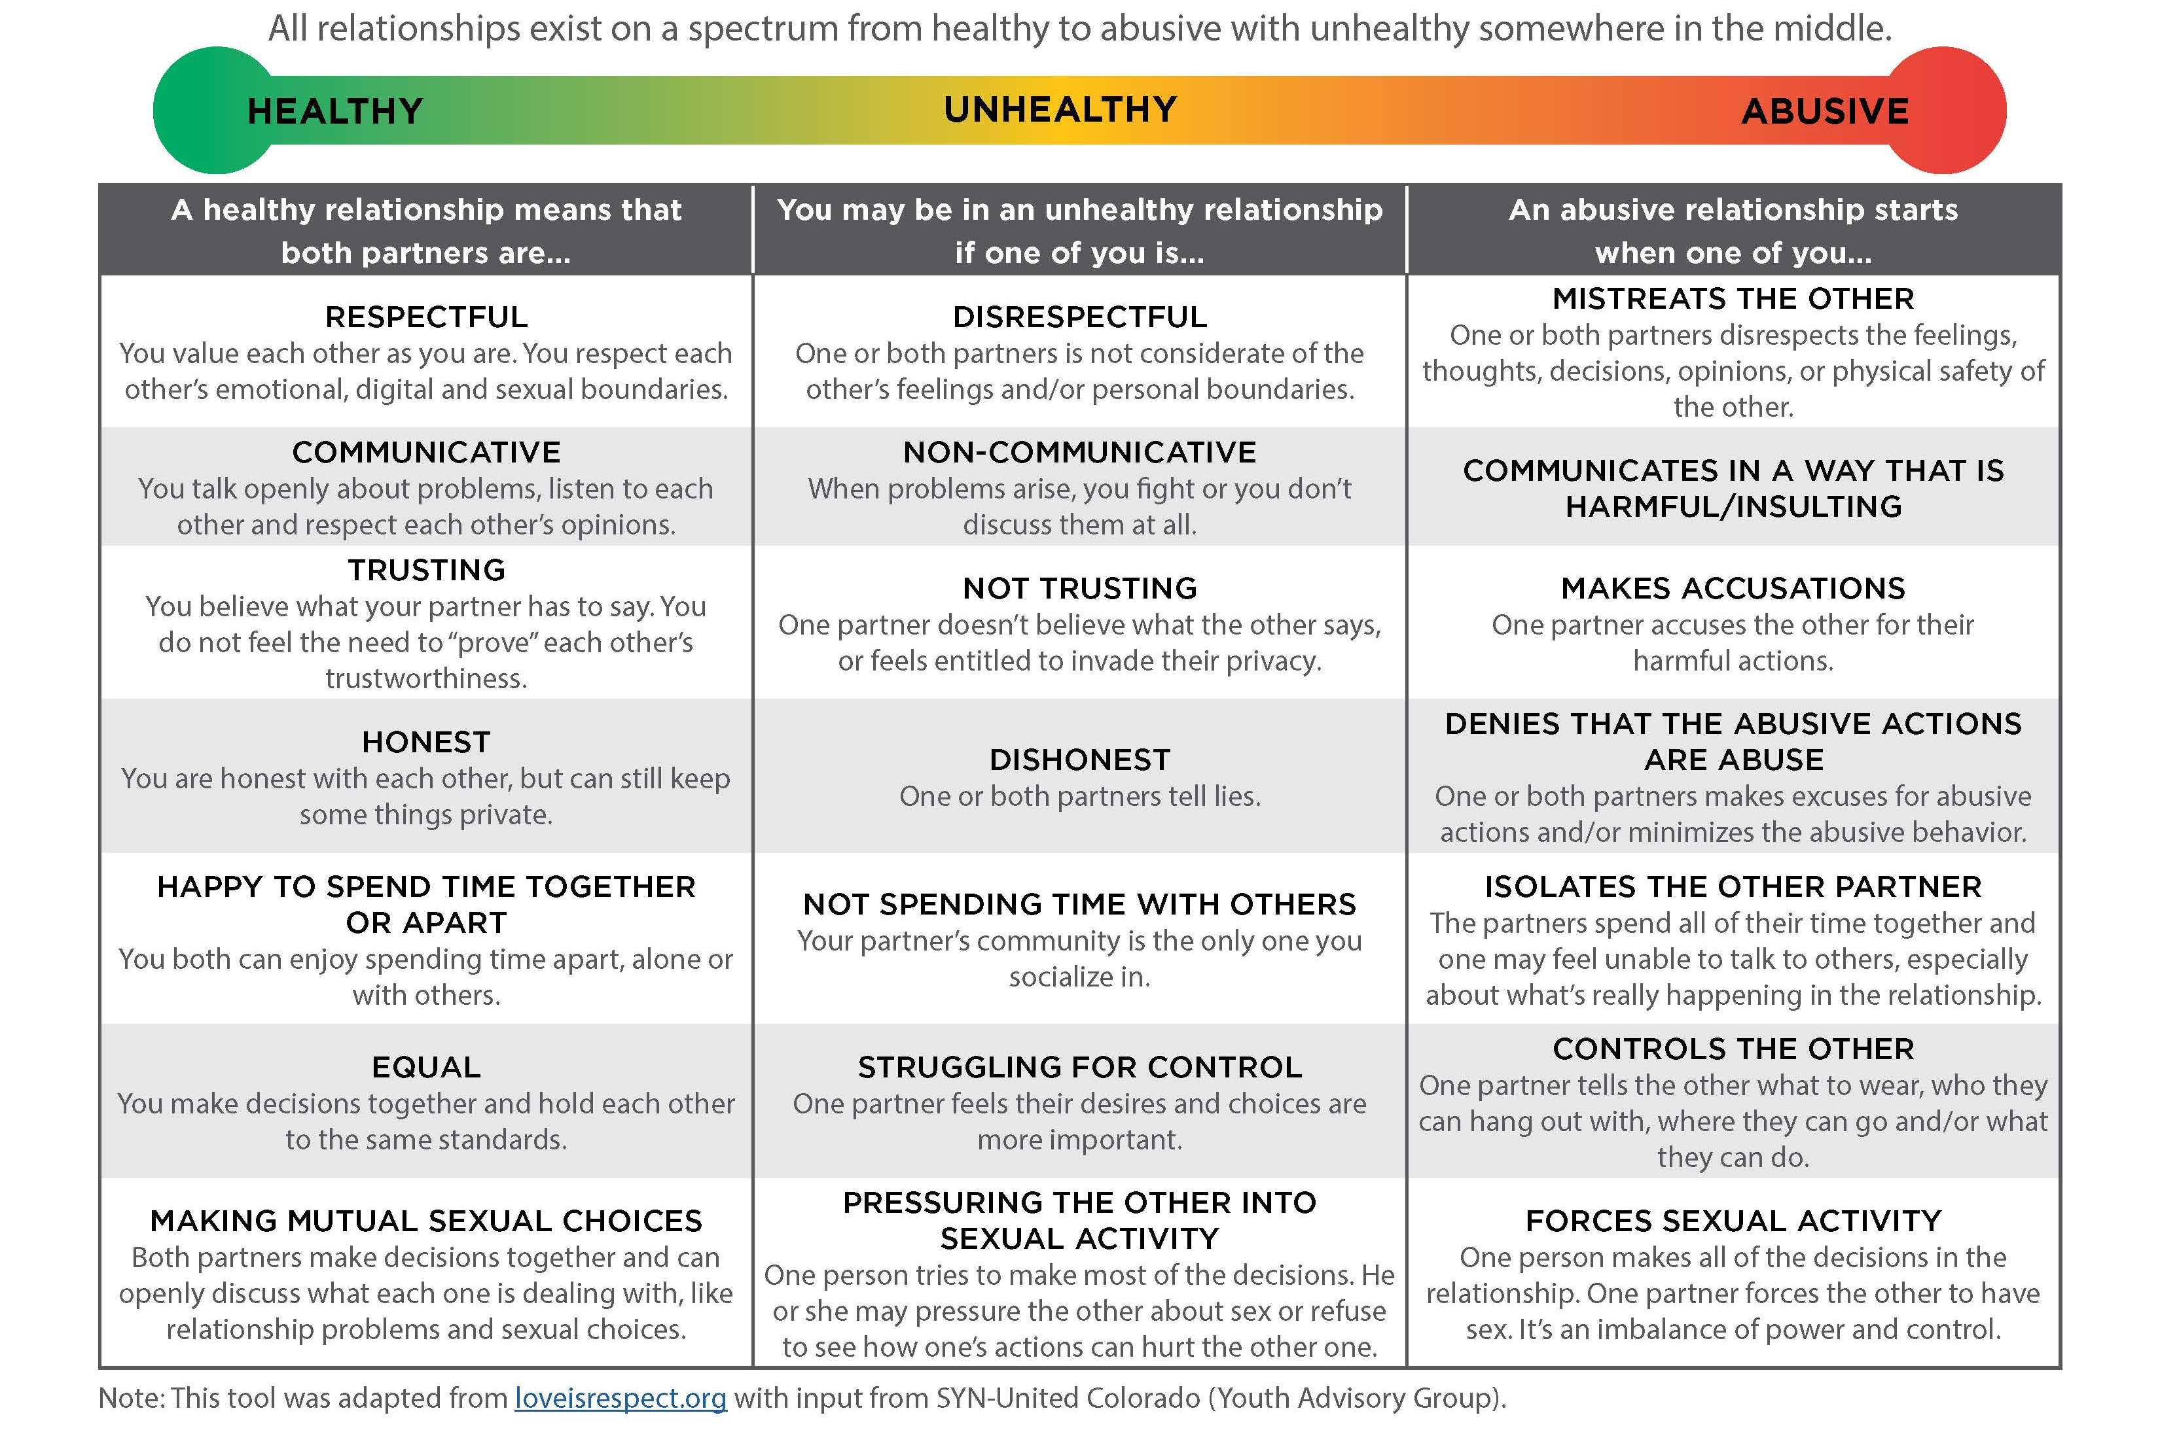
Trauma-Informed Reporting
Relationship Spectrum
Notes:
Facilitator Notes
On the opposite side of the Healthy Relationship Wheel is the Relationship Spectrum, which has been adapted from www.loveisrespect.org. It can also provide a guide to counseling adolescents that all relationships exist on a spectrum from healthy to abusive with unhealthy somewhere in the middle.

Slide 50
Trauma-Informed Reporting
Best Practice 8
8. Always assess for safety before the end of the visit.
  “Are you currently safe where you are now?”
  “What has been the worst fight? Were weapons used?”
  “Do you ever think about hurting or killing yourself?”
  “Are you afraid that you could be hurt or killed?”
  “Do you have an adult you can confide in?”
  “Have you tried to leave your relationship before? If so, what happened?”
  “In a crisis, where would you go/who could you turn to for help?”
Notes:
Facilitator Notes
Assess for safety. If the youth is afraid of her/his partner or parent, get assistance with safety planning from Child Protective Services or a domestic violence/sexual assault advocacy program. Some questions to ask the client are:
Are you currently safe where you are now?
What has been the worst fight? Were weapons used?
Do you ever think about hurting or killing yourself?
Are you afraid that you could be hurt or killed?
Do you have an adult you can confide in?
Have you tried to leave your relationship before? If so, what happened?
In a crisis, where would you go/who could you turn to for help?

Slide 51
Trauma-Informed Reporting
Best Practices Summary
If the youth does not feel safe returning to home or school:
Contact reporting authority and request immediate response
Emphasize importance of support from a trusted adult
Offer to facilitate discussion with youth and adult to ensure clear communication, provide resources, and develop a safety plan
Partner with domestic violence or sexual assault program advocates
Notes:
Facilitator Notes
If the youth does not feel safe returning to home or school:
Contact reporting authority and request immediate response
Emphasize importance of support from a trusted adult
Offer to facilitate discussion with youth and adult to ensure clear communication, provide resources, and develop a safety plan
Partner with domestic violence or sexual assault program advocates

Slide 52
Key messages that convey support
“I'm so sorry this is happening, you don’t deserve it, no one deserves this.”
“I’m worried about your safety.”
“You’re not alone, there is help available.”
“It’s not your fault.”
Notes:
Facilitator Notes
Here are some examples of key messages that convey support:
I’m worried about your safety
I’m so sorry this is happening. You don’t deserve it. No one deserves this.
You are not alone. There is help available.
It is not your fault.
Remember: You do not have to be a child abuse expert to recognize and help youth experiencing coercion and abuse.

Slide 53
Activity
Tanya is very nervous and afraid she won’t be safe if her mother learns that her abuse has been reported.
What can you do to make sure Tanya feels safe and cared for?
Notes:
Activity
Tanya is very nervous and afraid she won’t be safe if her mother learns that her abuse has been reported.
Participant Instructions
Working in pairs, discuss how you would use Trauma-Informed Reporting Best Practices to practice what you would say to Tanya.
Group Discussion
What if the perpetrator had been Tanya’s boyfriend instead of her mother? Discuss how abuse by a parent versus abuse by a partner would be handled the same or differently.
Notes to Facilitator
Check your intimate partner violence and domestic violence reporting laws to accurately answer this question. Information provided during a health appointment is confidential and cannot be disclosed to anyone, unless there is an exception in the law that requires disclosure. However, mandatory reporting of child abuse is an exception that allows and requires a mandated reporter to make a report to child abuse/law enforcement. If your state only requires a report when the abuse is perpetrated by a caregiver, the provider cannot make a report if the abuse is by a partner. The provider can encourage the client to disclose to a guardian, or to law enforcement, but the provider cannot contact police, unless the state law specifically requires intimate partner violence/domestic violence be reported. (See slide 24 for more information.)

Slide 54
Other Reporting Considerations

Slide 55
Parent/Guardian Notification
It is important to communicate to the youth:
Title X confidentiality laws prevent the provider from disclosing to parents without permission from the youth
Child Protective Services and law enforcement MAY inform parents/guardians that an abuse report has been filed
Notes:
Facilitator Notes
Restate the Title X confidentiality laws to the youth to ensure she/he understands that permission must be given by the youth to disclose any information to a parent. However, if an abuse report has been filed, Child Protective Services and law enforcement may inform parents/guardians.

Slide 56
Learn About the Reporting System
Develop relationships with county reporting authorities to gain an understanding of how cases are prioritized
Prepare clients for what is likely to happen when a report is filed
Frame the information as “what usually happens in our county”
Notes:
Facilitator Notes
Develop relationships with county reporting authorities and develop an understanding of how they prioritize and pursue cases.
Use this understanding to prepare the client for what is likely to happen when a report is filed.
Frame the information as ”what usually happens in our county,” rather than implying any guarantee of how the agency will deal with the report.

Slide 57
When the State’s Definition of Abuse and Neglect Differs From Ours
What situations do you consider “abusive” but are not included in our state law definition of abuse?
Notes:
Facilitator Notes
Your personal understanding of abuse may not always align with state law definitions used for mandatory child abuse reporting purposes.
You may realize that there are behaviors or situations that you consider “abusive,” but that our state law does not include in its legal definition of abuse and does not require mandated reporters to report.
Discuss (or ask yourself)
Are there any behaviors or situations that you personally consider abusive, but do not meet our state’s definition of abuse or neglect?
If the law does not explicitly define the behaviors as abusive, ask yourself whether your judgment is based on your education and training as a health care professional, or on your personal moral or religious stance.
Consult with a colleague if you are having difficulty answering this question, but remember that, as a mandated reporter, it is ultimately your responsibility to determine whether a report should be filed.
Explore how the client feels about the situation.
If a client also agrees that this is a difficult/coercive or abusive situation and wants support, facilitate connection with other resources and referrals that can be helpful to the client. If law enforcement involvement would be helpful, ask the client for permission to call law enforcement/child welfare or offer to support her/him in contacting.
If you have client authorization, you can make reports even when those reports are not required by law, though the authorities may not respond in a helpful way if it is not obvious abuse.

Slide 58
When the State’s Definition of Abuse and Neglect Differs From Ours (cont.)
Situations our state law defines as “abuse” that you do not consider “abusive.”
Notes:
Facilitator Notes
You also may realize that there are behaviors that state law defines as “abuse” and requires mandated reporters to report, but that you do not consider “abusive.”
In some instances, state law is very explicit regarding situations that are reportable as abuse.
Examples:
California law explicitly defines sexual intercourse when one partner is 13 years old or younger and one partner is 14 years old or older to be reportable as abuse. In a case like this, regardless of the mandated reporter's opinion about the nature or quality of the relationship, the mandated reporter MUST file a report when the above stated conditions (sexual intercourse has occurred between one partner who is <13 years old and the other partner is >14 years old).
In many instances, the law relies on the mandated reporter's professional assessment to determine if abuse has occurred. Note that this is your professional assessment, based on your training and education, NOT your personal moral or religious stance regarding appropriate adolescent behavior.
Discuss (or ask yourself)
Are there behaviors that our STATE LAW defines as abusive that you do NOT consider to be abuse?
If the law explicitly defines the behaviors as meeting the criteria for abuse filing, you are obligated to file a report regardless of your professional opinion as to whether the behavior is abusive or not.

Slide 59
Local Resources
[INSERT LOCAL/STATE-SPECIFIC INFORMATION HERE (identify adolescent health champions in local Child Protective Services and law enforcement who can provide advice on tough questions)].
[INSERT LOCAL/STATE-SPECIFIC INFORMATION HERE (include important phone numbers)].
Notes:
Facilitator Notes
We all serve key roles in identifying potential child abuse and providing appropriate care. However, our local partners are just as important. Here is a list of local experts and organizations in our area with whom we need to form strong relationships.

Slide 60
Additional Resources
Adolescent Health Working Group (AHWG) http://www.ahwg.net/index.html
National Network to End Domestic Violence http://nnedv.org/
Rape, Abuse and Incest National Network http://www.rainn.org/
Love is Respect http://www.loveisrespect.org/
Futures without Violence http://www.futureswithoutviolence.org/
The National Human Trafficking Hotline https://humantraffickinghotline.org
Notes:
Facilitator Notes
Here are some additional, excellent resources.

