Slide 1
Stock a Broad Range of Contraceptive Methods
Contraceptive Access Change Package Best Practice 1
Last Reviewed March 2020
Notes:
Facilitator Notes
Today we will be discussing stocking a broad range of contraceptive methods.
Ensuring contraceptive access is a fundamental part of the Title X program. Title X-funded projects are required to provide a broad range of acceptable and effective family planning methods.
Thus, stocking a broad range of methods is important to ensuring access.
Activity
Conduct participant and facilitator introductions.

Slide 2
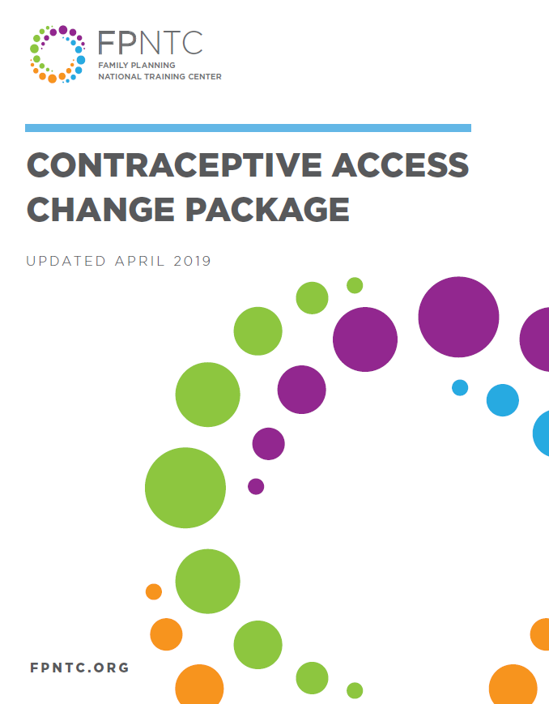
Introduction to the Contraceptive Access Change Package
Best Practice Recommendations
Stock all methods
Utilize patient-centered counseling
Offer same-visit access
Reduce cost as a barrier
Link: https://www.fpntc.org/resources/contraceptive-access-change-package
Notes:
Facilitator Notes
Stocking a broad range of methods is the first best practice recommendation outlined in the Contraceptive Access Change Package, which was developed by the Family Planning National Training Center.
The Contraceptive Access Change Package, which is an overview of the best practice recommendations and strategies, draws from the literature and most current practice guidelines to increase access to the full range of contraceptive methods.
The other three Best Practices in the Contraceptive Access Change Package are:
BP 2: Discuss pregnancy intention and support patients through evidence-informed, patient-centered counseling that enables them to choose from the full range of contraceptive methods if they do not desire pregnancy presently.
BP 3: Develop systems for same-visit provision of all contraceptive methods, at all visit types.
BP 4: Utilize diverse payment options to reduce cost as a barrier for the facility and the patient.
In order to increase access, it’s important to consider all four best practices and utilize a comprehensive approach that addresses each. We strongly encourage you to refer to the Contraceptive Access Change Package for more ideas about strategies and successes. It can be found on the FPNTC website.

Slide 3

Contraceptive Access Change Package:
Best Practice 1
Stock a broad range of contraceptive methods including all provider-dependent FDA-approved contraceptive methods
Notes:
Facilitator Notes
We are going to start with Best Practice 1. Stock a broad range of contraceptive methods, including all provider-dependent FDA-approved contraceptive methods.
This first best practice is a prerequisite for the other three. Methods must be stocked and immediately available on site in order to fully implement the other best practice recommendations.

Slide 4
Meeting Objectives
By the end of today, you should be able to:
Describe the importance of stocking a broad range of contraceptive methods, including provider-dependent methods
Describe common challenges related to stocking a broad range of contraceptive methods
Describe at least one strategy to improve site-level stocking practices
Notes:
Facilitator Notes
There are 3 objectives for today’s discussion. By the end of today, we hope you will be able to:
Describe the importance of stocking a broad range of methods, including provider-dependent methods
Describe common challenges related to stocking a broad range of contraceptive methods
Describe at least one strategy to improve site-level stocking practices
As the objectives imply, we want to take time today to talk about not just what should happen, but also what makes these recommendations a challenge. By discussing challenges, we hope to identify potential strategies for breaking down those barriers—ultimately, to increase patients’ access to their contraceptive methods of choice.

Slide 5
Rationale for Stocking a Broad Range of Methods
Patients who obtain their method of choice are more likely to use it correctly, and be more satisfied
Many patients do not return for follow-up visits
Stocking all methods is necessary for providing methods to patients during the same visit they initially request it
Notes:
Facilitator Notes
Title X-funded projects are required to provide a broad range of acceptable and effective family planning methods and services. A broad range of contraceptive methods should be accessible and available on site.
Why is making a broad range of methods available important? Providing a method that best fits a patient’s unique circumstances is patient-centered and a core characteristic of quality care. Patients who obtain their method of choice are more likely to use it consistently and correctly and have higher satisfaction and continuation rates.
Stocking all methods that require provider intervention, such as long-acting reversible contraception (or LARC) and Depo Provera in advance of request, is crucial to reducing barriers to care, as a large percentage of patients do not return for follow-up visits. Since there is no medical reason to routinely require multiple visits to initiate any contraceptive method (provided you can be reasonably sure that the patient is not pregnant), having a broad range of methods available on site for same-visit delivery can reduce a substantial burden for patients to obtain their preferred methods. (Note to facilitators: See the Best Practice 3 discussion guide on developing systems for same-visit provision of all contraceptive methods, at all visit types, for more on this topic.)
It is important that services are provided on a purely voluntary basis. Patients should not be coerced to use, or not use, any particular contraceptive methods.
Sources (for reference)
Gavin L, Moskosky S, Carter M et al. Providing Quality Family Planning Services: Recommendations of CDC and the U.S. Office of Population Affairs. MMWR 2014;63(4)
Institute of Medicine (IOM). Crossing the Quality Chasm. Crossing the Quality Chasm: A New Health System for the 21st Century. Washington, D.C: National Academy Press 2001.
Office of Population Affairs. Title X Program Requirements. https://www.hhs.gov/opa/guidelines/program-guidelines/program-requirements/index.html

Slide 6
Defining a Broad Range of FDA-Approved Methods
At a minimum, at least one type of all provider- dependent methods should be stocked on site
FDA-approved methods include:
Services or referral for sterilization (vasectomy, abdominal, laparoscopic, hysteroscopic)
Hormonal implant
Levonorgestrel intrauterine device (LNG IUD)
Copper intrauterine device
(Cu IUD)
Hormonal injection
Oral contraceptive
Contraceptive patch
Vaginal ring
Diaphragm and cervical cap
Sponge
Condoms (male and female)
Spermicide
Notes:
Facilitator Notes
As we’ve discussed, Title X clinics are required to stock a “broad range” of contraceptive method types. So, when we say, stocking a broad range of methods, what exactly does this mean?
Some methods may be obtained by prescription, or over the counter. Methods that require provider to obtain, however, are more challenging to access.
To facilitate access to the full range of methods, at least one type of each Food and Drug Administration (FDA)-approved provider-dependent methods should be stocked (i.e., at least 1 hormonal IUD, the copper IUD, the injectable, and the implant).
Sources (for reference)
Office of Population Affairs. Title X Program Requirements. https://www.hhs.gov/opa/guidelines/program-guidelines/program-requirements/index.html
US Food and Drug Administration. Birth Control: Medicines to Help You. http://www.fda.gov/ForConsumers/ByAudience/ForWomen/FreePublications/ucm313215.htm

Slide 7
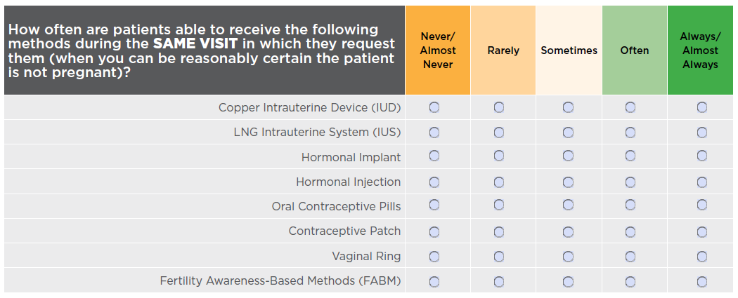
Contraceptive Access Assessment
Notes:
Facilitator Notes
If you haven’t already, please take a minute to complete the Contraceptive Access Assessment questions related to stocking. Consider how often all methods are immediately available (i.e., stocked on site) to patients. We encourage you to be critical—how often are these practices happening really (not what you hope is happening)? This tool is designed to help you identify areas to improve.
Activity
Participants will fill out or refer to the Contraceptive Access Assessment tool. Ask participants to fill out ahead of time, or provide 10-15 additional minutes to fill it out during the session.

Slide 8
Discussion of Challenges Related to Stocking Methods
What methods are not stocked always/almost always? What are the challenges related to stocking these methods?
  Hormonal IUD
  Copper IUD
  Contraceptive implant
  Depo
  Pill, patch, ring
Notes:
Facilitator Notes
Stocking all methods can be a challenge. Let’s discuss what the barriers are that keep you from being able to stock all methods.
Discuss
Reflecting on the results of your Contraceptive Access assessment, which methods are you not stocking always/almost always?
What are the barriers to stocking these methods?
If you are currently not stocking a method, why not? What are the main challenges preventing you from having this method on site?
For methods you are stocking, how frequently do stock-outs occur?
If you are already stocking all methods, what challenges remain?

Slide 9
Overview of Stocking Strategies
Obtain lower-cost supplies
Optimize inventory system
Stock and inform patients about emergency contraception (EC), including copper IUD as EC
Ensure staff with patient contact are:
  aware of and trained in current recommendations
  available to provide the broad range of methods
Notes:
Facilitator Notes
Now let’s talk about some strategies for addressing some of the concerns that came up during our discussion.
The primary strategies for achieving this best practice recommendation are to:
Obtain lower cost supplies
Optimize the inventory system
Sites should stock emergency contraception (EC) and also inform patients of its availability, including the copper IUD as EC
Also, in addition to having the methods available, sites should ensure staff with patient contact are:
Aware of and trained in current recommendations
Available to provide the broad range of methods

Slide 10
Strategies for Obtaining Affordable Supplies
Participating in 340B program
Stocking Liletta
Purchasing in bulk
Utilizing 90-day net terms, other payment options
Centralized ordering
Patient assistance programs (e.g., ARCH)
Additional grant funding
Others?
Notes:
Facilitator Notes
First, we’ll talk about how to manage cost as a barrier.
Cost is often a barrier to stocking all methods, particularly the more expensive provider-dependent methods.
Strategies that can be used to obtain low-cost supplies include:
Participating in 340B program
Stocking Liletta, a low-cost hormonal IUD
Purchasing in bulk
Utilizing 90-day net terms, other payment options
Centralized ordering
Patient assistance programs (e.g., ARCH)
Additional grant funding
(Note to facilitators: See the discussion guide for Best Practice 4 on utilizing diverse payment options to reduce cost as a barrier for additional billing, coding, and reimbursement-related strategies)
Discuss
Which of these strategies for obtaining affordable supplies are you currently utilizing?
Which are the most effective? Which have the biggest impact?
What else are you doing that is not listed here?

Slide 11
Insurance Coverage of Contraceptive Methods
Preventive services requirement: most plans must cover without cost-sharing:
  Items or services that have an “A” or “B” rating from the USPSTF
  Immunizations recommended by CDC’s Advisory Committee on Immunization Practices
  HRSA-supported preventive care and screenings for infants, kids, and adolescents
  Preventive services for women determined by HRSA
  All FDA-approved contraceptive methods, sterilization procedures, and patient education and counseling
Notes:
Facilitator Notes
In addition to obtaining low-cost supplies, reimbursement for methods should be widespread. The ACA expanded the availability of public and commercial insurance options that are required to cover all FDA methods of contraception (including LARC) without cost-sharing.
No cost-sharing means that patients should not have any out-of-pocket costs, including deductibles, co-payments, co-insurance, fees, or other charges for coverage of contraceptive methods, including LARC. Patients cannot be asked to pay upfront and then be reimbursed.
“All FDA-Approved Contraceptive Methods, Sterilization Procedures, and Patient Education and Counseling” has been clarified to mean that plans must cover a least one in every category of FDA-approved method, including the implantable rod, copper IUD, and at least one IUD with progestin. The law requires coverage of brand-name contraceptives that do not have generic equivalents, thus all LARC methods that do not have a generic equivalent must be covered (e.g., Nexplanon, NuvaRing).
While not all plans must comply (i.e., plans that were grandfathered), the majority of plans—including new ones, those purchased on the individual market, and coverage through Medicaid expansion—do comply.
Discuss
How frequently are you getting rejections? Are the denials from plans that are exempt from ACA for some reason?
Under what circumstances, if any, do you still need to call for pre-verification of methods because they are not being covered? How frequently are you calling for pre-verification, and for whom?

Slide 12
Insurance Claim Denials
Respond immediately with appeal
Track and monitor reasons for denial
Watch adjustments carefully
Prevent future denials
Notes:
Facilitator Notes
Don’t assume all denials are final.
If you (or your patients) do have any problems with denials, and believe the service should be covered, you can take steps to appeal:
Make sure to follow up and appeal the denial in a timely manner and respond immediately upon learning of the decision
Include documentation of reason you believe it should be a covered service
Track and monitor denials—keep a record of the type, number, source, and amount of revenue
Watch revenue adjustments carefully, and
Prevent future denials—use a checklist and keep track of reasons for denials

Slide 13
Strategies for Optimizing the Inventory System
Forecast the range and number of each method needed
Conduct a regular (e.g., monthly) inventory of stock
Monitor dispensing amounts and adjust ordering accordingly
Utilize a “buy and bill” approach (for procurement of methods stocked on site)
Notes:
Facilitator Notes
Now let’s talk about the next strategy: optimizing the inventory system.
One of the challenges with stocking a broad range of methods is ensuring that you don’t have too many of one method or have supplies that expire. Also, you want to avoid “stock-outs” where you run out of any method. The goals is to always have enough, but not too much of all methods stocked.
Strategies to optimize inventory include:
Forecast the range and number of each method needed
Conduct a regular (e.g., monthly) inventory of stock
Monitor dispensing amounts and adjust ordering accordingly
Utilize a “buy and bill” approach (for procurement of methods stocked on site)
We’ll discuss these strategies a little bit more in detail now.

Slide 14
Potential Sources of Information for Forecasting
Patient
Annual contraceptive patient population
Provider
Number of providers trained in certain methods
Policy around same-day placement
Finance
Patient health care coverage
Funding available for procurement
Historical demand data
Annual provision at other sites
Adapted from: http://larcprogram.ucsf.edu/forecasting
Notes:
Facilitator Notes
It can be particularly challenging when starting out (or when expanding method choices) to know how much of a method to stock. For instance, if a practice has not stocked IUDs or implants before, it may be challenging to estimate patient demand.
You can use a combination of patient, provider, and finance factors to calculate this. Some potential sources of information include:
patient (historical data, patients seen, reach out to other sites and ask—“collaborative”)
provider (e.g., training for specific methods that require training
finance (coverage and funding)
Discuss
What systems are you currently using to ensure adequate stock? What data do you use? How often do you monitor and adjust?
Do you ever run out of a method? What systems are working well to ensure that you don’t experience stock-outs?

Slide 15
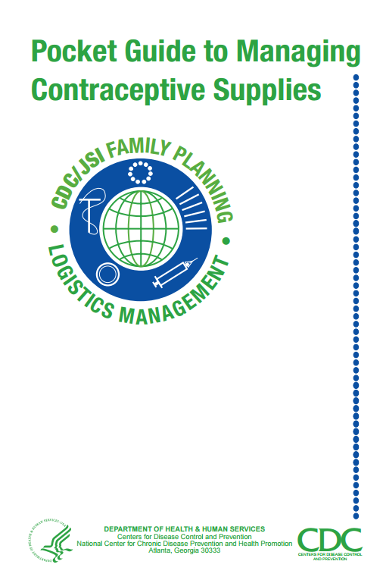
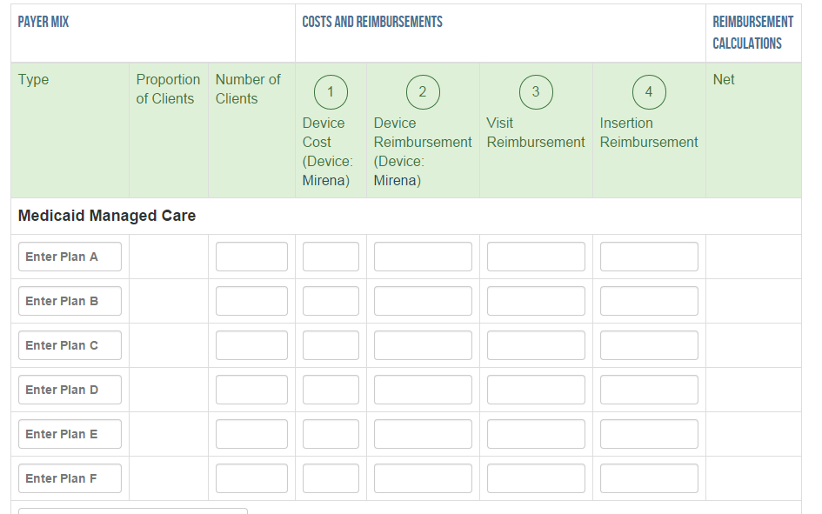
Forecasting Resources
LARC Modeling Tool (CAI)
http://www.caiglobal.co/larc/
http://www.who.int/rhem/supplychain/pockguidmanacont/en/
Notes:
Facilitator Notes
The “Pocket Guide to Managing Contraceptive Supplies” is one tool that can help you organize plans for stocking, inventory, and forecasting. It is used internationally, but has tools that could be applicable anywhere. It was developed by JSI in collaboration with CDC and USDAID.
The LARC Modeling Tool, developed by CAI Global, is another tool that may be helpful to providers who do not currently offer LARC methods to estimate potential revenue loss or gain by adding LARC methods.
This tool uses information about a practice’s estimated LARC demand, payer mix, and reimbursement rates to explore the costs associated with provision of each LARC method. It may also help identify payers with anomalously low reimbursement rates and provide information that can be useful in future contract negotiations.
Efficacy and patient satisfaction rates for LARC methods can also be useful during discussions with third-party payers to negotiate increases in reimbursement rates.

Slide 16
Buy and Bill
Medical Benefit
Pharmacy Benefit
Provider bills insurance for method and service
Buy and bill
Provider bills for service
Pharmacy bills for method
Notes:
Facilitator Notes
Finally, there is the purchasing of the methods.
In general, there are two ways that contraceptive methods can be covered by patients’ health insurance plans: as a medical benefit or a pharmacy benefit.
Medical benefit: Providers buy the method directly from the manufacturer or a designated pharmacy or specialty distributor, and bill the patient’s insurance carrier for the method and (if applicable) the insertion procedure. This is commonly described as “buy and bill” and presents the fewest barriers to care for the patient.
Pharmacy benefit: A pharmacy or specialty distributor bills the patient’s insurance carrier directly for the method. A provider obtains the method from the pharmacy and bills the patient’s insurance carrier for related procedures and services.
Many plans will allow for both. Utilizing a buy and bill mechanism for injectables, IUD, and implant procurement allows immediate access to the product.
(See the discussion guide for Best Practice 4 for utilizing diverse payment options to reduce cost as a barrier for additional strategies.)
Discuss
Are you using buy and bill? If not, in what situations are you not?

Slide 17
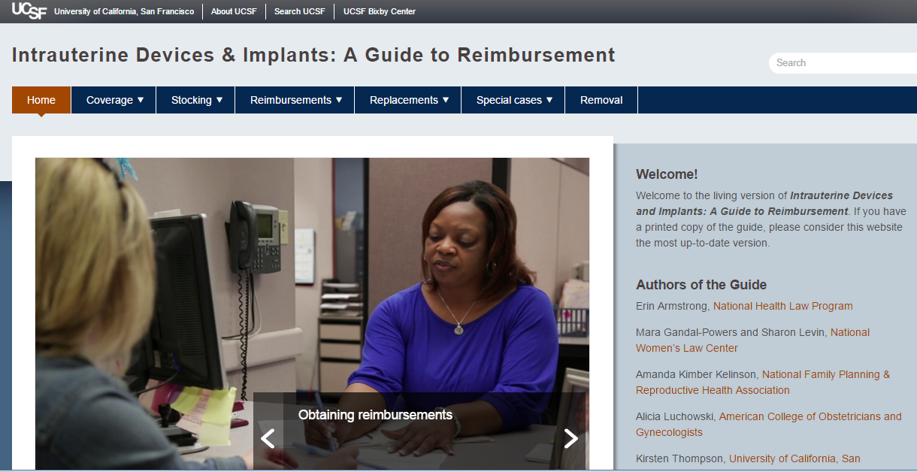
IUDs & Implants: A Guide to Reimbursement (UCSF)
Link: http://larcprogram.ucsf.edu
Notes:
Facilitator Notes
Many of these strategies, and more, are covered in more detail in this great resource from the University of California San Francisco (USCF) called IUDs and Implants: A Guide to Reimbursement. The link is on this slide. We encourage you to check this out.

Slide 18
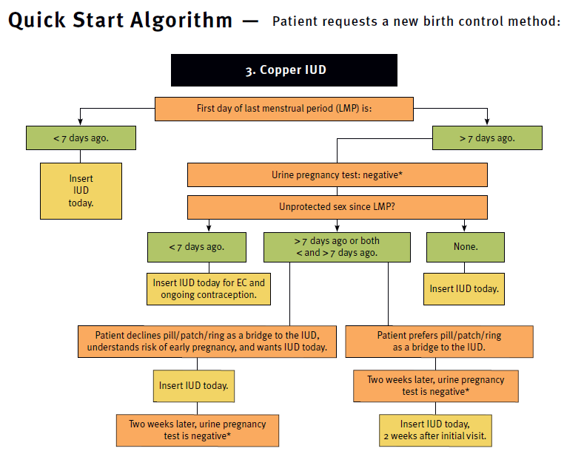
Stocking Copper IUD as EC Option
According to ACOG 2015 EC Guidelines, “Insertion of a copper IUD is the most effective method of emergency contraception (EC).”
Emergency contraception. ACOG 2015
Link: https://www.fpntc.org/resources/quick-start-algorithm
Notes:
Facilitator Notes
Although less common than hormonal EC, according to ACOG Emergency Contraception Guidelines: “The most effective method of emergency contraception is copper IUD insertion.”
Stocking copper IUD makes it available to be used as EC.
Copper IUD can be used as EC up to 5 days after unprotected sex (implantation occurs 6-12 days following ovulation so this is still before any chance of an existing pregnancy).
This quick start algorithm from the Reproductive Health Access Project demonstrates, based on US Selected Practice Recommendations, how copper IUD can be used as EC.
Discuss
Are you offering copper IUD as EC?
If no, why not? What have been the challenges/concerns? What strategies could you use to try this practice?
If yes, what strategies did you use to implement this practice?
How were you able to address concerns that were raised?
Source (for reference)
Emergency contraception. Practice Bulletin No. 152. American College of Obstetricians and Gynecologists. Obstet Gynecol 2015;126:e1-11
Quick Start Algorithm available at: https://www.fpntc.org/resources/quick-start-algorithm

Slide 19
Contraceptive Access Assessment
Notes:
Facilitator Notes
Before we wrap up for the day, there’s another important piece of this best practice recommendation—that providers are trained and available to provide all methods.
Return to the Contraceptive Access Assessment and consider these questions about provider availability. By this, we mean that providers are available who can provide these methods during standard business hours (Monday through Friday, 9am to 5pm) or whenever your service site is open.
Activity
Participants will fill out or refer to the Contraceptive Access Assessment tool. Ask participants to fill out ahead of time, or provide 10-15 additional minutes to fill it out during the session.
Discuss
Reflecting on the results of the Access Assessment, for which methods is a clinician not “always” or “almost always” available to provide?
Why is a clinician not available to provide these methods?
Are all clinicians trained in insertions? Managing side effects? Removals?
Are there any clinicians who are on site that are not trained? For example, pediatricians, who could be trained to increase access?
What other strategies can you implement to increase clinician availability?

Slide 20
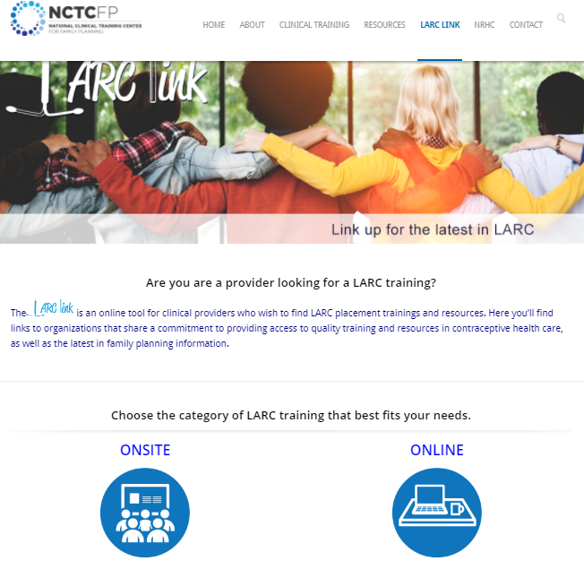
LARC Insertion Trainings
LARC Link is an online tool for clinical providers who wish to find LARC placement trainings and resources
Link: http://www.ctcfp.org/larc-link/
Notes:
Facilitator Notes
If you have clinicians who are not trained in LARC insertions, be sure to check out LARC Link on the National Clinical Training Center for Family Planning’s website for an up-to- date list of training opportunities.

Slide 21
Case Scenario
You find that you often run out of Nexplanon. In the past you ordered 3-6 devices, per month. Demand has increased, however, and you are experiencing stock-outs every couple of months. Due to the high cost of the device, the organizational policy is to order only 3 at a time.
What do you do?
Notes:
Facilitator Notes
Let’s work through a scenario together: You find that you often run out of Nexplanon. In the past you ordered 3-6 devices, per month. Demand has increased, however, and you are experiencing stock-outs every couple of months.
Discuss
You find that you often run out of Nexplanon. In the past you ordered 3-6 devices, per month. Demand has increased, however, and you are experiencing stock-outs every couple of months. Due to the high cost of the device the organizational policy is to only order 3 at a time.
What do you do?
What data will you look at to estimate new demand?
How will you make the case that more devices should be purchased and the policy changed?
What is a small change you can make, and how can you measure improvement?

Slide 22
Success Story: Stocking Liletta (Cameron County, TX)
Large percentage of patients below FPL
Began stocking Liletta in March 2016
Then able to insert Liletta during the same visit initially requested by patient because it was routinely stocked
Continue to monitor stock to ensure it meets demand
Key point: As a lower-cost option ($50 at 340B pricing), stocking Liletta can meet unmet patient demands for IUD
Notes:
Facilitator Notes
Now let’s look at a success story from the field. We know it can be valuable to see how are other Title X sites are implementing these best practice recommendations.
This is a story from a site that participated in the Family Planning National Training Center (FPNTC) Performance Measurement Learning Collaborative. The site’s story was written up as a short case study, and included in the Contraceptive Access Change Package.
Prior to March 2016, Cameron County Department of Health and Human Services (CCDHHS), a sub-recipient of Women’s Health and Family Planning Association of Texas, did not stock IUDs on site. A challenge for CCDHHS has been that a majority of its patients are below the federal poverty level. Additionally, a large number of patients do not have coverage for high-cost contraceptives. Liletta offers a lower-cost option for the site using 340B pricing. CCDHHS reached out to another site in their network that had already planned a Liletta insertion training and was able to train their one clinician on Liletta insertion. CCDHHS then established an account with Liletta and ordered 20 IUDs and also ordered 40 Nexplanon. Over 20 Nexplanon and three Liletta were inserted between March and May 2016. Now with a stock of LARC methods on site, CCDHHS has the ability to provide same-visit LARC when patients request it. CCDHHS continues to monitor its inventory to ensure that current stock adequately meets client demand.
The key takeaway of this story: As a lower-cost option ($50 at 340B pricing), stocking Liletta can help meet unmet patient requests for IUD.
Discuss (if time allows)
If you aren’t already stocking Liletta, what can you do to start stocking it?

Slide 23
Success Story: Stocking Nexplanon (Southern Nevada)
Patients are interested in and asking for Nexplanon
Began stocking Nexplanon in 2016
Developed policy, arranged for training, ordered devices
Prepared insertion kits to facilitate insertion process
Key point: Many patients, including adolescents, are interested in the contraceptive implant. Stocking it is important for ensuring access.
Notes:
Facilitator Notes
A second success story from the field. This is also a story from a site that participated in the FPNTC’s Performance Measurement Learning Collaborative, and is included in the Contraceptive Access Change Package
Southern Nevada knew that some of their patients wanted Nexplanon, but prior to May 2016 they did not stock it and were not able to provide this method to their patients consistently. To increase access and meet the needs of their patients, they focused on making this available in their clinic. They developed a policy for Nexplanon, arranged for an insertion training for the provider, and ordered the devices. They also prepared Nexplanon insertion kits, with everything the provider might need, to facilitate the insertion process for their APRN. Within a two-month window, they inserted 27 Nexplanon at their East Las Vegas Clinic and 14 at their West Las Vegas Clinic. The proportion of women using a LARC method increased from 13% in March to 16% in May, and these patients were grateful for access to their chosen method.
The key takeaway of this story is that: Many patients, including adolescents, are interested in the contraceptive implant. Stocking it is important for ensuring access.
Discuss (if time allows)
If you aren’t already stocking the contraceptive implant, what can you do to start stocking it?

Slide 24

What other questions do you have?
What other issues would you like to discuss?
Notes:
Discuss (if time allows)
What other questions do you have for each other before we end? Are there other issues or challenges that we haven’t discussed yet? (Note to facilitators: If challenges came up in earlier discussions, this could be a good time to discuss them.)
Before we leave, what is one thing you will take away from today’s discussion? (Note to facilitators: Consider round robin sharing or ask a couple of participants to share.)

Slide 25
Thank you!
Contact:
fpntc@jsi.com
Notes:
Facilitator Notes
Thank you for participating in today’s discussion.
If applicable, you can contact me at:_________
You can also always contact the Family Planning National Training Center (fpntc@jsi.com) with questions/comments.

