Slide 1
Sustain and Spread
Improvements
Last Reviewed November 2017
Notes:
Facilitator Notes
Today’s session is about sustaining and spreading improvements.
Activity
Conduct participant and facilitator introductions.

Slide 2
Meeting Objectives
By the end of today, you should be able to:
Identify one next step for sustaining changes
Identify one strategy for spreading changes to other sites
Identify one strategy for building a culture of quality at your agency
Notes:
Facilitator Notes
By the end of today’s meeting you should be able to:
Identify one next step for sustaining changes that have resulted in improvements at your site
Identify one strategy for spreading changes to other sites
Identify one strategy for building a culture of quality at your agency

Slide 3
Then & Now
What has changed at your site over the past few months?
In what way is this an improvement for your clients?
What data shows this improvement?
What are remaining challenges?
Notes:
Activity (optional)
Look at data in comparison to baseline, using an appropriate assessment tool.
Consider what changes have come about in the past few months. (Note to facilitators: Ask participants to reflect on changes that have been made prior to the session. Ask participants to bring performance indicator data, and/or assessment results, if applicable.)
Discuss
What has changed at your site over the past few months?
In what way is this an improvement for your clients?
What data show this improvement? How has performance changed over the past few months?
What challenges remain?

Slide 4
Next Steps to Sustain and Spread Changes
Sustain changes that have resulted in improvements
Spread improvements across other network sites
Promote a culture of quality across the organization
Notes:
Facilitator Notes
Improvements have been implemented at your site, but that doesn’t mean the work stops there. In fact, there are many steps to take to ensure these changes are sustained, spread to other sites, and contribute to building a culture of quality at your organization.
After making improvements, you will want to consider how to:
Sustain improvements, and bring those improvements to other parts of your practice and organization
Spread improvements across other network sites
Promote a culture of quality across the organization

Slide 5
Three Keys to Sustainable Quality Improvement
Focus and measure. Be clear about what you are trying to achieve and zealous about measuring it.
Focus on 2-3 critical actions that will produce the greatest amount of needed change.
Engage all available sources of influence by tapping into people’s motivation and abilities.
Grenny, J. 2013
Notes:
Facilitator Notes
After making changes that you have decided are improvements, your first consideration should be how to sustain those gains.
It’s helpful to think about change with a change management framework. Well-managed change leads to sustained improvements.
In Joseph Grenney’s model for leading change, there are 3 keys to leading sustainable quality improvement. They are to:
Focus and measure—be clear about what you are trying to achieve and zealous about measuring it
Focus on 2-3 critical actions that will produce the greatest amount of needed change
Engage all available sources of influence by tapping into people’s motivation and abilities
Source (for reference)
Grenny, J. (2013). Influencer: The new science of leading change (Second edition, Rev. and updated second edition.) McGraw-Hill.

Slide 6
Focus and Measure
Articulate a clear goal
  Unclear goal: We will improve STD screening rates
  Clear goal: We will increase the proportion of sexually active female patients age 16-24 with a chlamydia test in the last year from 30% to 60%
Measure what you need to know if goal was met
Share data about progress frequently
Grenny, J. 2013
Notes:
Facilitator Notes
The first of Grenney’s keys to leading change is to focus and measure.
It can be easy to get caught up in checking tasks off the “to do” list, but it’s really important to keep in mind how changes are having an impact on the results you hope to achieve.
First, keep your goal clear and actionable. For example, saying that you will increase the proportion of sexually active female patients age 16-24 with a chlamydia test in the last year (the HEDIS Chlamydia Screening measure) from 30% to 60% is much more actionable than saying generally that we want to improve our STD screening rates. You will actually know when you have achieved it and if you are making progress.
Then, measure the right things in order to help you determine if your goal is met. Too often we track what is available, rather than what is most valuable. Make sure what you are tracking is what will tell you if you are making progress toward your goal.
Frequently measure progress against the goal, and share your progress. The whole team needs to know how you are doing. Make sure you share data frequently and celebrate success, even incremental improvements.
Source (for reference)
Grenny, J. (2013). Influencer: The new science of leading change (Second edition, Rev. and updated second edition.) McGraw-Hill.

Slide 7
Choose a Few Vital Actions
Pareto principle: 80% of desired effects come from 20% of the effort
To identify vital actions:
  Look at what should be done (but may not be done consistently)
  Look at crucial moments
  Learn from individuals and agencies who have figured out ways to overcome the challenge
Grenny, J. 2013
Notes:
Facilitator Notes
The second of Grenney’s keys to leading change is to focus on a few vital actions and put your energy there.
One useful concept here is the “Pareto principle.”
The Pareto principle states that roughly 80% of the effects come from 20% of the causes, and can be observed in everything from software engineering to investment.
Using this principle, focusing on the few vital actions that will have the most impact, can give you the most improvement early on, and can help increase acceptance of subsequent changes.
To identify vital actions for early wins:
Look at what should be done (but may not be done consistently)
Look at crucial moments—where you see problems with the system. Understanding those circumstances can help determine strategies for improvement
Learn from individuals and agencies who have figured out ways to overcome the challenges
Source (for reference)
Grenny, J. (2013). Influencer: The new science of leading change (Second edition, Rev. and updated second edition.) McGraw-Hill.

Slide 8
Engage Six Spheres of Influence
 | Motivation | Ability
Personal | Make the change less painful | Ensure necessary skills
Social | Harness peer pressure | Find strength in numbers
Structural | Offer rewards and demand accountability | Change the environment
Grenny, J. 2013
Notes:
Facilitator Notes
The third of Grenney’s keys to leading change is to engage the six spheres of influence.
Most people will try something if they can answer two basic questions: is the change worth it? And, can I do what is needed to make the change? These questions boil down to “motivation” and “ability.”
Tapping into these sources of influence—people’s motivation and ability—can build buy-in and capacity for implementing changes.
Within these two sources of influence, are three other levels: personal, social, and structural.
To engage personal motivation, how can you make the change less painful?
For personal ability, do staff have the necessary skills?
For social motivation, can you harness peer pressure?
For social ability, how can you find strength in numbers? Engage all staff, and encourage working together
To engage structural motivation, can you offer reward or demand accountability?
And for structural ability, how can you change the environment to support success?
Discuss
Reflecting on what changes have been made in your site:
What are the changes you want to sustain?
What do you think contributed to any changes?
What is one approach you will use to ensure changes are sustained?
Source (for reference)
Grenny, J. (2013). Influencer: The new science of leading change (Second edition, Rev. and updated second edition.). McGraw-Hill.

Slide 9
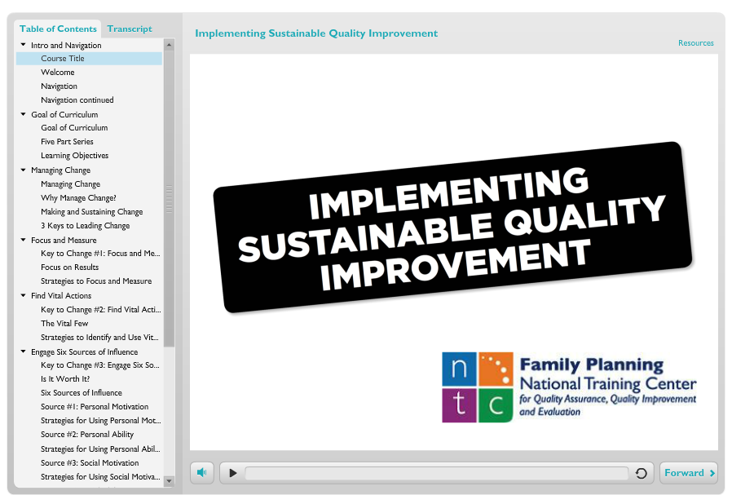
QI eLearning Course Module 4
Link: https://fpntc.org/training-and-resources/quality-improvement-for-family-planning
Notes:
Facilitator Notes
To learn more about sustainable quality improvement, check out module 4 of the Quality Improvement in Family Planning eLearning course from the Family Planning National Training Center, titled “Implementing Sustainable Quality Improvement.”

Slide 10
Model for Improvement
What are we trying to accomplish?
How will we know that a change is an improvement?
What changes can we make that will result in improvement?
ACT
PLAN
DO
STUDY
Notes:
Facilitator Notes
Now let’s talk more about how to spread these changes across other sites in your network.
The Model for Improvement, made popular by the Institute for Healthcare Improvement (IHI), is based on a combination of three fundamental questions that drive all improvement:
What are we trying to accomplish? (What is our goal?)
How will we know that a change is an improvement? (i.e., what do we need in terms of measurement and data)
What changes can we make that will result in improvement? (What can you do about it?)
The MFI then uses rapid tests of change, using the PDSA cycle, to test change ideas.
(Note to facilitators: for more on the MFI, see the discussion guide titled Develop a Site-Level Improvement Plan)

Slide 11
PDSA Scale-Up
ACT
PLAN
DO
STUDY
Learn from one cycle and apply those findings to the next.
ACT
PLAN
DO
STUDY
ACT
PLAN
DO
STUDY
ACT
PLAN
DO
STUDY
Notes:
Facilitator Notes
After changes have been implemented and determined to be effective, then we think about making those PDSAs bigger and bigger. This might be within the same pilot site, or it may be across network sites.
As we take interventions to scale and spread, the PDSA cycles continue. The tests of change continue—but get bigger. The cycle of testing and learning continues as you expand it to other sites.

Slide 12
Institute for Healthcare Improvement Model for Spread
“Pockets of excellence exist in our health care systems, but knowledge of these better ideas and practices often remains isolated and unknown to others.”
-Institute for Healthcare Improvement
Massoud MR et al. IHI 2006
Notes:
Facilitator Notes
We know that, “pockets of excellence exist in our health care systems, but knowledge of these better ideas and practices often remains isolated and unknown to others.”
Sharing that knowledge gained from successful interventions is essential for those in other network sites who can then build on that foundation.
But how do we spread this to other sites across the network?
To explore this, we’ll be diving into a white paper from the Institute for Healthcare Improvement, titled: A Framework for Spread: From Local Improvements to System-Wide Change.
Source (for reference)
Massoud MR, Nielsen GA, Nolan K, Nolan T, Schall MW, Sevin C. A Framework for Spread: From Local Improvements to System-Wide Change. IHI Innovation Series white paper. Cambridge, Massachusetts: Institute for Healthcare Improvement; 2006. (Available on www.IHI.org)

Slide 13
Tips for Planning for Spread
Align improvement with organizational strategy
Demonstrate feasibility / implementation at one site first
Make it a team effort
Identify potential early adopters
Focus on infrastructure changes
Massoud MR et al. IHI 2006
Notes:
Facilitator Notes
One of IHI’s key points is that spread is a thoughtful process, more than just disseminating lessons learned.
Here are some tips to think about when planning for spread:
Make sure that the improvement aligns with organizational strategy
Demonstrate feasibility/implementation at one site first—who can then be the model and reference site for others testing the changes
Make it a team effort. This should include leadership as well as on-the-ground implementation staff who can lead the changes
Identify early adopters by utilizing broad-based communication, “thought leaders,” and sharing comparative data
And finally, focus on spreading infrastructure changes. Systems-level changes have the ability to make a real impact
Source (for reference)
Massoud MR, Nielsen GA, Nolan K, Nolan T, Schall MW, Sevin C. A Framework for Spread: From Local Improvements to System-Wide Change. IHI Innovation Series white paper. Cambridge, Massachusetts: Institute for Healthcare Improvement; 2006. (Available on www.IHI.org)

Slide 14
Tips for Communicating Spread
Define benefits of implementation
Communicate comparative data
Leverage all channels of communication
Utilize peer-to-peer interactions
Involve successful sites in providing technical support
Massoud MR et al. IHI 2006
Notes:
Facilitator Notes
Some tips when it comes to communicating the successes that you’ve had so far:
Define the benefits of implementation—package your story of improvements in a compelling way to share with other sites
Prepare the comparative data that proves this changes is worthwhile
Use diverse channels of communication
And finally, leverage peer-to-peer interactions and involve successful sites in providing technical support. Hearing directly from successful sites can be the most meaningful way to spread changes. It’s always helpful for people to hear directly from those who have gotten a change to work effectively
Source (for reference)
Massoud MR, Nielsen GA, Nolan K, Nolan T, Schall MW, Sevin C. A Framework for Spread: From Local Improvements to System-Wide Change. IHI Innovation Series white paper. Cambridge, Massachusetts: Institute for Healthcare Improvement; 2006. (Available on www.IHI.org)

Slide 15
Tips for Managing Spread
Define responsibilities for collecting, summarizing, reviewing the data frequently
Provide feedback to implementing sites on progress
Develop feedback loop for how new knowledge gained from spreading across sites will be shared
Massoud MR et al. IHI 2006
Notes:
Facilitator Notes
Finally – here are some tips for managing spread:
Define responsibilities for data collection/summary and review. Data should be reviewed frequently (e.g., monthly)
Establish systems for feedback, including providing feedback to the implementing sites on their progress. Also, get feedback from your implementing sites on what knowledge they gained from testing the changes at their own sites
Discuss
How ready are you to spread changes to other sites in the network? What can you do to increase readiness?
What is one approach you will use to start spreading best practices to other sites?
How will you support other sites to make improvements (e.g., peer-to-peer support, technical assistance)?
Source (for reference)
Massoud MR, Nielsen GA, Nolan K, Nolan T, Schall MW, Sevin C. A Framework for Spread: From Local Improvements to System-Wide Change. IHI Innovation Series white paper. Cambridge, Massachusetts: Institute for Healthcare Improvement; 2006. (Available on www.IHI.org)

Slide 16
A Quality Improvement Project vs. A Culture of Quality
A culture of quality is looking at all systems
and practices for opportunities to continuously improve.
QI Project
QI Culture
Notes:
Facilitator Notes
Finally, sustaining and spreading changes, that is, keeping the improvements going, contributes to a culture of quality ultimately.
Many agencies undertake quality improvement projects, meaning that they engage in limited or defined efforts to improve a particular measure.
But building a culture of quality isn’t just looking for what (or where) things are wrong, or when a standard isn’t being met. It involves looking at all systems and practices for improvement, and continuously looking for ways to improve.

Slide 17

Strategies to Create a Culture of Quality
Be client-centered
Engage leadership
Involve all staff
Communicate goals
Create and maintain a QI infrastructure
Notes:
Facilitator Notes
Here are five strategies to create a culture of quality:
First, be client-centered. Quality is defined by client expectations and values. Maintain a client focus when making decisions about clinic operations even if it’s easier to make decisions based on the organization’s or staff’s priorities.
Next, engage leadership (if you haven’t already). Support from the top is critical to building a culture of quality. Involve leaders in quality improvement efforts and keep stakeholders informed about incremental improvements.
It’s important to involve everybody—all staff—when building a culture of quality. Quality improvement requires involvement and buy-in from staff at all levels. All staff have important roles to play in providing quality services.
Identify and clearly communicate the agency’s improvement goals. The goal should be clear and meaningful, and understood by all staff.
Finally, create and maintain a QI plan to adopt, systematize, and scale-up improvements.
Discuss
What is one strategy you can implement to promote a culture of quality at your organization?

Slide 18
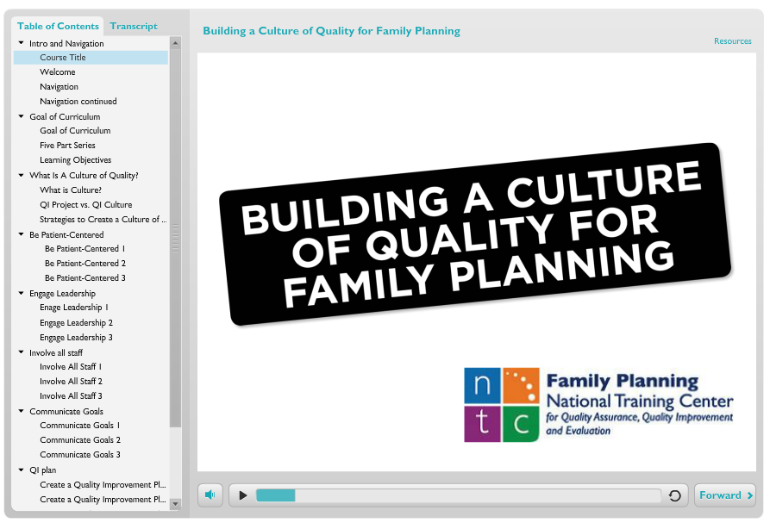
QI eLearning Course Module 5
Link: https://fpntc.org/training-and-resources/quality-improvement-for-family-planning
Notes:
Facilitator Notes
If you’re interested in learning more about sustainable quality improvement, check out module 5 of the Quality Improvement in Family Planning eLearning course from the Family Planning National Training Center. Its title: “Building a Culture of Quality for Family Planning.”

Slide 19

What are your next steps?
What is one thing you will take away?
Notes:
Discuss (if time allows)
What other questions do you have for each other before we end? Are there other issues or challenges that we haven’t discussed yet?(Note to facilitators: If challenges came up in earlier discussions, this could be a good time to discuss them.)
What are your next steps for sustaining and spreading improvements?
Before we leave, what is one thing you will take away from today’s discussion? (Note to facilitators: Consider round robin sharing or ask a couple of participants to share.)

Slide 20
Thank you!
Contact:
fpntc@jsi.com
Notes:
Facilitator Notes
Thank you for participating in today’s discussion.
If applicable, you can contact me at:_________
You can also always contact the Family Planning National Training Center (fpntc@jsi.com) with questions/comments.

