Slide 1
Develop Systems for
Same-Visit Provision of
All Contraceptive Methods
Contraceptive Access Change Package Best Practice 3
Last Reviewed March 2020
Notes:
Facilitator Notes
Today we will be discussing developing systems for same-visit provision of all methods, at all visit types.
The goal of this best practice recommendation is to make it possible for patients, including women who choose LARCs, to leave their visit with their selected contraceptive method.
Activity
Conduct participant and facilitator introductions.

Slide 2

Introduction to the Contraceptive Access Change Package
Best Practice Recommendations
Stock all methods
Utilize patient-centered counseling
Offer same-visit access
Reduce cost as a barrier
Link: https://www.fpntc.org/resources/contraceptive-access-change-package
Notes:
Facilitator Notes
Ensuring same-visit access to all methods is the third best practice recommendation from the Contraceptive Access Change Package, which was developed by the Family Planning National Training Centers.
The Contraceptive Access Change Package, which is an overview of the best practice recommendations and strategies, draws from the literature and most current practice guidelines to increase access to the full range of contraceptive methods.
The other three Best Practices in the Contraceptive Access Change Package are:
BP 1: Stock a broad range of contraceptive methods, including provider-dependent methods.
BP 2: Discuss pregnancy intention and support patients through evidence-informed, patient-centered counseling that enables them to choose from the full range of contraceptive methods if they do not desire pregnancy presently.
BP 4: Utilize diverse payment options to reduce cost as a barrier for the facility and the patient.
In order to increase access, it’s important to consider all four best practices. We strongly encourage you to refer to the Contraceptive Access Change Package for more ideas about strategies and successes. It can be found on the FPNTC website (the link is provided on the slide).

Slide 3

Contraceptive Access Change Package:
Best Practice 3
Develop systems for same-visit provision of all contraceptive methods, at all visit types. Make it possible for patients, including women who choose LARCs, to leave their visit with their selected method.*
*Provided that you can be reasonably sure that the patient is not pregnant
Notes:
Facilitator Notes
So, now let’s focus on this best practice. Best Practice 3 again is to develop systems for same-visit provision of all contraceptive methods, at all visit types. The goal is that all patients, including women who choose LARCs, should be able to leave their visit with their selected method, if they desire it, and provided you can be reasonably certain the patient is not pregnant.

Slide 4
Meeting Objectives
By the end of today, you should be able to:
Describe why it is important to offer methods during the same visit initially requested by the patient (i.e., same-visit)
Identify at least one challenge to providing methods same-visit
Identify at least one strategy to increase same-visit access
Notes:
Facilitator Notes
There are 3 objectives for today’s discussion. By the end of today, we hope you will be able to:
Describe why it is important to offer methods during the same visit initially requested by the patient (i.e., same-visit)
Identify at least one challenge to providing methods same-visit
Identify at least one strategy to increase same-visit access
As the objectives imply, we want to take time today to talk about not just what should happen, but also what makes these recommendations a challenge. By discussing challenges, we hope to identify potential strategies for breaking down those barriers—ultimately, to increase patients’ access to their contraceptive methods of choice.

Slide 5
Defining Same-Visit Access
“Same-visit” access to all methods means that during a single visit, patients can request a method and leave their visit with that selected method*
  Not requiring patients to come back for new appointment on a different day, or later the same day
Option should be available to patients
  Regardless of reason for initial visit
  Not expected that this will work for all patients
*Provided that you can be reasonably sure that the patient is not pregnant
Notes:
Facilitator Notes
The term “same-visit” may be confusing. To clarify: When we say same-visit access to methods, we mean that during a single visit, patients can request a method and leave their visit with that selected method. This means that there is no requirement for patients to come back for separate appointments on different days, or even later the same day.
This option should be made available to all patients—regardless of reason for the initial visit—although it is not expected that all patients will choose this option.
That said, we recognize this is a challenge and know it won’t be possible for all patients, all the time. But the goal is to work toward this being common practice.

Slide 6
Rationale for Same-Visit Access
There is no medical reason to routinely require multiple visits to initiate any contraceptive method, if the provider can be reasonably sure that the patient is not pregnant
CDC, ACOG, and other organizations agree that clinicians can initiate and provide the patient’s method of choice in a single visit, unless additional testing is medically indicated
Notes:
Facilitator Notes
Patients should be offered the option to begin contraception at the time of visit rather than waiting for their next menses, or returning for another appointment (also known as Quick Start).
There is no medical reason to routinely require multiple visits to initiate any contraceptive method if the provider can be reasonably sure that the patient is not pregnant.
Although it has been common practice to require multiple appointments for methods such as the IUD or implant, there is now agreement among CDC, ACOG, and other organizations that clinicians can initiate and provide the patient’s method of choice in a single visit, unless additional testing is medically indicated.
Ideally, these services are offered during the same visit because patients might not return at a later time for services.
If a patient seeks pregnancy testing, a negative pregnancy test result provides an opportunity to discuss pregnancy intention and/or a reproductive life plan and ongoing reproductive health needs.
All services should be provided on a voluntary basis. A patient should not be coerced into using a method, or selecting any particular method.
Sources (for reference)
Gavin L, Moskosky S, Carter M et al. Providing Quality Family Planning Services: Recommendations of CDC and the U.S. Office of Population Affairs. MMWR 2014;63(4)
Curtis KM, Jatlaoui TC, Tepper NK, et al. U.S. Selected Practice Recommendations for Contraceptive Use, 2016. MMWR Recomm Rep 2016;65(No. RR-4):1–66.
American College of Obstetricians and Gynecologists (ACOG). Practice Bulletin No 121. Long- Acting Reversible Contraception: Implants and Intrauterine Devices. July 2011.
American Academy of Pediatrics (AAP). Contraception for adolescents: Policy Statement. September 29, 2014.
Eisenberg, D. Best Practices in Long-Acting Reversible Contraception: Recommendations from ACOG and CDC. Presentation. September 18, 2014.
Bergin A(1), Tristan S, Terplan M, Gilliam ML, Whitaker AK. A missed opportunity for care: two-visit IUD insertion protocols inhibit placement. Contraception. 2012 Dec;86(6):694-7.

Slide 7
How to Be Reasonably Certain a Patient is Not Pregnant (CDC)
If a woman has no symptoms or signs of pregnancy and meets any one of the following criteria:
  is ≤7 days after the start of normal menses
  has not had sexual intercourse since the start of last normal menses
  has been correctly and consistently using a reliable method of contraception
  is ≤7 days after spontaneous or induced abortion
  is within 4 weeks postpartum
  is fully or nearly fully breastfeeding (exclusively breastfeeding or the vast majority [≥85%] of feeds are breastfeeds), amenorrheic, and <6 months postpartum
US Selected Practice Recommendations for Contraceptive Use, 2016
Notes:
Facilitator Notes
The CDC’s 2016 Selected Practice Recommendations include guidance for determining how to be “reasonably certain a patient is not pregnant.” Clinicians may be hesitant to offer same-visit insertions out of concern that a patient is pregnant. CDC offers this checklist as a way to be reasonably certain a patient is not pregnant.
According to CDC, a health care provider can be reasonably certain that a woman is not pregnant if she has no symptoms or signs of pregnancy and meets any one of the following criteria:
is ≤7 days after the start of normal menses
has not had sexual intercourse since the start of last normal menses
has been correctly and consistently using a reliable method of contraception
is ≤7 days after spontaneous or induced abortion
is within 4 weeks postpartum
is fully or nearly fully breastfeeding (exclusively breastfeeding or the vast majority [≥85%] of feeds are breastfeeds), amenorrheic, and <6 months postpartum
Source (for reference)
Curtis KM, Jatlaoui TC, Tepper NK, et al. U.S. Selected Practice Recommendations for Contraceptive Use, 2016. MMWR Recomm Rep 2016;65(No. RR-4):1–66.

Slide 8
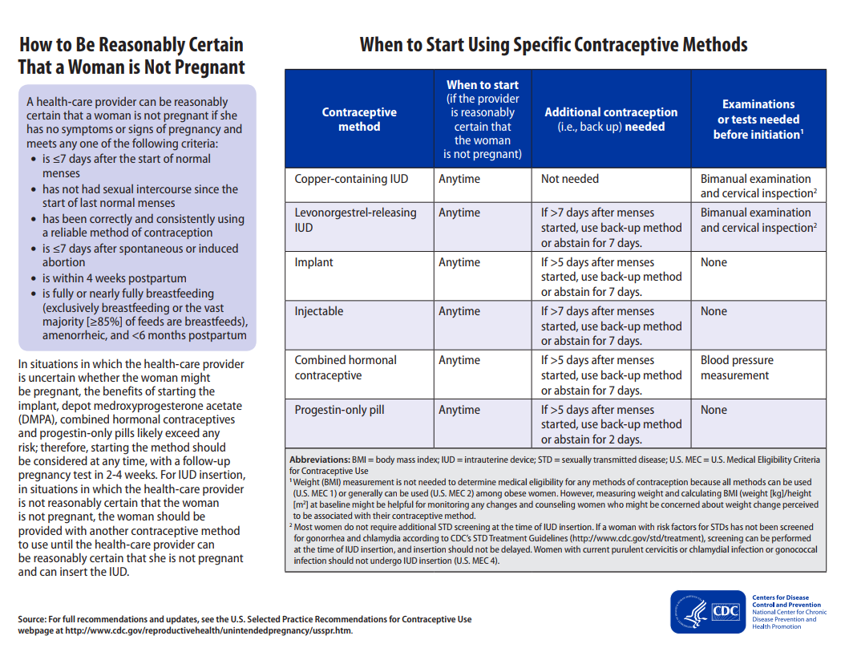
Notes:
Facilitator Notes
According to CDC, if providers can be reasonably certain a patient is not pregnant, they can start any method at any time. Further, CDC does not recommend that providers wait until the next menses to start a contraceptive method, if the provider can be reasonably certain the patient is not pregnant. This has, however, been common practice, and so for many providers can be a challenging shift.
Source (for reference)
Curtis KM, Jatlaoui TC, Tepper NK, et al. U.S. Selected Practice Recommendations for Contraceptive Use, 2016. MMWR Recomm Rep 2016;65(No. RR-4):1–66.

Slide 9
Notes:
Facilitator Notes
For implants and injectables, as well as progestin-only pills, there are no necessary exams or tests needed before initiation. For the copper IUD and hormonal IUD, bimanual examination and cervical inspection are needed before initiation.
“Most women do not require additional STD screening at the time of IUD insertion. If a woman with risk factors for STDs has not been screened for gonorrhea and chlamydia according to CDC’s STD Treatment Guidelines (http://www.cdc.gov/std/treatment), screening can be performed at the time of IUD insertion, and insertion should not be delayed. Women with current purulent cervicitis or chlamydial infection or gonococcal infection should not undergo IUD insertion.” (See footnote #2 on the slide)
Source (for reference)
Curtis KM, Jatlaoui TC, Tepper NK, et al. U.S. Selected Practice Recommendations for Contraceptive Use, 2016. MMWR Recomm Rep 2016;65(No. RR-4):1–66.
Workowski K, Bolan G. Sexually Transmitted Diseases Treatment Guidelines, 2015. MMWR Recomm Rep 2015;64(no.RR-3):1-134

Slide 10
Additional Visits are a Barrier for Patients
Family Planning Clinical Training Center online survey of APRNs (n=390)
  35% of respondents reported having policies that permitted provision of method during same visit
  Over half (56%) required 2 or more visits to provide method
  Every one visit increase required for LARC provision resulted in fewer LARC placements (see right)
Family Planning Clinical Training Center, 2016
Notes:
Facilitator Notes
There is evidence that each additional visit women make to return to the clinic greatly reduces the likelihood that they will receive a LARC after having selected it as their method of choice.
This study from the National Clinical Training Center of APRNs found that each additional visit resulted in 24% fewer placements of copper IUDs, 27% fewer placements of hormonal IUDs, and 32% fewer placements of implants.
The low rate of follow-up for visits, along with subsequent lack of access to methods due to multiple visits, means that patients are choosing a method and then NOT getting the method they want. The system is not working for them, and they continue to be at risk of unintended pregnancy, despite coming to the clinic and in order to prevent pregnancy.
This can also represent unrecognized revenue for the clinic. When you can provide the method same visit, you are able to bill for those services. However, we know that about 50% of patients don’t show up for return visits, which is a lost opportunity for billing for services provided.
Source (for reference)
National Clinical Training Center: Findings from a National APRN LARC Survey. Presented at the National Family Planning and Reproductive Health Association Meeting April 19, 2016

Slide 11
Overview of Strategies to Ensure Same-Visit Access
Develop clinical and administrative systems to support same-visit access
Remove unnecessary barriers such as examinations and tests
Offer Quick Start for all methods*
Offer emergency contraception when appropriate
*Provided that you can be reasonably sure that the patient is not pregnant
Notes:
Facilitator Notes
In order to make same-visit access available, clinics need to:
Develop and implement the necessary administrative and clinical support systems to increase efficiency and support immediate/same-visit access to all methods.
Remove unnecessary barriers to contraceptive access, including:
Pelvic exams, unless inserting an IUD or fitting a diaphragm
HIV screenings
Cervical cytology or other cancer screening, including clinical breast exam
Laboratory tests for lipid, glucose, liver enzyme, and hemoglobin levels or thrombogenic mutations
Conduct STD screening, and provide preventive health services in accordance with CDC’s STD Treatment Guidelines.
Offer emergency contraception (copper IUD or pills) when appropriate

Slide 12

Clinician Testimonial: Same-Visit is Possible!
David J. Holcombe, MD, MSA
Regional Administrator/ Medical Director
Office of Public Health, Region VI
Louisiana Department of Health and Hospitals
Link to Audio Recording: https://fpntc.adobeconnect.com/p60z0wcga4b/
Notes:
Activity
Listen to this brief (5-minute) testimony of Dr. David Holcombe in Louisiana talking about how important same-visit is for patients.
Dr. Holcombe is a Regional Administrator/Medical Director at the Office of Public Health of the Louisiana Department of Health and Hospitals.
Discuss
How do providers (you or others) feel about the idea of offering methods same-visit?
What are your fears and reservations?
Does this recording have any impact on those fears?

Slide 13
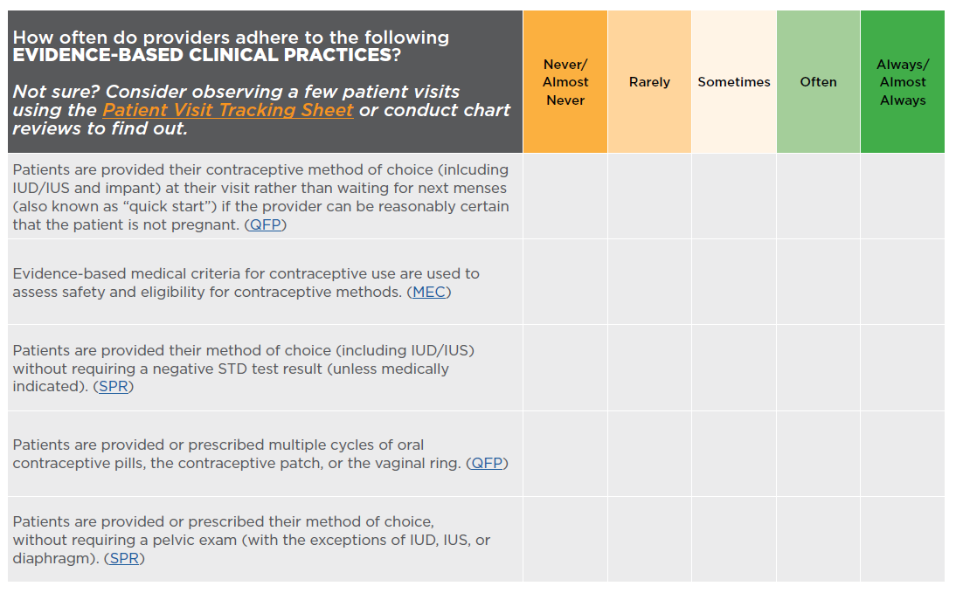
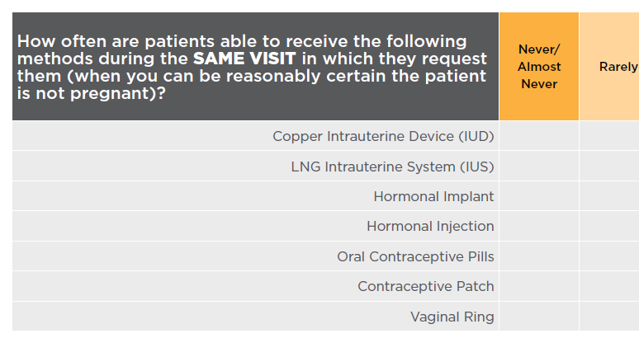
Contraceptive Access Assessment
Notes:
Facilitator Notes
If you haven’t already, please take a minute to complete the Contraceptive Access Assessment questions related to stocking. Consider how often all methods are immediately available (i.e., stocked on site) to patients. We encourage you to be critical—how often are these practices are really happening (not what you hope is happening)? This tool is designed to help you identify areas to improve.
Activity
Participants will fill out or refer to the Contraceptive Access Assessment tool. Ask participants to fill out ahead of time, or provide 10-15 additional minutes to fill it out during the session.

Slide 14
What Methods are Available Same-Visit?
What methods are you currently able to provide during the same visit initially requested by the patient?
  Hormonal IUD
  Copper IUD
  Contraceptive implant
  Depo
  Pill, patch, ring
Notes:
Discuss
Reflecting on the results of your Contraceptive Access assessment, what methods are you currently able to provide during the same visit initially requested by the patient?
For methods that have historically been a challenge to provide same-visit (i.e., IUDs and implants), how often are you able to offer these methods same-visit currently?
Are there any other methods not available immediately (e.g, Depo, pill, patch, or ring)?

Slide 15
Why is It Challenging to Offer Some Methods
Same-Visit?
What makes it challenging to offer these methods during the same visit initially requested by the patient?
  Hormonal IUD
  Copper IUD
  Contraceptive implant
  Depo
  Pill, patch, ring
Notes:
Discuss
We know offering methods same-visit is hard to implement. Why is that? What makes it challenging to offer these methods during the same visit initially requested by the patient?
Are clinicians on board with new recommendations to offer methods same-visit? What concerns do they have?
Are there requirements that routinely require patients to return for a follow-up visit (e.g., requiring STD results prior to insertion)?
Are all methods stocked and readily available for patients who choose them?

Slide 16
Overview of Same-Visit Implementation Strategies
Obtain provider buy-in for same-visit provision
Utilize Quick Start
Create kits for IUD and implant insertions
Adjust schedule to allocate time in clinician’s schedule for insertions
Conduct LARC insertion trainings
Track insurance coverage and reimbursement
Stock all methods, including provider-dependent methods
Notes:
Facilitator Notes
Now let’s talk about some strategies for addressing some of the barriers and concerns that came up during our discussion.
Implementation strategies that can support same-visit access to all methods include:
Obtaining provider buy-in for same-visit
Utilizing Quick Start
Creating kits for IUD and implant insertions
Streamlining appointment types
Allocating time in clinician schedule
Conducting LARC insertion trainings
Tracking insurance coverage and reimbursement
Stocking all methods, at least all provider-dependent ones
We’re going to talk about each of these individually and discuss what you have tried or could try in the future.

Slide 17
Provider Buy-In for
Same-Visit Insertions
Share evidence and data
  CDC Selected Practice Recommendations
  CHOICE data on satisfaction, continuation of LARC
“Work Smarter, Not Harder”
Support implementation: insertion kits, support staff, documentation burden
Find a champion clinician
Start small
Notes:
Facilitator Notes
Let’s start with obtaining provider buy-in. Obtaining provider buy-in can be a challenge, but there are strategies that can help you bring everyone on board.
It’s important for providers to understand the reasons why this is recommended, and to also be supported in making whatever changes are required to make this feasible and not feel like it’s just adding, “one more thing.”
If they can see that there is evidence behind making this change, that can help with buy-in. Sharing the CDC job aids for the Selected Practice Recommendations such as the one on the prior slide, can be a good starting point. Sharing CHOICE study data can also be helpful. In the 2015 study by Diedrich et al (a three-year follow up with patients in the CHOICE study) continuation and satisfaction rates were consistently higher with LARC compared to other methods.
It’s important to emphasize to providers that this change is about working smarter, not harder. Sometimes this means systemic changes are necessary. Staff and providers may be concerned that they are being asked to do “more work” or that any change will make their lives harder. If they perceive that they are just going to be asked to do the same things but “turn up the speed dial” (or just do more—e.g., same visit insertions) without making any overall and necessary changes to your clinic’s system, then they are not likely to be unenthusiastic about making changes. But, if they can see that the idea is that they are part of the solution—that it is essential that they are involved in making changes, providers will be more likely to be supportive. Ask for their input. Involve them.
Make sure you do everyone that you can to support your clinicians. Make operations easier for them (insertion kits, support staff, reducing documentation burden, etc.). We’ll discuss insertion kits shortly.
Of course if clinicians can see that others have made changes, or are in the middle of doing so, this will help with buy-in. So start with a clinician champion. Clinicians are great at bringing other clinicians along. You can share the audio clip of Dr. Holcombe with clinicians at a staff meeting and use it as a discussion starter.
Finally, start small. Try same-visit insertions with one clinician, one time, one day. Then work out the kinks and go bigger. Don’t try to change decades of practice all at once.
And let them know that you aren’t asking that same-visit be done every time for every patient. Some patients will choose to wait for the insertion, and that’s totally fine. Sometimes the schedule may not work out right. But the goal is that this patient-centered service be standard practice.
Discuss
What concerns have you heard from providers about providing methods same-visit? How have you/do you think you’ll be able to respond to these concerns?
Source (for reference)
Diedrich JT, Zhao Q, Madden T, Secura GM, Peipert JF. Three-year continuation of reversible contraception. Am J Obstet Gynecol. 2015 Nov;213(5):662.e1-8. doi: 10.1016/j.ajog.2015.08.001. Epub 2015 Aug 7.

Slide 18
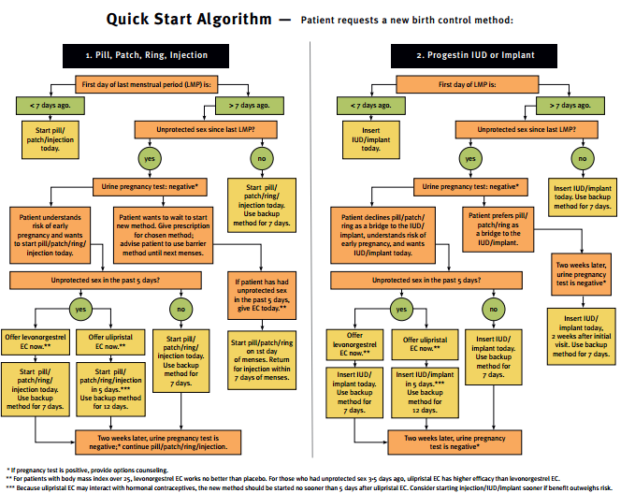
US Selected Practice Recommendations for Contraceptive Use, 2016
Link: https://www.reproductiveaccess.org/wp-content/uploads/2014/12/QuickstartAlgorithm.pdf
Notes:
Facilitator Notes
Here’s another tool that can help clinicians utilize “Quick Start,” that is, not waiting until patients are on menses to initiate contraception.
The algorithm helps providers determine if Quick Start is an option based on the method selected by the patient. For example, providers can use this tool to confirm that patients whose first day of last menstrual period (LMP) is greater than seven days ago, and who did not have unprotected sex since LMP may start their method of choice during that day and use a back up method for 7 days, if not otherwise contraindicated and if the patient desires it.
This algorithm is from the Reproductive Health Access Project (see link on slide).
Source (for reference)
Curtis KM, Jatlaoui TC, Tepper NK, et al. U.S. Selected Practice Recommendations for Contraceptive Use, 2016. MMWR Recomm Rep 2016;65(No. RR-4):1–66.
The Quick Start algorithm is available at: https://www.reproductiveaccess.org/wp-content/uploads/2014/12/QuickstartAlgorithm.pdf

Slide 19
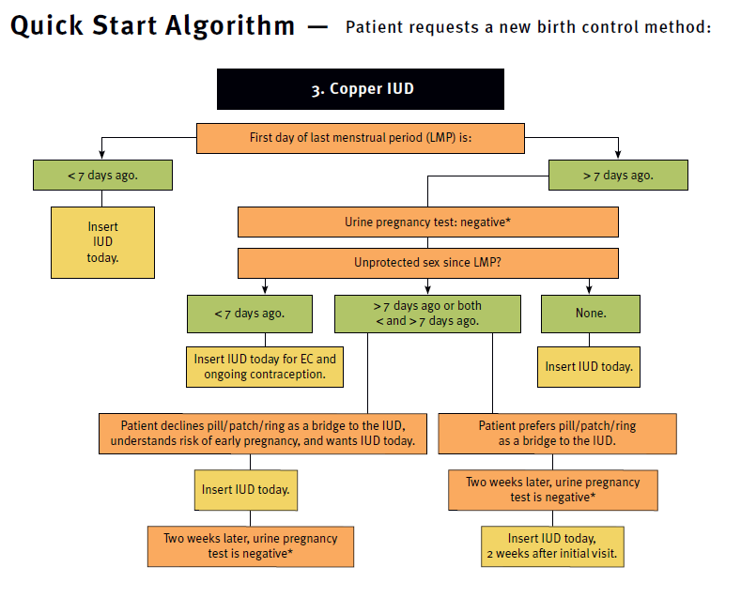
Quick Start Algorithm (cont.) - Copper IUD as EC
US Selected Practice Recommendations for Contraceptive Use, 2016
Notes:
Facilitator Notes
Copper IUD as emergency contraception (EC) is one way to introduce same-visit LARC. The picture on the slide shows the algorithm for Quick Start of copper IUD, including as EC.
The use of copper IUD as EC has been promoted, but use is not widespread.
Discuss
Are you offering copper IUD as EC?
If no, why not? What have been the challenges/concerns? What strategies can you use to try this practice?
If yes, what strategies did you use to implement this practice? How were you able to address concerns that were raised?
Sources (for reference)
Curtis KM, Jatlaoui TC, Tepper NK, et al. U.S. Selected Practice Recommendations for Contraceptive Use, 2016. MMWR Recomm Rep 2016;65(No. RR-4):1–66.
The Quick Start algorithm is available at: https://www.reproductiveaccess.org/wp-content/uploads/2014/12/QuickstartAlgorithm.pdf

Slide 20
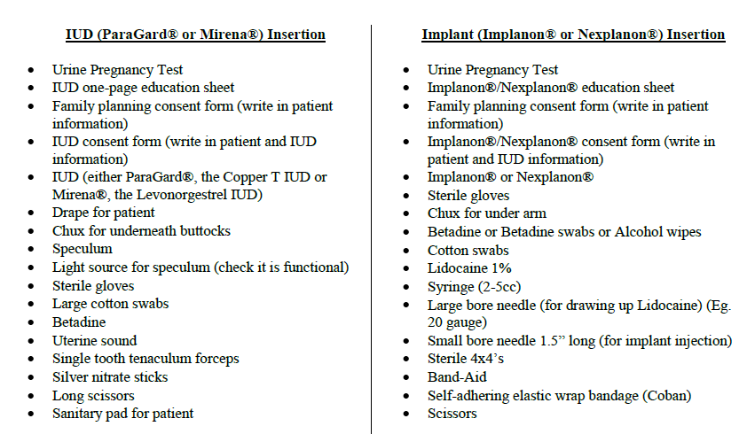
LARC Insertion Kits
Unity Healthcare: Supplies to Set Up for Insertions:
Notes:
Facilitator Notes
Setting up insertion kits is a helpful strategy for streamlining the workflow, thus increasing access to methods same-visit. If staff and providers have all the materials easily on hand, no time is wasted gathering materials and might prevent a patient from being able to get a method.
These kits should be ready and accessible in the exam room; they can be in a cart, caddy, or wrapped up for each individual insertion.
This sample list of materials for insertions is courtesy of Unity Healthcare in DC. At Unity, providers have found that having the insertion tools easily on hand expedites the process of preparing for insertions, so they are able to accommodate patients who request a method same-visit.
Discuss
Has anyone tried creating insertion kits?
If yes, what did you learn during the process? How do they help? What would you do differently if you were to do it again? Did you have to purchase new supplies? Where are they stocked?
If no, how will you go about creating them?

Slide 21
Schedule Adjustments
Do a time study.
Adjust standard visit length
  Use 1 appointment type of 15-20 minutes
  Calculate average appointment length by looking at past patient volume and visit type
Block visits to allow for anticipated LARC insertions
Notes:
Facilitator Notes
Providers might be concerned about trying to fit in the insertion within the schedule. In truth, insertions do not take much extra time, especially when they are done by providers who are familiar with the procedure and exam rooms are stocked with the necessary supplies. That said, in an already busy clinical setting with a full schedule at full capacity, staff and providers cannot be asked to do more without any adjustment. Some ways to adjust the schedule to allocate time for insertions include:
First, do a time study. How long does IUD/implant insertion actually take when the materials are already gathered? How many do you anticipate per day based on your current numbers?
Second, adjust the visit length. Some options for figuring out how long to set your standard visit length include:
Use 1 appointment type of 15-20 minutes for all visit types, rather than different lengths for specific visits
Calculate a standard appointment length by looking at past patient volume and visit types. If you already have high productivity, you may need to make adjustments to the schedule to accommodate insertions.
You can adjust visit length or block visits to allow for anticipated LARC insertions as “catch-up” if you do not have a no-show rate that allows for this kind of flexibility.

Slide 22
Schedule Adjustments
An example:
  On average, you do 4 LARC insertions/day; 2 of those are same-visit. Your standard appointment length is 15 mins.
  You could: block off 2 appointments per day to allow for insertions.
  If you have a high no show rate, you may not need to block any appointments.
Notes:
Facilitator Notes
Here is an example to show how these schedule adjustments can work:
Let’s assume a clinic does approximately 4 LARC insertions per day, approximately 2 are anticipated to be same visit, and you already have appointment slots for 15 minutes each.
You may need to block off 2 appointments to make up for same-visit insertions. If, however, you have a high no-show rate or are not seeing that many patients, these additions should fit in.
Discuss
Does anyone use standard appointment lengths? For people who have either made all appointments the same length or made adjustments to the schedule, how long of a visit do you have? How is it working? What has been the impact of this change?
Does anyone block visits? Which visits do you block? How is that working? What has the impact been?
How will you try these strategies if you aren’t already using them?

Slide 23
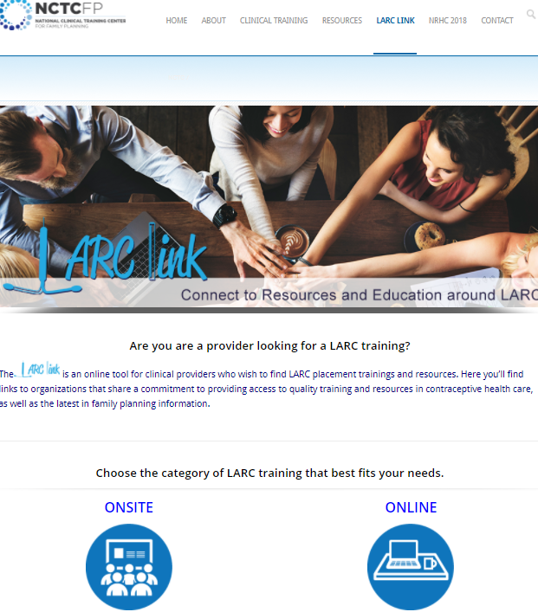
LARC Insertion Trainings
National Clinical Training Center for Family Planning LARC LINK
Link: http://www.ctcfp.org/larc-link/
Notes:
Facilitator Notes
We won’t spend much time on this, but of course, you can’t offer same-visit insertions if providers aren’t trained to do the insertions.
The National Clinical Training Center for Family Planning’s LARC Link is where you can find upcoming insertion trainings that are in person, as well as online training opportunities.
After providers are trained, it is important that they have the opportunity to practice insertion skills so they feel comfortable providing insertions same-visit.

Slide 24
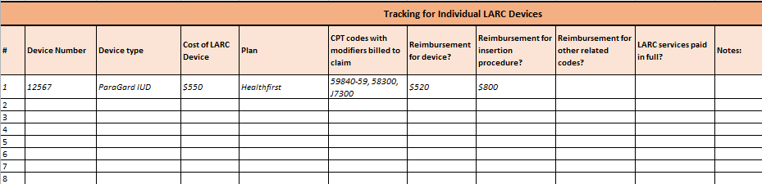
Tracking Insurance Coverage & Reimbursement
Verify before patients comes in when asking about general coverage
Track LARC cost, reimbursement and notes by insurer
Ann Finn Consulting (www.annfinnconsulting.com)
Notes:
Facilitator Notes
All patients should have access to services regardless of ability to pay.
Obtaining reimbursement for services is important for ensuring sustainability. One way to ensure you are receiving reimbursement is to track which insurance plans will cover which methods, and under what circumstances.
Discuss
Are you having issues obtaining reimbursement for LARC methods? (If yes, report to the National Women’s Law Center! Pill4us@nwlc.org.)
What level of pre-verification of coverage for LARC do you do before the visit?
Do you track information about cost and reimbursement by insurer? If not, could this be helpful?

Slide 25
Stocking a Broad Range of Methods
At a minimum, at least one type of all provider dependent methods should be stocked on site.
See Best Practice 1. Stock a Broad Range of FDA-Approved Methods of the Contraceptive Access Change Package
FDA-approved methods include:
Services or referral for sterilization ;
Hormonal implant;
LNG IUD;
Cu IUD;
Hormonal injection;
Oral contraceptive;
Contraceptive patch;
Vaginal ring;
Diaphragm and cervical cap;
Sponge;
Condoms (male and female); and
Spermicide.
Notes:
Facilitator Notes
Finally, it’s impossible to offer methods same-visit if the methods aren’t stocked on site. Title X-funded projects are required to stock a “broad range” of Food and Drug Administration (FDA)-approved contraceptive method types. At a minimum, at least one type of each FDA-approved provider-dependent methods should be stocked (i.e., at least 1 hormonal IUD, the copper IUD, and the implant). (Note to facilitators: See the Best Practice 1 discussion guide on stocking a broad range of methods for more on stocking-related challenges and strategies.)
Discuss
Are you stocking all methods? If not, what methods aren’t you stocking? What barriers prevent you from stocking these methods, and what steps can you take to start stocking them?

Slide 26
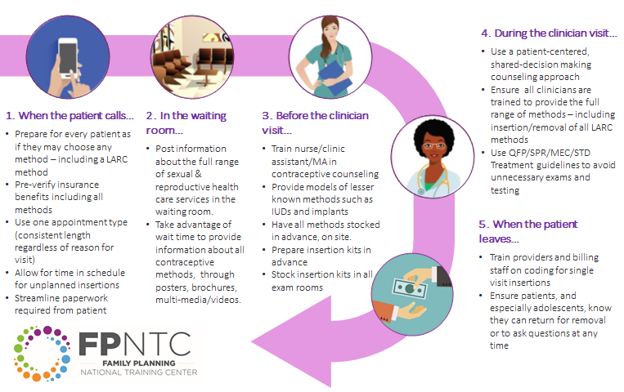
Strategies to Support Same-Visit Access to Methods
Notes:
Facilitator Notes
We know that offering same-visit access to methods can be a challenge, but if you start with small changes, it’s possible!
This one-pager has a list of ideas that can help support same-visit availability of methods at the various stages of a visit. You may want to print it out to refer to and see if there are other strategies you can try to increase access to methods same-visit.

Slide 27
Success Story: Make a Case with Data (Johnston County, NC)
Worked with finance department to maintain inventory of LARC methods
Shared data on number of insertions, cost, and reimbursement rated to justify need
Same-visit insertions increased 36% to 50%
Key point: Use data – insertions, cost, and reimbursement – to ensure adequate stock to meet demand for same-visit insertions.
Notes:
Facilitator Notes
Now let’s look at a success story from the field. We know it can be valuable to see how are other Title X sites are implementing these best practice recommendations.
This is a story from a real site that participated in the Family Planning National Training Center (FPNTC) Performance Measurement Learning Collaborative. Their story was written up as a short case study, and included in the Contraceptive Access Change Package.
When Johnston County Public Health Department, a sub-recipient of the North Carolina Department of Health and Human Services, explored barriers to same-visit provision of LARC, they discovered that they did not have enough stocked methods on site to make this an option to women who desired it. They worked with their finance department to purchase and maintain an inventory of LARCs on site. Managers provided finance staff with the number of inserts from previous months, as well as cost and reimbursement rates, which helped justify the need to order and maintain an adequate number of LARCs on site. The proportion of LARC insertions provided during the same visit as the patient’s initial consult increased from 36% in November 2015 to 50% in May 2016.
The key point of this story: data—including data on insertions, cost, and reimbursement—are essential for making the case to ensure there is adequate stock to meet the demand for same-visit insertions.
Discuss (if time allows)
What opportunities exist for you to share utilization, cost, reimbursement, or other data, to make the case for same-visit access?

Slide 28
Success Story: Clinician Champions (Rapides Parish Health Unit, LA)
Strategies to support same-visit access
  Insertion kits in exam rooms
  Staggered clinician lunch schedules
  Clinician champion
  Education about current recommendations that support same-visit availability
Key point: Clinician champions are key to helping push this effort forward.
Notes:
Facilitator Notes
A second success story from the field: This site also participated in the FPNTC’s Performance Measurement Learning Collaborative, and this story is included in the Contraceptive Access Change Package.
With support from the Louisiana Department of Health and Hospitals’ Office of Public Health, the Rapides Parish Health Unit was able to offer same-visit provision of LARC relatively early compared to peer sites. A number of strategies contributed to this success. First, all clinicians were trained on all methods. Second, they put together LARC insertion kits and stored them in exam rooms. Third, they staggered clinicians’ lunch schedules to ensure that someone was always available for an insertion. An experienced clinician’s buy-in greatly contributed to the success of their efforts. The clinician shared guidelines to support same-visit provision as well as his own experiences with these process changes. Having a clinician champion led credibility to the effort and, ultimately, normalized same-visit provision of LARC in the clinic.
The key point of this story: clinician champions can help push this effort forward, and reinforce the importance of same-visit access as changes/new strategies are implemented.
Discuss (if time allows)
Who can champion same-visit access at your site(s)?
Who do you need to involve in to these efforts?

Slide 29

What other questions do you have?
What other issues would you like to discuss?
Notes:
Discuss (if time allows)
What other questions do you have for each other before we end? Are there other issues or challenges that we haven’t discussed yet? (Note to facilitators: If challenges came up in earlier discussions, this could be a good time to discuss them.)
Before we leave, what is one thing you will take away from today’s discussion? (Note to facilitators: Consider round robin sharing or ask a couple of participants to share.)

Slide 30
Thank you!
Contact:
fpntc@jsi.com
Notes:
Facilitator Notes
Thank you for participating in today’s discussion.
If applicable, you can contact me at:_________
You can also always contact the Family Planning National Training Center (fpntc@jsi.com) with questions/comments.

