Slide 1
Experiences from the Field:
How Title X Grantees are Providing Substance Use Services
July 28, 2020
Notes:
Experiences from the Field: How Title X Providers are Offering Substance Use Services

Slide 2
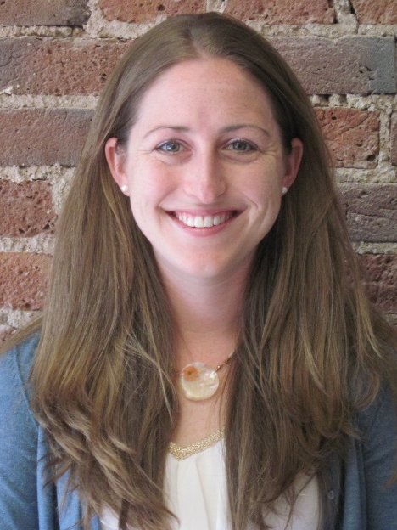
Speaker: Caitlin Hungate
Caitlin Hungate, MDP
Training and TA Provider, Family Planning National Training Center (FPNTC)
Notes:
Caitlin Hungate, MDP, is a Project Manager with ten years of domestic and international experience providing training and technical assistance with the Family Planning National Training Center. Ms. Hungate provides T/TA specific to integrating Title X with primary care providers such as community health centers, to improve financial operations and management, and to address substance use in family planning settings. Ms. Hungate led a five-month peer learning group focused on substance use services in Title X settings. We’ll first hear from Caitlin and then we’ll hear from a panel of peer learning group participants – one grantee and two subrecipients to share their experiences what they are doing or plan to do

Slide 3
Learning Objectives
Describe the importance of screening for substance use in a family planning visit.
Identify two strategies to address the substance use needs of clients.
Identify one strategy described by a peer that could be used at your agency or site to implement and/or enhance screening for substance use.
Notes:
Describe the importance of screening for substance use in a family planning visit.
Identify two strategies to address the substance use needs of clients.
Identify one strategy described by a peer that could be used at your agency or site to implement and/or enhance screening for substance use.

Slide 4
Poll
What best describes how you are screening for substance use?
Currently screening for substance use
Preparing to screen for substance use
Not screening for substance use
N/A – We do not provide services directly
Notes:
Before we begin, we wanted to see where folks were at with regards to screening for substance use. Please take a minute to answer this brief poll.
Are you
Currently screening for substance use?
Preparing to screen for substance use?
Not screening for substance use?
Or, not applicable, we do not provide services directly

Slide 5
OPA Priority
“Providing the tools necessary for the inclusion of substance abuse disorder screening into family planning services offered by Title X applicants.”
Source: Office of Population Affairs, Fiscal Year 2019 Program Priorities
Notes:
Screening for substance use is a key issue fiscal year 2019. Specifically OPA prioritized screening and applicants in 2019 fiscal year were asked to document how they would address screening. The language about screening is on the slide.
Source:
Office of Population Affairs, Fiscal Year 2019 Program Priorities (https://www.hhs.gov/opa/title-x-family-planning/about-title-x-grants/program-priorities/index.html#:~:text=The%20FY%202019%20key%20issues,merely%20the%20absence%20of%20disease.)

Slide 6
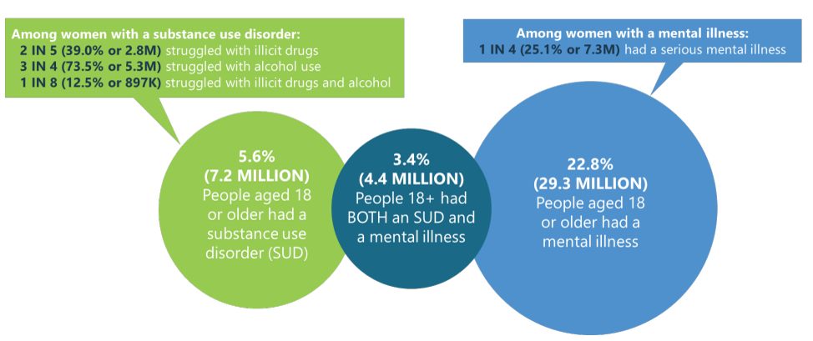
Why Screen?
In 2018, 32.1 million adult women had a mental illness and/or substance use disorder.
Source: Substance Abuse and Mental Health Services Administration, 2018 National Survey on Drug Use and Health: Women
Notes:
There is a lot of data around the rates of substance use and mental health across the US – substance use and mental health needs are increasing. We’ve seen increases in opioid use related overdose deaths (prescription and illicit)
The data on the slide is from SAMHSA or the Substance Abuse and Mental Health Services Administration from their 2018 National Survey on Drug Use and Health. This data is specific to women.
Of note, 32.1 million adult women had a mental health illness (or challenge) and/or substance use disorder.
We are also in the midst of a collective trauma and many experts are anticipating a rise of substance use and mental health needs – from the mental health risks due to social isolation and more. Here’s a recent Kaiser Family Foundation article about this from April 2020:
The Implications of COVID-19 for Mental Health and Substance Use
https://www.kff.org/coronavirus-covid-19/issue-brief/the-implications-of-covid-19-for-mental-health-and-substance-use/
Source:
Substance Abuse and Mental Health Services Administration, 2018 National Survey on Drug Use and Health: Women
https://www.samhsa.gov/data/sites/default/files/reports/rpt23250/5_Women_2020_01_14.pdf

Slide 7
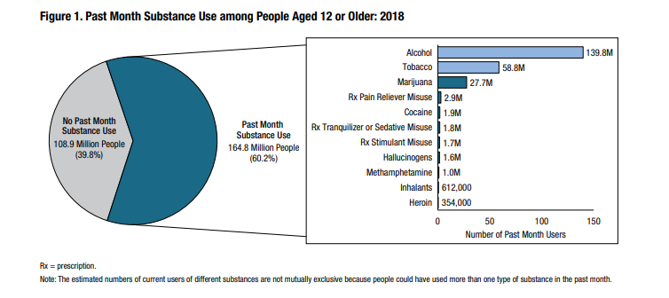
Past Month Substance Use
Source: SAMHSA, Key Substance Use and Mental Health Indicators in the United States, 2018
Notes:
Data on substance use indicates about 60% of Americans aged 12 and older used a substance in the past month.
The three most common substances individuals reported using included alcohol, tobacco, and marijuana.
Alcohol use in the past month refers to having more than a sip or two from any type of alcoholic drink (e.g. can/bottle of beer, glass of wine or wine cooler, shot of liquor, or mixed drink with liquor)
Tobacco includes cigarettes, smokeless tobacco, cigars, and pipe tobacco
Note that the total number of past month users exceeds the 164.8 million people who used substances due to polysubstance use – or using more than one substance. Responses are not mutually exclusive.
While these may have been the three most common in 2018, we know that in many communities that Title X serves, including for a couple of our presenters on this webinar, prescription opioid misuse and heroin use are significant issues.
Source:
SAMHSA, Key Substance Use and Mental Health Indicators in the United States, 2018
https://www.samhsa.gov/data/sites/default/files/cbhsq-reports/NSDUHNationalFindingsReport2018/NSDUHNationalFindingsReport2018.pdf

Slide 8
Unmet Need for Treatment
21.2 million Americans ages 12 and older needed treatment for substance use in 2018
  1 in 13 people
1 in 7 young adults aged 18 to 25 needed treatment for substance use (about 15%)
About 3.7 million people received any substance use treatment and about 2.4 million people received specialized treatment
Source: SAMHSA, Key Substance Use and Mental Health Indicators in the United States, 2018
Notes:
While data is from 2018, the need for treatment is increasing from prior years. Data from 2017 was 20.7 million Americans, in 2018 this was 21.2 million Americans.
Screening is important as there is a significant unmet need for treatment across the US.
SAMHSA estimates 21.1 million Americans 12 and older needed treatment for substance use in 2018. This is about 1 in 13 people
And for young adults aged 18-28, there is a greater need for treatment – about 1 in 7 young adults or about 15% of the population
Source:
SAMHSA, Key Substance Use and Mental Health Indicators in the United States, 2018
https://www.samhsa.gov/data/sites/default/files/cbhsq-reports/NSDUHNationalFindingsReport2018/NSDUHNationalFindingsReport2018.pdf

Slide 9
Screening in Title X family planning visits
Family planning is the usual source of care for 6 in 10 women (Guttmacher)
Unique vulnerabilities of women (NIDA)
  Substance use may progress more quickly from first use to addiction
  Substance use during pregnancy can harm pregnant woman and fetus
Source: Guttmacher Institute, The Role of Family planning Centers as the Gateways to Health Coverage and Care
National Institute of Drug Abuse, Substance Use in Women Drug Facts
Notes:
Family planning is the usual source of care for 6 in 10 women (Guttmacher)
As many of the folks on this webinar know, Title X agencies are the usual source of care for 6 in 10 women. This may be the only health care clients access.
Unique vulnerabilities of women
The National Institute on Drug Abuse and many other scholars note unique issues around substance use specific to sex and gender. These may differ (sex) based on biology or gender (differences based on cultural norms and role). A few things to note,
Substance use may progress more quickly from first use to addiction – while women often use smaller amounts of certain substances to
Substance use during pregnancy can harm pregnant woman and fetus – when a woman uses some drugs during pregnancy, the baby can go through withdrawal after birth. This is called neonatal abstinence syndrome (or NAS) and you will get to hear more about this from a grantee shortly.
I want to also mention our sister training center, the National Clinical Training Center for Family Planning hosted a three-part webinar series about substance use and family planning settings. We have linked the series at the end. The webinars go into greater detail on some of the unique sex and gender differences specific to women when it comes to substance use. I encourage you to listen to those great archived webinars.
Sources:
Guttmacher Institute, The Role of Family planning Centers as the Gateways to Health Coverage and Care
https://www.guttmacher.org/gpr/2011/06/role-family-planning-centers-gateways-health-coverage-and-care
National Institute of Drug Abuse, Substance Use in Women Drug Facts
https://www.drugabuse.gov/publications/drugfacts/substance-use-in-women

Slide 10
Recapping the Peer Learning Group
FPNTC facilitated a 5-month virtual peer learning group (October 2019-February 2020)
  Open application, 10 grantees and 11 subrecipients volunteered to participate
  Engaged with a peer expert (former Title X subrecipient in New York) who provides substance use services on-site, including medication assisted treatment (MAT)
  Engaged with regional Addiction Technology and Transfer Center (ATTC) who has worked with Region III family planning grantees
Notes:
The FPNTC facilitated a 5-month peer learning group with 10 grantees and 11 subrecipients across the country to discuss and operationalize screening for substance use in family planning visits
We engaged a former Title X subrecipient who is not only screening all clients for substance use but also went through the DEA MAT waiver process and is providing onsite MAT as needed.
We also engaged a regional Addiction Technology Transfer Center funded by SAMHSA who has worked with Title X grantees and subrecipients in Region III on integrating screening for substance use.

Slide 11
Topics Covered
Assessing need for substance use services
Screening for substance use in a family planning visit
Training staff and evaluating services
Integrating substance use services into a clinic workflow
Ensuring effective referrals and/or providing treatment
Notes:
In the peer learning group, we approached substance use services holistically and acknowledged for many grantees and their network the need for services varies, as you’ll hear from some of our panelists today. While our focus was on screening for substance use and the steps needed to take and considerations necessary, we also talked about referring to treatment and providing treatment on-site. We talked about different screening tools, training staff and how to measure or evaluate services, workflow changes, and referrals to treatment.

Slide 12
Tennessee Department of Health
Neonatal Abstinence Syndrome (NAS) Education and Expanded Access to Family Planning

Slide 13
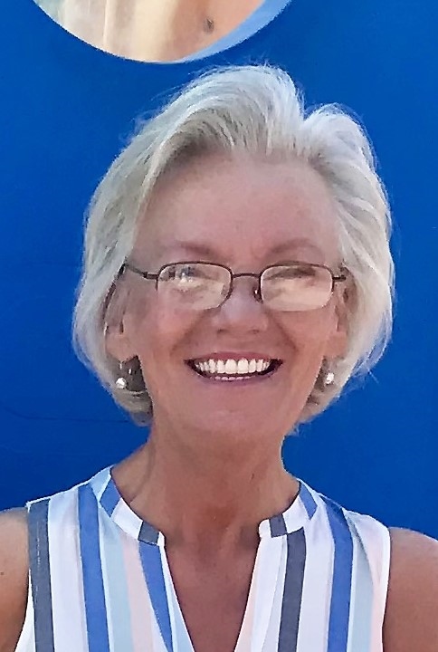
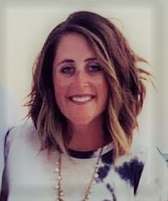

Meet Our Speakers: TN Department of Health
Danni Lambert, RN
Tennessee State Family Planning Director
Sasha Foust, RN
Family Health and Wellness Director, East Region
Notes:
Danni Lambert is a Registered Nurse and the Tennessee State Family Planning Director. The Tennessee Family Planning Program consists of 124 Title X sites and has been a grantee for over 50 years. Since she began working with the Department of Health in 2006, Danni has taken an active role in working to protect, promote and improve the health and prosperity of people in Tennessee. Danni has always been a strong family planning champion who believes in, and actively supports, Family Planning and adolescent reproductive health.
Sasha Foust is a Registered Nurse and Family Health and Wellness Director for the East Region at the Tennessee Department of Health. She has a passion for Family Planning and all programs involved in Family Health and Wellness. She enjoys working with the community to provide these many services in the Health Departments and community partners. Sasha has been with the Department of Health since 2014. When beginning as a public health nurse in 2014, Sasha knew she had a passion for empowering clients to have an active role in their own reproductive health.

Slide 14

Why Participate in the
SUD Peer Learning Group?
Eager to Learn
Best practices
Share resources
Validated screening tools
Peer networking
SUD data & prevalence tools
Neonatal Abstinence Syndrome (NAS) in Tennessee
Notes:
Danni Lambert:
In Tennessee, we chose to participate in SUD peer learning group because we were eager to learn what other states were doing to combat substance use and abuse. Like many of you, our numbers have been steadily rising, and anything we could do to help decrease that, even one death, we felt it was worth it. We hope to learn best practices as far as screening and learn about validated tools while we were screening use. It could be cumbersome and referral process really took a lot of time for providers and nurses.
What we learned the most about was all the resources that were shared by all of our peers in this learning group. What we found most valuable was just that. Our peers, people in our same roles in other states were able to share what they had learned and what worked and what didn't work. We learned how to find data and tools to help us meet our goals. We were unsure on whether or not we should participate in peer learning group, because we were afraid of the amount of time it would take away from work to participate. But just let me know go off to the side a second. If you get an opportunity to participate in one of these peer learning groups, I highly recommend it. We learned a lot, got a lot of tools, and what I found most valuable was the camaraderie and learning that we weren't out there dangling by ourselves, that the problems we were having, other people were having and you were able to make some really strong connections and networking.
One of our major problems was neonatal abstinence syndrome or NAS as I'll refer to it. That's when an infant is born dependent on a drug because mom used while she was pregnant.

Slide 15
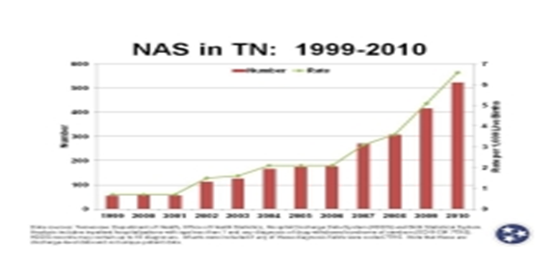
Is Neonatal Abstinence Syndrome (NAS) a problem in Tennessee?
15-fold increase in the incidence of (NAS), In the decade prior to 2013
Far exceeding the
national rise
Infants with NAS have
prolonged hospital
stays, experience serious
medical and social complications, and place a tremendous strain on health and human service systems
Notes:
The Tennessee Department of Health (TDH) developed a Primary Prevention program for local health departments to provide education about the risks of Neonatal Abstinence Syndrome (NAS) and family planning options to reduce unintended pregnancies among women who use substances. Subcontractors choosing to implement this activity have an opportunity to provide prevention education and public health services in settings outside of the health department. Subcontractors will use available public health data to identify high risk populations and develop targeted outreach plans. TDH Family Planning resources and technical assistance are available for localities interested in implementing this initiative.

Slide 16
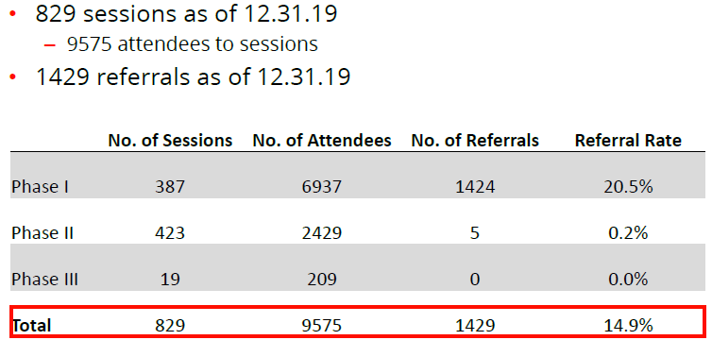
Education Sessions and Referrals
Notes:
Sasha Foust:
And as you can see on the referral rate, around 20% of the referrals came into our health department for family planning, long-acting contraceptive services. And then while we offer these services, we educate our clients on the many services we do offer, including family planning services, STI screenings, immunization, and tobacco and substance use screenings. And I might add, we don't coerce clients to receive any birth control methods, however we encourage them to think about their reproductive life plan and what that looks like in their life.
So working with the criminal justice system and the community partners, it's just opening an a door to empower and to work together in the substance use screening world, and working to decrease NAS cases together.

Slide 17
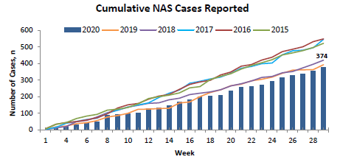
Cumulative NAS Cases
As of 7/18//2020
Notes:
How we are meeting the substance use needs of our family planning clients.
How we have taken what we learned with your NAS work and integrated screening into family planning visits.
TN Together https://www.tntogether.com/
The TN Together campaign is a statewide effort to impact the state's opioid crisis through messaging, information, and inspiration.
Media Campaign Primary messages:
Addiction is a disease, not a moral failing
Addiction is a community issue that affects everyone
Everyone can contribute to help end the crisis
Substance abuse treatment resources are available
People of all walks of life are living in long-term recovery
Television and Digital Video Ads
Count It! Lock It! Drop It!
Family Recovery Stories
Teen PSA Video Competition
Faces of Addiction
NARCAN Trainings
The Tennessee REDLINE (1-800-889-9789) is a toll-free information and referral line coordinated by TAADAS and funded by the Tennessee Department of Mental Health Substance Abuse Services. The purpose of the REDLINE is to provide accurate, up-to-date alcohol, drug, problem gambling, and other addiction information and referrals to all citizens of Tennessee at their request. The Redline provides referrals for Co-Occurring A&D disorders that arise along with Mental Health disorders.
Laws and Policies:
Prescription Guidelines – Graphic Summary
The Need for Opioid Prescription Limits
FAQ for Prescribers and Dispensers
Buprenorphine Treatment Guidelines
Pain Management Guidelines for Medical Practitioners
Naloxone
Public Chapter 1039
Public Chapter 1040
Services:
Faith-Based Initiatives
Help for Court Issues
Housing & Homeless Services
Oxford Houses

Slide 18
Family Planning Center of Ocean County, NJ
Insights from Working in Behavioral Health: Applications for Title X Agencies

Slide 19
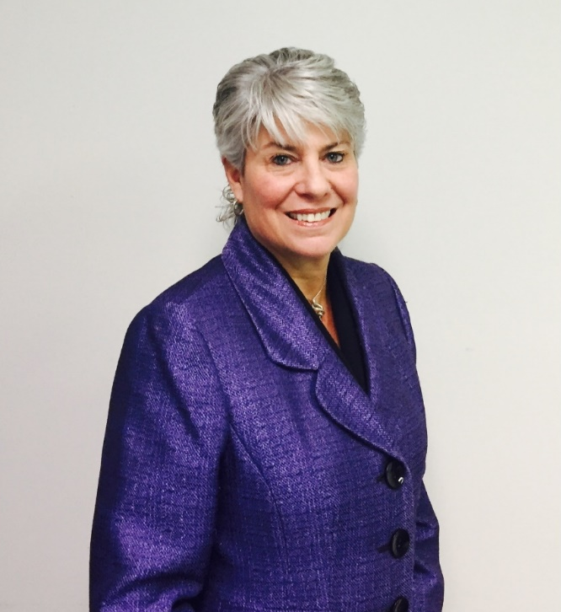

Meet Our Speaker: Family Planning Center of Ocean County
Gina Polese-Grosso, MSW, LCSW
President and Chief Executive Officer,
Family Planning Center of Ocean County
Notes:
Gina Polese-Grosso is the CEO and President of the Family Planning Center of Ocean County in New Jersey. She also is a certified school social worker, a licensed clinical social worker, and a certified clinical supervisor in social work. Gina has served and continues to serve on the Central Jersey Family Health Consortium, Ocean County Children’s Intra Agency Coordinating Council, the Children’s Systems Review, Youth Aging-out Committee, the Ocean County Youth Service Commission, Human Service Advisory Board, Homeless Prevention Advisory Committee, Private Industry Council, Prescription Misuse Committee, Ocean County DART. She is a board member of Ocean Partnership for Children, serving as the President, HR chairwoman, and a member of the executive committee.

Slide 20
Our Community Context
Ocean County is along the Jersey Shore in central New Jersey and has shore, rural, and suburb communities
2013 – 2016 substance use rates skyrocketed. Ocean County was 2nd in the state with opioid deaths
State funded substance use programs and many private programs were implemented
Notes:
Gina Polese-Grosso:
New Jersey consists of 21 counties with the urban areas well north of Ocean County closer to New York City. Ocean County is located along the Jersey Shore in the central portion of New Jersey and has been one of New Jersey's fastest-growing counties in the state. It consists of shore, rural, and suburb communities.
2013 through 2016 the substance abuse rate skyrocketed with Ocean County ranking 2nd in the state with opioid deaths. We slowly progressed to 4th in the state in 2019.
State-funded substance use programs, and a many private substance use programs were newly implemented to combat this crisis.
Screening, Brief Intervention, and Referring to Treatment(with a warm hand off when needed) is the appropriate positioning for Family Planning in our county.

Slide 21
Insights on Screening for Substance Use from PLG
Screening is at least a start
Review EHR to see if system has a built in screening tool
Begin the conversations with clients
Don’t be discouraged if a client doesn’t embrace conversation
Notes:
The most basic type of screening is at least a start.
See if your electronic record has a built in screening tool that you can turn on if it is not already in use.
Begin the conversation with your patient if there are concerns about their use of substances.
Don’t be discouraged if the patient doesn’t embrace your offer to assist or even admit to having an issue.

Slide 22
Our Takeaways
Assess your own setting/context about service delivery norms
Take time to clarify your agency goals and vision rather than assume staff are on the same page
Assess staff members’ comfort level in speaking to clients about substance use
Assess staff members’ knowledge about resources in your community
Notes:
It’s important to assess your own paradigm about service delivery norms.
Take the time to clarify your own goals and vision for the organization rather than just assuming that your staff are on the same page.
It’s important to assess where your staff members are with their comfort level in speaking to a patient about substance use.
Assess your staff member’s knowledge about resources in your area.

Slide 23
Efforts to Implement Screening
Reviewed EHR (e-Clinical Works) to see if screening is built in; built-in assessment is now turned on
Met with staff to review what is currently being done and how
Prepared a referral list of substance use providers in Ocean County
Notes:
The Family Planning Center of Ocean County uses e-Clinical Works for its electronic health record. This program has a built in assessment that has been turned on. It begins with simple questions and utilizes drop downs when indicated. Every patient is screened with this tool and it is required in order to move forward during the intake.
I met with staff and reviewed what they are doing and how they are doing it encompassing:
The screening tool
Their comfort level
How they approach their patient with their findings
How familiar they were with the resources available in our community
I prepared a list of Ocean County’s Substance Use Providers for the patients that will be handed out with other information that is routinely handed out.

Slide 24
Prior Experience & Lessons Learned for Title X
3+ decades at a behavioral health organization that started as mental health aid
Worked on mental health and substance use programs including social services, childcare centers, in-home services from crisis intervention to parenting skills
Screening is crucial for all health facilities
If moving into substance use treatment, assess the community for the need; it may be more beneficial to partner with an existing organization
Collaboration and partnerships are key
Notes:
35 years at the same behavioral health organization starting as a mental health aid, went to therapist, to program director, to Vice President of Children’s Service, and to Chief Operation Officer of Children’s Services.
Duties: designed programs with a mental health and substance use focus, proposal/grant writing, implementation and program supervision.
Supervised and coordinated the provision of the behavioral health, substance use, social services, childcare centers and in-home services ranging from parenting skill to crisis intervention.
In today’s environment of comprehensive healthcare, screening is crucial for all health facilities in caring for their patients.
From my perspective as a CEO, if considering moving into substance use treatment, assess the community for the need, and any organizations doing at least some of this work. It might be more beneficial to partner rather than competing and starting up a new program.
Collaboration and partnerships are key.
Participate in as many community boards and committees as you can.
Lend your services to other organizations as much as possible.

Slide 25
Portsmouth City Health Department, Ohio
Meeting Community Need with Comprehensive Substance Use Services

Slide 26
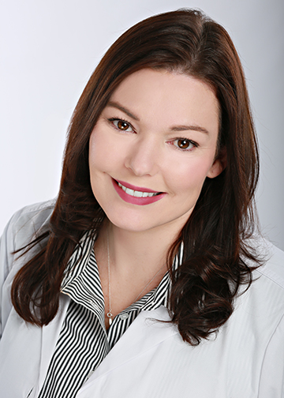
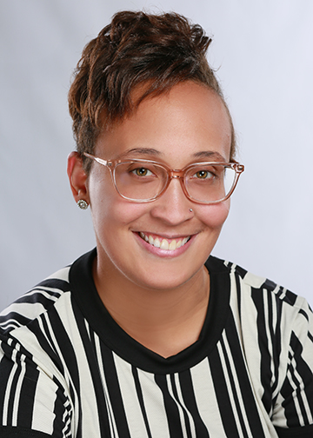

Meet our Speakers
Tiffany Wolfe, RN FNP
Family Nurse Practitioner
Elyse Waugh, MS, CDCA
Program Coordinator/Client Navigator
Notes:
Tiffany Wolfe has a Masters of Science in Nursing from the University of Cincinnati. She has been with Portsmouth City Health Department for eight years now.
Elyse Waugh has a Masters of Science in Criminal Justice from the University of Cincinnati. She obtained her Chemical Dependency Counselor Assistant license and has been with the Portsmouth City Health Department for a year.

Slide 27
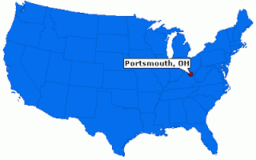
Community Context
Portsmouth City Health Department is located in rural Appalachia, near border of West Virginia and Tennessee
Community has been dealing with opioid misuse and dependence for some time
Notes:
Portsmouth City Health Department is in rural Appalachia.
Located on the Ohio River and directly borders northern Kentucky or South Shore Kentucky. Portsmouth is located in Scioto County, which is one of the 88 counties in Ohio. Our total population is around 77,000 and our median age is around 39. Approximately 71,000 are white and about 2,000 black. Poverty rates in Scioto County is 24%. Nine percent of our population is between the age 18 and 24. Twenty-eight percent of our population is age 25-44, and 22% is around age 45-64.
Community has been dealing with opioid misuse and dependence for some time
Approximately 63% of overdose deaths are between ages 25 and 44 years old. The highest growing rate of overdose and opioid abuse disorder is in females across the country and in Scioto County. The most recent statistics reported 80 deaths in the last year, which ranks Scioto County for the most overdose-related deaths in Ohio, followed by Gallia County, Pike County, which is our neighboring counties.
The most current threat from 2019 to 2020 fiscal year data suggests that Scioto County's death rate is the highest annual death rate reported by any Ohio county ever, even higher than during the heart of the carfentanyl and overdose surge in 2016 to 2017. The cause of the surge of the 2019 to 2020 is not 100% clear, but out of all the deaths recorded so far, 86% involve fentanyl or fentanyl analogs. The biggest picture of the overdose death toll and opioid abuse epidemic for 2019 shows no evidence how the drug overdose catastrophe is receding. This is the largest and fastest growing number of deaths and addiction rates of our females. Females represent the fastest growing group at risk for fatal prescription overdose across the country.
This group also leads the way in the most unintended pregnancies. A recent report by the Children's Defense Fund finds that Scioto County has the highest birth rate of drug-addicted babies in the state. The report also explains that 76 babies out of every 1000 births in the county are born with neonatal abstinence syndrome, as Tennessee went over earlier.
Another heartbreaking fact is a public servant services issue and has reported children born to mothers addicted to opioids accounted for nearly one-third of all children in custody. Those children in custody are also struggling with many health care needs, physically and mentally, which also are very costly.
A study from the CDC reports women who use opioids just prior to pregnancy or in the first trimester were twice as likely to have a baby born with a heart deficit. These children are born with major health care issues, mentally and physically, which in turn, causes them to be left behind from their peers. Frequently, these babies also turn to substance abuse due to the situation they were born into. This cycle has continued to rise since the 1980s, and I predict if substantial interventions are not done, we will continue to grow and reach other parts of the country as well, as we have seen in the past few years.
Our community has been dealing with opioid misuse, independence for many years. The inventor or founding father of the term "pill mill" was developed by a Dr. David Proctor in 1979, just five minutes south of Portsmouth, which is in South Shore, Kentucky. The term "pill mill" is typically used to describe a doctor clinic, prescribing or dispensing controlled prescription drugs inappropriately. Dr. David Proctor is also well-known for what's called the "Portsmouth cocktail," or a deadly combination of Xanax and Oxycontin. Dr. Proctor treated other physicians over the years and some of them moved to Portsmouth and other cities to open their pill mills.
Another doctor, Dr. John Willey, opened a profound pill mill in 1999, which he wrote thousands of opioid pain prescriptions in a period of three years. Dr. John Willey wasn't in practice very long due to other criminal activities, but as soon as his clinic shut down, Dr. Paul Workman relocated from Chicago to open up a pill mill in Scioto County. In 2004, Dr. Workman ordered 457,000 oxycodone pills, the most of any doctor in the nation that year, according to DEA reports. He also made patients sign a form saying that they were not undercover police officers or other informants. More than a dozen of Dr. Workman's patients died, which is why he is now serving four life sentences in the federal penitentiary.
One other key physician is Dr. Margaret Temponeras, who wrote 1.7 million opioid prescriptions between 2006 and 2012. These doctors typically made around $350 cash for each patient visit, and this is why despite the ongoing investigations and charges, pill mills continue to open in Portsmouth and surrounding areas.
Although there were more than eight major pill mills in or near Scioto County, in the Portsmouth area, today's pill mills are gone but we are still struggling with the aftermath. Now that there is no pill mill, the drug of choice is a mixture of heroin and fentanyl. The consequences have caused great damage to our community, and we continue to strive to correct the situation.

Slide 28

Services We Provide
Family planning services
Talking about family planning and substance use in a community
Comprehensive services, including screening and treatment
Notes:
We provide family planning services for anyone of reproductive age:
NEXPLANON, IUDs, and all other forms of contraceptives
Testing for infectious diseases, including STDs, Hep-type A, B, and C, HIV
PrEP provider for HIV prevention. Prep, as in, pre-exposure prophylaxis program, and provides daily medication to prevent HIV transmission in the high-risk population
Offer condoms five days a week to our community without the need of an appointment.
Many patients are also encouraged to take advantage of our primary care services, Ryan White HIV program, children with medical handicaps, child and adult immunizations, child care seat program, and Project DAWN, a naloxone overdose death prevention program.
Each of our family planning patients are screened for substance abuse and we refer them to our Recovery Gateway program for further supplemental treatment needs. Due to the sensitive context of our screening, we try very hard to approach each individual with a non-judgmental, holistic type care.
We start off by telling each of our patients that their visit is totally confidential.
Explain to the patient that we are a guest in their life, and we are not here to judge them, and we are just here to help.
Tell them we are concerned with risky lifestyles and behaviors, but we are not here to reprimand them for those actions or force our views upon them.
Help guide them to a healthier lifestyle.
Explain that we believe there is no perfect person in the world, and we all make mistakes. We further explain to them our job here is to help them heal with a treatment plan that best meets their needs. We try not to even force our treatment plans upon them.
We believe everyone should be treated with respect and dignity, regardless of their past, sexual preference, socio-economical status, or current mistakes or failures. This is how we help develop trust with our patients. Some of our patients may not completely trust us on their very first visit, but most remember our kind words and frequently return for our drug treatment programs, STD treatments, or other services that can sometimes be uncomfortable to obtain care for.
I do see a lot of family planning patients who didn't quite admit on their first visit, or even second, that they had a substance abuse problem return to our clinic for Vivitrol treatment or the use of the Recovery Gateway services.
Our Vivitrol treatment is the 28-day opioid or alcohol blocker, in which they cannot use opioids or alcohol on top of, or else it causes severe side effects and is non-addictive and habit-forming.
Scioto County is located in what is called the Bible Belt area. Religious views, which are usually associated as a wonderful community aspect, has also involved a culture that has shied away from talking about family planning and substance abuse.
Substance abuse problems have a tendency to produce crime and hate in the community, which develops stigmas. These stigmas seem to be changing over the years with multiple organizations in the community striving to change.
Many of our local churches have addressed this issue and now reach out to those with substance abuse problems and offer counseling and other programs to them.
Outreach programs have been developed in which we attend events such as the county fair, festivals, or other large gatherings. In the past, we were not encouraged or allowed to discuss family planning or substance abuse at these events. Now our community organizes parades, fundraisers, walk/runs, to help educate and fund substance abuse treatments and bringing awareness to this community, not only for that but family planning as well.
There are still some people in our community that are outraged by our intent to change the stigma and increase awareness, but we feel education and community awareness will triumph in the end.
How do you connect the dots between family planning needs and substance abuse, if at all?
We have many programs here at the Portsmouth City Health Department.
Because we try to do holistic type care, we noticed that primary care and family planning was highly utilized by our substance abuse patient population.
As time went on, and we developed a stronger trust base with our patients, we noticed family planning patients returned for substance abuse treatment. Like I've said before, a large majority of the patients are female, which is the largest growing population in the opioid use disorder and overdose death in our country.
In addition, we have an alarming and increasing number of unhealthy babies born to opioid-addicted mothers who did not plan on starting a family.
Therefore by combining these programs, we have helped women and men make sober, healthier decisions about their futures and family plans.
Furthermore, most of our substance abuse patients, male and female, have multiple mental health care needs. They usually put off treatment due to bad stigma they receive in most health care settings, which is strange to me, honestly, because health care workers should be educated enough, in my mind, to realize that substance abuse is almost always originated from mental health disease. The brain is an organ, just like the heart or kidneys.
Why do we treat a cardiac patient any different than somebody with a mental health disease or problem with their brain? Family planning is not about preventing pregnancy, treating STDs. Family planning is overall health of an individual, their family, and preventing disease and negative health care outcomes. With strong family planning, with strong families, we build strong communities.
Elyse Waugh:
Recovery Gateway is a public health navigation program here at the Portsmouth City Health Department.
It serves as an access point for high-risk individuals seeking help for addiction treatment, harm reduction, or any other medical or social services.
Regardless of where an individual may be in their personal recovery, we will guide them in the right direction that we feel is fit for their needs.
We assist with applying for medical insurance; we have all of our linkage to care for treatment services; we just started our new program, called the Early Intervention program.
It's with our prosecutor here, and basically it's a way to help individuals extinguish non-violent criminal charges.
By completing this program, the individual will have their charge forgiven from their record.
We also incorporate the Thinking For a Change, which is a cognitive behavioral curriculum developed by the Nashville Institute of Corrections, and it basically concentrates on changing the criminal thinking of the offender.

Slide 29
Lessons Learned
We are not alone with coming up with ideas to make our community better
Other Title X agencies may address issue differently or have different issues in their community
Importance of having a plan in place, and a follow-up plan
Ask about need for family planning
Focus on mental health
Notes:
Tiffany Wolfe:
We are not alone with coming up with ideas to make our community better.
We have made partnerships with almost all the drug detox programs, rehab facilities, and hospitals in our area through our County Health Coalition.
The County Health Coalition was developed by our health commissioner, Chris Smith, who developed a community partnership to promote optimal health in our communities. They meet once a month to discuss and plan for ways to meet health care needs in our community.
Other Title X agencies may address issues differently or have different issues in the community.
We are different than most, or majority, of Title X agencies, in that we have a large population of substance abuse, which is kind of growing across the country.
Unintended pregnancies, teen pregnancies, and children in foster care.
We learn to adapt to our community needs along with incorporating family planning services, despite this overwhelming health care crisis in our community.
Plans are very important, because it helps you identify goals that your team wants you to achieve.
Our team develops plans based on our current health care crisis in ways that we thought would best intervene and make an impact.
Our views and needs were out of the ordinary, and therefore a lot of our plans changed along the way, where we learned by trial and error.
We were sort of like an experimental site for the entire state at the time when we started these programs. We found that the plans may change, but if we focus on our goals and move forward despite our struggles, eventually our goals will be reached along the way. And we just grow and learn.
We learned while treating substance abuse patients there was a huge need for family planning.
Most of our patients with substance abuse have very dysfunctional families and relationships.
Also a majority of our patients had children who were in foster care and who would benefit from future family planning service to prevent some of this from occurring. In addition, patients with substance abuse disorder have very risky lifestyles with multiple partners, sexual partners, and also exchange sex for drugs or money to support the addiction.
Most patients made these bad choices while intoxicated or suffering the effects of substance abuse withdrawal syndrome, which distorts their decision making dramatically. We took note of these issues and started offering family planning services to these patients while they were sober and able to make better decisions for themselves and their family's future.
I highly encourage Title X agencies to include mental health screenings for their patients with substance abuse.
The majority of the patients who have this disorder, as pointed out previously, have self-treated their mental health disorder.
These patients who turn to substance abuse are trying to cope with emotional or mental pain or trauma. And when mental health issues are found, it's best to have a plan in place to assist or refer these patients to mental health care treatment facilities, out-patient, in-patient, whatever.
You just need to develop that rapport with the agencies around you. Reach out, email, call, text, whatever you've got to do.
Also you need to be prepared for those who may come into your clinic that are suicidal, and what actions are you going to take then? Do you have a suicide prevention in mind? Do they go to their local ER? You've got to have a plan in place or a policy in your clinic.
We usually train our peers with on-site training.
We allow them to observe and review our policies and procedures to get them started. We're also available to them by phone, email, text, when they encounter any problems that arise.
We're happy to guide them and help them in any way we can. And all of our staff is usually trained from billing to the front desk, so we kind of match each person in either the peer clinic or someone in ours, so that everybody's trained from, like I said, billing to front desk to whatever it may be.
Our major training success is focused on lowering stigma, and reminding them that addiction treatment is uncomfortable for those patients but the reward from helping someone recover from addiction is beyond comprehension.
It not only helps the individual, but the community in the long run, so you have to keep that in mind.
We also teach them to treat every single person like they're your child, mother, father, sister, because they are someone's same close family member, and we have to embrace that and treat them as such. Every life is worth saving.

Slide 30
Resources
Substance Use & Family Planning Webinar Part 1, Part 2, and Part 3
Coding with Ann: Coding for SBIRT, episode 11
Leveraging the Opioid Response Network in a Title X Setting Webinar
Addiction Technology Transfer Center Network
Providers Clinical Support System
Notes:
Caitlin Hungate:
Thank you to all of our presenters. On the slide we have several resources that are now available to support Title X grantees and their network with integrating screening for substance use. The first is an archived webinar series from the National Clinical Training Center for Family Planning
Second, is a Coding with Ann episode specific to SBIRT.
Another resource from the National Clinical Training Center for Family Planning is a virtual coffee break (shorter webinar) discusses the Opioid Response Network, which provides training and technical assistance for addressing substance use disorder in all types of settings, including in family planning settings.
The Addiction Technology Transfer Center network, is comprised of a national and regional TA centers. We partnered with the Region III to implement the peer learning group. We recommend looking into the ATTC in your region for events, tools, and resources.
Additionally, the Providers Clinical Support System is a resource to inform and educate medical professionals and funded by SAMHSA in response to the opioid overdose epidemic to train primary care providers in evidence-based treatment and prevent of opioid use disorders. There are a lot of great on-demand resources!
Resources:
Substance Use & Family Planning Webinar Part 1 (https://www.fpntc.org/resources/substance-use-family-planning-webinar-part-1), Part 2 (https://www.fpntc.org/resources/substance-use-family-planning-webinar-part-2), and Part 3 (https://www.fpntc.org/resources/substance-use-family-planning-webinar-part-3)
Coding with Ann: Coding for SBIRT, episode 11 (https://www.fpntc.org/resources/coding-ann-coding-sbirt-episode-11)
Leveraging the Opioid Response Network in a Title X Setting Webinar (https://www.fpntc.org/resources/leveraging-opioid-response-network-title-x-setting-webinar)
Addiction Technology Transfer Center Network (https://attcnetwork.org/)
Providers Clinical Support System (https://pcssnow.org/)

Slide 31
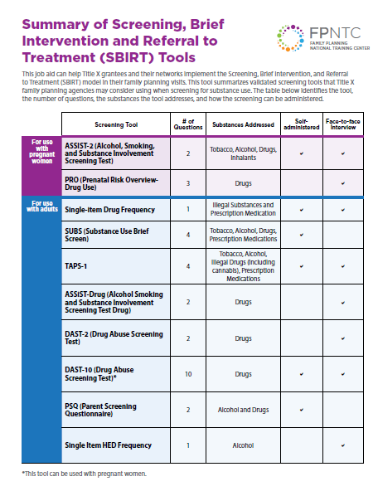
Coming Soon
Coming Soon:
SBIRT Screen Tool Job Aid
SBIRT Implementation in a Family Planning Setting
Notes:
The FPNTC will soon be posting (or share it has been) a job aid adapted from the Danya Institute Inc., which runs the Region III ATTC. This job aid outlines different validated screening tools for SBIRT.
Another resource that is coming soon and should be available during the National Clinical Training Center for Family Planning’s virtual National Reproductive Health Conference August 11-12 is an SBIRT Implementation toolkit developed by the Danya Institute.

Slide 32
Questions?

Slide 33
Thank you!
Email fpntc@jsi.org
Subscribe at www.fpntc.org/enewsletter
This presentation was supported by Award No. FPTPA006028-04-00 from the Office of Population Affairs (OPA). Its contents are solely the responsibility of the authors and do not necessarily represent the official views of OPA or HHS.
Notes:
FPNTC Email fpntc@jsi.org
Subscribe to the FPNTC eNewsletter at www.fpntc.org/enewsletter

