Slide 1


Exploring What Works in Youth HIV Prevention & Treatment
June 20, 2018
2–3 pm ET

Slide 2
Webinar Objectives
By the end of this presentation, participants will be able to:
Describe the current state of youth HIV/AIDS among youth in the U.S.
Explain modern HIV prevention and treatment strategies.
Recognize opportunities for family planning providers to enhance linkages between HIV testing and treatment.
Notes:
By the end of the webinar, you will be able to:
Describe the current state of youth HIV/AIDS among youth in the U.S.
Explain modern HIV prevention and treatment strategies
Recognize opportunities for family planning providers to enhance linkages between HIV testing and treatment.
There have been major advances in HIV prevention including the role that treatment plays in prevention.

Slide 3
WWYH Goal
Improve the health and well-being of America’s adolescents by providing practical and innovative website content that empowers youth-serving providers to meet the needs of youth at highest risk for HIV/AIDS.
Notes:
What Works in Youth HIV is a project funded the Office of Adolescent Health with funding from the HHS Secretary’s Minority AIDS Initiative Fund.
Its goal is to ensure that all people who work with youth have the information they need to educate young people about HIV.
This includes people who work in organizations with a primary focus on HIV as well as health teachers, social workers, and after school program staff.

Slide 4
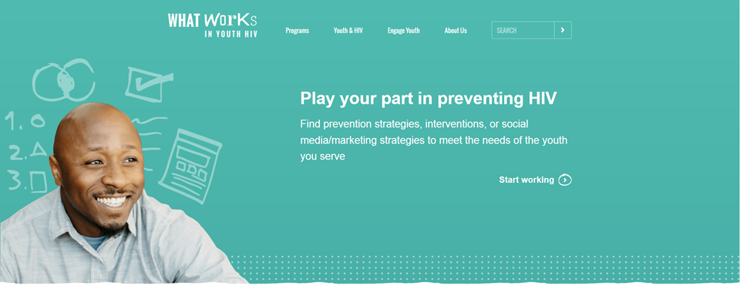
whatworksinyouthhiv.org
Notes:
Specifically, the project:
Supports and promotes interventions and strategies to better integrate HIV prevention focused on youth,
Promotes evidence-based programs and practices, and
Connects youth-serving providers across the U.S. with training and technical assistance opportunities, including social media and educational campaigns.
To learn more about us, please visit whatworksinyouthhiv.org. Recently, the project has published audio and video stories from people in the field. Check out the latest podcast on using SnapChat for health education in a family planning setting.

Slide 5

Young people under 26 years of age, born after June 5, 1981, have never known a world without HIV.
June 5, 1981
Centers for Disease Control & Prevention
cdc.gov/hiv/group/age/youth
Notes:
On June 5, 1981 CDC reported the first cases of what we now know as AIDS.
Many people remember the news reports of this disease that was sweeping many communities in the nation.
But anyone born after this day has never known a world with HIV and they may be the first to see it end.
November 2017 Kaiser Family Foundation survey showed that only 18% of young people 18-30 know someone who is living with HIV or has died from AIDS.
Therefore they have less of a personal connection to the disease.
That same survey showed that stigma and misperceptions exist in this group as well.

Slide 6
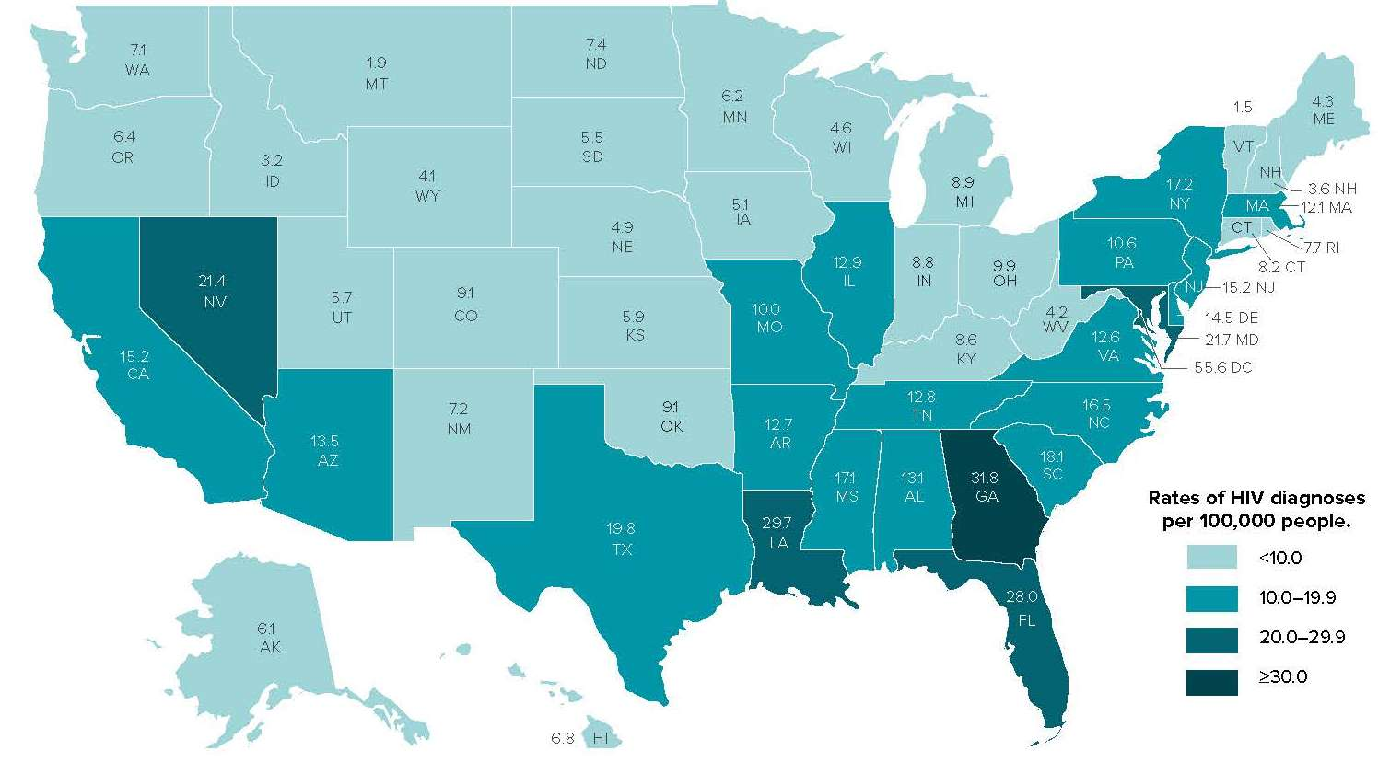
Rates of HIV Diagnoses in 2016, by State
Centers for Disease Control & Prevention
cdc.gov/hiv/pdf/statistics/cdc-hiv-geographic-distribution.pdf
Notes:
This map shows the rate of HIV diagnosis by state. As has been the case for most of the epidemic, CDC reports that most HIV cases occur in metropolitan areas.
Most of the new diagnoses occur in the Northeast, and more recently in South.
The rise of HIV in the South is important because the HIV prevention and care infrastructure and referral relationships are not as well established as they are in places that were a part of the early epidemic.

Slide 7
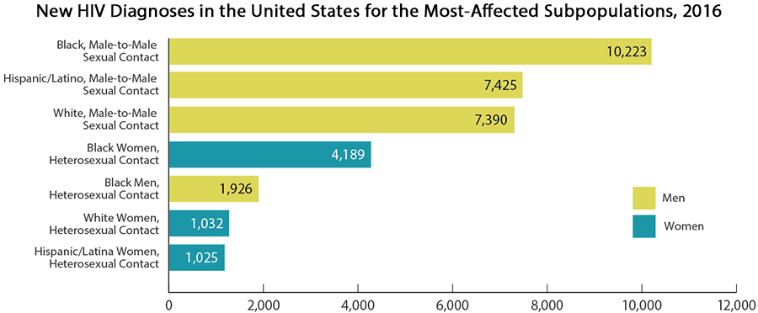
New HIV Diagnoses in the U.S. for Subpopulations, 2016
Centers for Disease Control & Prevention
cdc.gov/hiv/pdf/statistics/cdc-hiv-geographic-distribution.pdf
Notes:
In the U.S. there are also differences in new HIV diagnosis rates by gender, race, and sexual contact.
Black, gay, and bisexual men have the highest rate, followed by Hispanic/Latino and White gay and bisexual men.
While HIV diagnosis rates among women are going down, HIV testing for women and connection to care still needs to be addressed so that this downward trend continues.

Slide 8



1 in 5 HIV infections in the U.S. occur in individuals between
the ages of 13–24.
About 4 in 5 were aged 20-24.
Centers for Disease Control & Prevention, 2018
cdc.gov/hiv/pdf/group/age/youth/cdc-hiv-youth.pdf
Notes:
21% of new HIV diagnoses are among youth, but youth only account for 16% of the U.S. population. This means that young people are disproportionally impacted by HIV.
About 4 in 5 HIV infections are among young people 20-24 years old, and half of youth ages 18-24 living with HIV in the U.S. do not know they are infected. Therefore it’s important to provide education and resources as early as possible.

Slide 9
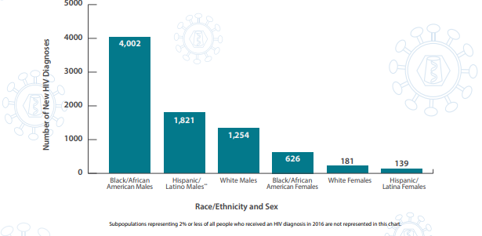
New HIV Diagnoses Among Youth in the U.S., by Race/Ethnicity and Sex, 2016
Centers for Disease Control & Prevention
cdc.gov/hiv/pdf/group/age/youth/cdc-hiv-youth.pdf
Notes:
Black, Hispanic/Latino, and white young males have the highest rate, followed by black white, and Hispanic/Latina young females.

Slide 10

Why Focus on Youth?
“Youth”: the period between childhood and adult age
Physical, cognitive, emotional and social changes occur that impact their health
Youth 13-24 years old experience disproportionate impact of HIV
Notes:
HIV disproportionately impacts young people ages 13-24.
People working with youth 13-24 years old, including family planning providers, play important roles in supporting healthy development and encouraging behaviors to prevent HIV – such as choosing not to be sexually active, consistent and correct condom use if sexually active, and regular HIV testing.
Adolescence is a critical time in a person's life.
Young people experience physical, cognitive, emotional, and social changes during the period and develop lifelong behaviors that impact their health.
During this time, youth explore and further develop their identities as individuals, within communities and the greater society, and related to their sexuality.

Slide 11

Youth Seeking Family Planning Services
1,750,472 or 43% of all Title X clients are ages 24 years or younger (FPAR, 2016)
Notes:
Why should this matter to the family planning community? According to the 2016 Title X Family Planning Annual Report, youth make up just under half of all Title X clients.
Family planning providers can play an important role in helping young people know their HIV status and contribute to ending the U.S. HIV epidemic.
Some young people may not receive education about HIV in their schools and colleges.
You can also provide basic HIV prevention education, referrals to testing, and connections to care education along with all of the valuable information and services you provide.

Slide 12
National HIV/AIDS Strategy (NHAS)
Goals:
Reduce new infections
Increase access to care & optimize health outcomes for people living with HIV (PLWH)
Reduce HIV-related health disparities & inequities
Achieve more coordinated national response to the HIV epidemic
HIV.gov
hiv.gov/federal-response/national-hiv-aids-strategy/overview
Notes:
The U.S. National HIV/AIDS Strategy was released in 2010 and guides the national response to the HIV epidemic.
While the strategies were updated in 2015 to reflect how our prevention toolkit has expanded, the four goals remain the same.
Reduce new infections
Increase access to care & optimize health outcomes for people living with HIV (PLWH)
Reduce HIV-related health disparities & inequities
Achieve more coordinated national response to the HIV epidemic

Slide 13
Youth as Priority Population in NHAS
Support engagement in care
Provide age-, developmentally- and culturally- appropriate programs and education
Provide comprehensive information about mental and emotional well-being
Address intersecting issues, such as intimate partner violence
Promote youth leadership, including youth living with HIV
HIV.gov
hiv.gov/federal-response/national-hiv-aids-strategy/overview
Notes:
Youth are a priority population in the National HIV/AIDS Strategy and specific strategies are recommended to address their unique needs.
Support engagement in care
Many adolescents do not see a doctor regularly or may have other barriers to care such transportation or cost.
They also may not have disclosed their HIV status to their families which makes it more difficult to remain in care.
Provide age-, developmentally- and culturally- appropriate programs and education.
Young people are different from adults and need services tailored them.
Provide comprehensive information about mental and emotional well-being
HIV continues to be a heavily stigmatized disease.
Youth may be hesitant to get tested or to stay to find out their results because they are afraid of how they might treated or that they may not get the support they need.
Youth living with HIV also need support after their diagnosis to process their emotions.
Address intersecting issues, such as intimate partner violence
Youth that are homeless, runaway, in foster care, or being exposed to violence don’t have prevention as the top of their list.
Addressing their other critical needs helps them be able to make better decisions about their health.
Promote youth leadership, including youth living with HIV
The HIV community has had a long history of peer services.
The positive youth development literature has shown that when youth are involved in the design, implementation, and evaluation of programs they take more ownership.

Slide 14
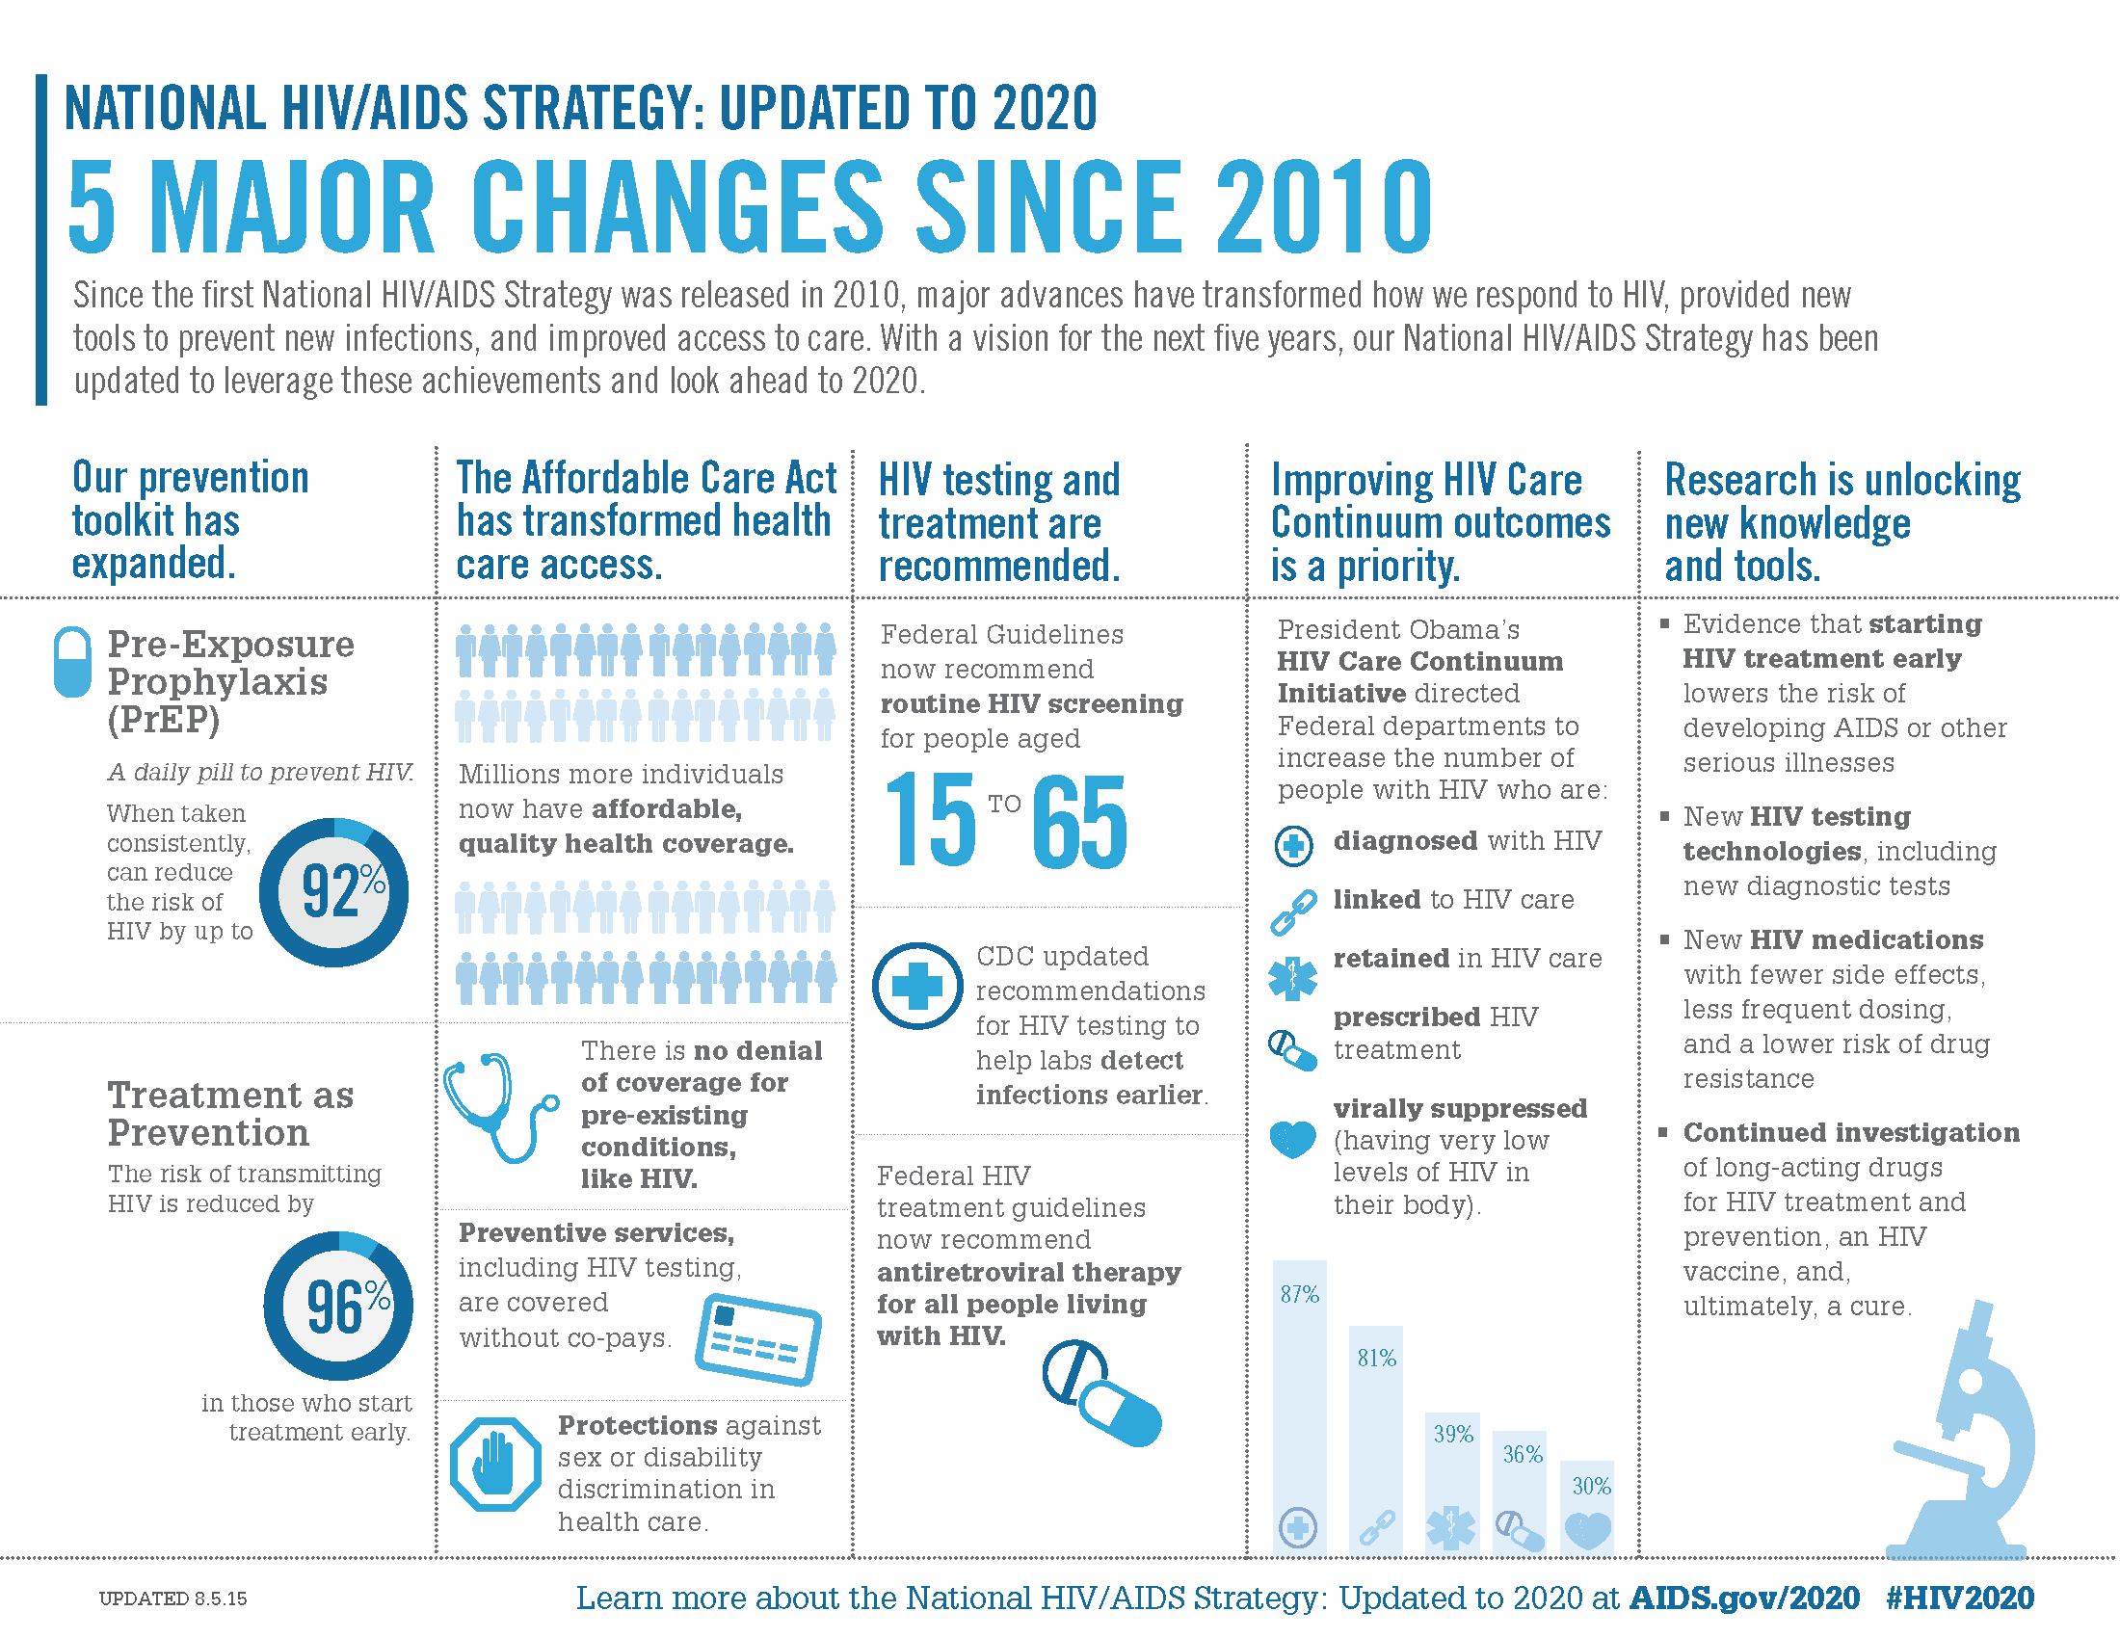
HIV Care Continuum
HIV.gov
files.hiv.gov/s3fs-public/nhas-update-5-things.pdf
Notes:
The Federal HIV Care Continuum Initiative directed Federal departments to fund and implement strategies to increase the number of people with HIV who are:
Diagnosed with HIV
Linked to HIV care
Retained in HIV care
Prescribed HIV treatment
Virally suppressed
The goal is to have as many people as possible meeting all of these stages.
While the majority of people living with HIV (87%) know their status there is still work to do related to linking people to HIV care, retaining them in care, prescribing HIV treatment, and maintaining viral suppression.

Slide 15
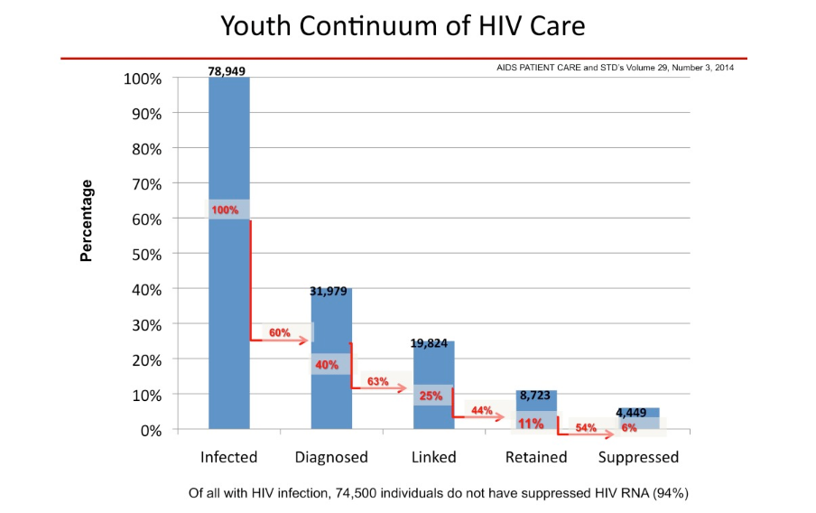
Youth HIV Care Continuum
AIDS PATIENT CARE and STD’s Volume 29, Number 3, 2014
Notes:
When it comes to youth progress through the continuum of HIV care, there is even more work to be done.
In 2014, a study in AIDS Patient Care and STD’s mapped how youth were faring along the HIV continuum.
Of the nearly 80,000 youth believed to be living with HIV only 40% had been diagnosed HIV.
Many have not been successfully linked to or retained in care, which makes viral suppression difficult to achieve.

Slide 16
HIV Care Continuum
What Can Family Planning Providers Do?
Offer routine HIV testing
Connect to HIV care providers
Connect to other local services/programs to help them meet their basic needs
Connect to HIV care and treatment
Support clients to continue ART, counsel clients interested in seeking pregnancy
HIV.gov
files.hiv.gov/s3fs-public/nhas-update-5-things.pdf
Notes:
What can family planning providers do?
Diagnosed with HIV
CDC recommends that all adolescents be tested for HIV infection at least once, and that persons at increased risk for HIV infection be tested at least annually.
Family planning providers play an important role in offering routine HIV testing as part of their ongoing services provided to patients.
Linked to Care
Not everyone who gets tested is getting into care. That’s particularly a problem for youth who face barriers to care due to limited access to youth-friendly services, lack of insurance coverage, and/or concerns about confidentiality (for example, belief that their HIV status may be disclosed on billing statements).
Family planning providers can connect youth who test HIV positive to HIV health care providers who offer treatment and prevention counseling to help them stay as healthy as possible and prevent passing HIV on to others as well.
Engaged or Retained in Care
Because there is no cure for HIV at this time, treatment is a lifelong process. To stay healthy, youth living with HIV need to receive regular HIV medical care.
Even for those who test HIV negative, family planning providers can play a role in connecting them to care to keep them healthy and HIV-negative.
For example, mental health services, and programs to help them meet their basic needs (e.g. employment, housing, food, etc.).
Prescribed Antiretroviral Therapy (ART)
ART are drugs used to prevent a retrovirus, such as HIV, from making more copies of itself recommended treatment for HIV infection.
Recommendations for starting ARTs have changed. It used to be the case that ARTs were prescribed when a patient’s viral level met a certain threshold. Now it is recommended that everyone start ARTs as soon as possible after a positive HIV test.
Family planning providers play an important role in connecting youth who test positive to local services for care and treatment.
Achieved Viral Suppression
When people living with HIV take their ARTs as prescribed, it reduces the amount of HIV in their body (viral load), keeps their immune system stronger, reduces their risk of transmitting HIV to others, and prevents drug resistance. Viral suppression is defined as having less than 200 copies of HIV per milliliter of blood.
The goal of viral suppression is to achieve and maintain a viral load that gets HIV to an undetectable level (so low that a test can’t detect it).
Family planning providers can support clients living with HIV to continue to take their ARTs and provide information about mother-to-child transmission for clients interested in seeking pregnancy.

Slide 17
Importance of Viral Suppression for HIV Prevention
People living with HIV who take HIV medicine as prescribed and get and keep an undetectable viral load have effectively no risk of transmitting HIV to their HIV-negative sexual partners.
ARTs need to be used in combination with other tools available to us, including condoms and contraception.
Notes:
Viral suppression benefits the person living with HIV and their sex partner(s).
Three different studies of the prevention effectiveness of viral suppression to reduce the risk for sexual HIV transmission have shown similar results.
Across thousands of couples with different HIV statuses and many thousand acts of sex without a condom or PrEP, no HIV transmissions were observed when the HIV-positive partner was virally suppressed as the result of antiretroviral treatment.
Getting and staying virally suppressed is not only the best thing people living with HIV can do to maintain their health, but also one of the best ways to prevent new infections through sex.
Family planning providers need to continue to encourage other methods of pregnancy and STI prevention (e.g., condoms, contraception) for women with HIV-positive partners who are virally suppressed.

Slide 18
Pre-Exposure Prophylaxis (PrEP) for HIV Prevention
A biomedical prevention method for people who are not HIV-positive but are at high risk of getting HIV.
Requires taking an ART every day to prevent HIV infection.
When taken as directed, PrEP has been shown to reduce the risk of HIV infection in people who are at high risk by more than 90%.
PrEP need to be used in combination with other tools available to us, including condoms and contraception.
Notes:
There are varied prevention methods to help young adults remain HIV-negative. Most of these methods involve changing behavior to prevent HIV (for example using condoms or choosing not to have sex).
Pre-Exposure Prophylaxis, referred to as PrEP, is a biomedical prevention method for people who are not HIV-positive but are at high risk of getting HIV.
It requires taking a pill (Truvada) every day to prevent HIV infection. Combined with other behavioral strategies, PrEP offers an effective way to prevent young adults from contracting HIV and becoming HIV-positive.
Effectiveness decreases when PrEP is taken inconsistently. The higher the concentration of PrEP medication in a person’s system, the more effective it is at preventing HIV. PrEP does not protect against other sexually transmitted infections (STIs) or pregnancy, making other prevention methods necessary to address other sexual health needs.
In 2012, the Food and Drug Administration (FDA) approved Truvada for use as PrEP for HIV prevention in people over 18. And just recently the FDA approved Truvada for use as PrEP for HIV prevention in people 15-18 years old.

Slide 19
Family Planning Providers & HIV Prevention
Educate and raise awareness of risks of HIV with youth.
Provide condoms and condom education.
Provide routine HIV testing and referrals to HIV treatment and PrEP for youth at high risk.
Encourage HIV positive youth to maintain viral suppression to remain healthy and prevent HIV transmission to sex partner(s).
Notes:
Family planning providers play an important role in:
Educating and raising awareness of risks of HIV with youth.
Providing condoms and condom education.
Providing routine HIV testing and referrals to HIV treatment and PrEP for youth at high risk.
Encouraging HIV positive youth to maintain viral suppression to remain healthy and prevent HIV transmission to sex partner(s).

Slide 20
FPNTC Resources
Sexually Transmitted Disease Services Training Package on fpntc.org
Delivering HIV Rapid Test Results: Experiences from the Field
Family Planning Provider PrEP Toolkit
Guidance for Delivering HIV Pre-Test and Post-Test Results: Integrating HIV Screening Into Title X Services
New Advances in HIV Diagnostic Testing: Training for Health Professionals
Virtual Coffee Break Webinar: PrEP Series, Part 1: HIV Testing Basics
Virtual Coffee Break Webinar: PrEP Series, Part 2: HIV Prevention in Women
Notes:
To access HIV testing and PrEP resources for family planning providers, visit fpntc.org

Slide 21
Thank You!
whatworksinyouthhiv.org
Email: whatworksinyouthiv@jsi.com
Notes:
To learn more about us and access resources and recorded webinars, please visit whatworksinyouthhiv.org.

