Slide 1
Promoting Youth-Friendly Environments in Title X Family Planning Clinics
March 12, 2020
Notes:
Welcome to today's webinar: “Promoting Youth-Friendly Environments in Title X Family Planning Clinics.”

Slide 2

Meet our speaker!
Azzia Roberts, MPH, CHES
Program Specialist
Adolescent Health Initiative
Notes:
Azzia Roberts, MPH, CHES, is a program specialist at the Adolescent Health Initiative, based at the University of Michigan School of Medicine.
Azzia is a certified health education specialist, with a background in health education and promotion.
She has served as a health advocate for disadvantaged youth, and has worked as a health and wellness program coordinator.

Slide 3

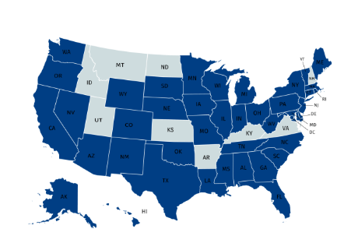
Adolescent Health Initiative (AHI)
AHI provides training, technical assistance, and coaching to health care providers, health systems, and organizations across the country to improve adolescent-centered care.
Our vision is to transform the health care landscape to optimize adolescent and young adult health and well-being.
Notes:
Adolescent Health Initiative is based out of the University of Michigan, in Ann Arbor, Michigan.
We provide training, technical assistance and coaching to health care providers, health systems and organizations across the country, to help them improve their adolescent-centered care, and our vision is to transform the health care landscape to optimize adolescent and young adult health and wellbeing.
This map highlights all of the different states that we've partnered with or worked with in some capacity.

Slide 4
Learning Objectives
By the end of this webinar, you will be able to:
Identify youth-friendly behaviors
Identify the characteristics of youth-friendly organizations
Describe opportunities for improving youth-friendly environments at your health center
Identify other supportive resources
Notes:
By the end of this webinar, you will be able to:
Identify youth-friendly behaviors,
Identify some of the characteristics of youth-friendly organizations,
Describe opportunities for improving youth-friendly environments are your health center, and
Identify some other supportive resources to get you going with implementing some of the strategies.

Slide 5
Teen Years Activity
I felt like my teen years were _______. | Here’s what was important to me when I was a teenager: | Here’s how I feel about working with teens:
The best thing about being a teen is: | The hardest thing about being a teen is: | If I could re-live my teen years again, I would do this differently:
The best thing about working with teens is: | The hardest thing about working with teens is: | What makes working with teens unique from working with young children and adults?
Notes:
To help us think back to our own experiences as youth, we’re going to do a quick activity.
The purpose of this activity was to help us think back to our own experiences as young people, and to remind ourselves that it might take special effort for us to meet their needs as we provide patient-centered care, from the front desk to exam room to check out.
Please take a look at the table and glance over some of the prompts. What I’m going to ask you all to do is take a look at the prompt in the first orange circle and complete the sentence.
The first prompt is, "Here's what was important to me when I was a teenager.“ Please chat over your response and I’ll take a second to read a few aloud.
We’re going to do this for 2 more prompts:
The second prompt is, "The hardest thing about being a teen is."
The third prompt is, "The best thing about working with teens is."

Slide 6

Teens Speak (1/3)
DRAWING A PICTURE: ADOLESCENT-CENTERED MEDICAL HOMES
https://youtu.be/vAu5ad827I8
Notes:
Let’s hear from teens directly in this three-minute video about how they want to be involved in their health care.
The teens in the video are from the Adolescent Health Initiative’s Teen Advisory Council.
As you watch, keep these questions in mind:
What might happen when youth don’t feel comfortable accessing services? What might happen when they do feel comfortable?
Link to video “Drawing A Picture: Adolescent-Centered Medical Homes”
https://youtu.be/vAu5ad827I8

Slide 7
Teens Speak (2/3)
What might happen when teens DON’T feel comfortable with their health care experience?
May not come back to that clinic
Will tell all of their friends about their experience
May not receive the care they need
Notes:
Now, after watching the video, we are going to get into a chat discussion on the question that I asked you all to think about:
What might happen when teens don't feel comfortable with their health care experience?
Summary of responses:
They won't come back and they don't refer their friends.
They're not as honest if they don't feel comfortable.
They won't return for refills, or results, or follow-up appointments.
They won't trust you.
They won't come in.
Even if they do come in, they're going to shut down based on previous experiences.
They'll give up on trying to reach out to any health care professional.
These are all really good things to keep in mind.
I want to go over a couple of the common things that we saw, and common responses that we see for these:
They may not come back to that clinic.
If they have one bad experience, it's very likely that they will not come back. And then not only will they not come back, they're going to tell all their friends about their experience, and then their friends won't come; so we want to keep that in mind. And then they may not receive the care that they need, and it's really important that young people are receiving the health care services that they need.

Slide 8
Teens Speak (3/3)
What might happen when teens DO feel comfortable with their health care experience?
Will feel more comfortable to open up about health care concerns
Will come back often to receive the care they need
Helps them develop good lifelong health care practices
Notes:
It's important that we make them feel comfortable. Let's get into the next question:
What might happen when teens do feel comfortable with their health care experience?
Summary of responses:
They will tell their friends.
They'll be in the health center all the time and they'll be glad to come back.
They'll be honest with you.
They'll want to bring others.
Doors open.
They'll be your best advocate.
They'll be satisfied with their service.
You start to build more trust with them.
Open dialogue.
They become informed health care consumers.
They'll feel safe and comfortable, and in turn that will help them feel more open and honest.
They will feel more comfortable to open up about health care concerns.
Will come back often to receive the care they need. Excellent.
Overall, it helps them develop good, lifelong health care practices.
We definitely want to keep all these things in mind in making sure that our young people are feeling comfortable when they come to our offices, so we're going to talk about ways to do that throughout the rest of our webinar.

Slide 9
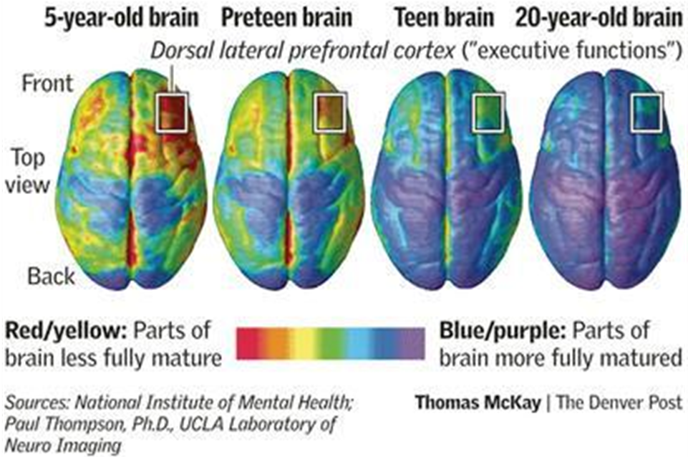
The Developing Teen Brain
Notes:
While teens are in this transitional stage of life, we know from research that teen brains are at a critical point of development.
The part of the brain that controls executive functioning – which includes judgment and cause and effect – is not fully developed until the mid-20s.
When teens make decisions that seem questionable, it’s helpful to remember that this can be developmentally appropriate, even if it’s frustrating for us to see.
You can see in the image that's on the slide the development of the brain from left to right, from ages five all the way up to age 20.
The box that's highlighted in that upper right side of each of those brain images highlights the pre-frontal cortex that controls our executive functioning, decision making, and cause and effect.
You can see that the red and the yellow colors, or the underdeveloped parts, become a little bit more developed as we age.
It's important to just keep in mind that during the teen years, young people are still kind of developing some of these things that are going to cause, that are going to control some of their cause and effect, and then also the decisions that they make.

Slide 10


Risk-Taking
Notes:
A great example of how teen brain development is unique to this age has to do with risk-taking. People of all ages take risks, but it’s at its peak during adolescence, and can be both good and bad.
There are emotional risks, social risks, and physical risks that all help adolescents to build their identity.

Slide 11

Risk Behaviors
3 out of 4 deaths, diseases, and injuries among teens are caused by risk behaviors
Alcohol and other
drugs
Distracted driving
Suicide
No seatbelt/
helmet use
Sexually transmitted
infections/HIV
Notes:
But, some risks can be unsafe.
The CDC reports that 3 out of 4 adolescent deaths, diseases, and disabilities are a direct result of risky behaviors. This is disproportionately high compared to other age groups. This also means that there are opportunities for prevention, and we could change the outcome for a teen through good screening and counseling.
So, if their behaviors are developmentally appropriate, as challenging as they may be, what can we, as adults, do to help them along the way and we, as health care professionals, do to be truly patient-centered?

Slide 12
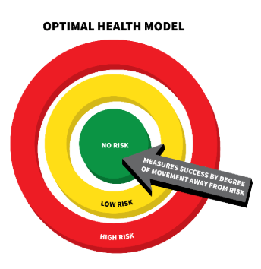
Optimal Health Model
Identify the health concern
Identify the risk factors that influence that health concern
Respond with an intervention that promotes the best possible health outcome for the population
Encourage individuals to make appropriate changes that will lead them towards a position of increasingly lower risk
https://www.hhs.gov/opa/reproductive-health/optimal-health/index.html
Notes:
The optimal health model prioritizes prevention through policies following these steps:
Avoiding risk is optimal or preferred to reducing risk, and primary prevention can lead to health outcomes that are generally improved when behavioral risks are avoided.
Public health advocates should encourage the development of the skills necessary to make healthy choices and avoid risky behaviors, or if currently engaged in those behaviors, to change the behaviors and avoid them in the future.
Optimal Health Model
https://www.hhs.gov/opa/reproductive-health/optimal-health/index.html

Slide 13
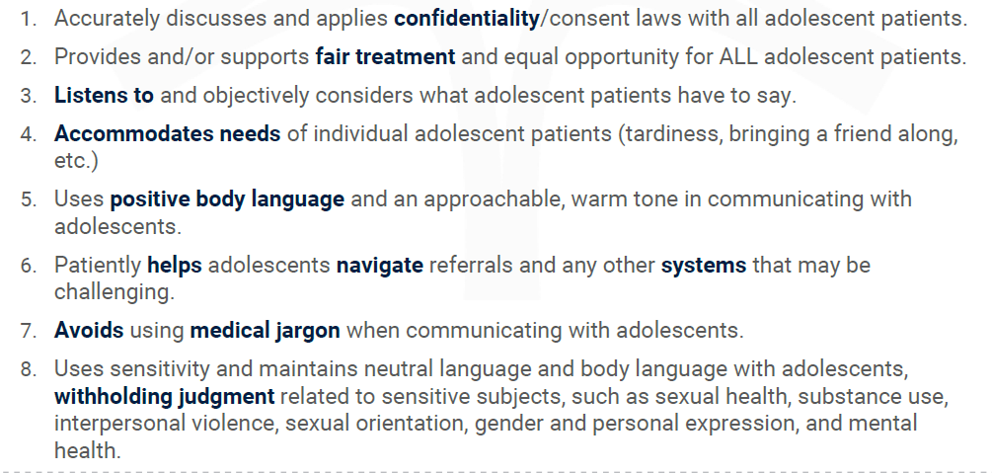
Youth-Friendly Behaviors (1/5)
Notes:
One of our main goals with becoming more youth-friendly is to look at how your team interacts with young people and help them feel welcome in your clinic . There are a lot of ways that health centers can be welcoming to young people, and we have 8 of these behaviors listed here:
Discuss and apply confidentiality and minor consent laws with adolescent patients.
Provide and support fair treatment and equal opportunity for all patients.
Listen to and objectively consider what young patients have to say.
Accommodate the needs of individual patients, so this might look like accepting or working with tardiness, allowing them to bring a friend along, things like that.
Use positive body language and appropriate, approachable, warm tones when communicating.
Help adolescents navigate referrals and any other systems that may be challenging to them.
Avoid using medical jargon when communicating with adolescents, and then withhold judgment when having conversations related to sensitive subjects like sexual health, substance use, interpersonal violence, sexual orientation, mental health, and gender or personal expression.
Next-we’re going to review just a couple scenarios, and I ask that you all chat over the number of the youth-friendly behavior that scenario relates to. There is no right answer, and for some there could be multiple answers.
We will bring this list back to the screen after each scenario.

Slide 14

Youth-Friendly Behaviors (2/5)
Notes:
The following story is from Ray at age 23:
“When I explained to the staff that I didn’t have insurance, she was like, ‘Oh, there’s this program, and there’s this resource, you can get help here, or you can go this route,’ and it was just like wow, no one ever told me that. Otherwise, I felt doomed, and she kind of gave me hope. I’ve gone to other really nice places, and same thing, they were just positive about it, like ‘That’s no big deal, we can work with that, and there’s options.’ Whenever I was given options and I didn’t feel hopeless, it was a good experience.”

Slide 15
Youth-Friendly Behaviors (3/5)
Notes:
Which youth-friendly behavior is this an example of?
[Answer: #6. Patiently helps youth navigate referrals and any other systems that may be challenging.]

Slide 16
Youth-Friendly Behaviors (4/5)
“You have to explain that nothing bad is going to happen if I’m honest…”
– Ciara, 15
Notes:
“You have to explain that nothing bad is going to happen if I’m honest.”- Ciara, age 15

Slide 17
Youth-Friendly Behaviors (5/5)
Notes:
Which youth-friendly behavior does this relate to?
[Answer: #1. Discusses with youth what information they share will be kept private.]
Brief review, but all of these behaviors listed are things to keep in mind if your goal is to help make young people feel more welcome and comfortable in your clinic.

Slide 18
Strategies for Providing Youth-Friendly Services (1/5)
Make your services accessible to youth
Flexible hours
Drop-in, same-day or next-day visits
$$$
Location
On-site or mobile services
Consider patient population
Notes:
So far, we’ve talked a lot about ways to exhibit youth-friendly behaviors, but now I want to pivot to talk more about how physical spaces and services offered at health centers can be welcoming to young people.
Defined: The World Health Organization describes youth-friendly services as those that are equitable, accessible, acceptable, appropriate, and effective.
The first strategy is making sure your services are accessible to young people. Offer your services at times when youth are available. This may include after-school, evening, and/or weekend hours. Survey your youth patients or consult with a youth advisory council on their preferences.
Provide youth access to services on short notice by offering drop-in, same-day, or next-day visits.
Establish policies and procedures to ensure young people can access services for free or at low cost (e.g., a sliding fee scale), especially for services that teens may want to keep confidential.
Provide services in a location that young people can easily get to. If your location is not ideal, try offering transportation assistance (e.g., bus tokens, cab fare, shuttle service). You can also install bike racks near your facility.
Bring your services to young people. This can include partnering with youth-serving organizations (e.g., schools, community centers) to offer your services onsite.
Provide services and materials in the languages spoken most in your community.
Lots of these strategies require money, many times leadership approval, and effort to implement.
Consider having a meeting with leadership to explain the importance of making services more accessible to youth to get the conversation going and see what things are actually feasible to put into action.
We recognize that some of these things (like location, hours, etc.) are impossible to change- but try to think about which strategies are do-able.

Slide 19
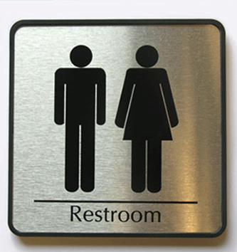

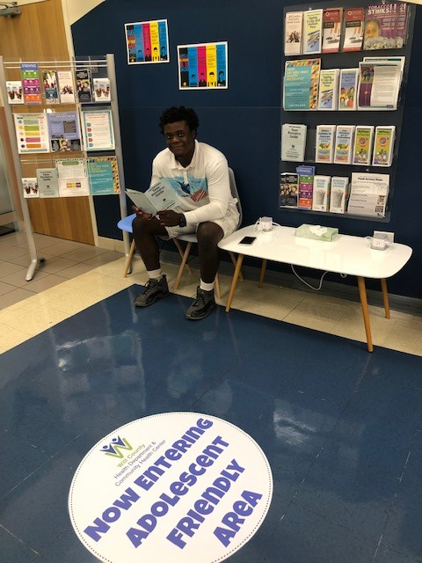
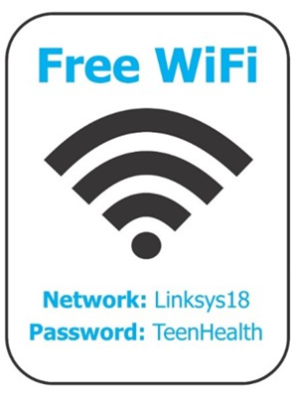
Strategies for Providing Youth-Friendly Services (2/5)
Create an environment that is welcoming to young people
Notes:
Maintain a clean and welcoming environment. Some ways to make your space more youth-friendly include having magazines for teens, cell phone charging stations, and artwork by local teens.
Provide visual and auditory privacy if you offer services that might be sensitive (e.g., counseling). Room dividers and white noise machines are quick fixes for an environment with limited privacy.
Develop and post a non-discrimination policy so youth of all identities know they are welcome.
Review intake forms, handouts, posters, and other materials to ensure they are inclusive (e.g., images reflect the diversity of your community, language is LGBTQ+ inclusive) and easy to understand.
Train staff to provide friendly, respectful, and non-judgmental services to youth.
Many of these strategies are easy to implement at little to no cost
Link to video: “Ways to make your space more youth-friendly”
https://www.youtube.com/watch?v=vAu5ad827I8
posters
http://www.umhs-adolescenthealth.org/wp-content/uploads/2017/01/tactac_poster-final-nologo_2.pdf
LGBTQ+ inclusive
https://www.lgbthealtheducation.org/wp-content/uploads/Collecting-Sexual-Orientation-and-Gender-Identity-Data-in-EHRs-2016.pdf
easy to understand
https://www.cdc.gov/healthliteracy/pdf/simply_put.pdf
Train staff to provide friendly, respectful, and non-judgmental services to youth
http://www.umhs-adolescenthealth.org/improving-care/spark-trainings/
Adolescent Health Initiative's Youth-Friendly Services Starter Guide
https://www.umhs-adolescenthealth.org/wp-content/uploads/2018/12/lgbtq-youth-friendly-services-starter-guide.pdf

Slide 20

Strategies for Providing Youth-Friendly Services (3/5)
Provide & promote confidential services
Notes:
Family Planning clinics offer services that are legally protected for adolescents (e.g., pregnancy testing)- so consider doing the following to promote these services:
Develop and post a confidentiality policy that is aligned with state laws.
Provide clear information to adolescents, parents, and staff about which services young people can access confidentially. Strategies to share information about your confidential services may include:
Provide handouts to adolescent clients and their parents describing the protections and limitations of confidentiality and minor consent.
Train all staff on the protections, rights, and limitations of confidential services.
Train all service providers to discuss these protections, rights, and limitations in all of their interactions with adolescent clients.
Develop procedures to preserve the confidentiality of youth (e.g., billing, documentation).
If parents or guardians are present, meet with young people one-on-one for a portion of every visit.
What does Confidential mean to adolescents?
Bottom line: What can I do here or what services can I get that my parents/caregiver won’t find out about?
This is important because it can and more than likely will determine how honest a young person is about their health behaviors
Confidentiality policy and handouts
http://www.umhs-adolescenthealth.org/improving-care/confidentiality/
Spark trainings
http://www.umhs-adolescenthealth.org/improving-care/spark-trainings/

Slide 21

Strategies for Providing Youth-Friendly Services (4/5)
Implement a youth-friendly marketing and communications plan
Utilize outreach workers and teens to promote your services
Referring organizations
Print materials
Website and social media presence
Notes:
Increase awareness of your services and how to access them by marketing your services to young people, parents, and other adults who work with youth. Engaging youth in the development of a marketing plan can help to ensure its relevancy. Marketing strategies may include the following:
Utilize outreach workers and teens to promote your services at youth-serving organizations and events.
Communicate regularly with referring organizations (e.g., schools, health centers, youth-serving organizations) and/or trusted adults who work with youth (e.g., school counselors and coaches) to ensure they are aware of your services and know how to refer youth to them.
Develop print materials to distribute throughout your community, especially to referring organizations.
Maintain an up-to-date website and social media presence.
The best way to market to youth is to connect with young people and find out the best ways to get information to them. The aforementioned strategies are all good places to start, but if you do not have the capacity to develop a full marketing plan, simply ask young people for their thoughts and opinions on how to make your materials/marketing more youth-friendly.
Example: I worked with a health center that was having trouble getting young people to utilize their MyChart/ Patient Portal system. They typically handed out a standard sheet of paper that had directions on how to register (not specific to youth). I suggested that they reach out to young people to ask them the best way to get them to use it. Young people responded saying that they don’t read any of the check out materials because they’re too long and aren’t appealing. So the health center created a small, quarter page handout that had youth- approved language and graphics that explained how to register for the patient portal. After a few months they saw an increase in the number of adolescent patient portal registrants.

Slide 22

Strategies for Providing Youth-Friendly Services (5/5)
Solicit youth feedback on your services
Find or develop a youth-friendly patient satisfaction survey
Adolescent Focus Groups
Youth Advisory Council
Notes:
Engage young people in providing feedback on your services. Youth engagement strategies may include:
Collect and review adolescent client/patient satisfaction surveys at least annually.
Invite a group of adolescent clients to participate in a focus group to learn about their experiences accessing your services and their ideas about how services can be improved.
Invite a local youth council to tour your organization and provide feedback (if you are unfamiliar with how to find a local youth council, reach out to local schools and youth programs to find out more information- no registry exists that I know of.)
Collecting Patient Satisfaction Survey Starter Guide
https://www.umhs-adolescenthealth.org/wp-content/uploads/2017/12/collecting-patient-satisfaction-surveys-from-adolescents-starter-guide.pdf

Slide 23
Case Study #1
Priority Areas
Extended hours
Comprehensive risk screening tool
Yearly training on non-judgmental approaches
Process
Reviewed available risk screening tools
Approval from leadership
Identify & implement trainings
Challenges
Staff turnover
EHR compatibility for risk screening tool
Outcomes
Now offer extended hours
Risk screening tool has been implemented
Completed trainings
Notes:
The first case study is of a Family Planning Clinic I worked with previously in Alaska.
Things they wanted to work on:
Extended hours
Comprehensive risk screening tool
Yearly training
Process:
Reviewed available risk screening tools
Approval from leadership
Identify & implement trainings
Challenges:
Staff turnover
EHR compatibility for risk screening tool
Outcomes:
Now offer extended hours
Risk screening tool has been implemented
Completed trainings

Slide 24
Case Study #2
Priority Areas
Visual cues
Extended hours
Cultural Humility Training
Process
Youth focus group
Mock adolescent visits
Approval from administration
Challenges
Administrative issues
Outcomes
Were able to extend office hours
Improved overall youth friendliness of climate
Notes:
The second case study is of Family Planning Clinic colleague worked with in Texas.
Priority Areas:
Visual cues
Extended hours
Cultural humility training
Created teen friendly training schedule
Process:
Youth focus group with peer educators
Mock visit
Approval from administration
Challenges: Administrative issues
Outcomes:
By the end of our work with these sites they were successful extending office hours & in improving the overall youth-friendly climate of their health center (physical space and staff attitudes).

Slide 25
Check In
Which strategies would you consider implementing at your health center?
Notes:
We’ve talked about several strategies that clinics can implement in their heath centers; visual cues, promoting confidential services more, collecting youth feedback, etc.
Are there any strategies you’re thinking about implementing in your health center?
Have participants chat over responses & read a few aloud

Slide 26
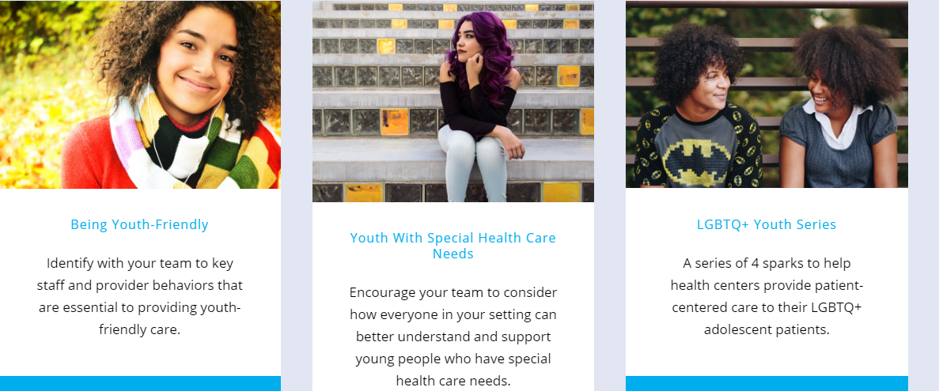

Additional Resources (1/2)
Spark
Trainings
Starter
Guides
Notes:
Here are some additional resources to help implement some of the aforementioned strategies- most of these resources are available fee for download on AHI’s website!
Spark Trainings
Pre-packaged mini-trainings that include a slide deck, script and any accompanying handouts. Also includes a cover page to help the facilitator prep for the training.
Several different topics related to providing adolescent centered care
Nice thing is that they are designed to be completed with multidisciplinary health center teams in about 15-20 mins.
Starter Guides
Toolkits developed to help health centers implement youth-friendly services
Range of topics; youth-friendly services, universal chlamydia screening, collecting adolescent patient satisfaction surveys
Adolescent Health Initiative website
https://www.umhs-adolescenthealth.org/

Slide 27

Additional Resources (2/2)
Youth-Friendly Posters
https://www.umhs-adolescenthealth.org/improving-care/health-center-materials/
Notes:
Created by AHI YAC
Free for download on AHI website
AdolescentHealth.org Improving Care/Health Center Materials
https://www.umhs-adolescenthealth.org/improving-care/health-center-materials/

Slide 28

Adolescent-Centered Environments
Notes:
Finally- I want to mention an opportunity for health centers to participate in an 18-month quality improvement project through AHI.
In an effort to help health centers identify barriers and promote their strengths to providing adolescent-centered care, we created the Adolescent-Centered Environment Assessment Process, also known as the ACE-AP.
Any health center that sees adolescent patients; (we’ve worked with Family planning, SBHC, Family Medicine) participate in an 18-month QI process to improve policies, practices, procedures, and environments of their health center and we provide them with a work plan and resources to make those improvements.
Includes:
Comprehensive data collection and reports
Regular check-in calls
3 Spark trainings
On-going coaching and TA
There is a cost associated with this project- please reach out if you have any questions or are interested in learning more.

Slide 29

Connect With Us!
Adolescent_Hlth
adolescent_health
Adolescent Health Initiative
adolescenthealth@umich.edu
Notes:
Find us on:
Twitter at Adolescent_Hlth
Instagram at adolescent_health
Facebook at Adolescent Health Initiative
Email at adolescenthealth@umich.edu

Slide 30
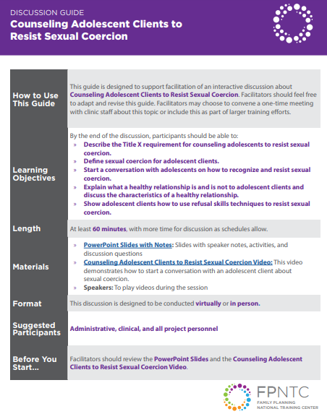
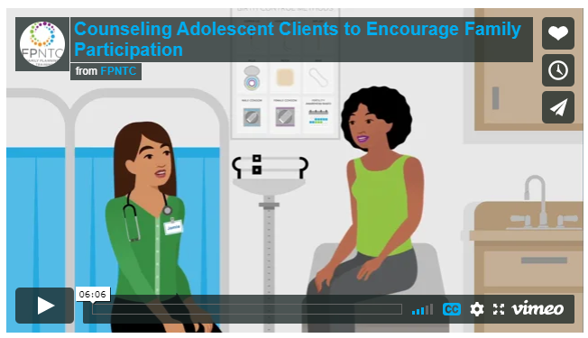
FPNTC Resources
Counseling Adolescent Clients to Encourage Family Participation Video & Training Guide
Counseling Adolescent Clients to Resist Sexual Coercion Video & Training Guide
Adolescent Brain Development Podcast (NCTCFP)

Slide 31
Thank you!
Questions or suggestions?
Email fpntc@jsi.org
Subscribe at www.fpntc.org/enewsletter
This presentation was supported by Award No. FPTPA006028-04-00 from the Office of Population Affairs (OPA). Its contents are solely the responsibility of the authors and do not necessarily represent the official views of OPA or HHS.
Notes:
FPNTC email address: fpntc@jsi.org
To subscribe to the FPNTC eNewsletter
http://www.fpntc.org/enewsletter

