Slide 1
Using the RHNTC Training Tracking System for Title X and TPP Programs
June 8, 2021
Notes:
Using the RHNTC Training Tracking System for Title X and TPP Programs
This presentation is supported by the Office of Population Affairs (OPA). Its contents are solely the responsibility of the authors and do not necessarily represent the official views of OPA, or HHS.

Slide 2


Welcome
Elizabeth Costello
JSI
Clancey Bateman
JSI
Notes:
Elizabeth Costello is the RHNTC Knowledge Management team lead.
Clancey Bateman leads the RHNTC Communications team.

Slide 3
Objectives
Distinguish between a Training Participant and
Training Administrator account on rhntc.org
Explain how the RHNTC Training Tracking System supports Title X and TPP grantees in achieving their program goals
Describe how to create and share a Training List and track training participation
Demonstrate how to request a Training Administrator account on rhntc.org
Notes:
Here’s an overview of what you should expect to be able to do after this presentation and live demo:
Distinguish between a Training Participant and Training Administrator account on rhntc.org
Explain how the RHNTC Training Tracking System supports Title X and TPP grantees in achieving their program goals
Describe how to create and share a Training List and track training participation
Demonstrate how to request a Training Administrator account on rhntc.org

Slide 4
Poll 1
What is your OPA grantee affiliation?
Title X Family Planning Program
Teen Pregnancy Prevention Program
Other (please share in the chat)
Notes:
Before we get started, let’s do two quick polls to find out more about who’s joining us today.
First, please let us know if you are affiliated with either the Title X Family Planning Program, the Teen Pregnancy Prevention program, or neither?
(read poll question and responses, then comment on results)

Slide 5
Poll 2
How would you describe your role related to training and/or professional development?
I am responsible for staff training or professional development at my agency
I have a different role at my agency but am interested in learning more about the Training Tracking System
I use the RHNTC website to track my own training
Other (please share in the chat)
Notes:
If you’re not responsible for staff training or PD, you’re welcome here
The focus of the presentation today will be for these folks but hopefully everyone will take something away from today’s info.
(read poll question and responses, then comment on results)

Slide 6
One system, two functions
The RHNTC Training Tracking System supports two user types:
Training Participants register for and track their own training completion on rhntc.org.
Training Administrators create and assign training lists (that can include both RHNTC and non-RHNTC trainings) and track training participation.
Notes:
The RHNTC Training Tracking System has two primary user roles: Training Participants and Training Administrators.
The Training Participant role is the default role you are assigned when you create an account on rhntc.org, which allows you to register for training and track your completion.
The Training Administrator role is a special role that you can request which allows you to create and assign lists of training resources, both from RHNTC and other sources, assign them with staff or others in your network, and track their completion.
We’ll go over each of these roles in more detail now.

Slide 7
Who is a Training Participant?
Anyone who creates an account (registers) on rhntc.org
Training Participants (registered users) can:
Save trainings and resources from rhntc.org for easy access
See trainings they have registered for and completed
Accept and complete RHNTC training lists
Download certificates of completion and CE credits
Download their personalized Training Report
Add non-RHNTC trainings to their Training Report
Notes:
A training participant is anyone who creates an account - or registers - on rhntc.org. If you’ve not already done so, we encourage you to create an account today! Anyone with an account can:
Save trainings and resources from rhntc.org for easy access
See trainings they have registered for and completed
Accept and complete RHNTC training lists
Download certificates of completion and CE credits
Download their personalized Training Report
Add non-RHNTC trainings to their Training Report

Slide 8
Who is a Training Administrator?
Anyone responsible for administering or tracking training and professional development plans at their organization
Training Admins can:
Create and share customized Training Lists with their network
Track Training Participants’ completion of assigned RHNTC and non-RHNTC trainings
Download completion reports
Notes:
I said earlier, a Training Administrator is a title that we’ve created for the RHNTC website that differentiates this special role from a regular user. But from a program perspective, a training administrator may refer to anyone who is responsible for administering or tracking training and professional development plans at their organization, even if Training Administrator is likely not your title.
Anyone can request a Training Administrator role on RHNTC, regardless of your role at your agency.
As an RHNTC Training Admin, you can do everything that a regular website user (or training participant) can do. But you also get access to some special features that we’ll share during our live demo soon. You can:
Create and share customized Training Lists with their network
Track Training Participants’ completion of assigned RHNTC and non-RHNTC trainings
Download completion reports

Slide 9

36,127
376
465
Training Participant Accounts
Training Administrator Accounts
Training Lists
As of May 31, 2021
Notes:
To give you a sense of how the system has been used to date:
Since the Training Tracking System initially launched in 2017, we have had over 36,000 users create training participants account on the website.
Since we introduced the Training Administrator role in 2018, we have had 376 users request Training Administrator accounts and those users have created 465 training lists.

Slide 10
How Title X-funded programs are using it
To develop training plans for their networks and track completion of assigned trainings
To ensure that subrecipients and service sites comply with Title X Program training requirements
Notes:
Since the system launched in 2018, we’ve seen that Title X-funded programs, including grantees and subrecipients, are using the training tracking system to develop training plans for their networks and track completion of assigned trainings and to ensure that subrecipients and service sites comply with Title X Program training requirements.

Slide 11
How TPP-funded programs can use it
To create, implement, and/or track completion of professional development or other training plans for their organization or implementation partners
To capture trainings and resources offered from different sources in a single, shareable list
Notes:
And as we’ve begun talking to TPP grantees through the RHNTC, we’ve discussed how TPP-funded programs could also benefit from the TTS.
You may wish to use it to:
Create, implement, and/or track completion of professional development or other training plans for their organization or implementation partners
Capture trainings and resources offered from different sources in a single, shareable list

Slide 12


How the Training Tracking System works
The Training Admin creates and shares a customized Training List with their staff, network, etc.
The Admin can then view completion status and download reports for all users who accept the list.
A Training Participant accepts the Training List (“opts-in”) and begins to complete trainings from rhntc.org or other sources.
The Participant can also download their own training report and certificate(s) of completion.
Notes:
Before we dive into the live demo, here are the quick high-level steps for the system:
The Training Admin creates and shares a customized Training List with their staff, network, etc.
Next, a Training Participant accepts the Training List (“opts-in”) and begins to complete trainings from rhntc.org or other sources.
The Admin can then view completion status and download reports for all users who accept the list.
Finally, the Participant can also download their own training report and certificate(s) of completion.

Slide 13
See the Training Tracking System in action

Slide 14
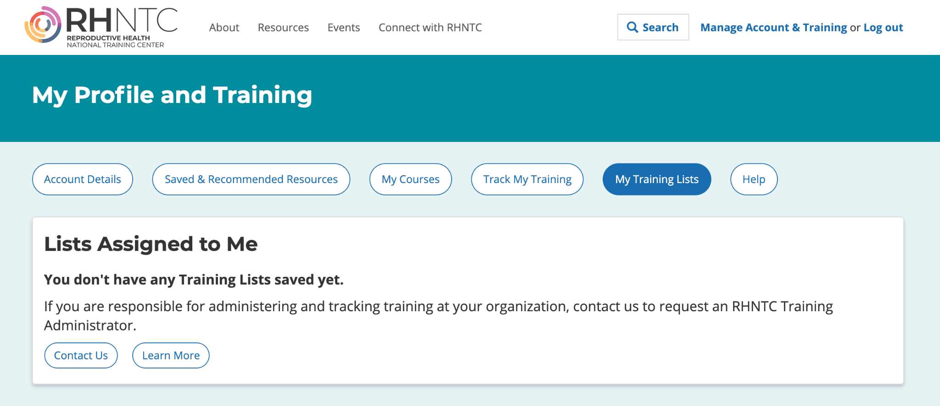
Logging in as an admin
Notes:
Let’s start by familiarizing ourselves with the Training Account interface, which you access from the upper-right hand corner.
Before you even log in, you can see the different training account tabs. Clancey will review the tabs for individual users in a bit, but at the far right is a new “My Training Lists” tab.
If you are a Training Admin, this is where you will go to create and track training lists.
If you are a training participant, this is where you will go to see the lists you’ve accepted and complete training.
For Training Admins, this is also where you go to request an account by clicking on the Contact Us button. We’ll discuss that more at the end of the demo.
Please note that if you try to log into the site now, you will not see these features because you don’t yet have a training administrator account. I just want to avoid any confusion if you’re trying to follow along with me!
I’m going to log in now with my Training Admin account.

Slide 15
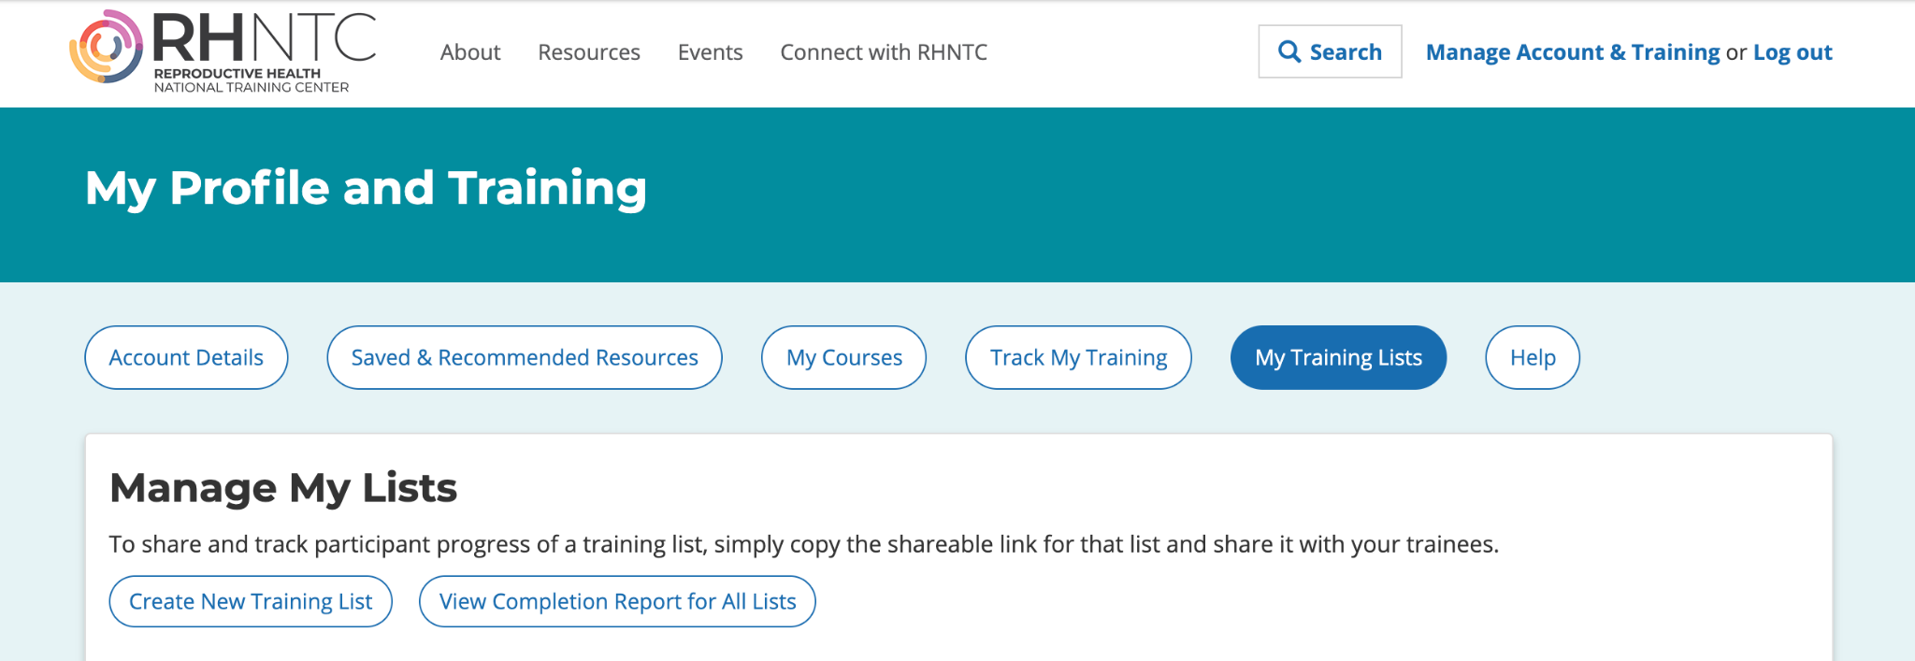
Creating a new training list
Notes:
Now that I’m logged in, you’ll see that I now have access to a few tabs:
Account Details, where you can change your password if need be
Saved and Recommended Resources, where you can quickly access any resources you’ve saved while browsing the site, and see a list of resources on our site that we recommend to help you meet Title X program requirements and QFP recommendations.
And there is the “My Training Lists” tab, which we’ll look at now.
When I first come to this page, I will not see any lists saved. Let’s think about what types of lists you might create and why.
You might create a list for all new staff for your agency, i.e. onboarding to Title X.
You might want create lists for different staff roles at your agency, such as a list for front desk staff, clinical staff, and staff who do billing and coding -- you might ask staff to complete these lists annually
You could create thematic lists by topic area, such as training to support implementation of the QFP recommendations.
[QUESTION] What other types of training lists might be useful for your agency? Please feel free to share that with us in the chat box as we go through the demo.
Now let’s walk through how to create one. First, we hit the ‘Create New Training List” button.

Slide 16
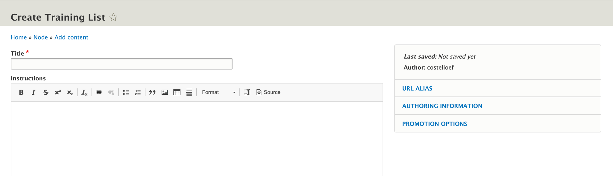
Adding a title and description
Notes:
Then, you will be prompted to name your list and provide instructions for the list.
I’m going to name this one, “New Title X Staff Training.”
The list name and instructions will appear to users BEFORE they accept your training list, so consider including information about why they are receiving the list and what to expect after accepting the list. You can go back and edit these fields later.
Now it’s time to add some trainings.

Slide 17
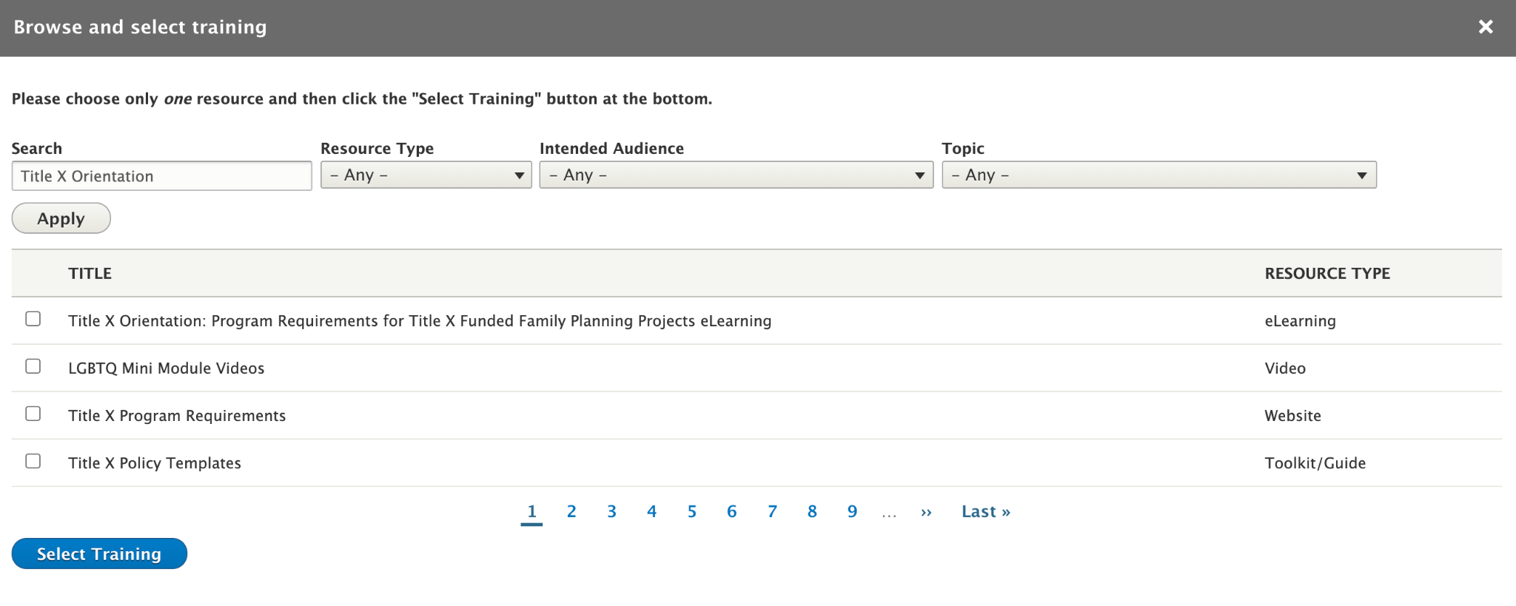
Adding trainings to your list
Notes:
The “Add Training” button opens a new window to browse and select training.
If you know a specific resource name or search term, you can search for it here. For example, if I want to add the “Title X Orientation” eLearning course first, I can simply enter that term and click “Apply.” Then I click the check box next to the resource title, and scroll down to click “Select Training.”
Now this resource has been added to my list!
There are two optional settings for resources. You can mark it required, and set a due date. I’ll go ahead and set this one required.
Now I’m going to add another resource so we can see the other browsing options.
You can browse by Resource Type, such as eLearning, Video, or Training Guide. You can browse by intended audience, and you can browse by topics. The topics in list corresponds to the topics of our different Training Packages.
So I know I want to include a resource on Human Trafficking, which I see is a topic here. I’m going to select the Archived Webinar and add it to my list
I’d also like to include the training guide on Encouraging Family Participation so I’ll add that.
Now I’ve got three resources on my new staff training lists. You’ll see I’ve got a mix of resource types, including an eLearning, and archived webinar, and a training guide. You can add any resource from the RHNTC website to a training list.
You can also add a non-RHNTC resource here if you like. We know this feature may be especially useful for TPP grantees.
But first let’s Save this list.

Slide 18
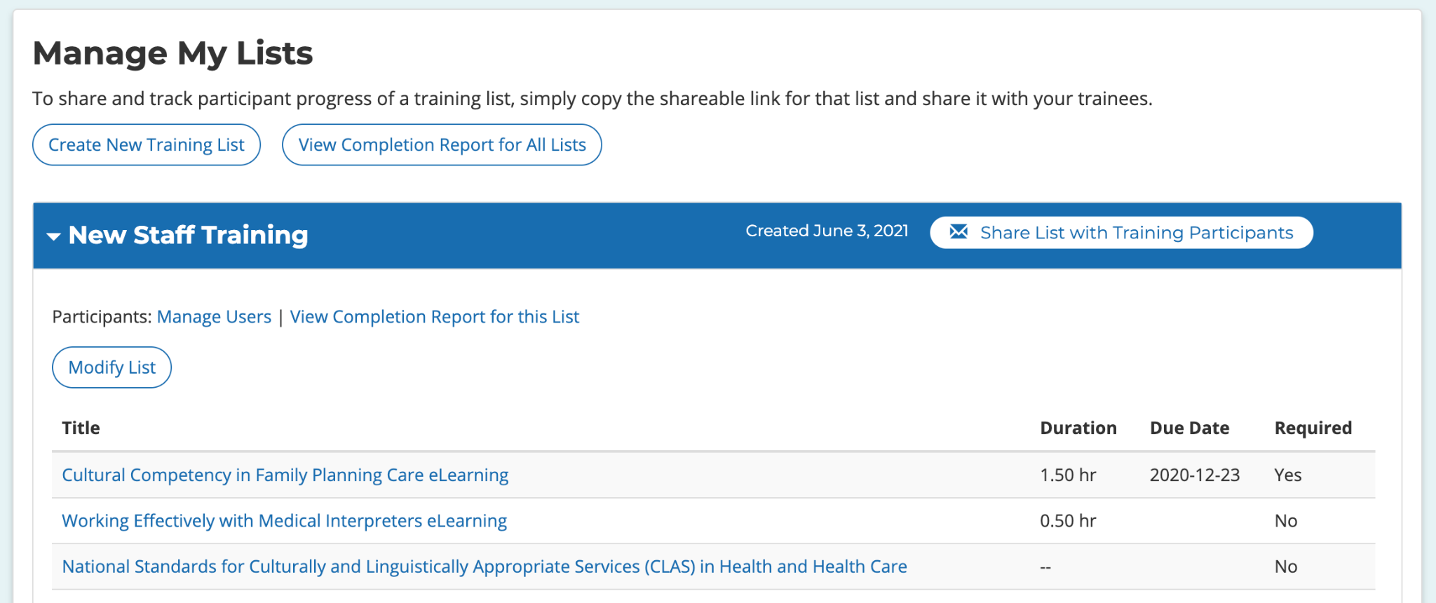
Saving and modifying your list
Notes:
This takes us back to the “My Training Lists” page, and now you’ll see your new list here!
If you need to change anything, just hit the Modify List button.
You can modify a list at any time, even after it’s been shared with users.

Slide 19
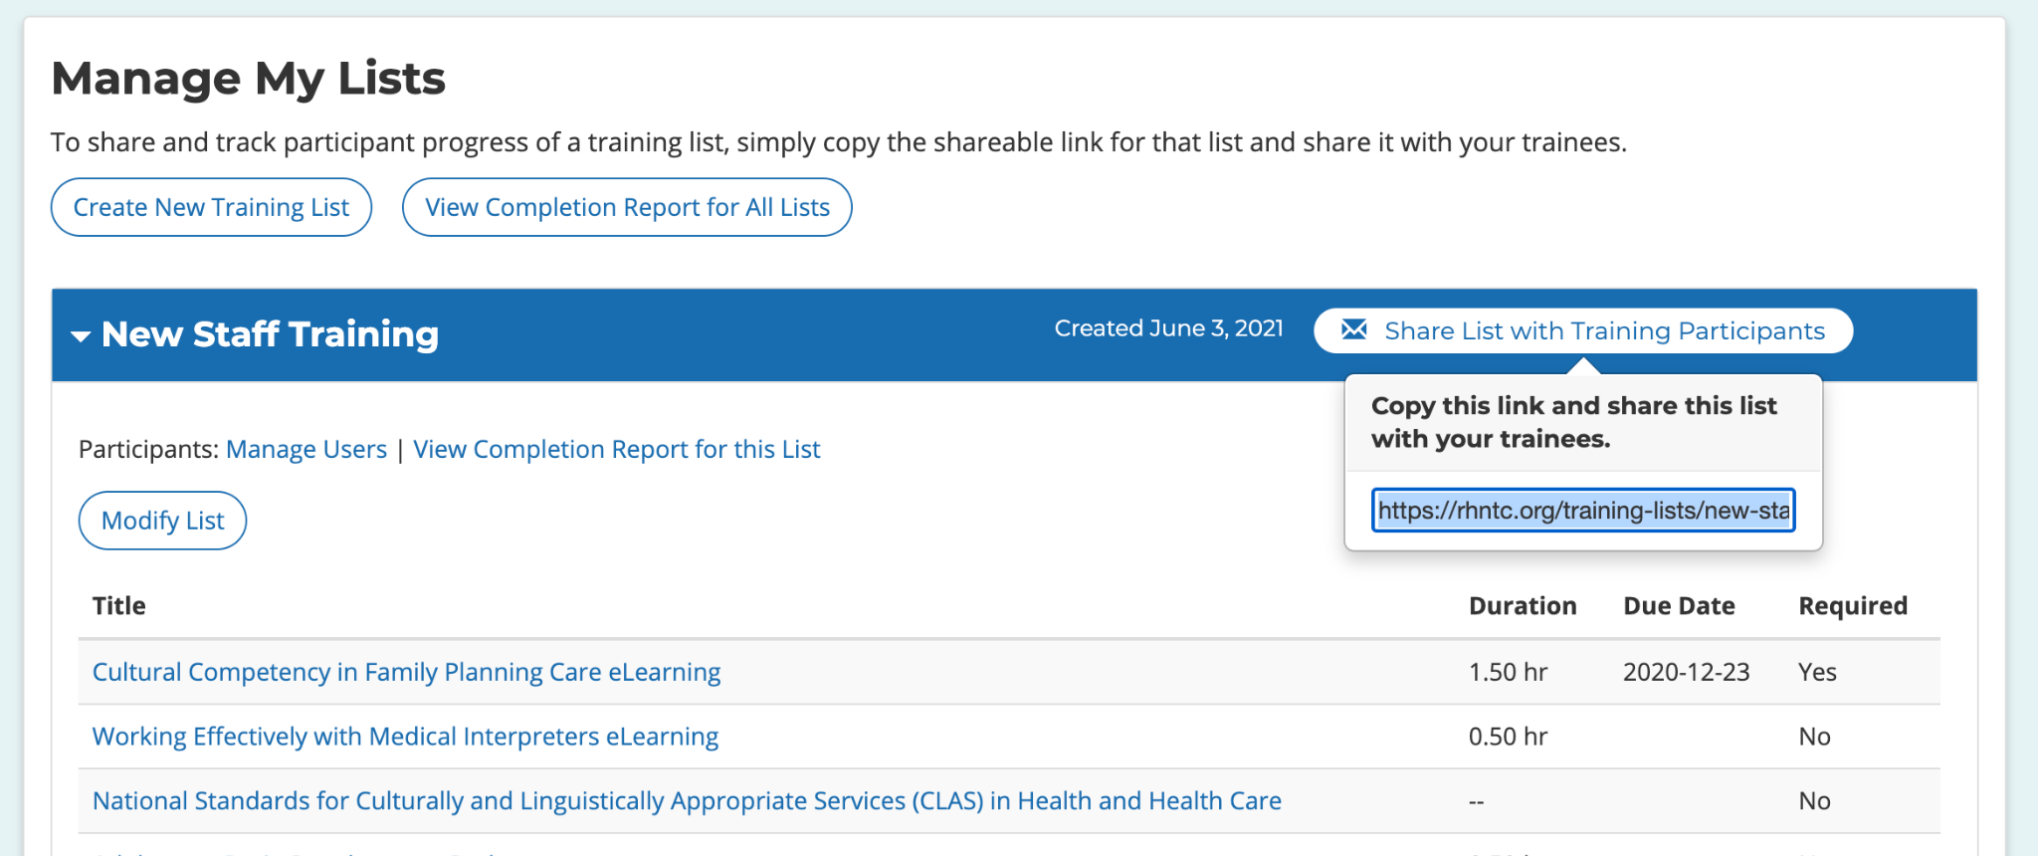
Sharing your new list
Notes:
Now it’s time to share this list with your program staff.
Click on the “Share lists with Training Participants” button. This will open a box with a link you can copy and paste via email.
We know that email is the primary way you’re already sharing and assigning training to program staff, so this stays within your current work flow and enables you to control who gets the request.
Hopefully you will have already asked that staff create an account on RHNTC before sharing a list, but if you share the list with someone who doesn’t have an account, they will be prompted to create one before they can accept the list.
I’m going to share this link with Clancey and turn over the demo to her to show you the next steps from the viewpoint of a training participant.

Slide 20
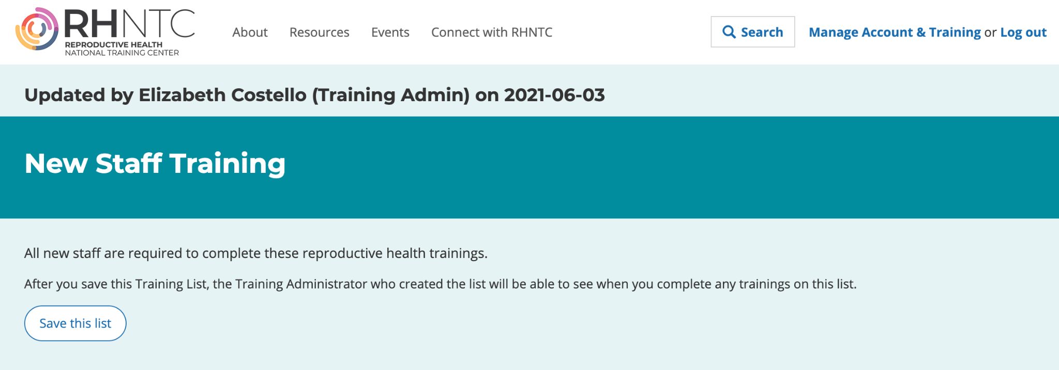
User accepts the list
Notes:
I’m now viewing the link that Elizabeth sent me.
You can see that it shows me who created this list and when it was last updated.
I can also see the instructions that Elizabeth entered, as well as some standard language that is included with all training lists, which says, “After you save this Training List, the Training Administrator who created the list will be able to see when you’ve completed any trainings list this list.”
Then I have the option to Save this list.
This step is the most crucial step in ensuring that connection between Training Administrators and Training Participants.
The only way that the Training Tracking System can associate an administrator with a participant is through this process of ‘opting in’ to save the list.
An Administrator cannot see any other information about a training participant – only completion information for the Training Lists they’ve accepted.

Slide 21
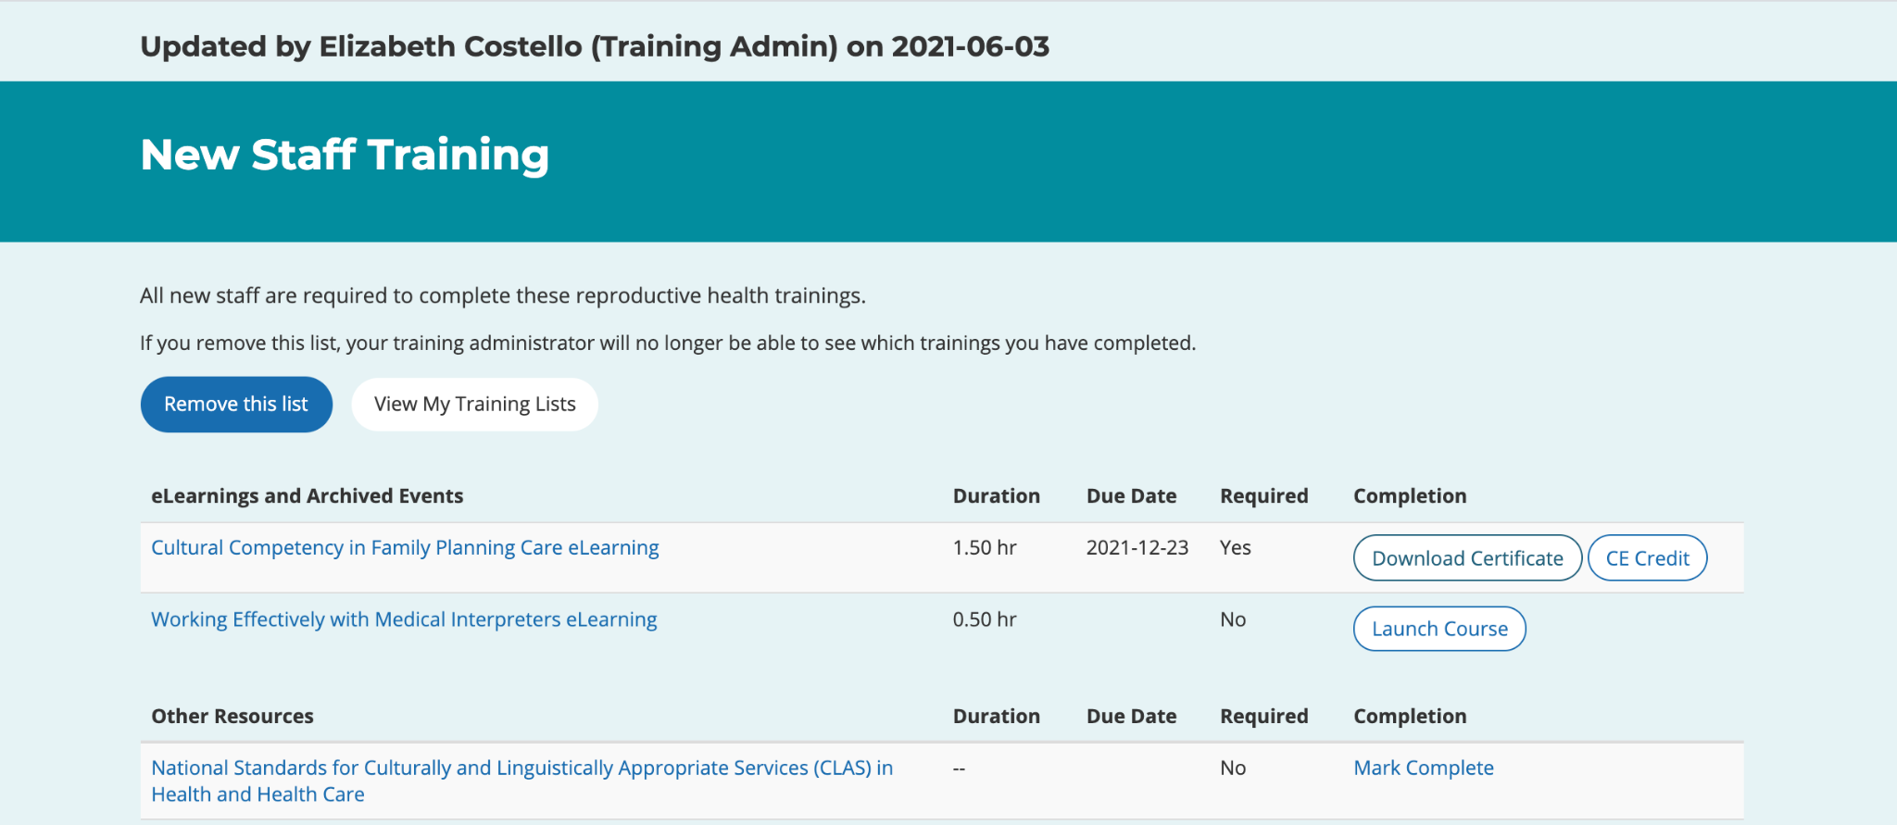
User completes training and evaluation
Notes:
I can launch this course directly from the Training List. For the sake of time, I’m going to go ahead and jump right to the evaluation that is available after I view the archived webinar. Let me quickly click through to complete this.

Slide 22
User views their completion information
Notes:
Now you see that when I come back to the “My Training Lists” tab, I can now access my certificate for that resource as well.

Slide 23
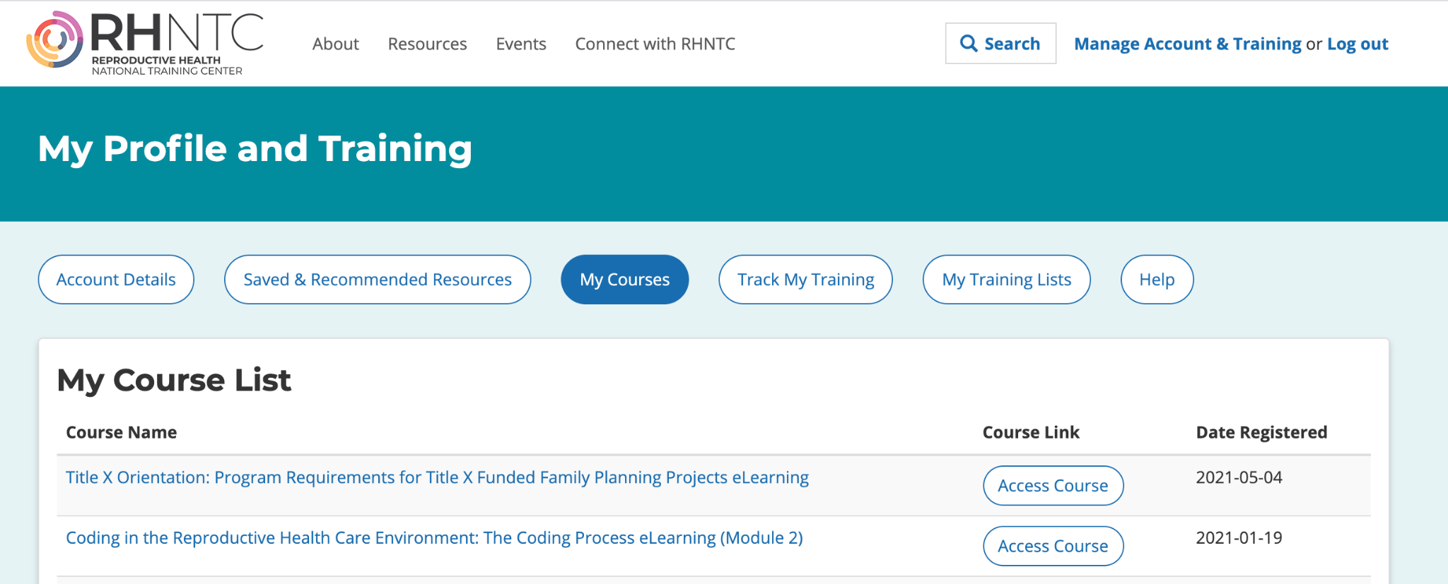
Training account interface
Notes:
I also want to walk through the Training Account interface from an individual user perspective. Earlier in the presentation, Elizabeth reviewed the Training Tracking System features available to individual users. This is where users can access those features.
[Click to My Courses] There is a “My Courses” tab that allows users to quickly access any trainings that they have registered for, either on their own or through a Training List. This tab has been in place since last October.
[Click to Track My Training] And here, the “Track My Training” tab shows completion for all trainings as well, whether they’ve been assigned through a Training List or not. This feature has also been available since last October. This tab shows completion for individual trainings, or users can click and download a Training Report that summarizes the same info in a PDF.
[Click to My Training Lists] Finally, the new “My Training Lists” shows the user any Training Lists they’ve accepted, and the resources in that list. Users can accept multiple training lists.
Now I’m going to turn it back over to Elizabeth so we can see how my completion information for the Training List she shared shows up for a training administrator.

Slide 24
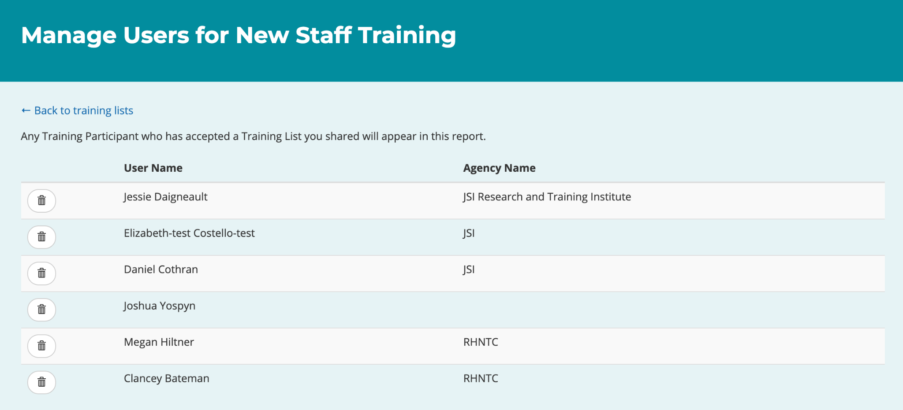
Seeing who has accepted a list
Notes:
Let’s go back to my list.
I also shared this list just now with a few other members of my team, so I can see everyone who has accepted this list. Remember, even if you SEND the link to multiple users, they will only show up here if they ACCEPT the list.
You can hit the “Manage Users” button to see who has accepted the list. There is also an option to delete a user from the list if you ever need that.
Now I want to view the completion report for this list.

Slide 25
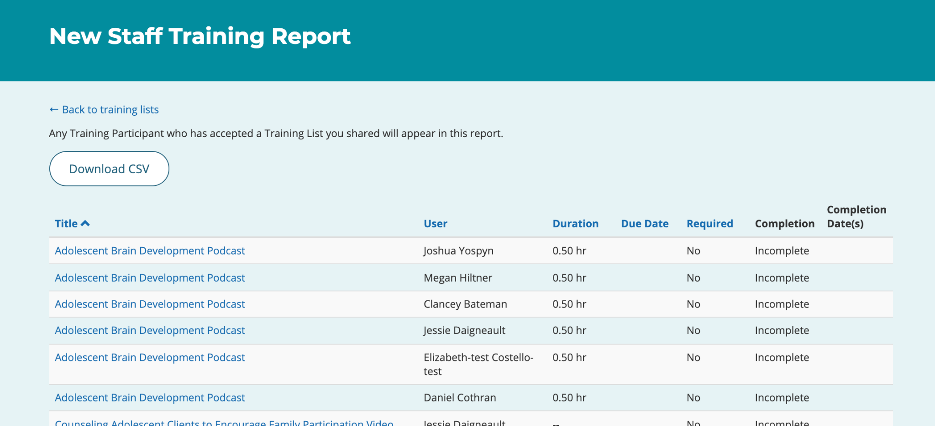
Download completion report
Notes:
This completion report shows all of the eLearnings and Archived Events from your Training Lists.
It does NOT show the “Other Resources” since those do not have certificates of completion.
There is an option to download a spreadsheet, which gives you a CSV file that you can filter, sort, and integrate with your other reporting processes.
And that concludes our live demo and the basics of creating, sharing, and tracking Training Lists! I’m going to hop back over to the PowerPoint to introduce a new resource that may help you as you develop training lists before we open it up for questions.

Slide 26
How could you use the Training Tracking System?
Notes:
Now that you’ve seen how the Training Tracking System works in action, I want to dive a bit more into how Title X and TPP programs can use it to meet their training and professional development needs.

Slide 27
Title X grantees use lists in different ways
Create a list and share the link with Title X subrecipients via email, on a webpage, or in a PowerPoint presentation
Use lists for tracking completion or as templates for other users (e.g., subrecipients) to copy and adapt
Notes:
We know that Title X grantees are already using training lists in different ways. Some are sharing the lists via email directly with staff as we demonstrated here. Others embed the link in a webpage or PowerPoint presentation so its accessible to staff when they are ready to engage with the training.
Other Title X grantees create and share a training list with their subrecipients with the expectation that the subrecipients will copy and add to that list for their staff or network.

Slide 28
Sample List 1: New Title X Staff Training
Title X Orientation: Program Requirements for Title X Funded Family Planning Projects eLearning
Cultural Competency in Family Planning Care eLearning
Trauma-Informed Mandatory Child Abuse Reporting in a Family Planning Setting Video
Mandatory Child Abuse Reporting State Summaries
SOAR to Health and Wellness Human Trafficking Training
Counseling Adolescent Clients to Encourage Family Participation Video
Counseling Adolescent Clients to Resist Sexual Coercion Video
Identifying and Responding to Human Trafficking in Title X Settings eLearning
Notes:
Here is an example of a list that someone created for new Title X staff.
You can see it includes a range of eLearning, videos, as well as some standalone resources tied to Title X annual training requirements.

Slide 29
Sample List 2: Title X Clinical Staff Onboarding
Title X Orientation: Program Requirements for Title X Funded Family Planning Projects eLearning
Trauma-Informed Mandatory Child Abuse Reporting in a Family Planning Setting Video
Identifying and Responding to Human Trafficking in Title X Settings eLearning Course
Counseling Adolescent Clients to Resist Sexual Coercion Video
Counseling Adolescent Clients to Encourage Family Participation Video
Mandatory Child Abuse Reporting State Summaries
Notes:
We often see that training admins will create a separate list for clinical staff vs. non-clinical staff.

Slide 30
Sample List 3: TPP Trainings on rhntc.org
SOAR to Health and Wellness Human Trafficking Training
Adolescent Brain Development Podcast
Healthy Relationship Wheel and Relationship Spectrum
Applying the Optimal Health Framework to TPP Programs Webinar
Integrating Sexually Transmitted Infection Prevention into TPP Programs Webinar
Meaningful Youth Engagement in TPP Webinar
Notes:
We’ve seen for several years now how Title X programs have been using the Training Tracking System, and we’re excited to have more TPP grantees starting to use it now, too.
Here is a potential training list of relevant TPP trainings on rhntc.org.

Slide 31
Create lists of external resources for professional development
Link to EBI Curriculum Training
Relationship Education: A Trauma-Informed Approach for Youth (Dibble Institute)
Adolescent Brain Development (AHI Spark Training)
Reproduction and Anatomy (SparkED)
Needs Assessment, Data Collection Tools and Fidelity (Live)
Cultural competency (ThinkCulturalHealth.hhs.gov)
Notes:
TPP Grantees can link to the required training.
This is a sample common external trainings that grantees frequently cite in their professional development plans.

Slide 32
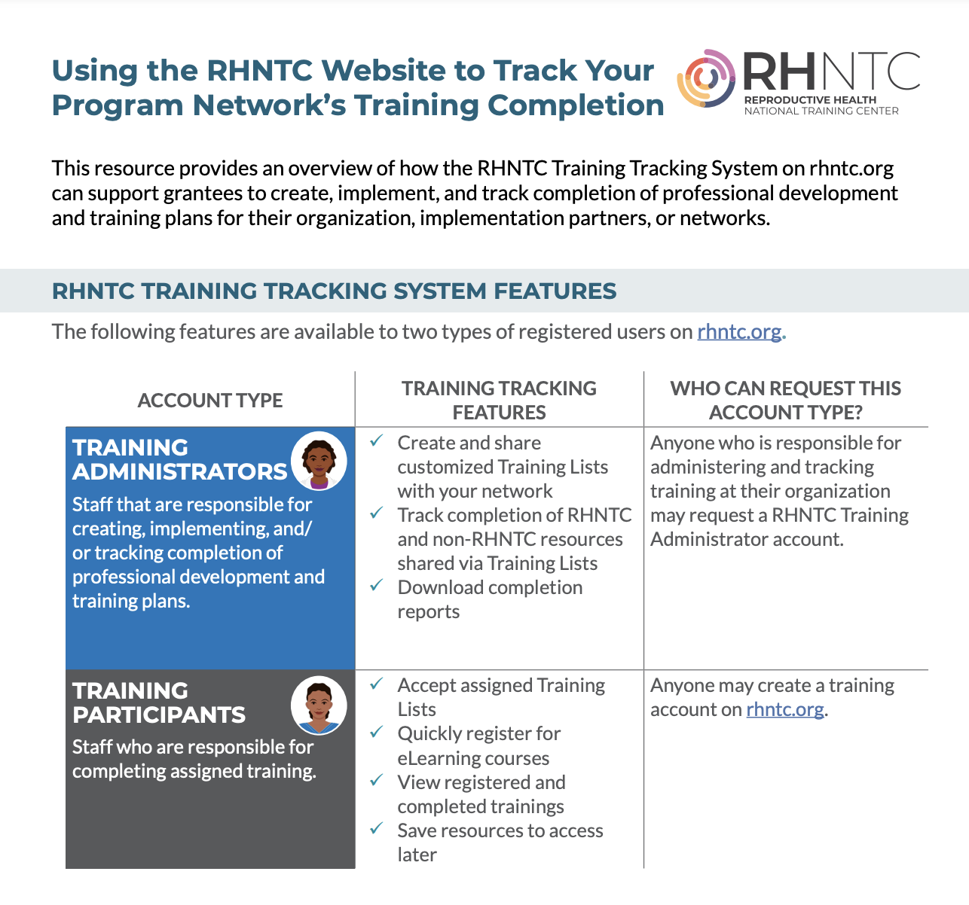
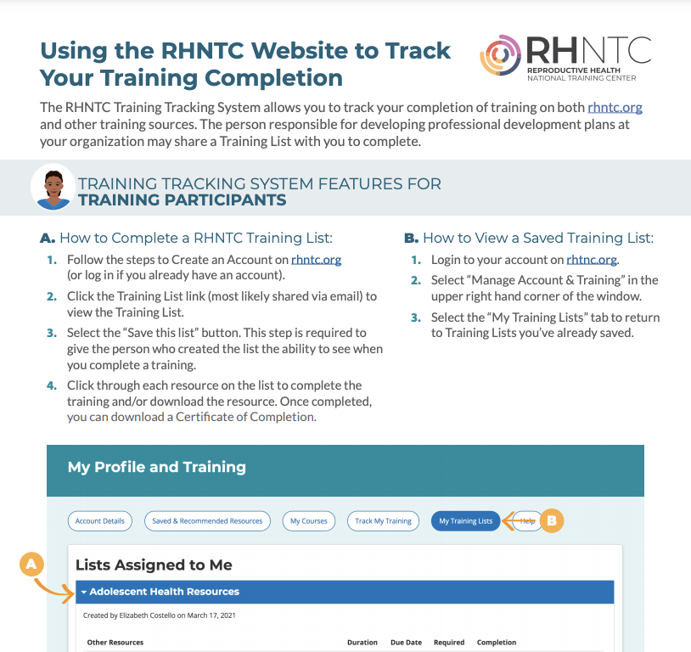
Job aids for you and your network
For Training Administrators
For Training Participants
1 general version, 1 Title X-specific version
1 general version, 1 Title X-specific version
Notes:
We’ve developed job aids for Training Administrators and Training Participants. We’re going to chat out the link to these resources now.
We designed these job aids as a tool for grantees to share with their networks, too.
For example, if you are a Title X grantee and would like to encourage your subrecipients to use the Training Tracking System, you can share the Title-X specific version of the Training Admin job aid to provide an overview of the features and benefits.
We also have a general version of the job aid that can be used by any program -- its not tailored to either TPP or Title X.
Finally, we have a companion job aid for training participants that explains how to accept a list and complete training. There is also a general version of this job aid and a Title X specific version.

Slide 33
Ready to request a
Training Admin account?
Create an account on rhntc.org (or log in, if you already have one).
Click on “My Training Lists” and then “Contact Us.”
Complete the form to request an account.
Notes:
Review the three steps to request a Training Administrator account.

Slide 34
Q&A
What questions do
you have for us?

Slide 35
How to Engage with Us
Subscribe to the RHNTC Monthly eNewsletter at rhntc.org/enewsletter
Contact us on rhntc.org
Sign up for an account on rhntc.org
Follow us on Twitter @rh_ntc

Slide 36
THANK YOU!
rhntc@jsi.com
This webinar was supported by the Office of Population Affairs (Grants FPTPA006030, TPSAH000006) and the Office on Women’s Health (Grant ASTWH2000-90-01-00). The views expressed do not necessarily reflect the official policies of the Department of Health and Human Services; nor does mention of trade names, commercial practices, or organizations imply endorsement by the U.S. Government.
Notes:
RHNTC email: rhntc@jsi.com

