Slide 1

Advancing Preconception Health Services Webinar
November 3, 2021
Notes:
Advancing Preconception Health Services

Slide 2
Welcome
Keiva Nelson, Lead Public Health Advisor
Division of Policy and Performance Management (DPPM)
Office on Women’s Health (OWH)
Notes:
Keiva Nelson is the Lead Public Health Advisor with the Division of Policy and Performance Management (DPPM) in the Office on Women’s Health (OWH).

Slide 3


Speaker
Sarah Verbiest, DrPH, MSW, MPH
University of North Carolina at Chapel Hill
Schools of Social Work and Medicine
Notes:
Dr. Sarah Verbiest brings is the Director of the Jordan Institute for Families in the UNC School of Social Work and the Executive Director of the Collaborative for Maternal and Infant Health in the UNC School of Medicine, Her book, “Preconception Health and Care: A Lifecourse Perspective,” was released in August 2020. Among other things, Dr. Verbiest is a Co-Principal Director for the Maternal Health Learning and Innovation Center, a new national resource center developed to accelerate innovative and evidence-informed interventions that improve maternal health and eliminate maternal health inequities.

Slide 4
Speaker 2
Debbie Farb, RN, BSN, MPH
University of North Carolina at Chapel Hill
Department of Obstetrics and Gynecology
Notes:
Debbie Farb has worked across the board in women’s health for over 20 years. Debbie is a Registered Nurse, and holds a Master’s degree in Public Health in Maternal and Child Health. Her background includes in-patient obstetrics/gynecology, clinic-based prenatal/postpartum care and family planning, mother/baby nurse home visiting, public health obstetrics case management, and public health nurse consulting/leadership. Debbie formerly served as the State Family Planning Nurse Consultant under North Carolina’s Title X program. She currently serves a Research Nurse for a gynecology clinical trial with UNC.

Slide 5
Learning Objectives
Explain the purpose of the preconception health toolkit
List at least two steps Title X agencies can take to enhance preconception health services and activities
Describe at least one new preconception health toolkit resource
Notes:
By the end of the session, participants will be able to:
Explain the purpose of the preconception health toolkit
List at least two steps to Title X agencies can take to enhance preconception health services and activities
Describe at least one new preconception health toolkit resource

Slide 6
Preconception Health Toolkit Rationale
Notes:
We want to begin by sharing the rationale behind the preconception health toolkit.

Slide 7
Why Focus on Preconception Health Services?
Preconception health services support the health of individuals of reproductive age before conception (preconception health services) or between births (interconception health services), which helps to reduce adverse outcomes for birthing people and their babies.
Preconception health services benefit all individuals of reproductive age, regardless of whether they are planning a pregnancy.
The preconception health toolkit can help Title X agencies review and strengthen the quality of preconception health services.
Notes:
During today’s webinar we will cover the benefits of preconception health services

Slide 8
OWH and RHNTC
OWH coordinates women's health efforts across the U.S. Department of Health and Human Services (HHS) and addresses critical women's health issues by informing and advancing policies, educating health care professionals and consumers, and supporting innovative programs.
RHNTC develops training and technical assistance to support OWH priorities, including preconception health, maternal mortality prevention, hypertension, and fertility services.
Notes:
OWH coordinates women's health efforts across the U.S. Department of Health and Human Services (HHS) and addresses critical women's health issues by informing and advancing policies, educating health care professionals and consumers, and supporting innovative programs.
The RHNTC develops training and conducts TA to support OWH priorities, including preconception health, maternal mortality prevention, hypertension, and fertility.

Slide 9
OPA’s Three Pillars
Quality
Equity and access are irrelevant if services are not of the highest quality.
The Title X Program addresses the needs of communities through quality care delivery and evidence-based practice.
Access
The Title X Program is a long-standing safety net for communities.
Title X agencies deliver essential services to all clients of all identities.
Equity
Advancing equity for all, including people who have been historically underserved, is a priority for the Title X program.
Title X staff provide services with cultural sensitivity and language proficiency.
Notes:
Let’s take a moment to review comments made by Jess Swafford Marcella, our Deputy Assistant Secretary for Population Affairs and Director, Office of Adolescent Health comments during the Title X Grantee meeting in July:
She reviewed OPA’s Three Pillars
Quality
OPA called this pillar is a “hallmark of Title X” and Equity and access are irrelevant if services are not at the highest quality
Ensure that providers have the resources they need to deliver proper care to their communities
Quality care delivery and evidence based practice will address the needs of communities
2. Access
Title X has been a safety net for communities and a provider of choice
Access and health care coverage are intertwined and providers must have the resources they need to deliver care that the quality reproductive health services that communities rely on
Title X is a program for all identities, existing high qualified systems should continue to deliver essential services to all clients regardless of insurance status and in communities where providers are “life lines”
Equity
This pillar echos the Biden’s administration's commitment to racial justice and OPA’s commitment to working with grantees to mitigate barriers for communities that have experienced inequities for “generations”
Advancing equity for all, including people from low-income families, and others who have been historically underserved, is a priority for the Title X program.
Title X staff who have cultural sensitivity and language proficiency that is required to provide service to all
These are not new pillars of Title X.
These are the values that have been core for decades that grantees have translated into programs that serve as the “Gold standard” for family planning and sexual health care.
Title X grantees make it a point to center clients care in needs in ensuring that they have access to quality care and information that meets their specific needs.

Slide 10
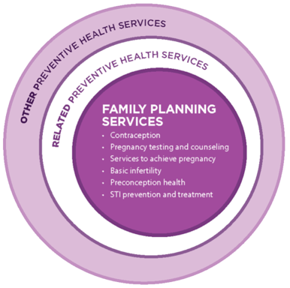
Recommendations for Providing
Quality Family Planning Services (QFP)
Notes:
Family planning providers can use this toolkit to:
improve preconception health knowledge, attitudes, and practices
strengthen preconception health services to support clients in attaining and maintaining optimal health
integrate contextual and environmental factors into preconception health services
reduce disparities in maternal and pregnancy outcomes.

Slide 11
QFP and Whole Person Care
A diagram depicting "The Clinical Pathway". The diagram reads as follows:
Box 1: Determine the need for services among female and male clients of reproductive age.
Assess reason for visit.
Assess source of primary care.
Assess reproductive life plan.
Box 1 branches out into boxes 2 and 3.
Reason for visit is related to preventing or achieving pregnancy:
Box 2: Contraceptive services. Pregnancy testing and counseling. Achieving pregnancy. Basic infertility services.
Clients also should be provided these services, per clinical recommendations.
Box 2a: Sexually transmitted disease services. Preconception health services.
Clients also should also be provided or referred for these services, per clinical recommendations.
Box 2b: Related preventative health services.
Initial reason for visit is not related to preventing or achieving pregnancy.
Box 3:
Acute care.
Chronic care management.
Preventative services.
Box 3a: Assess need for services related to preventing or achieving pregnancy.
If needed, provide services: Box 3a connects to Box 2.
If services are not needed at this visit, reassess at subsequent visits.
Notes:
The "Clinical Pathway" (available on the RHNTC website), is a diagram of the QFP recommendations.

Slide 12
Title X and Whole Person Care
SisterSong defines reproductive justice as “the human right to maintain personal bodily autonomy, have children, not have children, and parent the children we have in safe and sustainable communities.”
When applied to preconception health care, whole person care uplifts reproductive justice and addresses inequity by providing respectful care that honors each person’s unique needs and strengths and supports their well-being as people.
Source: SisterSong, Women of Color Reproductive Justice Collective. (1994). What is Reproductive Justice? Retrieved from https://www.sistersong.net/reproductive-justice/
Notes:
The toolkit is focused on preconception health in the context of the QFP.
We are going to talk about preconception health more broadly in the context of whole person care and reproductive justice.
We want to expand how preconception health is interpreted and services delivered to reach a larger population and is more inclusive.

Slide 13
Aspects of a Person's Health
Tobacco, substance use alcohol, medications
Fertility, sexuality, contraception
Environmental exposures
Chronic disease prevention & management
Genetics & age
Immunizations, infections (e.g., Zika, STIs)
Mental wellness
Physical, sexual, & emotional violence
Weight, physical activity, & nutrition
Source: National Preconception Health and Health Care Initiative (2020). Women’s Health Practice Bulletin. Retrieved from https://beforeandbeyond.org/wp-content/uploads/2021/02/phc-bulletin-0223211.pdf
Notes:
As you will see in the preconception health checklist and toolkit, there are a number of components that impact various aspects of a person’s health.
We often view each of these areas as separate and distinct.

Slide 14
Context
Notes:
However, after talking with individuals about their perspectives they actually see less separation and note how these issues are connected.
For example, a person struggling to manage a chronic condition may have some mental health impacts from that struggle.
A person struggling with depression may have a hard time following up on suggestions for healthy eating. We know that a person’s context really matters, so advising someone on exercise and eating when they are working multiple jobs and have limited access to what they need to be well can be counter productive.
Thinking about all of these items is part of whole person care.

Slide 15
Partnership Matters
Community
Clinic
Woman
Notes:
Thinking about all the intersecting factors just described, we knew that it was important to think about all of the places for intervention. People of course ultimately decide what they want in their lives. Just telling your patient what she/they needs to do is not enough. They need to hear that from a provider who she trusts and who provides unbiased, person-centered care. And there have to be resources in the community to support the clinician and the individual in acting on what is needed for them to be healthy and well.
While Title X providers are pretty awesome, they can’t do it all. This is why identifying community-based organizations and resources is a key way to support YOUR work and the people you serve.
It is also important to remember that your patients have relationships with other people–their family, friends, and co-workers who all influence their ability to be healthy and well.

Slide 16
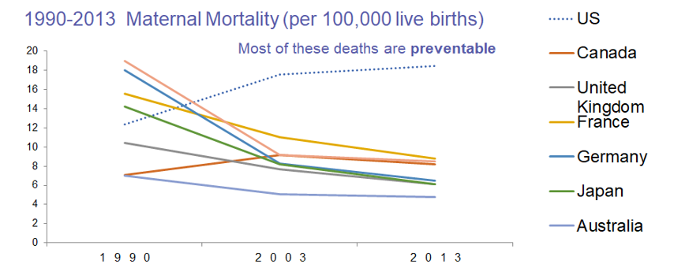
Urgent Need for Action
Global, regional, and national levels and causes of maternal mortality during 1990-2013: a systematic analysis for the Global Burden of Disease Study. Kassebaum, N.J., et al. (2014). Lancet. 384:980-1004.
Notes:
What happens when we are unable to provide equitable, quality, whole-person care?
The United States is the only industrialized nation where maternal death and sickness is on the rise. We may spend more overall on health care but our results are unimpressive and the urgency for action is now.
Of note, mortality is like the tip of the iceberg. Many more women experience severe morbidity.

Slide 17
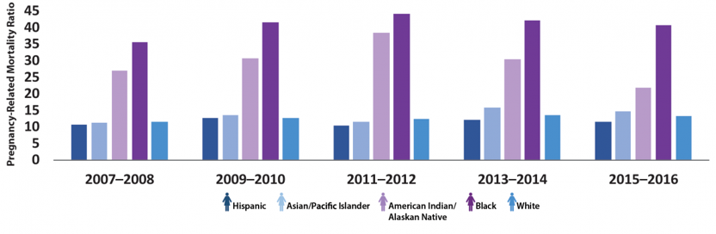
The Impact of Historic and Structural Racism
Data confirms significantly higher pregnancy-related mortality ratios among Black and American Indian/Alaskan Native women. These gaps have not changed over time.
Source: https://www.cdc.gov/reproductivehealth/maternal-mortality/disparities-pregnancy-related-deaths/infographic.html
Notes:
The differences in pregnancy related death rates among Black women (shown in dark purple) as well as American Indian/Alaskan Native women (lighter purple bar) have persisted nationally for decades.
Nationally, Black women are three times more likely to die from this cause compared to white women. This is the result of historic and systemic oppression that has impacted every aspect of life for people of color in the US.
Source:
Infographic: Racial/Ethnic Disparities in Pregnancy-Related Deaths — United States, 2007–2016 (https://www.cdc.gov/reproductivehealth/maternal-mortality/disparities-pregnancy-related-deaths/infographic.html )

Slide 18
The Case for Health Promotion, Preventive Care, and Preconception Health Services
Although federal health agencies recommend that women routinely receive disease prevention and health promotion services, the reality is that many women don't routinely receive this care.
When women don’t receive these services, we see increasing
rates of…
  Severe complications during and after pregnancy
  Short- and long-term adverse health effects among women who experience these complications
  Severe birth outcomes, including miscarriage, stillbirth, preterm birth, and birth defects
https://www.cdc.gov/reproductivehealth/maternalinfanthealth/severematernalmorbidity.html
Notes:
There are many strategies for closing disparities and improving maternal health.
This is where Title X comes in. You have the opportunity to provide health promoting, preventive care to women / individuals across the country.
Title X providers often are THE people who provide access to people who wouldn’t get it anywhere else.
When we don’t provide care, there is an impact.
AND you all play a key role in the maternal health continuum.
Source:
Severe Maternal Morbidity in the United States (https://www.cdc.gov/reproductivehealth/maternalinfanthealth/severematernalmorbidity.html)

Slide 19

Call to Action
Women of reproductive age can experience health issues that negatively affect their health, fertility, and future pregnancies.
13% of women ages 18–39 have chronic hypertension.​
36.5% of women are obese.​
Infectious diseases are common and can complicate pregnancies​ and impact fertility.
15.7% of women 18 years and older use tobacco products​.
Substance use disorders are underdiagnosed among women​.
More than 20% of women each year experience a mental, behavioral, or emotional disorder​.
More than one in three women have experienced interpersonal violence over their lifetime.
Maternal mortality review committees—along with many organizations, including the CDC and ACOG—underscore the necessity of improving people’s health before pregnancy in order to prevent maternal mortality and morbidity.
Source: U.S. Department of Health and Human Services. (2020). The Surgeon General's Call to Action to Improve Maternal Health. Retrieved from https://www.hhs.gov/sites/default/files/call-to-action-maternal-health.pdf
Notes:
To underscore the need for your work, MMRCs across the country have highlighted the importance of addressing health, including providing family planning, in reducing maternal mortality and morbidity.
If you are looking for other ideas for improving maternal health you might want to review the Surgeon General’s Call to Action to Improve Maternal Health–which includes ideas for businesses, policy makers, families and clinicians. Data from that report offers examples of the work ahead.
Source: The Surgeon General's Call to Action to Improve Maternal Health https://www.hhs.gov/sites/default/files/call-to-action-maternal-health.pdf

Slide 20
Preconception Health Toolkit Overview

Slide 21
Preconception Health Toolkit Goals
Access the toolkit at http://rhntc.org/preconception
Improve preconception health knowledge, attitudes, and practices
Strengthen preconception health services to support clients in attaining and maintaining optimal health
Integrate contextual and environmental factors into preconception health services
Reduce disparities in maternal and pregnancy outcomes
Notes:
Family planning providers can use this toolkit to
improve preconception health knowledge, attitudes, and practices
strengthen preconception health services to support clients in attaining and maintaining optimal health
integrate contextual and environmental factors into preconception health services
reduce disparities in maternal and pregnancy outcomes

Slide 22
Preconception Health Toolkit Steps
Assess your agency's preconception health services
Expand opportunities to engage staff in preconception health interventions
Routinely conduct high-quality preconception health assessments
Strengthen the quality and responsiveness of preconception health services
Collaborate with community partners to improve preconception health
Notes:
The toolkit proposes five steps to enhance Title X programs' preconception health services and activities:
Assess your agency's preconception health services
Expand opportunities to engage staff in preconception health interventions
Routinely conduct high-quality preconception health assessments
Strengthen the quality and responsiveness of preconception health services
Collaborate with community partners to improve preconception health
We will briefly take a look at each steps and some of the supportive tools that are available within the toolkit and on the RHNTC website.

Slide 23
Step 1: Assess Your Agency's Preconception
Health Services
Review current preconception health evidence-based guidelines and recommendations.
Assess preconception health policies and protocols based on evidence-based guidelines and recommendations.
Track preconception health measures over time.
Include preconception health messaging in Community Participation, Education, and Project Promotion (CPEP) plans.
Notes:
As an initial step, family planning agencies and clinics should assess the preconception health services they provide and identify gaps between current and recommended practice.
There are four recommended activities in this step:
Review current preconception health evidence-based guidelines and recommendations.
Assess the extent to which preconception health policies and protocols reflect evidence-based guidelines and recommendations.
Track preconception health measures over time to identify opportunities to expand preconception health services and make other related improvements.
Include preconception health messaging informed by community members with diverse reproductive intentions and goals in Community Participation, Education, and Project Promotion (CPEPPP) plans.

Slide 24
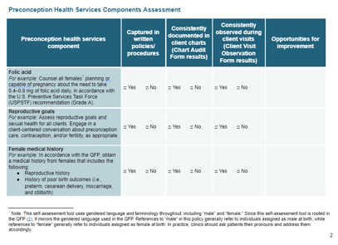
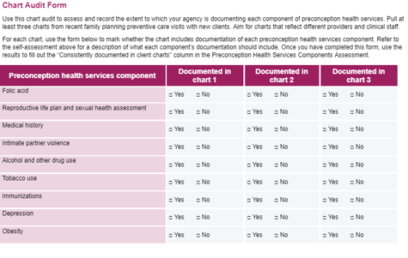
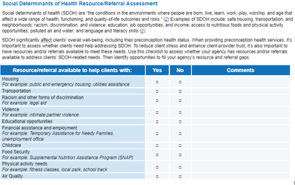
Preconception Health Services Self-Assessment Tool for Family Planning Service Sites
Notes:
There are three new resources that support these action steps contained within the Preconception Health Services Self-Assessment Tool for Family Planning Service Sites.
The Preconception Health Services Component Assessment can help you look methodically at each aspect of recommended preconception care and document whether the agency’s current policies support the provision of those services, whether documentation of services is consistently found in client charts, and if the service is consistently observed during client visits.
The Chart Audit Form can be used to spot check documentation of provided preconception health services and inform quality assurance and improvement efforts.
The Social Determinants of Health Resource/Referral Assessment can be used to determine where there may be gaps in community resources and referral sources currently used by the agency to support needs, such as food insufficiency and unstable housing, that are external to Title X services.

Slide 25
Step 2: Expand Opportunities to Engage Staff in Preconception Health Interventions
Train staff on the root causes of reproductive and sexual health inequities and ongoing harms experienced by communities of color.
Train staff on shared decision making and client-centered care.
Train staff on the foundations of preconception care counseling.
Notes:
Title X services are one of the essential ways that people who are not pregnant, especially women, receive primary care. So many of the services provided by Title X agencies and providers are part of essential preconception and interconception care–it goes way beyond providing a contraceptive method! It can be hard, though, when you’re in the flow of providing services to clients to contextualize this care as preconception health.
Providing opportunities for staff to connect the essential services they provide to the systems and inequities that influence the current health of their clients–and may affect any future pregnancies–can provide context and support their work.
One of the ways that you can help support that connection to the larger work to improve health inequities is through training.
The first recommendation is to train staff on the root causes of reproductive and sexual inequities and on-going harms experienced by communities of color. There are free training resources from the Office of Minority Health (thinkculturalhealth.hhs.gov/education), as well as many communities have local organizations that provide racial equity training.
The second is to continue to provide training for staff on shared decision-making and client-centered care. This has always been one of the essential tenets in Title X, and something Title X providers do really well! And it supports their efforts to provide preconception care that takes the reproductive desires of the client into consideration.
The third recommendation is to make sure staff have training on the foundations of preconception care and counseling.

Slide 26
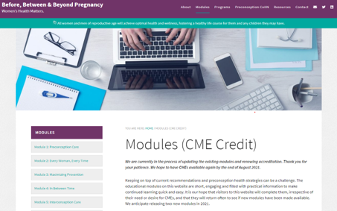
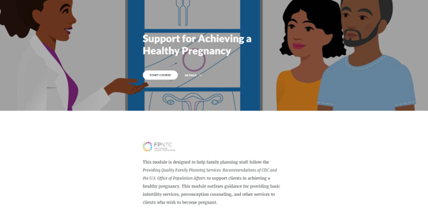
eLearning Modules
Notes:
The Toolkit includes a number of recommended elearning modules.
One of the easiest ways for staff to access training on preconception health and health care is through the online modules available from www.BeforeandBeyond.org and the RHNTC.
Before and Beyond has recently updated modules, offer continuing education credits, and cover topics such as essentials of preconception counseling, how to talk with someone about their reproductive goals and desires, how to provide care when someone says “yes – I want to be pregnant”, providing interconception care for women who experienced a high-risk pregnancy, and how to provide respectful, client-centered care.
The RHNTC also has a number of elearning modules on shared decision making and client-centered care. The Putting the QFP into Practice Series Toolkit includes seven elearning modules, including “Support for Achieving a Healthy Pregnancy,” which covers how to help clients maximize their fertility and optimize their preconception health.

Slide 27
Step 3: Routinely Conduct High-quality Preconception Health Assessments
Assess all clients' reproductive goals.
Assess risk factors for adverse health and adverse pregnancy outcomes before conception.
Assess and address social needs to support each client's ability to engage in healthy behaviors.
Optimize clinic flow to efficiently collect clients' preconception health assessment data.
Notes:
Providing client-centered preconception care starts with a high-quality assessment that takes into consideration both a clients’ current health status and their social context. We want to make sure when staff are providing this assessment, that they assess all clients’ reproductive goals–including teens, LGBTQ+ folks, medically complicated folks, and those with intellectual or developmental disabilities.
We also want to make sure staff are adequately assessing risk factors for adverse health, and connecting those to potential adverse pregnancy outcomes in those who would like to be or are ok with being pregnant in the next year.
Making recommendations that folks cannot follow doesn’t help anyone, so we want to ensure that staff assess social needs, make recommendations that take into account that context, and provide referrals or resources to support those needs.
No one wants the collection of this information to be an added burden on a clinic, so as you are rolling out new or updated policies or procedures, ensure that the clinic flow is optimized to support these efforts. This may mean meeting with a variety of staff to figure out how a new policy or procedure is going to change clinic flow and being willing to try new and different approaches if the first one doesn’t work.

Slide 28
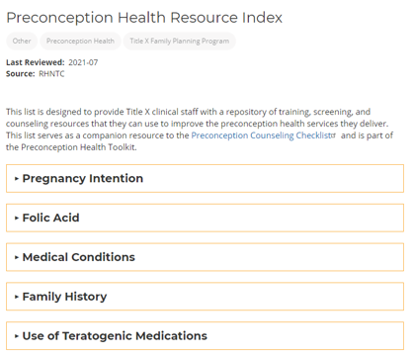
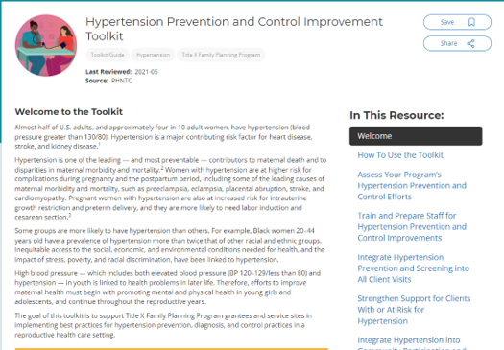
Preconception Health Resource Index
Notes:
The Preconception Health Resource Index lists training, screening, and counseling resources by issue or condition that agencies and sites can use to improve their preconception health services. The index serves as a companion resource to the Preconception Counseling Checklist and is part of the Preconception Health Toolkit.
The Index also includes the Hypertension Prevention and Control Improvement Toolkit released in May of this year (2021).
The toolkit supports Title X Family Planning Program grantees and service sites in implementing best practices for hypertension prevention, diagnosis, and control practices in a reproductive health care setting.
All of these resources can be found on rhtnc.org.
Resource:
Preconception Health Toolkit (https://rhntc.org/resources/preconception-health-toolkit)

Slide 29
Step 4: Strengthen the Quality and Responsiveness of Preconception Health Services
Provide clients with risk reduction strategies that reflect their preconception health assessment and evidence-based guidelines and recommendations.
Provide clinical and non-clinical resources and referrals to support clients in reaching their general and reproductive health goals.
Gather client satisfaction data and use results to enhance preconception health services.
Notes:
Once Title X staff have performed a high quality preconception health assessment, we want to make sure that the resulting education, counseling, care, and referrals align with evidence-based guidelines and take into account the goals, risks, social needs, and contextual and environmental factors gathered during a client’s assessment.
As we talked about before, it doesn’t do anyone any good to make recommendations a client cannot follow. Making sure that risk reduction strategies are aligned with what was discovered during a client’s preconception health assessment, while also reflecting the evidence-based guidance, can ensure that recommendations are actually actionable and will support improved health.
Providing clinical and non-clinical resources and referrals, including the ones documented during step 1 on the Social Determinants of Health Resources/Referrals checklist–will support clients’ current health goals, as well as the health of any future pregnancies they may have.
It is important to consistently gather feedback from clients and to use those results to enhance services, including preconception health services.

Slide 30
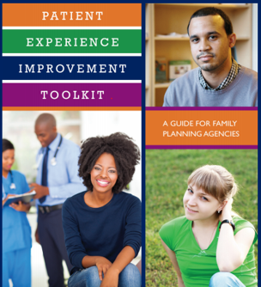
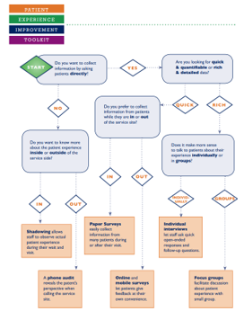
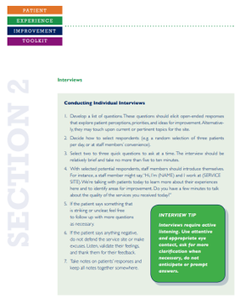
Patient Experience Improvement Toolkit
https://rhntc.org/resources/patient-experience-improvement-toolkit
Notes:
The Patient Experience Improvement Toolkit is an RHNTC resource that will help family planning clinics improve their patients’ experience and increase patient retention at low or no cost.
It contains a range of information, including how to develop patient experience goals, give your site a makeover, and sustain improvements.
By the way, the RHNTC is currently in the process of revamping this toolkit and making it more interactive and accessible, so stay tuned for these updates coming soon!

Slide 31
Step 5: Collaborate with Community Partners to Improve Preconception Health
Work with community partners to identify root causes of inequities in maternal morbidity and mortality.
Build relationships with community partners that work toward improving healthy conditions for individuals of reproductive age.
Collaborate with community partners to implement strategies that can address underlying causes of inequities in maternal morbidity and mortality.
Integrate culturally appropriate wellness and healthy living messaging into community education and outreach activities.
Collaborate across sectors (for example, health care, education, housing, law enforcement) to expand opportunities to advance health equity.
Notes:
We know that family planning clinics can’t do everything on their own. Because preconception health is so tightly intertwined with social determinants of health, family planning sites should consider the engagement of community partners who are also working toward improving health outcomes, particularly maternal health outcomes.
We also know sites already work closely with many community partners.
This is a good opportunity to think about which community partners are already doing work around mitigating health inequities and their causes, including implicit bias. This is also an opportunity to liaise with community organizations, especially those that represent marginalized or vulnerable communities, to ensure that community outreach and education activities are culturally appropriate and relevant.
Collaborating with folks across multiple sectors, including housing, education, transportation, and urban planning, can provide the opportunity for those sectors to better understand how their work and decisions affect family planning and build relationships that can ultimately improve the health (including preconception health) of a community.

Slide 32
Q&A
What questions do
you have for us?
Notes:
Resource:
Show Your Love (https://beforeandbeyond.org/show-your-love/) is a national campaign designed to promote wellbeing and support young adults as they strive to achieve their goals and make healthy lifestyle choices today. It is a project of The National Preconception Health and Health Care and The University of North Carolina at Chapel Hill and is a great resource to support Title X agency messaging.

Slide 33
How to Engage with Us
Subscribe to the RHNTC Monthly eNewsletter at rhntc.org/enewsletter
Contact us on rhntc.org
Sign up for an account on rhntc.org
Follow us on Twitter @rh_ntc

Slide 34
THANK YOU!
rhntc.org
Please fill out the evaluation form after the webinar!
CONTACT US
rhntc@jsi.com
This webinar was supported by the Office of Population Affairs (Grants FPTPA006030, TPSAH000006) and the Office on Women’s Health (Grant ASTWH2000-90-01-00). The views expressed do not necessarily reflect the official policies of the Department of Health and Human Services; nor does mention of trade names, commercial practices, or organizations imply endorsement by the U.S. Government.

