Slide 1
Facilitation Strategies to Address Virtual
Burnout Among Youth
April 21, 2021
Notes:
Hello everyone.
This is Megan Hiltner from the Reproductive Health National Training Center and I’m pleased to welcome you all to today’s panel presentation and peer sharing titled Facilitation Strategies to Address Virtual Burnout Among Youth.
I have a few announcements before we begin.
During the presentation portion of the webinar participants will be muted, given the large number of folks joining.
We will take time for questions following the presentation, but keep in mind you can ask questions at any point using the chat function.
Then during the small group discussions you’ll be unmuted.
We would encourage and share and ask questions among your small group.
A recording of today’s webinar, the slide deck, and a transcript will be available on RHNTC.org within the next few days.
We will also be sharing back a summary of ideas generated during our small group discussion.
This presentation is supported by the Office of Population Affairs (OPA). Its contents are solely the responsibility of the authors and do not necessarily represent the official views of OPA, or HHS.
Finally, as we begin, we want to acknowledge the many challenges TPP programs have worked through in the past year, and continue to work through, in order to provide high quality programming to youth and their families.
We admire your dedication to your participants and the critical mission of your programs.
Thank you.

Slide 2
Objectives
Identify challenges youth experience in virtual learning environments and factors that
contribute to burnout
Identify opportunities and steps that staff can
take to address these challenges and to prevent burnout in virtual programs
Notes:
Okay let’s get started.
During this webinar, we’ll feature feedback directly from youth from a social media outreach conducted by Healthy Teen Network regarding how frontline staff might go about preventing burnout among youth - shared directly from their perspective.
Then we’ll have small group discussions where you all can discuss these findings.
At the end of this event we hope that you all will be able to:
Identify challenges youth experience in virtual learning environments and factors that contribute to burnout.
Identify opportunities and actionable steps to address challenges that front line staff can apply to prevent burnout in virtual programs.

Slide 3



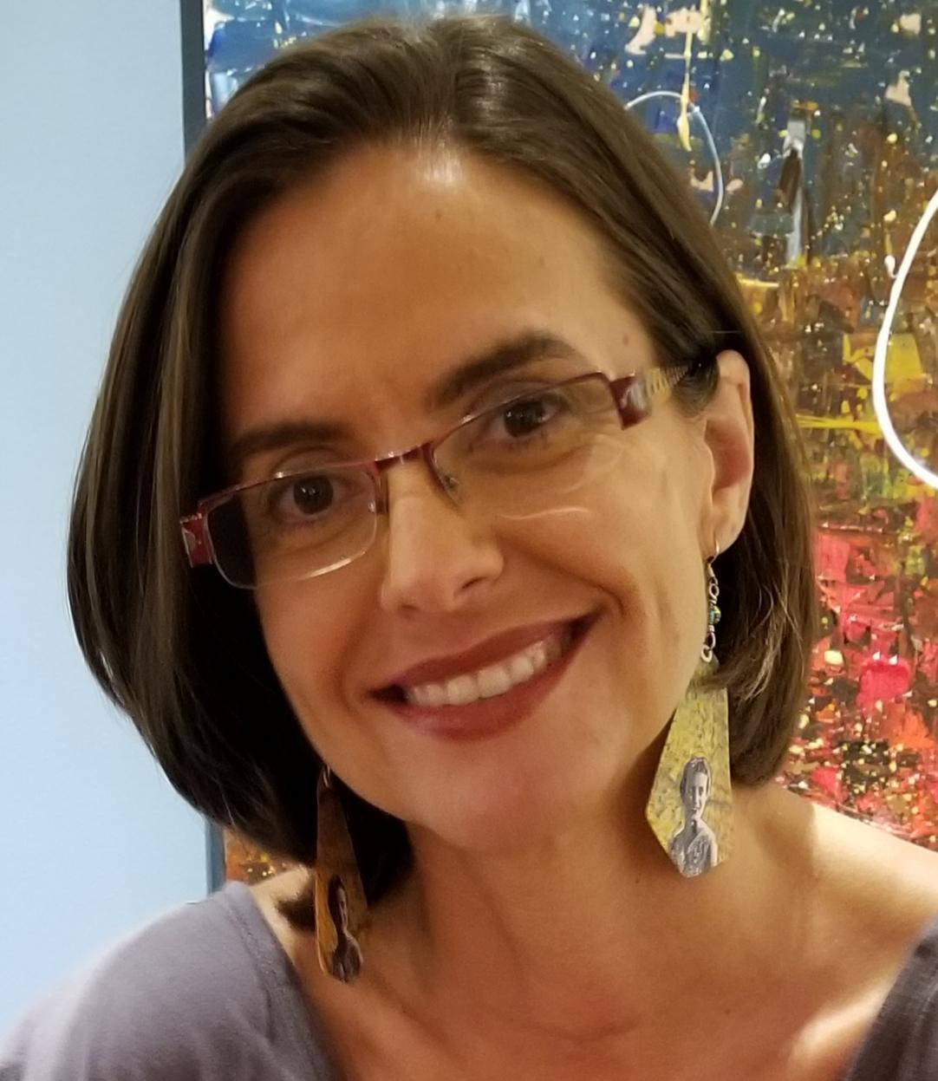
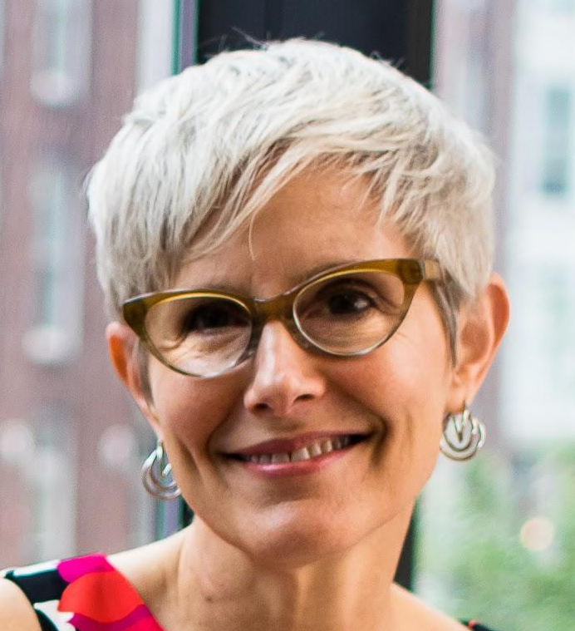
Presenters
Genevieve Martinez-Garcia, PhD
Healthy Teen Network
Director, Innovation and Research
Valerie Sedivy, PhD
Healthy Teen Network
Director, Capacity Building and Evaluation
Notes:
I’d like to briefly introduce our speakers today from the Healthy Teen Network: Genevieve Martinez-García, PhD and Valerie Sedivy, PhD.
Genevieve Martinez-Garcia currently serves as the Director of Innovation and Research at Health Teen Network.
Her work has focused on developing tech-based products to engage youth in their sexual health.
Valerie Sedivy currently serves as the Director of Capacity Building and Evaluation at Healthy Teen Network.
For the last 10 years, a large part of her work has involved helping sex educators improve their facilitation skills.
And, let me also introduce our facilitators that will be taking part in the small-group sharing breakout rooms.

Slide 4
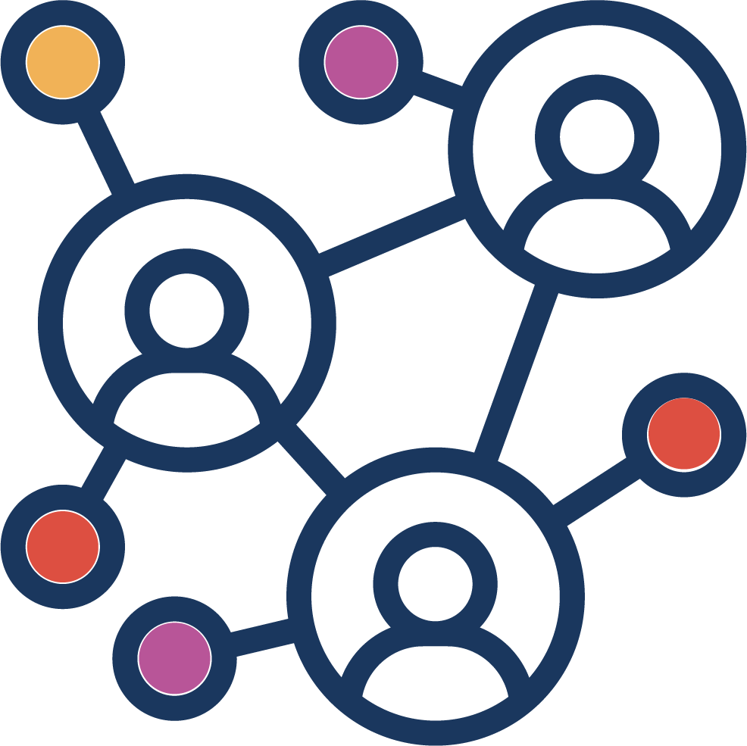
Small Group Facilitators
Megan Hiltner
Donna Ellison
Stacey Moody
Aisha Moore
Notes:
Along side Geneieve and Valerie, these RHNTC staff will facilitate the breakout discussions – myself, Donna Elliston, Stacey Moody and Aisha Moore.
With that, I’d now like to turn things over to Genevieve Martinez-Garcia to present the summary of results from a social media outreach they conducted with youth.
In addition, they will share tips they have gathered from their work.

Slide 5
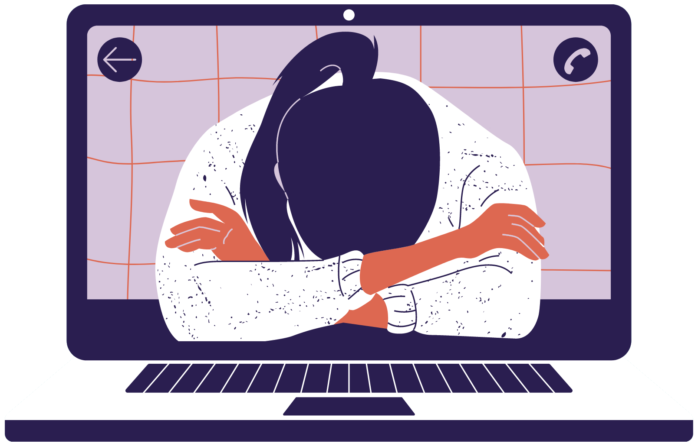
Findings
“It was fun in the beginning, but it kinda went down hill slowly and just became boring.”
“Hurts my eyes.”
“Not engaged in learning online due to lack of human contact.”
“Toooooo muchhhhhh virtual stuff.”
“Hurts my eyes.”
“It was fun in the beginning, but it kinda went down hill slowly and just became boring.”
“It’s really hard to pay attention to class when ur phone is right next to u.”
“Toooooo muchhhhhh virtual stuff.”
“It’s really hard to pay attention to class when ur phone is right next to u.”
“Not engaged in learning online due to lack of human contact.”
Notes:
Thank you so much, Megan.
It is an honor to be with you today.
We wanted to incorporate the youth today, but for many reasons, we were not able to have youth with us so we can hear straight from their experience.
We did the next best thing that we could do, which is to ask them directly.
We did that by reaching out through social media, especially through Facebook and Instagram.
We asked them, "What don't you like about virtual learning or what we're calling Zoom classes? What makes you so fatigued?"
We did this by deploying ads in diverse cities and towns all across the continental and non-continental United States.
We don't know exactly where our ads were being seen or where the comments were coming from, however, we know that we were able to reach a nice cross section of the United States.
We received numerous comments.
You can see on the slides, these are actual comments verbatim.
This really expressed some of the frustration that some of the youth may face.
One said, "It hurts my eyes.“
"It was fun at the beginning, but it went downhill from there.“
"Too much virtual stuff.“
According to the youth, when we compiled all these comments together, we know that virtual learning is not exciting anymore.
You could see on the screen that it was fun in the beginning, but it went downhill.
It was the novelty of being at home and having all these changes, but then it just gets repetitive and boring.
Once the thrill of staying at home and going virtual passed, students were not very excited about continuing virtual education for a long time.
There are persistent problems that really arose from the experience, such as connectivity issues, which was really big, both on the teacher and students side.
When teachers get disconnected, one of our youths commented, "The students take over and they kind of like party in class when teacher gets disconnected because there's no one monitoring.“
According to a lot of youth, teachers don't understand when the students are the ones having connectivity issues, and teachers expect the same level of engagement no matter the connection
Staying engaged was the second really strong theme that emerged from their comments, and the lack of engagement is caused by many reasons.
Several youth mentioned that classes were just boring.
It was hard to stay committed and motivated with a lack of human contact with their teachers and with their friends.
Another barrier was distractions.
As you can see from one of the comments, they say, "It's really hard to pay attention to your class when your phone is right next to you.“
I think we can totally relate and empathize with their experience.
The third theme was the pressure and this high level of expectations that teachers put on youth has become very stressful for the students.
One of them said that they feel that they are being more pressured now, and they're going through more content now than they did in a face-to-face class.
One of the youth commented, "I wish teachers would allow us to hand in work by the end of the marking period and have flexible deadlines.“
Some students have multiple responsibilities at home, and they don't have that protected space of school to finish the work.
Just as we are, the youth are managing their virtual work or learning with the other responsibilities that they have to juggle in their own home.

Slide 6
Findings 2
“I need more breaks for my mental health because I’m in such a low point, I don’t want to continue my education anymore.”
“I get headaches from staring at the screen for hours.”
Findings
“15 hours of the day on our computers, making it hard to enjoy our lives.”
“Teacher doesn’t understand wifi struggles.”
“I get headaches from staring at the screen for hours.”
“I need more breaks for my mental health because I’m in such a low point, I don’t want to continue my education anymore.”
“I think teachers think that online is easier for us, so their giving more assignments.”
“Teacher doesn’t understand wifi struggles.”
“I think teachers think that online is easier for us, so their giving more assignments.”
“15 hours of the day on our computers, making it hard to enjoy our lives.”
Notes:
Here we continue those same themes of being tired, the lack of motivation, the expectations, and the physical exhaustion.
One person said that they have physical pain in their eyes.
They get headaches from staring at the screen for more hours and that they need breaks for their physical and also their mental health.
This was one of the comments that see on the screen, I find it particularly moving: "I need more breaks for my mental health because I'm in such a low point. I don't want to continue my education anymore.“
When I read that, I was really touched because the students are at the point that they just don't want to get educated and they want to drop out because of that physical and emotional exhaustion.
We can do better as educators and facilitators.
All of these comments come directly from youth but youth are not the only ones experiencing this.
I think it's really important once we identify solutions to empathize with the youth and reflect on our own experience.
There has been a lot of research done, over the last couple of years, but more so over the last year on how people are feeling with remote work and the findings really reflect what the youth are saying.
When we are in gallery view in Zoom, the screen is cluttered with multiple webcams and gives us what is called constant gaze fatigue.
You're not focusing on a speaker, you're focusing on all the little squares of people in the screen.
That is really stressful and really fatiguing for the eyes because it's really hard for our brains to focus on one thing when there is so much stimuli staring back at them.
Our brain becomes overwhelmed with the excessive stimuli while trying to decode nonverbal cues and ignore background noise, and all of that causes stress.
It's not about the presenter, it's about everything else that is going on in the screen.
Reading the nonverbal communication becomes extremely hard when we are in this virtual environment.
Researchers at Stanford found that people tend to send extra cues when they're in a virtual environment.
When you are in a classroom, you can passively react to content, but people in the real life environment tend to speak a little bit louder or nod a little bit more to emphasize non-verbal cues
The person on the other end also receives those enhanced non-verbal cues.
This tires both the sender and the receiver.
There are large amounts of verbal and non-verbal information that our brain tries to decode, and that makes us tired.
We are also dealing with a high level of physical fatigue with strained eyes and sitting in a chair all day.
Similarly to how we don't have the benefit of going to a different meeting room and walking up and down the stairs to move around, the students are not walking down the hallway to change into a different class.
All of those components are making people tired, anxious and increasingly stressed.
It happens to us, and it happens to them
I'm going to turn it over to Valerie to continue the discussion and talk about what we can do to support the students in their virtual learning.

Slide 7
Let’s Chat...
What does virtual burnout look like for the young
people you serve? What are you hearing from them?
Notes:
Hi everyone, I am Valerie with Healthy Teen Network and I would like for us to use the chat function.
In the chat box, please answer the following questions:
What does virtual burnout look like for the young people you serve?
What are you hearing from them?
They're overwhelmed, feeling lonely and isolated, like so many of us as adults.
Their cameras are off, they have checked out.
Loss of time.
Irritability.
Lack of motivation.
So many of these things are things that I know that Genevieve has highlighted, but it's interesting to see that many of you are echoing some of the things that we've already found.
They do not pay attention to their computer.
Not wanting their families to overhear or watch.
Distracted.
When we're all at home, school life blends right into personal life.
Thank you, Nicole, for bringing up this issue about being a bit self-conscious about your body and not wanting to necessarily see yourself.
That's a really unusual thing that we're finding; we see ourselves when we interact in this virtual environment, and we don't typically see ourselves and when we're talking in an in-person environment.
We're going to talk a little bit about ways to manage some of these in a moment.
I'm going to share a few things that we have learned.

Slide 8
5 Tips to Prevent Virtual Burnout
Prioritize your face over slides
1. Prioritize your face over slides
Notes:
We started this journey of virtual learning ourselves, as trainers, about this time last year.
We've learned a little bit about some of the things that we can do to try to make virtual training, a little bit less painful for everyone.
The first tip is to frequently change up what they see on the screen, prioritizing your face over slides.
Young people are looking at a lot of text on a screen already, so turn off slides when possible to maximize human contact.
Mixing it up is also a way of changing the energy and prompts people to pay attention.
Depending on the size of the group, that might work less well or better.
Having a smaller group all on camera together can be really helpful.
Mixing it up is also a way of changing the energy and it prompts people to pay attention.
We take notice when something changes.
If you've ever been part of a call on hold, if you've ever been on hold for a long time with an automated service, you'll hear them come on from time to time and say, "We appreciate your patience.“
They're doing that because that's keeping our attention.
Another fun way to mix it up is to use your Powerpoint slides as a virtual background, so that your face appears in your slide presentation.
I will demonstrate this now.
If I had a funny slide, a picture of a cow or a goat or some strange thing, I could be holding up the cow or the goat.
It's a small little thing, but it's something that can be entertaining and just change the energy for a moment.

Slide 9
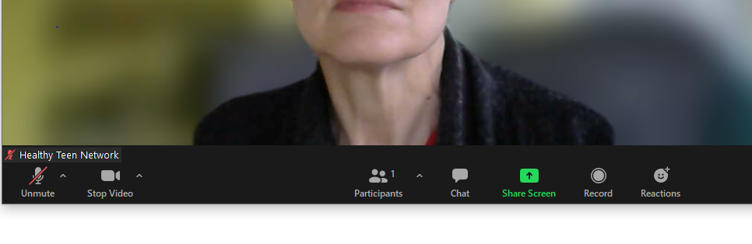
Inserting Yourself into Your Slide Show
Click on the Share Screen button
Click on the Share Screen button
Notes:
The first thing that I will do to do that is to click on the Share Screen option, at the bottom of the screen.

Slide 10
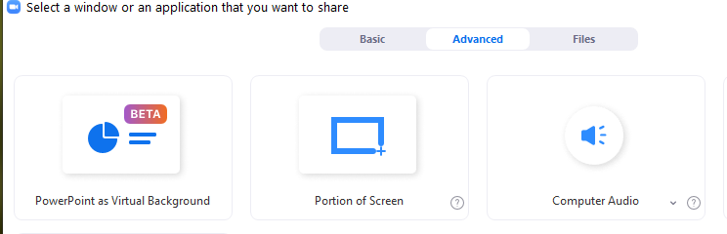
Inserting Yourself into Your Slide Show 2
Inserting Yourself into Your Slide Show
Choose “Advanced” and click on “PowerPoint as Virtual Background”
Choose “Advanced” and click on “PowerPoint as Virtual Background”
Notes:
Once I do that, you're going to see there are three tabs that say Basic, Advanced and Files.
Choose the Advanced tab and you'll see one of the choices is to use your PowerPoint as a virtual background.
You would just choose the PowerPoint as the virtual background, and then once you select the file, you'll be able to just be inserted into your slide.
Just a quick note, that this will only work if it's a PowerPoint slide and not Google slides, but it's really easy to just download your Google slides as PowerPoint slides if you have PowerPoint.
This is just a small little thing, but it's kind of a fun way to gain people's attention and sometimes inject a little humor, depending on what's on the back of your slide

Slide 11
5 Tips to Prevent Virtual Burnout 2
5 Tips to Prevent Virtual Burnout
Prioritize your face over slides
Ask for “face time” from youth at strategic moments
2. Ask for “face time” from youth at strategic moments
Notes:
The second tip is to see if you can increase video participation by asking people to ‘pop in’ at just a few strategic times.
This reduces the burden on youth to be on camera for a full session after a long day on Zoom.
You can make this fun.
I’ll demonstrate now, and feel free to play along.You have 10 seconds to find an object you can reach and try to wear it as a hat.
The winners are the first person to show me an object they are balancing, and the second winner is for the most unusual hat.
My idea here is that you can do a really quick little energizer that might motivate people to turn on their cameras for just a moment.
I'm going to move on to the third tip.

Slide 12
5 Tips to Prevent Virtual Burnout 3
5 Tips to Prevent Virtual Burnout
Prioritize your face over slides
Ask for “face time” from youth at strategic moments
Give them choices in how to interact
3. Give them choices in how to interact
Notes:
The third tip is to give people some choices in how to interact.
This might seem kind of intuitive, and we've already heard that they're potentially finding it exhausting to keep their cameras on, but just recognizing that they may or may not be comfortable speaking aloud can help.
For example, they may not be comfortable speaking aloud, but may be willing to participate via the chat.
If you are able to provide earbuds, this may also help with any privacy issues they may be experiencing.
Make sure to monitor the chat continuously or have a co-facilitator do this for you, and respond to reinforce the comments you get.

Slide 13
5 Tips to Prevent Virtual Burnout 4
5 Tips to Prevent Virtual Burnout
Prioritize your face over slides
Ask for “face time” from youth at strategic moments
Give them choices in how to interact
Use virtual backgrounds and filters for fun
4. Use virtual backgrounds and filters for fun
Notes:
The fourth tip is to show youth how to change their virtual background and use video filters, and incorporate activities that allow them to play with these features.
Examples might include picking a filter that best matches their mood at the moment, or who they would like to be for a day.
You’ll want to remind youth to keep their images appropriate.
If someone does share an offensive image, you can always turn their video off by hovering on their video, and then send them a private message asking them to change the image they are sharing.
You can also use a filter yourself to add a little humor and change the energy from time to time.
I’m going to demonstrate this now and show you how to play along if you wish.

Slide 14
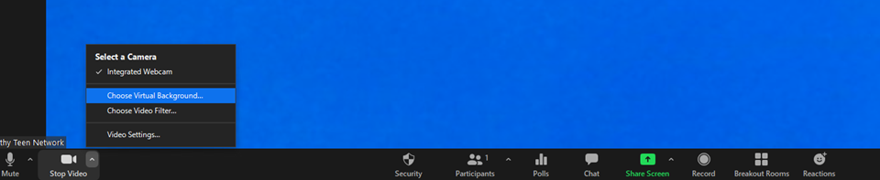
Using Backgrounds & Filters: Let’s Practice
Click on the “^” beside
the Video button and click
“Choose virtual background”
Click on the “^” beside
the Video button and click
“Choose virtual background”
Notes:
Click the menu beside the Stop Video button and select Choose Virtual Background.

Slide 15
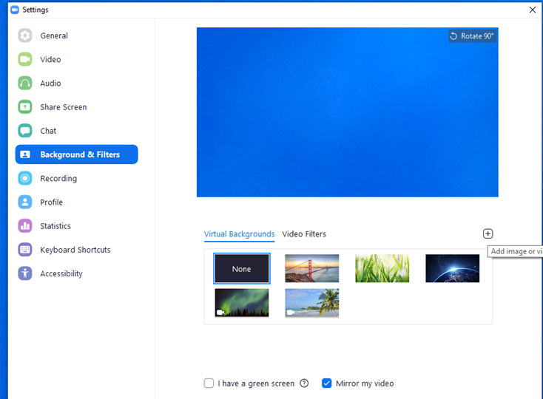
Using Backgrounds & Filters: Let’s Practice 2
Choose an image by clicking on it, or click the “+” on the right side to add your own image
Choose an image by clicking on it, or click the “+” on the right side to add your own image
Notes:
If you click the second tab, you can choose an video filter.

Slide 16
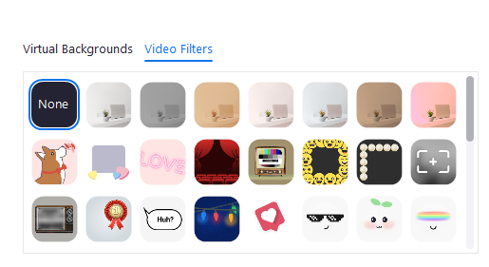
Using Video Filters
Choose Video Filters, and click on one of the images below.
Choose Video Filters, and click on one of the images below.
Notes:
This is a fun way of changing the energy and encouraging people to put on their cameras for a moment and let people have a little bit of fun.
The more fun they have, the more likely they are to feel engaged and it's a way of just alleviating that burnout, just for about that moment, at least.

Slide 17
5 Tips to Prevent Virtual Burnout 5
5 Tips to Prevent Virtual Burnout
Prioritize your face over slides
Ask for “face time” from youth at strategic moments
Give them choices in how to interact
Use virtual backgrounds and filters for fun
Provide incentives (strategically)
Provide incentives (strategically)
Notes:
Tip #5 is to provide incentives, but choose them wisely.
Ask your participants for their ideas about ways to make their virtual life more fun and incentives that might make participation feel more rewarding.
Rather than just giving out prizes for tuning in, consider having contests like choosing a song that fits the theme of the presentation, and having the winner lead a dance break.
This may be a good way to change the energy during a virtual session, and to get participants up and moving.
If you have a budget for incentives, you can ask participants what they would most appreciate.
Some facilitators have used prizes like gift cards or a temporary subscription to a channel such as Disney Plus.
Those are some things that we've heard from people that they have used and that have been successful for them.
I am going to turn it back over to Megan for a moment to see if we have any Q & A questions and then we'll move on from there.

Slide 18


Q&A
What questions do
you have for us?
Notes:
Thank you so much, Valerie and Genevieve.
What great tips and ideas and sharing and ideas.
We'll take just a couple of questions here if you have specific questions for Valerie or Genevieve before we move into breakouts.
I am going to chat out a link for a tip sheet from our last RHNTC webinar where some ideas around recruiting and retaining youth, specifically some resources around incentives were shared, but again, that's on the website as well.
I'm not seeing any questions right now and so I'm thinking without further ado, I think we should let folks talk and share and discuss. So I think let's transition to our small group discussions.
Again, huge thank you, Valerie and Genevieve, for getting us started with some of these ideas.

Slide 19
Small Group Discussion
Notes:
You’re going to be transported into a small group discussion, your microphones will be un-muted and you'll be able to share and discuss.
We're going to come back here after about 25 minutes and debrief, and then close up the webinar.
Stay tuned and we'll look forward to seeing you back here after about 25 minutes
Once in your respective breakout:
We hope to reflect on what was shared and also offer space to discuss the tips shared specific to your situation AND pull together other things you’ve tried that could also add to our shared understanding of how to address burnout.
Note to facilitators:
Ask folks to offer their name and grantee organization the first time they share.
Also remind the group that we will be using Miro to capture the discussion and tips shared during the conversation.
This will be shared with all individuals attending as reference.
Discussion questions:
What strategies have you tried and are effective?
What strategies have not been effective? Why?
What tips would you like to know more about?
Any tips that weren’t mentioned that you’ve tried? If yes, how did it go?

Slide 20
Takeaways
What is one strategy or tool that you learned
about in your small group discussion?
What is one strategy or tool that you learned about in your small group discussion?
Notes:
Valerie is going to lead us in a debrief quick of what we learned, but just note that the mural board findings are going to be shared back, so you're going to have a lot of great ideas and strategies to follow up on.
What is one strategy that you can employ right now?
Post your response in the chat.
Virtual gift cards.
Five minute walks.
Staring at something that is 20 feet away for 20 seconds every 20 minutes to give your eyes a break.

Slide 21
Contact Information
Valerie@healthyteennetwork.org
Genevieve@healthyteennetwork.org
Notes:
Thank you Valerie and Genevieve for sharing such, such great tips and getting conversations started.
We've put your email addresses here.
If folks have questions, you can contact them.

Slide 22
Resources
Increasing Access to TPP Program Activities
in a Virtual Setting
Recruiting and Retaining TPP Program Participants Virtually—Strategies From the Field and Peer Sharing
Show and Tell of Virtual Tools
Notes:
Here are some additional, excellent resources that can help you as you’re working to implement your programs virtually.
You can located the first two resources on rhntc.org and the last one has been referenced on Max.gov.
We will also be sharing the notes from our breakout discussions as a resource in the future.

Slide 23
Upcoming Activities
Trauma-Informed Approach in Adolescent Health:
Team Meeting Series
This series of four meeting packages will be
released throughout the spring of 2021.
Building Partnerships Job Aids May 2021
Systems Thinking Toolkit May 2021
Notes:
We do have some upcoming activities.
We have a Trauma-Informed Approaches in Adolescent Health: Team Meeting Series that we'll be sharing a bit more on at the grantee meeting in May.
Those will be team meeting packages that will be posted.
Look out for a couple of Job Aids that we're doing around building partnerships and a Systems Thinking Toolkit that will be coming out too.

Slide 24




How to Engage With Us
Subscribe to the RHNTC monthly eNewsletter at rhntc.org/enewsletter
Contact us on rhntc.org
Sign up for an account on rhntc.org
Follow us on Twitter @rh_ntc
Notes:
Finally here are a variety of ways you can engage with us.
We have a monthly newsletter that we’d love you to subscribe to.
You can also send us an email on the website under the contact us tab.
You can sign up for an account at RHNTC.org .
And lastly you can follow us on Twitter at @rh_ntc.

Slide 25
Thank You! Please fill out the evaluation form after the webinar! Contact Us
rhntc@jsi.com
Notes:
Thank you all for joining us today.
Please join me in thanking our panelist today.
As a reminder, we will have the materials from today’s session available within the next few days.
If you have additional questions for the RHNTC on this topic, please don’t hesitate to email us at rhntc@jsi.com.
Our final ask is that you please complete the evaluation today.
The link to the evaluation will be chatted out now and will be emailed to you after the webinar.
We really love getting your feedback and we use it to inform future sessions.
Thank you again for joining us.
That concludes today’s session.

