Slide 1
Information and Education Materials Review
April 27, 2021
Notes:
Information and Education Materials Review

Slide 2
Welcome!

Slide 3
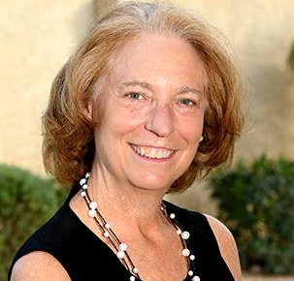
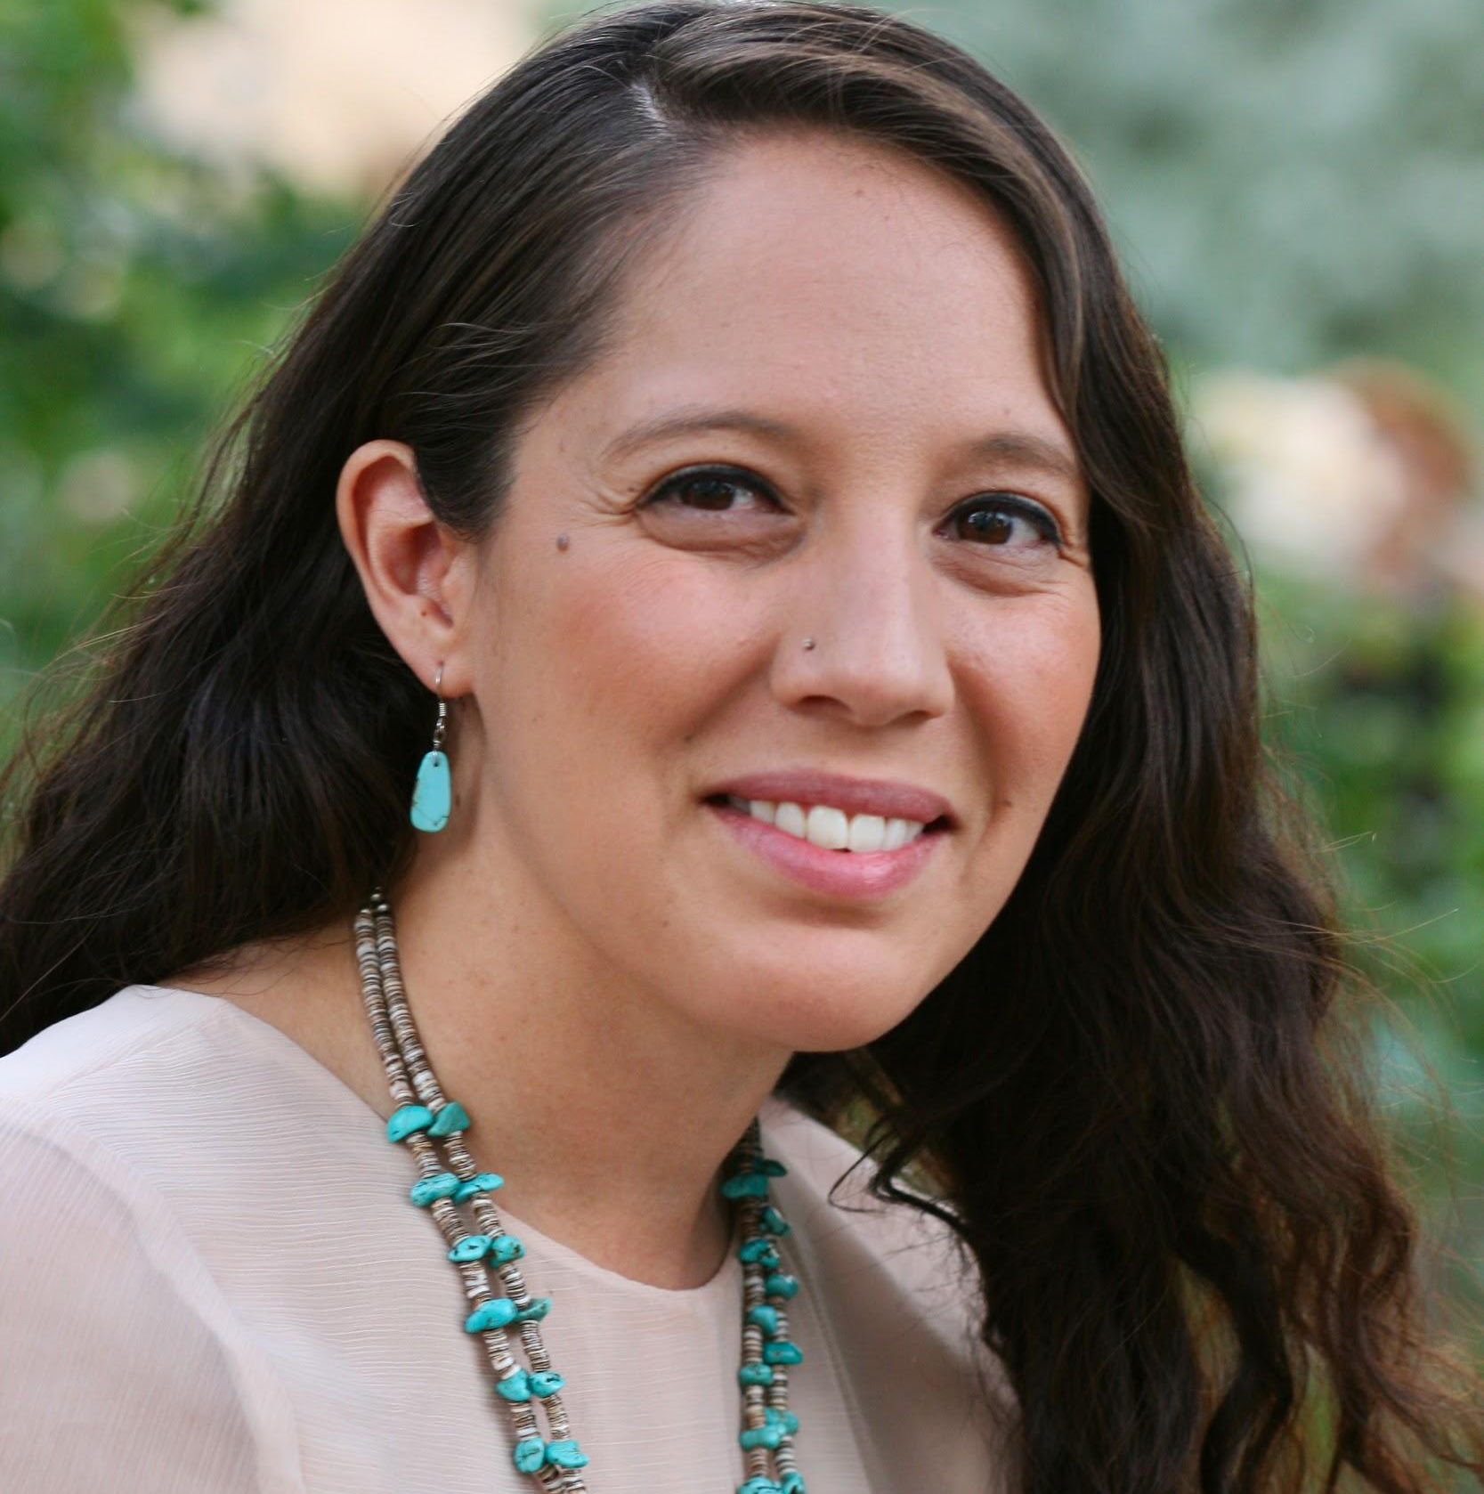
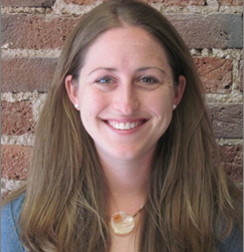
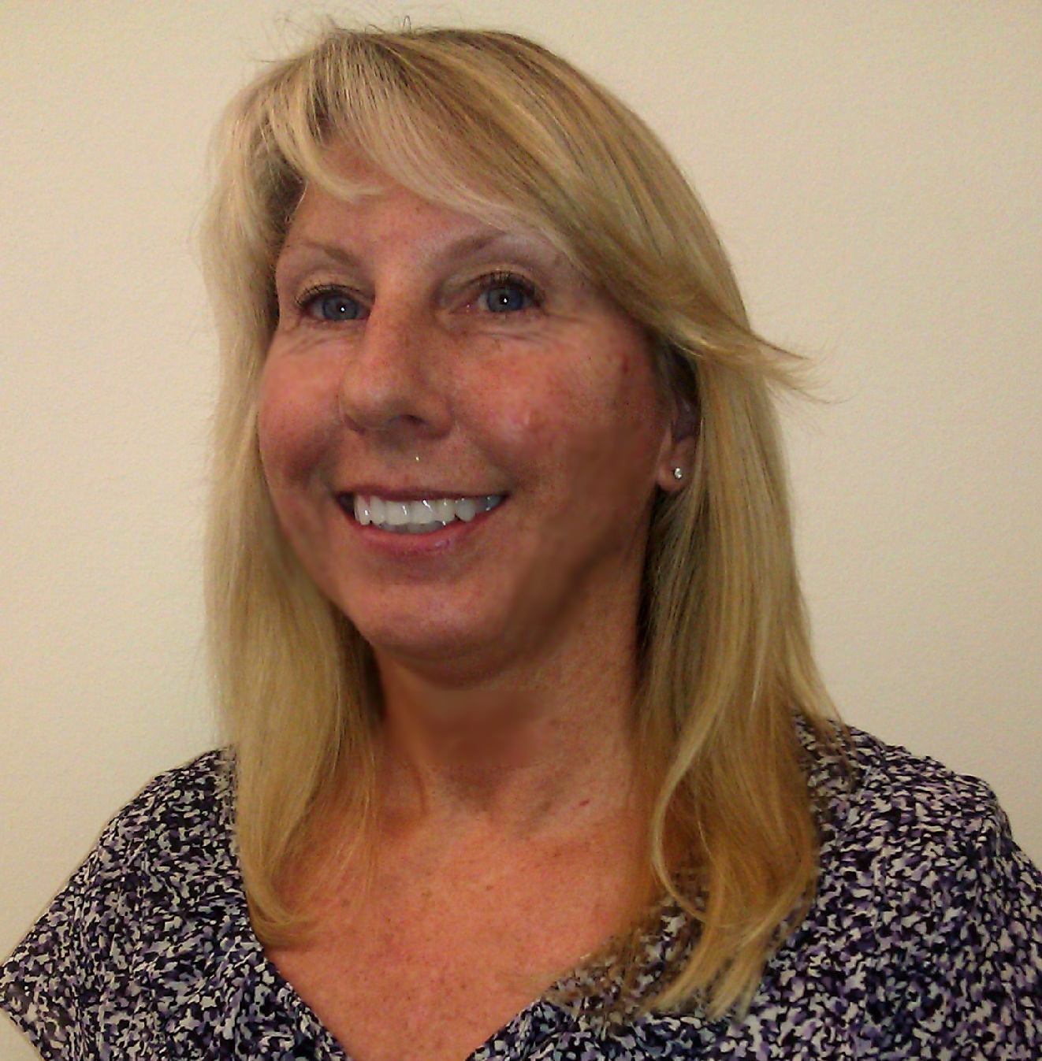
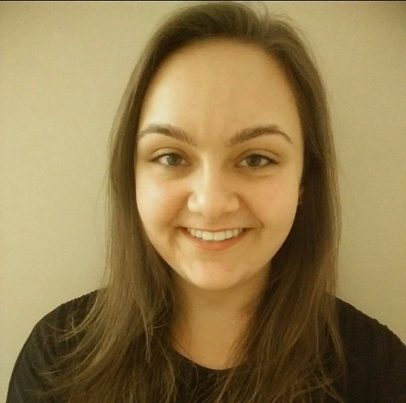
Today’s Webinar Team
Lisa Schamus
Hannabah Blue
Caitlin Hungate
Nancy Thomas
Angelique Higgins
Notes:
I’d like to briefly introduce our speakers today, my Reproductive Health National Training Center colleagues Lisa Schamus, Hannabah Blue, Nancy Thomas, and Angelique Higgins.
Lisa currently serves as the Title X lead for the RHNTC. Lisa comes to this position with two decades of Title X experience. During Lisa’s work as the Director of Program and Evaluation for the Arizona Title X grantee, she had the opportunity to both carry out I&E materials review and work with subrecipients on their I&E materials review processes. Lisa is one of two RHNTC co-presenters on today’s webinar.
Hannabah, our other co-presenter, a training and TA provider with the RHNTC, is Dine' or Navajo from New Mexico. She has been working in sexual and reproductive health for the past 10+ years. Her expertise includes equity centered approaches, working with diverse communities, youth, LGBTQ+ individuals and Tribal communities.
Nancy is a member of the RHNTC Title X team and has been working behind the scenes to make sure that today’s webinar runs smoothly and that participants and presenters have the resources they need. Nancy has over 10 years’ of Title X experience.
Angelique, who is new to Title X and comes to the RHNTC team from a behavioral health background, was a part of the development team for this webinar and will be facilitating the more interactive aspects of today’s session.

Slide 4
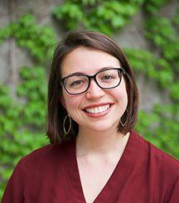

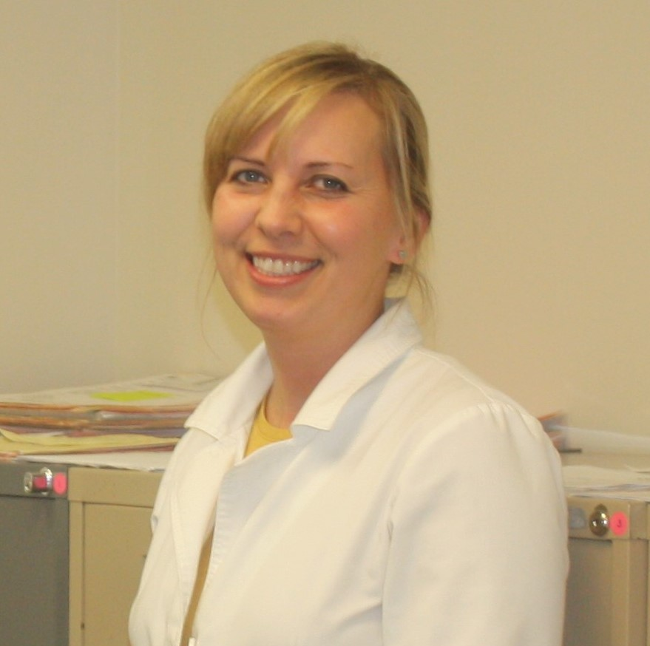
From the Field
Ashley Kuykendal
Missouri Family
Health Council
Lisa Ecsi Davis
Tri-Rivers
Family Planning
Lucia Obergoenner
East Missouri
Action Agency
Notes:
This webinar also features the I&E experiences of one grantee, the Missouri Family Health Council, and two of MFHC’s subrecipient agncies. This team includes:
Ashley, who is a Program Manager at Missouri Family Health Council, Inc. and has been a part of the Title X network in various ways since 2016. She is excited about ensuring our family planning services grow in service of the queer and trans community and in alignment with the reproductive justice movement. Ashley loves living in South St. Louis City with her housemates, pups, and burgeoning garden;
Lucia, who is the Program Director and the Nurse Practitioner at East Missouri Action Agency Women's Wellness Center. She has served as a Title X provider since 2010 and is most passionate about providing quality one-on-one reproductive health care that is all inclusive and client centered. Her favorite motto is "Far and away the best prize that life has to offer is the chance to work hard at work worth doing." Outside of work, Lucia enjoys spending time with her husband and their furry family, crafting, and volunteering; and
Lisa, who is the Director of Operations at Tri Rivers Family Planning. She has been a part of the Title X network for 30 years and is most passionate about helping human beings be sexually healthy. Outside of this work, Lisa enjoys reading, crocheting, Facetiming with family in IN and NY, spending time with her husband and her dogs, and dominating her breast cancer with a powerful, positive attitude.
Ashley, who will be presenting today on behalf of all three organizations.

Slide 5
Objectives
By the end of the session, participants should be able to:
Explain the difference between community participation, education, and project promotion (CPEP) and Information and Education (I&E)
Describe Title X I&E materials review requirements
Identify strategies for recruiting and retaining I&E materials reviewers
Identify in-person and virtual strategies for gathering material review input
Notes:
During my time as the Director of Program and Evaluation in Arizona, Information and Education Materials Review, or I&E as it is commonly referred to in the Title X community, was one of the Title X requirements that, while seeming simple in theory, was often hard to operationalize.
During my time at the RHNTC (and the FPNTC before it) I have had the opportunity to speak with many grantees and subrecipients about their I&E experiences.
These conversations, as well as conversations with OPA, have helped inform this session and it is my hope that the information we share with you today will help clear up any potential confusion regarding the I&E process, and provide you with suggested strategies and tools that you can use to operationalize I&E in a way that solicits meaningful feedback from clients and potential clients for whom the materials are intended.
To meet those goals, by the end of today’s session, participants should be able to:
Explain the difference between community participation, education, and project promotion (or CPEP) and I&E
Describe Title X Information and Education (I&E) material review requirements
Identify strategies for recruiting and retaining I&E materials reviewers, and
Identify in-person and virtual strategies for meaningfully gathering material review input

Slide 6
Community Participation, Education, and Project Promotion (CPEP) or I&E?
CPEP
Purpose: Achieve community understanding of the objectives of the program, inform the community of the availability of services; and promote continued participation
in the project.
Who to engage? Persons broadly representative of all significant elements of the population to be served, and by others in the community knowledgeable about the community's needs for family planning services.
For example: Youth and client advisory committees, social service agencies, primary care agencies, faith-based community organizations, school personnel, etc.
I&E
Purpose: Review and approval of informational and educational materials developed or made available under the project to assure that the materials are suitable for the population or community to which they are to be made available.
Who to engage? Include individuals broadly representative (in terms of demographic factors such as race, color, national origin, handicapped condition, sex, and age) of the population or community for which the materials are intended.
For example: Clients and potential clients.
Notes:
Before we take a deep dive into I&E, I wanted to start off by making sure we all have an understanding of I&E and the difference between I&E and Community Participation, Education, and Project Promotion, or CPEP, as I often hear that there is confusion about the difference between these two Title X requirements.
The chart on this slide provides a quick synopsis of the purpose and audiences for both CPEP and I&E. In looking at this, we see that the purpose of CPEP is to achieve community understanding of the objectives of your Title X program, inform the community of the availability of services, and to promote continued participation in Title X. CPEP has a very broad purpose - or even purposes.
Comparatively speaking, the focus of I&E is much more narrowly defined. The purpose of I&E is to ensure that information and educational materials developed or made available under the project are suitable for the population or community to which they are made available.
While it is true that Title X projects need to engage community members to address both CPEP and I&E, the makeup of the people you are engaging, while potentially having some overlap, is different.
For CPEP, Title X agencies should be engaging a wide range of individuals and groups who are broadly representative of all significant elements of the population to be served and - this is where the distinction is - by others in the community knowledgeable about the community’s need for family planning services.
Some examples include social service agencies, primary care agencies, faith-based organizations, school personnel, and youth and client advisory committees.
So, the potential overlap is that you may have clients and potential clients involved in both CPEP and I&E but you will be engaging a much broader audience for CPEP activities.
Put simply, CPEP is about the whole program while I&E is about materials.
What is also true of both, is that, when done in the spirit of the Title X CFR, these two parts of your TItle X program can be instrumental in guiding your Title X projects equity, diversity, and inclusion work.
In terms of what materials should be included in your Title X I&E materials review, you’ll want to make sure you include any family planning and reproductive health related materials REGARDLESS of whether it was designed in-house, by the CDC, or a company that creates health education materials.

Slide 7
Poll
In your Title X network, does the grantee conduct the I&E materials review,
or is it delegated to subrecipients?
The grantee conducts the materials review
The subrecipient(s) conducts the materials review
Both the grantee and subrecipient(s) conduct the materials review
I don’t know
Notes:
Let’s take a quick poll.
As a quick reminder - the grantee is the agency that gets funds directly from the Office of Population Affairs while a subrecipient is funded by the grantee.

Slide 8
I&E Materials Review Process
Understanding I&E
Conducting I&E Review
Preparing for I&E
Documentation and Follow-up
Notes:
We will be walking through these four stages of the I&E Materials Review process.
First, we will review the foundations of I&E and it’s importance.
We will discuss how to prepare for the I&E review, including recruiting for reviewers.
We will share strategies and hear from Ashley with the Missouri Family Health Council (MFHC) about their process.
And finally, we will share information about documenting and integrating the feedback from the I&E Committee reviewers. As well as how the grantee can plan for the I&E program review with OPA and subrecipients and service sites can plan for site visits from the grantee.

Slide 9
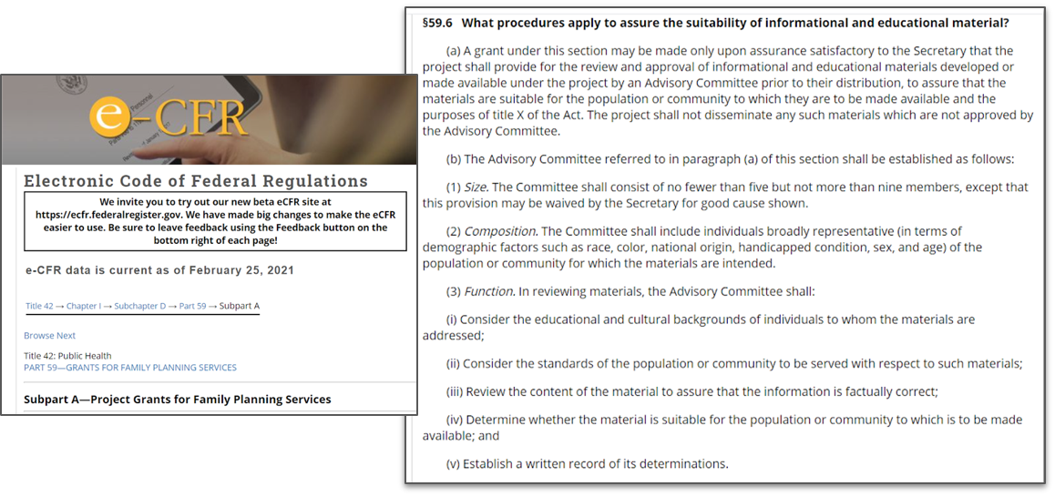
Understanding I&E
e-CFR link
Notes:
The I&E process is mandated through the Code of Federal Regulations or CFR, as part of the Program Guidance for Family Planning Services.
The specific requirements for the I&E review are included in section 59.6, which is shown here.
You can review it by going to the link, but we are going to summarize it here.
Resource:
eCFR (https://www.ecfr.gov/cgi-bin/text-idx?node=se42.1.59_16&rgn=div8)

Slide 10
CFR 59.6: Purpose
Review and approval of informational and educational materials
developed or made available under the project by an Advisory
Committee prior to their distribution.
Assure that the materials are suitable for the population
or community to which they are to be made available and
the purposes of Title X.
Ensure nothing is disseminated that is not
approved by the Advisory Committee.
Notes:
The purpose of the I&E review is to ensure that materials go through a review and approval process to ensure:
That they are suitable for the population or community they will be made available for, and
That nothing is disseminated without going through this process.

Slide 11
CFR 59.6: Process
The Advisory Committee must have, 5–9 members, include individuals broadly representative (in terms of demographic factors such as race, color, national origin, handicapped condition, sex, and age) of the population or community for which the
materials are intended, and complete a documented review of materials for:
Educational and cultural backgrounds of individuals to whom the materials are addressed
Standards of the population or community to be served with respect to such materials
Factually correct information
Suitability for the population or community to which
it is to be made available
Notes:
What does the CFR say about how that will be done?: through the recruitment of 5-9 individuals who broadly represent the population or community for which the materials are intended, who will complete a review that is documented.
They will review to ensure that the materials are not just factually accurate, but also take into account their educational and cultural background and standards, so they are suitable for the population or community who will receive them.

Slide 12
Totally Clear, Right?
What are informational and educational materials?
Who is considered within the population or community for which
the materials are intended?
What does broadly representative mean (in terms of demographic factors
such as race, color, national origin, handicapped condition, sex, and age”)?
What are the standards of the population or community to be served?
What is suitable for the population or community to be served?
When are there exceptions (if any) to the I&E Materials Review process?
Notes:
From talking to grantees, we know that there are still questions about what this all means in actuality when you are looking to conduct the I&E process with your organization.
Here are some questions that we’ve heard from grantees about the process. The language that is underlined is taken directly from the CFR.
What are I&E materials?
Who is considered part of the population or community for which the materials are intended?
What does broadly representative mean in terms of demographic factors?
What are the standards and what is suitable for the community or population to be served?
When are there exceptions, if any, to the I&E materials review process?
We will come back to these throughout the presentation, to try to provide some clarity on them.

Slide 13
Why is the I&E Materials Review Process Important?
Let’s hear from you!
  Why is the I&E Materials Review process important?
  Please keep your responses to short phrases (1–3 words).
Notes:
Now we want to hear from you.
What have you seen, that shows why the I&E materials review process is important?
Because we will be using an interactive platform, we ask that you keep your responses to 1-3 words, and 25 characters or less.
We advise you to go to this website on your phone. This will help with displaying everyone’s input in a word cloud. If you are unable to chat into the Mentimeter, you can chat into the Zoom chat box, and we will add your response into the Mentimeter.
Please keep the Mentimeter up on your device, and it will refresh with a new question, when we get to that point in the presentation.

Slide 14
Why is the I&E Materials Review Process Important? (cont’d)
Connects with diverse clients
Ensures inclusive and respectful resources
Ensures materials are understandable
Gives committee members a voice
Addresses health disparities
Takes an equity approach
Addresses the needs of priority populations
Notes:
Just as many of you have indicated, there are many reasons that the I&E materials review process is important.
Many of these align with what you shared.
The process provides the opportunity for Title X projects to be inclusive and engage diverse audiences in an equitable fashion.
We also want to acknowledge that many Title X programs are often trying to balance all of the work of their programs.
We know that grantees are all in different stages in conducting I&E, and do it different ways.
So we hope that you can take some information, strategies and tools from this webinar to help with your efforts to meet the requirements from the CFR.

Slide 15
Preparing for the I&E Materials Review Process
Create internal I&E policy
Define I&E review structure, including:
  Responsibility for review and approval process
  Monitoring of subrecipients and service sites for compliance
  Mechanism of reviews (in person, electronically)
  Criteria used for reviews and approvals
  Frequency of reviews and approvals
  Documentation needed for compliance
  Staff training needed for this process
*Internal Policy Template available on RHNTC.org
Notes:
Let’s move from understanding I&E to preparing for it. Here are a few steps in order to do that.
You can start by creating an internal I&E policy or ensuring that the one you have in place meets the requirements.
This includes several elements that can help to organize the work, including who is responsible for the review and approval process, monitoring for compliance, how material reviews will be conducted, including the mechanism, criteria used, frequency and how they will be documented.
They can also include the staff orientation and training for the process.
The RHNTC has a resource on the website that provides a template for this policy.

Slide 16
Preparing for the I&E Materials Review Process (cont’d 2)
Identify ideal Advisory Committee Member characteristics
  Based on FPAR data: broadly representative:
    Identify and make a list of demographic categories. Be specific.
    Keep in mind the population or community for which the materials are intended
  Using an equity approach can identify critical reviews needed:
    Review community data, such as Census data, to identify which groups are experiencing the largest disparities, including those that are not shown in FPAR data. These may be groups that need services, but you are not currently reaching.
    Consider groups that may need materials specifically tailored to them, such as people of color, LGBTQ+ individuals, and youth
Notes:
Preparing for the I&E materials review process also includes recruiting individuals who will review the materials.
Please note that while this slide and the CFR says “advisory committee”, it is not required to actually have a committee in the sense that we often think about committees.
It can be a group of folks that are asked to review materials, but they don’t have to meet as a formal group of people regularly.
They can have a committee, but there are also other ways of engaging the reviewers, which we will get into later.
When identifying characteristics of reviewers that you would like to recruit and engage for the I&E materials review process, it is important to come back to that language in the CFR to identify those characteristics that are “broadly representative” of who the materials are intended for.
You can identify those demographic characteristics by reviewing your FPAR data.
This will identify those who you are already reaching.
When identifying these characteristics, it is important to be specific. Think about the materials that are being developed and who they are intended for.
But you also want to seek reviewers that are representative of groups that you are currently not reaching.
Example: When Lisa Schamus (now with the RHNTC) was the program director of a Title X program, they looked at Census data to identify groups that they were not currently reaching. I&E reviewers from these groups could help to identify how to develop materials that can provide information to groups that may need to have information specifically tailored to them.
This includes groups such as LGBTQ+ individuals, people of color and youth.
This strategy is also inline with taking an equity approach, where you can identify groups that are experiencing disparities in your community, and tailoring messages that speak to them.
When taking this approach, it is important to consider how to respectfully engage individuals from these groups.
Consider the time and effort it may take to build relationships with individuals from these communities, especially if you are not currently engaging them in your services.
When you are planning your review process, think about how to structure your materials reviews to best meet the needs of members of this group.
When thinking about youth, consider the time of day that you are asking them to meet or conduct reviews.
Consider what compensation would be most appropriate, and any other processes.

Slide 17
How are you currently recruiting
Advisory Committee members?
Let’s hear from you!
Please keep your answers to short phrases (1–3 words).
Notes:
We want to hear from you again.
How are you currently recruiting I&E reviewers?
Please fill out the information on the Mentimeter, and again, please keep your answers to 1-3 words.

Slide 18
How do you retain members or keep them engaged?
Let’s hear from you!
Please keep your answers to short phrases (1–3 words).
Notes:
Now that you have recruited reviewers, how do you continue to engage them?
Again, this may not be a steady group of people that meets regularly over time.
But we know that some programs do use that model.
We have also heard that programs sometimes have a hard time retaining people to serve as materials reviewers.
What have you found to be effective or helpful in continuing to engage your reviewers? And again, short answers please.

Slide 19
Preparing for the I&E Materials Review Process (cont’d 3)
Recruit or re-engage Advisory Committee members
  Ask clients to review materials while they are waiting for their appointment
  Engage youth advisory groups
  Ask for assistance with recruitment from partners, such as social service and primary care provider agencies
  Recruit through social media, tabling or other CPEP activities
Reminder: It may not meet your I&E purposes to rely on your CPEP Community Advisory Committee solely.
Notes:
Aligned with many of the strategies that you shared, here are some that we have also seen be effective.
You can ask clients to review materials while waiting for their appointments. You can engage reviewers from a youth advisory group, or ask your community partners to recommend reviewers or help to recruit for them. You can also recruit through social media or other CPEP activities.
Keep in mind that your CPEP advisory committee will probably not meet your I&E review purposes because CPEP advisory members may not be clients and/or potential clients but rather folks that are more broadly representative of your community who are familiar with the family planning needs of community.
Now we’ll talk about strategies and tools for actually conducting the process.

Slide 20
Conducting I&E Materials Review
The structure for the reviews can take many forms:
Who:
Representatives from community/service area(s) engaged by:
Grantee
Subrecipient(s)
Service site(s)
What:
Educational and promotional materials:
For all current or potential family planning clients
For specific subrecipient or service site(s)’ current or potential clients
For current or potential clients from specific communities or populations
For What:
Medical and factual accuracy
Reading level
Appropriateness, relevance, and fit
Cultural responsiveness
Other identified elements

Slide 21
Conducting I&E Materials Review (cont’d)
The structure for the reviews can take many forms
How do you conduct I&E Materials Reviews? (Chat into the chatbox.)
How:
  In-person
    In the waiting room
    At reviewer pizza parties
    At client appreciation parties
    At tabling events
  Virtual
    Through email
    Through Zoom or phone conferences
    Structured survey and/or open-ended responses
Notes:
The structure of the reviews can take many forms.
We have listed some of the methods used to conduct reviews here; but, this is by no means an exhaustive list.
Please chat into the chatbox other ways to conduct the reviews while we go over some of the ones listed on this slide.
While each of the methods outlined in this list has some benefits, they can also come with challenges.
For example, while asking clients in the waiting room to review materials may be extremely convenient for the Title X agency, and ensures that the feedback is from your client population, a client may be feeling stressed about their visit and may not be able to provide as thoughtful a review as they could in a setting designed specifically for giving feedback.
For obvious reasons, during the pandemic, getting input at pizza parties and client appreciation parties is problematic.
Even before the pandemic, we often heard that brining groups of reviewers together can be challenging due to scheduling, transportation, and other concerns.
A benefit, however, is that, when doing the review in groups, reviewers are often able to be more thoughtful about their feedback by listening and responding to other reviewers considerations.
In terms of virtual reviews, these have the benefit of not requiring people to travel, and, of course, during the pandemic, the benefit of ensuring that reviewers and staff that conduct the reviews are not put in harm's way.
Having said that, not everyone has access to devices or wifi and there can often be challenges with sharing files - so electronic and virtual reviews are not always possible.
Email reviews have the benefit that reviewers can provide the feedback at a time that works for them; though again, there is potential that the feedback might not be as rich as feedback provided during a zoom meeting or phone conference where reviewers can hear each other’s thoughts which may spark richer reviews.
In addition to the review methods listed here, some of the other ideas folks have chatted in include:

Slide 22
I&E Materials Review Tools
Materials Review documents (I&E Materials Templates available on RHNTC.org)
  Materials Inventory Log
  I&E General Staff Review Form
  I&E Medical Staff Review Form
  I&E Advisory Committee Review Form
The RHNTC tools are not required! They provide one of many ways to document your process.
These tools have been developed for you to modify to meet your
agency’s needs.
Notes:
To assist with the review process, regardless of whether you conduct the reviews through pizza parties, Zoom meetings, or any other method, the RHNTC has a number of tools that TItle X agencies can modify to meet their unique needs.
These tools are by no means required. They are provided as one of many ways to document your process.

Slide 23
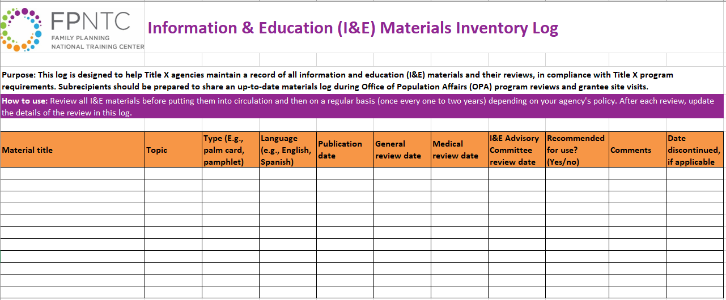
Materials Inventory Log
Notes:
One way to approach I&E materials review is to start with a materials inventory log to track the family planning and reproductive health materials used in your Title X program such as the materials in your waiting room, materials that staff provide to clients, and materials that you use at community events to promote your Title X program.
When considering what materials to add to your I&E tracking system and materials review process - whether that be through a log such as this or another mechanism - you’ll want to make sure you include any family planning and reproductive health related materials regardless of whether it was designed in-house, by the CDC, or by a company that creates health education materials.
This Materials Inventory Log is designed to include documentation of a general staff review, medical staff review, and I&E committee member review.
If that is not how your process works, the log can be modified to mirror your I&E policies and processes.
One option is that new subrecipients who are just starting the I&E process begin by taking an inventory of all of their relevant materials.

Slide 24
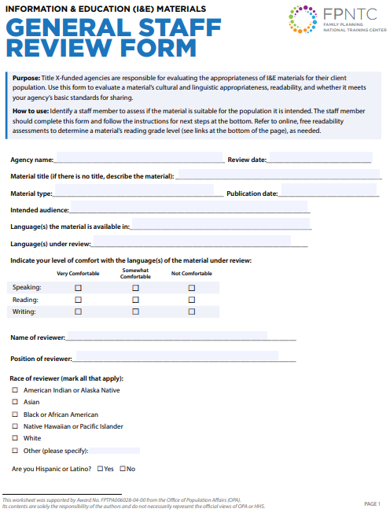
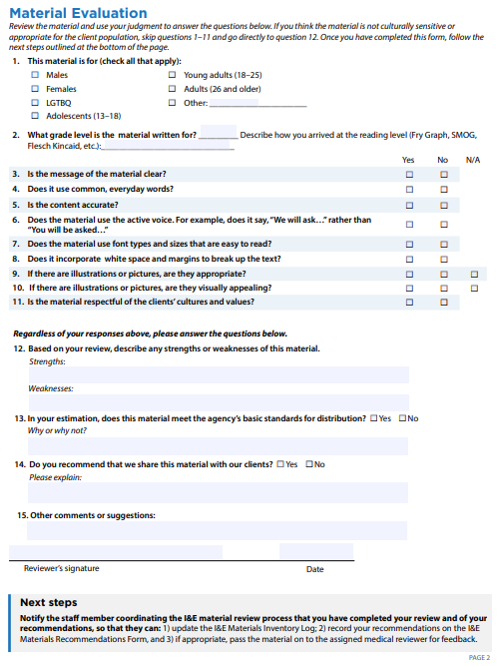
I&E General Staff Review Form
Notes:
After making sure that all the materials were on the inventory log, we recommended that the next step be a general staff review. Again, this is simply a recommendation.
This tool, that Title X agencies can modify to meet their needs, can be used by staff to ensure that the material aligns with the backgrounds and needs of the client population. Some of the questions that this part of the review considers include:
who the material is intended for,
what grade level the material is written for,
whether or not the message is clear, accurate, uses common words,
whether or not the material is visually appropriate and appealing, and
if the material is respectful of the clients’ cultures and values.
While a staff person may be best suited to ask some of these questions, it is important to to also get input on many of these questions from the I&E committee members - so - when we look at the sample committee member review form, you will see many of these questions again.
It is also important to note that any staff members that are reviewing materials can NOT be counted towards the 5-9 committee member requirement.

Slide 25
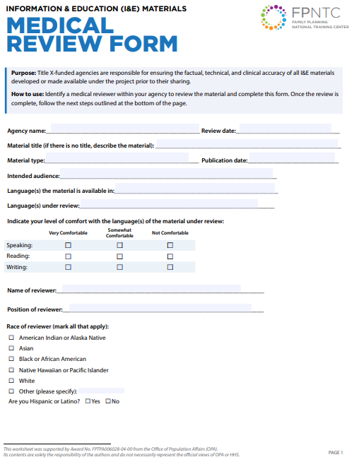
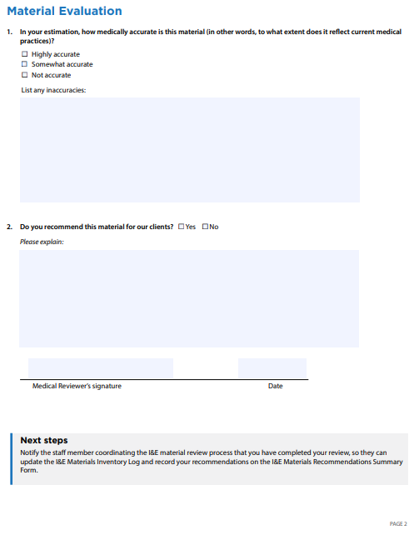
I&E Medical Staff Review Form
Notes:
In addition to the general staff review form, the RHNTC has a Medical Staff Review form that you can modify to meet the needs of your Title X agency.
This form can be used to document that I&E materials have been evaluated by a medical reviewer for factual, technical, and clinical accuracy.
This part of the review is fairly simple - with one main question about the accuracy of the materials.
Many agencies may want to combine this review with the general staff review.
Taking these two steps - of conducting the general and medical staff reviews before brining the materials to your advisory committee can reduce the burden on the committee by ensuring that some of the requirements are met before the committee review.
For example, the I&E process may stop after a general staff or medical staff review if, the general staff review reveals that the reading level is at a higher level than desired, that the materials does not use everyday words, or the medical review reveals that the information is not medically accurate.
In such cases, using the process outlined in the RHNTC toolkit, the process would be documented in the materials log and, if already in circulation, the materials would be pulled and discontinued.

Slide 26
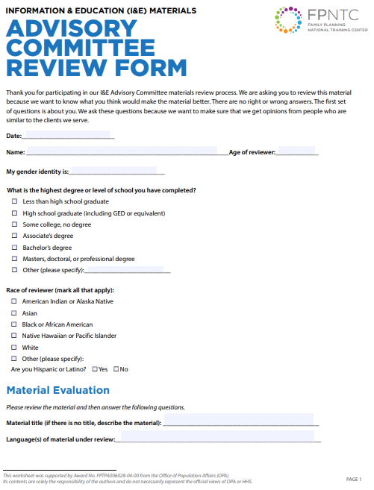
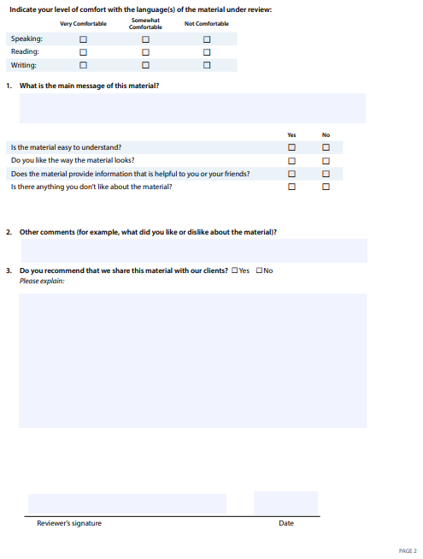
I&E Advisory Committee Review Form
Notes:
The next step in the process outlined in the toolkit is the actual I&E committee review.
Earlier in this webinar, we talked about the various configurations of the committee.
Regardless of how you solicit the feedback, the feedback does need to be documented.
Remember that this I&E Advisory Committee Review Form itself is not required and can be modified to meet the needs of Title X agencies for those documentation purposes.
In addition to collecting feedback from committee members, this form also collects some basic demographic information from committee members so that you can assess if you are collecting input from all those in need of services in your service area.
This form asks just a few questions to make sure that the main message of the material is understood by committee members, to ensure that committee members like the look of the material, and to ensure that committee members think the material provided useful information.
Finally, committee members are asked if they recommend that the material be shared with clients and has space for them to elaborate on their response.

Slide 27
Documentation and Follow-up
Integrating recommendations and feedback
  What are the standards of the population or community to be served?
  What is suitable for the population or community to be served?
Sharing feedback back to reviewers
Material Review documents (I&E Materials Templates available on RHNTC.org)
  Summary of Reviews and Recommendations Form
Notes:
Though not shown here, the toolkit also has forms that you can modify to meet your needs to summarize the findings of the review process and a checklist to ensure you have everything you will need in place for your program review or site visit.
The Summary of Reviews and Recommendations form pulls all the information together and can help with integrating recommendations and feedback.
The information gathered from this process, will give you an indication of what is suitable for the materials' intended audience(s).
The more representative the members of the I&E reviewers are of the intended audience, the more reflective the feedback will be of these standards.
In addition, if you take an equity approach by considering what information is needed by who, the more you will be able to make an impact on your entire community.
Though not necessarily a common practice, one suggestion from a grantee is to share the feedback with the reviewers.
In addition to any stipends or “thank-yous”, providing this information back to reviewers goes a long way in demonstrating that their time, knowledge, and input is valued.

Slide 28
From the Field (revisiting)
Ashley Kuykendal
Missouri Family
Health Council
Lisa Ecsi Davis
Tri-Rivers
Family Planning
Lucia Obergoenner
East Missouri
Action Agency
Notes:
This webinar also features the I&E experiences of one grantee, the Missouri Family Health Council, and two of MFHC’s subrecipient agencies. This team includes:
Ashley, who is a Program Manager at Missouri Family Health Council, Inc. and has been a part of the Title X network in various ways since 2016. She is excited about ensuring our family planning services grow in service of the queer and trans community and in alignment with the reproductive justice movement. Ashley loves living in South St. Louis City with her housemates, pups, and burgeoning garden.
Lucia, who is the Program Director and the Nurse Practitioner at East Missouri Action Agency Women's Wellness Center. She has served as a Title X provider since 2010 and is most passionate about providing quality one-on-one reproductive health care that is all inclusive and client centered. Her favorite motto is "Far and away the best prize that life has to offer is the chance to work hard at work worth doing." Outside of work, Lucia enjoys spending time with her husband and their furry family, crafting, and volunteering, and
Lisa, who is the Director of Operations at Tri Rivers Family Planning. She has been a part of the Title X network for 30 years and is most passionate about helping human beings be sexually healthy. Outside of this work, Lisa enjoys reading, crocheting, Facetiming with family in IN and NY, spending time with her husband and her dogs, and dominating her breast cancer with a powerful, positive attitude.
Ashley, who will be presenting today on behalf of all three organizations.

Slide 29
Grantee Story: Missouri Family Health Council

Slide 30
Missouri Family Health Council (MFHC)
Hybrid approach
  MFHC reviews materials available to entire network
  Each subrecipient conducts I&E materials review process
  for all other materials
  Subrecipients use a variety of methods to recruit, retain,
  and obtain input from community for materials review
Notes:
Within our network, we use two different strategies.
For any I&E materials that are relevent for all of our subrecipeints, MFHC’s I&E Committee reviews them.
We also know that our subrecipients and subcontractors have clinic-specific materials that are best suited to reach their communities.
For those materials, individual subrecipients have I&E Committees reflective of their own communities to review materials.
Today, I’ll walk you through MFHC’s process, and the processes two of our subrecipients use: one of which is entirely virtual and the other rests on in-person interaction.
Within our network, each subrecipient does things a little bit differently, but these two represent both ends of a spectrum of the most commonly used approaches.

Slide 31
MFHC Approach
Virtual Reviews

Slide 32
MFHC: Recruitment and Representation
MFHC recruits people from all across the state through our existing network of providers, activists, clients, advocacy partners, and more with a specific eye to:
  Race
  Ethnicity
  Sexual orientation
  Gender identity
  Age
  Geographic location
Previously, this work was done through a board committee of folks representative of MFHC’s network.
Notes:
MFHC recruits our I&E Committee members from a variety of places, including our stakeholder networks, including advisory boards for other programs, our providers, our activist network, our advocacy partners and more, keeping a particular eye on being representative of our Missouri community in terms of race, ethnicity, sexual orientation, gender identity, age, and geographic location.

Slide 33
MFHC: Process Overview
Reviews are conducted
  As-needed, at least yearly
  Via conference call or email
  Among a relatively stable group of folks
Reviews focus on educational materials available to all subrecipients, after staff have reviewed for factual accuracy and reading level.
Notes:
This relatively consistent group of folks reviews materials virtually (either by e-mail or conference call) at least once per year.
This review focuses on educational materials available to all subrecipients, including our Safer Sex brochures and our pregnancy options cards.
Our staff, internally, reviews materials first for medical accuracy and reading level before passing the drafts along to our committee.
After we receive their feedback, we make any suggested changes before distributing the materials to the network.

Slide 34
MFHC: Challenges and Tips
Challenge: Having to reorient people to the review process, if they’re only being involved once a year
Tip: Consider offering a quick video introduction that folks can review
Tip: Allow folks to review in advance leads to more thorough responses and better resource suggestions
Notes:
The biggest challenge of operating this way, having one large review session annually, is that there’s a period of time spent re-orienting your members to the review process and, absent more frequent check-ins, sometimes response rates are lower.
One way to get around this is to offer opportunities for asynchronous review.
While the idea of a “first reaction” can be helpful, community members may feel intimated by the process and be worried about speaking up immediately after seeing the materials.
Another benefit to offering folks an opportunity to review and respond is that you get more thoughtful feedback and connections to resources – for example, we once had a committee member pass along a tool that allows you to compare the color contrast of a particular document to see if it is accessible enough for folks with visual impairments.
Because she had time to sit with the material and offer more feedback after thorough consideration, we learned about a new resource we didn’t know about before.
One other way you can get around the reorientation process is to record a quick video explaining the process in leui of a lengthly email.
It may better resonate with your committee.

Slide 35
Tri-Rivers Family Planning (TRFP)
Virtual Reviews
Notes:
The first subrecipient example we’ll showcase today comes from Lisa, the I&E Champion from Tri-Rivers Family Planning, a single-clinic family planning agency in rural Southwest Missouri.
Tri-Rivers staff have an exclusive history of conducting their I&E Committee meetings virtually, and have some great tips to share about being as welcoming and positive as possible for your community members.
In case you don’t already know Lisa, she’s an exceptional member of the Title X network who is always ready with a positive attitude, the perfect joke to make you laugh, and a healthy series of cartoons for her e-mail correspondences.
Here’s a little bit more about how Lisa approaches their I&E Committee.

Slide 36
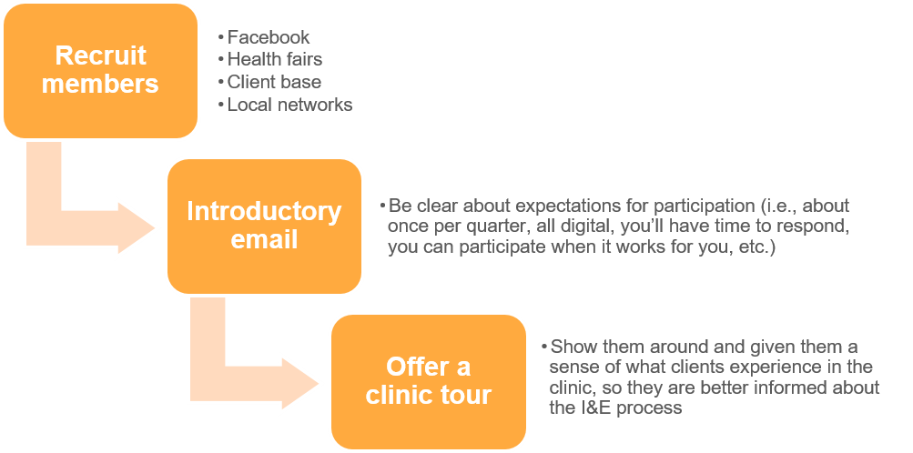
TRFP: Recruitment and Representation
Notes:
Tri-Rivers Family Planning staff are always keeping the I&E committee membership in the back of their minds as they’re interacting with patients, community members, prospective clients at project promotion events, and within their local network of advocates.
When they identify someone who might be a good fit, they reach out to them and tell them a bit about the committee.
If that person agrees to join, Lisa, their I&E Champion, sends a lighthearted introductory e-mail to break the tension of the sometimes overly-formal nature of committees like these to ensure the community member feels comfortable and valued.
She sets expectations that she’ll reach out to them digitally about once per quarter to ask for feedback about various materials.
She encourages them to participate actively when they can, but that she understands that sometimes are busier than others and they may not have time to respond.
She encourages them to take their time in reviewing the materials but to offer any of the valuable feedback they have.
Then, she invites new members to attend a clinic tour so they can better ground themselves in an understanding of what it’s like to be a patient at the clinic, if they haven’t been one before.

Slide 37
TRFP: Process Overview
The clinic staff reviews for medical accuracy and literacy level
The committee reviews for appropriateness
of fit for materials
The committee is asked to process things regularly
Notes:
For most materials, their staff, including MAs, NPs, front desk staff, and other front-line workers, review them first for medical accuracy, completeness, and cultural appropriateness.
Lisa corresponds with their medical director for feedback, when necessary and does all preliminary literacy level checks herself.
Then, the committee reviews on all of these factors, in addition to the general relevance of materials for their community. In order to best keep them engaged, she sends them a variety of materials on a regular basis, about once per quarter.
Lisa shared that she never wants them to feel like they’re checking a box, but rather, that everyone is really benefiting from their participation, that their opinions are truly valued.

Slide 38
TRFP: Challenges and Tips
Challenge: The process can be intimidating
Tip: Keep things lighthearted
Challenge: Reviewers can get overwhelmed
Tip: Be intentional about how often you’re engaging
committee members
Challenge: Located in rural, conservative community
Tip: Be community-oriented in an intentional way
Notes:
When we chatted with Lisa, she really emphasized the importance of the lighthearted nature of her approach, sending memes along with emails, offering chocolate along with the clinic tour.
Viewing the committee members as humans first who might be somewhat intimated about participating in a committee like this, especially with “approval power” over materials, can be delicate.
So, by removing the overly-formal tone she gets more honest feedback from her participants, both about the resources but also about their realistic capacity to participate.
Based on previously gathered feedback, she’s surmised that sending material for review about once per quarter is usually enough to keep people engaged and familiar with the process, while not overwhelming them with too many asks in an already busy time.
Finally, she advises that when choosing committee members, you’re mindful of incorporating a myriad of perspectives among those who support the fundamental mission of the organization.
This is especially important in her rural area of Missouri where it would be easy to find a plethora of people who don’t believe, for example, that birth control access is important.
It may be self-defeating to have someone with such a perspective on your committee.
So, be sure that you’re representing your client base without undermining the integrity of the committee to have your clients’ best interest at heart.

Slide 39
East Missouri Action Agency (EMAA)
In-Person Reviews
Notes:
Next, we’ll review EMAA’s plans for an in-person Committee Appreciation Day as their strategy for gaining meaningful feedback.
This process is led by Lucia Obergoenner, a phenomenal, patient-centered nurse practitioner who consistently goes above and beyond to meet the needs of her rural clients, day in and day out.

Slide 40
EMAA: Recruitment and Representation
Clients for this I&E committee meeting are recruited directly from patient populations, in conjunction with FPAR data for verifying representation
It’s a stable committee
Notes:
Lucia at EMAA recruits for their I&E committee directly from their patient population and tries to ensure that representation closely matches their FPAR data for the entire patient population.
Once folks join the committee, EMAA strives to maintain their participation over a longer period of time for more consistent feedback.

Slide 41
EMAA: Process Overview
This committee reviews factual accuracy, cultural appropriateness, and literacy level, alongside clinic staff
Meetings are held once a year
  Committee Appreciation Day
    Clinic walk-through
    Lunch
  Email correspondence, as needed
Notes:
This committee is asked to review materials for factual accuracy, cultural appropriateness, and literacy level.
EMAA has a relatively small staff of just a few folks, so their entire Family Planning staff usually reviews this as well.
While they’ve held virtual meetings in the past (via email, mostly), their model for a Committee Appreciation Day involves having the committee join together at the clinic for a meal in the lobby followed by a clinic walkthrough so that all aspects of the clinical environment can be reviewed, along with all educational and informational materials present in the space.
Then, the group comes back together to fill out review forms about any additional client educational materials with our material review templates.
When needed, Lucia still e-mails the committee for approval of all other materials.

Slide 42
EMAA: Challenges and Tips
Challenge: Documentation can be difficult
Tip: Having templates in place to guide documentation is
really helpful
Challenge: Due to COVID, getting people to respond by email is hard
Tip: Consider asking dedicated review committee members if they know anyone who might be a good fit for the committee
Notes:
Lucia noted during our interview that having templates in place to guide the documentation can be super useful.
My organization, MFHC, as the grantee, offers meeting minutes templates and material review forms to all of our subrecipients.
Our meeting minutes template includes key questions that must be answered about the committees, along with check boxes for all I&E Committee requirements enumerated in the regulations to better assist subrecipients in ensuring that they’ve functionally met all requirements for the meeting.
It also prompts them to think more concretely about questions like, “How did you ensure your committee is broadly representative of your patient population?”
In addition to the use of these network-wide templates, she offered advice about gathering more robust feedback or reaching more people.
We know, especially during COVID, that even some of the most dedicated I&E committee members have had too much on their plate to respond to requests for review.
While it’s important to maintain the broad representation on your committee, asking dedicated I&E committee members to make referrals of others they know who could offer valuable feedback to the committee can be a helpful strategy.
Like snowball sampling, asking people who are already committed to participate if they can help add one more person to the committee can be a good way to build buy-in among new members and ensure that you’re reaching folks in the community at large, even if they aren’t already connected to your clinic.
One suggestion Lucia made was recruiting partners of participants to join the committee, to not only add additional perspective, but to better understand how their educational materials are perceived by partners of patients.
Family members, friends, and colleagues can also be great folks for existing committee members to ask about joining the committee.
We’ve reviewed several different models, and with great thanks to Lisa at Tri Rivers and Lucia from EMAA, we can say –
The best advice we heard from everyone in our network is to:
conduct the I&E Committees by meeting your committee members where they are,
make sure they know that whatever feedback they have is the “right” kind of feedback, and
ensure that you do your part to keep them engaged over a longer period of time.
These efforts go a long way towards retaining members and ensuring they know their feedback is valued.
Keeping it light and relatable is key to ensuring you’re getting the most honest feedback possible, allowing you to make changes that most adequately meet the needs of the community you serve.
We hope that sharing some of these tips and tricks we’ve gathered over the years was helpful to you and we welcome anyone reaching out for more information about anything we’ve talked about today.

Slide 43
Resources
eCFR
Information and Education (I&E) Materials Review Toolkit
Title X Family Planning Annual Report National Summary Data
Census Data
Notes:
It was great hearing about the MFHC, EMAA and Tri-Rivers processes.
As we can see from these, there is more than one way to obtain meaningful input to inform your materials review process.
As you develop or refine your systems, we wanted to remind you to make sure that the process conforms with the eCFR which you can find through the link on this slide.
The second link takes you to the I&E Materials Review Toolkit that has suggestions for one way the process can be carried out and the sample tools that you can download for modification and use.
The last two resources, the link to the FPAR summary report and census data are to help ensure that you have the data you need to determine the demographic makeup of your ideal I&E committee members.
The FPAR data can let you know who you are serving, and you can use the Census data to see if you are missing significant populations in your service area that you want to draw into the process to ensure that the materials are not a barrier in ensuring that their needs are also met.
Resources:
eCFR (https://www.ecfr.gov/cgi-bin/text-idx?node=se42.1.59_16&rgn=div8)
Information and Education (I&E) Materials Review Toolkit (https://rhntc.org/resources/information-and-education-ie-materials-review-toolkit)
Title X Family Planning Annual Report National Summary Data (https://opa.hhs.gov/sites/default/files/2020-09/title-x-fpar-2019-national-summary.pdf)
Census Data (https://data.census.gov/cedsci/)

Slide 44


Q&A
What questions do
you have for us?

Slide 45




How to Engage with Us
Subscribe to the RHNTC Monthly eNewsletter at rhntc.org/enewsletter
Contact us on rhntc.org
Sign up for an account on rhntc.org
Follow us on Twitter @rh_ntc

Slide 46
THANK YOU!
rhntc@jsi.com
This webinar was supported by the Office of Population Affairs (Grants FPTPA006030, TPSAH000006) and the Office on Women’s Health (Grant ASTWH2000-90-01-00). The views expressed do not necessarily reflect the official policies of the Department of Health and Human Services; nor does mention of trade names, commercial practices, or organizations imply endorsement by the U.S. Government.

