Slide 1
Lessons for Innovation Projects:
Highlights from OPA’s Innovation Accelerators
July 20, 2021
Notes:
Hello everyone.
I’m Megan Hiltner from the Reproductive Health National Training Center and I’m pleased to welcome you all to today’s presentation Lessons for Innovation Projects: Highlights from OPA’s Innovation Accelerators.
Today’s session will offer insights from OPA’s two TPP15 2a Innovation Accelerators - iTP3 and Power to Decide.
I have a few announcements before we begin.
We are recording this webinar.
During the presentation portion of the webinar participants will be muted, given the large number of folks joining.
We will take time for questions via chat following the presentation.
A recording of today’s webinar, the slide deck, and a transcript will be available on RHNTC.org within the next few days.
We will also be sharing back a summary of ideas generated during our small group discussion as well!
This presentation is supported by the Office of Population Affairs (OPA).
Its contents are solely the responsibility of the authors and do not necessarily represent the official views of OPA, or HHS.

Slide 2
Objectives
Learn helpful tools for managing an innovation project
Hear strategies for sustaining momentum of an innovation project
Learn tips for disseminating the findings of your program
Hear about the peer learning group on managing innovation projects for TPP20 IIN grantees
Notes:
Okay let’s get started.
At the end of this event we hope that you all will be able to:
Learn helpful tools for managing an innovation project
Hear strategies for sustaining momentum of an innovation project
Learn tips for disseminating the findings of your program
Hear about how to sign up for the Project Management for Innovation peer learning group for IIN grantees

Slide 3
TPP2A Innovation Accelerators (2015-2020)
Established two independent intermediaries (one focused on technology and one on program/systems interventions) to select, fund, and support a portfolio of innovators across the country to advance adolescent health and prevent teen pregnancy
Designed to expand evidence base in TPP
Grantees: Innovation Next and iTP3
Notes:
And for those of you that may not be familiar with the Tiers of the TPP program.
Tier 1 programs are funded as replication programs of evidence for what works.
Tier 2 programs are building the evidence for what works.
So Tier 2 hopefully will become part of tier 1.
The two programs featured today were funded under TPP2A as Innovation Accelerators from 2015-2020.
They were Innovation Hubs that funded teams to do the work.
They were specialists in innovation theory and methods.
This is slightly different from our Network approach of the tier 2 innovation and impact network granttees that are currently funded and doing very important work.

Slide 4





Presenters
Sarah Axelson, MSW
Power to Decide
Kelly Wilson, PhD
iTP3
Notes:
I’d like to briefly introduce our wonderful speakers today.
Sarah Axelson, MSW, is the Interim Head of Programs at Power to Decide, where among other projects she managed the Innovation Next program, supporting innovative technology-based solutions to preventing teen pregnancy and improving adolescent health.
She has worked in the field of adolescent sexual health for over 15 years and is also a Lecturer at The George Washington University in Washington, DC.
Kelly Wilson is Dr. Wilson is an Associate Professor in the Department of Health and Kinesiology at Texas A&M University.
Dr. Wilson has considerable experience managing school and community-based research and practice related projects including 1) serving as evaluator or co-evaluator on teen pregnancy prevention projects; 2) developing professional development for teachers and sexuality educators; 3) developing curricula for dating violence prevention efforts and 4) directing local efforts to a federally funded evaluation of teen pregnancy prevention evidence-based programs.

Slide 5
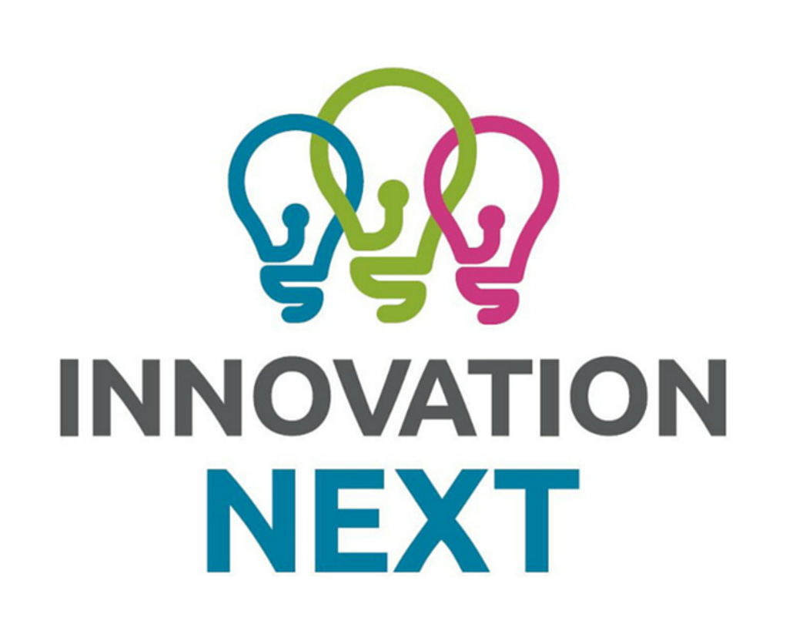
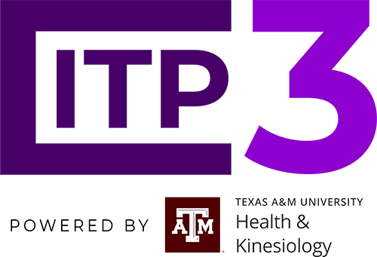


Overview of Each Project
Innovation Next
iTP3
Notes:
I'll turn it over to Sarah to begin with talking and sharing a little bit more about Innovation Next.

Slide 6
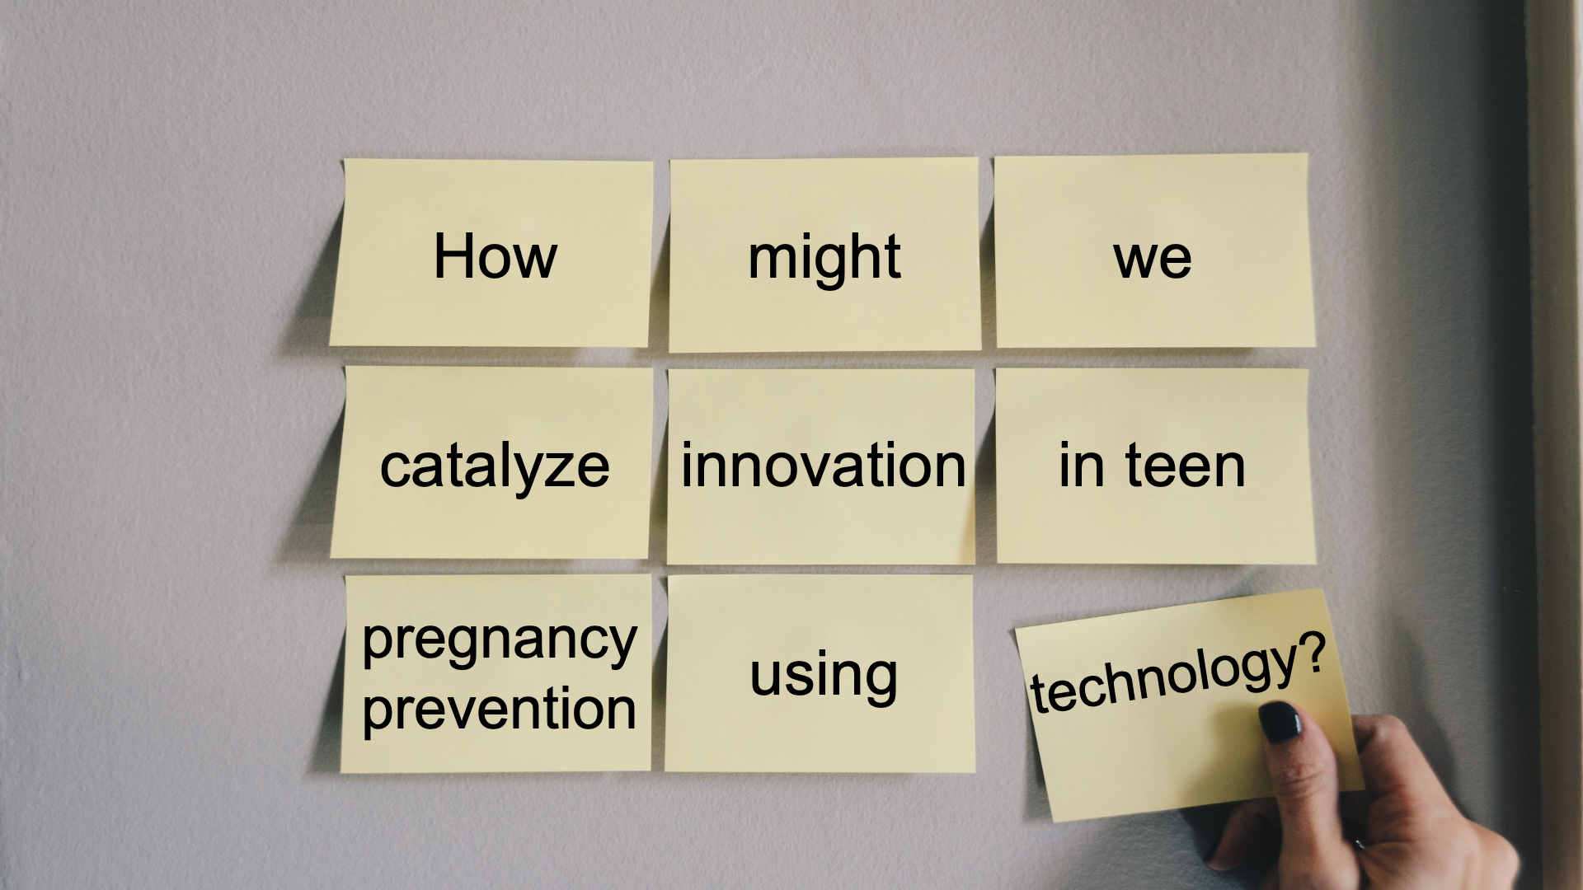
Innovation Next
Innovation Next
Notes:
At Power to Decide, we believe that all young people should have the opportunity to pursue the future they want, realize their full possibility, and follow their intentions.
These beliefs guide our work to ensure that all young people have the power to decide if, when, and under what circumstances to get pregnant.
We applied that perspective to the opportunity that presented itself when the Tier 2a grants were released by OPA.
Specifically, we set out to address the question - How Might We catalyze innovation in teen pregnancy prevention using technology?

Slide 7
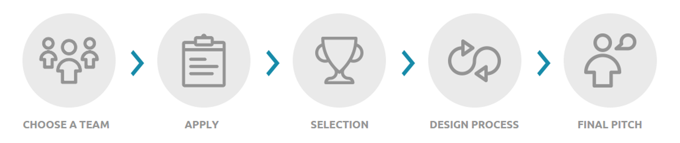
Innovation Next
Notes:
In total, Innovation Next ran for 6 years and just ended this past June.
During that time, we had 3 unique cohorts of Innovators and a fourth that included various innovators from each of the first three cohorts.
We structured our approach very intentionally, but, as is often the case in design thinking, we learned some things along the way and had to make some pivots as well.
One of the most important things we did was to invest in people first (in teams of three), then ideas.
We structured our application process so that applicants selected a team of 3 and applied for the accelerator program as a team.
Working in teams is one of the “rules to live by” for human-centered design, which I’ll talk about in just a second, because it generates creativity and energy.
We encouraged applicants to think creatively about who was on their team as well, and to consider folks from sectors that we don’t typically work with in adolescent sexual health, like user experience designers, behavioral psyhologists, and many many more.
In their application, we required that teams identify a “challenge”, something that they felt wasn’t working or that they wanted to solve in the field of TPP.
And we required that they give us at least two, totally different potential solutions, because we wanted to ensure that they weren’t wedded to any assumptions about what the solution should be, but that they were open to what they would learn from their end users.
Teams that were selected received a series of workshops from our Power to Decide staff to teach them the process of human-centered design, also known as design thinking.
They also received support and coaching in between those workshops with Power to Decide staff who have expertise in HCD.
At the end of the process, which lasted anywhere from 8 months to 18 months depending on which cohort they were in, teams pitched their final solutions – which were almost always completely different from their initial ideas BECAUSE the HCD process gave them new insights and learnings that informed their designs.

Slide 8
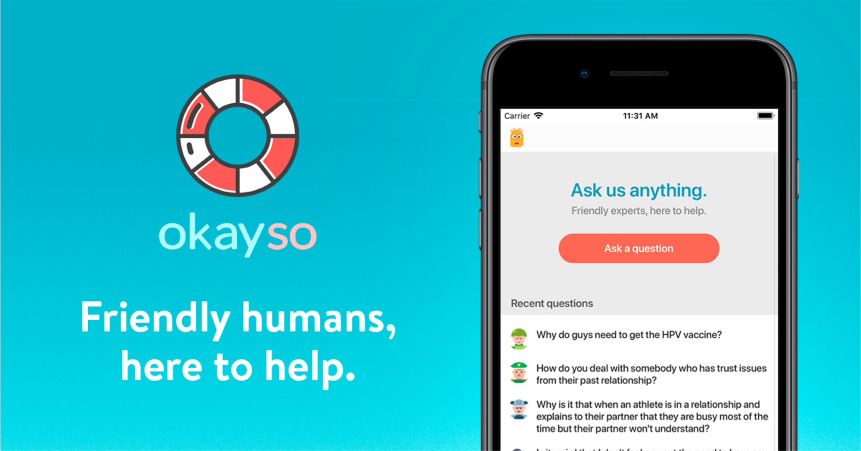
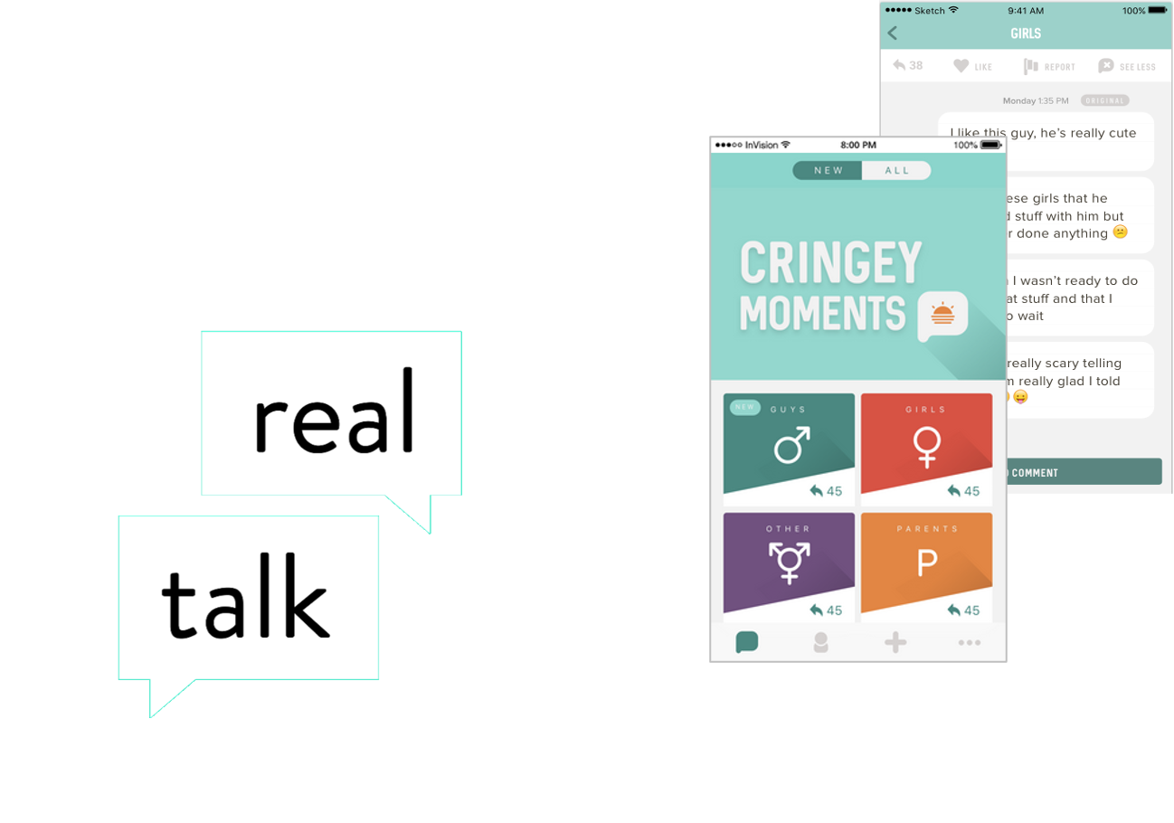

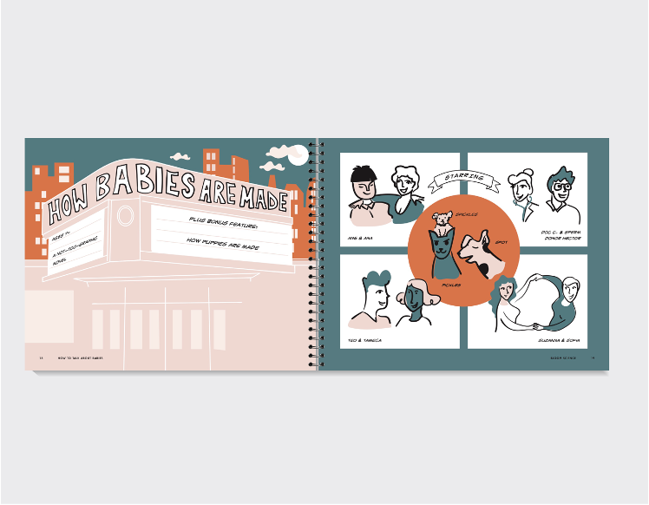

A Few Examples
Notes:
Here are a few examples of the innovations that were developed through Innovation Next and are now out in the world, being used by real young people.
Okayso is an app that gives youth access to experts they can’t reach any other way to get support and information whenever they need it.
Young people pick a team of experts, ask their question anonymously, and multiple people from the expert team will respond.
Depending on what they ask, the team will follow up to check in on the young person to see how they’re doing and if there is anything else the experts can do.
Real talk is an app that crowdsources stories about sexual health topics from young people themselves.
The stories are vetted by trained health educators and share with other youth to build community.
Hello America is a youtube series developed by and for refugee youth.
In it, young people tackle some of the sexual health education topics that are most taboo for refugee youth, in a culturally responsive, appropriate, and engaging manner.
Finally, Bloom Playbooks help families to have big and small conversations with the young people in their lives.
Designed for youth ages 5-10, 7-12, and 9-14, they focus on topics like empathy, safety, and biology.

Slide 9
“Innovation Next has definitely—not even changed—but has defined how we do things now at my organization.”
“It gave us a structure for how we do our work. Teens are now at the center of the work and we’ve transferred this idea to everything we do—our board meetings, our retreats, our way of life here.”
“Our front desk is Sticky Note city, and we’ve taught the process to youth who work with us. HCD has been instrumental in helping us with other projects.”
“Innovation Next has definitely—not even changed—but has defined how we do things now at
my organization.”
“It gave us a structure for how we do our work. Teens are now at the center of the work and we’ve transferred this idea to everything we do—our board meetings, our retreats, our way of life here.”
“Our front desk is Sticky Note city, and we’ve taught
the process to youth who work with us. HCD has
been instrumental in helping us with other projects.”
Notes:
And we think our approach was pretty successful.
Not only did our teams develop the innovations you just saw and many more, but it changed their approach to their work more broadly.
Here’s a quote from one Innovation Next innovator about just that.

Slide 10
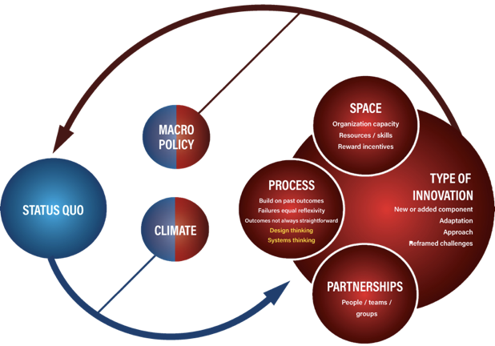
Development of Innovative Programs
Notes:
Over the past 5 years, our team has worked to develop a conceptual model that illustrates the process of creating innovations in public health.
The graphic on the screen represents our model.
This model is meant to describe key aspects of a developmental process that takes place in a fluid environment, shaped by policy and climate.
It is depicted as a feedback loop to show that innovation is both an outcome and starting point.
Before describing the different components in the model, I’ll share a brief history of how this model came to be.
When we started the iTP3 project, we adapted an existing conceptual model called the Interactive Systems Framework, which was developed by Dr. Abe Wandersman.
This model has been used to translate innovative programs and approaches into practice across a variety of health topics.
The model illustrates how to build organizational and innovation-specific capacity to execute new products or processes in healthcare settings.
It also shows how innovation is embedded within a larger context of policy and research that influences the extent an innovation can be adopted and replicated.
The ISF model is very helpful and we have successfully used it in other projects.
However, overtime, we realized that when adapting it for iTP3, the ISF didn’t capture one of the critical component to innovation--the development part. Essentially, we needed a model to illustrate the activities that take place before those described in the ISF--one that showed a process for developing innovations, prior to translating them into practice.
Over the last 5 years of iTP3, we evaluated the process of innovation as more than 20 iTP3 funded organizations developed new teenage pregnancy prevention programs.
We sought expert feedback from Dr. Wandersman, our internal innovative advisory committee, our counterpart in technology, the Power to Decide, OPA, and a group of adolescent health experts across the country.
All of this data and consultation has resulted in the model that we are presenting to you today.

Slide 11
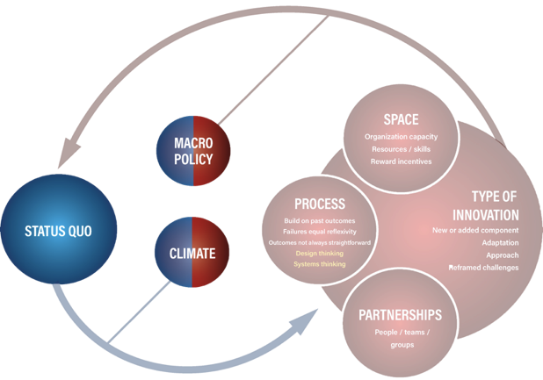
Development of Innovative Programs
Notes:
To understand how to develop innovations, we must first understand the context in which they occur.
An innovation like a new health product, process, or program is developed within an existing condition, and the degree to which an innovation will be accepted or adopted is based on historical circumstances.
In order to represent this context, our model shows the “status quo.”
The status quo is the prologue to innovation.
It is the current state of the field and includes both climate and macro policy.
Thomas Kuhn proposes in his book, “Structure of Scientific Revolutions,” that new theories replace old ones rather than building on them.
He describes the 4 staged process of emergence, normal science, crisis, and revolution as the lifecycle of a scientific paradigm.
The Kuhnian idea of “normal science” and “crisis” are useful to understand the junction at which an innovation can be introduced.
Two things must be present for the potential of innovation to occur.
First, people must be dissatisfied with current circumstances.
The idea of “status quo,” draws from Kuhn’s idea of normal science, in which practitioners and scientists use a common understanding to address problems.
Widespread belief in an approach and a shared understanding of truth support the actions of a collective.
However, when nuances emerge that cannot be explained by the normal science (or status quo) disruption occurs.
Scientists argue about the right approach and communities aren’t able to meet the needs of residents, therefore a crisis, as Kuhn’s describes emerges.
The crisis represents dissatisfaction with the status quo in this model.
This dissatisfaction is necessary for innovation because it propels the desire for newness, meaning the more unsatisfied people there are, the more potential for radical change.
Climate represents social and cultural norms surrounding the health topic.
Health topics not synonymous.
The way the public views teenage pregnancy prevention and obesity are drastically different, therefore, climate varies based on the topic that innovation is addressing.
While this model was originally developed for innovation in teenage pregnancy prevention, it applies to a wide array of health topics, therefore, it is important to understand the climate specific to each health topic addressed.
Lastly, “macro policy” informs the status quo because it both limits and propels what type of innovation is possible through things like funding, support, and sanctions.

Slide 12
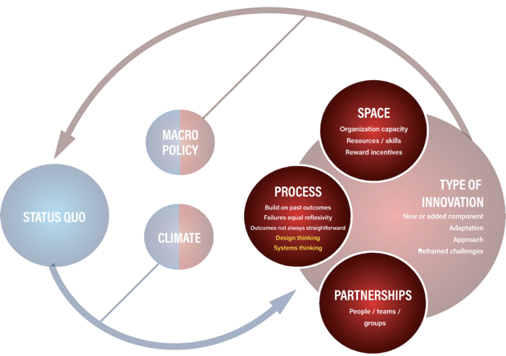
Development of Innovative Programs
Notes:
The second component of the model describes three essential aspects for innovation--space, process and partnerships.
A space to be innovative is necessary, but not sufficient on its own.
Space represents the organizational support for innovation.
These are things like supportive leadership, incentives for employees to pursue innovation, and resources and skills to develop and respond to innovation.
It is important to note that the process of innovation cannot occur without space for innovation.
The process piece of the model represents an iterative approach to development that allows for failure and reflexivity.
This process component acknowledges that outcomes in innovation are not always straightforward.
For instance, when a new program is developed and tested, but the results are not positive, this is seen as success in the process.
Instead of investing time and resources in that particular approach, the process allows for iteration and learning from mistakes, then moving on.
Our model supports two process approaches--design thinking and systems thinking to drive the development of innovation.
Both design and systems thinking are processes in and within themselves, but when viewed within this larger model, they ensure that key elements like ecology and human centeredness are incorporated into health innovation.
These two processes will be described in detail later in the presentation.
The last component is partnerships.
This includes the people, teams, or groups who engage in the process of innovation.
It is also implied that they reside within a supportive space to be innovative, as previously described.
Partnerships represents individuals with the capacity for innovation, as well as working practices that ensure teamwork and encouragement throughout development.
Because innovation is a unique activity that is not routinely engaged in within public health, support mechanisms and social connectedness is essential for teams to continue.

Slide 13
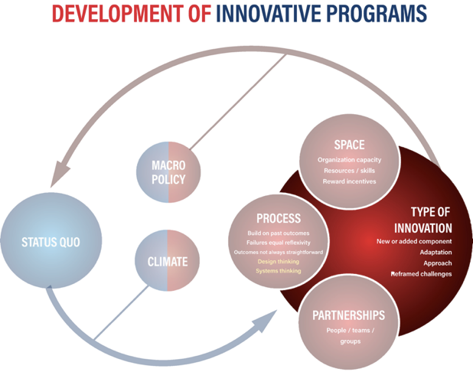
Development of Innovative Programs
Notes:
The last component of our model describes the type of innovation that can occur and its feedback to the status quo.
The 5 year iTP3 project revealed a variation in the type of innovation that occurs in public health.
We originally ascribed to Roger’s Diffusion of Innovation theory, which describes innovation as an “idea, practice or object that is perceived as new by an individual or unit of adoption.”
However, over the course of the iTP3 project, we saw four distinct variations in the type of innovation that occurred.
These four types of innovation proceeded in complexity and corresponded to the degree of disruption to the status quo that was previously described.
The first type of innovation is a new or added component to an existing health product, program, or process.
This is the most simple type of innovation because it does not totally replace an existing practice, instead it adds to it in order to meet a need.
A new or added component represents things like adding social media to an existing sexuality education program.
This can be done in response to user need or changes in technology or societal norms.
It does not radically alter the existing program or product, rather it improves it to make it more relevant.
The second type of innovation is an adaptation.
Adaptations represent a modified way of doing something.
An example is adapting an existing evidence-based program for a new target population.
In order for adaptation to occur, the fundamental theory of change stays the same, but things like language and setting are modified.
Frequently, we see adaptations to meet the needs of different cultural groups or genders in teenage pregnancy prevention programming.
The third type of innovation is approach.
Approach is more drastic than the previous two types because it represents a new way of doing something.
An example of a new approach is a trauma informed approach to sexuality education or the switch from abstinence only to comprehensive sexuality education.
Frequently a new approach means a new theory that guides facts and requires a change in terminology.
Therefore, it causes a great deal of disruption because it represents something completely different, as opposed to adapting or adding a new component to an existing program or product.
The last and most radical type of innovation is reframing the problem or challenge completely.
This type of innovation is similar to a paradigm shift in Kuhns’ Scientific Revolution because it implies a new understanding of a health issue, new methods to address the issue, and a new way of understanding success.
An example of a reframed challenge is the HIV and AIDS epidemic.
When AIDS was first discovered, scare tactics and radical strategies like banning the entry of HIV positive people into the U.S. were used.
Public health programs were designed to increase AIDS awareness and provide basic information regarding symptoms.
Since then, programs using scare tactics and discrimination have been replaced with anti-stigma campaigns and a focus on antiretroviral treatment.
The “challenge” was reframed from dying of AIDS to living with HIV.
The type of innovation that emerges from this model, informs the status quo.
The status quo is constantly shifting and as innovation emerges and is translated into practice.
This is represented by the feedback loop connecting the red and blue circles of the model.

Slide 14

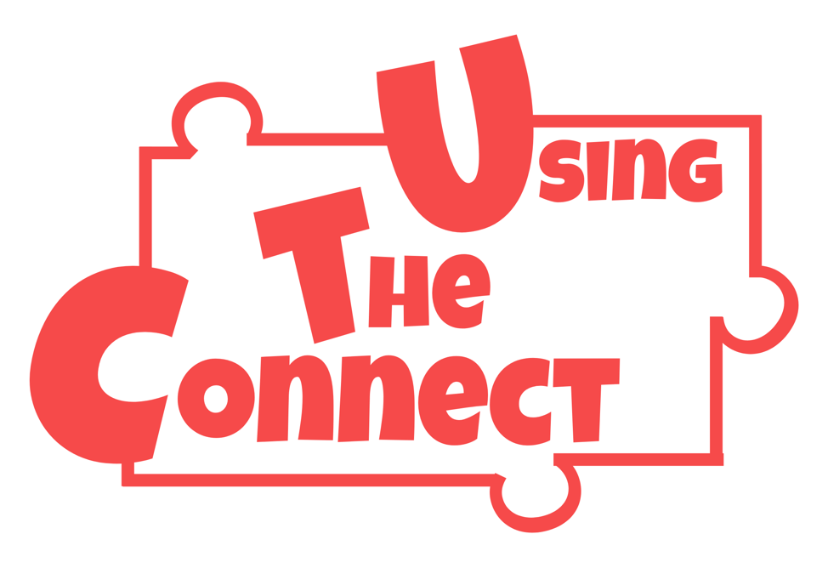
Using The Connect
Notes:
So, the next slide is actually going to bring in an example of a program that emerged from ITP3.
We had 20 different teams that we worked with over the course of the five years of ITP3 and this was a program that started with a boot camp, so it was a community based boot camp.
And then a team was selected to move forward with program development.
They brought together a design team and went through design sprints with that team.
And this is a video prototype of the program that was developed and then that moved into feasibility testing.
https://www.youtube.com/watch?v=X7jrdUr791E

Slide 15
What are some tools or resources that you found helpful when managing your innovation project?
Notes:
What are some tools or resources that you found helpful when managing your innovation project?

Slide 16

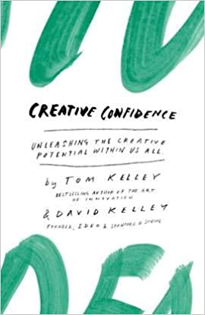
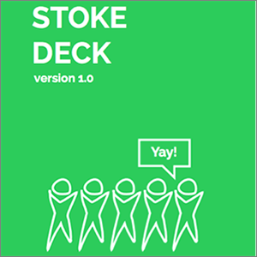
IDEO Field Guide
d. school Stoke Deck
Creative Confidence
Notes:
I will point to our Human-Centered Design and design thinking resources, like the IDEO Field Guide to Human-Centered Design, which you see on the left here, which became almost a guidebook for our teens in the different tools and strategies that they could use in implementing design thinking in their own communities, on their own projects, in between our workshops, the things that they were working on.
The D. School Stoke Deck is a tool that I really love.
It is a ton of different, almost energizers and icebreakers, but they're a little bit different than those that we typically use in our field.
And they're intended to bring out people's creative nature and to get them to think differently.
So, many of the mindsets in design thinking revolved around being willing to take risks, to fail early, and often to try new things even if you aren't 100% sure if they're going to work.
And so, the tools and strategies that the Stoke Deck provides are intended to get people used to that feeling of doing something uncomfortable, maybe even feeling a little bit silly in the process, but just being in that space and being willing to take that on.
And then the last tool that I have up here on the Human-Centered Design slides is there is a book called Creative Confidence, which I really love.
And this book is about how every single one of us is creative in what we do and how we do it, and how we can do it.
And it's about recognizing what our own creativity looks like, and how we can contribute that to a particular project.
Our approach to evaluation in Innovation Next revolved around evaluating both the structure and the process through which we hope to foster innovation with our teams.
And specifically whether or not we were able to help our teams create their innovative interventions. So, many of our evaluation activities were summative evaluation activities.
We were also guided by what is called a developmental evaluation approach, and that is an approach that is most useful when innovation is a core value to your project, when there is a need to be really responsive in context throughout a project, and responsive to what we call emergent and complex environments.
Developmental evaluation is really about facilitating almost close to real time feedback with program staff, and creating that sort of continuous development loop that I think we often talk about in federal projects with continuous quality improvement.
This really gives a very specific set of tools for how to do that. And it focuses on data collection as a rigorous way to sort of compliment the innovation process, and inform really intentional change, as well as tracking again, the process of innovation itself.
The last thing I'll mention is just that developmental evaluation for us provided accountability by documenting those pathways to innovation, key insights that folks had or teens had, and sort of the cumulative decisions that they need that helped lead them toward a new innovation.
This Luma book is one that gives us activities and strategies, and also how to put them together in recipes, so that you can make a short term or a long term workshop, meeting, whatever about with different activities and strategies.
Another one is a book called a Primer to Systems Thinking by Donella Meadows.

Slide 17
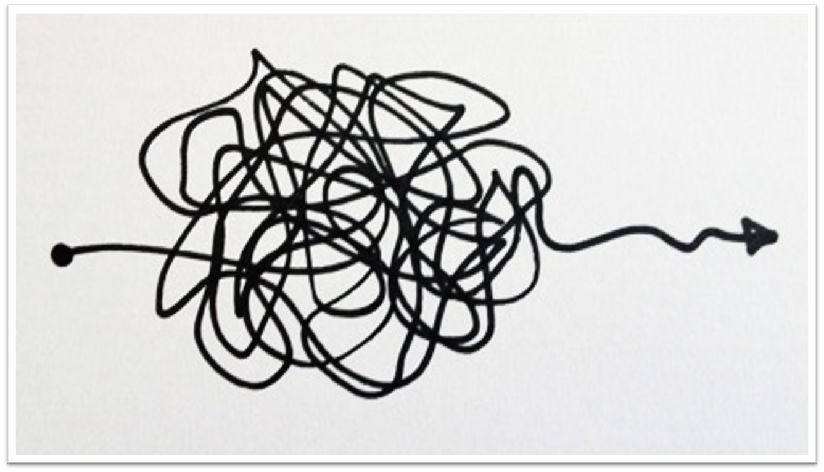
Human-Centered Design is messy...
Notes:
Human-Centered Design is messy.
A lot of Human-Centered Design starts with insights and so, getting that insight is really clear.
But then you continue to get more and more insights from your user population, your priority population, then you start analyzing it and prototyping and you don't know exactly where you're heading.
They may think that they're having to do like formal research when they're gaining insights.
I think one of the things that I hear the most, and it's funny because I hear it with our adult groups more than our young adolescent groups, is they're worried about whether they're doing an activity or a strategy the right way.
You're really finding what is the best option for the challenge that we're facing and there's not always a right or a wrong way to get there.
And sometimes, you find your golden nuggets by taking the wrong way or you find, it's like you really find your pockets by challenging the outside the norm.
Iterate, iterate, iterate.
Keep trying, keep testing, keep doing something new.
And don't be afraid of trying a new prototype, a new test.
Test all kinds of different concepts even make some sacrificial ones that you just know are bad, just to throw in the bunch and see what happens.
There's actually a skill involved in that.
As Kelly said, I would also say learn to get really comfortable with ambiguity and uncertainty.
We usually pull this image back up when we see our teams and we can recognize that they're stuck in the middle of it.
We bring it back and we say like, "Remember, you're right here right now and it feels this way and that is totally okay. It's reflective of where you are in the process and we promise that if you trust the process, you will get somewhere.“
And then the last thing I would say is think about new and different metrics, and what information has value in innovation project.
So, in a typical project, we might not track all of the pivots that we make, we might not highlight those in a report, right?
People might be afraid, like, "Oh, a lot of changes mean something wasn't working," and so that reflects poorly in a report.
In an innovation project, highlighting pivots and changes and things that you learned and even places that you failed is key.
And in fact, I would credit all of the amazing OPA project officers who understand that and reinforce for innovation grantees that they should be highlighting and reflecting on those things and not afraid to mention them.
ust as one example, even our "how might we" questions from our teams changed over time, and we track all of those things in a spreadsheet.
Stuff we never thought we would look at then became very, very valuable in the context of an innovation project.
So, I would just start to shift your thinking around what the metrics are that you're looking at and what you want to make sure that you're keeping track of.

Slide 18
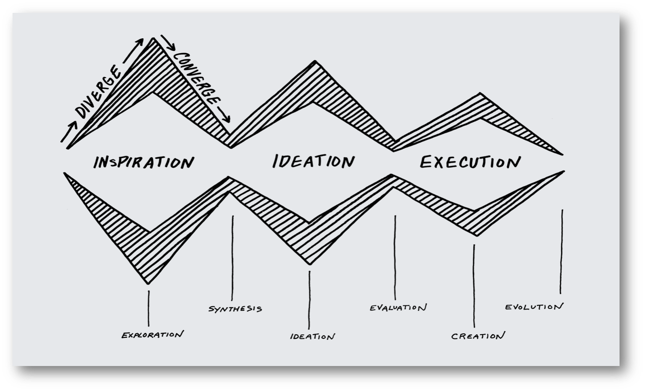
Graphic on inspiration, ideation, and execution
Notes:
What you see up here is sort of the parallel companion to that messiness slide.
This is a reminder that even when the process feels messy and horrible and you can't sustain the momentum, because you don't even know what's going on and you only know your very next step.
There actually is a process informing all of that.
There are steps you're following and what you're feeling is that convergence and divergence of sort of going big and wide, and then narrowing down.
But as you see, it does move closer and closer towards concepts.
So, this process gives you a way to go from that huge space of feeling like, "Oh, my gosh."
It's like, "How am I going to sustain this when I don't even know what I'm trying to figure out to actually getting to something?"
The other things I would say are important in sustaining your momentum, again, you're going to hear a theme here are pivots, being willing to change and try new things are a key part of sustaining the momentum.
And in fact, if you go to one of the questions that just got dropped in the chat that I noticed around what really didn't work well about these programs and what did you end up changing?
So, we sustained the momentum in our project by changing the things that didn't work well.
Our first cohort was 18 months, that didn't work.
In our second cohort, we dropped that down to eight months and in our third cohort, we dropped it down to six months, which worked out really, really well.
We also were planning to do a brand new fourth cohort.
But what we learned along the way is that innovators, no matter how many resources they had, and how much time they had, and how far along you thought they would get, they needed more time and more resources.
So instead of funding a fourth cohort, we then funded many of the teams from our cohorts, one through three, who wanted to reapply for more funding in the fourth cohort.
So, those pivots are the kinds of things that help you sustain your momentum.
I would also say talking about your work early and often sharing at conferences, see everything as an opportunity for dissemination.
Because when we were recruiting teams, we needed to get the word out about our project.
We needed new folks to always be coming in and a new cohort to be learning about Innovation Next in our work.
And so, talking about it, wherever we went, was a great opportunity to do that..
So, I will say that part of the momentum is recognizing that sometimes you might fail.
And that is when you have the ideal time for that pivot. So, you're like, "What caused the failure?“
And to me failure and using this with community organizations, failure is a hard word to hear.
So kind of like Katie asked in the chat box, it's like, "What didn't work?"
Well, there were things that were failures, but what did work was that encouragement to move forward.
So, that's where we really had organizational support from most of the organizations that we were working with, that it's okay that you got to design session three of four and then you made a complete pivot.
Even though you think that you're 75% of the way finished, you have design teams in tears, but then come design session four, they're super excited about the direction that they ended up going.
And that really was an example that we had a design team who thought that they failed because they made a major change at design, session three of four, and then it wasn't a failure.
It was actually where they really have their tipping point and really started moving forward, moving forward, overall.
So, the other thing that I would say with momentum is continuing to think forward and thinking about that concept of evaluation.
So, it's hard for design because at the beginning, you don't necessarily know what you're designing.
And if you're really gaining insight from your priority population, you don't know what they're going to say that they need.
And so, it's hard to know what you're going to be evaluating.
But as you move through that understanding the data and as you start moving forward into prototyping, that's when you start asking your evaluation questions.

Slide 19
What are some of the ways you are considering disseminating your results or lessons learned?
Notes:
We do journal articles (joint and solo), conference presentations (sexual health and innovation spaces), Power to Decide blogs, online learning platform, broader organizational work.

Slide 20


Q&A
What questions do
you have for us?
Notes:
Megan
Here are some additional questions we can prepare for them in case questions don't come in via the chat:
1. How they situate the goal of preparation for rigorous evaluation within their overarching project management/evaluation planning, and how to best prepare dev teams and interventions for future rigorous evaluation.
2. Did you find that design teams needed more coaching or support in certain areas?
3. Did you receive any additional external funding for your projects?
4. how did you encourage your innovators to "fail forward" and create and maintained a culture of testing and iterating through out the project?

Slide 21

New Opportunity for TPP20 Tier 2 IIN Grantees- Coming August 2021!
Project Management for Innovation
Peer Learning Group (PLG)
Learn how to foster innovation throughout your project life cycle
  Hear from experts and peers who have managed innovation projects
  Learn about best and/or promising practices
  Discuss strategies for success with peers who are tackling similar challenges
  Share tools and resources
Details on how TPP IIN grantees can register will be
sent via the RHNTC Training Alert
Project Management for Innovation Peer Learning Group (PLG)
Learn how to foster innovation throughout your project life cycle
  Hear from experts and peers who have managed innovation projects
  Learn about best and/or promising practices
  Discuss strategies for success with peers who are tackling similar challenges
  Share tools and resources
Details on how TPP IIN grantees can register will be sent via the RHNTC Training Alert
Notes:
We are excited to share a new opportunity for IIN grantees- the innovation management peer learning group (or PLG).
We know that Project managers within innovation projects must play a different role when overseeing innovation-oriented projects.
This means transitioning from task management to information, creativity and innovation management.
Project management itself plays a critical part in creating a culture of innovation.
The goal of the Innovation Project Management PLG is to increase IIN grantees’ project management skills and knowledge to support innovation throughout the project life cycle.
Project managers can develop competencies that support this culture of innovation, including communication, time management and risk-taking.
The peer learning group format is designed to foster an environment where subject matter experts provide resources and knowledge that build grantees capacity in the topic area.
And ample time is given for facilitated discussions among you and your peers to share what you are doing, learning, struggling or succeeding with.
The peer learning group format acknowledges that each grantee may have different experience and capabilities in this area and creates an environment where you each can learn, share and grow.
The PLG will be monthly meetings starting in August and ending in December.
We welcome and encourage all IIN grantee project managers and their internal team members to register and attend the PLG sessions.

Slide 22
Upcoming Activities
Systems Thinking Toolkit
Grantee Meeting Series: Sustainability
  July 22, 29, and 30 from 1–4pm ET
Notes:
The systems thinking toolkit will be released soon.
There is a Grantee Meeting Series on sustainability over the next two weeks.

Slide 23




How to Engage With Us
Subscribe to the RHNTC monthly eNewsletter at rhntc.org/enewsletter
Contact us on rhntc.org
Sign up for an account on rhntc.org
Follow us on Twitter @rh_ntc
Subscribe to the RHNTC monthly eNewsletter at rhntc.org/enewsletter
Contact us on rhntc.org
Sign up for an account on rhntc.org
Follow us on Twitter @rh_ntc
Notes:
Finally here are a variety of ways you can engage with us.
We have a monthly newsletter that we’d love you to subscribe to.
You can also send us an email on the website under the contact us tab
You can sign up for an account at RHNTC.org
And lastly you can follow us on Twitter at @rh_ntc

Slide 24
Thank you!
rhntc@jsi.com
Notes:
Thank you all for joining us today.
Please join me in thanking our presenters today.
As a reminder, we will have the materials from today’s session available within the next few days.
If you have additional questions for the RHNTC on this topic, please don’t hesitate to email us at rhntc@jsi.com
Our final ask is that you please complete the evaluation today.
The link to the evaluation will be chatted out now and will be emailed to you after the webinar.
We really love getting your feedback and we use it to inform future sessions.
Thank you again for joining us. That concludes today’s session.

