Slide 1
Enhancing Community Awareness of Title X Services Through Project Promotion
April 3, 2024
Notes:
Meg Sheahan:
Welcome. Welcome, everyone. We are so excited that you're able to join us today. Thanks for joining. My name is Meg Sheahan. I'm with the Reproductive Health National Training Center and I'm really excited to welcome you to today's webinar on Enhancing Community Awareness of Title X Services Through Project Promotion.
I have a few housekeeping announcements before we get started. The first is that everyone on the webinar today is muted given the large number of participants. However, we'll have some time at the end for questions, so please, feel free to type any questions you have into the chat at any time. We will capture them and we will get to them at the end. And also, a recording of today's webinar, the slide deck and the transcript will be available on rhntc.org within the next couple of days. We also emailed all registered participants a copy of the slide. We have enabled closed captioning. So, to view that, please click the CC icon at the bottom of your screen.
And as always, your feedback is really important to us. Your comments help us improve. So, please take a second to open the evaluation link that is in the chat. And I'm going to pause for a second right now and please give me a thumbs up or the emoji of your choice to let me know that you've opened the link. Thanks everybody.
Please note that in order to obtain a certificate of completion for attending the webinar, you actually need to be logged in to rhntc.org when you complete the evaluation. So, if that certificate of completion is important to you, please make sure that you log in before you complete it.
And finally, this presentation was supported by the Office of Population Affairs. Thank you, OPA. Its contents are solely the responsibility of the authors and do not necessarily represent the official views of OPA or HHS.
Evaluation Link: https://rhntc.org/evaluations/evaluation-enhancing-community-awareness-title-x-services-through-project-promotion

Slide 2

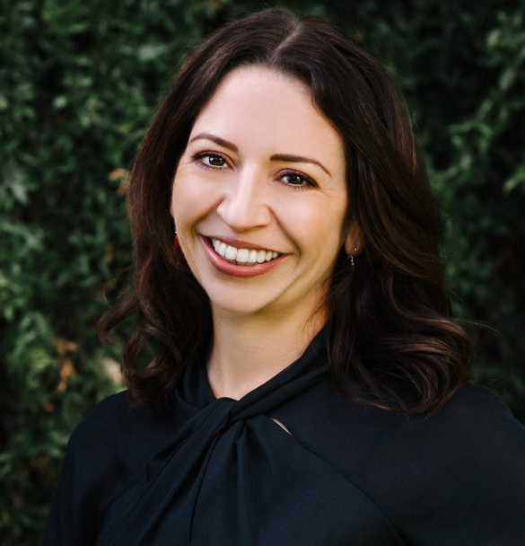
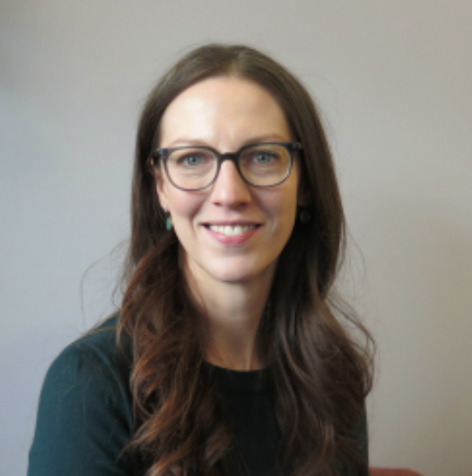
Nice to see you!
Meg Sheahan
RHNTC Consultant
Catherine Alonzo
Javelina Founder & CEO
Analise Goedeke
Kachemak Bay Family Planning Clinic
Operations & Grants Coordinator
Notes:
Meg Sheahan:
All right. And if we could go to the next slide. Thanks. Some introductions. As I just mentioned, my name is Meg Sheahan. I'm a consultant with the RHNTC. Prior to joining the RHNTC, I directed the Title X program in the US Virgin Islands for almost a decade. I'll pass it over now Catherine and then Analise to introduce themselves.
Catherine Alonzo:
Thanks, Meg. Hi, everyone. My name is Catherine Alonzo and I am the CEO and founding partner of Javelina, which is a branding and marketing agency. And I'll tell you a bit more about in a second. I've been growing Javelina for nearly 13 years now. And prior to that, I really came up professionally through political campaigns, working for a wide range of elected officials and local initiatives and city council elections, things like that. One other thing I'll tell you is that I am originally from the UK and I share that just to save you wondering what part of Australia I am from for the next 60 minutes. Analise, over to you.
Analise Goedeke:
Hi, good morning from Homer, Alaska. My name is Analise Goedeke and I work in operations and grants for Kachemak Bay Family Planning Clinic. We are a small sexual and reproductive healthcare and education agency that has been a Title X subrecipient with the Alaska Department of Health since 2001. Happy to be here.

Slide 3
Objectives
By the end of this session, participants will be able to:
Explain the value of Title X project promotion activities
Describe a process for developing a project promotion plan that centers the needs, values, and preferences of the Title X project’s priority audiences
Describe the project promotion activities of a peer Title X project
Identify at least two resources they can use to develop a project promotion plan
Notes:
Meg Sheahan:
All right, so by the end of this session, we hope that you'll be able to explain the value of Title X project promotion activities, describe a process for developing a project promotion plan that centers the needs and values and preferences of your Title X project's priority audiences. Catherine is going to explain all of that.
We hope you'll be able to describe the project promotion activities of a pure Title X project. That would be the Kachemak Bay Family Planning Clinic. Thank you, Analise. And identify at least two resources that you can use to develop a project promotion plan. And I'll be the one sharing these with you.

Slide 4
The Value of Title X Project
Promotion Activities
Notes:
Meg Sheahan:
What is the value of promoting your Title X project?

Slide 5
What’s the benefit of promoting your services?
Notes:
Meg Sheahan:
And I'm actually going to throw this question out to all of you, so please take some time, type in some responses into the chat. What's the benefit of promoting your services? So, we can see increased patient volume. I see prevention. I'm thinking prevention activities. The community will find out where you are. You can make more clients. Aware of our services. Awareness and education. Raise public awareness. Keeping our clinic alive. Yes, sustainability. Awesome, awesome. Increased education, access. Thank you. These are perfect. Great answers. Thank you.
So, as you all are chatting in, project promotion increases your visibility. More people know about your services, so more people know where to go to get the services they need. Promotion creates brand recognition. Catherine's going to talk all about that. Brand recognition over time means that you become memorable to clients so that when they have a need for services, they remember that you're there. You're the go-to to help meet that need.
Project promotion can also engage existing and potential clients and other stakeholders. And this engagement fosters interaction and that interaction and helps build relationships.
And all of this, as you all noted in the chat, can help increase the number of clients you have, which can make the services that you provide more sustainable. The research that you conduct while developing your project promotion activities will help you understand the people you want to reach and serve what they want, what they need so that you can improve and tailor your services to be responsive to them.
Also, project promotion can create a sense of belonging amongst clients. They see your promotions and they think, "Oh, that's my clinic," or "Oh, that's my healthcare provider." And it creates a sense of familiarity and stability that can create a feeling of ease that encourages people to come in or to come back in for care. And all of that, why we do it is that it ultimately increases access to services and improved health outcomes.

Slide 6
Title X Program Expectations
Title X recipients are expected to:
“Provide for opportunities for community education, participation, and engagement to: achieve community understanding of the objectives of the program; inform the community of the availability of services; and promote continued participation in the project by diverse persons to whom family planning services may be beneficial to ensure access to equitable, affordable, client-centered, quality family planning services.”
42 CFR § 59.5(b)(3)
Notes:
Meg Sheahan:
So, another thing is that Title X program expectations require that Title X agencies provide opportunities for community education, participation and engagement so that people understand what your program offers and that services are available. So, a project promotion plan can help you comply with and show compliance with this expectation, like for example, during part of a site visit or a program review.

Slide 7
Suggestions for showing compliance
A written community education and service promotion plan you have implemented (e.g., developed media spots/materials, event photos, participant logs, and monitoring reports).
States that the purpose is to achieve community understanding of the objectives of the project, make known the availability of services to potential clients, and encourage continued participation by diverse persons to whom family planning may be beneficial
Promotes the use of family planning among those with unmet need
Utilizes an appropriate range of methods to reach the community
Includes an evaluation strategy
Notes:
Meg Sheahan:
So, to draw a clear connection between a project promotion plan and showing compliance with Title X program expectations, during this webinar, Catherine's going to describe a process for developing a project promotion plan. Towards the end of the presentation, I'm going to share some resources with you that will guide you through this process so you don't have to take crazy notes and just know that there is a structure in place to help guide you through this process. And I'm going to share those resources with you.
Part of these resources include a spreadsheet where you can document and organize your plan as it comes together. This spreadsheet can also be used to show your compliance with Title X expectations, like I said, for example, during a site visit or a program review. So, we've designed the process and what you will develop through it to align with Title X program expectations and to demonstrate compliance with them.

Slide 8
Developing a Project Promotion
Plan That Centers the Needs,
Values, and Preferences of Your
Priority Audiences
Notes:
Meg Sheahan:
So, with no further ado, I'm going to pass it over to Catherine, who will discuss Developing a Project Promotion Plan That Centers the Needs and the Values and the Preferences of your Priority Audiences. Thanks Catherine.

Slide 9
Build the foundation for your project promotion activities
Notes:
Catherine Alonzo:
Thanks so much, Meg, and thank you so much to everybody for being here. Like I mentioned, I'm the CEO of Javelina, which is a branding and marketing agency and we work with all different kinds of organizations to advance social change in their local communities and we help them do that by developing powerful stories.
And the reason that I am so enthusiastic and passionate about project promotion is that it is essentially about telling powerful stories. So, as Meg said, what I'm going to do is talk you through the steps of developing a project promotion plan and the very first step is to build the foundation for all of the activities that come after it.

Slide 10
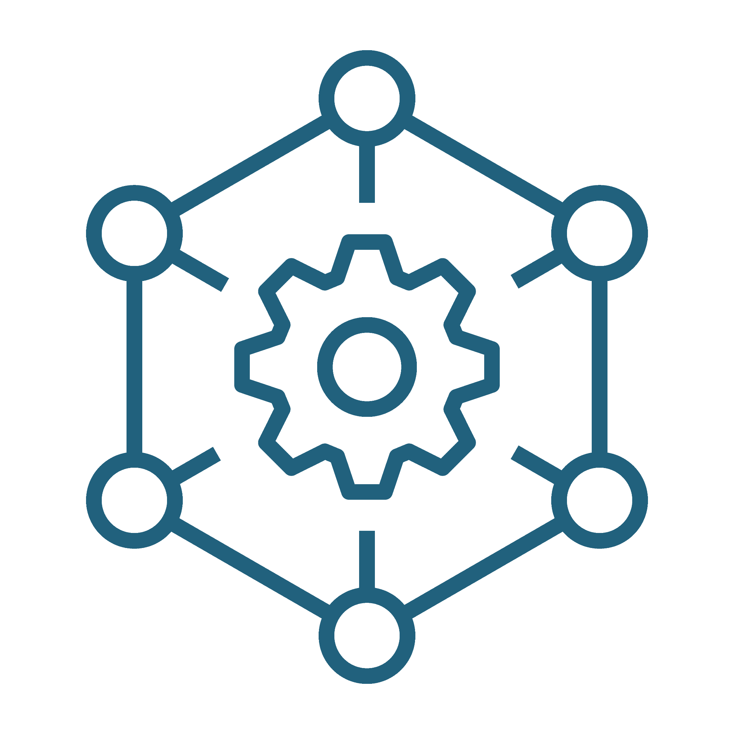
Align promotion activities with your agency’s mission and approach
Develop (or review) your agency’s:
Core brand identity (what your agency does and why you do it)
Brand voice (your agency’s personality)
Key messages (5–7 things any audience should know about your agency)
Notes:
Catherine Alonzo:
So, when developing your project promotion plan, the very first thing you want to do is start with this foundation. And it includes a couple of things. It includes your core brand concepts such as your core identity, your brand voice, and your key messages, as well as your goals, your priority audiences, and your objectives, which I'm going to explain a bit more about on the next slide. But to start off with, I want to go through these three things, your core brand identity, your brand voice, and your key messages.
So, your core brand identity is it encapsulates what your agency does on a day-to-day basis and the outcomes that you achieve, also known as your mission commonly, as well as why you do it or the larger purpose or vision that your work is in service of. And this core brand identity is so incredibly important and can be really quite difficult to develop because it entails getting very clear on what your agency does and why.
The brand voice captures your agency's personality and the tone that you'll use in all of your messages. So, you want to think about if our organization was a person, what would they be like? For example, would they be casual and friendly, caring and professional? Are they fun-loving? Are they serious? It's really important to define the personality traits that best reflect your brand as this really guides the development of all of your communications from here on out and it ensures that your communications are consistent. When you have clarity around your core brand identity and your brand voice, it really enables that consistent communication over time.
And then finally, you are looking to develop key messages that include any vital information that your audiences need to know about your agency. And this one really can build upon your core identity to include things like what sets you apart from other agencies, the primary services that you offer, or any additional outcomes that you create or any special things that you bring to how you approach the work.

Slide 11
Example: core brand identity
Our purpose is to create a future where everyone has the trust, support, and information they need to make the right sexual and reproductive health choices for themselves.
That’s why we make sexual and reproductive health care accessible to everyone, no matter who they are or where they come from. We do this by offering affordable, convenient, and inclusive sexual and reproductive health services and health education.
Notes:
Catherine Alonzo:
So, I want to show you an example of a core brand identity. Here is an example for core identity for a family planning agency. Our purpose is to create a future where everyone has the trust, support and information they need to make the right sexual and reproductive health choices for themselves. That's why we make sexual and reproductive healthcare accessible to everyone, no matter who they are or where they come from. We do this by offering affordable, convenient, and inclusive sexual and reproductive health services and health education.
As you can see, this core identity captures your vision for the world. We envision a future where everyone has the trust, support and information they need. That is your vision for the world. It also captures what you do on a day-to-day basis to make that vision a reality. So, here, that's why we offer sexual and reproductive healthcare services and then how you do it. We do this by offering affordable, convenient, and inclusive sexual and reproductive health services and education.

Slide 12

Establish promotion goals, priority audience, and objectives
Goals = the broader outcomes you want to achieve and for whom
Priority audience = the specific group of people you want to reach
Objectives = the milestones you will reach on the way to achieving a goal
Notes:
Catherine Alonzo:
Part two of building your foundation focuses on your goals, your priority audiences, and the objectives for your project promotion activities. So, let's dig into each one of these and understand a little more the purpose that these serves. So, first of all, you'll want to identify your goals. These are the broader outcomes that you want to achieve and the group of people among whom you want to see these outcomes. So, it's really what are we doing? What do we want to achieve or move or change and for whom?
Next, you want to identify the specific priority audiences you want to reach in order to achieve these outcomes. This could be current or potential clients. It could include other people who influence their beliefs such as parents, teachers, partners or healthcare providers. You want here to consider groups of people in your community who would benefit the most from family planning services and may be unaware of them and people who help you reach those people.
And then lastly, you want to brainstorm your objectives for each goal. Your objectives are really the milestones you reach on the way to achieving that goal. And I want to show you an example of a goal and an objective on the next slide so you can see how these two things work together.

Slide 13
Examples: Goal, priority audience, objective
Example goal: Increase uptake of family planning services
among teens.
Example priority audience: Sexually active teens ages 14–19 who identify as female and Latinx and who live in our county.
Example objective: Generate 500 visits to our website in the
next four months.
Notes:
Catherine Alonzo:
An example goal might be we want to increase the uptake of family planning services among teens in our county or in our region. And an example objective might be to do that, we will generate 500 visits to our website in the next four months.
So, you can see how the goal and the objective interplay with one another. And then of course specified here is who. Who is this for? So, the example here, the priority audience is sexually active teens ages 14 to 19, who identify as female and Latinx and who live in our county or in our region. And so, here very succinctly you have what are we trying to achieve. We want to increase the uptake of our services. Who? Who is that audience?
And it's a little bit more granular than just saying teens. And then how are we going to achieve that goal? What is our objective to generate 500 visits to our website in the next four months? And of course the assumption is baked in here is that an increase in website traffic translates to an increase in uptake of services. By achieving that objective, you really are increasing the likelihood of visits to your clinic, which will bring you closer to that broader goal.
So, one more thing before we go to the next slide that I'll say about this foundation, the things that we just went over. So, your core ID, your brand voice, your core messages, and then your goals and objectives is that you'll likely have a lot of this information within your organization and within your work already.
When you follow along with the project promotion activities, it's really intended to strengthen it, to secure it, to make sure that everybody on your team is on the same page to clear up any areas that you don't have clarity around, to ensure that that foundation is as strong as it possibly can be. Because just like a foundation in the house, everything that comes after it is built on these initial phases, these initial things. And if there's weakness within them, everything you do after this will be less effective.

Slide 14
Understand & gather information about your priority audience
Notes:
Catherine Alonzo:
Okay, so we've talked about that foundation and now, I want to talk about determining who your priority audience is, but also taking the time to gather all the information that you can about them so that you can reach them more effectively.

Slide 15
Understand your priority audience to craft tailored promotion messages and strategies
Identify what you know and what more you need to learn.
  Demographics
  Behaviors
  Attitudes
  Beliefs
  Needs
Gather information to strengthen your understanding.
Notes:
Catherine Alonzo:
To really understand your audiences and how you can effectively reach them, you really need to know more than just their demographics, like where they live, how old they are, what their gender identity is or what they do for work.
You also need to know things like what are their biggest needs. What are their current attitudes toward the services that you offer? And then finally, what are their behaviors? Where do they get their information? Where do they spend most of their time? Identifying what you already know about your audience is going to be really, really helpful. And then thinking about what else you need to learn about them in order to really understand what would motivate them to engage with your organization.
So, you really want to gather all of the information that you can and the ultimate goal is to be able to create a profile of your priority audience that paints a full picture of who they are. And this is really, really crucial when developing the rest of your project promotion plan because project promotion is ultimately about seeking the people that we want to reach. And in order to do that effectively, you really need to understand who it is that you're trying to reach.
Most of our clients that we work with benefit the most, see the most uptick in their project promotion or marketing activities when they focus on understanding their priority audience. Because oftentimes, we either make assumptions about our priority audiences or we make generalizations. We can make a lot of mistakes by not digging in here and seeking more information about them.
And there are a number of ways to gather the information that you need to be able to get a full picture of who it is that you're seeking to reach. You can do pretty formal things like focus groups or interviews. You can meet with your stakeholders. You can do surveys, online research. This can be as easy as identifying a couple of people that you're already working with who are representative of who you want to reach more of and asking them questions about what is relevant for them.

Slide 16

Example: priority audience persona
Name: Sara Age: 20 Relationship status: Unmarried, several sexual partners Children: None Occupation: Student, part-time barista Living situation: Lives with her mom and two younger brothers Media habits: TikTok, SnapChat, online versions of magazine and news outlets Shopping habits: Mostly online and consignment stores Interaction with Title X org: Reproductive health needs, sexual health awareness
Notes:
Catherine Alonzo:
Okay. So, here what you are seeing is an example of a priority audience profile or a persona for a family planning organization. So, what this is is essentially a fictionalized generalized profile of somebody who is representative of the types of audiences that this particular agency is seeking to reach and connect with. This priority audience persona's name is Sarah.
We know from the persona here that Sarah is 20. She's unmarried. She's sexually active. She's a student who lives with her mom and younger brothers and she works as a barista part-time. She mainly gets her information from social media. The platform she utilizes the most are TikTok and Snapchat. And then she also gets some information from digital magazines or news articles mostly that are served to her online.
This is all absolutely crucial information to help an organization really understand who is Sarah, how do we reach her, and how are we going to be most effective at making her aware of the importance of sexual and reproductive healthcare? For instance, as she's a student with a part-time job on the side, it's safe to assume that she doesn't have a lot of money to spare. So, maybe it could be beneficial to emphasize the convenience and the affordability of your services. Because she lives with her family and with younger siblings, we can make an assumption that privacy and confidentiality are going to be important to her. So, what you start to see here is that getting a complete picture of who we are seeking to reach is really, really important in helping to actually reach them

Slide 17
Select the right promotion channels for your priority audience
Notes:
Catherine Alonzo:
And the next step after we really understand our target audiences and who we are seeking to reach is developing your project promotion plan is selecting the right channels for your audience. So, we know who our audience is at this point, we know who is seeking to reach, we know more about them, how do we do it? How is it that we're going to go about getting in front of them?

Slide 18

Promotion channels
Digital:
Social media (X, Instagram, YouTube, etc.)
Email
Paid ads (Google ads, website banners, etc.)
Traditional:
Radio & television ads
Print ads (magazine, newspaper, etc.)
Direct mail
Outdoor (billboards, bus ads, etc.)
Community outreach (community events, door-to-door communication, etc.)
Notes:
Catherine Alonzo:
Here you see some examples of different channels that you can use to promote your project. And you can think about this in two broad categories, digital, so that includes social media, email, paid ads, a lot of the online platforms that we're all familiar with. And then traditional. So, traditional channels include radio and television, print ads, direct mail, billboards, events, and then other things, community outreach, one-on-one outreach, going to door to door, things like that.

Slide 19
Be strategic when selecting promotion channels
Learn about the strengths and limitations of each channel.
Select channels that align with your project goals, priority audience’s preferences, and organizational capacity.
Plan the tasks you’ll need to complete in order to implement your project promotion activities (strategies).
Notes:
Catherine Alonzo:
Your priority audience profile helps you determine which channels align with your audience's preferences. I want to say that again because it is really a super duper important point. Your priority audience profile will help you determine which channels align with your audience's preferences. So, for instance, with Sarah, we saw that digital channels like social media are likely going to be the best way to reach her. And this of course is true generally speaking for our younger priority audiences, whereas other audiences, perhaps more traditional channels like bus ads or billboards could be more effective.
And sometimes even with younger audiences, it pays to think about what really is the best way to reach people. Our younger audiences perhaps taking the bus or the public transportation, which could be a way for us to capture their attention and not always needing to rely on digital channels. But the channels you select, they also should align with the goals and objectives that you set.
So, for example, let's say one of your objectives is to increase website traffic, then digital ads or collateral event with a QR code that leads people to your website could really make sense. And I think the important point of these examples is seeing how your project promotion activities all build on one another. So, you need to know that foundational piece, what are our goals and objectives. And you need to know who is our target audience and what is all the information we have about them before you even start thinking about what the channels are that you might use.
And finally, you want to make sure that the channels that you do select work for your organization's capacity. I cannot emphasize this enough. Taking some time to learn about the strengths and the limitations of each of the different channels and select which ones work for you for your budget and capacity while aligning with your goals and audiences is so incredibly important.
So, let me give you an example that I see all the time. A lot of organizations are seeking to connect with younger people, teams, tweens, young adults. And so therefore, invest heavily in social media and quite often set up the laundry list of social media platforms, Facebook, Instagram, TikTok, perhaps YouTube and keep going. Snapchat, there's a long list.
But each platform really demands its own content strategy. The content does well and works differently on each platform. And given the confines of your organization's capacity, it can be much, much better to select the specific platforms that you think are most appropriate for your audience and that you have the capacity to do really, really well rather than trying to do all of them.
Another example is that certain channels will cost less and require less time and they might be better for your agency, whereas if you have the time and the resources, something like community outreach might be better for reaching your specific priority audience. So, really thinking about what is realistic within the resources that you have is an important part of selecting channels.
Once you have selected your channels, then you can start really planning the tasks you'll need to complete in order to implement your project promotion activities. This is where we really start to get into the stuff and you can think of these as your strategies. So, I want to show you some different examples of different channels and strategies across the next couple of slides to demonstrate what I mean.

Slide 20
Example promotion strategies
Develop and post 1-2 Instagram posts per week about STI prevention, screening, and/or treatment.
Produce 1 longer video about STI screening and treatment services to feature on your clinic’s website.
Send a direct mail postcard about your services to targeted households in your area or zip code.
Notes:
Catherine Alonzo:
Okay, so here are some examples of different strategies that incorporate different kinds of channels. So, a strategy may be, okay, we are going to develop and post one to two Instagram posts a week. We're going to focus those on STI prevention, screening at screening and or treatment. So, this is a strategy and it incorporates not only the channel, Instagram, but also the message that we are going to use.
Another strategy might be we're going to produce one longer video about STI screening and treatment services and we're going to feature that on our website. Or another one might be we are going to send a direct mail postcard about our services and we're going to send those to targeted households in our area or as a code. And these don't necessarily have to exist in a vacuum. You could do all of these depending on what your goals are, what your capacity is, and who you're trying to reach.

Slide 21
Develop promotional content to
engage your priority audience
Notes:
Catherine Alonzo:
Okay. So, at this point, you have your foundation, you have your core identity, your goals and objectives. They are thoughtful and intentional and you are able to use those consistently across all your materials. You also know who your target audiences are and a lot about them. You know who your priority audiences are and what it is going to take to reach them. You've selected the channels that make the most sense for your organization, for your goals and objectives, for your priority audiences and your capacity. And you've developed some key strategies that are going to help you reach the audience. So, then it's about creating the content. Now, we have to really think about how are we telling this story in a way that reaches our audiences the most effectively?

Slide 22

Create content that your priority audience can understand, relate to, and act on
Examples of promotional content include:
Social media posts
Print ads
Radio ad scripts
Notes:
Catherine Alonzo:
The type of content will be very much determined by your strategies, which really continues our theme that everything builds on each other, that at each stage of the project promotion really leans on all of the work that you've done up to this point. So, your content can include anything from social media posts to radio ad scripts or flyer copy and more.

Slide 23
For each piece of promotional content, ask yourselves:
What do we want this content to do?
  E.g., raise awareness, share a resource, promote a service
What do we want the audience to do after seeing it?
  E.g., share on social, visit our website, make an appointment
Remember to align this content with your agency’s core brand identity, brand voice, and key messages.
Notes:
Catherine Alonzo:
For each piece of content, you want to ask yourselves the following question. First of all, what do we want this content to do? For example, it could be we want to raise awareness for our clinic, we want to share an educational resource about sexual health, or maybe we want to promote one of the clinic's specific services that we offer. Remember here that you want to keep in mind what you know about your audience, for instance, what their needs, their attitudes are so that you can develop content that will resonate with them.
And I really would like to emphasize this point because one of the things that we just do as people a lot of the time is develop content that we think we would respond to. But unless you are representative of the target audience, what matters more is what is the people that we are trying to reach, what will resonate with them.
The second question you want to ask yourself is, what do we want the audience to do after seeing it? This could be maybe we want them to share this post with their networks. We want them to visit our website. We want them to call us to make an appointment. If it's clear what you're asking your audience to do, they will be far more likely to act. And I really want to emphasize this point about calls to action because oftentimes with our clients, when we're working with our clients and we get to this point and we say, "What is it that you want your audience to do after seeing it?" Their answer will quite often be the very last thing that they want them to do, which is usually come into our clinic and make an appointment.
But there's a lot of pre-steps that you want to focus on. We want them to visit the website and read about us. Or we want them to visit the website and make an appointment. Or we want them to pick up the phone and make an appointment. And so, it's the very specific action that you want them to take after seeing your content, your ad that you want to get really, really clear on.
Another thing here is that you want to make sure that all of your messages align with your core brand identity, the voice and the key messages that we set up in the foundation, so that your content is not only consistent, but it's authentic to who you are and what you're up to. You also want to make sure that the key information about your organization and what purpose you serve is evident through the content. When you look at all different kinds of brands in the public sphere and in the private sphere, the ones that are most successful do this really consistently, that they're telling a story that is consistent with their brand voice and their key messages.
It is possible given your organization's resources and capacity that you might want to engage marketing professionals to help develop the content. So, for example, if social media is really important to your project promotion, but nobody on your team has social media experience, perhaps that's something that you need to bring into the team, whether it's through a freelancer or it's outsourced or maybe hiring somebody that specializes in social media.
At this point, I'm going to hand over to Meg for a second who is going to explain the role of the advisory committee in ensuring that your informational and educational materials are in compliance. Over to you Meg.
Meg Sheahan:
Yeah, thanks, Catherine. I just wanted to chime in about this one piece related to making sure that the materials you create or the products you create resonate with the population that you're seeking to reach.
So, as we know, Title X projects are expected to have an advisory committee. Sometimes we refer to it as an information and education committee. And this committee reviews and approves print and electronic informational and educational materials developed or made available under the project. And they review it prior to distribution out to assure that the materials are suitable for the audience and the purposes of Title X.
And the committee should include individuals who are broadly representative of the population or the community which the materials are intended for. So, this is a great committee to tap into to review your materials and provide feedback on your materials to make sure that they resonate with your priority audience. All right, so thanks for that sidebar, Catherine. I'm going to pass it back to you.

Slide 24
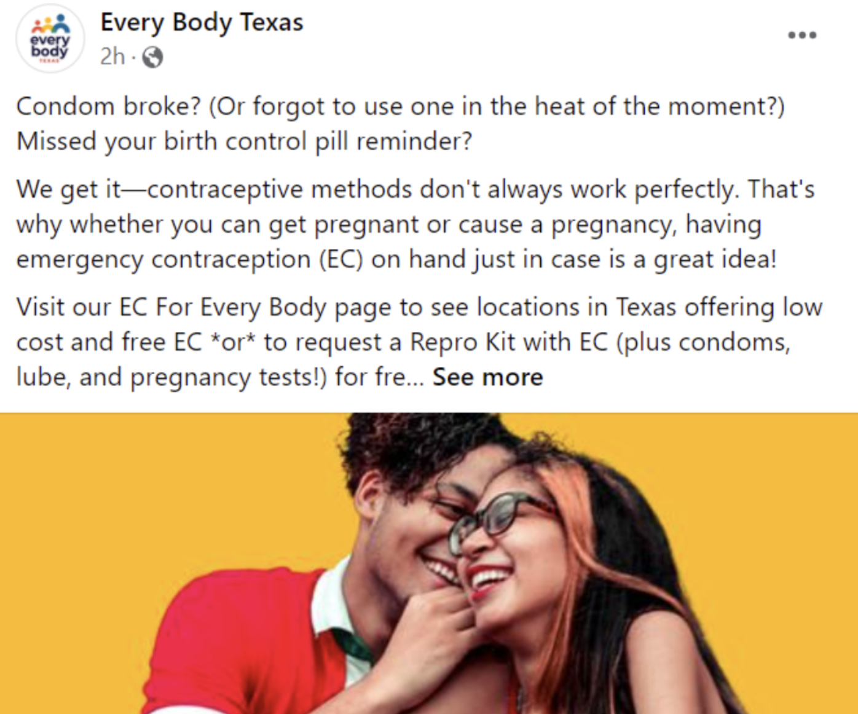
Example: Every Body Texas
Every Body Texas is working to ensure that all people can access safe, unbiased, high-quality sexual and reproductive healthcare
Notes:
Catherine Alonzo:
Awesome. Thanks Meg. Okay, so what you are looking at here is an example of what promotional content can look like in comparison to your messaging. Here's a fantastic example from EveryBody Texas.
On the left, you see this is their organizational mission, which is to ensure that all people can access safe, unbiased, high quality sexual and reproductive healthcare. And on the right, you see an ad, an example ad that they use on Facebook. And this was targeted at younger people promoting a specific service that they offer. The promotional content is really the vehicle that allows them to increase access. So, to be most effective, their individual pieces of content are tailored for their audience and they have a clear and specific call to action and a friendly non-judgmental brand voice that aligns well with their machine.
So, these are two very different pieces of content, but there is alignment. There's alignment in the tone. There's alignment in the things that are important and one is very much in service of the other.

Slide 25
Evaluate your project promotion activities
Notes:
Catherine Alonzo:
Okay. So, we have reached the last step in your project promotion plan, which is really to determine how you are going to evaluate your efforts. How do you know that everything that you're putting, time, energy, and resources into is effective in moving the needle?

Slide 26
Identify what data you need to evaluate your promotion efforts
Collect and track data on your promotion activities
and outcomes.
Use this data to evaluate the effectiveness of your efforts and determine if your investment in them is well placed.
Based on your evaluation, adjust your promotion
approach or future promotion efforts, as needed.
Notes:
Catherine Alonzo:
So, here, you want to think about what types of data you need to collect and track in order to understand how well your project promotion activities are performing. What would you need to know in order to know whether you're meeting your objectives?
So, for instance, a thing to think about here is how would you be able to tell how many people you're reaching or whether or not your brand awareness has increased? And this can entail some brainstorming and getting creative. But once you've identified the data you need to track in order to answer these questions, you can begin tracking it on a regular basis and then you can evaluate the data from time to time to determine how well your activities are performing.
We always advise our clients to collect data for at least six months before they start to change things because that's really when you can see patterns emerging. Based on your evaluation, you may want to adjust your approach as needed, and I want to talk you through an example of that on the next slide.

Slide 27
Examples of data to track
Number of appointments made by teens
Number of website visits
Number of likes, comments, and shares on Instagram
Notes:
Catherine Alonzo:
So, here are some examples of data you could be tracking. For instance, you might want to know the number of appointments made by teams, if this aligns with the goal and objective that you've set. Maybe you want to know about the number of website visits and how that's changing over time. Perhaps you're really interested in the number of likes, comments or shares you have on Instagram or a different social media platform.
So, if your objective is to generate 500 visits to your website in the next four months, then the number of website visits is really crucial to understanding whether or not you're missing that objective. And that of course might seem super obvious. But oftentimes, the number of appointments made by teens is also really crucial if your goal is to increase the uptake of your services among teens. So, it's not necessarily about measuring one thing but figuring out all of the things that you want to measure.
And then when it comes to evaluating this data, if after tracking for a number of months you realize that you are nowhere near the number of website visits you would need to be, then you can revisit your strategies and seek other ways, test other ways of guessing people to come to your website. And if you are getting the number of website visits that you want to in order to meet that goal but you aren't seeing an increase in appointments, then it gives you a lot of information about whether that was the right objective in order to enable you to meet your ultimate goal.
So, the answers you are looking for in terms of are our efforts successful lie in collecting and analyzing the data. And then by when you are tracking and evaluating your data on a regular basis, then you can ensure that you're on your right track with your project promotion activities and that your investments, your time, energy, your money, all of that is really well-placed.

Slide 28
Project Promotion Activities at Kachemak Bay Family
Planning Clinic
Notes:
Catherine Alonzo:
Okay, that is all. Thanks so much for going through the steps with me. It's a lot to take in. It is a ton of information. I'm happy to answer questions later. But for now, I'm going to pass over to Analise to talk about her Title X project promotion activities and you can see what all of this really looks like in action.

Slide 29

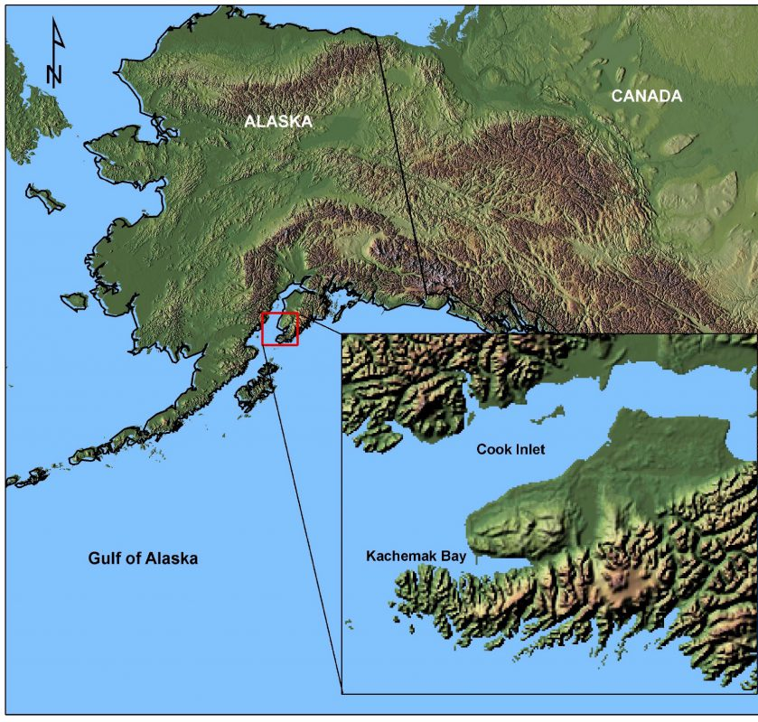
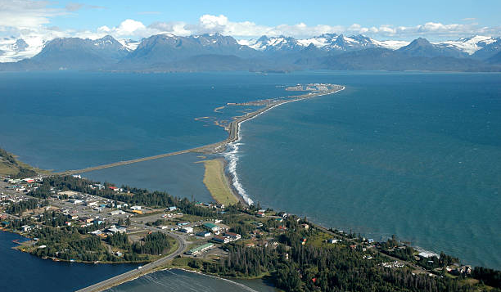
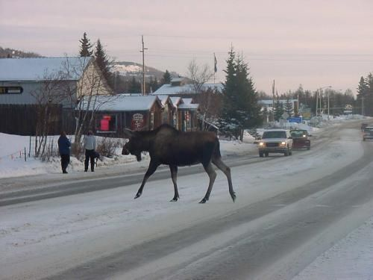
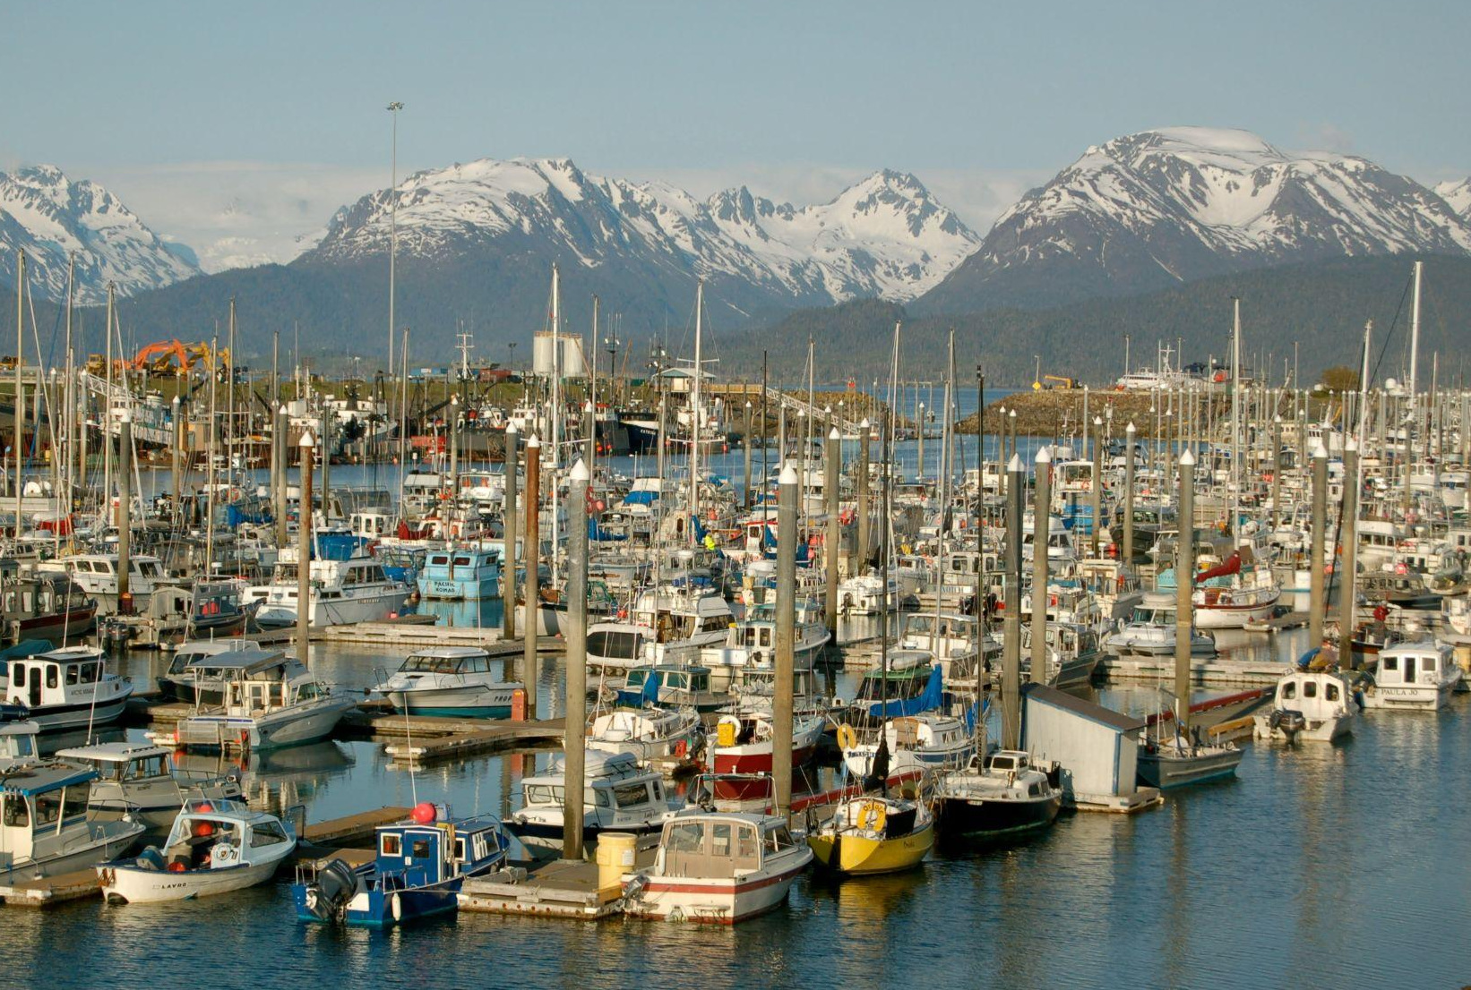
Kachemak Bay Family Planning Clinic
Serving Alaska’s Kenai Peninsula
Credit: NOAA
Notes:
Analise Goedeke:
Thank you, Catherine. Hi, again, everyone. I'm going to start with a little bit of background about our agency since providing and promoting our reproductive healthcare in a rural region of a very unique state also gives us some unique challenges and opportunities.
So, Kachemak Bay Family Planning or KBFPC has been providing reproductive healthcare at no or low cost in Homer, Alaska for over 40 years now. We are based literally at the end of the road on the Kenai Peninsula, which is that detail on the map there. And that landmass, that area is about the size of West Virginia. Just for context for people who don't know Alaska well.
Homer, where we're based, is a coastal community on the shores of Kachemak Bay. It serves as a hub for other diverse regional communities in the area. Some of which are only accessible by four-wheel drive or boat or plane. And we are pretty isolated from Alaska's larger population centers with a five-hour drive between us and Anchorage, which has the closest international airport.
A little more context for some of the examples you're going to see next. After our region's only other dedicated reproductive healthcare clinic offering care regardless of the ability to pay, after they closed about a year and a half ago, KBFPC expanded our service area to include the entire Kenai Peninsula, which has a population of approximately 58,000. And we now provide pop-up clinics servicing other areas, as well as continuing to provide our comprehensive services at the flagship clinic in Homer and telehealth visits.

Slide 30
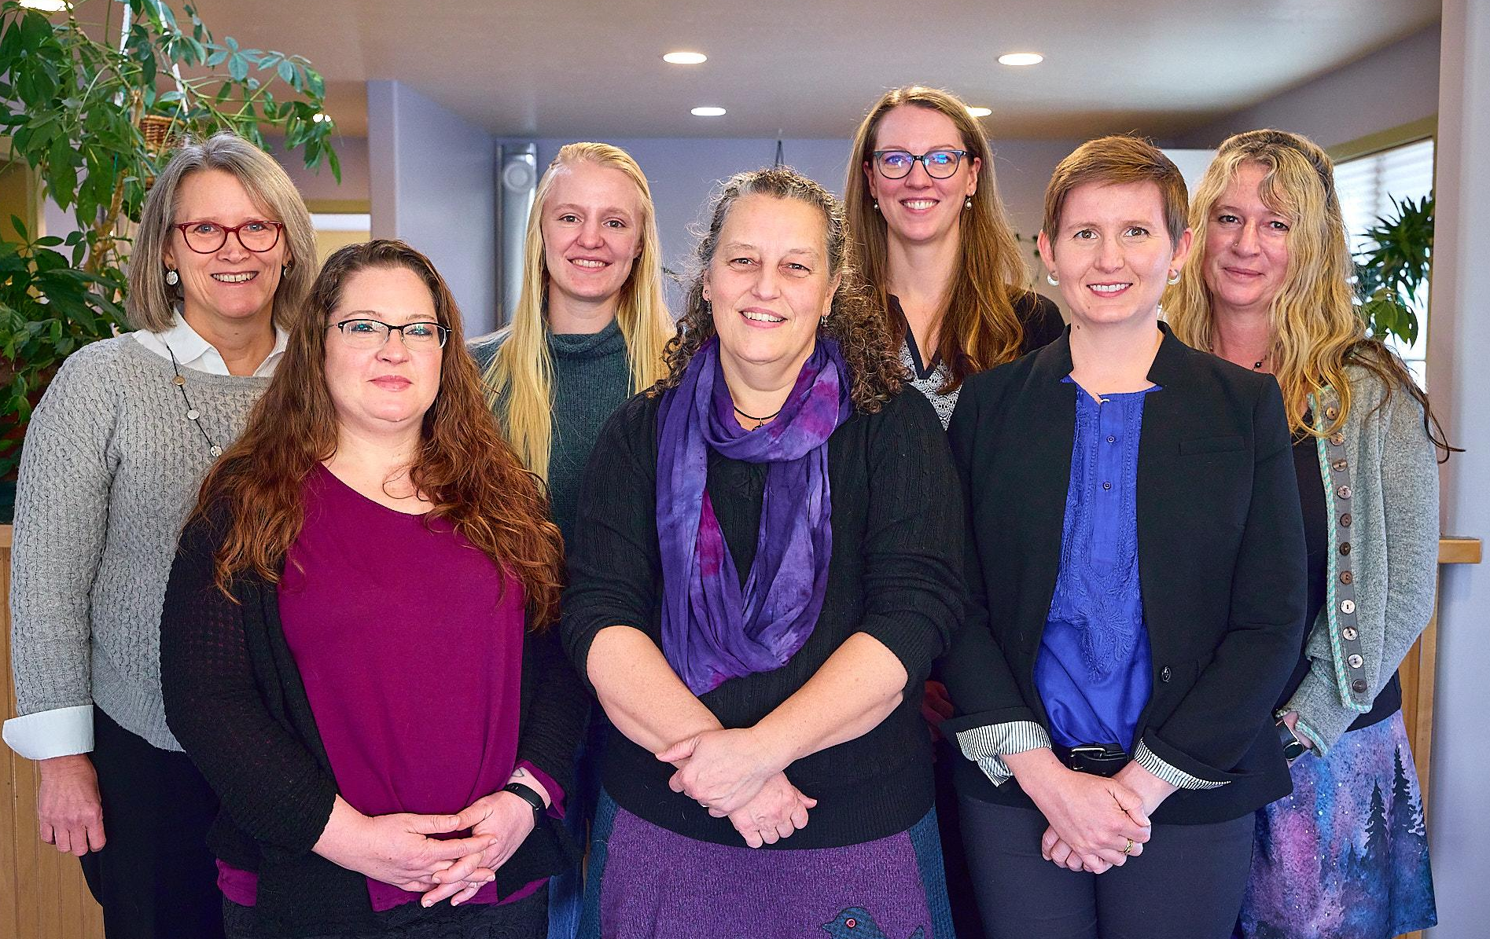

Project Promotion Experience
Client-centered care, not marketing experts
TA Group with RHNTC/Javelina early 2022
Notes:
Analise Goedeke:
So, our agency is a small, independent non-profit. We have limited staff capacity. We do not have a dedicated marketing director or even an identified communications staff team. But after the height of the pandemic and some staffing and service changes, we really needed renewed publicity in order to reconnect with our community and recruit new clients.
And we had a chance to learn more about how to structure and execute specifically Title X project promotion as part of a technical assistance group with RHNTC and Javelina in early 2022. But prior to this, again, none of our staff had any formal marketing experience and so the TA process and the toolkit was a really helpful training resource. We put many of the lessons to use immediately as we were working out new services and it also laid the groundwork for how we think about our promotion strategies in general now.

Slide 31
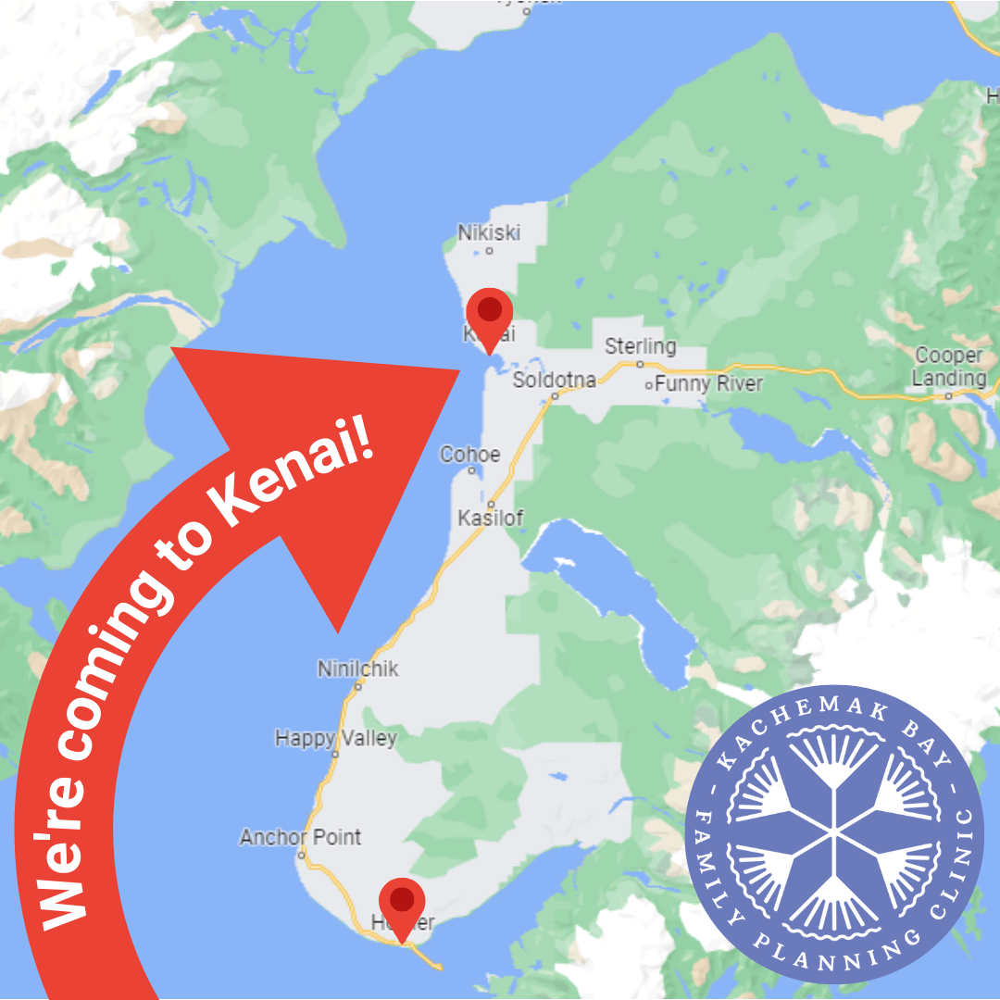
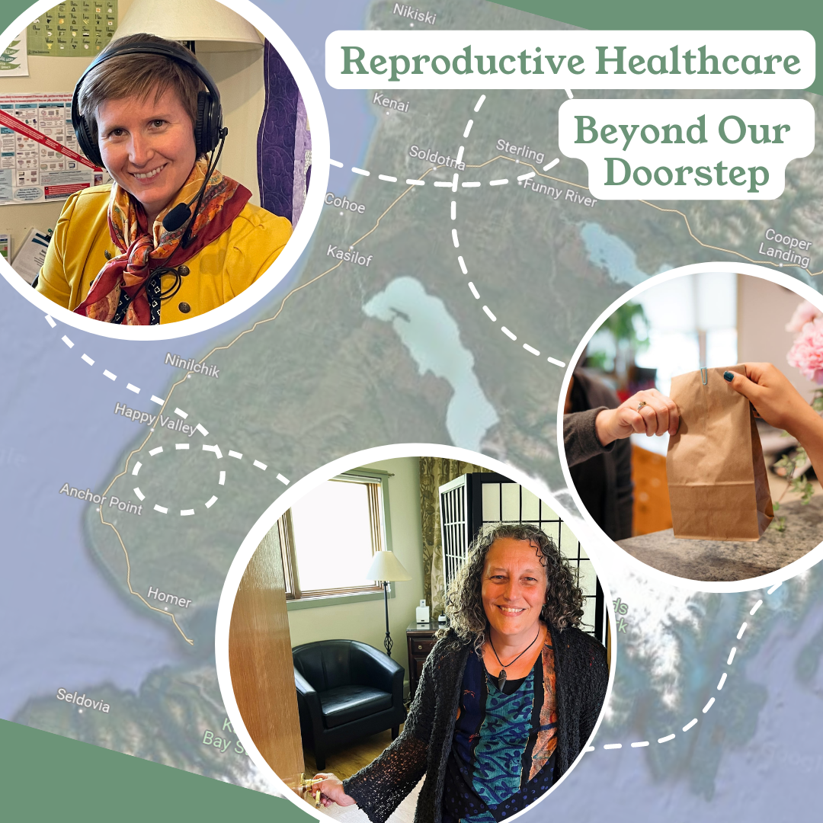
2023 Service Area Expansion
Identifying new priority populations
Learning to target specific audiences for messaging
Notes:
Analise Goedeke:
So, with that recent service area expansion, the project promotion framework really gave us tools to identify and explore particular traits of our new target audiences that we wanted to reach farther north on the peninsula. And that area is a somewhat different landscape both physically and culturally from Homer, where we'd been based for decades with the communities up there experiencing different issues accessing care and different needs and values than the Homer area that KBFPC had known and served for so long. So, this required different outreach, different promotional messaging, especially on social media.

Slide 32
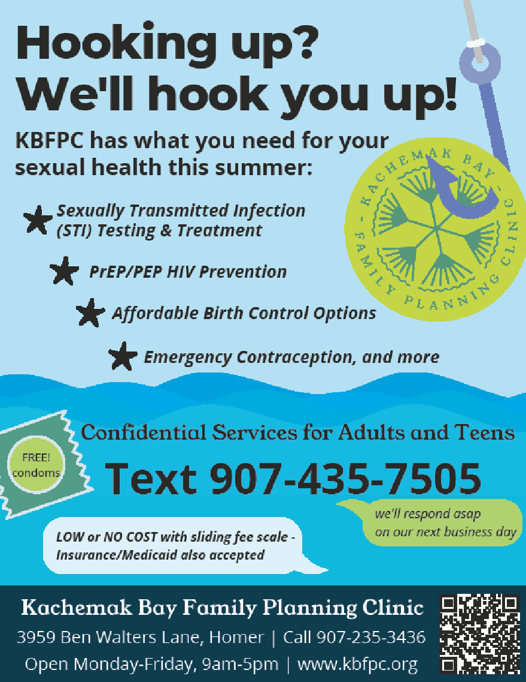
Reaching New Clients
Creating clear goals: “brand” recognition vs. active client recruitment
What does our target audience need to know?
Notes:
Analise Goedeke:
In reaching these new clients, we worked to set clear goals, as Catherine outlined, for these planned publicity efforts, learning to differentiate between the desire or the need for general community awareness of the agency, brand recognition or sharing specific service information when trying to reach those new clients. And this flyer campaign that you can see on the slide was actually the first item we created as a result of this project promotion learning process.
Our goal here was to increase STI testing and the number of male clients seen at the clinic. The target audience was identified as a summer worker in our area because Homer actually sees our population almost double every summer with people relocating here to support the main seasonal industries of tourism and commercial fishing.
So, the messaging we worked up was for a snappy local business flyer with colorful fishing imagery and promoting our text line for immediate contact. That way, someone wouldn't have to remember to call us when we're open on Monday, for example, after seeing this in a bar bathroom flyer, a bulletin board on a Saturday night.

Slide 33
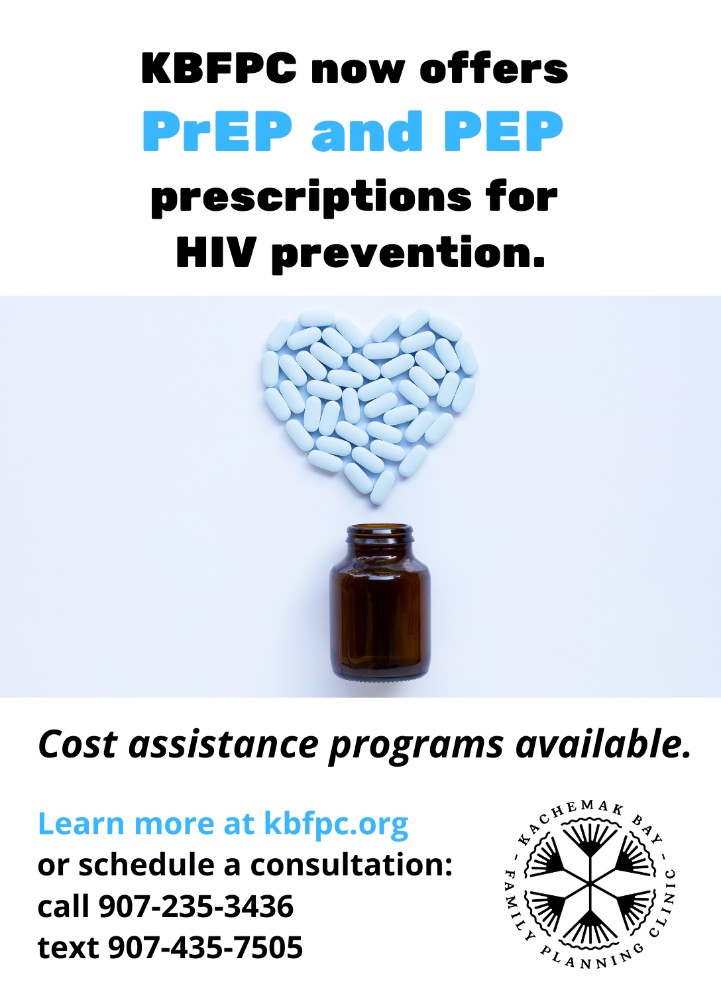
Announcing New Services
Diversifying media methods & contact frequency
Budgeting: intentional spending to reach goals
Notes:
Analise Goedeke:
So, in all of this content that we explored with Javelina, we were really struck by learning how often someone needs to see or hear or engage with your message in order for them to absorb it and take that desired action, which was seven times on average, as well as the importance of layering multiple methods or channels that Catherine outlined, like sharing this new service announcement when we added PrEP and PEP services to our clinic services, sharing that on traditional platforms like a printed ad as well as digital channels like social media and email. So, giving people multiple opportunities to engage with the message. And this project promotion process really helped us also identify the specific and practical costs of these marketing efforts to reach our goals, which helped us plan and budget with more intentionality.

Slide 34
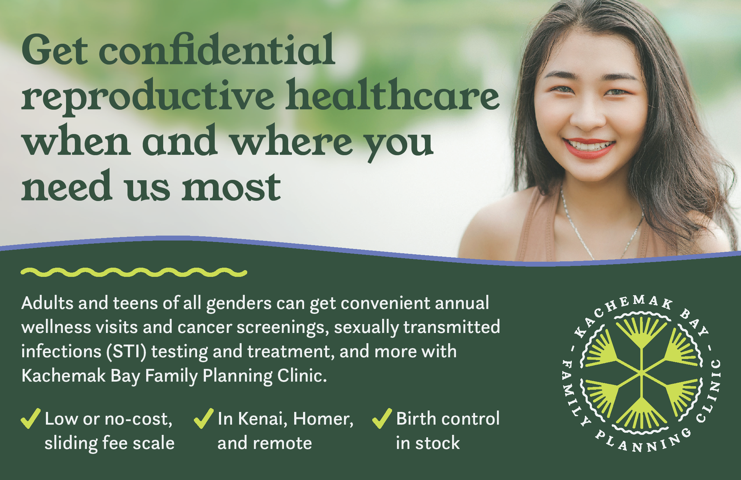
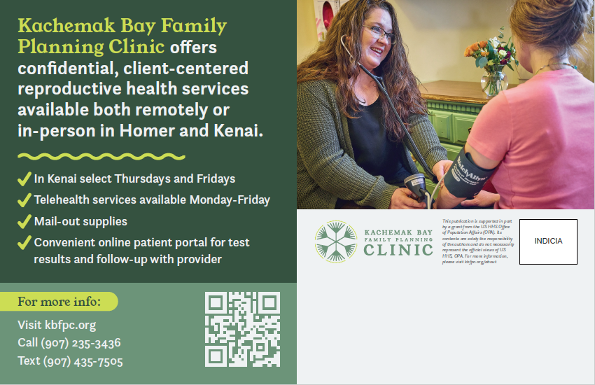
Continued Effectiveness
Laid the foundations
Stronger strategies
Working with contractors
Notes:
Analise Goedeke:
So, in addition to some of those practical tools that we implemented right away, the process helped us build stronger strategies long term and develop more specificity and diversity and measurable outcomes for the required annual project plan. And it provided what we think of as foundational knowledge to help us find the right strategies, the right content internally, as well as finding and working with the right contractors or external content creators to support our work and then navigate those projects with improved vocabulary, clearer goal setting and ideas about our priority audience identities and their needs and desires.
So, this postcard on the slide was actually the result of a continued TA opportunity that RHNTC made possible, where we were able to work with Javelina again to design a direct mail postcard for delivery to select ZIP codes around our new target service areas.

Slide 35
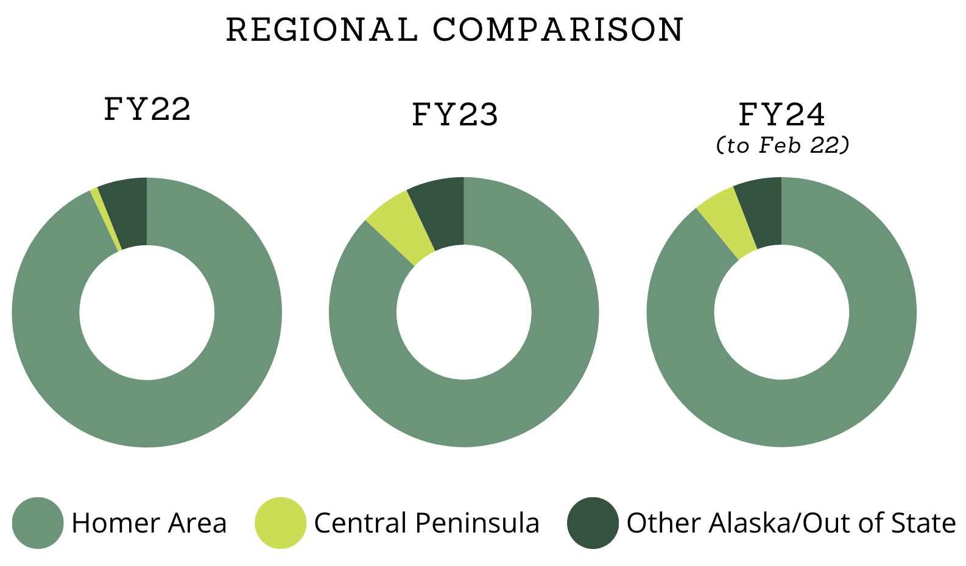
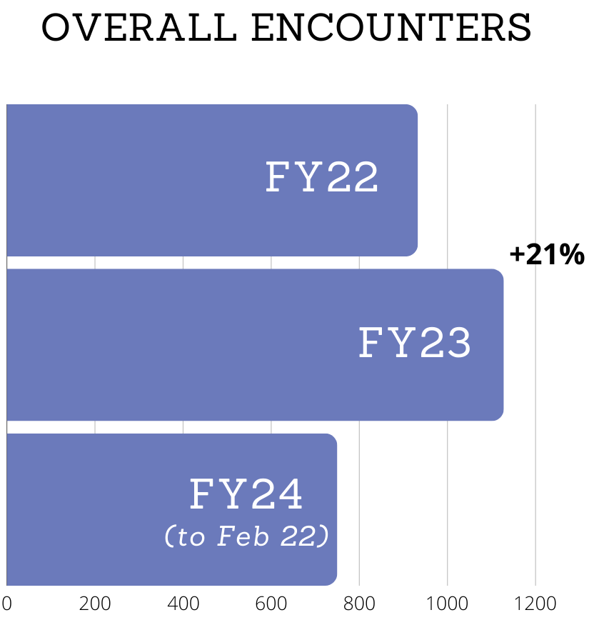
Client Encounter Growth
Notes:
Analise Goedeke:
And from fiscal year '22 when we began the process of improving our project promotion to FY '23, we saw a 5% jump in encounters with clients from targeted Central Peninsula ZIP codes. We also saw a 1% increase in clients from other Alaska regions, and so far in fiscal '24, we're seeing similar numbers. We also experienced a 21% increase in client encounters overall between FY '22 and '23. And so far in FY '24, we've actually seen a more than 100% increase in telehealth visits over last fiscal year, which reflects interest from clients who may not be able to easily travel to our Homer flagship clinic for services.
It was slow growth at first rolling all of new services and new promotion methods out, but now a little more than a year after the formal launch of those pop-up clinics, our remote clinic dates are seeing consistent clients and we've also seen more clients from the Central Peninsula communities at our flagship clinic in Homer. So, they are hearing about our services. The word is getting out.

Slide 36
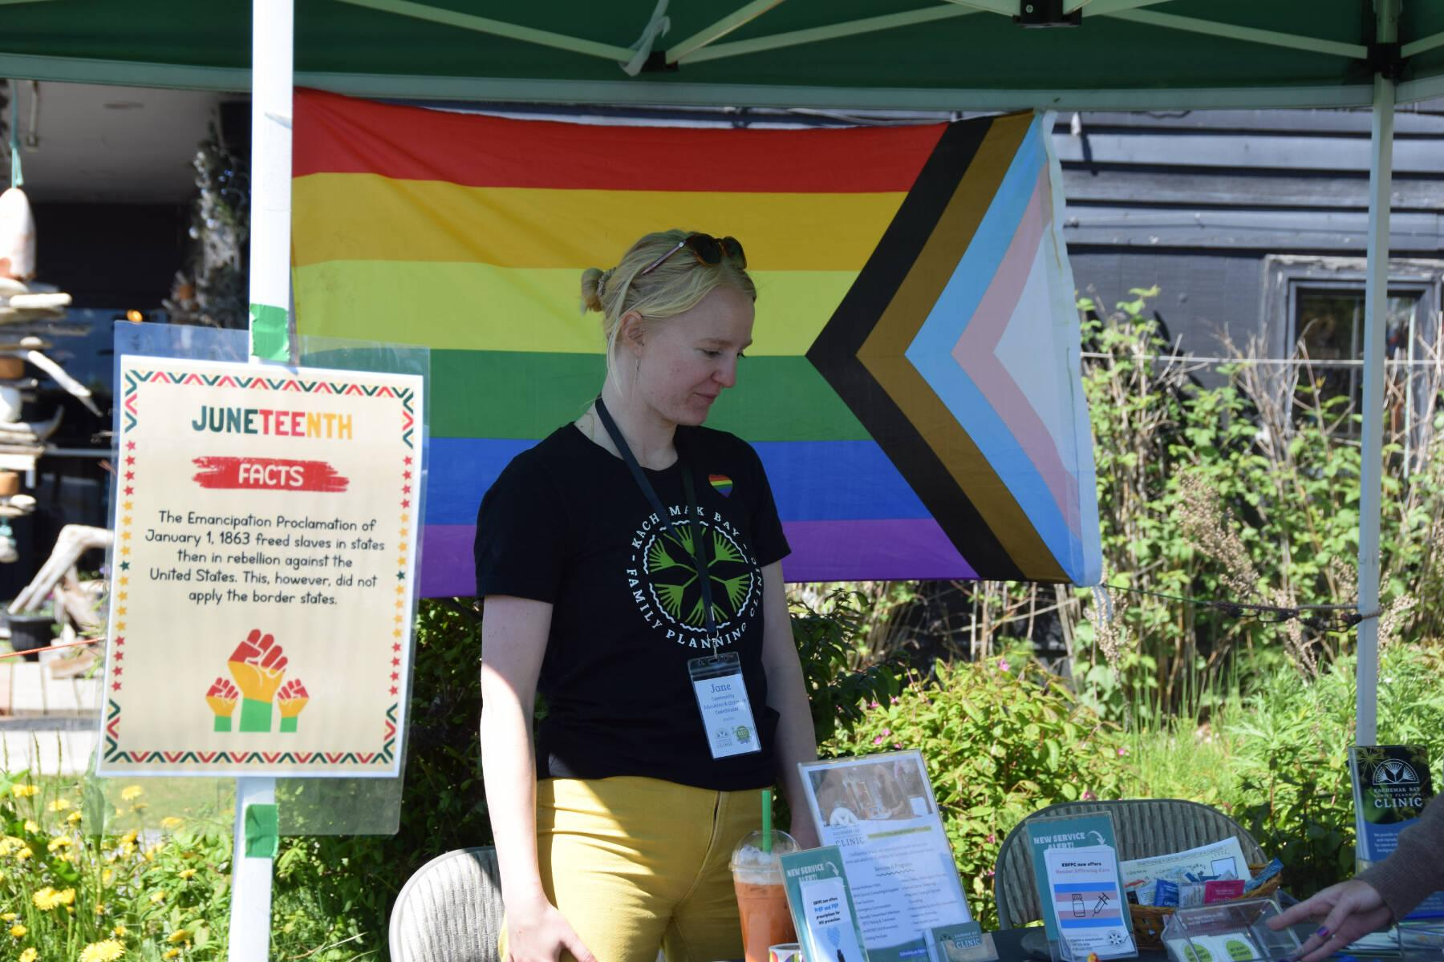
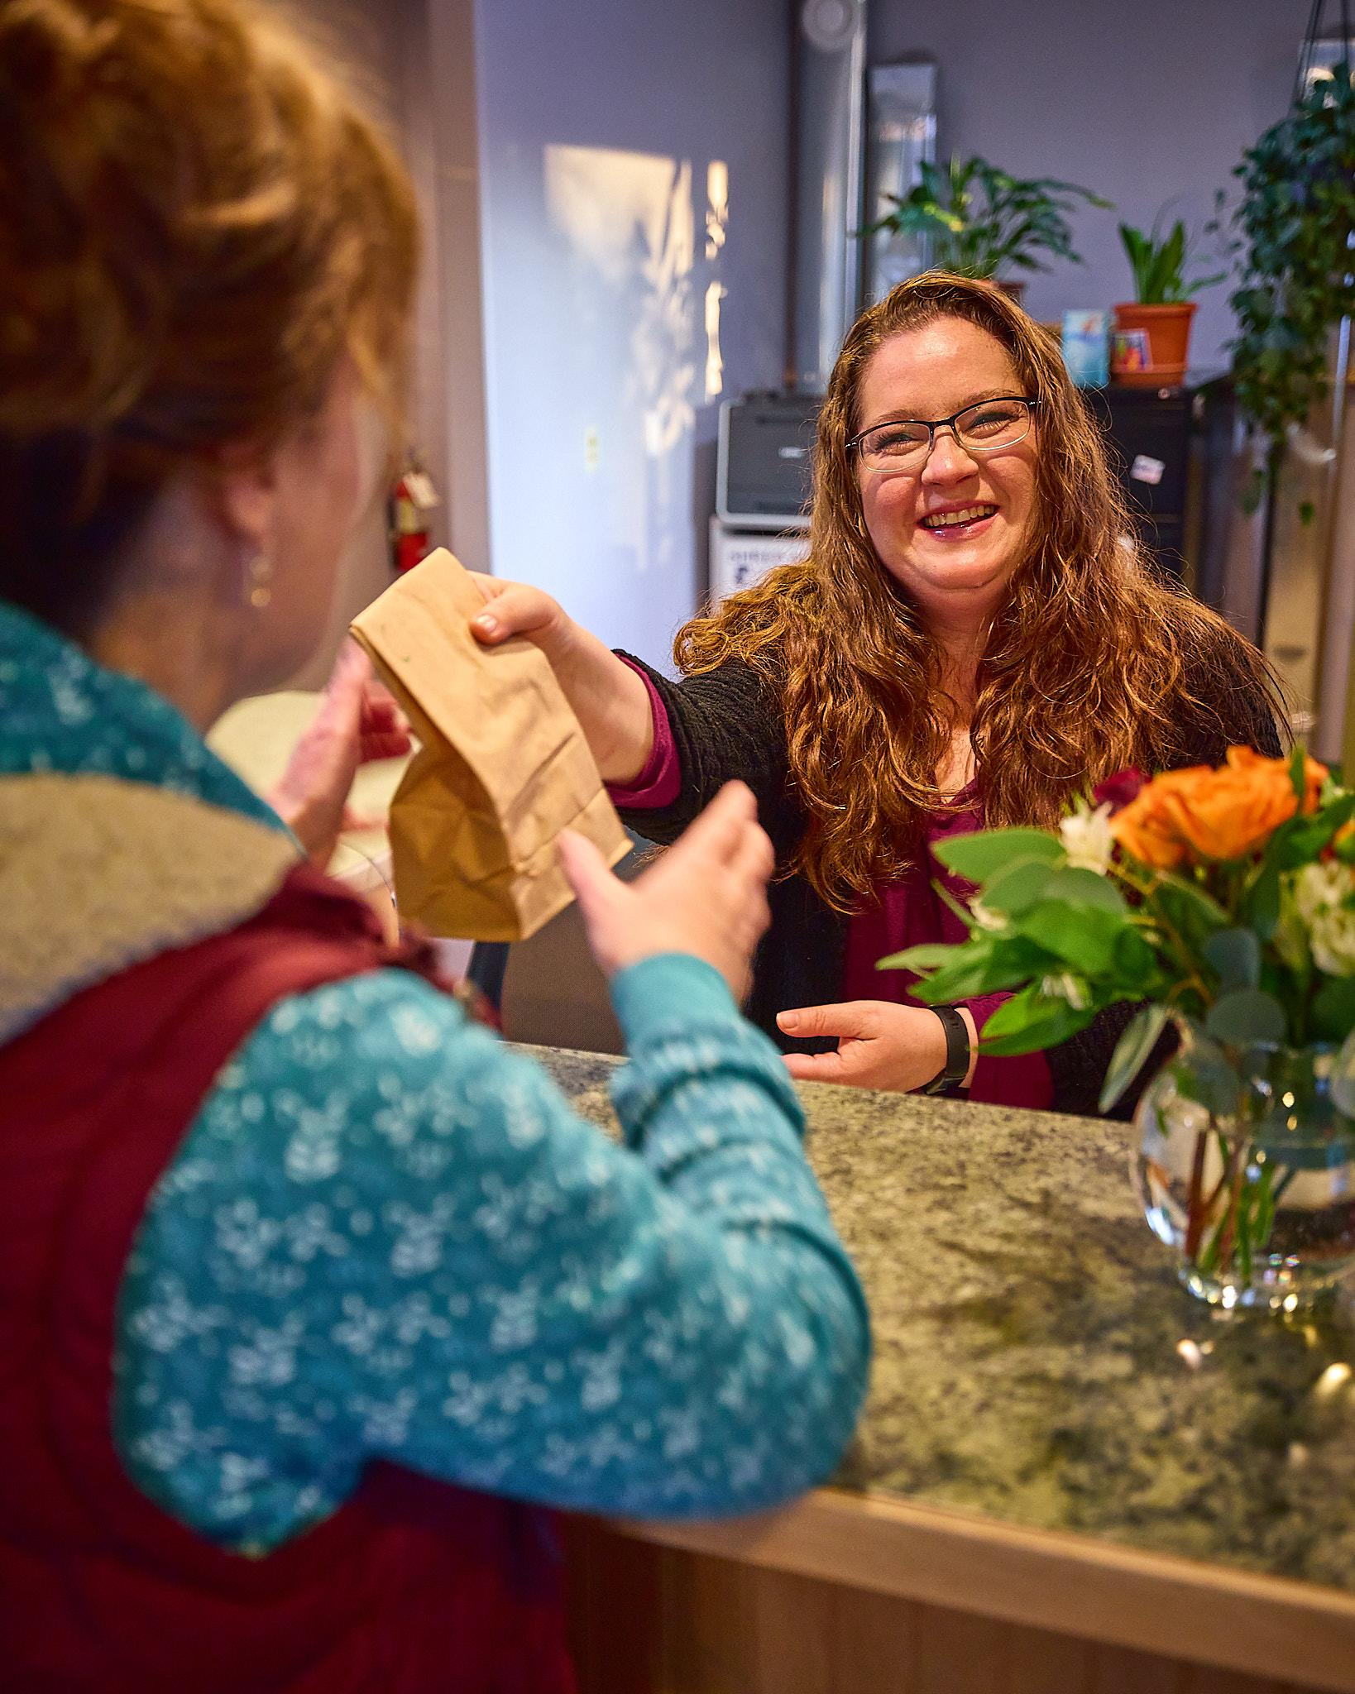
An Ongoing Process…
Notes:
Analise Goedeke:
One last example of how this process has helped us speak with more specificity to reach and impact our intended audience and that persona and focus on cultural relevance. By monitoring our content engagement trends and those evaluation methods we outlined, we were able to identify that our most successful messaging and imagery is pretty hyperlocal. Alaska is really unique. It is a giant state, but it feels like a small town. And with our area's unique landscape and small communities, people really seem to respond more favorably to recognizable elements and faces. And so, that was a very specific example of what we were able to uncover by going through this whole process.
I would suggest if you're trying to consider and figure out how this will work with your own projects, that even going through this project promotion framework together once gives your team really a valuable foundation, a shorthand for improved communication and valuable tools, building blocks for more adaptable, impactful strategies as you grow into it.
At KBFPC, we have integrated these resources into our staff training plans and our onboarding and we expect it to be a really useful resource training for future staff, whether through inevitable turnover or adding new members of the team to help everyone get on the same page and develop that shared language for more effective decision-making.
In truth though, getting real, it's an ongoing process. We are definitely still working to solidify effective assessment metrics, that evaluation piece and keep that cycle of planning, implementation, evaluation, quality improvement more consistent. But overall, the experience really helped us go from honestly relatively minimal promotion to now a multifaceted strategy, which encompasses multiple districts in our service area with different target audiences and a range of messaging goals.
So, I hope our examples of learning as we went and continuing to figure it out are encouraging. I really think that even if an element of this new process or framework might be intimidating like the evaluation piece I mentioned or maybe it's content creation for you, whatever it is, don't let that keep you from giving it a try because it's been really successful for us.

Slide 37
Project Promotion Resources
Notes:
Analise Goedeke:
And now, I will pass it back to Meg to talk about some resources.
Meg Sheahan:
Yeah, thank you, Analise. That was great.

Slide 38
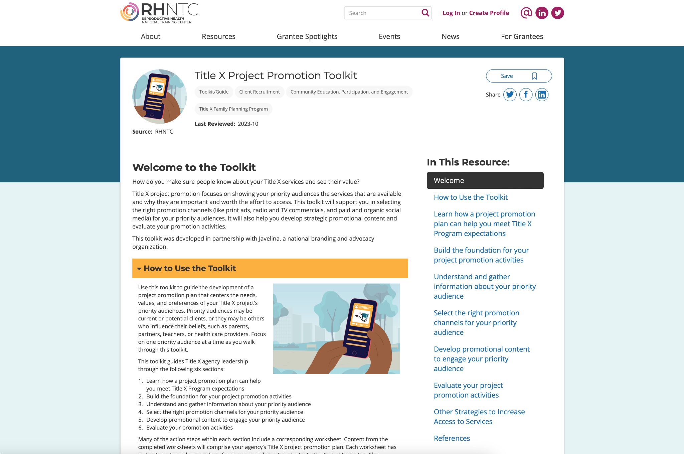
Title X Project Promotion Toolkit
Notes:
All right. There is a lot to the process that Catherine described and the application that Analise described. It's way too much to remember. So, the RHNTC has developed a toolkit that you and your team can use that walks through the process that Catherine described step by step and that Kachemak Bay followed.
And you can find this Title X Project Promotion Toolkit at rhntc.org. When you reach the home page, you can simply search Project Promotion Toolkit and we'll also chat the link out right now in case you'd like to open it up and have it on your desktop to take a look at.
This toolkit guides users through the development of a project promotion plan that centers the priority audiences. It's divided into the steps that Catherine just discussed. Each step contains worksheets that you then complete with your team and then content from the completed worksheet come together as a written project promotion plan.
This project promotion plan, it's been easy to reference and to share. The written plan aligns with the program expectations, Title X program expectations. So, it can be used during a site visit or a program review to demonstrate compliance with Title X program expectations around community participation, education and project promotion.
And to note, this toolkit is designed with a wide range of Title X projects in mind. It can be followed even if your project doesn't have access to a communications or marketing expert team. And it can be used in house with communications teams that may be you do have on board or it can be used with an external communications consultant to sort of structure a plan that you can partner with them on.

Slide 39
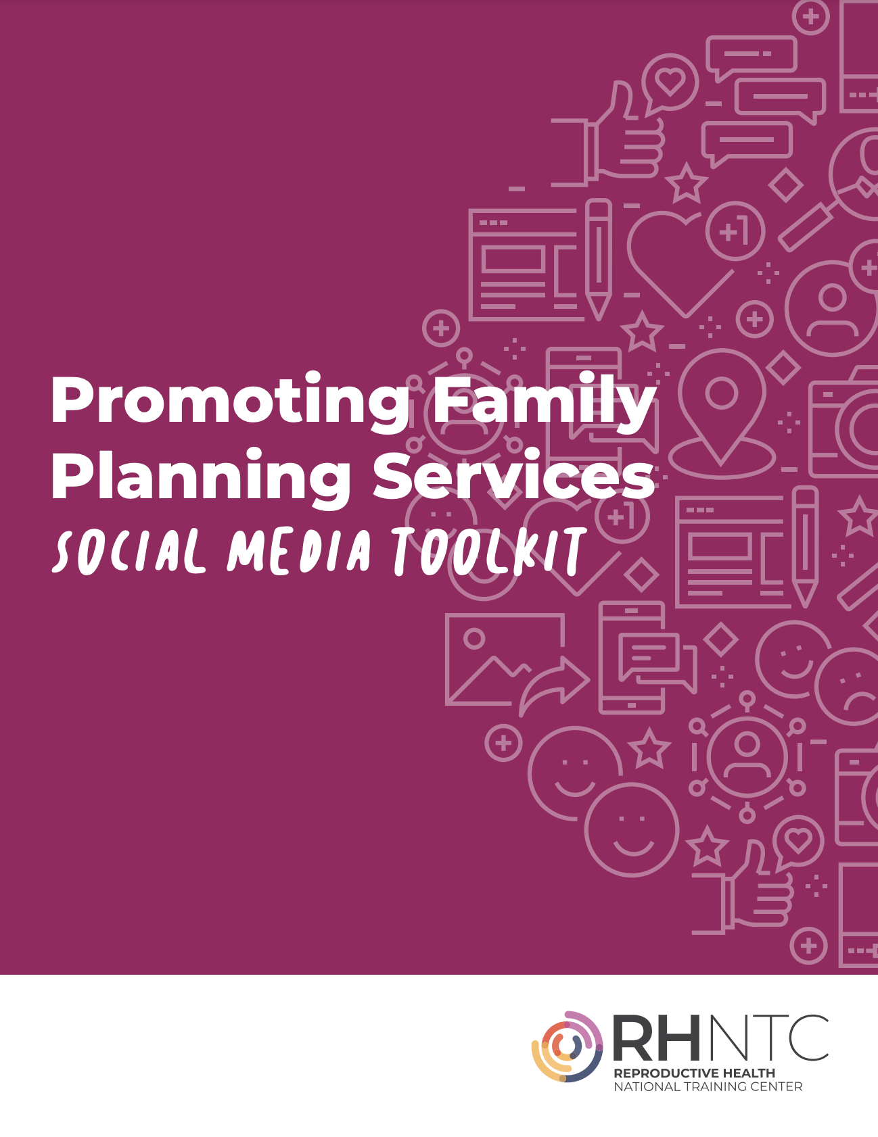
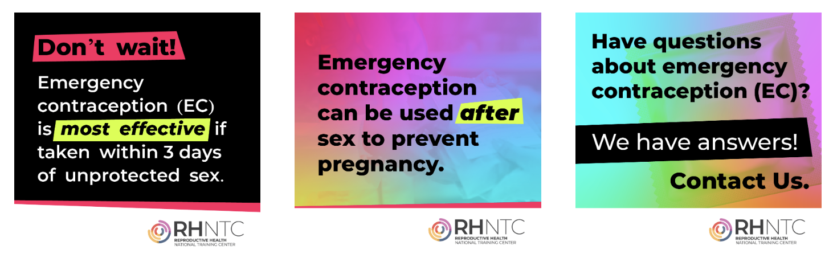
RHNTC social media toolkits
Promoting Family Planning Services
Social Media Toolkit
Emergency Contraception Social Media Toolkit
Notes:
Meg Sheahan:
So, I saw a question come into the chat about this. Thank you, Kristen for asking. Has the RHNTC considered making some content that is editable for reproductive health sites to use on social media? And I'm happy to say the answer is yes. I'm highlighting these social media toolkits. You can see screenshots of them on your screen right now. I'm highlighting them because they're such gems. These social media toolkits provide graphics and messages that you basically just lift up and post right to your social media pages.
The messages and the images are affirming. They're supportive. They're beautifully done. And they encourage clients to seek services and take control of their well-being. The images are provided in dimensions that can be used on Facebook, Instagram, and Twitter. And they can be customized with your agency's logo using instructions that are provided. You just basically download the images and list the messages and upload it to your social media platform. So, you can use them as is. And you can also use them to spark ideas for images or messages that you could create on your own.
You can find the social media toolkits on rhntc.org and I'm highlighting four of them today. The first here on the left focuses on promoting family planning services in general. And then we have another one that's focused specifically on emergency contraception to increase people's awareness of emergency contraception.

Slide 40

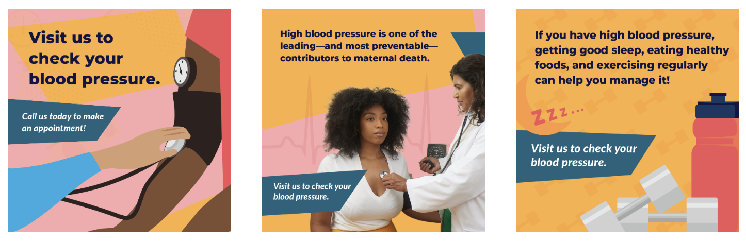
More RHNTC social media toolkits
Male Engagement Social Media Toolkit
Hypertension and Reproductive Health Social Media Toolkit
Notes:
And then we have the two that you see here. The one on the left is focused on reaching males and getting them in the door and on the right, we have one that's focused on hypertension and reproductive health.
So, we're putting these links in the chat. But if you don't catch them now or you don't keep all the links, you can also search on rhntc.org using the term "social media toolkits". With those search terms, you'll find these toolkits and a few other interesting resources that you might like to check out.

Slide 41
Wrap-up
Notes:
So, all right folks, this is nearly a wrap, but first before we close, we wanted to open the door for questions. So, please go ahead and type your questions into the chat and we'll answer. We'll start off by answering a few that we've already got coming in.
So, a question that we have that came in is, where do you find your priority audience profile? Where do you find your priority audience profile? And I'm going to pass this one over to Catherine.
Catherine Alonzo:
Great. Thanks, Meg. And that's a great question. So, the priority audience profile is something that you develop yourself based on information that you already have about your audience, and then that you might need to do some research to answer any questions that you don't have.

Slide 42
Q&A
What questions do
you have for us?
Notes:
Catherine Alonzo:
There is a step-by-step worksheet in the toolkit that leads you through exactly how to research and put together a priority audience program.
Meg Sheahan:
All right, thank you. Thank you, Catherine. Okay. How do you gain buy-in from the public information officer? This one comes from Deb. Okay, so I can speak to this and then I'm actually going to pass it over to Analise and Catherine to see if they have more to add to this.
I work within a Title X program within a department of health. Our department of health had a public information officer, and Deb, I'm going to guess this is kind of where you're coming from. We had a public information officer, and so all information sort of had to go through them and be approved through them.
And sometimes, a couple of the challenges that we bumped into is that promoting ... We were one of many programs. Promoting our program was not necessarily her only priority or thing that she needed to do. Another thing is that sometimes, our vision of the information that needed to be promoted didn't necessarily align with their vision.
And so, one of the things that we did was we used the social media toolkits and I kind of was like, "Look, this exists. It's going to make our lives so much easier." It's professionally done. It's professionally sort of vetted. It aligns with Title X values and what we were trying to, what the Title X program as a whole is trying to create. And all you have to do, all we have to do is lift it up and dump it into our social media thing.
And they liked that because the social media toolkits, the messages and the graphics were beautiful and very professionally done, and she got to upload them or put them on our social media pages and it made her job easier and it made the department of health look great because we were putting out such beautiful content.
Another thing, frankly, that I had to do was follow up quite a bit because they have a lot of information that they're trying to get out there. So, I had to do a lot of follow up. And so, I got kind of regular calls with them. I also tried to be part of a bigger movement. So, it wasn't just me, the family planning program, trying to get her ear. It was how do we move together as a team with many different programs? How do we move together as a team to get all of our information out and create sort of a bigger movement of public information?
That's what I'll add, but I'll pass it over to Analise and Catherine to see if either of them have any thoughts based on their experiences.
Analise Goedeke:
Our circumstance at KBFPC is a little different as a small independent nonprofit, as a subrecipient of Title X. But what we found really effective in gaining buy-in from anyone involved in our project promotion efforts was the, I mean basically data. The audience exploration and the profile steps that Catherine went through give you a lot of really valuable information about who this priority audience is that you can then point to and use that to convince someone who's not sure what the purpose of whatever's going on is.
And the other piece is the evaluation. If you have a goal with an objective and a measurable outcome that was or wasn't successful, then you can point to that in your next effort and say, "Here's what we learned last time, here's how we're going to build on that." And it gives people something a little more concrete to land on when they're not necessarily in this project promotion world. Catherine?
Catherine Alonzo:
Yeah, I think those were both really excellent and helpful answers. I'll build on top because there's a couple of other specific ways I think that you can create buy-in, and you could do either/or or both.
So, one of them is, as you're working through the toolkit, a lot of it is very process driven, that a lot of it will be group people within your organization, your team working through and making decisions and reflecting on the foundation together. And so, you could do a couple of things. If feasible, you can include the PIO in that process. If not feasible, what you can do is once you've moved through those foundational pieces as a team, you can share that with the PIO to either seek feedback or to say, "This is the intentionality that we are working from."
And really building on top of what Analise was saying, it gives additional information that explains why you are making the decisions that you are making.
Meg Sheahan:
That is such good intel. Thanks to both of you. Well, we're at pretty much the top of the hour, so I want to move us forward and just give a big thanks. Thanks everyone for joining us. A big thanks to Catherine and Analise for sharing their expertise and their experience, and to the RHNTC team who works behind the scenes to help us bring these webinars together so beautifully.

Slide 43
THANK YOU!
Please fill out the evaluation form after the webinar!
rhntc@jsi.com
This webinar was supported by the Office of Population Affairs (Grants FPTPA006030, TPSAH000006) and the Office on Women’s Health (Grant ASTWH2000-90-01-00). The views expressed do not necessarily reflect the official policies of the Department of Health and Human Services; nor does mention of trade names, commercial practices, or organizations imply endorsement by the U.S. Government.
Notes:
Meg Sheahan:
Again, please complete the eval. The link should pop up for you. We truly appreciate your thoughtful feedback and we use it to improve our work to better serve you. Finally, please connect with the RHNTC and the resources and support that we have for you.
If you go to our homepage, rhntc.org, you can browse or search for training and resources. You can request technical assistance. You can learn more about the training tracking system that we've got to help you develop your training list for your team and track their completion. And you can sign up for our newsletter, which will keep you up to date on all things Title X, all the information and all the resources to support your work.
So, thanks again everybody for joining us.

